Slide 1

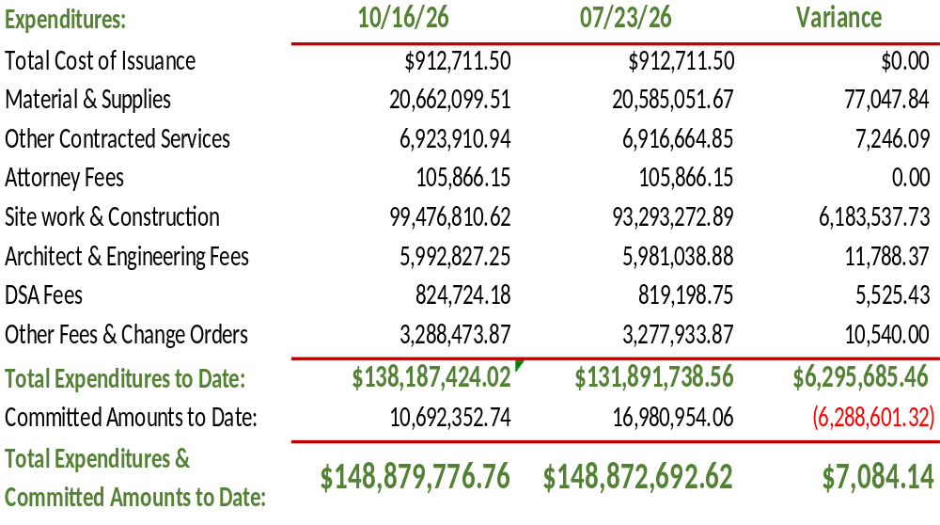

Measure BB - Expenditures & Committed
2026/27

