Slide 1
Class of 2027
Parent Night
WELCOME – DR. MULLER
PTSO – WENDY LEE
SENIOR INFORMATION & UPDATES - COUNSELING
HERFF JONES – CHRIS WIECZOREK

Slide 2
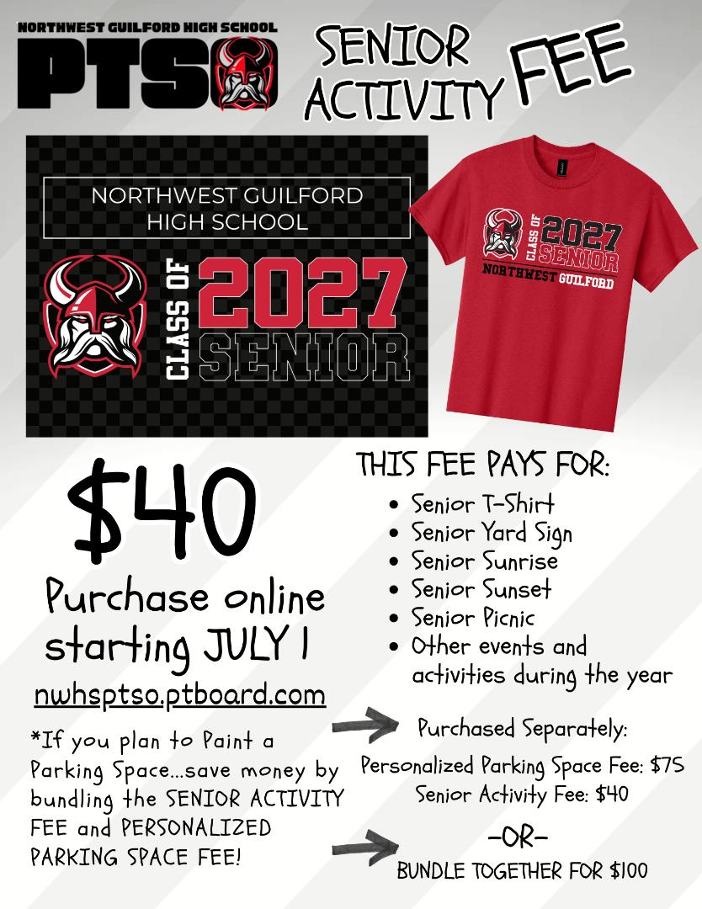
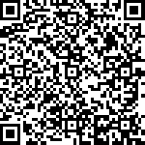
PTSO PRESIDENT
WENDY LEE

Slide 3
STUDENT SERVICES
Counselors:
  A-Co: Ms. Garner, garners@gcsnc.com
  Cr-G: Mrs. Lucas, lucase@gcsnc.com
  H-Le: Ms. Thomas, thomasd5@gcsnc.com
  Li-O: Mr. Kaplan, kaplanm@gcsnc.com
  P-Sp: Mr. Devonmille, devonmj@gcsnc.com
  St-Z: Mr. Murphy, murphya@gcsnc.com
Counseling Secretary: Mrs. Marshall, marshal4@gcsnc.com
NW Social Worker: Mrs. Paschal, paschas@gcsnc.com
NW Registrar: Mrs. Bobetich, bobetit@gcsnc.com
Career Devel. Coordinator: Ms. Jenkins, jenkinw@gcsnc.com

Slide 4
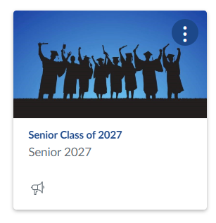
CLASS OF 2027 CANVAS COURSE
Canvas instructions are on the NW website – menu- families

Slide 5
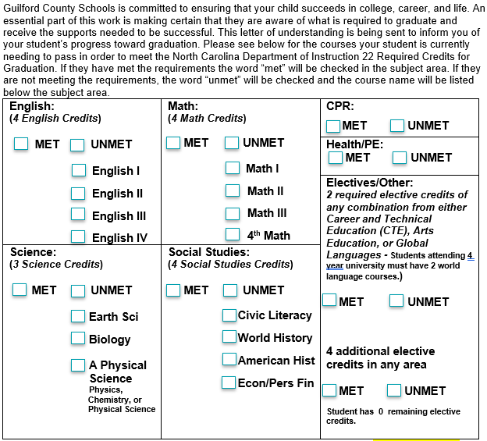
Letters of Understanding & Senior 1:1’s
Counselors will be meeting with seniors through their NW English IV classes in late September and October
Seniors who are not taking English IV at NW should email their cousnelor for an appointment
The LOU and unofficial transcript will be reviewed

Slide 6
TRANSCRIPTS
Official senior transcripts are available
CFNC = in-state colleges & community colleges
  Create CFNC account, Go to Application Hub to send transcript
CommonApp – type counselor email in carefully
SendEDU – if college is in NC, use CFNC
ScribOrder – GCS secure records request
  Schools not in NC or on Common App
  Monitor email after submitting request
GTCC Dual Enrollment = student requests through GTCC

Slide 7
WHAT IS ON A TRANSCRIPT?
Identifying student & school information
Courses listed by grade/year
  Includes applicable middle school courses
Mark = Grade, Weight = like credit, Credit
GPA, Rank, Mark (Grade) & Total Credits
In-Progress Courses
Standard Tests – CPR, EOC Note: AP Exam and SAT/ACT scores are NOT listed
Credit Summary
Endorsements(12th Gr) – may not be reflected with Infinite Campus
Awards/Achievements(12th Gr) – may not be reflected with Infinite Campus
Limited to Microsoft Certification, National Achievement Award, National Honor Society, National Merit Scholar, NC Academic Scholar & Salutatorian/Valedictorian

Slide 8

NC College Connect
Seniors with a weighted GPA of 2.8 or above, will receive a letter with details about the direct admissions process
Go to CFNC – look for green claim your spot button – log in – review offers – submit simplified applciation
Many schools are waiving application fees during CFNC’s free application week 10/20-26

Slide 9
COLLEGE PREPARATION
Explore colleges - campus tours, open houses
Understand admissions requirements
SAT/ACT test optional (will review) vs test blind (will not review)
Complete NC Residency Determination www.ncresidency.org (CFNC login)
Complete Applications:
College Connect
CFNC.org – most NC colleges & universities
Common Application

Slide 10
PAYING FOR COLLEGE
Many scholarships are listed on the senior CANVAS course
  Turn in ALL offers of money even if you don’t accept it
Review college and department scholarships
Check with employers and local churches
Search at Fastweb, College Board, CFNC & other free sites like Google.
  DO NOT PAY!!
Complete the FAFSA – it opened early on 9/23
Student need their SS# to claim their FSA account

Slide 11
Employment
Guilford Apprenticeship Partners
GAP
Get paid to work & earn Associate of Applied Science degree
Choose from over 35 companies
If selected for next year:
On the job training 80%
Community college classes 20%
Paid for 40hrs a week
Student information session Tuesday, September 29, 2nd period - Register with QR code on Canvas
NW contact Mrs. Jenkins jenkinw@gcsnc.com

Slide 12
EMPLOYMENT – FAME
North Carolina Federation of Advanced Manufacturing Education
Job training
Salary
Free associates degree
Over 450 manufacturers
Information Session on Monday, 9/28 2nd period
NW contact Mrs. Jenkins jenkinw@gcsnc.com

Slide 13
MILITARY
Branch representatives visit during lunches
1
A local Army, Air Force, Navy and Marine recruitment office
2917 Battleground Ave, Greensboro
2
Take the ASVAB on 10/23
Sign up with
Mrs. Jenkins jenkinw@gcsnc.com
3

Slide 14
Graduation Student Speaker
Process will be shared in November with speeches due in January
Students will upload a 2-3 page, 12pt font, double-spaced preliminary speech
Members of the NW community will blind read submissions
One student will be selected who will work with staff to finalize speech
Questions: Contact Mr. Ferris, ferrisk@gcsnc.com

Slide 15
SERVICE LEARNING
Exemplary Award = 100-199 hours – certificate
Diploma = 200+ hours – graduation cord
Recognition at senior awards night
Deadlines
  Summer 12/1
  Final TBA
NW Contact = Ms. Thomas thomasd5@gcsnc.com

Slide 16
YEARBOOK
Seniors must have their picture taken with CADY in order to be in the yearbook.
01
Senior ad deadline = January 15 Upload photos and
messages on yearbookforever.com
02
Questions:
Mrs. Terwilliger, terwilp2@gcsnc.com
03

Slide 17
Important Dates
September 29 = NC College Fair, Greensboro Coliseum
  Field trip details under announcements in Canvas
October 15 – senior assembly with Herff Jones – VIP
October 23 – ASVAB military test - registration required
October 19-25 = Free Application Week (CFNC)
May 3-14 = AP Testing
May 27-June 10 = Exams (subject to change)
June 7, 12:30 – 3 = Mandatory Graduation Rehearsal
June 9, 6pm = Graduation
TBA
Senior Awards Ceremony
Senior Picnic

Slide 18
QUESTIONS?

Slide 19
HERFF JONES
CHRIS WIECZOREK

Slide 20


Slide 21
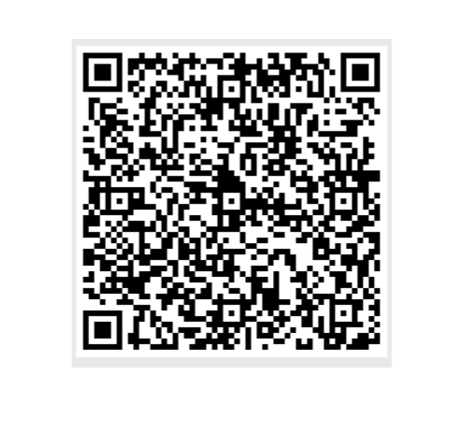

Slide 22
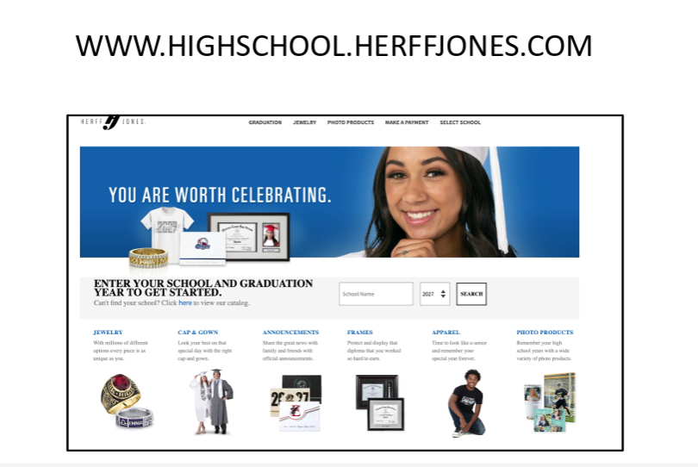

Slide 23
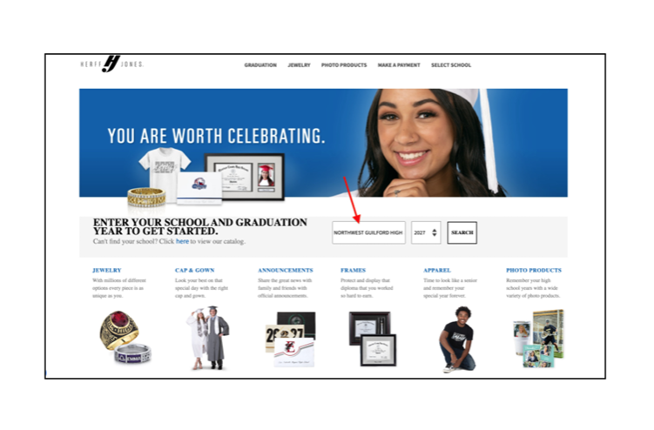

Slide 24
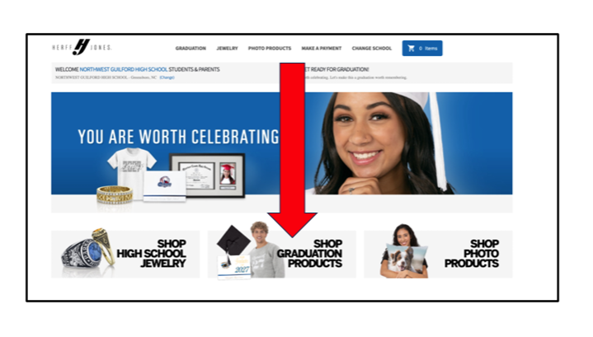

Slide 25
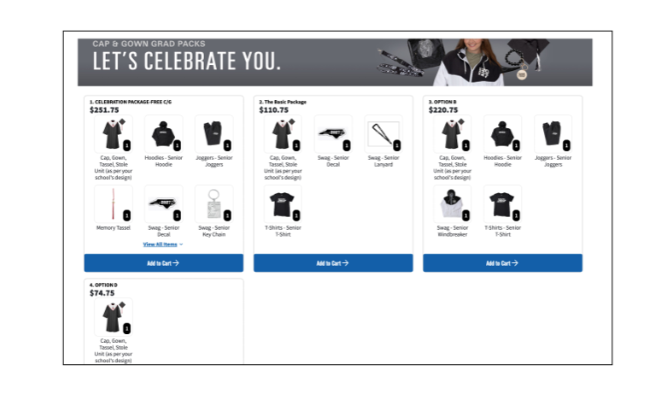

Slide 26


