Slide 1
OPEN HOUSE
2026–2027
Mr. Beers, Fourth Grade

Slide 2

ATTENDANCE MATTERS
We need your scholar at school every day for the full instructional day. Our goal is 95% daily average attendance.
  Gates open at 8:15am
  School starts at 8:45am - you are tardy after this time
  All doors are locked - please be on time

Slide 3

WELCOME TO
MY CLASS
Mr. Beers
Fourth Grade
Science and
Reading interventions
Be kind. Be curious. Be you.

Slide 4

NEW YEAR,
NEW OPPORTUNITIES
A fresh space to learn and grow.
New friends and connections.
Set goals and work hard.
Celebrate every success.

Slide 5

OUR CLASSROOM SCHEDULE
8:30–8:45 AM
Homeroom
9:35–10:40 AM
Period 1
10:40–11:45 AM
Period 2
11:50 AM–12:20 PM
Lunch
12:25–1:30 PM
Period 3
1:30–2:35 PM
Period 4

Slide 6
OUR PRIDE EXPECTATIONS
RESPECT
Listen when others speak. Care for people and materials.
KINDNESS
Use kind words and actions. Include others.
TRY YOUR BEST
Come prepared, stay focused, and learn from mistakes.
ASK QUESTIONS
Be curious. Ask for help when you need it.
CELEBRATE GROWTH
Celebrate successes, big and small.

Slide 7
OUR CURRICULUM
READING INTERVENTIONS
MATH AT HOME
Understand texts and key details.
Review current classwork together.
Build academic vocabulary.
Ask your child to explain how they solved a problem.
Read accurately and with expression.
Organize ideas. Use text evidence.
Practice skills assigned by the math teacher.
Analyze and make connections.

Slide 8
SCIENCE
NATURE OF SCIENCE
Questions, investigations, and evidence
EARTH AND SPACE
Earth in space, rocks, minerals, and natural resources
PHYSICAL AND LIFE SCIENCE
Matter, energy, motion, heredity, reproduction, and ecosystems

Slide 9
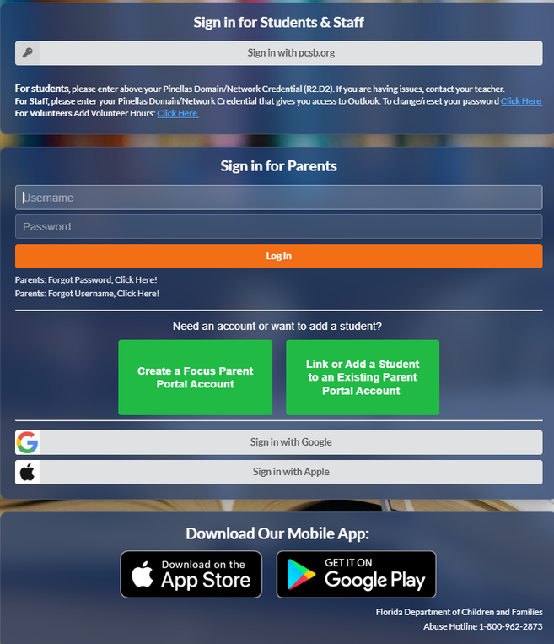
FOCUS PARENT PORTAL
Check FOCUS for:
Grades and test scores
Teacher communications
Report cards
Absences and tardies
Keep your phone number and email up to date.

Slide 10

SUPPORTING YOUR CHILD
Read together for 20–30 minutes each night.
Ask your child to explain what they learned.
Practice vocabulary and assigned skills.
Check FOCUS and teacher messages regularly.
Celebrate effort, kindness, and progress.

Slide 11

LET’S STAY CONNECTED
EMAIL IS BEST
Beerswi@pcsb.org
URGENT MATTERS
727-893-2643
MONDAY–FRIDAY
7:30 AM–3:30 PM

Slide 12
THANK YOU FOR SUPPORTING
YOUR SCHOLAR & OUR SCHOOL!
Please sign the Title I compact.
Contact me to arrange a parent–teacher conference.
Thank you for trusting me with your child.

