Slide 1
2026-27
Annual Title I & Family Engagement Meeting
Sea Isle Elementary School
September 10, 2026
Ms. Tamara P. McCray, PLC Coach

Slide 2
Why are we here?
The Every Student Succeeds Act (ESSA) requires that each Title I school hold an annual meeting of Title I families in order to:
      inform you of your school’s participation in Title I,
      explain the requirements of Title I, and
      explain your rights as parents and family members to be involved.

Slide 3
What will I learn?
What is a Title I school?
What are my rights?
What can Title I funds be used for?
How does our school use Title I funds?
What is the SIP?
What are our schoolwide program goals?
How is parent and family engagement funded?
What is the Parent and Family Engagement Policy?
What is the School-Parent Compact?
What curriculum does our school use?
What tests will my child be taking?
How can I be involved? (Parent & Family Engagement Requirements; Parent-Teacher Conferences; Availability of Parent Training)
Who can I contact for help?
Parents’ Right to Know (including Teacher Qualifications)
District/School Progress/School Status
Reporting Pupil Progress
Opportunities for Additional Parent Meetings

Slide 4
What is a Title I school?
Title I was passed in 1965 under the Elementary and Secondary Education Act (ESEA). It is the largest federal assistance program for our nation’s schools.
Title I schools receive extra funding (Title I dollars) from the federal government. These dollars are used to:
      identify students experiencing academic difficulties and provide assistance to help these students;
      purchase additional staff, programs, materials, and/or supplies; and
      conduct parent and family engagement meetings, trainings, events, and/or activities.

Slide 5
What can Title I funds be used for?
In general, Title I funds may be used for:
      additional school staff
      additional training for school staff
      extra time for instruction (before and/or after school programs),
      parent and family engagement activities, and/or
      a variety of supplemental teaching materials, equipment, and technology.

Slide 6
How does our school use Title I funds?
In 2026-27, our school was allotted approximately $244,638.94 in Title I funding.
We developed a Schoolwide Program, which means we plan to spend our funds on the following:
      Supplemental staff:
        PLC Coach
        Math Coach
      Programs/Materials/Supplies:
        Copier (lease & maintenance), math manipulatives, large/small group carpets, iReady Workbooks, headphones, copy paper, and various other instructional materials/supplies

Slide 7
What is the SIP?
The SIP is the School Improvement Plan. It includes:
      the identification of the school planning team and how they will be engaged in the planning process;
      a needs assessment and summary of academic and non-academic data;
      prioritized goals, strategies, and action steps to help address the academic and non-academic needs of students;
      teacher and staff professional development needs; and
      budgets and the coordination of resources.
The school must include family representatives on our school planning team.

Slide 8
What are our schoolwide program goals?
By May 2029, Sea Isle Elementary School will increase the percentage of students who score proficient in 3-5 ELA for all students from 30.9% (2025) to 42.1% (2029); students with disabilities (SWD) from 11.8% (2026) to 23.8% (2029); and English Language Learners (ELL) from 5.3% (2026)to 17.3% (2029).
By May 2029, Sea Isle Elementary School will increase the percentage of students who score proficient in 3-5 Math for all students from 43.2% (2025) to 55.2% (2029); students with disabilities (SWD) from 19.6% (2026) to 31.6% (2029); and English Language Learners (ELL) from 15.8% (2026)to 27.8% (2029).

Slide 9
What is our school’s designation status?
In accordance with Tennessee’s accountability system, the Tennessee Department of Education (TDOE) determines designations for all public schools. Designations include:
      Reward Schools: Recognizes schools with high levels of performance or student growth, including the top 5% of schools.
      CSI (Comprehensive Support and Improvement): Also known as Priority schools, these are identified for being in the bottom 5% of overall performance or having a graduation rate below 67%.
      TSI/ATSI (Targeted/Additional Targeted Support and Improvement): Also known as Focus schools, these are identified when specific student groups underperform.
      SEA ISLE DOES NOT HAVE A DESNIGNATION STATUS

Slide 10
What is the State Report Card?
TDOE releases an annual Report Card on Tennessee schools.
This report displays state-, district-, and school-level data for each school year.
It includes information on demographics, achievement, academic growth, attendance, graduation rate and more.
You can view the data statewide, or you can choose a specific district or school.
You can view the report card here:
      https://www.tn.gov/education/families/report-card.html

Slide 11
What curriculum does our school use?
The Tennessee Academic Standards provide a common set of expectations for what students will know and be able to do at the end of a grade for each subject area.
Tennessee's academic standards form the framework for everything taught at Sea Isle Elementary School.
For more information about Tennessee’s academic standards, see: Academic Standards
https://www.tn.gov/education/districts/academic-standards.html

Slide 12
What curriculum does our school use?
Sea Isle Elementary School uses the following curricula to guide students toward mastery of state standards per grade level:
ELA (Reading) – McGraw-Hill Wonders
Math – Envision Mathematics
Science – Savvas Elevate Science
Social Studies – Studies Weekly
RTI²-A – i-Ready TN Social Studies (3-5)

Slide 13
What tests will my child be taking?
Universal Screener (Fall, Winter, Spring)
  The proficiency expectation is all students will score above the 25th percentile.
CFAs (Common Formative Assessment) administered quarterly
  The proficiency expectation is all students will score at or above 75%.
TCAP (April 2027)
  The proficiency expectation is all students score on-track or mastered on all content areas.
    The following link is to the MSCS Assessment Calendar. This calendar identifies when all scheduled assessments will be administered during SY27. https://www.scsk12.org/calendar25/files/26/MSCS%20Assessment%20Calendar%202026%202027%20FINAL%20PDF%2007_13_26.pdf
    For access to various assessment resources, please click the link(s) below:
    https://www.scsk12.org/calendar25/files/26/2026-2027%20MSCS%20Reporting%20Periods.pdf

Slide 14
What is parent and family engagement?
Family engagement is a shared responsibility in which schools and other community agencies and organizations are committed to reaching out to engage families in meaningful ways and in which families are committed to actively supporting their children's learning and development.
Family engagement is continuous across a child’s life and entails enduring commitment but changing family roles as children mature into young adulthood.
Effective family engagement cuts across and reinforces learning in the multiple settings where children learn – at home, in pre-kindergarten programs, in school, in after-school programs, in faith-based institutions, and in the community.
Source: The National Association for Family, School, and Community Engagement (https://nafsce.site-ym.com/page/definition)

Slide 15
What is parent and family engagement?
“Through effective communication with parents, teachers can have the greatest impact on their day-to-day success with students. With parents on their side, teachers can more effectively manage most academic and behavioral issues that arise. When the most important adults in a child’s life are working together, students benefit enormously.”
                —Lee and Marleen Canter
Source: Parents on your Side: A Teacher’s Guide to Creating Positive Relationships with Parents

Slide 16
What is a Parent and Family Engagement Policy?
These plans address how the district and school will implement the parent and family engagement requirements of ESSA. Components should include:
      how parents and families can be involved in decision-making and activities;
      how parent and family engagement funds are being used;
      how information and training will be provided to families; and
      how the school will build capacity in families and staff for strong parent and family engagement.
You, as a Title I parent or family member, have the right to be involved in the development of these plans.

Slide 17
What is a Parent and Family Engagement Policy?
The district Parent and Family Engagement Policy can be found here:
      Memphis Shelby County Schools
      District Website – Community tab – Family Engagement
The school Parent and Family Engagement Policy will be shared as a handout during the Annual Title I meeting on September 10, 2026.
In addition, the policy can be found here:
      District Website – Schools – Sea Isle Elementary School – Parent & Students -Resources-

Slide 18
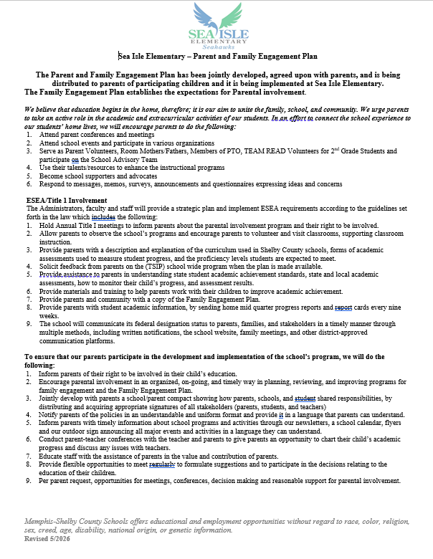

Slide 19
Table Activity
Partner with those at your table to discuss the following questions:
      What form of communication works best for you? (e.g., phone calls, texts, emails, notes, face-to-face, etc.)
      What kinds of information do you most want to receive from the school?
      What might the school do differently to improve communication between school and home?
Record your group’s thoughts on chart paper.
Be prepared to share!
Notes:
An option is to provide a QR code to survey parents and include it here. Kahoot!, MentiMeter, and MS Forms are options for immediate questioning feedback.

Slide 20
How is parent and family engagement funded?
Any district with a Title I allocation exceeding $500,000 is required by law to set aside 1% of its Title I allocation for parent and family engagement.
Of that 1%, 10% may be reserved at the district for system-wide initiatives related to parent and family engagement. The remaining 90% must be allocated to all Title I schools in the district.
You, as Title I parents and family members, have the right to be involved in how this money is spent.

Slide 21
How is parent and family engagement funded?
In 2026-27, we received approximately $2,900.00 in parent and family engagement funding.
We plan to use these funds for:
      Parent and Family Engagement Meeting and Events
        Annual Title I Meeting – September 10, 2026
        Family Literacy Night – Literacy on the Lawn – September 10, 2026
        Title I Annual AM Meeting – September 25, 2026
        Family Math & Science Night – November 19, 2026
      Materials/Supplies
        Refreshments for Annual Title I Meeting
        Materials for parent training – make-n-take (Family Math & Science Night)
        Refreshments for School Data Night
        Materials to work with your children at home

Slide 22
What is a School-Parent Compact?
A school-parent compact is a written commitment that outlines how the entire school community – teachers, families, and students will share the responsibility for improved academic achievement.
The compact must describe how the school will:
      provide high-quality curriculum and instruction;
      hold parent-teacher conferences, annually in elementary schools;
      provide parents with reports on their child’s progress;
      provide parents reasonable access to staff.
      provide parents opportunities to volunteer; and
      ensure regular two-way meaningful communication between family members and staff, to the extent practicable, in a language family members can understand.
You, as a Title I parent or family member, have the right to be involved in the development of the compact.

Slide 23
What is a School-Parent Compact?
The school-parent compact will be shared as a handout during the Annual Title I meeting on September 10, 2026. In addition, the compact can be found here:
      District Website – Schools – Sea Isle Elementary Website– https://seaisle-es.scsk12.org/
      Parent & Students – Resources- Parent Resources

Slide 24
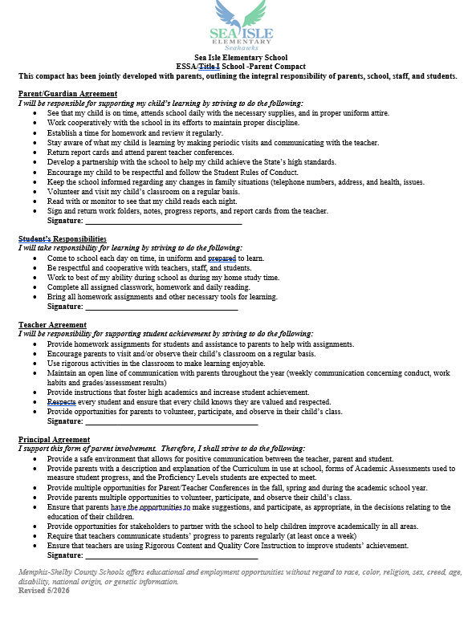

Slide 25
What are the benefits of family engagement?
For students:
Higher grades and test scores
Better attendance
More positive attitudes and better behavior
Higher graduation rates
Greater enrollment in postsecondary education
For Parents and Families:
More confidence and trust in the school
Increased confidence in their parenting skills
Creates a home environment that encourages learning
Encourages families to form stronger relationships with teachers and other families
For Schools and Teachers:
Improved teacher and staff morale
Higher ratings of schools and teachers by families
More support from families
Higher student achievement
Increased and improved relationships within the community

Slide 26
How can I be involved?
We need you! Research has proven that family engagement in education has more impact on student achievement than any other factor.
To get involved with the SIP, please make note of all meetings from the invitation (flyer, Class Dojo, Blackboard communication – text and/or email, and school’s social media outlets) and plan to attend each meeting.
To get involved with the Parent and Family Engagement Policy, please make note of the planning meeting from the invitation (flyer, Class Dojo, Blackboard communication – text and/or email, and school’s social media outlets) and plan to attend the planning meeting.
To get involved with the School Parent Compact, please make note of the planning meeting from the invitation (flyer, Class Dojo, Blackboard communication – text and/or email, and school’s social media outlets) and plan to attend the planning meeting.

Slide 27
How can I be involved?
Some examples of how you can be involved in your child’s education include, but are not limited to:
    encouraging attendance;
    monitoring grades and schoolwork on an online system or portal;
    be knowledgeable and understand the Student Code of Conduct
    attending family events and meetings;
    observing or volunteering in classrooms;
    joining family groups and committees (e.g., PTA/PTO, advisory councils, etc.); and
    reading school/classroom newsletters or utilizing websites that contain examples of learning activities families can do with students at home.
Additionally, Sea Isle Elementary School’s FEP describes several other opportunities for you to be involved in the education of your child.

Slide 28
What are my rights?
The families and parents of Title I students have a right, by law, to:
      be involved in decisions made at both the school and district level;
      be provided with information on your child’s level of achievement on tests in reading/language arts, writing, mathematics, and science;
      request and receive information on the qualifications of your child’s teacher and paraprofessionals who are working with your child by contacting the principal and
      request opportunities for regular meetings to formulate suggestions and to participate, as appropriate, in decisions about the education of your child. The school is required to respond to any such suggestions as soon as practicably possible.

Slide 29
What are my rights?
Every Student Succeeds Act (ESSA)
Parents’ Right-To-Know
All parents have the right to request the following:
• A teacher’s professional qualifications, which include: state qualifications, licensure, grade/s certification, waivers
• A teacher’s baccalaureate and /or graduate degree, fields of endorsement, previous teaching experience
• A paraprofessional’s qualifications
• An assurance that their child’s name, address, and telephone listing not be released to military recruiters
All parents will receive information on the following:
• Their child’s level of achievement in each of the state academic assessments
• Their option to request a transfer to another school within the district if their child is the victim of a violent crime at school
• Their right to timely notification that their child has been assigned, or has been taught for four or more consecutive weeks by, a teacher who is not highly qualified

Slide 30
Who can I contact for help?
For general questions, call the front office at: 901.416.2104
To reach the principal, Dr. Meeks, call: 901.416.6100
To reach the school counselor, Mrs. McGhee, call: 901.416.6104
To reach your child’s teacher, send a message on Class Dojo, call the front office or view our staff directory at: https://seaisle-es.scsk12.org/our-staff/meet-our-team

Slide 31
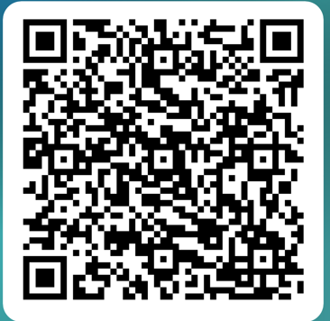
Sea Isle Elementary School
Family Engagement & Communication Survey

Slide 32
WE JUST WANT TO SAY…
THANK YOU!
Notes:
Be sure to thank families for their time.

