Slide 1

2026 – 2027
After school Program
Mandatory Parent orientation

Slide 2
Program Important information
Five program components to follow
Free program for all
Only enrolled for 2026 -2027 school year

Slide 3
Five components
Homework Support * Parents Must still check and sign homework when you are home * subject to change due to student pick up
Academic *45 min of literacy support subject to change to student pick up
Physical Education * structure P.E with tutor's guide students must participate
Enrichment * fun steam education subject to change based on vendor – 2 vendors a year – one each semester
Snack * two snack a day one served at 2:00- 2:30 second snack 5:20 students are not allowed to take home they will be instructed to throw away in the trash

Slide 4
Behavior expectations
Day school expectations are to be followed in the after-school program * if student is not following the rules they will receive consequences
Misbehavior will result in a suspension from the program
Three write ups = drop from the program
*if behavior is major can be dropped immediately without 3 write ups
Once student is dropped, they can't be enrolled until next school year
Kindergarten students if the child is not prepared for the program and becomes frustrated or crying for long periods of time it can result into a drop *staff will support with student and calming down and identifying strong emotions

Slide 5
Pick up policy
Only adults / family members listed will be able to pick up *ID will be required until Site lead can recognize trusted adult ( add everyone to the list student will not be released if they aren’t listed)
1
Parents / Family can pick up at any time during the program
2
We are open until 6:00 PM anything passed the time will result in a write up or drop from the program
3
Students are not allowed to be picked up from the black top all students check in and must be signed out from ASP. This can also result into a drop
4
Sports students must check into ASP with their tutor if they do not, they will receive consequences
5
WALKERS are dismissed by 4:30 no one is allowed to walk home unless parents have communicated
6

Slide 6
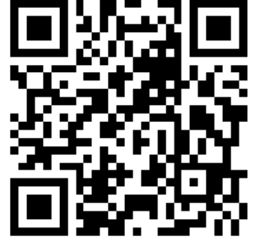
SIGN out procedure *CELLPHONE IS REQUIRED
Step 1 – Parent MUST BE PHYSICALLY PRESENT * no student will be released if you are in your vehicle
Step 2 - scan QR code with cell phone
Step 3 – Enter Cellphone number
Step 4 – enter access code
Step 5 – SIGN OUT
Step 6 – select student names and sign out selecting a code and adding signature

Slide 7
Complete enrollment
You have all received an invitation link – Email or text
Click on Link
Enter phone Number
Enter Access Code
Continue Second Step
Agree
Add all pick up contacts *all numbers contgacts can scan QR code
All numbers generate from pervious years – you can add or remove pick up on your end

Slide 8
ASP CONTACT
559-803-3495 – SITE LEAD
559-519-6828 – Coordinator

