Slide 1


SAT Suite of Assessments Student Readiness Check
Mrs. Lipinski, Testing Coordinator
September 2026

Slide 2
Table of Contents
01
Preview of the PSAT/NMSQT
02
Overview of the Student Readiness Check
03
Bluebook Login and Setup
04
Test Day Experience
05
What’s Next
06
Final Checklist and Reminders

Slide 3
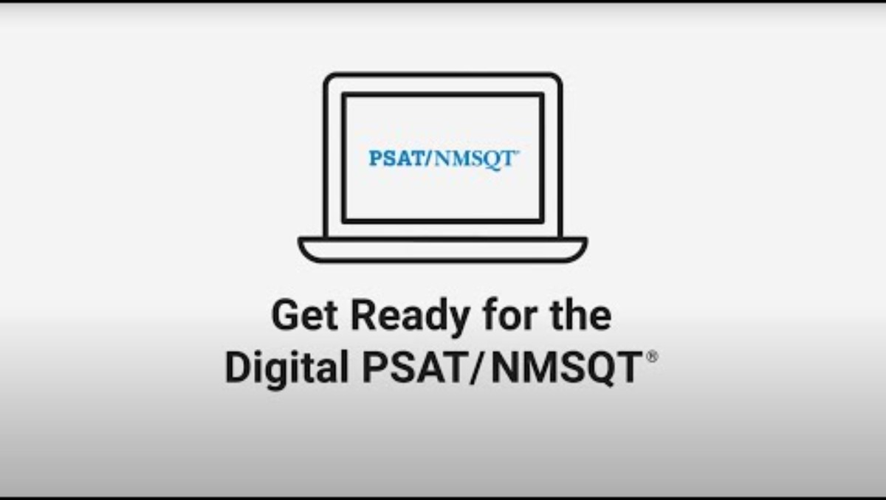
Get Ready for the Digital PSAT/NMSQT

Slide 4
Why the Student Readiness Check Matters
Setup + Opportunity Activation
This is your chance to try everything out before test day
Practice
Opportunities
You can add your mobile number during exam setup to access BigFuture® School.
Opt in to Connections™, a student-centered recruitment tool.
Students who plan to test on a personal device can make sure it will work on test day. Students will also confirm that their legal name, date of birth, and accommodations are correct.
Taking a full-length practice test in Bluebook™, the digital testing app, lets students get to know helpful in-app testing tools, sample the different types of test questions, and try out the built-in Desmos calculator.
More information on BigFuture® School and Connections™:
Big Future® School: This free app helps you explore colleges and careers, see how your skills may connect to future options, and get personalized guidance, all in one place.
Connections: This program, if allowed, helps you to discover nonprofit colleges, scholarships, and government agencies offering educational programs that may be a good match and are actively looking for students like you.
Note: Some schools, districts, or states may not provide access to Connections™.

Slide 5
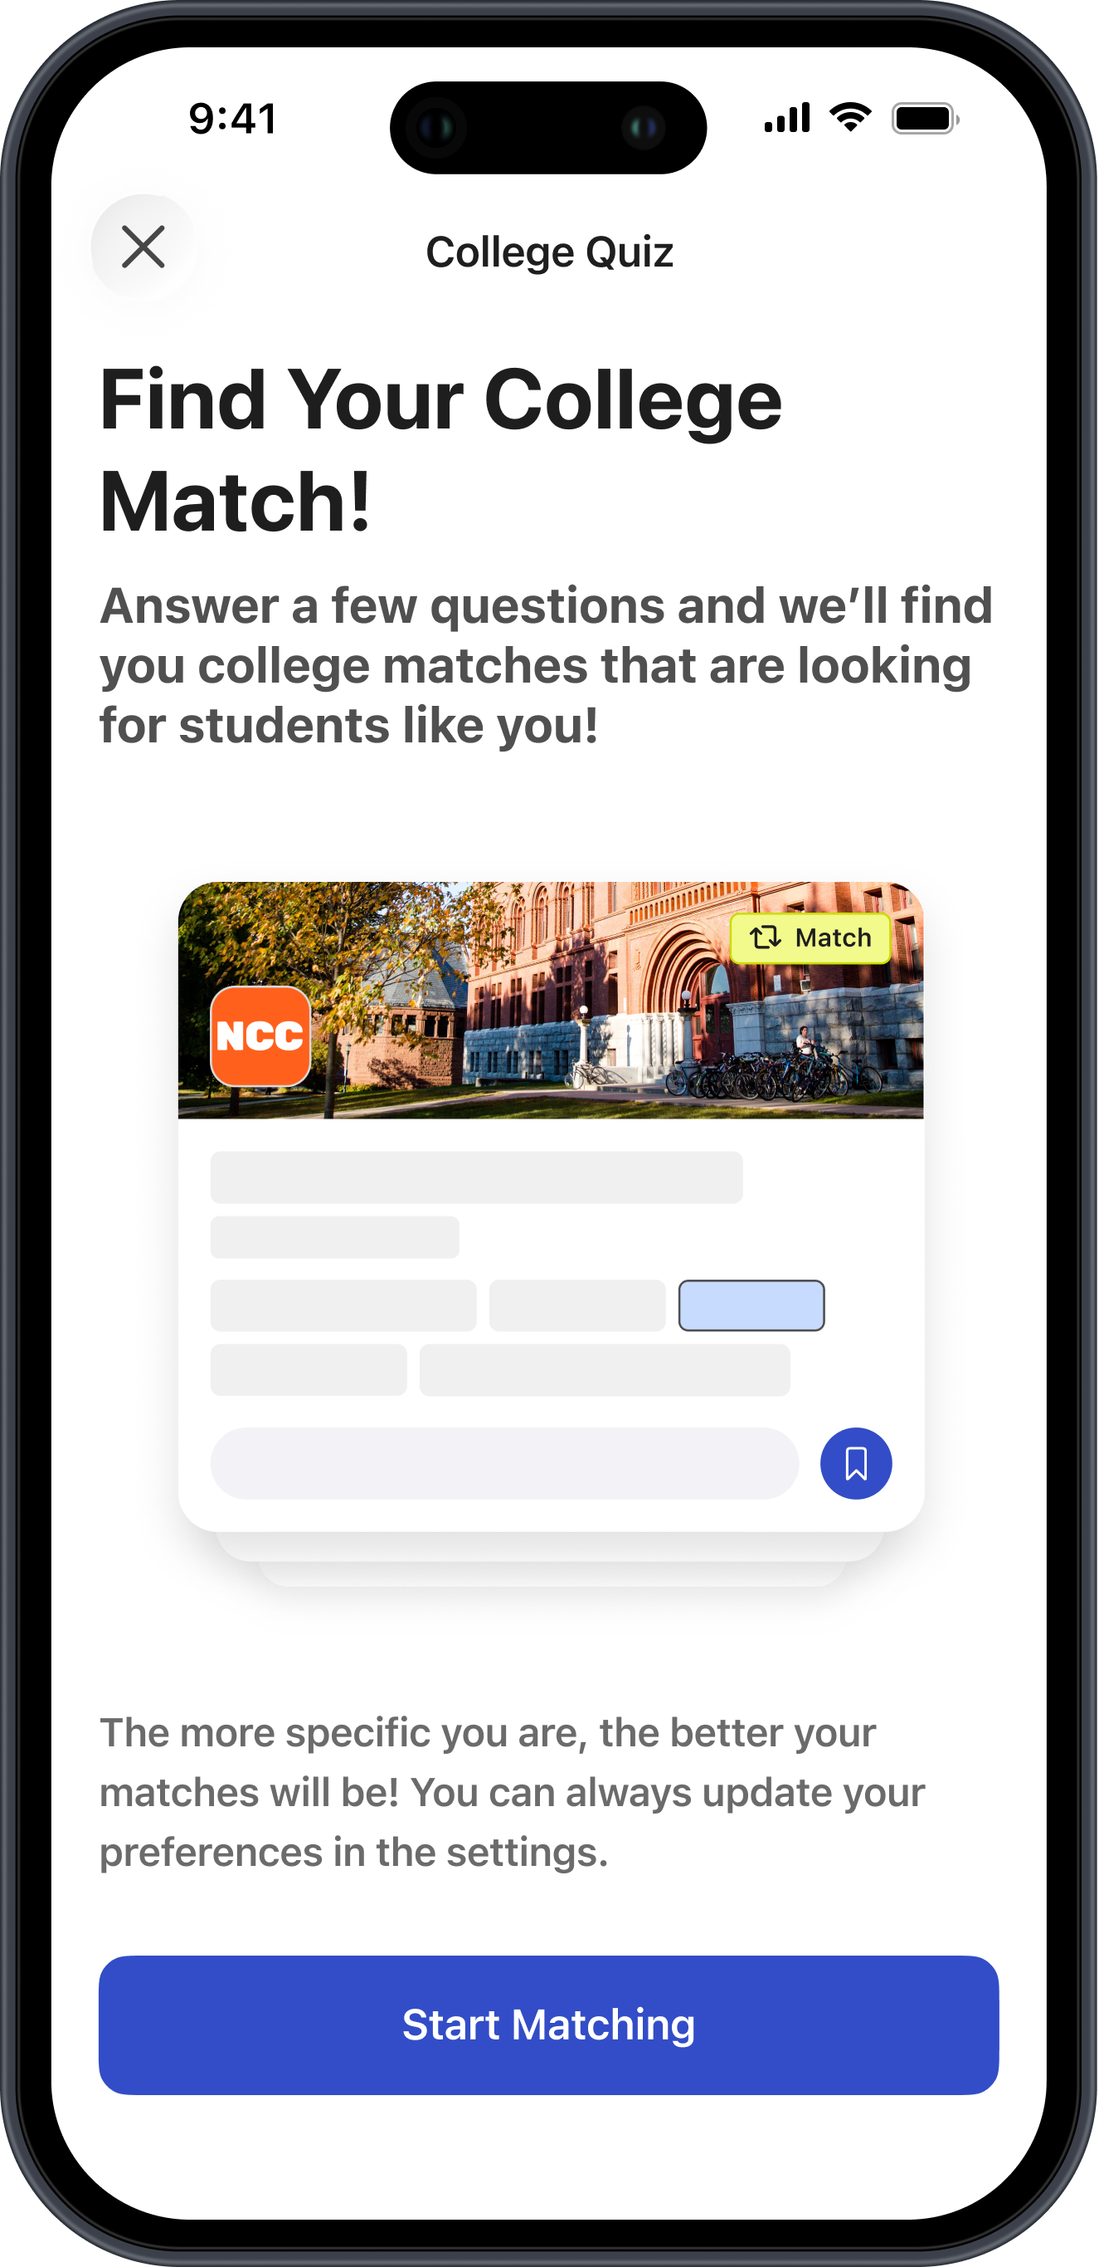
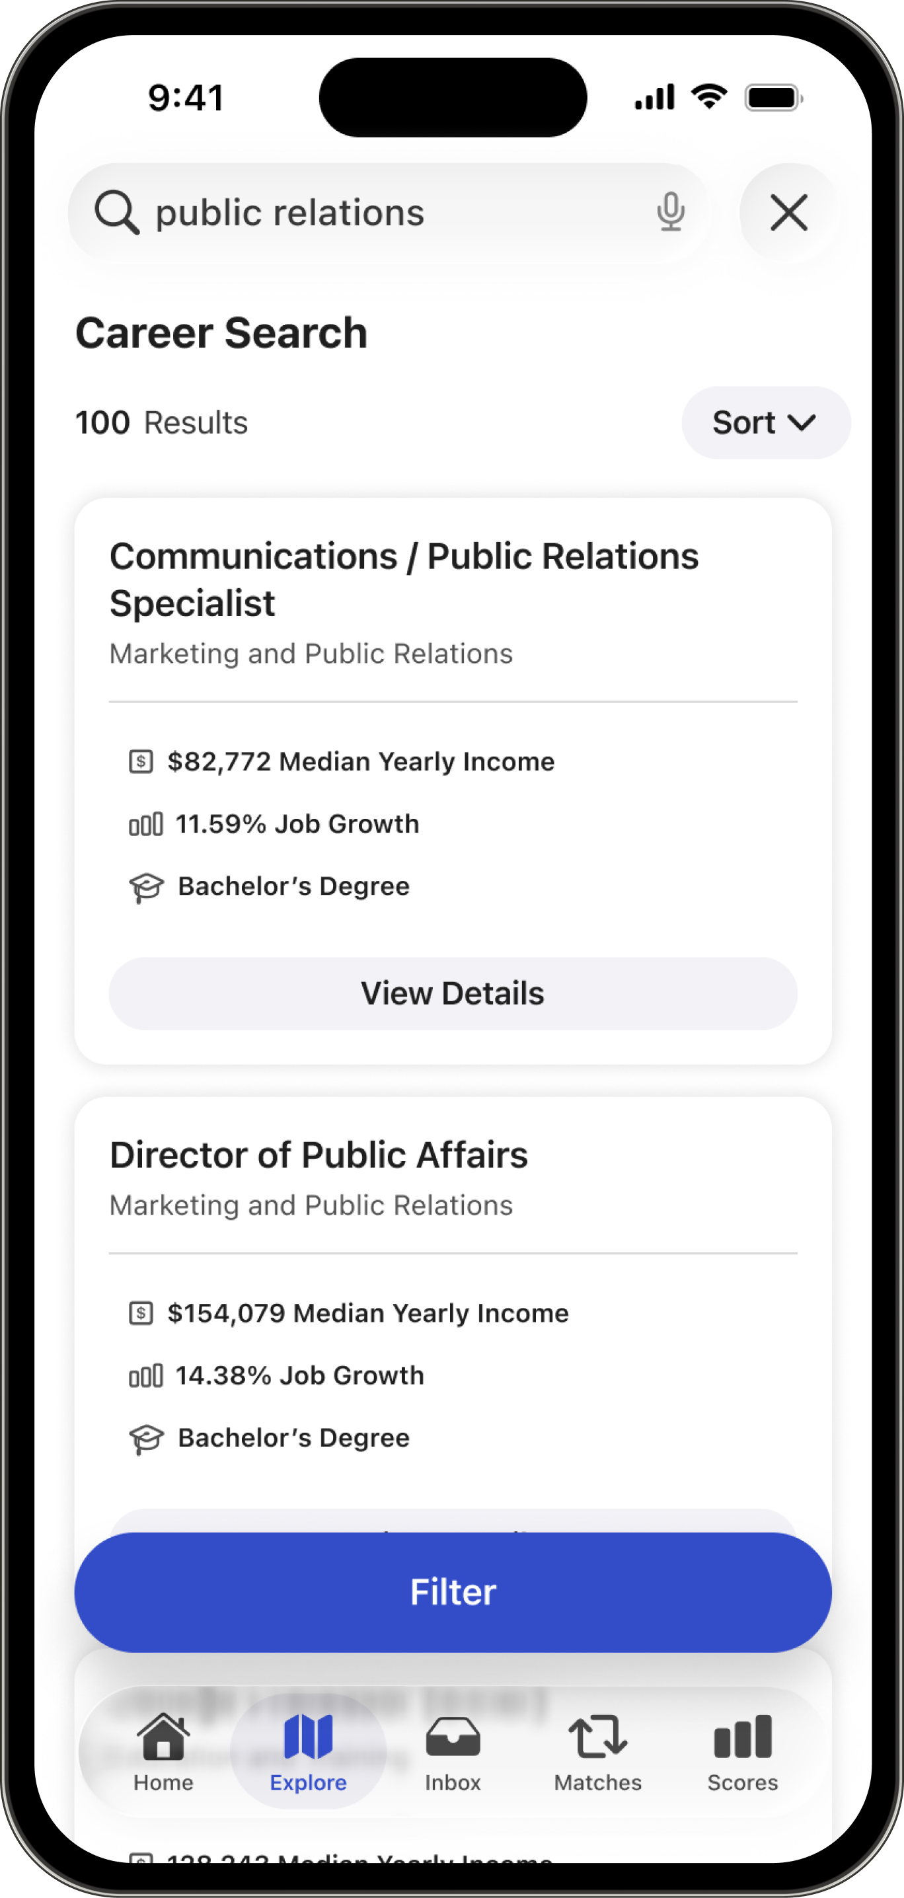
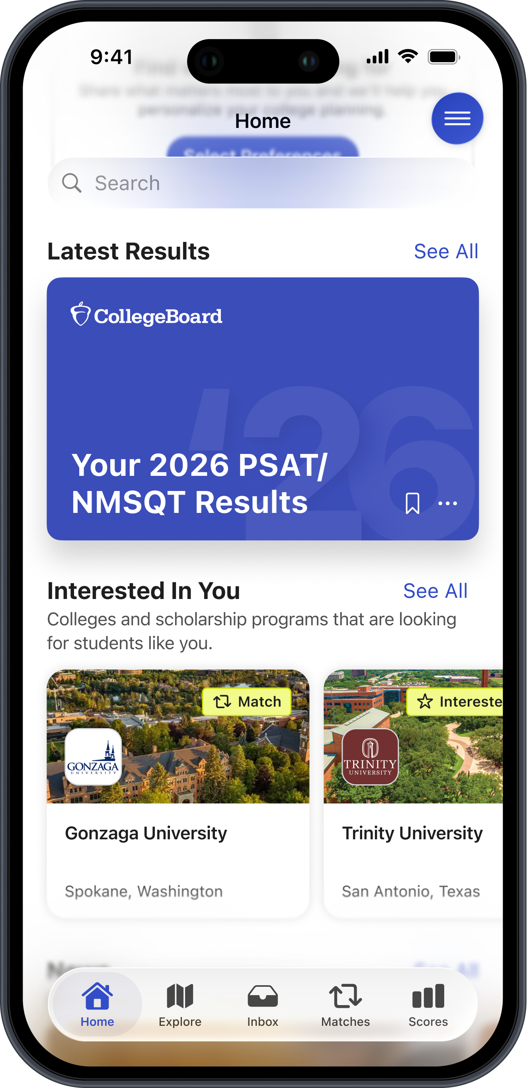
College and Career Planning at Your Fingertips
BigFuture® School is a free app you
can access when you take an in-school
PSAT assessment or SAT.
With the app, you can:
View Scores Easily
You'll receive a text when your scores and Career Insights Snapshot are available in
the app.
Explore College and Career Options
That Fit What You're Looking For
Use interactive tools to personalize exploration.
Match with Colleges and Expand
Your Possibilities
With Connections, you can opt in to discover nonprofit colleges, scholarship providers, and programs that match your goals and interests.
*Connections is not available to 8th graders taking the PSAT 8/9 or New York test takers*
Notes:
**Connections is not available to 8th graders taking the PSAT 8/9 or New York test takers**

Slide 6
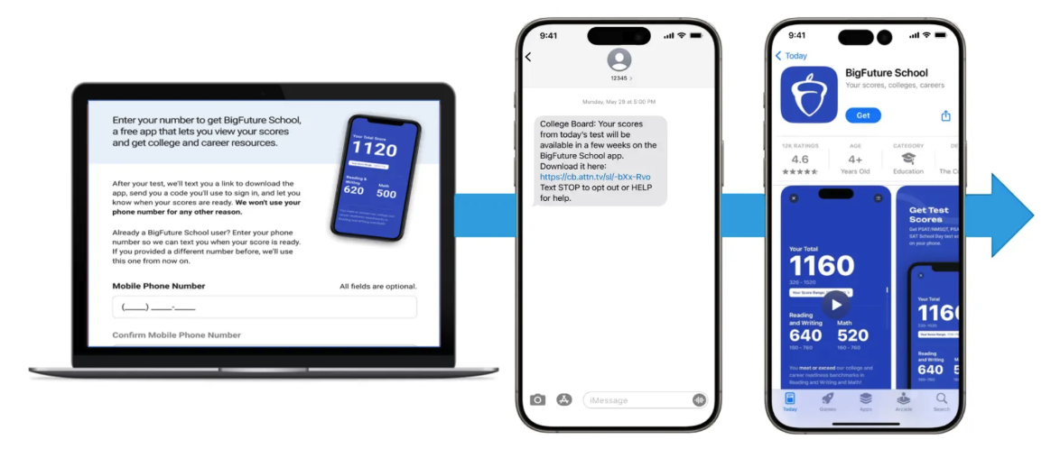
How to Gain Access to BigFuture® School and Connections™
You can provide a mobile number during exam setup to access the app. The mobile number is used to send limited texts related to app access, authentication, and score availability.
You will receive a text after test day with a download link and a secure code to successfully log in after entering your mobile number in the app. You will get a text alert when your scores are available in the app.

Slide 7
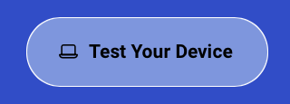
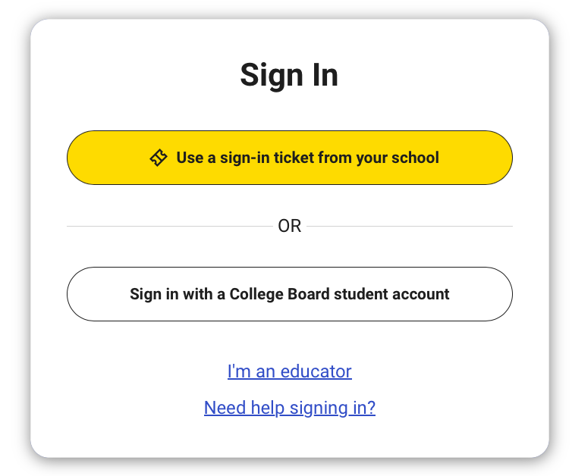
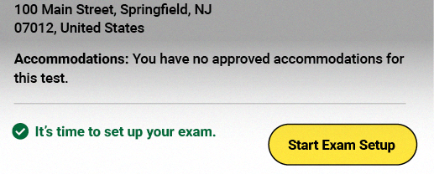
Bluebook Login and Device Setup
Test Your Device
Once you open up Bluebook, you will see a button on the upper right that says Test Your Device. Click on this and Bluebook will run a quick check to ensure your device meets all requirements.
Sign into Bluebook
Open the Bluebook app and log in using the credentials on the sign-in ticket your teacher gave you. Note: even if you have a College Board account, sign in using the info on the sign-in ticket.
Exam Setup
Under “Your Tests”, select Start Exam Setup and you will be prompted through
a series of screens.
Complete these steps and look up when you are finished.
Some questions are optional. You can skip them as needed.

Slide 8
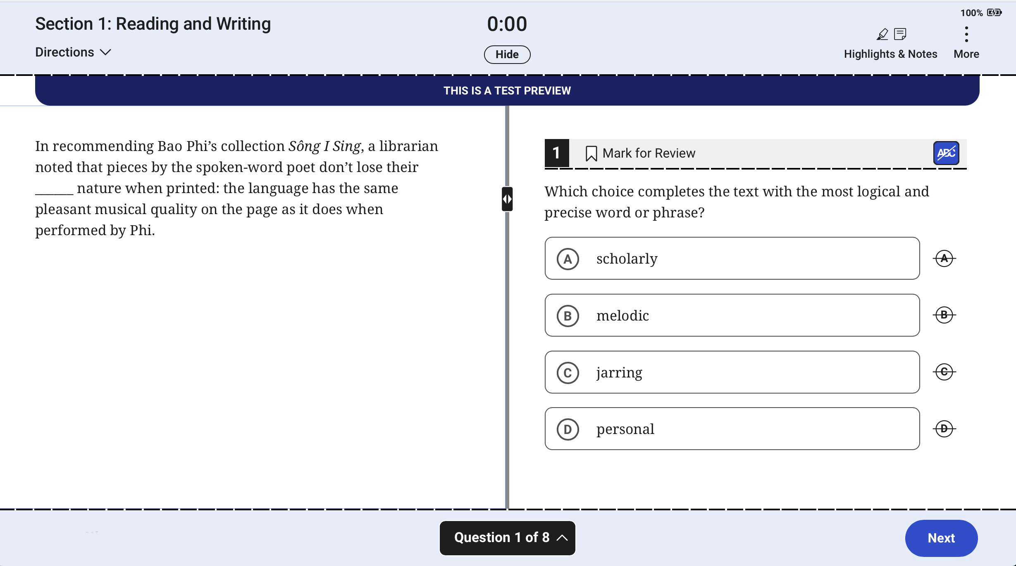
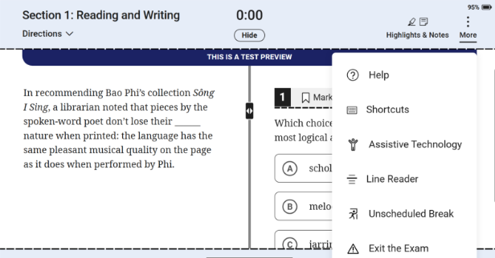
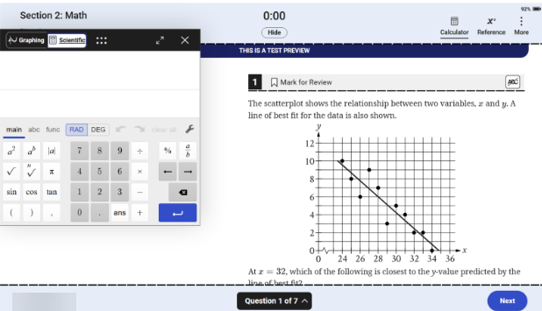
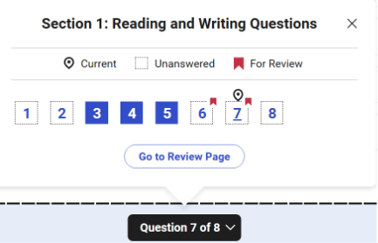
Test Day Experience - Universal Tools (1)
1
2
3
4
General Tools
More Menu
Math
Navigation
There are several general tools available to all students.
The More menu is available throughout the exam and offers a variety of options.
These tools are available only in the math section.
You can review questions skipped or marked for review and navigate to any question in the section.

Slide 9
General Tools – Zoom
You can use keyboard shortcuts on laptops or pinch and zoom on tablets to get a closer look at any part of a question.

Slide 10
General Tools – Mark for Review
If you click the bookmark icon next to the question number, you can mark this question for review and come back to it.

Slide 11
General Tools – Highlights & Notes
You can use the Highlights and Notes tool in the reading and writing sections to highlight text from a question or leave yourself a note.

Slide 12
General Tools – Answer Eliminator
You can cross out answer choices you think are wrong by selecting the crossed- out letter next to each answer.

Slide 13
General Tools – Timer
A timer will let you know how much time is remaining in each section of the test. It can be hidden until there are 5 minutes remaining.

Slide 14
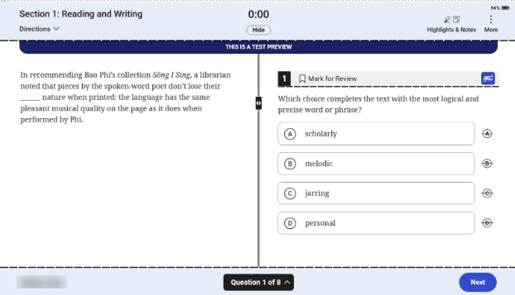
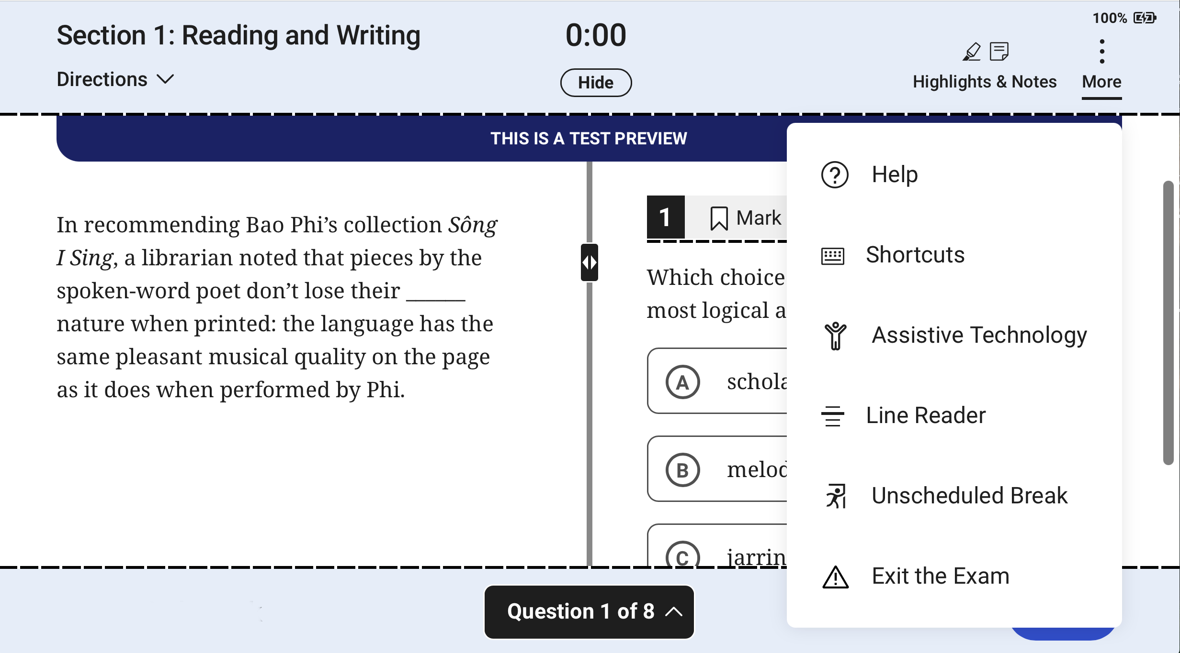
Test Day Experience - Universal Tools (2)
1
2
3
4
General Tools
More Menu
Math
Navigation
There are several general tools available to all students.
The More menu is available throughout the exam and offers a variety of options.
These tools are available only in the math section.
You can review questions skipped or marked for review and navigate to any question in the section.

Slide 15
More Menu
The More menu, available throughout the exam, offers a variety of supports, shown here.

Slide 16
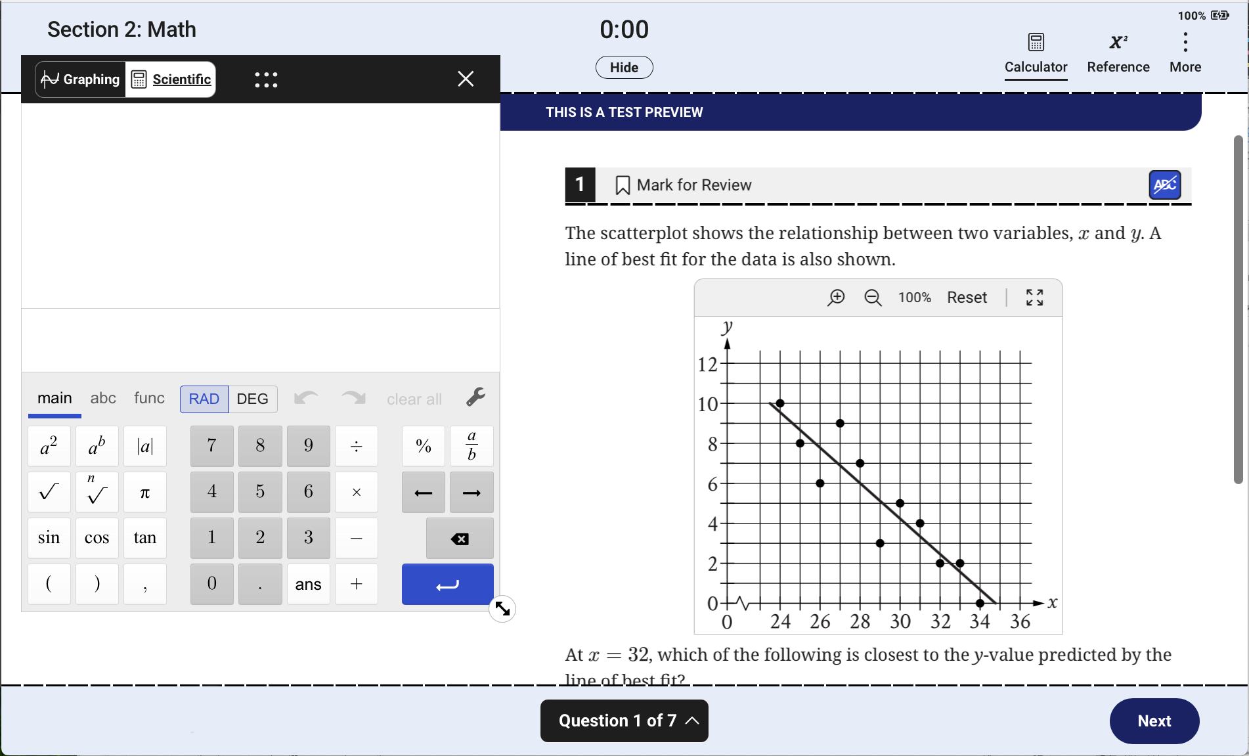
Test Day Experience - Universal Tools (3)
1
2
3
4
General Tools
More Menu
Math
Navigation
There are several general tools available to all students.
The More menu is available throughout the exam and offers a variety of options.
These tools are available only in the math section.
You can review questions skipped or marked for review and navigate to any question in the section.

Slide 17
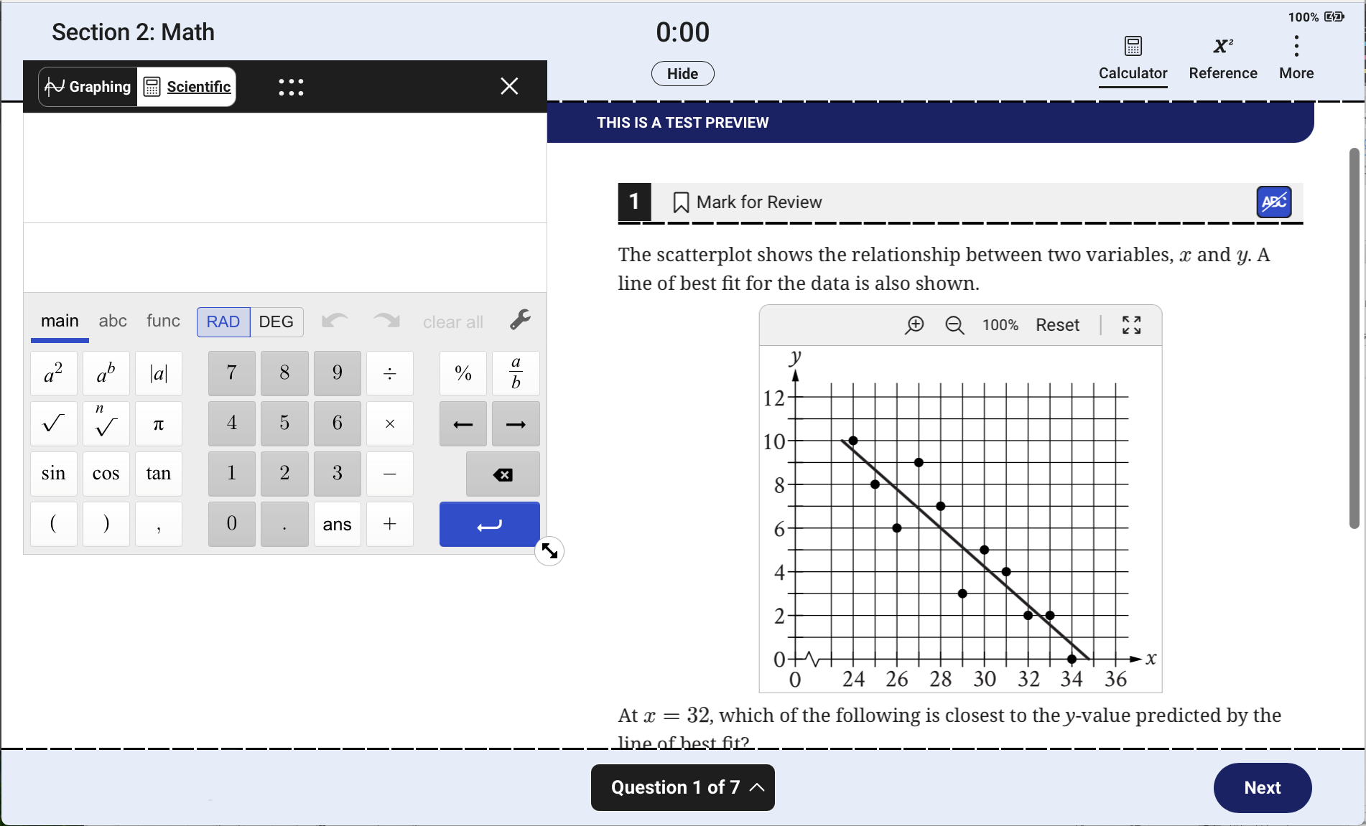
Math Tools - Calculator
A Desmos calculator is available on SAT and PSAT math sections. It can be resized and moved around. You can also toggle between a graphing and scientific calculator at any time.

Slide 18
Math Tools - Reference
A reference sheet, with commonly used formulas, is available on all tests with math questions.

Slide 19
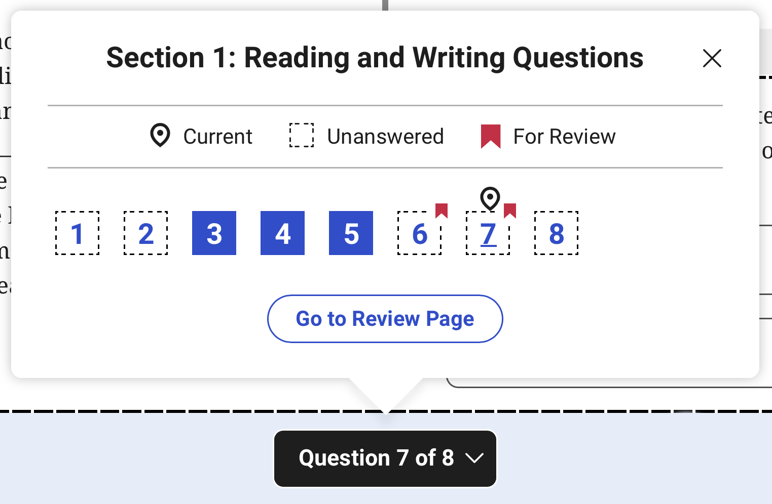
Test Day Experience - Universal Tools (4)
1
2
3
4
General Tools
More Menu
Math
Navigation
There are several general tools available to all students.
The More menu is available throughout the exam and offers a variety of options.
These tools are available only in the math section.
You can review questions skipped or marked for review and navigate to any question in the section.

Slide 20
Question Menu
This question menu is available at the bottom of the screen. You can use it to review questions skipped and marked for review, or to navigate to any question in this section.

Slide 21
Practice!!
Take this time to start a full practice test.
Return to the first window in Bluebook. (You may have to back out of the page you are currently on).
When you have time, you can finish this and other practice tests later, at home.
The test preview will not be scored, but the full-length practice test will!
STOP!

Slide 22

Next Steps
1
Finish Your Practice Test at Home
Complete your practice test at home to help you prepare for test day and create a study guide.
Next Steps for SAT Success
2
Review your Student Guide
Student Guides provide useful information about testing. Links to the guides are on the next slide.
After you have completed the Student Readiness Check and Planning for your Future, there are some key steps to ensure you can show up on SAT test day as prepared as possible.
3
Take a Full Practice Test
Full practice tests are scored, so you can see where you should focus study. They are also timed, just like the real test.
4
Get Ready for Test Day
Sleep well, review any practice tests, eat a healthy breakfast, and don’t bring any prohibited devices with you to test.

Slide 23

Test Day Reminders
Make sure you arrive to school by 7:30 AM.The test will start promptly at 8:00 AM.
Bring your fully-charged, school-issued laptop and charger
Bring a #2 pencil/pen, College Board approved calculator (​https://satsuite.collegeboard.org/psat-nmsqt/whats-on-the-test/math/calculator-use, if desired
Bottle of water, snack(s) to eat on 10-minute break (optional)
Permitted: external mouse/mouse pad
Prohibited: phones, smartwatches, other electronic devices, external keyboards, notes/books/other reference materials, personal scratch paper, headphones/earbuds, earplugs, any camera, recording device, Google Glasses or timer; hats and hoods from hoodies cannot be worn during testing

Slide 24
Closing Checklist
Before you leave today, you should have done/learned the following:
1
Downloaded and signed into Bluebook
2
Tested your device and completed exam setup
3
Enrolled in BigFuture® School and
Connections, if available
4
Tried the test preview and learned how to take the test,
including starting a full practice test.

Slide 25
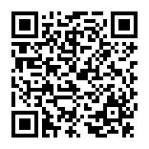
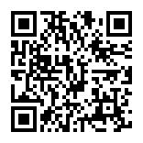
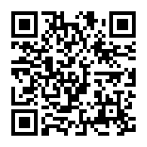
Student Guides
Scan the QR Codes to Access the Appropriate Student Guide
SAT
PSAT/ NMSQT
PSAT 8/9
Notes:
**Skip this slide if students are not allowed to use their cell phones in class.

Slide 26

Additional Practice Test & Test Prep
Visit the College and Career Center website for resources:
CUSD College and Career Exploration and Resources Padlet
*Scroll to the right to find College Admission Testing. Then scroll down to find Test Prep Resources!

Slide 27
Thank You!
Mrs. Lipinski
lipinski.crystal@cusd80.com
Room A52
© 2026 College Board. College Board, BigFuture, and SAT are registered trademarks of College Board. Bluebook and Student Search Service are trademarks owned by College Board. Visit College Board on the web: collegeboard.org.

