Slide 1

Sophomore Timeline

Slide 2


Sophomore Timeline

Slide 3
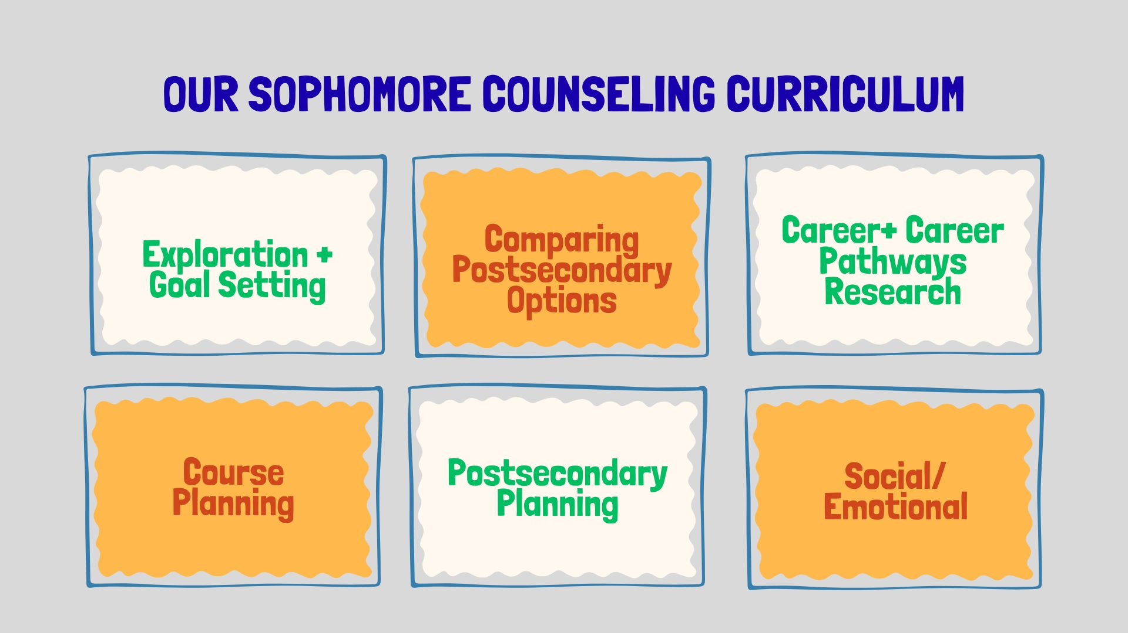
Sophomore Timeline

Slide 4
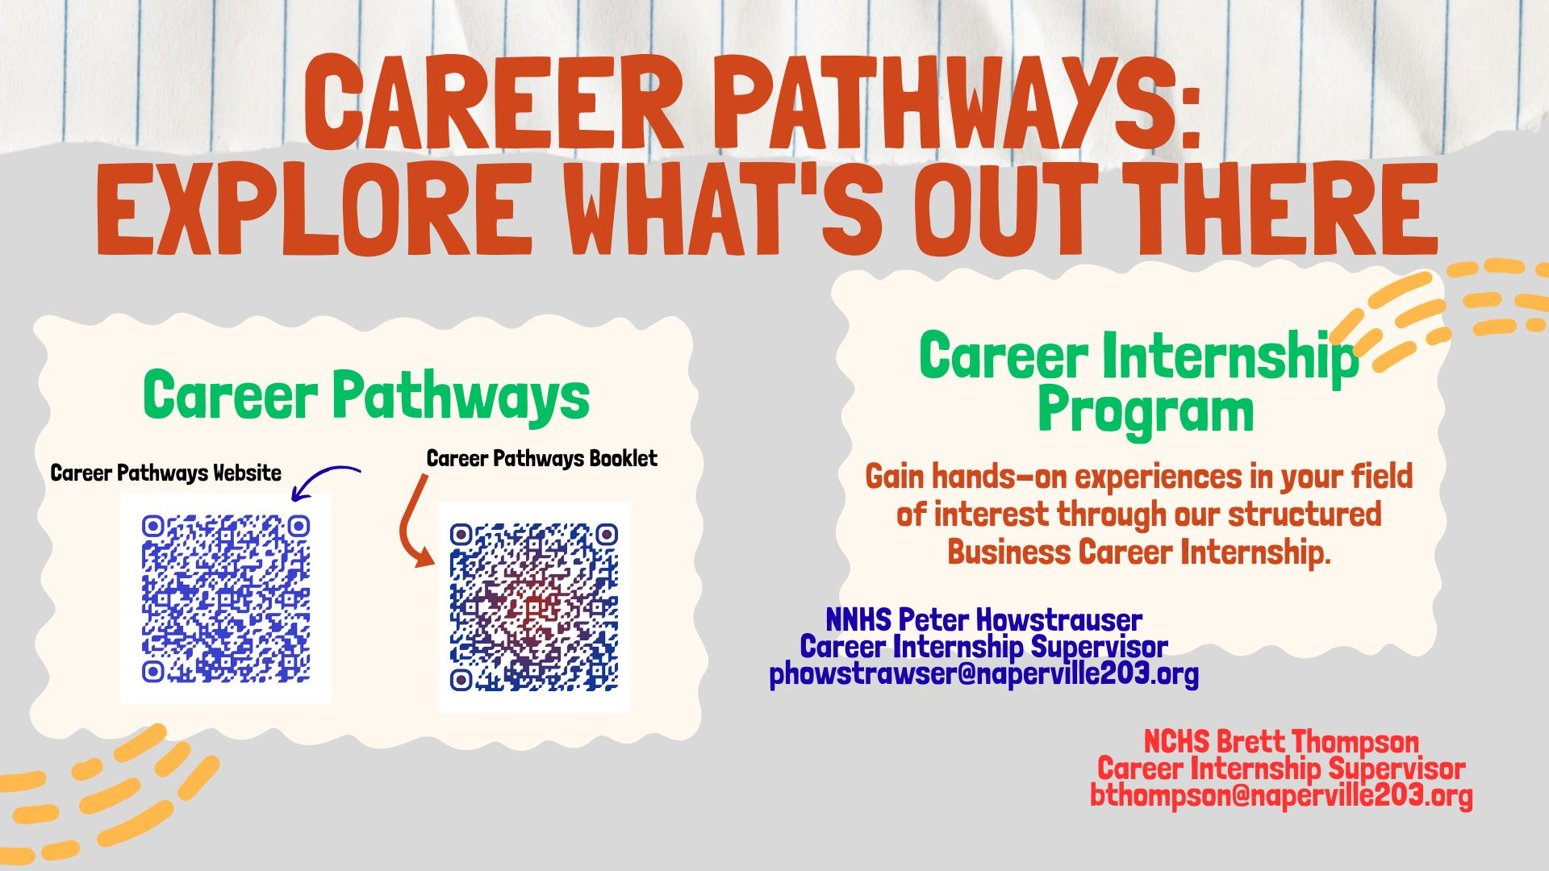
Sophomore Timeline
Notes:
Throughout the fall, we want to highlight a few items for Juniors to focus on. A great way to explore colleges is by taking virtual tours, or visiting them in person if available. NNHS also offers virtual colleges rep visits throughout the Fall. As you begin to create a list of schools you are interested in, we encourage students to favorite them in SchooLinks. This will allow students to have a running list of schools they are interested in. For those in AP classes, the fall is when you need to register for AP testing. Information will be shared by your teachers and through email. For ALL students, make sure you are making academics a priority. Remember that junior year is the best reflection of your academic potential and for colleges to see trends over your first three years in high school.

Slide 5
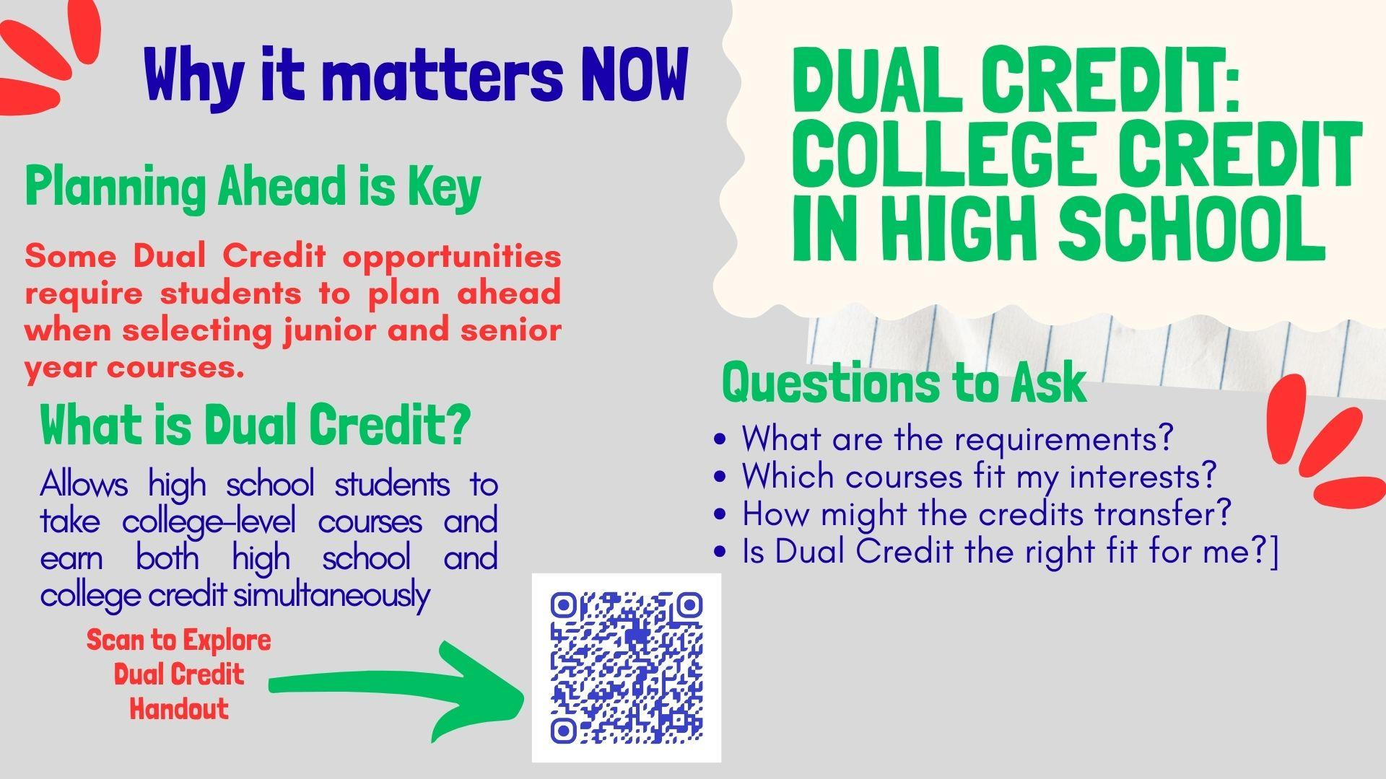
Sophomore Timeline

Slide 6
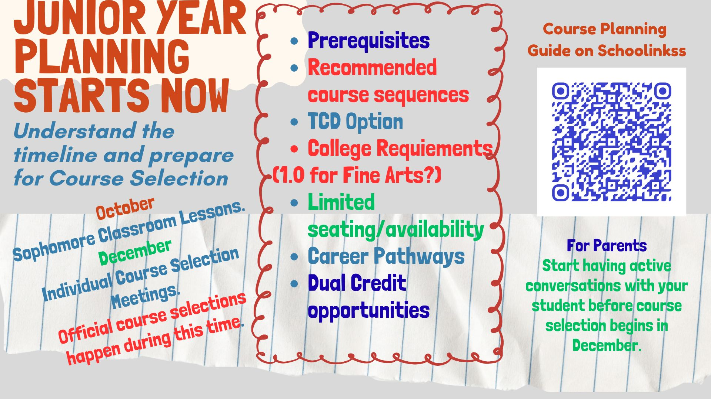
Sophomore Timeline
Notes:
Heading into Spring, we want to highlight a handful of items for Sophomores to focus on. First, sophomores can be preparing for the PSAT10 which will be taken the 2nd week in April (April 10). Students can review College Board website for test information and test prep- Khan Academy and practice tests.
College Fairs and Campus Visits- North Central College March 14th is next fair- provides sample questions. National virtual fairs on March 19 through NACAC information page In person, visits here at North will start back in the fall (register in Schoolinks).
Track Experiences- If you have had experiences, start tracking them in Schoolinks with a a list of your experiences. Keep track of of volunteer hours, work, internships, job shadow, clubs/activities, and much more.
Profile- video 1 min 30 seconds
Finish strong- sophomore year checklist
Summer jobs- look for opportunities- soccer ref example

Slide 7

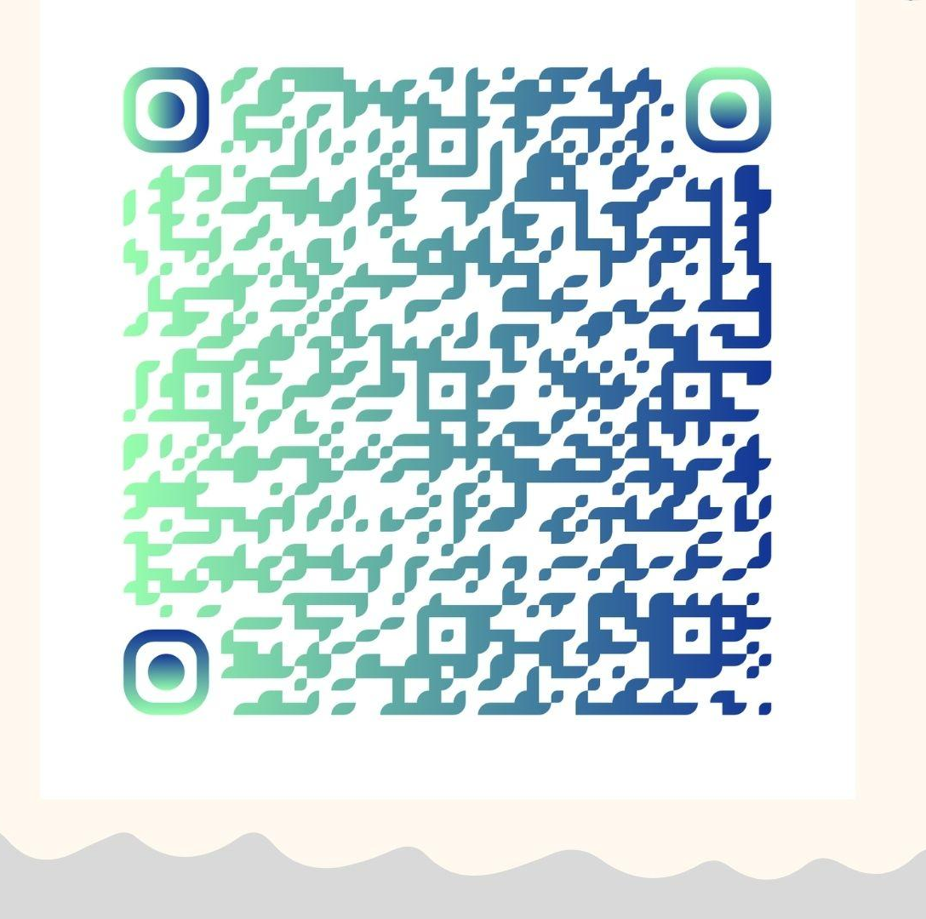
Sophomore Timeline
SCAN FOR TCD OFFERINGS
Field Trips Available! See Your Counselor!
Notes:
Heading into Spring, we want to highlight a handful of items for Sophomores to focus on. First, sophomores can be preparing for the PSAT10 which will be taken the 2nd week in April (April 10). Students can review College Board website for test information and test prep- Khan Academy and practice tests.
College Fairs and Campus Visits- North Central College March 14th is next fair- provides sample questions. National virtual fairs on March 19 through NACAC information page In person, visits here at North will start back in the fall (register in Schoolinks).
Track Experiences- If you have had experiences, start tracking them in Schoolinks with a a list of your experiences. Keep track of of volunteer hours, work, internships, job shadow, clubs/activities, and much more.
Profile- video 1 min 30 seconds
Finish strong- sophomore year checklist
Summer jobs- look for opportunities- soccer ref example

Slide 8

Sophomore Timeline
Notes:
Heading into Spring, we want to highlight a handful of items for Sophomores to focus on. First, sophomores can be preparing for the PSAT10 which will be taken the 2nd week in April (April 10). Students can review College Board website for test information and test prep- Khan Academy and practice tests.
College Fairs and Campus Visits- North Central College March 14th is next fair- provides sample questions. National virtual fairs on March 19 through NACAC information page In person, visits here at North will start back in the fall (register in Schoolinks).
Track Experiences- If you have had experiences, start tracking them in Schoolinks with a a list of your experiences. Keep track of of volunteer hours, work, internships, job shadow, clubs/activities, and much more.
Profile- video 1 min 30 seconds
Finish strong- sophomore year checklist
Summer jobs- look for opportunities- soccer ref example

Slide 9
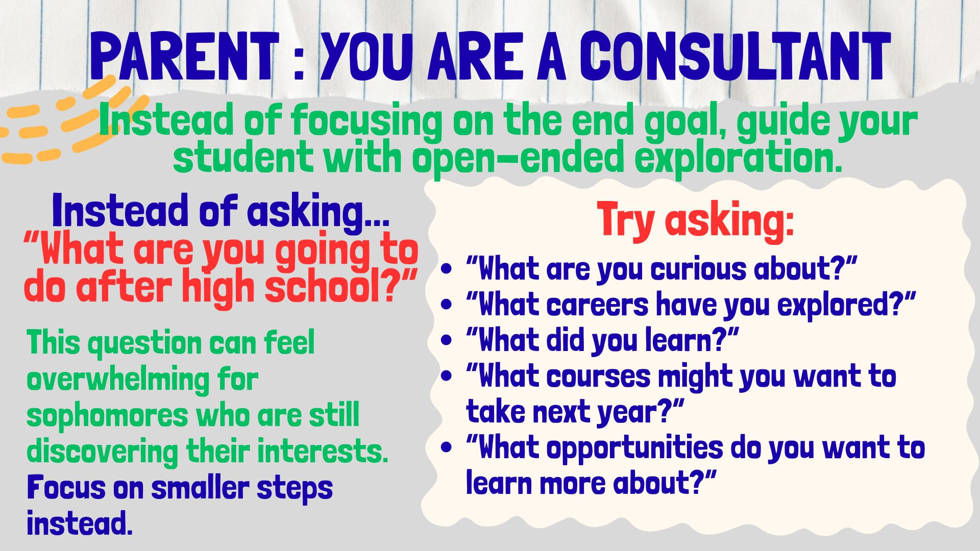
Sophomore Timeline
Notes:
All parents/guardians have observer access to their student SchooLinks account. These accounts provide view only access but allow parents to work with their student on postsecondary planning. There will be links available below this video to guide you through the sign up and matching process with your student’s account.
Links for parents will be on the page below this video

Slide 10
Sophomore Timeline
Your Sophomore Resources
Explore tools, planning guides, and counselor support to plan your path.
Essential Resources
Career Pathways Website
Career Pathways Booklet
Dual Credit Handout
Available at the Resources Table
Course Selection/Planning Guide on Schoolinks
TCD Offerings and Information
Your School Counselor
Your best starting point for questions
Carerr Interest Inventory
Career Fair
One Last Thought
“Sophomore year isn't about deciding your future.”
It's about gathering enough information to make good decisions about your future.
Notes:
In regards to college visits, there is no substitute for seeing a college yourself. Unfortunately, we know many colleges/universities are not all open for visits, but we encourage you to check out their website for more information on those who are offering in person visits. The link below is a great resource as well to get some helpful tips on navigating virtual college visits.

Slide 11
Upcoming Opportunities
Tonight
Sessions 2 & 3 Tonight
A few options for families to choose from to help with postsecondary planning [cite: 10]
Sept 1 -
Oct 30
In-School College Visits
Connect with admissions representatives directly at your school [cite: 10].
Sept 26
NACAC National College Fair @ Navy Pier (Chicago)
A national college fair, featuring more than 200 colleges & universities from across the country [cite: 10].
Sept 29
Navigating a Shifting Testing Landscape
An evening program at Naperville Central (6:30pm in Auditorium) to discuss college admission testing [cite: 10].
Oct 13
Illinois Regional College Fair @ Benedictine Univ. (Lisle)
Another college fair opportunity, bringing in additional colleges & universities from across the country [cite: 10].

