Slide 1

The College Considerations Game
The College Considerations Game
Notes:
Pre-Session Script
Thank you for attending the [Insert Session Name Here] session. Before we get started, just a few quick notes:
Please silence all cell phones for the duration of the presentation.
The nearest restrooms are located __________.
All slides & links from this presentation will be posted to the Parent Univ. website tomorrow (Friday, Sept. 9th).
And finally, we will have a brief exit survey that we would like each of you to complete at the conclusion of each presentation this evening.

Slide 2
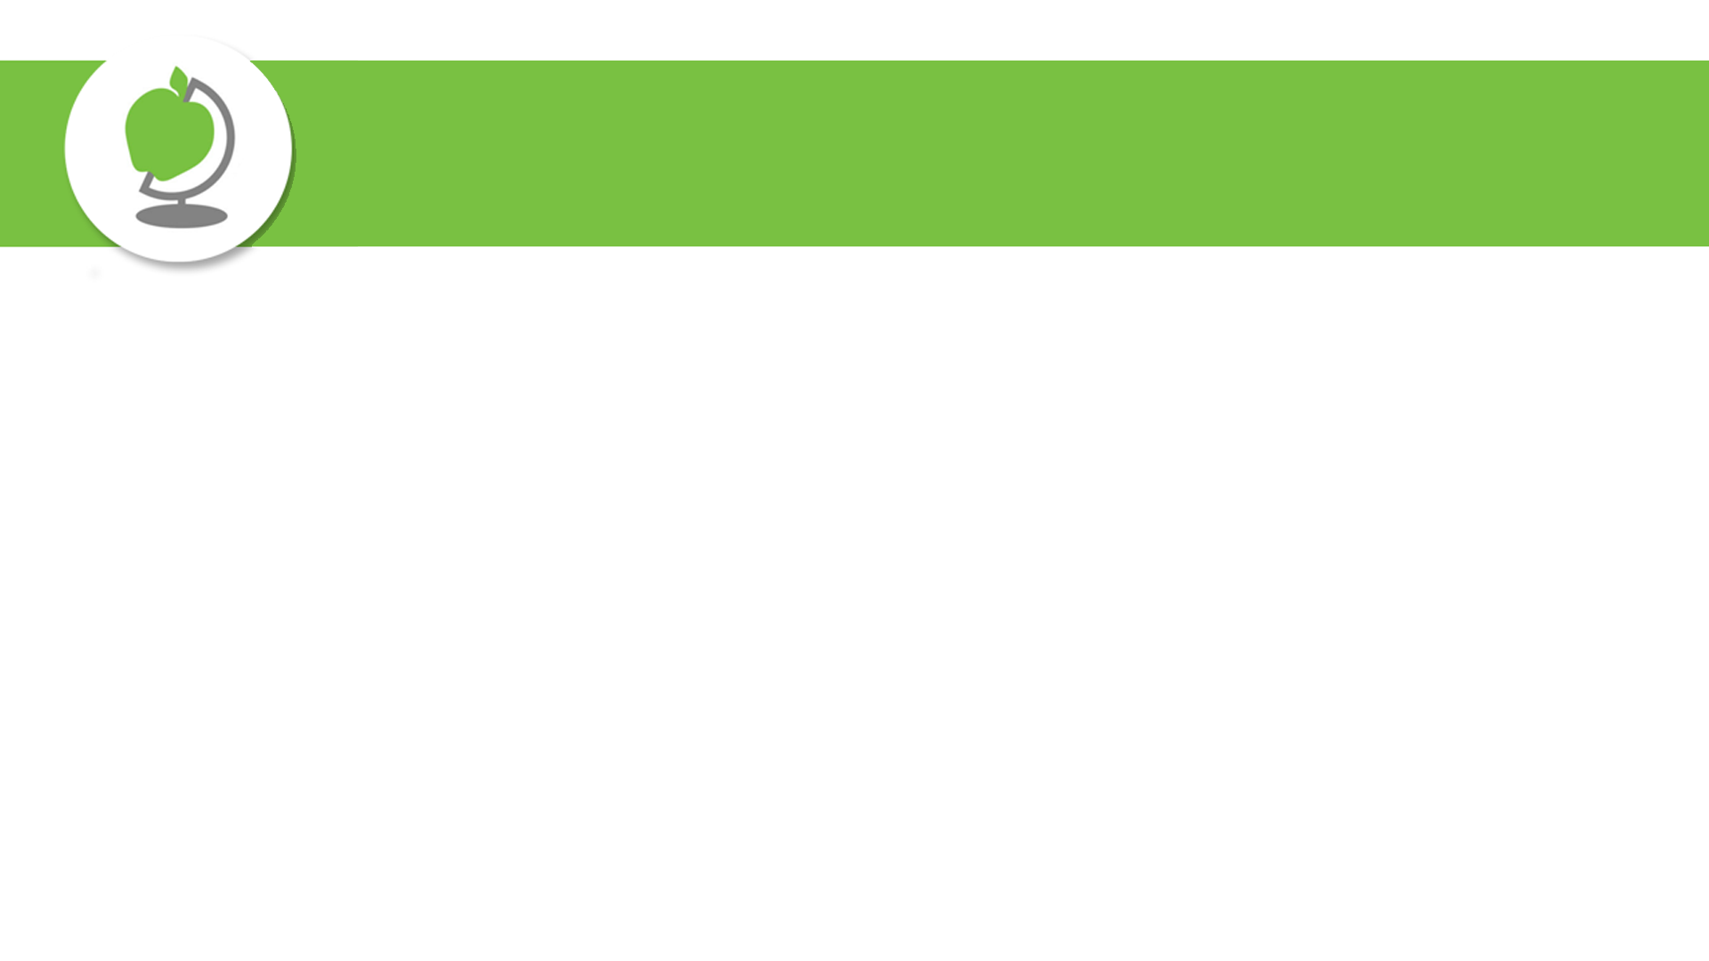
How to Play
You’ll be given two schools to consider
Based on the information provided, you’ll be asked to consider which school sounds more appealing to you
There are no wrong answers!
We’ll play 3 rounds, starting with…

Slide 3
Round 1
Intended Major: Business / Accounting
School A | School B
CPA Pass Rate: 53.2% Avg. COA: $32,000 Avg. Class Size: 30:1 Prox. to Major City: ~140 miles Research Opportunities: Research assistant (collect data) | CPA Pass Rate: 54.4% Avg. COA: $25,000 Avg. Class Size: 15:1 Prox. to Major City: ~40 miles Research Opportunities: Faculty-mentored research projects
Acceptance Rate: < 24% | Acceptance Rate: > 50%
Univ. of Illinois, Urbana-Champaign | Northern Illinois Univ.

Slide 4
Round 2
Intended Major: Medicine / Pharmacy
School C | School D
Avg. $ of Merit Aid (Fresh): $3,700 Avg. COA: $84,000 Avg. Class Size: 15:1 # of Hospitals within 20 miles: 10 Both schools offer early acceptance PharmD programs | Avg. $ of Merit Aid (Fresh): $14,000+ Avg. COA: $52,000 Avg. Class Size: 12:1 # of Hospitals within 20 miles: 8 Both schools offer early acceptance PharmD programs
Acceptance Rate: < 16% | Acceptance Rate: > 60%
Univ. of Michigan, Ann Arbor | Benedictine Univ.

Slide 5
Round 3
Intended Major: Engineering
School E | School F
Avg. COA: $92,000 Avg. Class Size: 20:1 ROI (10 years out): $208,000 Courses with Teaching Assistants: Common Both schools offer ABET accredited degrees | Avg. COA: $62,000 Avg. Class Size: 20:1 ROI (10 years out): $200,000 Courses with Teaching Assistants: Rare/non-existent Both schools offer ABET accredited degrees
Acceptance Rate: < 29% | Acceptance Rate: > 70%
Case Western Reserve Univ. | Bradley Univ.
ROI information comes from Georgetown University’s ROI Rankings.

Slide 6
Food for Thought
When picking a postsecondary option, what are you / your student prioritizing?
Brand recognition?
Selectivity?
Prestige / Rank?
The best fit for you?
Something else?

Slide 7
*BONUS*
Top 5:
College Myth Busting

Slide 8

College Myth Busting
We can’t afford to attend a private school.
Going to a higher ranked school is significantly better than a lower (or non-ranked) school.
The name on the sweatshirt/sticker determines my future salary.
______________________________________ is a safety school.
Univ. of Illinois, Urbana-Champaign
5. College decisions are personal.

Slide 9


Additional Resources
NCompass
Dist. 203 Postsecondary Planning Guide
In-School College Visits
Instructions on how students can attend in-school college visits
On-Campus College Visit Tips
Tips for students planning to visit college campuses

Slide 10
Upcoming Opportunities
Session 3 Tonight
A few options for families to choose from to help with postsecondary planning
Sept. 1 - Oct. 30: In-School College Visits
Sept. 26: NACAC National College Fair @ Navy Pier (Chicago)
A national college fair, featuring more than 200 colleges & universities from across the country.
Sept. 29: Navigating a Shifting Testing Landscape
An evening program at Naperville Central (6:30pm in Auditorium) to discuss college admission testing, test-optional landscape, and best strategies when it comes to testing
Oct. 13: Illinois Regional College Fair @ Benedictine Univ. (Lisle)
Another college fair opportunity, bringing in additional colleges & universities from across the country.

