Slide 1


College-Bound Student Athletes

Slide 2

College-Bound Athletes
What Aspiring College Athletes
Need to Know
A Guide to NCAA & NAIA Eligibility, Academics, Standardized Testing, Participation and Amateurism and Name, Image & Likeness (NIL)

Slide 3
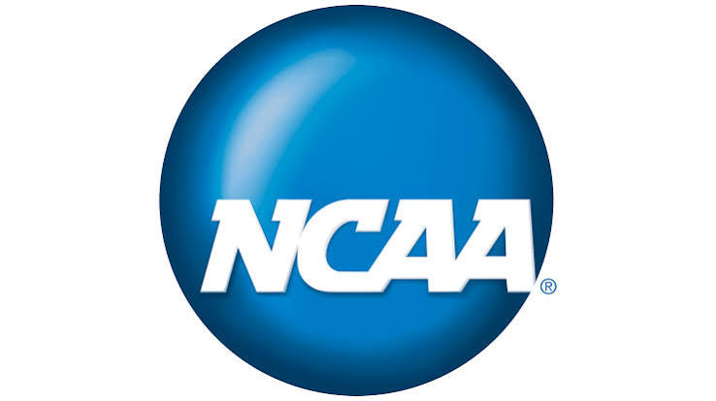
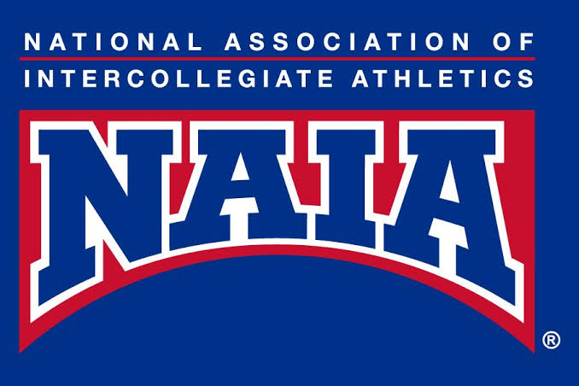
Governing Associations
Understanding the structure of college athletics and finding your best collegiate fit.

Slide 4
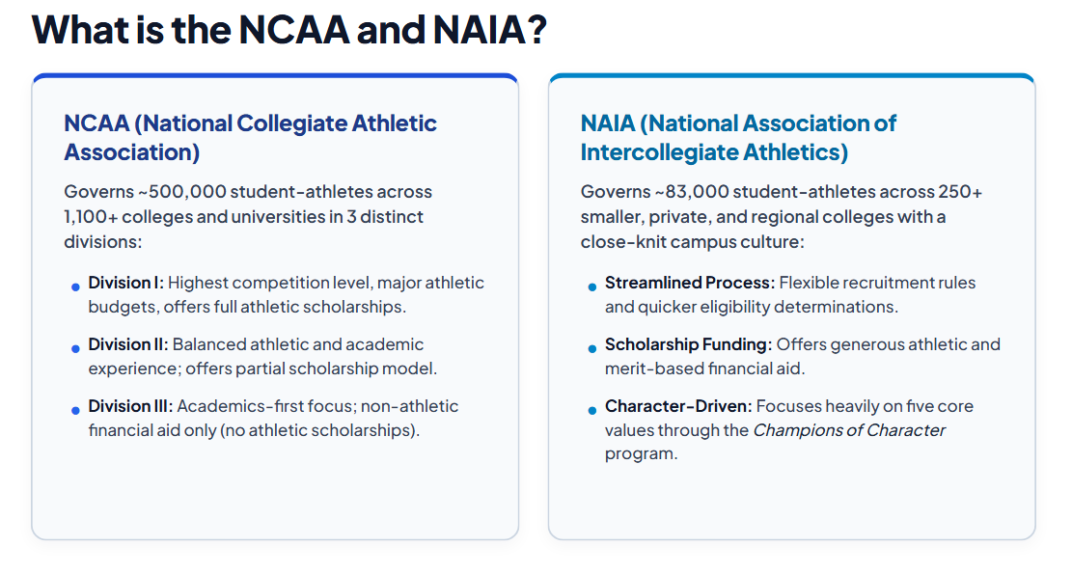
NCAA vs. NAIA

Slide 5
What is the NCAA and NAIA Eligibility Center?

Slide 6


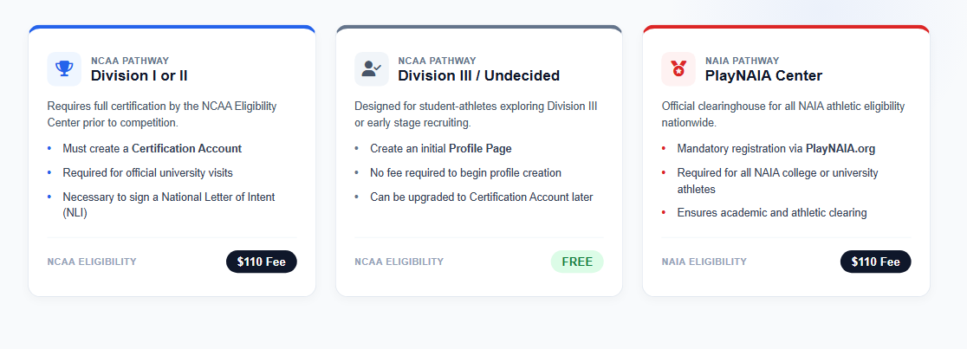
Eligibility Center
Notes:
Both the NCAA and NAIA Eligibility Centers evaluates and certifies prospective student athletes for collegiate competition.
They focus on: academic preparedness, sports participation, and high school courses.
Students who want to compete at NCAA Division I and II schools and the NAIA need to meet Eligibility Center:
Academic initial-eligibility requirements and Amateurism requirements.

Slide 7
High School Timeline
Notes:
College-bound student-athletes should follow these suggestions to prepare for initial-eligibility requirements.

Slide 8
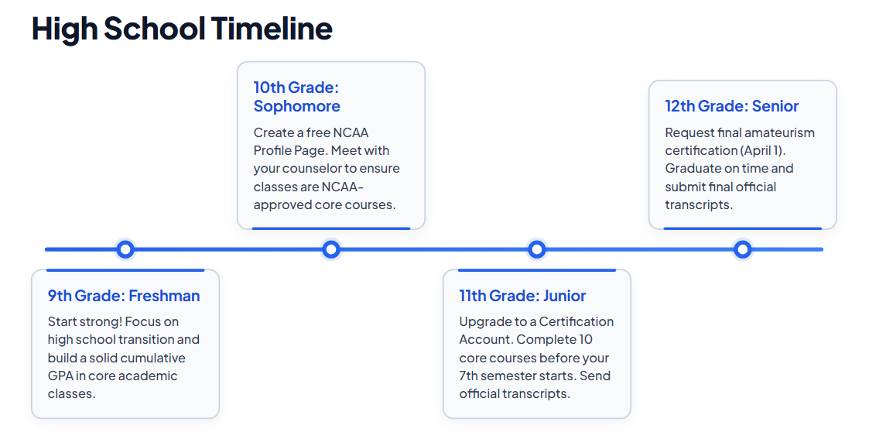
High School Timeline
Notes:
WHAT IS A CORE COURSE? NCAA core courses include courses that: Qualify for high school graduation in English, mathematics (Algebra 1 or higher), natural or physical science, social science, foreign language or comparative religion or philosophy. Are considered four-year college preparatory. Are taught at or above the high school’s regular academic level. Are taught by a qualified instructor.

Slide 9
Initial Eligibility Standards
Notes:
Students need to meet the following academic requirements to be eligible to compete in college sports.

Slide 10
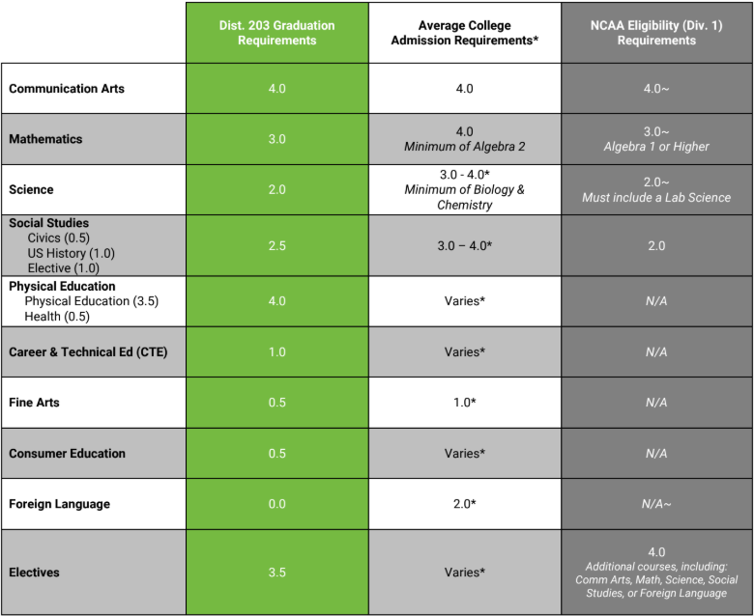
Initial Eligibility Standards

Slide 11
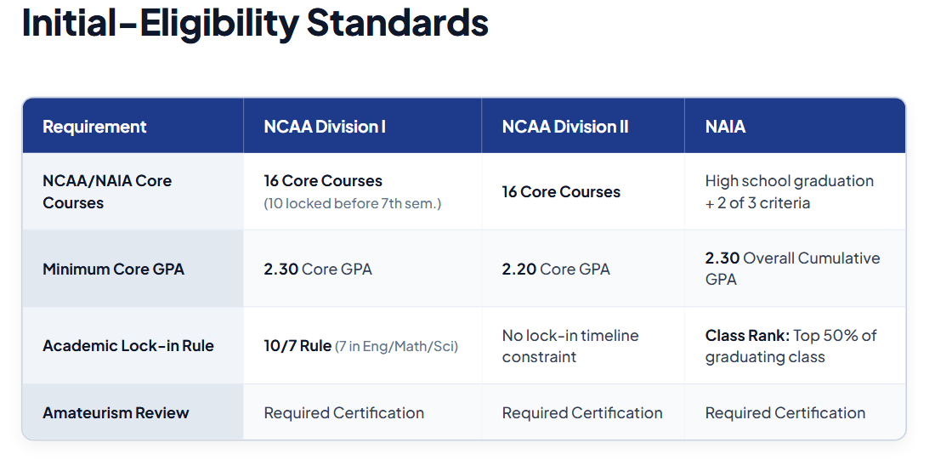
Initial Eligibility Standards

Slide 12
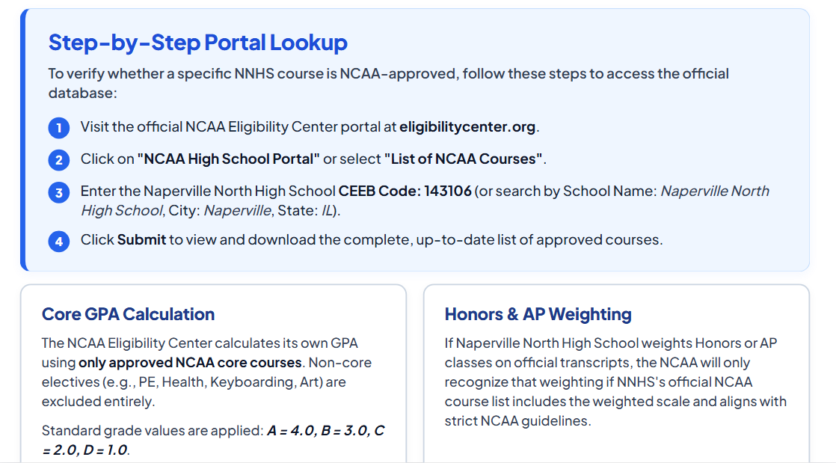
Initial Eligibility Standards
NCAA Transcript Evaluation

Slide 13
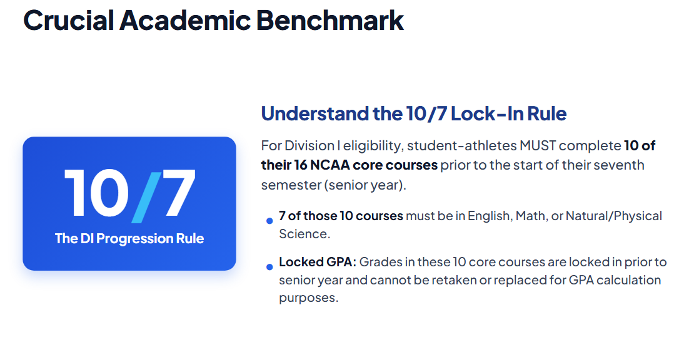
Initial Eligibility Standards

Slide 14


Initial Eligibility Standards
DIVISION I: INITIAL-ELIGIBILITY ACADEMIC REQUIREMENTS
click here
DIVISION II: INITIAL-ELIGIBILITY
ACADEMIC REQUIREMENTS
click here
NAIA: INITIAL-ELIGIBILITY
ACADEMIC REQUIREMENTS
click here
DIVISION III: INITIAL-ELIGIBILITY
ACADEMIC REQUIREMENTS
click here
Notes:
NCAA Division I,II and III and the NAIA have different initial eligibility standards. Please click the links above to learn more information.

Slide 15
Standardized Test Score Information

Slide 16
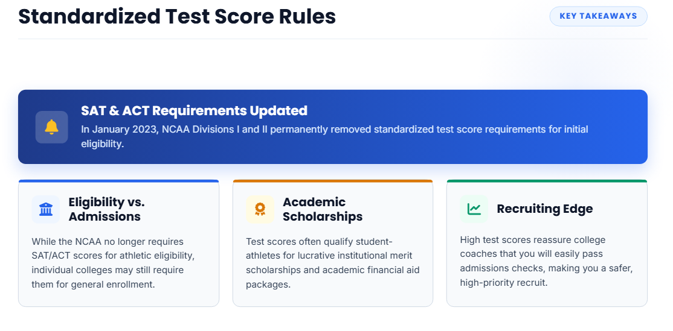
Test Score Information

Slide 17
Sports Participation

Slide 18
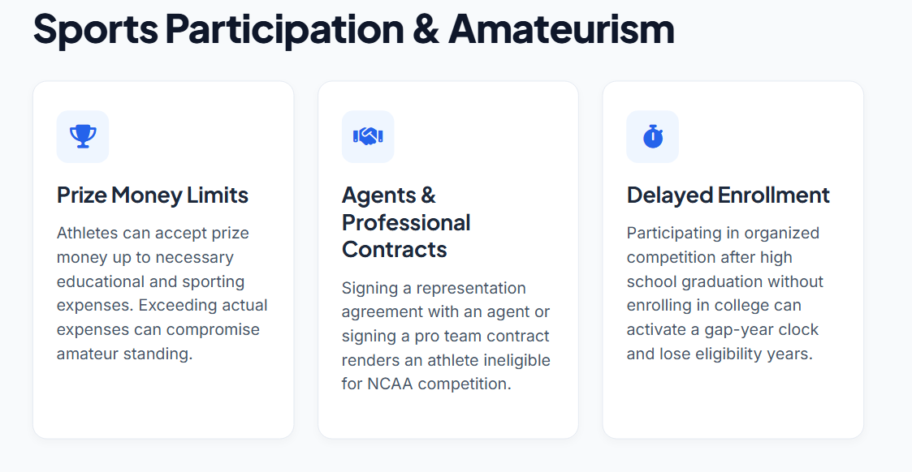
Sports Participation
Notes:
Both the NCAA and NAIA Eligibility Centers evaluates amateurism. Students must follow these tips to stay eligible to compete in college sports before full-time enrollment. Only amateur students-athletes are eligible to participate in a given sport. An amateur engages in athletics contests for educational values, personal pleasure, satisfaction, and for the love of the sport, not for monetary or material gain. If you become a professional in a particular sport recognized by the NAIA, you will be considered a professional in that sport only and are ineligible for intercollegiate competition in that sport.

Slide 19
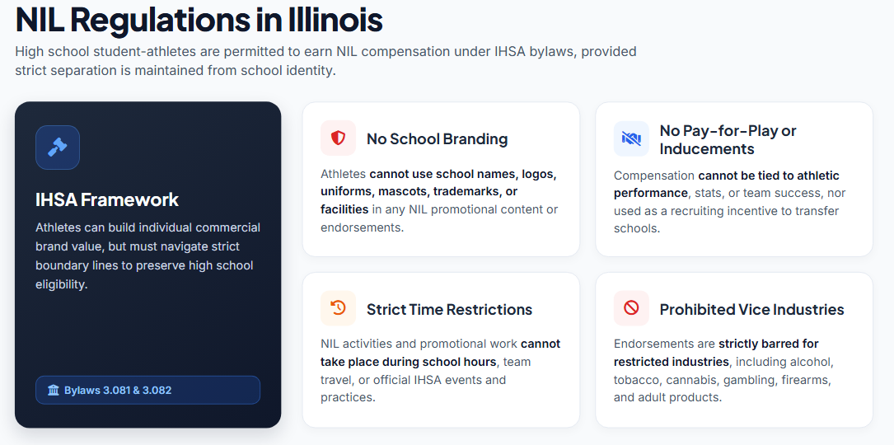
Sports Participation

Slide 20
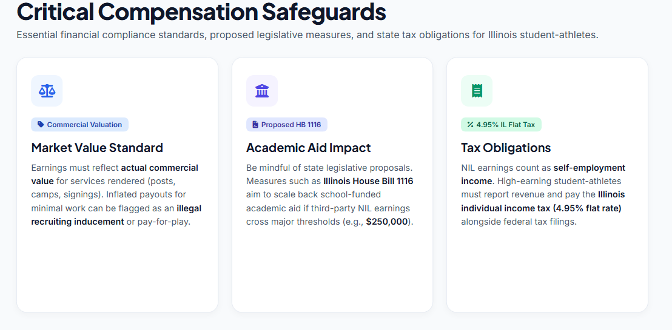
Sports Participation

Slide 21
Next Steps

Slide 22
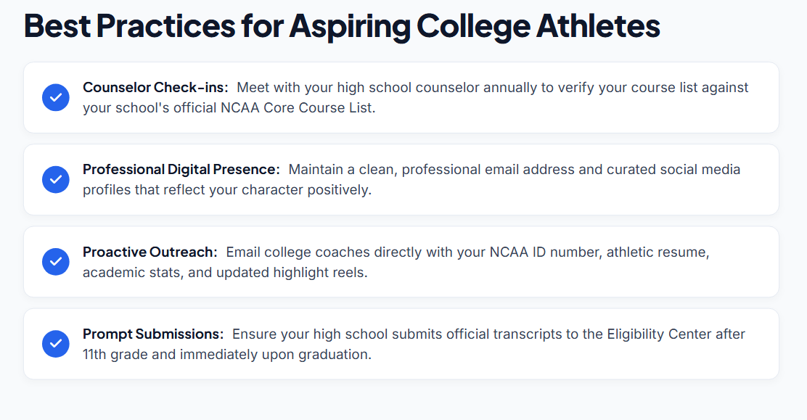
Next Steps

Slide 23
Resources

Slide 24
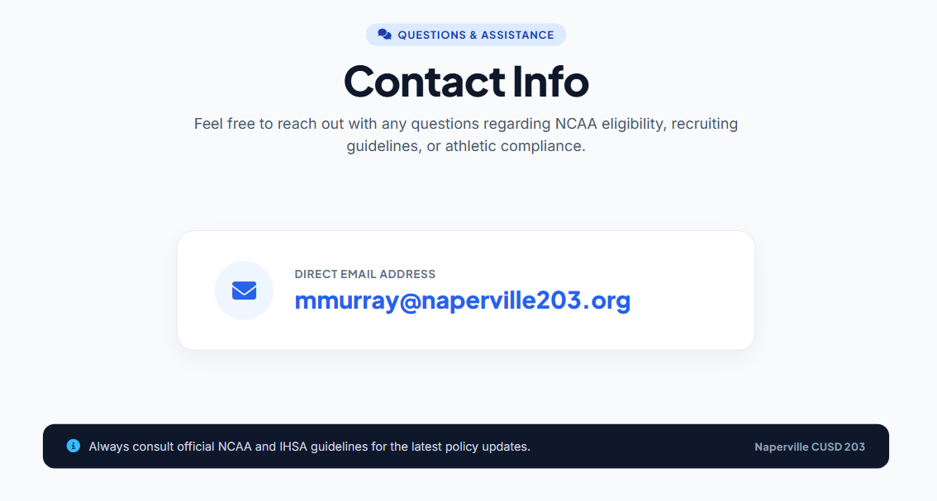
Resources
Notes:
For more information about initial eligibility, amateurism requirements and other valuable insight, visit the following resources.

Slide 25

Resources
https://play.mynaia.org/
https://www.naia.org/landing/index
eligibilitycenter.org
NCAA Initial-Eligibility Brochure
ncaa.org/playcollegesports
Guide for the College-Bound Student-Athlete
Notes:
For more information about initial eligibility, amateurism requirements and other valuable insight, visit the following resources.

Slide 26

Additional Resources
NCompass
Dist. 203 Postsecondary Planning Guide
In-School College Visits
Instructions on how students can attend in-school college visits
On-Campus College Visit Tips
Tips for students planning to visit college campuses

Slide 27
Upcoming Opportunities
Tonight
Sessions 2 & 3 Tonight
A few options for families to choose from to help with postsecondary planning [cite: 10]
Sept 1 -
Oct 30
In-School College Visits
Connect with admissions representatives directly at your school [cite: 10].
Sept 26
NACAC National College Fair @ Navy Pier (Chicago)
A national college fair, featuring more than 200 colleges & universities from across the country [cite: 10].
Sept 29
Navigating a Shifting Testing Landscape
An evening program at Naperville Central (6:30pm in Auditorium) to discuss college admission testing [cite: 10].
Oct 13
Illinois Regional College Fair @ Benedictine Univ. (Lisle)
Another college fair opportunity, bringing in additional colleges & universities from across the country [cite: 10].

