Slide 1






What’s Next?
Notes:
Ross

Slide 2
Important Factors to Consider
Environment
Major
Fit
Notes:
Ross

Slide 3
Environment
Location/Size
Type of School
Rigor/Stress of Academics
Sports/Activities
Notes:
Greek

Slide 4
Major
Does it have your major?
Options if changing of major, and does it put me behind?
Area of Specialty
Undecided Students?
Notes:
Katy

Slide 5
Fit
Rankings and reputation
What does a “good college” mean?
Comparison to others
After college?
Notes:
Ross

Slide 6
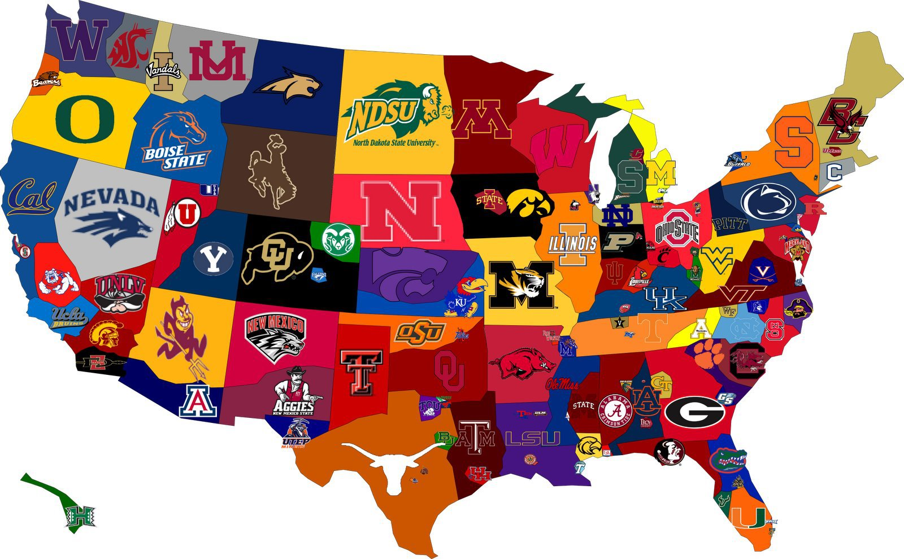
College Search
Reach / Target / Safety Schools
So...how many should I apply to?
Varies by student!
Average 5-8 applications
(app fee + test scores)
Far Reach & Dream Schools?
  Have back-up Plans B, C, and D
International Colleges
Notes:
Greek

Slide 7
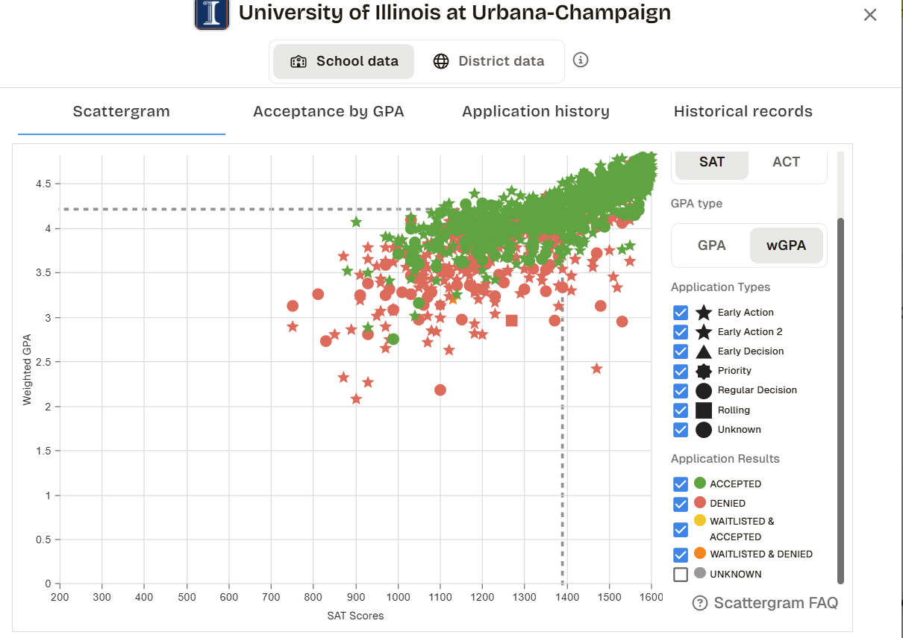
Generate a Plan
Explore Colleges & Develop Your List
  Use Schoolinks
  Keep Lines of Communication Open
Know How You Compare
  Use Scattergrams in SchooLinks
  Be realistic
  Affordability/cost
Notes:
Ross

Slide 8

Visiting Colleges
There is no substitute for seeing a college yourself!
Check out our On-Campus College Visit Tips!
Also check out local College Fairs to meet with
a number of reps from various institutions.
Notes:
Katy

Slide 9
College of DuPage
2 year Associate’s Degrees
Vocational Certifications
Project Hire-Ed Apprenticeship Program
3+1 Bachelor’s Degree Programs
Engineering Pathways
Notes:
Ross

Slide 10
Apprenticeships/Trades
On the job training, lasts from 1-6 years depending on the trade
No debt from college and can work your way up in a company or start your own
Project Hire-Ed
Technology Center of DuPage
Notes:
Ross

Slide 11
Military
Armed Services Vocational Aptitude Battery (A.S.V.A.B.)
  Career Exploration Program includes multiple aptitude tests and interest inventories
  Tests administered in October/November
Air Force
Army
Army National Guard
Coast Guard
Marines
Navy
Notes:
Angelo

Slide 12
Gap Year Programs
Students can take time off between high school and college to gain real-life experiences through travel, language immersion, internships, and more.
Gap Year Program Information
Notes:
Katy

Slide 13

Postsecondary Planning Guide
https://www.naperville203.org/NCompass
Information covered includes:
Grade-level Timelines
College Application Process
Financial Aid Information & Terms
Unique College Considerations
And more!
Notes:
Katy

Slide 14
Takeaways
Treat the post secondary search like a part-time job
  RESEARCH your schools & have an open mind
  EXPLORE and don’t be afraid - you’ll have more than one fit!
  Keep PERSPECTIVE
  Plan and VISIT
Maintain core academic rigor throughout high school
  You want your grades to be competitive
  Senior year classes & grades DO count!
Notes:
Angelo

Slide 15

Additional Resources
NCompass
Dist. 203 Postsecondary Planning Guide
In-School College Visits
Instructions on how students can attend in-school college visits
On-Campus College Visit Tips
Tips for students planning to visit college campuses
Notes:
Ross

Slide 16
Upcoming Opportunities
Sept. 1 - Oct. 30: In-School College Visits
Sept. 26: NACAC National College Fair @ Navy Pier (Chicago)
A national college fair, featuring more than 200 colleges & universities from across the country.
Sept. 29: Navigating a Shifting Testing Landscape
An evening program at Naperville Central (6:30pm in Auditorium) to discuss college admission testing, test-optional landscape, and best strategies when it comes to testing
Oct. 13: Illinois Regional College Fair @ Benedictine Univ. (Lisle)
Another college fair opportunity, bringing in additional colleges & universities from across the country.
Notes:
Ross

