Slide 1

Postsecondary Resources
Notes:
Pre-Session Script
Thank you for attending the [Insert Session Name Here] session. Before we get started, just a few quick notes:
Please silence all cell phones for the duration of the presentation.
The nearest restrooms are located __________.
All slides & links from this presentation will be posted to the Parent Univ. website tomorrow (Friday, Sept. 9th).
And finally, we will have a brief exit survey that we would like each of you to complete at the conclusion of each presentation this evening.

Slide 2

Outcomes
Families will know what postsecondary resources are available through Dist. 203
Families will know how to best utilize SchooLinks & NCompass
Families will know who to reach out to if they have postsecondary questions

Slide 3














Postsecondary Resources

Slide 4



Postsecondary Resources
X

Slide 6
SchooLinks
SchooLinks is our digital college & career readiness platform, used for grades 6-12
Students & Parents can access SchooLinks here
Parents/Guardians: If you have not set-up your SchooLinks Parent account, check out this guide.

Slide 7
SchooLinks Resources
School Search Tool: How to use the college/university search tool in SchooLinks
Favorite Schools: Add colleges/universities to your “favorites” list
College Visits: How to access upcoming college visits in SchooLinks
Scattergrams: How to read & understand scattergram data within SchooLinks
Planning Assessments: Multiple assessments to help you better plan for your future
  Find Your Path: Get suggested careers and college majors based on your personality.
  Would You Rather: Choose your favorite activities to get career suggestions.
  Top Skills: Discover your top skills and areas for improvement.
  Discover Your Campus Lifestyle: What kind of lifestyle do you want to lead on your college campus?
Student Profile: Use this section to keep track of your high school experiences, achievements, & more! This will help a LOT when completing college applications!
Finances: This section will be more relevant during Senior year. But this is a great time to check out what financing & scholarship opportunities are out there, so you can plan accordingly for Senior year!
Experience Tracking: This allows you to track your volunteer hours, which may be needed when completing college applications.

Slide 8
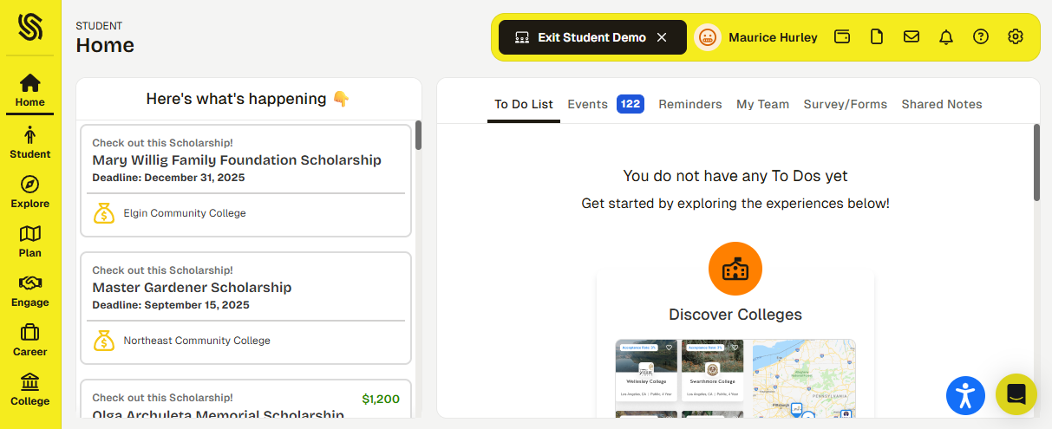
SchooLinks Walkthrough

Slide 9
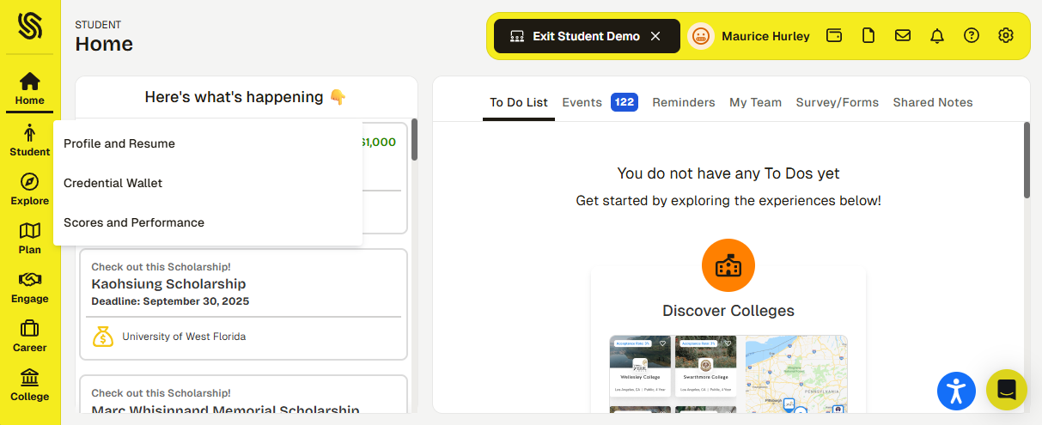
SchooLinks Walkthrough
This is where students can keep track of their postsecondary goals & activities (this is incredibly helpful for the activities section on college applications!).
This is where students can view their GPA, as well as test scores (ACT, SAT & AP).
NOTE: This is NOT accessible by colleges/universities

Slide 10
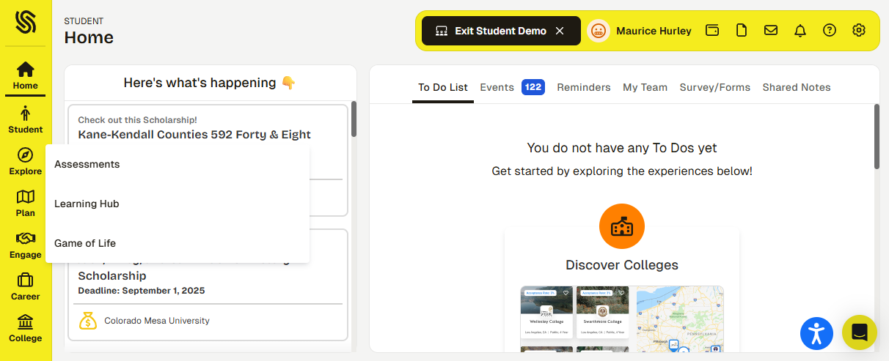
SchooLinks Walkthrough
This is where students can complete career interest inventories, to help with career exploration & goal setting.
Students can find supplemental, self-paced lessons on career exploration, college search, and financial aid.

Slide 11
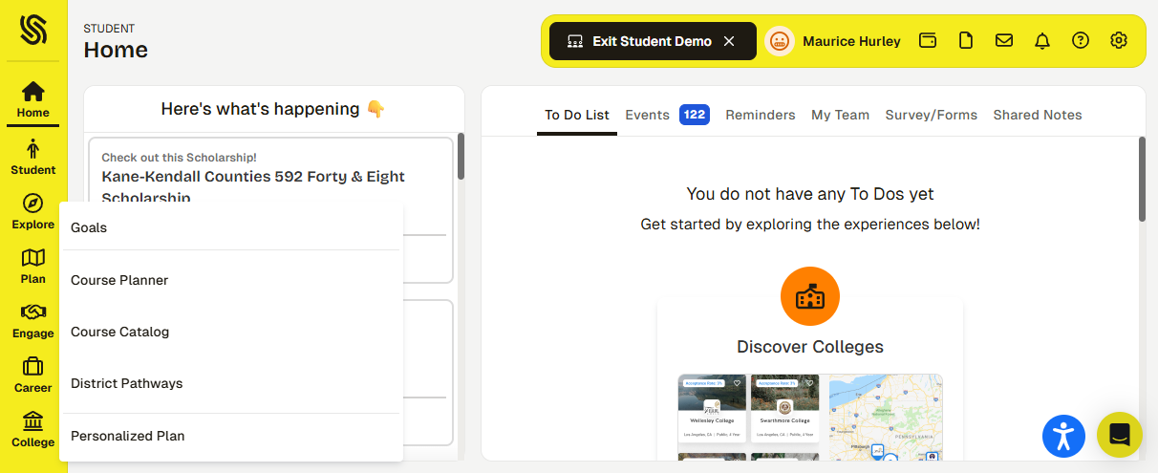
SchooLinks Walkthrough
Students can set postsecondary, career, college, & major goal (and quickly access supplemental information about those goals) in this section.
This is where students enter their courses for the upcoming school year (November).
This is where students can find course descriptions, prerequisites, and additional information (such as Early College Credit or TCD).
This is where students can learn more about District Pathways & Diploma Endorsements.

Slide 12
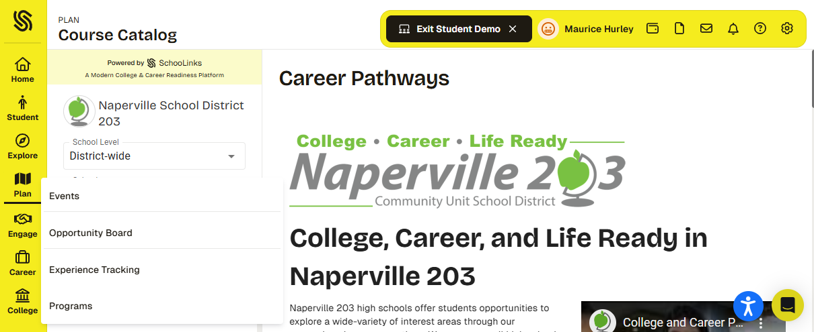
SchooLinks Walkthrough
This is where students can see which colleges / universities are visiting this fall and register to attend.
This is where students can find a variety of available opportunities: part-time employment; volunteer opportunities; and summer pre-college programs.
This is where students can track their service hours throughout their time in high school.

Slide 13

SchooLinks Walkthrough
This is where students can search for additional information regarding careers (filtered by degree level, career cluster, growing industries, etc.)

Slide 14
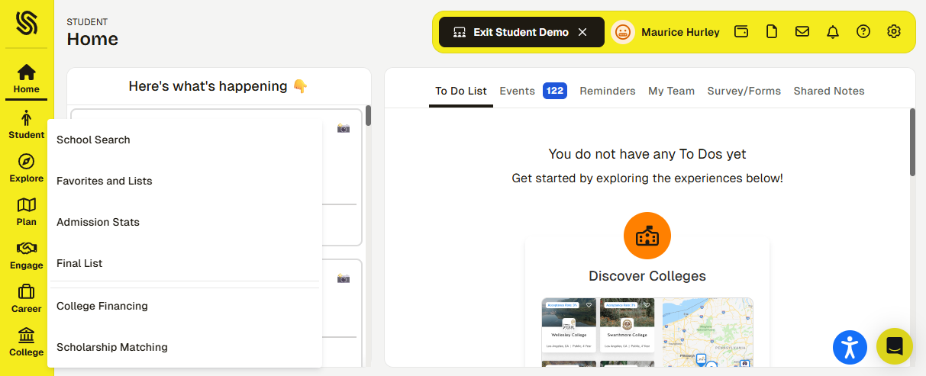
SchooLinks Walkthrough
Students can search for colleges & universities, using a variety of filters to narrow their results.
Students can save lists of their favorite search results, making information quickly available. Students who favorite schools will also be notified of opportunities for that particular institution.
Seniors can use this section to find local scholarships vetted & posted by staff at NNHS & NCHS.

Slide 15


Slide 16
NCompass
Collaborative digital postsecondary planning guide, created by The PARCs at NNHS & NCHS
Best of the best of both internal & external resources
Provides resources & information for all postsecondary options: four-year college, community college, the trades, the military, and gap year programs

Slide 17
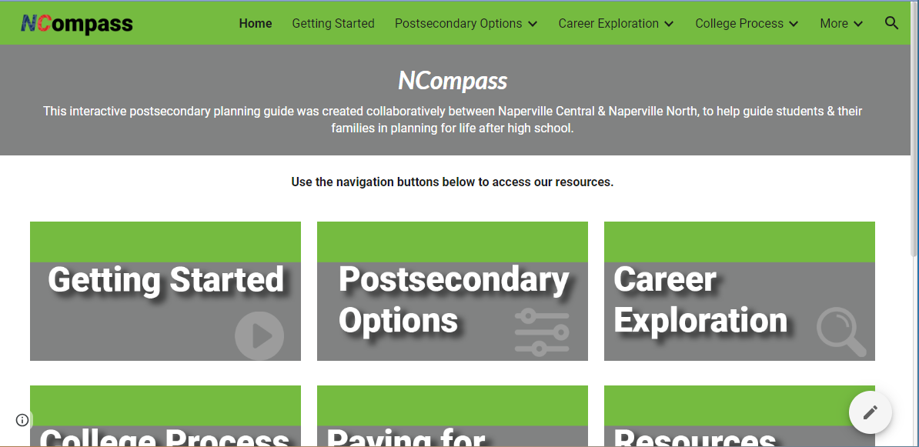
NCompass Walkthrough

Slide 18
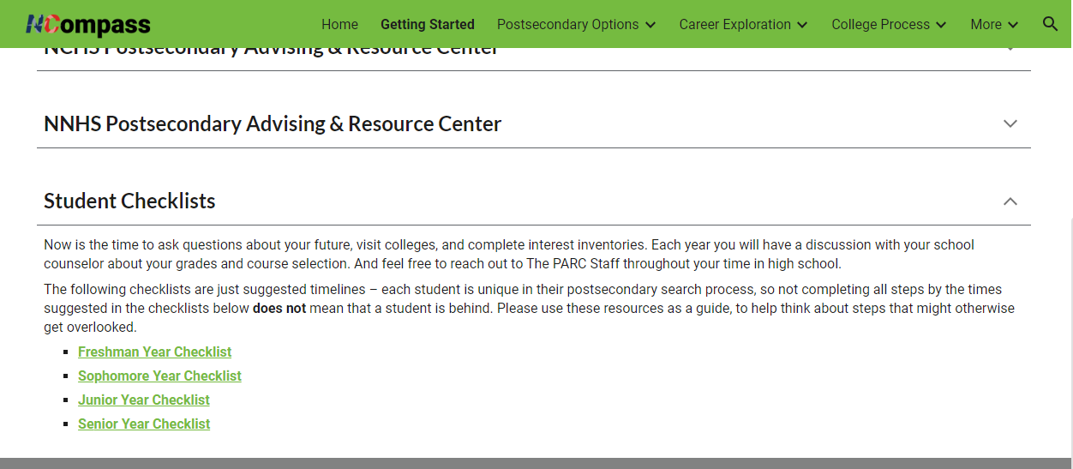
NCompass Walkthrough

Slide 19
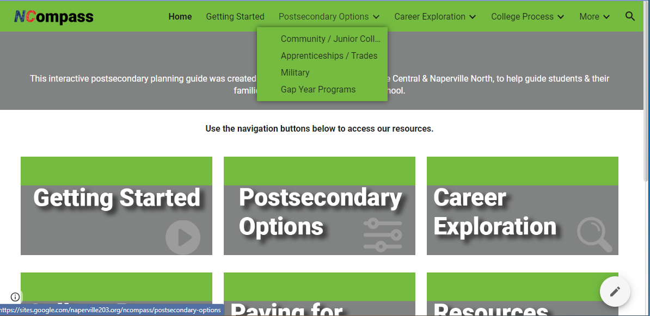
NCompass Walkthrough

Slide 20
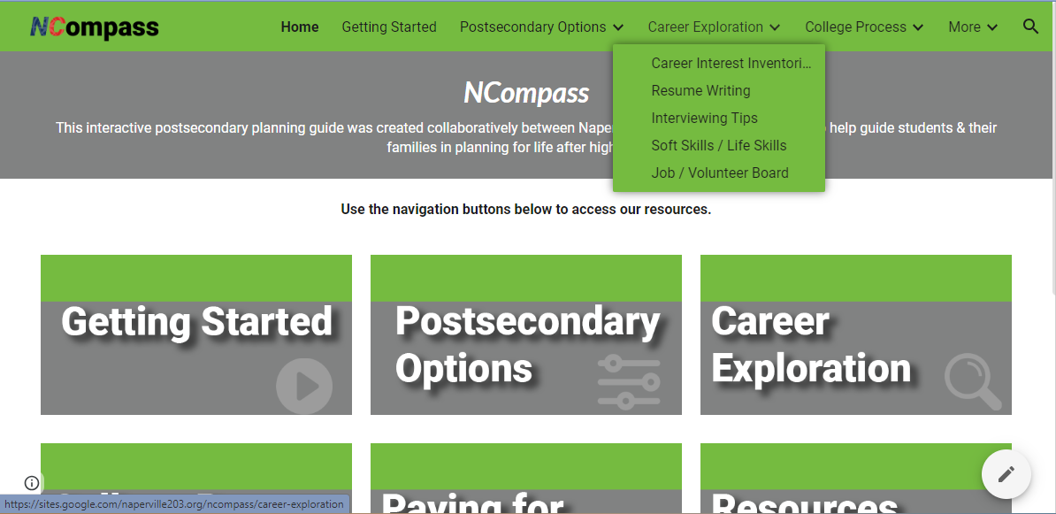
NCompass Walkthrough

Slide 21
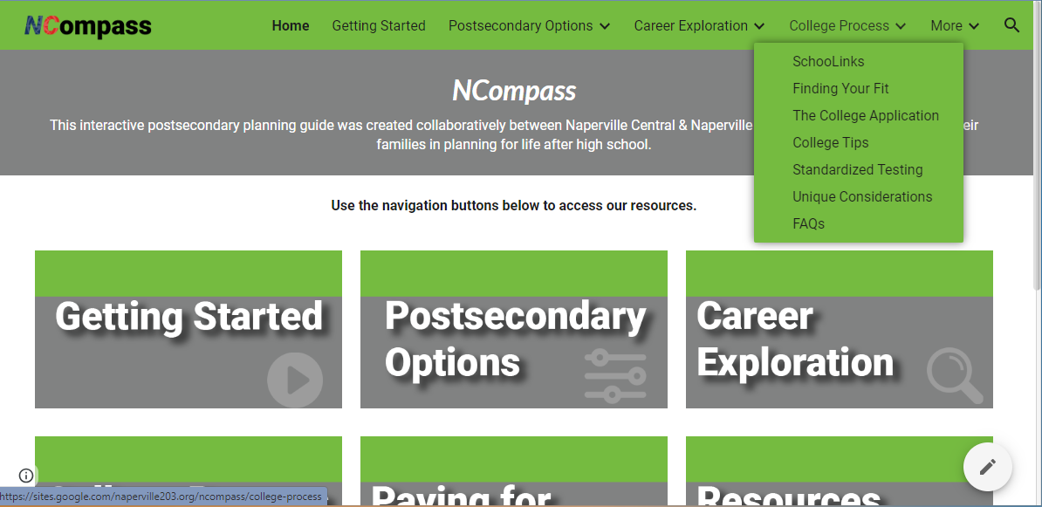
NCompass Walkthrough

Slide 22
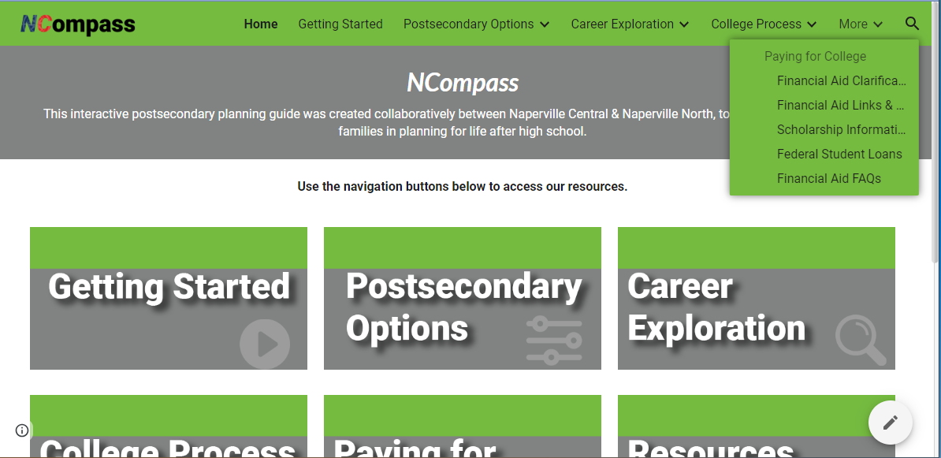
NCompass Walkthrough

Slide 23
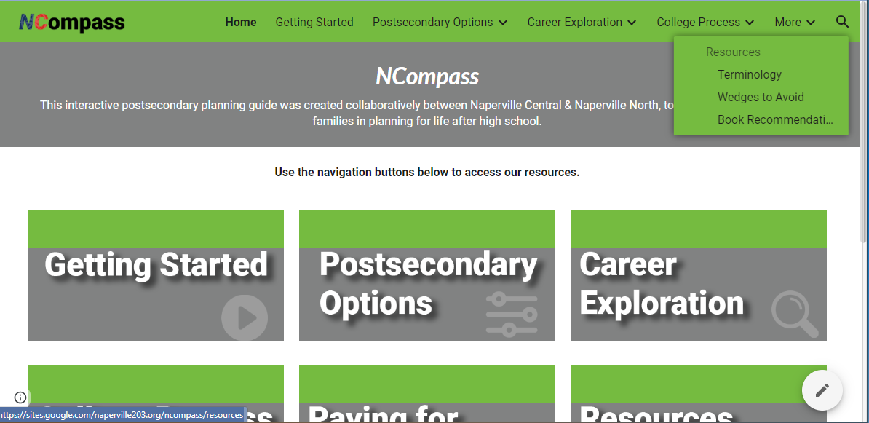
NCompass Walkthrough

Slide 24
Postsecondary
Questions?
Reach out to your student’s School Counselor or The PARC
NCHS Counselors
& PARC Staff
NNHS Counselors
& PARC Staff
Notes:
Post-Session Script
Thank you for your time & attention this evening. We hope you found the information presented in this session to be helpful to you and your family. At this time, we would ask that one member of your family please complete the Exit Survey posted on the screen(s). You can either scan the QR code, or enter the short URL to access the survey.
Sessions 1 & 2
There will be a 5 minute passing period before the next presentation begins, to give you enough time to choose your next location, as well as have an opportunity to use the restroom if needed.
Last Session
This concludes this evening’s program. We thank you for coming out tonight, and hope you enjoyed the information presented. If after tonight you have questions, please feel free to contact your student’s school counselor.

Slide 25

Additional Resources
NCompass
Dist. 203 Postsecondary Planning Guide
In-School College Visits
Instructions on how students can attend in-school college visits
On-Campus College Visit Tips
Tips for students planning to visit college campuses

Slide 26
Upcoming Opportunities
Sept. 1 - Oct. 30: In-School College Visits
Sept. 26: NACAC National College Fair @ Navy Pier (Chicago)
A national college fair, featuring more than 200 colleges & universities from across the country.
Sept. 29: Navigating a Shifting Testing Landscape
An evening program at Naperville Central (6:30pm in Auditorium) to discuss college admission testing, test-optional landscape, and best strategies when it comes to testing
Oct. 13: Illinois Regional College Fair @ Benedictine Univ. (Lisle)
Another college fair opportunity, bringing in additional colleges & universities from across the country.

