Slide 1

2027-2028 FAFSA
Presented by:
Jennifer Stewart
Interim Financial Aid Director
College of DuPage

Slide 2

Free Application for Federal Student Aid, FAFSA
2027-2028 FAFSA
  Fall Semester 2027
  Spring Semester 2028
  Summer Semester 2028– depends on eligibility
Apply online at student.gov
Application opens October 1, 2026

Slide 3

Beta Testing – 2027/2028 FAFSA
Sign up to complete the FAFSA prior to October 1st
During Beta Testing, you are submitting an actual FAFSA
It allows Federal Student Aid to monitor issues/concerns prior to October 1st.

Slide 4
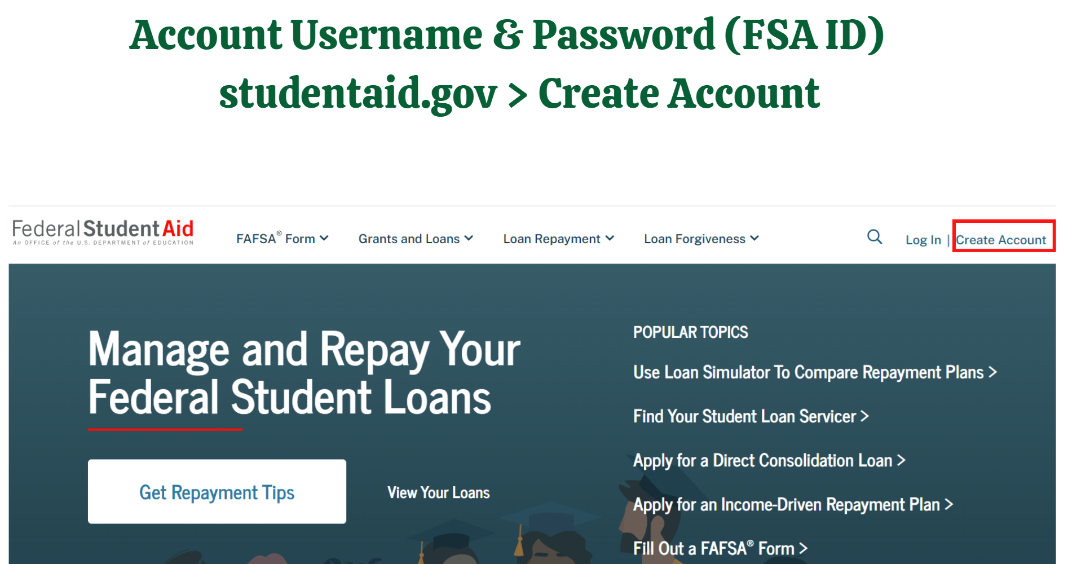

Slide 5
Who needs to create a FSA ID…..
Anyone who is required to provide consent on the FAFSA
Student
If parents are married AND filed a joint tax return with current spouse
  Only 1 parent provides consent and 1 parent needs to have a FSA ID
If parents are married AND filed separate tax returns
  Both parents provide consent and both parents need to have a FSA ID
If parents are unmarried BUT live together
  Both parents provide consent and both parents need to have a FSA ID
If parent(s) did not file a tax return
  Both parents provide consent and both parents need to have a FSA ID

Slide 6
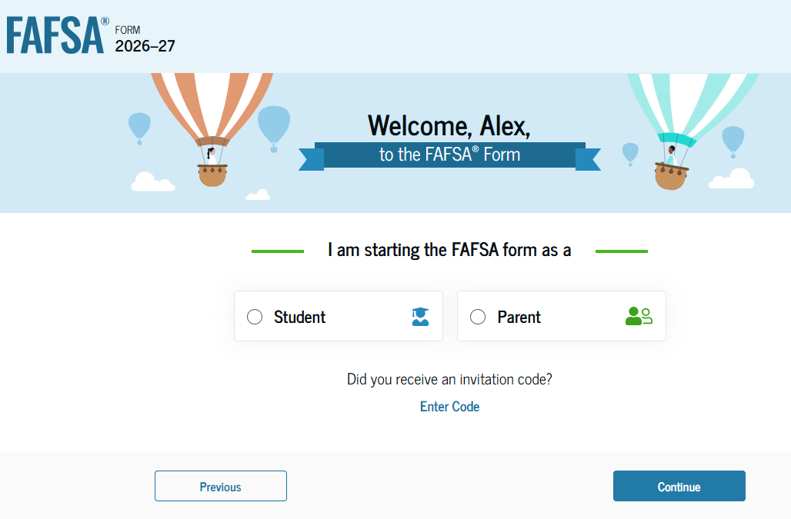

Slide 7
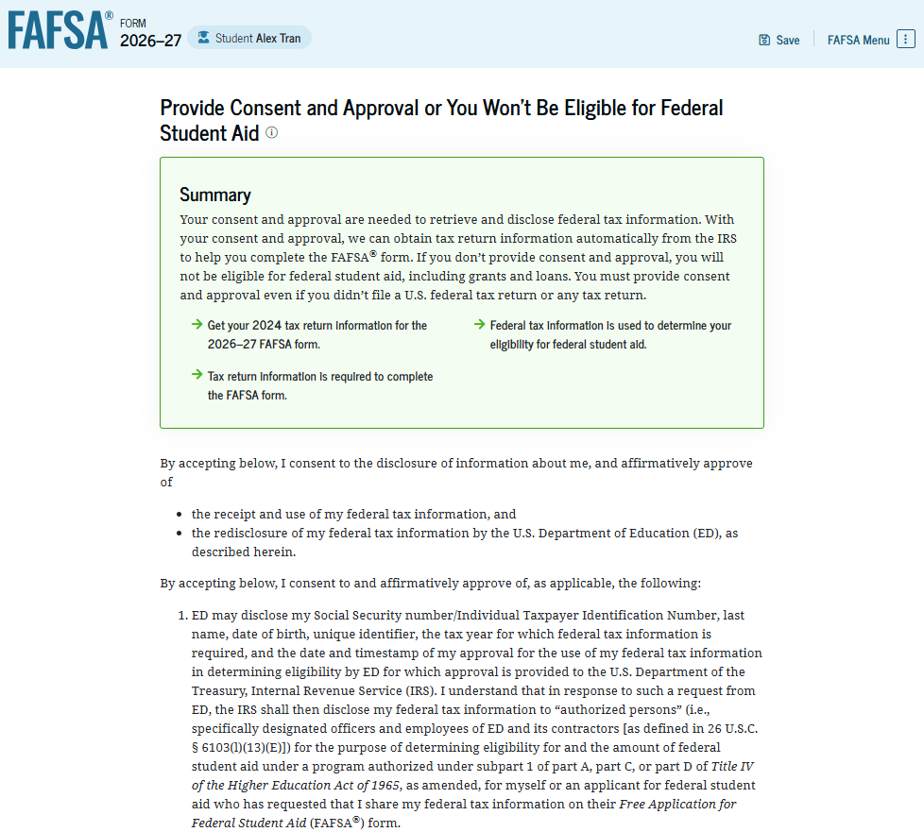
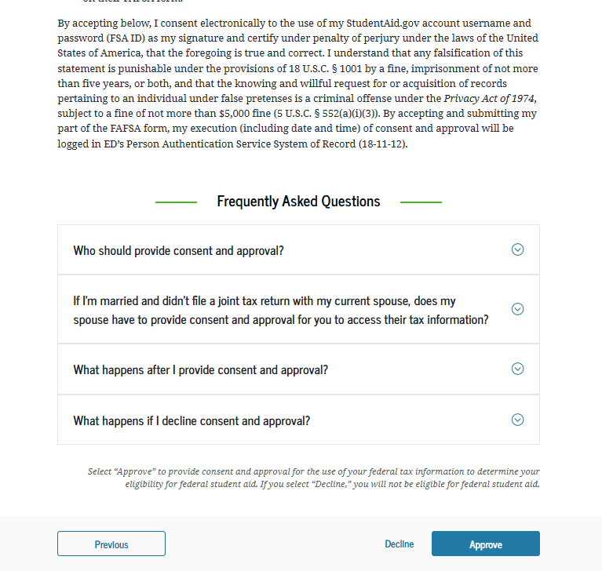
Direct Data Exchange: Allows IRS information to transfer directly to the FAFSA
NOTE: When completing the 27/28 FAFSA, the tax year will be 2025

Slide 8

Student Section
Personal Circumstances
Demographics
Financials
Colleges
Contributor Invite
Signatures

Slide 9
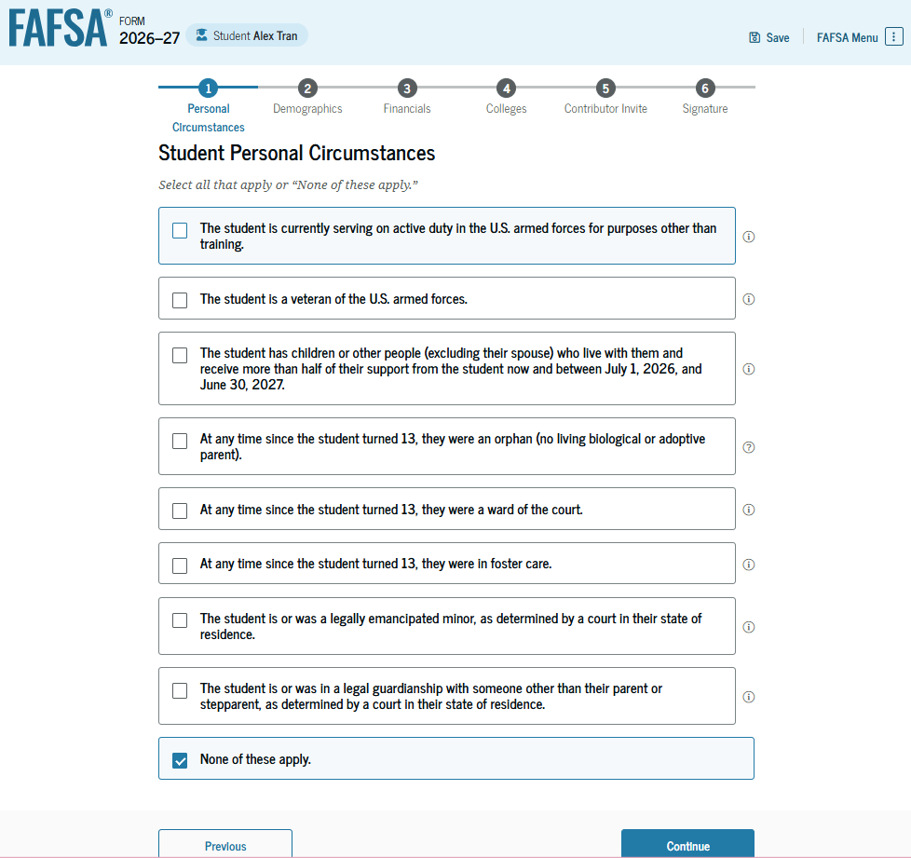
On the 27/28 FAFSA, the dates will reflect July 1, 2027 to June 30, 2028

Slide 10
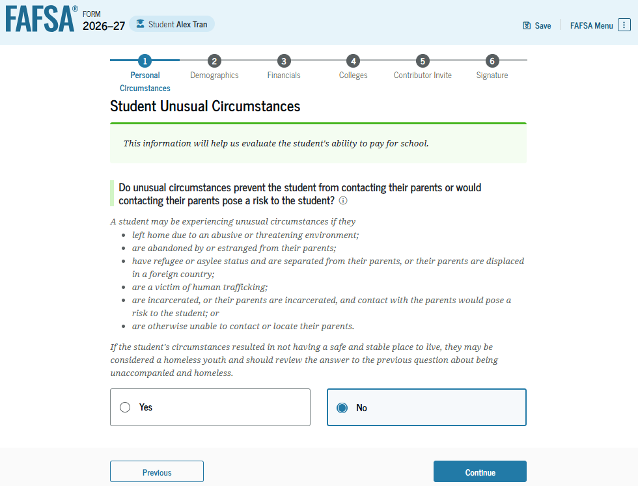
Dependency Appeal:
If student answers Yes, the student will follow up with their respective college to provide documentation

Slide 11
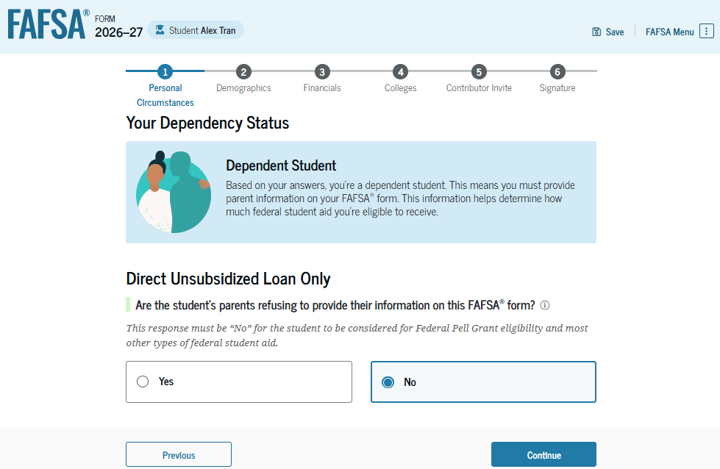
Personal Circumstances
Only answer Yes…If parents are refusing to provide their information on the FAFSA
This allows the student to only be eligible for a Direct Unsubsidized Loan

Slide 12
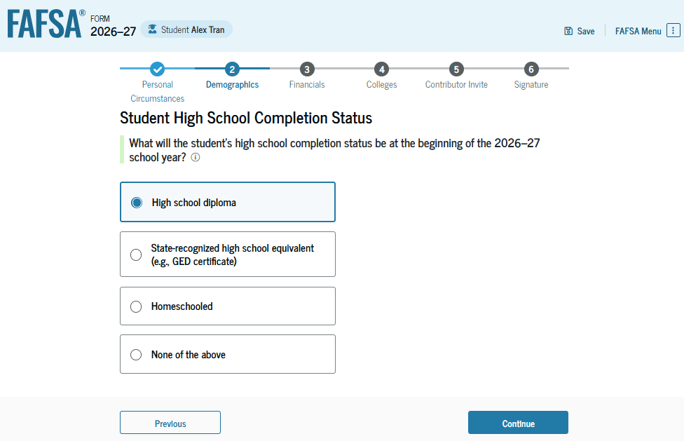
Common Mistake:
Students indicate None of the Above
NOTE: For the 27/28 FAFSA, it will reference High School completion for the 27/28 school year

Slide 13
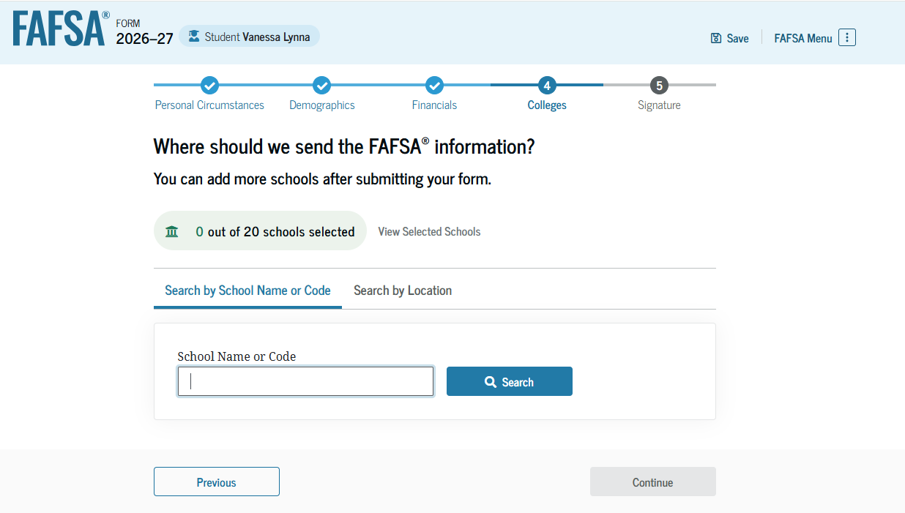
Student can list up to 20 schools…student does not need to be Admitted first

Slide 14
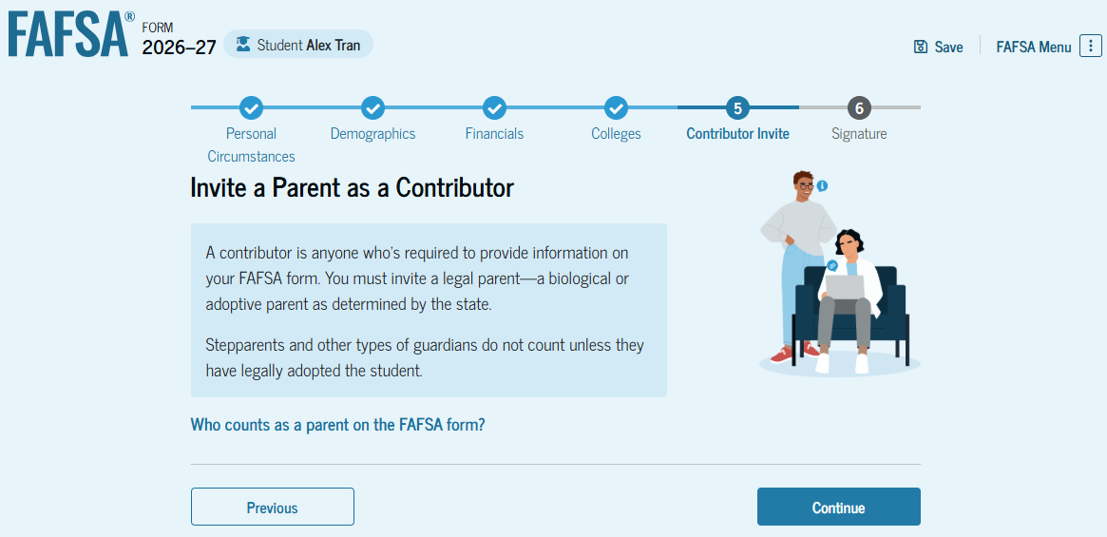

Slide 15
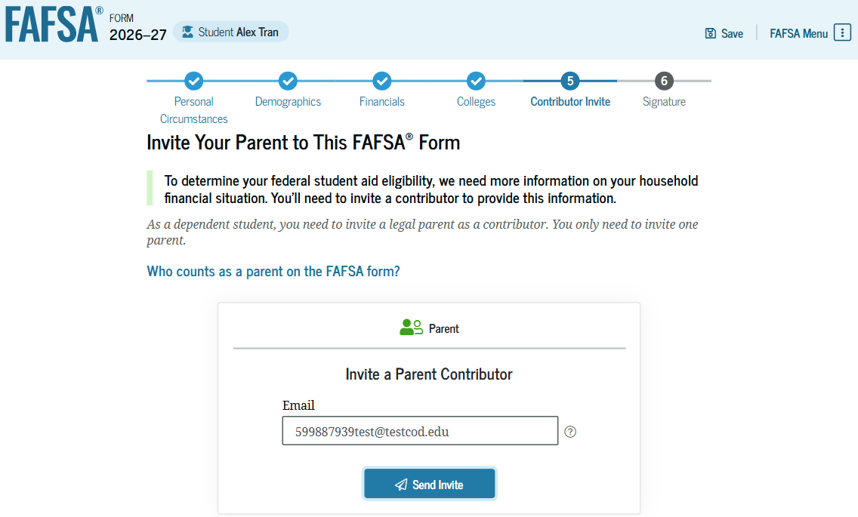
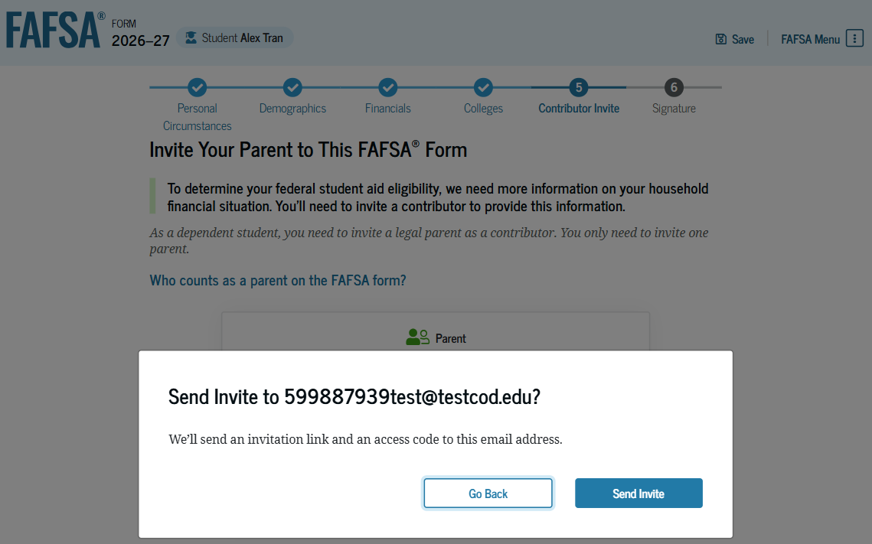

Slide 16
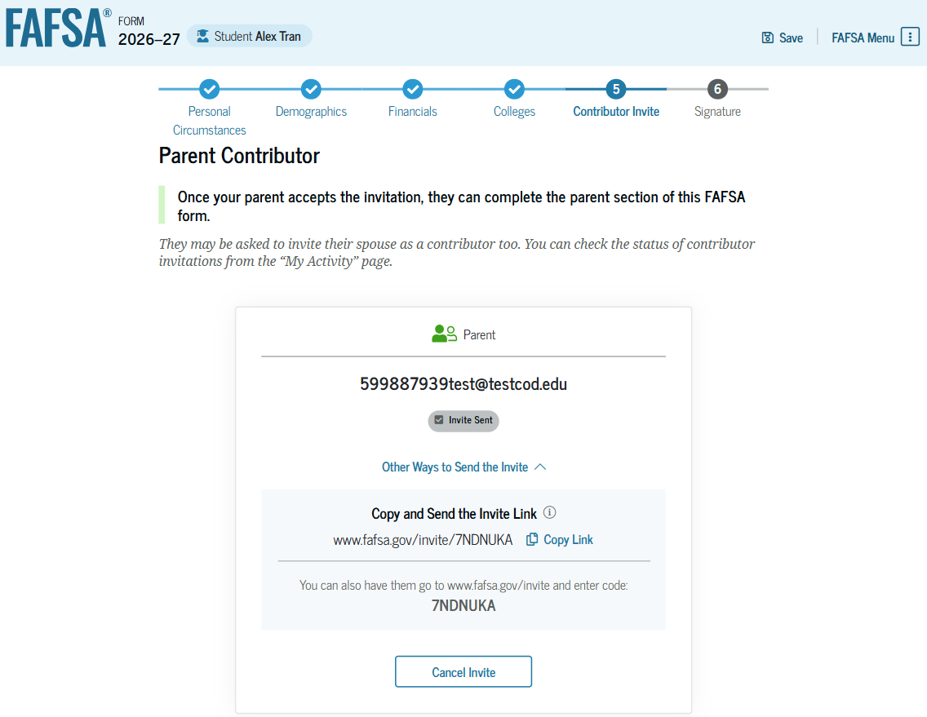
Helpful Note:
Be sure the student takes a screenshot of this page
If parent accepts invite from the email, the parent will not need to enter the code
If the parent goes directly to studentaid.gov to accept the invite, the parent will need to enter the code from this page

Slide 17
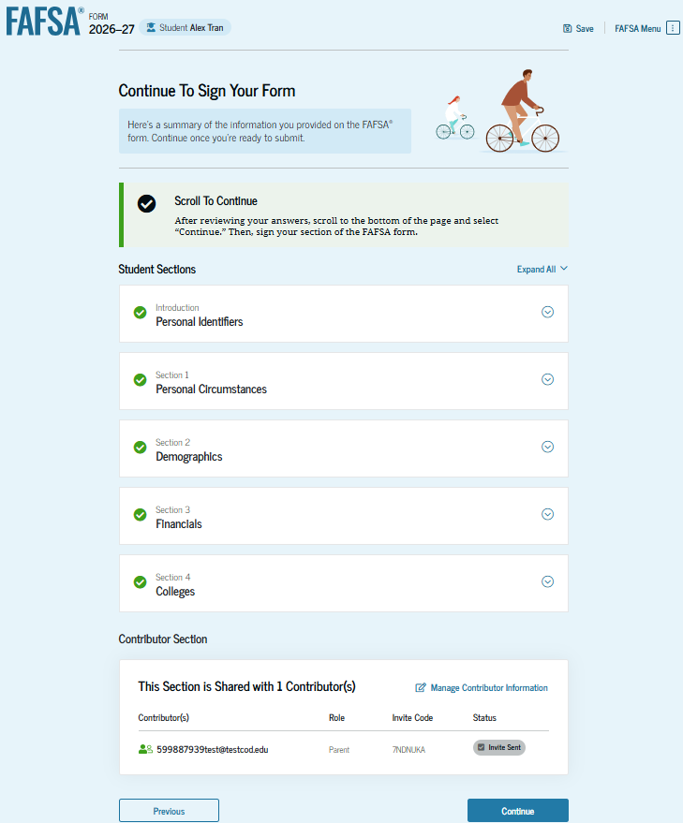
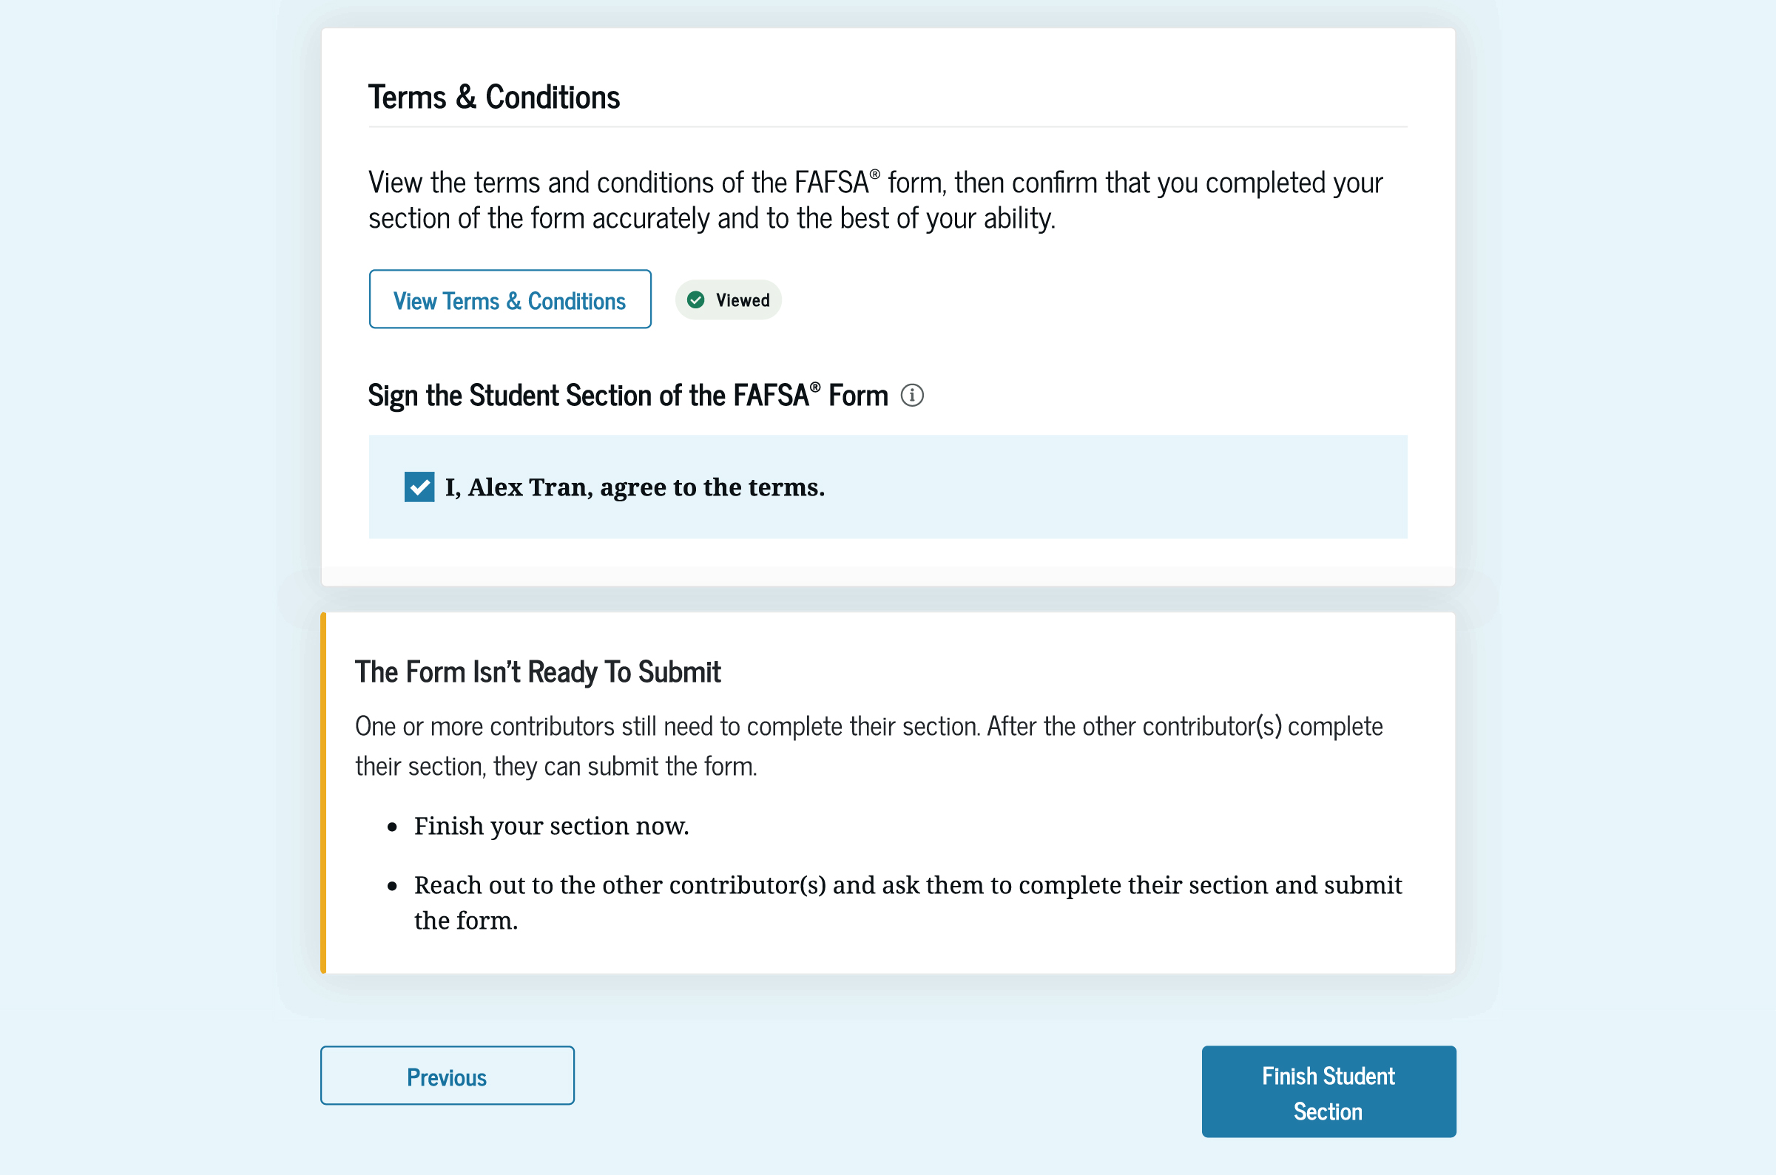
After the student has read the terms and conditions,
Student will digitally sign their section of the form by
  checking the checkbox and
  selecting “Finish Student Section.”

Slide 18
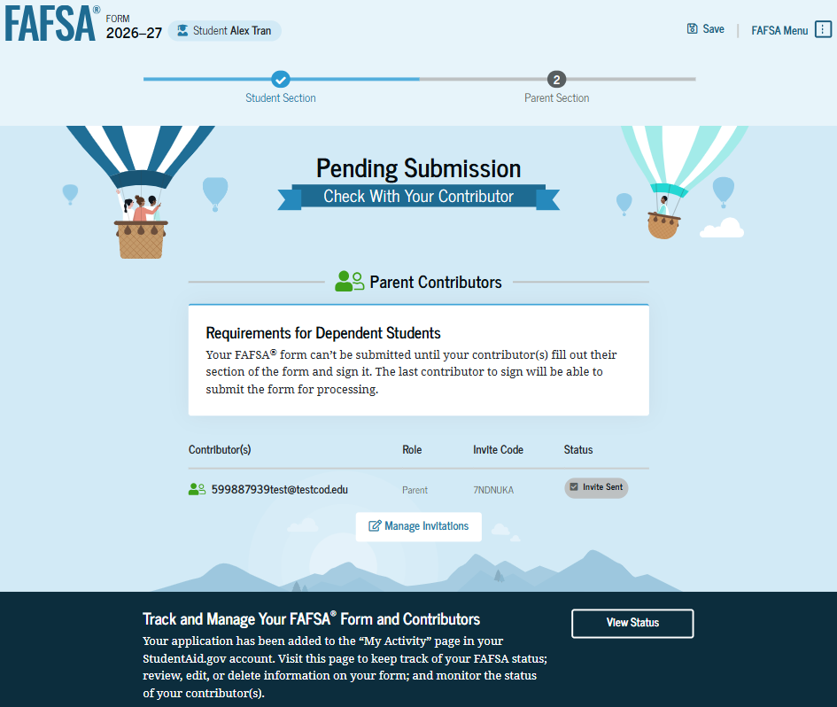

Slide 19
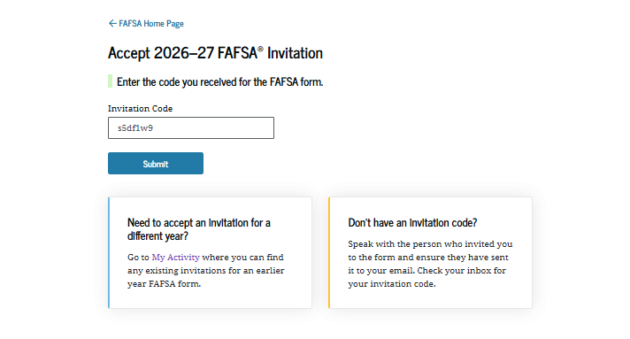
If parent logs into studentaid.gov….

Slide 20
Direct Data Exchange: Allows IRS information to transfer directly to the FAFSA
NOTE: When completing the 27/28 FAFSA, the tax year will be 2025

Slide 21
Parent Section
Demographics
Financials
Signatures

Slide 22
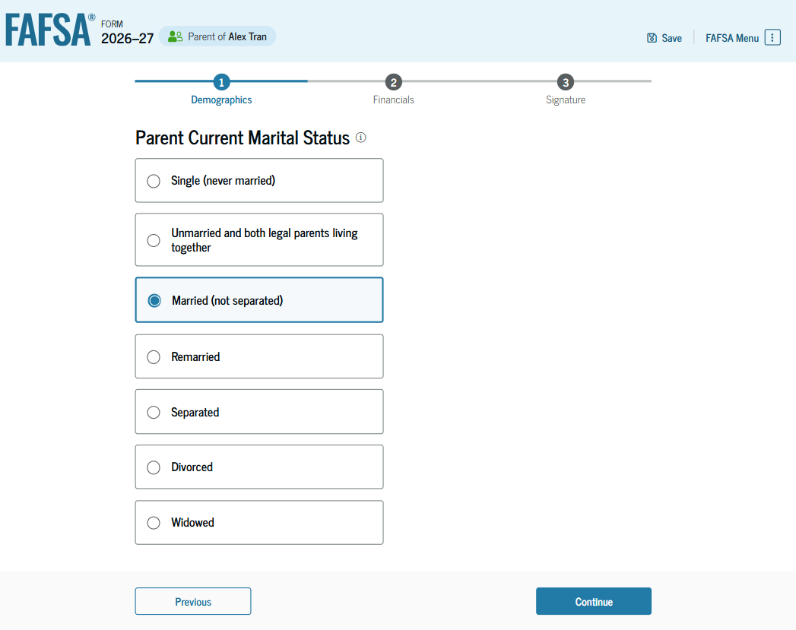
If the student’s legal parents are:
Not married to each other and live together,
  Select “Unmarried and both legal parents living together.”
Divorced but living together,
  Select “Unmarried and both legal parents living together.”
Separated but living together
  Select “Married”

Slide 23
Which parent should include information?
Scenario 1:
If the student’s parent was never married and does not live with the student’s other legal parent, or if the parent is widowed and not remarried, that parent should only provide their own information.
Scenario 2:
If the student’s widowed parent is remarried as of today, answer the questions about that parent and the stepparent.

Slide 24
Which parent should include information?
Scenario 3:
If the parents are divorced or separated, answer the questions about the parent who provides the greater portion of the student’s financial support, even if the student does not live with them.
If both parents provided an exactly equal amount of financial support during the past 12 months, or if they don’t support the student financially, answer the questions about the parent with the greater income and assets. (The parent who provided more financial support may or may not be the parent that the student lives with.) If this parent is remarried as of today, answer the questions about that parent and the stepparent.

Slide 25
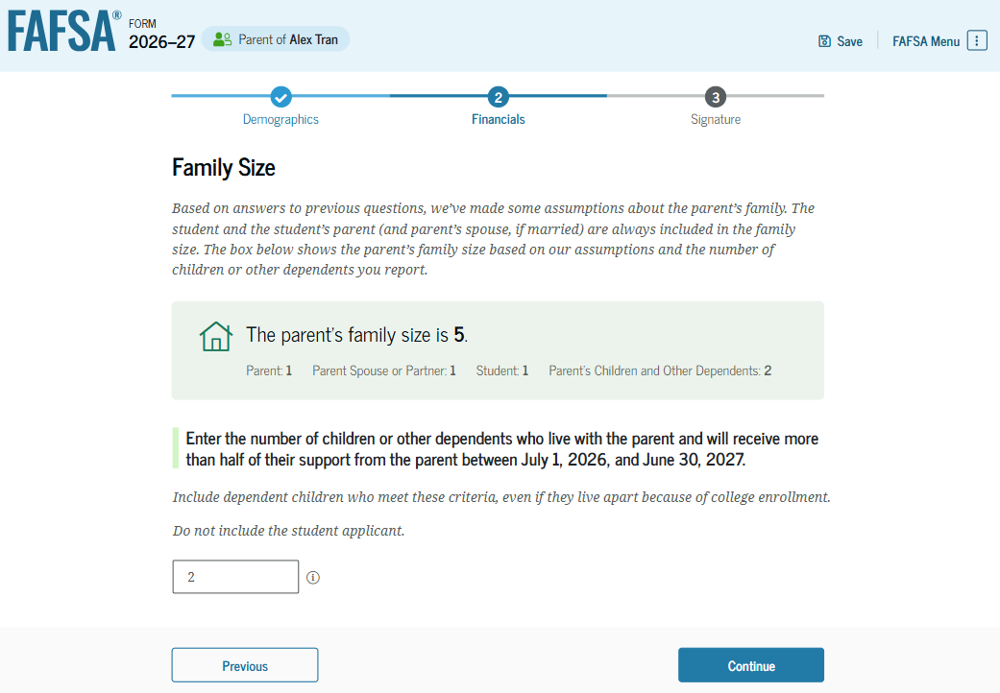

Slide 26
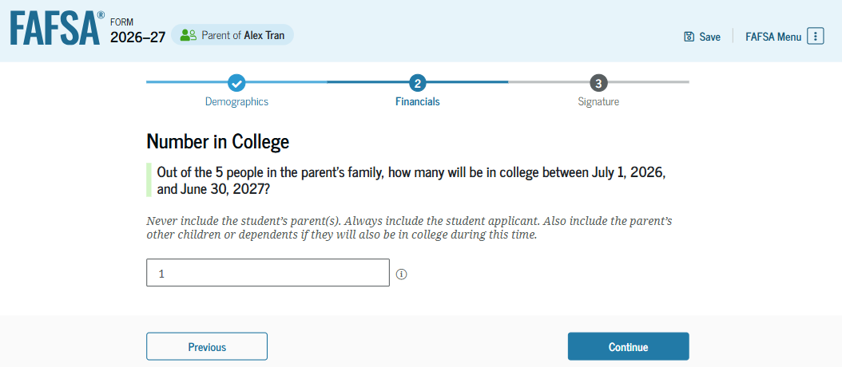
Note:
For the 2027/2028 FAFSA, the year referenced will be July 1, 2027 to June 30, 2028
Under FAFSA Simplification – the number in college will not be used when determining financial need for the Pell Grant or calculating the Student Aid Index (SAI)

Slide 27
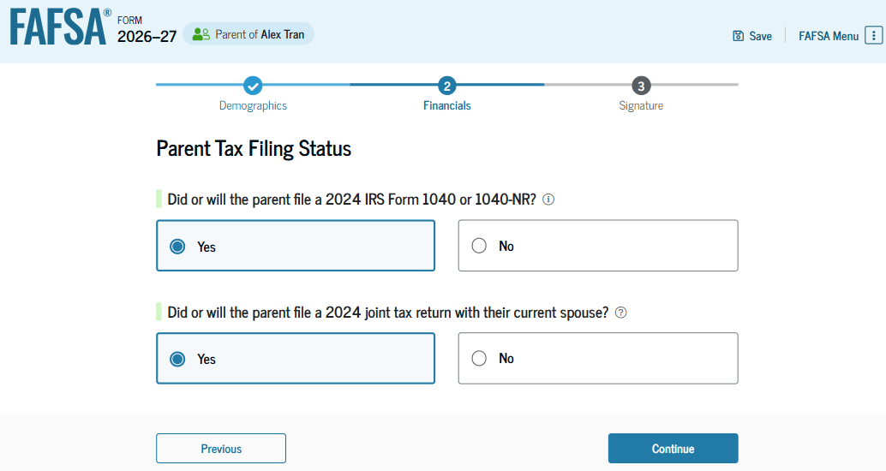
Note: For the 2027/2028 FAFSA, the tax year referenced will be 2025

Slide 28
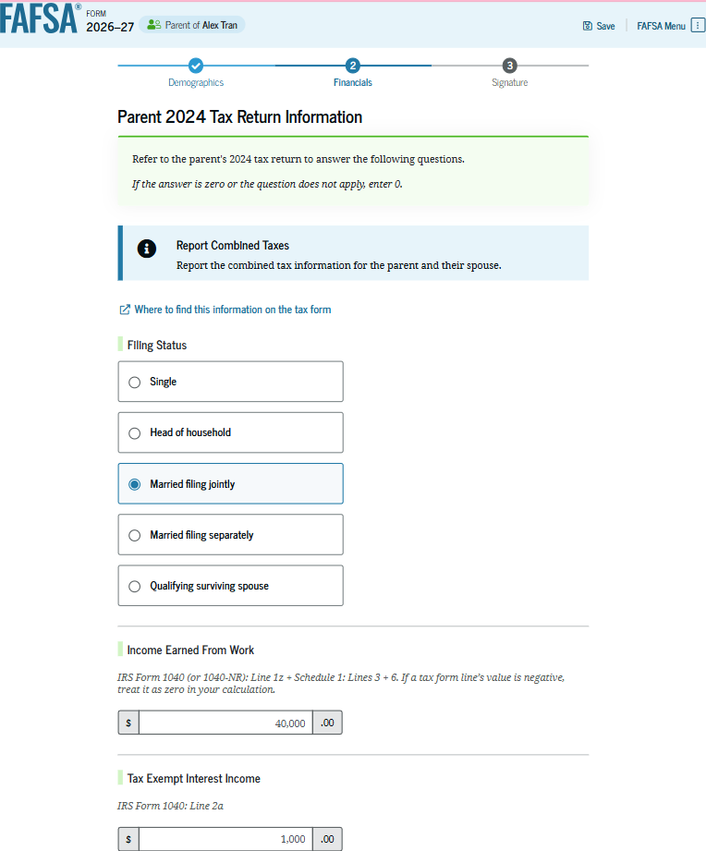
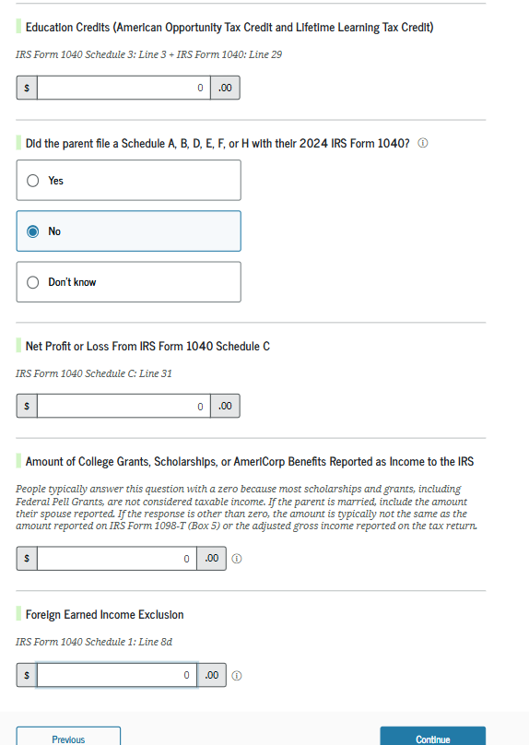
Note: For the 2027/2028 FAFSA, the tax year referenced will be 2025
Manual Entry for Tax Info:
Marital Status has changed since filing 2025 tax return
IRS cannot retrieve the tax information

Slide 29
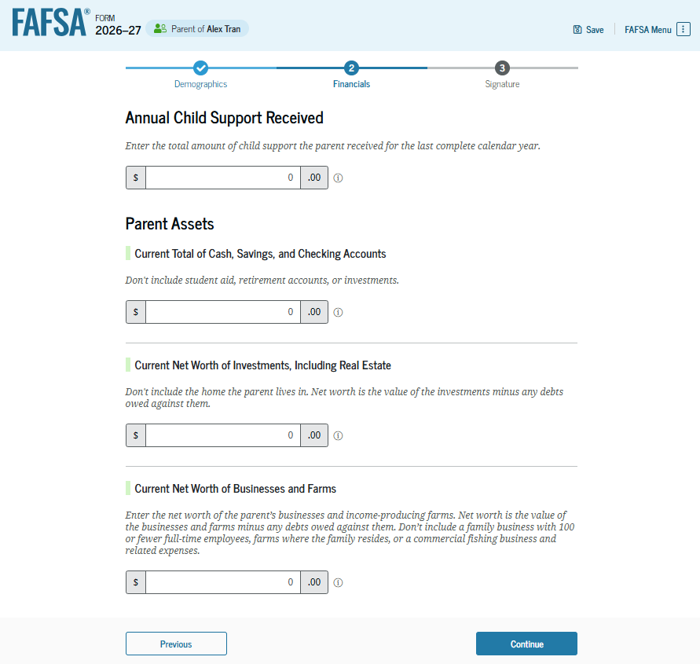
Child Support Received:
Last complete calendar year
Example:
27/28 FAFSA filed in 2026, then child support received is from 2025
27/28 FAFSA filed in 2027, then child support received is from 2026

Slide 30
Investments
Investments include:
Real estate (do not include the home in which you live)
Rental property (includes a unit within a family home that has its own entrance, kitchen, and bath rented to someone other than a family member),
Trust funds, UGMA and UTMA accounts,
Money market funds, mutual funds, certificates of deposit,
Stocks, stock options, bonds, other securities,
Installment and land sale contracts (including mortgages held), commodities, etc
Qualified education benefits or education savings accounts such as Coverdell savings accounts, 529 college savings plans, and the refund value of 529 prepaid tuition plans.
  If the student is required to report parent information on the FAFSA form, parents should not report the value of education savings accounts for other children. Qualified education benefits or education savings accounts must be reported as an asset of the parent if the student is required to report parent information.
UGMA and UTMA accounts are considered the assets of the student and must be reported as an asset of the student on the FAFSA form, regardless of whether the student is required to report parent information.

Slide 31
Investments/Business/Farms
Investments do not include:
The home you live in
The value of life insurance, ABLE accounts, retirement plans (401[k] plans, pension funds, annuities, non-education IRAs, Keogh plans, etc
UGMA/UTMA accounts for which the student is the custodian but not the owner
Value of qualified education benefits or education savings accounts that are for the benefit of the parent’s other children (not the student).
Businesses and farms do not include businesses with 100 or fewer full-time (or full-time equivalent) employees
The value of a family farm on which the family resides
The value of crops that are grown solely for consumption by the student and their family
A commercial fishing business and related expenses, including fishing vessels and permits owned and controlled by the family; or the home in which you live.

Slide 32
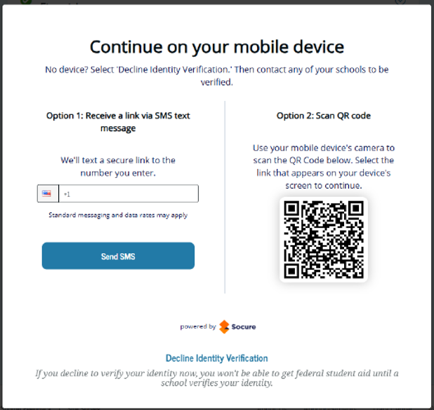
Identity Verification
While completing the FAFSA, if selected, student will need to present an unexpired government issued ID:
Driver’s License
State ID
U.S. Passport
Permanent Resident Card
Be sure student has an unexpired government issued ID with them when completing the FAFSA.

Slide 33
Questions

