Slide 1
PARENT UNIVERSITY
NCHS Senior Year Overview and College Application Information
September 2026
Notes:
Good evening and welcome Naperville Central parents! Thank you for partnering with us to make the college application process as smooth as possible for your student. My name is …. I am one of a large group of dedicated professionals behind the scenes working to assist our seniors through this process.

Slide 2
Slides will be emailed home and posted on our website later this week.

Slide 3
What We’re Covering Tonight
1
College Applications
Timelines and Deadlines
2
NCHS Procedures
Using SchooLinks & understanding specific NCHS application procedures
3
How Parents Can Help
Parent role in the process
Notes:
This evening is divided into four main categories: The College Application Process, including timeline and deadlines, Admissions Tests and applying test-optional, NCHS procedures which includes how to use Schoolinks for the college application process and specific procedures and guidelines that we have in place at NCHS, and finally, how parents can help and a little information about financial aid.
Please hold your questions for the end of the presentation, as sometimes questions you have will be covered at a later point in this presentation.

Slide 4

College
Applications
1
Timelines and Deadlines

Slide 5
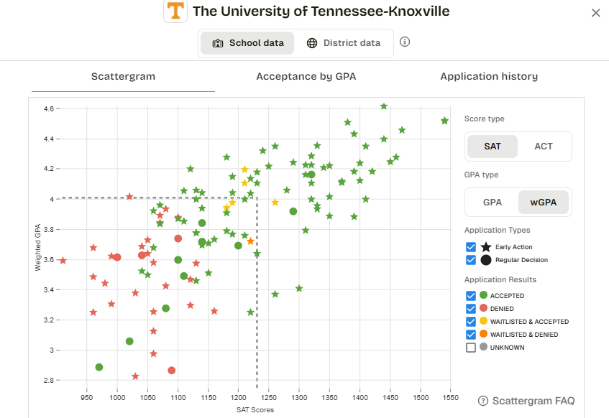
Junior Year Recap
As a reminder, juniors participated in our counseling curriculum, which was a series of 3 videos
Students were encouraged to
  Deep dive into research (including using scattergrams in SchooLinks) and college fit
  Create a balanced college list (reach, target, likely)
  Finalize their college list to be ready for application season
  Get organized and begin some college application components over the summer

Slide 6

Senior Year Timeline
Fall Semester
Spring Semester
SchooLinks training with school counselors (Aug. 24th and 25th)
Continue college visits, as needed
Begin applications
Request transcripts & letters of recommendation (if required)
Send test scores (if applicable)
Write admissions essays
Finalize & submit applications
Complete FAFSA (opens October 1)
Consider acceptance letters and financial aid awards
Research scholarships and student loans, if needed
Formally select a college (by May 1)
Send in deposit and housing form
Notes:
While we have been working with our students for quite some time on the research process, this is a list of the final steps that they should be focused on for the fall and spring semesters.
Counselors visited senior English classes on August 25th to introduce them to SchooLinks as an organizational tool and pathway for sending support documents to individual schools.
Students should be finalizing their list of colleges soon if they have not done so already. They can continue visiting college campuses, when possible. Nothing replaces the experience of getting onto a college campus; there are also many good virtual options still available.
Once a student’s list is finalized, they can begin applying, requesting transcripts and letters of recommendation, if needed, sending test scores, and writing their admissions essays. Each school’s requirements are a little different. Then a student can submit their applications.
Finally, families should work together to complete the Free Application for Federal Student Aid - or FAFSA. The FAFSA will be available on October 1st.
By the time spring semester rolls around, students will be in the final stages of the process, including making a final decision where to attend. Students should consider all acceptance letters and financial aid awards to make the best decision on a college.
Once the final decision is made, the student will formally accept that college’s offer of admission. This is usually done by May 1st. Once students have made their decision, it is also courteous to inform the other schools that they will not be attending that institution. The most common way for a student to formally accept a college’s offer of admission is to send in a monetary deposit and submit a housing form, if applicable.
As you can see from this timeline, the majority of the application process takes place in the fall semester and the decision-making process is primarily in the spring semester.

Slide 7

Which Admissions Type Best Suits Your Student?
Non-Restrictive App Plans
Best for which students?
Early Action
Priority-Filing Period
Often used for scholarship or honors program deadlines
Regular Decision
Latest possible deadline by which one can apply
Rolling Admissions
Applications are processed as they are received by the university
EA & rolling are best for students who would like to apply early and receive a decision early
Non-restrictive plans are best for students who want to compare offers and financial packages from multiple colleges
Notes:
Understanding the different types of deadlines in the application process is very crucial. Deadlines drive the process and missing a deadline will most likely prevent the student from being able to apply to that school.
Early Action or a Priority deadline is non-binding - most common Early Action deadline is November 1st.
By applying early, students will find out their admission decision earlier. If students apply after the early action deadline, there maybe be higher standards as schools generally accept more students from the early action applicant pool. Many colleges also have their scholarship or competitive major deadlines as part of this early action deadline.
Regular Decision is the latest possible deadline by when a student can apply. Typically these deadlines fall during 2nd semester.
Rolling Admission means applications are processed as they are received by the university. Once a student sends in a completed application to the university, a decision on admission will usually be released to the student within a couple weeks of submission.
The three admissions types that were just discussed are all non-restrictive application plans. These types of plans are great for students who want to apply early and receive a decision early as well as having the ability to compare offers and financial packages from multiple colleges.

Slide 8
Which Admissions Type Best Suits Your Student?
Restrictive App Plans
Best for which students?
Early Decision (binding)
Can only apply to one college through ED
Requires a discussion with counselor
Parent, student, and counselor must sign agreement
Restrictive Early Action (non-binding)
Restricted from applying to other schools ED or EA.
Can vary by school.
Only for those who:
Have a definite first choice college
Are confident about how they intend to finance their education
Notes:
Early Decision is another admission type not to be confused with Early Action from the last slide.
Early Decision is a restrictive application plan and is binding.
If accepted, they must attend that school and withdraw all applications to other schools.
May only apply to ONE college through Early Decision (like proposing marriage)
Should only be used by students who have a definite first-choice college AND are confident about how they intend to finance their education.
Students and their families should consult with the student’s counselor before applying to a school Early Decision as the counselor, parent, and student must sign an agreement.
Another restrictive application plan is restrictive early action, which is only used by a handful of highly selective colleges. Students are responsible for knowing the restrictions for the school they are applying to.
ED Examples - Northwestern, UChicago, UPenn, Cornell, Carnegie Mellon
REA Examples - Harvard, Stanford, Princeton, Yale, Notre Dame

Slide 9

The Application
Students should visit the college’s website
Students may have the option of using:
  The college’s own application
  The Common Application
    If applying to three or more schools that accept Common App, use Common App
  Other App Types (Coalition, Common Black College App, etc.)
Notes:
While Naperville Central will use SchooLinks to send supporting documentation, it’s important to note that students do not apply to colleges via SchooLinks. There are two main way students apply to colleges: the individual school’s website and the Common Application. Each individual school communicates their application options on their admissions website. Some colleges only use one, other schools might use both. If a student is applying to three or more schools that accept the Common App, using the Common App will save your student time.

Slide 10

NCHS Procedures
2
Using SchooLinks & understanding specific NCHS application procedures
Notes:
NCHS counselors process MANY applications each year – 4,900 for the Class of 2025 to be exact – therefore, we have procedures in place to guarantee proper handling and distribution of all components of these applications. Last week, counselors met with Seniors during their English class to explain these procedures.

Slide 11
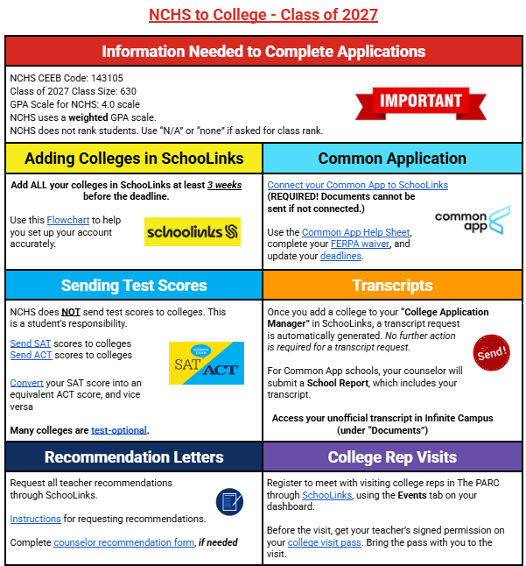
NCHS to College Hyperdoc
ONE STOP SHOP RESOURCE!
bit.ly/NCHStoCollege27
Notes:
Counselors shared this hyperdoc with seniors last week. We asked students to bookmark this document as it is a one-stop resource for our NCHS-specific procedures and how to use SchooLinks. When your student has questions, they may be able to find the answer in this hyperdoc. We will share the link to this hyperdoc with you in our follow-up email.

Slide 12
SchooLinks
Primary communication tool between student, counselor, and teacher
ALL colleges to which the student is applying MUST be entered by the student into their SchooLinks account
ALL college application deadlines must be accurately recorded in SchooLinks (verify deadline on college website)
SCHOOLINKS IS NOT AN APPLICATION METHOD
Notes:
SchooLinks is the primary communication tool between the student, counselors, and teachers. SCHOOLINKS IS NOT AN APPLICATION METHOD.
How counselors will know which schools students are applying to.
Way for students to keep an organized list of their colleges and their progress all in one place.
All colleges a student is applying to must be entered and tracked in SchooLinks.
Counselors and teachers use the deadlines the student chooses in SchooLinks, so it is very important for students to record accurate deadlines. If a student is applying early action but puts the deadline for regular decision, a supporting document could get to the school late, so students must ensure that deadlines are correct.

Slide 13
SchooLinks & Common App
SPECIAL NOTE FOR STUDENTS USING THE COMMON APPLICATION:
Student must connect their Common Application account to SchooLinks
Students must enter their application deadlines in Common App which are then transferred to their SchooLinks account
SCHOOLINKS IS NOT AN APPLICATION METHOD
Notes:
If a student is applying to schools using the Common Application, the student must connect their Common App account to their SchooLinks account. The necessary information from Common App is then transferred over to SchooLinks, including deadlines.

Slide 14

SchooLinks
Counselors and teachers use SchooLinks to transmit confidential, official, and secure documents to colleges.
Transcript requests are automatically placed when a student enters a college in SchooLinks. ALL colleges must be entered in SchooLinks.
ALL requests for teacher letters of recommendation must be entered in SchooLinks after having a conversation with the teacher.
Notes:
Besides tracking and organizing, students use SchooLinks to request document transmission to colleges, including transcripts, school reports, and letters of recommendations.
All transcripts will be sent through SchooLinks. When a student enters a new college in SchooLinks, a transcript request is automatically sent to the counselor.
The transcript is not instantaneously sent. The counselor needs to review the request, attach a secondary school report or letter of recommendation if applicable, and then release the transcript to the college.
Once sent by the counselor, the college or university must open the transcript. Therefore, it is extremely important that students are inputting their colleges in SchooLinks well in advance of deadlines, preferably at least 3 weeks before to ensure documents arrive on time.
For Common App schools, “Transcript” does not show in Schoolinks; it is listed as “School Report” which includes the transcript and a secondary report completed by the counselor
It is important to note that we do not send official transcripts via email.
Letters of recommendation submitted on behalf of students by counselors and teachers are submitted through SchooLinks. Students should be having a conversation with their teacher before submitting an official request in SchooLinks. There is more info about recommendation letters in a moment.

Slide 15


Standardized Test Scores
NCHS does NOT send test scores!
It is the student’s responsibility to send test scores to colleges.
Students must have test scores sent directly from the testing agency to the college. Allow ample time.
Some colleges may accept self-reported scores; verify on their website.
There is a fee for sending test scores ($15 for SAT; $20 for ACT).

Slide 16


Letters of Recommendation (LOR)
Students Should
Students Shouldn’t
Ask for an LOR if the college does not require one
Ask for more than one letter unless a college requires it
Ask a teacher from freshman year
Do research on college websites
Allow adequate time, 3-4 weeks notice
Ask teachers BEFORE requesting LOR through SchooLinks
For counselor LOR, fill out the counselor questionnaire (only if counselor letter is needed)
Notes:
Not all schools require a letter of recommendation. * Check college websites about whether or not they require letters of recommendation.
For many colleges, one letter is enough. Some selective colleges require more, but that is not the norm
Students should not ask more than two teachers to write a letter unless a college requests it.
When requesting:
Ask recommender in person if possible (if not, email) - give some background information (can share a resume, or complete teacher survey)
Request in SchooLinks for EACH school that needs a letter - this is where teacher uploads and sends the letters
Give 3 weeks notice
Teachers want to write strong letters, and additional time/ information can only help strengthen their letters!
TIPS:
Ask teacher from junior year.
Ask teacher from core academic subject (English, Math, Science, Social Studies, Foreign Language)
Some highly selective schools require a counselor letter of recommendation. If a counselor letter is required, students should contact their counselor directly and fill out their counselor’s recommendation questionnaire. A link to the counselor recommendation questionnaire is on the NCHS to College hyperdoc - which we will share later. If given a choice between counselor or teacher letter, general guideline is to ask a teacher, who has seen more of the student and knows more about what they are like as a learner.

Slide 17
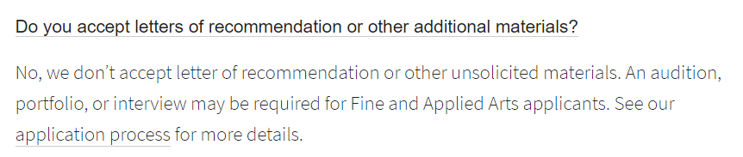

Notes:
This slide is an example of a college (the University of Illinois) that does not accept letters of recommendation. Students should not be sending recommendation letters to a college if they do not require them. Colleges expect students to follow their set of rules and policies when applying.

Slide 18

Application Reminders
Be patient!
It is critical for students to honor NCHS deadlines
Allow 3 weeks to process requests
Track application status in SchooLinks
Requesting a document does not mean it is sent automatically.
Sending things electronically does not mean they are processed by the college instantaneously.
Once the application is submitted, students typically receive an automatically generated email about “missing materials”. This doesn’t necessarily mean they are missing!
Notes:
Now that seniors have had their SchooLinks training session, they are able to begin using the various college application functions in SchooLinks. Please encourage your senior to be patient with themself, as well as others, during this process!
Once a student knows that they are going to apply to a college, we encourage them to add that school to SchooLinks (or Common App). They do not need to submit their application before adding the school.
To be considered complete, ALL of the required components for an application must be received and processed by the college. This may include test scores, letters of recommendation, secondary school report forms, counselor forms and transcripts. Colleges are able to receive and process these applications very quickly.
We will begin sending transcripts during the week of Sept. 15; transcripts list high school courses a student has already taken as well as courses “in progress,” which are the student’s senior year classes. If a student decides to drop a class or change their second semester schedule after that point, they will need to contact the schools to which they are applying to notify them of the change.
Sometimes transcripts are not sent until accompanying documents, such as a school report or recommendation letter, are also ready to send.
Colleges automatically generate emails asking for transcripts/scores/etc. as soon as they receive a student’s online application; they will always say they want materials as soon as possible. When your student receives this message, Do not panic! - these are automated messages that are sent so the student knows what needs to be completed. By following NCHS procedures, all documents will be to the college in plenty of time.

Slide 19
Students can submit their portions of applications separately (at any time) from supporting documents which include official transcripts and letters of recommendation.
Notes:
Students can submit their portions of the applications separately from any supporting documents. We appreciate your patience while counselors work as efficiently as possible to meet deadlines for all students on their caseload.
Some colleges don’t require an official transcript and want students to self-report or upload an unofficial transcript which they can find in Infinite Campus.
Transcripts won’t begin being sent until end of September.

Slide 20
How Parents Can Help
3
Parent role in the process
Notes:
While it is important to remember that the college application process is the student’s journey, parents can help to alleviate stress by supporting their child in several ways. Let’s dig in to how parents can best help their child during the college application process.

Slide 21

Parents Can Help
Arrange for campus visits and/or manage virtual visits
Organize & proofread application components
Order test scores to be sent to colleges
Research financial aid opportunities
Complete the FAFSA or Non-Participation Form
Be supportive & have meaningful conversations
Review monthly counseling newsletters for important reminders, dates, and information
Notes:
By dividing these tasks and creating clear boundaries and expectations from the beginning of this process, students and parents can have a much more enjoyable time navigating the college application process.
Parents can help by researching campus tours and going on visits. Helping your child to manage this process can take some of the stress off their shoulders.
Parents can also organize & proofread application components. Organizing a spreadsheet with requirements and deadlines for each college can be beneficial. Parents can also proofread essays and short answers for grammatical errors.
If students are sending SAT or ACT scores to colleges, parents can assist by ordering these test scores to be sent to each college.
Parents can also help with the financial part of this process by researching financial aid and scholarship opportunities. Additionally parents can complete the Free Application for Federal Student Aid or FAFSA, which opens on October 1st. The FAFSA is used by each college to determine a student’s eligibility for financial aid including grants, federal student loans, and work-study.
It can be helpful to engage your student in meaningful conversations about:
What they are looking for in a college
Budget
Distance from Home - if far away, how will students get there/back? Will they come home for every holiday/break?

Slide 22
SchooLinks Observer
Parents can create an observer account on SchooLinks. You can use this account to search schools and view your child’s progress.
To create a parent/guardian account, follow these instructions.
Notes:
These instructions are also in every Counseling Newsletter and on our website
Parents can create a parent account on SchooLinks. This is an observer account only, but as a parent, you can use the search tools in SchooLinks and view your child’s progress. You cannot make changes in your child’s account.

Slide 23

Resist the Urge
As tempting as it might be, please don’t:
Complete or submit your child’s application
Write your child’s essay
Contact college representatives on behalf of your child
Manage your child’s SchooLinks or Common App accounts
Notes:
Parents can learn how to help without taking over!
It’s true that the college application process holds some new and difficult tasks, but your child must rise to the occasion and you can help them!
Be their coach, their cheerleader, their comforter, their teacher.
Direct your child to get help from their counselor, the college and career counselor, the PARC (formerly CCC), and the college itself when they have questions.
Do not complete your child’s application or write your child’s essay. It is extremely obvious to an admissions committee when a parent is writing the essay.
Let your child call and/or email college admissions offices. If they’re reluctant, coach them and even role-play what they can say when they communicate with the colleges. Their counselor can help with this process as well.
SchooLinks is the primary communication tool between the student and their counselor. If parents manage their child’s SchooLinks account, this may cause confusion and impact the transmission of important application documents from the school to the applicant’s colleges. However, parents do have the opportunity to have a SchooLinks account to view (not edit) their child’s progress.
At the end of the day, remember this is about the student and their journey to apply to college. So cheer them on, but let them sit in the driver’s seat.
Some parents have found success in planning a weekly college meeting with their senior. This helps to keep all conversations about college to a specified and sacred time instead of trying to talk about it in small increments on the way home from the soccer game.

Slide 24

2027-28 FAFSA & Form
Filing Requirement
FAFSA available beginning October 1, 2026
State of Illinois requires all students to file a financial aid form to earn a high school diploma.
To fulfill this requirement, students must:
File a FAFSA (Free Application for Federal Student Aid) OR
File the Alternative Application for Illinois Financial Aid OR
File a waiver/opt out form
Notes:
On June 1, 2020, Public Act 101-0180 (issued by the State of IL) went into effect which requires a student to file a financial aid form to earn a high school diploma beginning with the graduating class of 2021. This is a state mandate. In order to fulfill this requirement, students must either:
File a FAFSA application
File an Application for State Financial Aid OR
File a waiver/opt out form, also called a FAFSA Non-Participation Form
As a reminder, you can start to file the FAFSA in October, not before. Student should only choose the second option and file an application for state financial aid if they are not eligible to file the FAFSA. For families who choose not to file a FAFSA, they must fill out the FAFSA Non-Participation Form.

Slide 25


FAFSA Resources
Financial Aid Information session - immediately following this presentation
Financial Aid Form Filing Night
  October 28th (6:30-8:00pm) in NCHS Learning Commons
  October 29th (5:30-7:00pm) in NNHS Learning Commons
ISAC Corps Representative, Payton Major
  Payton.Major@illinois.gov
  (309) 756-8175
Notes:
NCHS and NNHS are partnering with COD to host a Financial Aid Information Night on September 11th at 6:00pm in the NNHS Auditorium.
Additionally, to assist families in the completion of the FAFSA, NCHS is hosting a Financial Aid Form Filing Night on October 29th from 6:30-8:00pm in the NCHS Learning Commons. Both events will be in person.

Slide 26

Thank you!
General questions? Raise your hand!
Credits:
Presentation Template: SlidesMania
Images: Unsplash
Fonts used in this presentation: DM Sans and Lexend Deca
Notes:
Thank you so much for attending. If you feel you got all of the information you needed tonight, please feel free to leave. If you have questions that pertain to the group, please raise your hand and wait for the microphone. If you have specific questions about your student, please reach out to your student’s counselor or the college and career counselor.

