Slide 1

Senior Year Overview

Slide 2
Senior Year Overview
Outcomes
Students & families will know appropriate times to complete tasks throughout their Senior year, and understand postsecondary terminology
Families will know how to support their students through the postsecondary planning process.
Students will know their responsibilities & expectations when applying for postsecondary options.

Slide 3
Senior Year Overview
Senior Week Recap
Students participated in Senior Week Presentations on Aug. 24 & 25
(in their Comm Arts classes)
Presentation including information on:
  Adding colleges to their SchooLinks account
  Requesting letters of recommendation within SchooLinks
  Signing-up for NNHS College Visits
Senior Week FlowDoc

Slide 4
College Applications

Slide 5
















Best School vs. Best Fit

Slide 6
Application Deadlines
Early Decision
BINDING Students make a commitment to a first choice college. If admitted under Early Decision, the student must attend.
Restrictive Early Action
NON-BINDING Students apply to a school of preference, and receive an earlier decision. Students may be restricted from applying ED or EA to other schools
Early Action / Priority
NON-BINDING Students apply early to a school or schools, and receive an earlier decision, ahead of the regular decision deadline
Regular Decision
NON-BINDING Last possible deadline a student can apply and still be considered for admission to a university.
Rolling Admission
NON-BINDING Schools review applications as they are submitted, and issue admission decisions on a rolling basis.

Slide 7
Fun Fact
Myth Busting
Univ. of Illinois, Urbana-Champaign is not a safety school for our students
Class of 2026 NNHS Admissions Data - Most Selective Majors
Business 59 students applied 41 students were denied 12 students were offered an alternative major 6 students were admitted (10% acceptance rate) | Engineering 53 students applied 34 students were denied 3 students were offered an alternative major 16 students were admitted (30% acceptance rate) | Psychology 11 students applied 6 students were denied 2 students were offered an alternative major 3 students were admitted (27% acceptance rate)

Slide 8
Fun Fact
Myth Busting
Univ. of Illinois, Urbana-Champaign is not a safety school for our students
Early Action vs Regular Decision Acceptance (2026)
Early Action 200 applied via EA 75 were offered admission (38% acceptance rate) | Regular Decision 41 applied via RD 11 were offered admission (27% acceptance rate) | Overall Admissions 241 applied to UIUC 86 were offered admission (35.7% acceptance rate)

Slide 9
Requesting Transcripts
Transcripts will not be sent out to
colleges until the week of Sept. 14

Slide 10
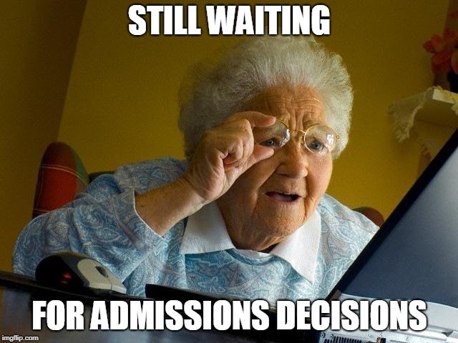

When will I know if I’m accepted?

Slide 11
Waitlisted: What does this mean?!
You have NOT been accepted, but you are “admissible” if there is room later.
Make other plans!
Questions? Call the college’s admissions office.

Slide 12
Supporting Your Senior

Slide 13

Supporting Your Senior
Visiting Colleges
There is great value in seeing a college in person!
Check a school’s Admissions Office website about upcoming visit opportunities.
Make sure if you visit a campus, you make it “official”
  Either take an official tour from Admissions, or visit the Admissions Office to let them know you are on campus (Demonstrated Interest)
Notes:
In regards to college visits, there is no substitute for seeing a college yourself. Unfortunately, we know many colleges/universities are not all open for visits, but we encourage you to check out their website for more information on those who are offering in person visits. The link below is a great resource as well to get some helpful tips on navigating virtual college visits.

Slide 14
Supporting Your Senior
FYI: State of Illinois Financial Aid Graduation Requirement
2027-28 FAFSA
  Will not be available until October 1, 2026
Net Price Calculators
SchooLinks Matching & 3rd Party (National) Scholarships
Watch Out for Scholarship Scams

Slide 15

Supporting Your Senior
Social / Emotional Support
Encourage your student(s) during postsecondary planning and research
Be supportive and communicate openly with your student(s)
Be patient with your student(s) throughout this process - this takes time
Notes:
Listed are a few areas we want to highlight in ways to support your senior. The postsecondary planning process can be a stressful one so please encourage your students during this process. Find ways to make this process fun and enjoyable. Be supportive and communicate openly with your student as they discuss their future goals and plans. Lastly, be patient with them. This process can take time and it’s important to give them the space needed as they prepare for their life after high school.

Slide 16
Senior Responsibilities

Slide 17
Senior Responsibilities
Every college/university has their own set of requirements for admission
Follow their directions carefully
  Schools look to see how well you follow directions
  Don’t send more, unless a school asks for more
  Reach out to the college directly if you need clarification
Check the Letter of Rec Requirements
  DO NOT ask for a letter of rec if your schools do not need a letter
  DO NOT ask for more letters than a school requires

Slide 18
Senior Responsibilities
Make sure you submit your applications early
  On-time is too late
Make sure you submit all necessary documents
  Transcript
  Test Scores (SAT, ACT, etc.) - if required
  Letters of Recommendation (ONLY if needed)
Make sure to thank those who write you a letter of rec.

Slide 19

Senior Responsibilities
Clean Up Social Media
Notes:
As you prepare for your postsecondary plans, we want to remind you to clean up your social media. Don’t underestimate the impact that your social media is leaving on your digital footprint, as it represents who you are.

Slide 20

Additional Resources
NCompass
Dist. 203 Postsecondary Planning Guide
In-School College Visits
Instructions on how students can attend in-school college visits
  Upcoming College Visits (Calendar for the next week)
  Upcoming College Visits (Alpha list of ALL upcoming visits)
On-Campus College Visit Tips
Tips for students planning to visit college campuses

Slide 21

Upcoming Opportunities
Session 2 & 3 Tonight: Financial Aid Info (NPAC)
For D203 families to receive updates regarding financial aid, including the 2027-28 FAFSA
Sept. 26: NACAC National College Fair @ Navy Pier (Chicago)
A national college fair, featuring more than 200 colleges & universities from across the country.
Oct. 13: Illinois Regional College Fair @ Benedictine Univ. (Lisle)
Another college fair opportunity, bringing in additional colleges & universities from across the country.
Nov 5: 3rd Annual Career Takeover (NNHS)
An even more robust program to help students in exploring postsecondary career opportunities!

