Slide 1

Junior Year Overview

Slide 2

Junior Timeline
Outcomes
Students will know appropriate times to complete tasks throughout their Junior year.
Students will know how to utilize resources provided to assist in the postsecondary planning process.
Students will know steps needed for continuation of postsecondary planning through summer leading into Senior year.

Slide 3
Junior Timeline
Junior Counseling Curriculum
Postsecondary Planning & Standardized Testing
Financial Fit
Course Planning
Understanding Postsecondary Requirements
Notes:
While this is not an exhaustive list of topics, we are going to focus on the following four main areas that will be covered throughout Junior year. Postsecondary planning and Financial Fit will be covered throughout Junior Parent University program. Course planning will cover the course selection process related to postsecondary requirements. Understanding postsecondary requirements will be covered through Spring Junior Week and Evening Programming. Students will be receiving the curriculum through presentations such as this, Canvas modules, and Zoom lessons. We want to encourage students to take advantage of these opportunities and resources being provided as they navigate their postsecondary plans.

Slide 4
Junior Timeline
Fall Activities
Attend College Visits (The PARC)
Favorite Schools on SchooLinks
Register for AP Testing (if applicable)
Make Sure Academics are a Priority
Notes:
Throughout the fall, we want to highlight a few items for Juniors to focus on. A great way to explore colleges is by taking virtual tours, or visiting them in person if available. NNHS also offers virtual colleges rep visits throughout the Fall. As you begin to create a list of schools you are interested in, we encourage students to favorite them in SchooLinks. This will allow students to have a running list of schools they are interested in. For those in AP classes, the fall is when you need to register for AP testing. Information will be shared by your teachers and through email. For ALL students, make sure you are making academics a priority. Remember that junior year is the best reflection of your academic potential and for colleges to see trends over your first three years in high school.

Slide 5
Junior Timeline
Winter Activities
Check Over Academic Requirements (if attending college)
Select Courses for Senior Year
Visit College/University Campuses
  On-Campus College Visit Tips
Notes:
As we move into winter, we want to highlight a few items for Juniors to focus on. All juniors should be checking over their academic requirements in regards to graduation and postsecondary planning. This includes purposeful course selection for senior year, while working with their Counselor to ensure they are on track in regards to their postsecondary plan. Continuing to attend virtual and in person college visits is also encouraged.

Slide 6
Junior Timeline
Spring Activities
Prepare to Take the State ACT
Keep an Eye out for Junior-Specific Programming in Homeroom/Advisory
Begin Asking Teachers for Recommendation Letters
(check college requirements first)
Register for the NCAA/NAIA Eligibility Center (if applicable)
Finish Junior Year Strong!
Notes:
Heading into Spring, we want to highlight a handful of items for Juniors to focus on. For those students who took the PSAT, we encourage you to use those results to prepare for the State SAT. Junior Week will be happening later in the spring and will have a Counselor-guided week preparing them to transition into senior year in regards to postsecondary planning. During this week, we will cover the beginning stages of the college application process, including teacher letters of recommendation, recommendation/scholarship survey and NCAA/NAIA eligibility. As we referred to earlier, junior year is important. For many colleges, this may be the last grades posted to the transcript to determine college admissions. Colleges want to see an upward trend, so finish strong!

Slide 7
Junior Timeline
Summer Activities
Continue Visiting Colleges
Review College Application Essay Requirements
Send your official SAT/ACT test scores to your colleges (if required)
Narrow down potential college application list in SchooLinks
REST (Seriously!)
Notes:
Summer is a good time to take a break from school, but not from planning for your postsecondary plans. Continue to visit colleges both virtually and in person. Use summer vacation as a great opportunity to visit schools you may be interested in. Continue working on the recommendation/scholarship survey, add in new activities and experiences, or update your interests for the future. Summer is also a great time to review college application requirements, especially if you are looking at schools with the Common App. Common App essay prompts are typically available for you to start working on so please take advantage of the time. Do your best to come into Senior year with your list of potential colleges narrowed down and updated in SchooLinks. This will make the application process easier at the start of your Senior year. Finally, rest. Seriously, rest. Take some time for yourself. Senior year is a busy time and we want you to enjoy the college application process as best as you can.

Slide 8
Supporting Your Junior

Slide 9
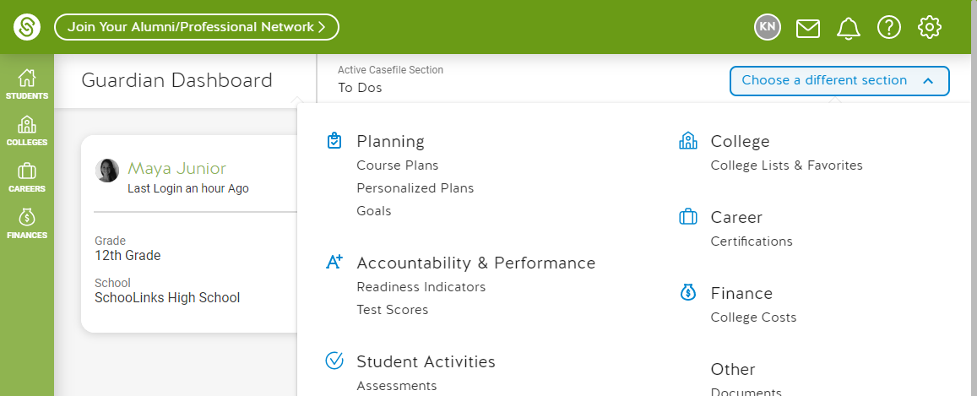
Supporting Your Junior
SchooLinks Parent Observer Accounts
Notes:
All parents/guardians have observer access to their student SchooLinks account. These accounts provide view only access but allow parents to work with their student on postsecondary planning. There will be links available below this video to guide you through the sign up and matching process with your student’s account.
Links for parents will be on the page below this video

Slide 10
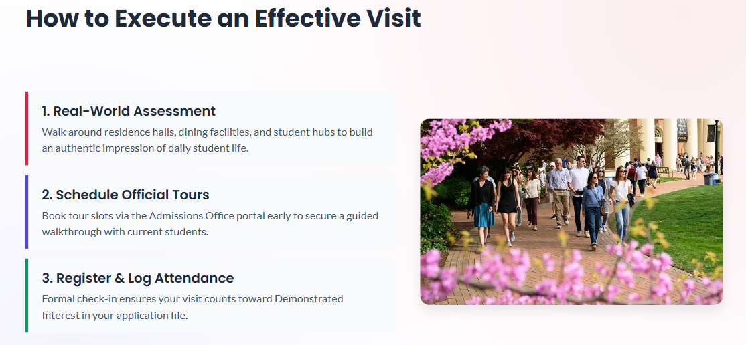
Supporting Your Junior
Visiting Colleges
Notes:
In regards to college visits, there is no substitute for seeing a college yourself. Unfortunately, we know many colleges/universities are not all open for visits, but we encourage you to check out their website for more information on those who are offering in person visits. The link below is a great resource as well to get some helpful tips on navigating virtual college visits.

Slide 11

Supporting Your Junior
Social / Emotional Support
Encourage your student(s) during postsecondary planning and research
Be supportive and communicate openly with your student(s)
Be patient with your student(s) throughout this process - this takes time
Notes:
Listed are a few areas we want to highlight in ways to support your junior. The postsecondary planning process can be a stressful one so please encourage your students during this process. Find ways to make this process fun and enjoyable. Be supportive and communicate openly with your student as they discuss their future goals and plans. Lastly, be patient with them. This process can take time and it’s important to give them the space needed as they prepare for their life after high school.

Slide 12
Junior Responsibilities

Slide 13
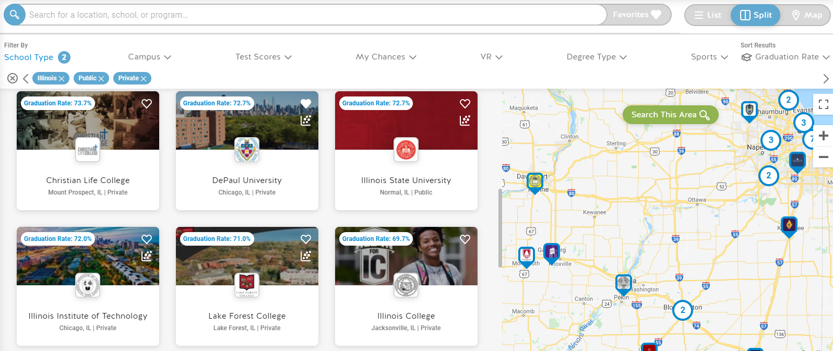
Junior Responsibilities
Favorite Colleges in SchooLinks
Notes:
As you begin researching postsecondary options, if there are colleges & universities you are interested in, we encourage students to favorite them in SchooLinks. This will allow you to keep a running list of schools you are interested in. To favorite a college or university, just click on the heart icon in the upper right-hand corner of the college card on the College Search page.

Slide 14
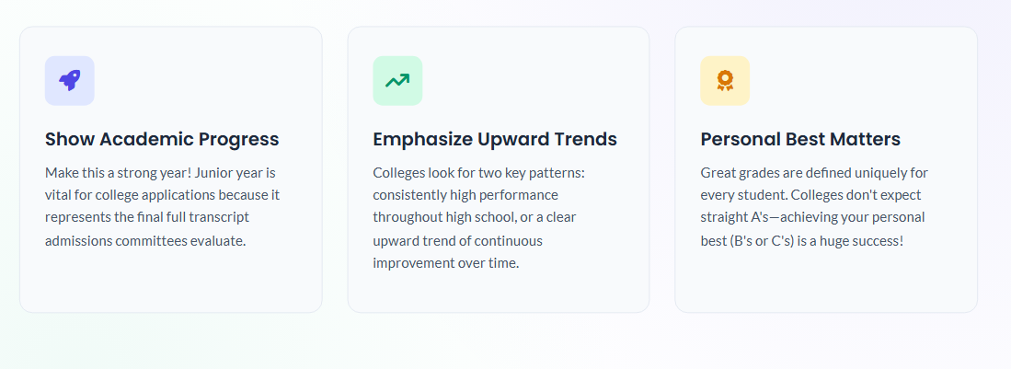
Junior Responsibilities
Notes:
As a sophomore, you were given curriculum that covered topics listed on the screen. To refer back to them, they have been made available under the Class of 2022 Canvas page, under modules. These lessons are just as important now, as they were during your sophomore year. We want to make sure that you have access to these resources to help you finish junior year strong.

Slide 15

Junior Responsibilities
Clean Up Social Media
Notes:
As you prepare for your postsecondary plans, we want to remind you to clean up your social media. Don’t underestimate the impact that your social media is leaving on your digital footprint, as it represents who you are.

Slide 16

Additional Resources
NCompass
Dist. 203 Postsecondary Planning Guide
In-School College Visits
Instructions on how students can attend in-school college visits
On-Campus College Visit Tips
Tips for students planning to visit college campuses

Slide 17
Upcoming Opportunities
Tonight
Sessions 2 & 3 Tonight
A few options for families to choose from to help with postsecondary planning [cite: 10]
Sept 1 -
Oct 30
In-School College Visits
Connect with admissions representatives directly at your school [cite: 10].
Sept 26
NACAC National College Fair @ Navy Pier (Chicago)
A national college fair, featuring more than 200 colleges & universities from across the country [cite: 10].
Sept 29
Navigating a Shifting Testing Landscape
An evening program at Naperville Central (6:30pm in Auditorium) to discuss college admission testing [cite: 10].
Oct 13
Illinois Regional College Fair @ Benedictine Univ. (Lisle)
Another college fair opportunity, bringing in additional colleges & universities from across the country [cite: 10].

