Slide 1
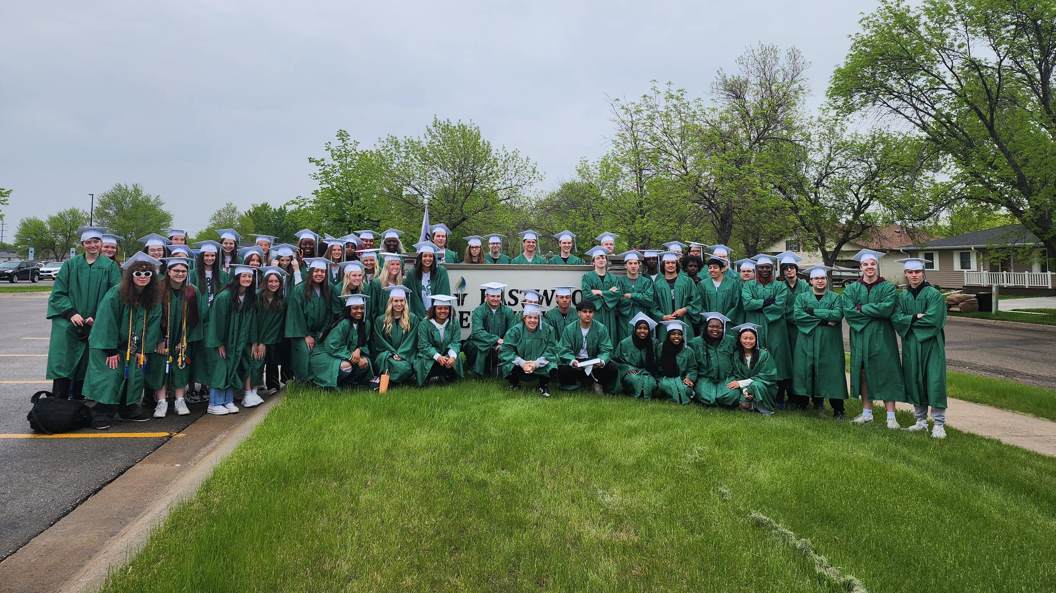
Welcome to Senior Year!
Asprey

Slide 2



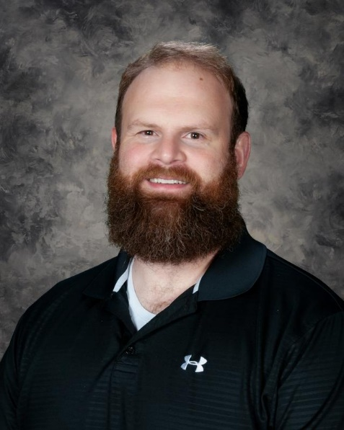

ADMINISTRATIVE TEAM
Dr. Bachmeier
Mr. Asprey
A-G
Mrs. Metz:
H-N
Dr. Samson:
O-Z
Mr. Wilson: Grade 9

Slide 3

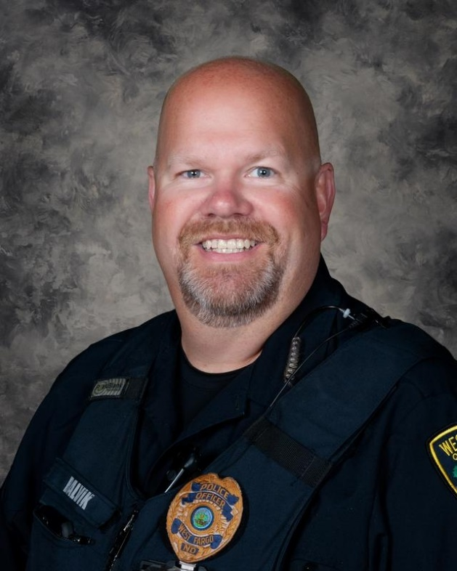
ADMINISTRATIVE TEAM
Mr. Behm
SRO Balvik

Slide 4
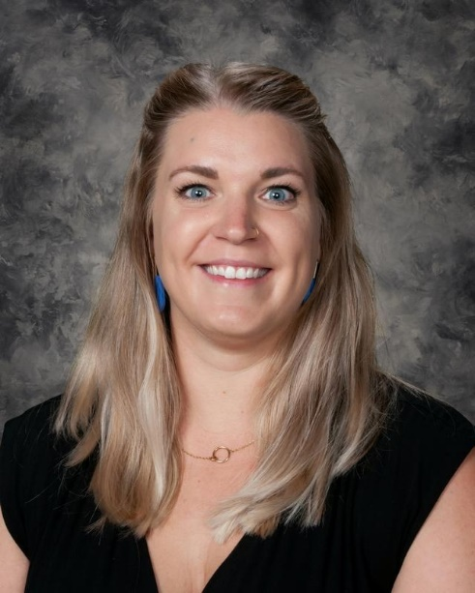


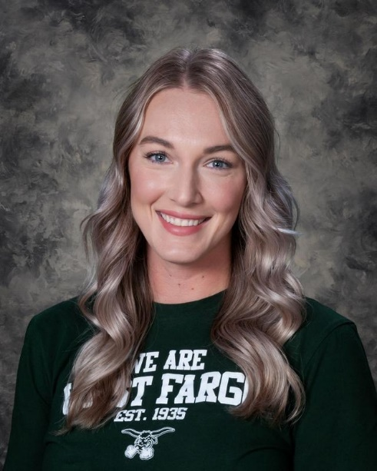
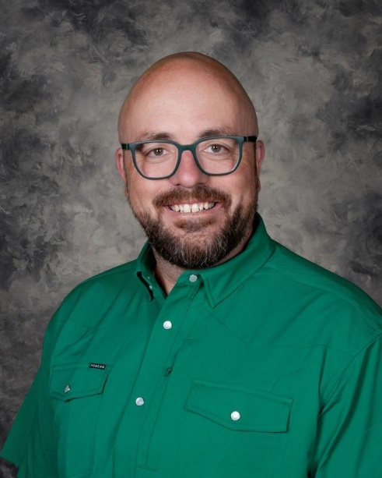
COUNSELING TEAM
Ms. Quist:
A-E
Mrs. Rosendahl:
F-Le
Mrs. Cowden:
Lf-Rh
Mrs. Roberts:
Ri-Z
Mr. Zuel:
Grade 9

Slide 5
Tonight’s Purpose:
Graduation Information
Choice Ready and North Dakota Scholarship
Q&A
Senior Checklist
Important Policies and Dates
Bachmeier
Notes:
Rachel

Slide 6



PACKER PRIDE: LEGACY LIVES HERE
Work Hard
Show up
Be prepared
Embrace Challenge
Try new things
Learn from mistakes
Build Community
Include others
Give your best effort
Manage your time responsibly
Follow through
Own your decisions
Keep improving
Ask for feedback and help
Do more than expected
Step out of your comfort zone
Don’t give up
Set ambitious goals
Zoom out and pivot your mindset
Be flexible
Show school spirit
Listen first
Get involved
Support your teammates and peers
Be kind to everyone
Make a positive impact
Give back through service

Slide 7

Senior Checklist:
General
Check your email! We will send important updates via school email and Schoology.
Submit your senior photo to the yearbook (QR codes around the school). They are due in December!
Review and discuss your future plans with your family, counselors, mentors, etc.
Request written letters of recommendation at least two weeks prior to deadlines. Provide them with necessary information!

Slide 8
Senior Checklist:
College Bound
Complete and submit your 2026-2027 FAFSA!
  Start looking at the Department of Education website to see what documentation you need to have ready!
  We will have help sessions during fall conferences!
Work hard all the way to graduation… second semester grades can affect scholarship eligibility!
Visit the schools you’re most interested in either virtually or in person.
Apply to the colleges you like most by the deadlines.
Complete scholarship applications.

Slide 9
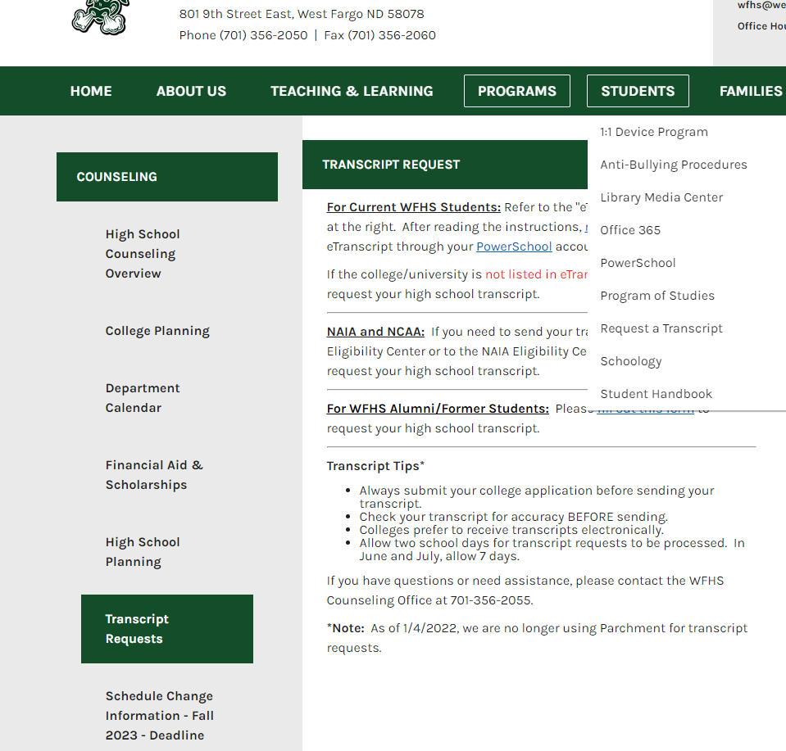
Requesting a Transcript
Refer to the eTranscript instructions on the WFHS website! You will need to know your PowerSchool log-in!
Transcript Tips*
Always submit your college application before sending your transcript.
Check your transcript for accuracy BEFORE sending.
Allow two school days for transcript requests to be processed.
If you have questions or need assistance, please contact the WFHS Counseling Office at 701-356-2055.

Slide 10

College Application Day
Monday, October 12
College App Day is an annual event at WFHS hosted by Bank of North Dakota.
  You will be able to apply to college and universities of your choice
  1 ND school fee will be covered by BND!

Slide 11
ABOUT GRADUATION
Graduation is on the afternoon of Sunday, May 30.
The ceremony begins at 3:00p and is at the Scheel’s Arena.
Graduates must be there by 2:00p.

Slide 12
BEFORE GRADUATION
There will be a mandatory graduation rehearsal on Friday, May 28. This is the day after the last day of school.
If a graduate does not attend rehearsal, they CANNOT walk at graduation.
If the student is going to miss rehearsal due to a sanctioned school activity (state track, etc.), they must have a representative stand in for you (it can be a friend, a parent, etc.). There will be a form for them to fill out about this beforehand. You can get this in the Main Office.
Rehearsal will last approximately 1 hour.

Slide 13
BEFORE GRADUATION REHEARSAL
You need to be cleared of all obligations.
  Detention hours
  Parking tickets
  Textbooks and class novels
  Library books
  Outstanding fees
  Uniforms
  Complete the senior survey
  Take the civics exam
  Complete your capstone presentation
  Return your iPad
Do not wait until May to take care of these! Time WILL run out.
If you have remaining obligations, you will NOT be able to attend graduation rehearsal and will NOT be able to walk at graduation.
Behavior issues (in and out of school) can also jeopardize your ability to participate in the graduation ceremony. Walking at graduation is a privilege.
Rachel

Slide 14

NORTH DAKOTA CHOICE READY

Slide 15
Grade 12 Advisory:
Capstone

Slide 16
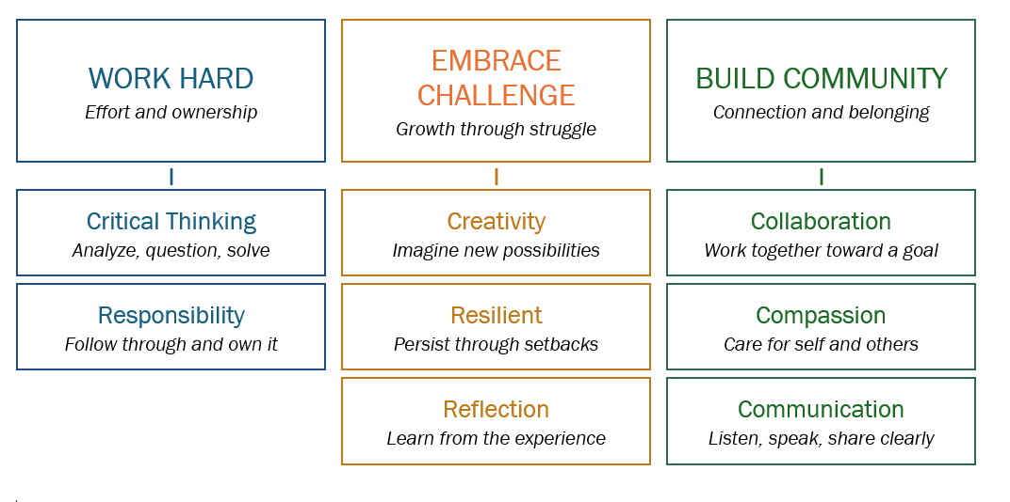
PACKER PRIDE at WFHS
Anchored by the Profile of a Graduate

Slide 17
Capstone Details
Build a PowerPoint (or other medium) presentation over the course of the year
Share celebrations from high school, application of skills to future endeavors, plans for after graduation
Presentation date: April 28
Please save the date! We’d love for you to join us!

Slide 18


Slide 19

MEET OUR CAREER ADVISOR
Career Advisor –Allison Caldwell
  Assist all learners in becoming Choice Ready through
    Exploration
    Planning
    Reflection
  Office 103F (back of library)
  Website –WFHS—Programs—Career Center
  College, Career, and Resource Center – library
Featured Events:
  WIN Sessions (weekly Sept-May)
  Choice Ready Fairs (Oct. / Feb. )
What Can I Help You With?
Post Secondary Readiness
  career and tech training and 2-4+ education programs
Workforce Readiness
  Work based learning opportunities
    Job shadows, events
  Personal marketing materials
    Resumes, cover letters
    Interview practice
Military Readiness
  WIN sessions
  Connection to representatives
Volunteer Opportunities
Notes:
Caldwell

Slide 20
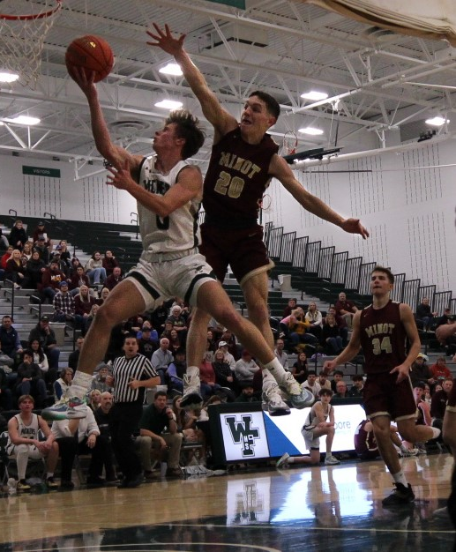
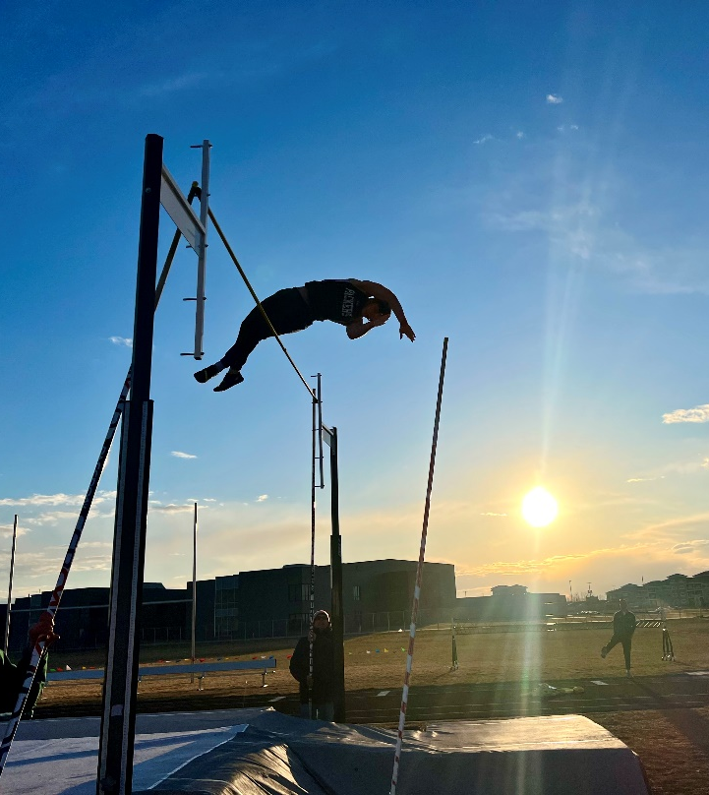
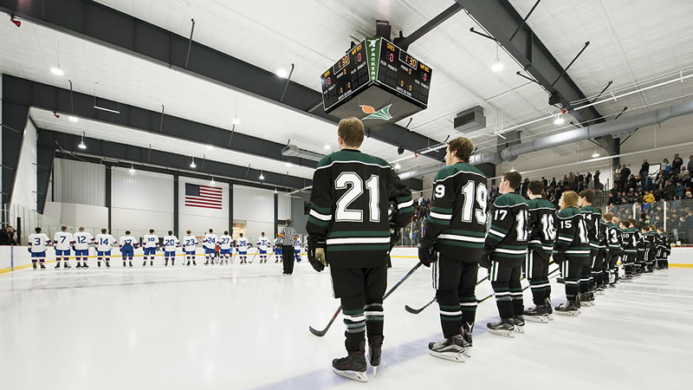
Eligibility
Need to be enrolled in six classes
Can only be failing ONE class
No outstanding detention hours
  Assigned for UTs and UVs
Teachers update grades weekly, and eligibility is pulled on Fridays

Slide 21
SCHOOL PROCEDURE: CELL PHONES
Learner cell phones, smart watches, and all other personal devices that can send and receive messages are OUT-OF-SIGHT and OUT-OF-USE from 8:25a until 3:35p.
Devices CANNOT be kept on your person (in a pocket, etc.). They must, at a bare minimum, be kept in a CLOSED backpack pocket. Devices can also be left in your car, at home, etc.
Devices CANNOT be utilized or checked during passing times, lunch time, or Open Campus if you chose to remain on campus.
If you choose to leave the classroom to visit the nurse, go to the bathroom, etc., your backpack (with your phone inside) STAYS IN THE CLASSROOM.

Slide 22

SCHOOL PROCEDURES: CELL PHONES
The device is brought to the Main Office, picked up by the student at the end of the student’s day
The device is brought to the Main Office, picked up by the parent/guardian at their earliest convenience not to be returned to the student until the end of the student’s day
The device is brought to the Main Office, picked up by the parent/guardian at their earliest convenience, not to be returned to the student until the end of the student’s day, additional plan assigned to the student
The device is brought to the Main Office, picked up by the parent/guardian at their earliest convenience not to be returned to the student until the end of the student’s day, 1 day ISS
The device is brought to the Main Office, picked up by the parent/guardian at their earliest convenience not to be returned to the student until the end of the student’s day, 1 day OSS
The device is brought to the Main Office, picked up by the parent/guardian at their earliest convenience not to be returned to the student until the end of the student’s day, transition to Virtual Program

Slide 23

Other Notes about the statewide cell phone ban:
The law address personal student devices like cell phones, laptops, and smartwatches. It does NOT include Bluetooth headphones as they do not have the capacity to send and receive messages.
Students with medical notes denoting required access to devices will be placed on special plans.
We encourage all families to utilize email to communicate with learners as they will still have access to their Outlook accounts.
Our Main Office staff is ready to receive and deliver emergency messages for students.
Please facilitate your learner memorizing important phone numbers or recording them in a note within their iPad.

Slide 24

ATTENDANCE & TARDIES
Attendance is one of the most important factors for student success.
After 8 absences in at least ONE block class, the student will be placed on a contract with an administrator.
After 10 absences in at least ONE block class, the student will no longer to be able to earn credit for assignments and assessments assigned or due in the course on days you are gone.
After 12 absences, you will be dropped from the class as Loss of Credit.
For every FIVE times you are marked UNEXCUSED TARDY (UT), you will receive 90 minutes of detention.
Notes:
Wayne

Slide 25
Student Attendance
Leaving the building for appointments- bring back a note!
    Doctor
    Dentist
    Chiropractor
All absences count TOWARD the limit EXCEPT: medical (those with an official note), school activities, and administrator approval
Absences can only be excused for two weeks after they occur

Slide 26
The purpose of Tardy a Free Week is to promote positive attendance habits, reinforce the importance of being on time to class, and offer learning and reflection opportunities for students who are late. The goal during Tardy Free Weeks is that ALL students are tardy free!
West Fargo High School is committed to running at least TWO Tardy Free Week windows in the fall: September 8-11 and November 5-6
During these weeks, students who are in the hallway without a pass after the bell rings will be redirected to the theatre to review expectations and complete a reflection activity with administration. They will also be assigned thirty minutes of detention, which can be served during lunch.
TARDY FREE WEEKS

Slide 27
DRUG USE: TOBACCO, MARIJUANA, ALCOHOL, etc.
First offense: Up to three days of suspension
Second offense: Up to five days of suspension
Third-Fourth Offense: Meeting to consider expulsion
Sharing of vapes will be considered distribution and will be sent for expulsion
Required education modules and partnership with Fargo Cass Public Health throughout

Slide 28
LET’s CELEBRATE PACKER PRIDE
If you work hard, embrace challenge, and build community, you have the potential to be recognized in the following ways:
Exchange Club Student of the Month (9 seniors only- scholarship opportunities!)
Student of the Quarter (work hard, embrace challenge, build community)
Fine Arts, Athlete, Volunteer (of the quarter)
Honor Roll (2.8 GPA and 4.0+ GPA) at the end of each semester
Valedictorian/Salutatorian (cumulative weighted GPA post Semester 1)
Packer Pride cards
Social media shoutouts
Academic Awards (at the end of the year), including department awards

Slide 29

CORDS AT GRADUATION:
National Honor Society
National Technical Honor Society
AVID Senior
Honor Cord (3.5+ GPA)
Commitment to armed forces
2+ years of varsity Packer activities

Slide 30
Supporting YOUR SENIOR
Check Infinite Campus and Schoology to monitor grades and attendance
1
Become familiar with the Choice Ready framework, especially the North Dakota Scholarship
2
Talk about the future and maintain high expectations through the end of the year!
3
Reach out to your student’s administrator or counselor with questions or concerns
4

Slide 31
IMPORTANT DATES
First Day of School: Thursday, August 27
  We are running special schedule. All students need to be on campus by 8:25a!
Second Day of School: Friday, August 28 (B-Day)
Homecoming Week: Monday, September 28-Friday, October 2 26
Quarter 1 Family Conferences: Thursday, October 8 (4:00-7:30p)
Senior Photos Due to the Yearbook: December 12
West Fargo Public Schools ACT Option: April 10, 2027 (tentative)
ASVAB Test (required): Week of April 12, 2027
Senior Capstone Presentations: Wednesday, April 28 in the morning
Prom: Saturday, May 1
Senior Day: Tuesday, May 20
Mandatory Graduation Rehearsal: Friday, May 28 @ 2:00p
Graduation: Sunday, May 30 @ 3:00p (graduates report by 2:00p)
Notes:
Rachel

Slide 32


STAY INFORMED!
@WFHighPackers
@wfhs.pack
https://www.west-fargo.k12.nd.us/wfhs
Notes:
Rachel

