Slide 1


Welcome to Junior Year!
Notes:
Rachel

Slide 2



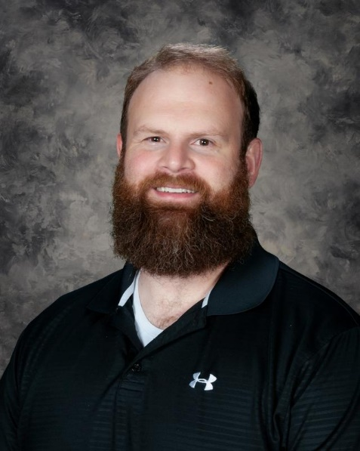

ADMINISTRATIVE TEAM
Dr. Bachmeier
Mr. Asprey
A-G
Mrs. Metz:
H-N
Dr. Samson:
O-Z
Mr. Wilson: Grade 9

Slide 3


ADMINISTRATIVE TEAM
Mr. Behm
SRO Balvik

Slide 4
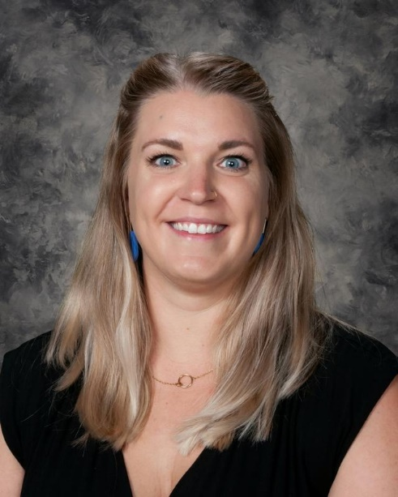



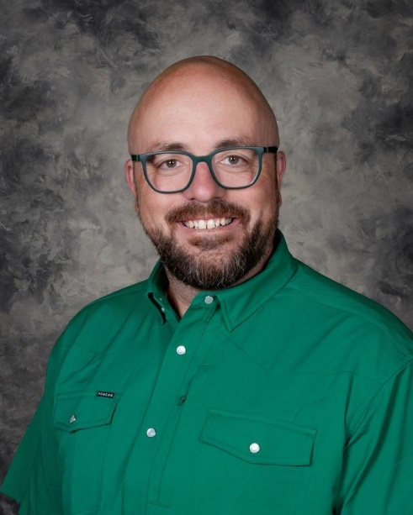
COUNSELING TEAM
Ms. Quist:
A-E
Mrs. Rosendahl:
F-Le
Mrs. Cowden:
Lf-Rh
Mrs. Roberts:
Ri-Z
Mr. Zuel:
Grade 9

Slide 5
Tonight’s Purpose:
Wellness Support
Choice Ready Support
Q&A
Academic Support
Important Dates

Slide 6



PACKER PRIDE: LEGACY LIVES HERE
Work Hard
Show up
Be prepared
Embrace Challenge
Try new things
Learn from mistakes
Build Community
Include others
Give your best effort
Manage your time responsibly
Follow through
Own your decisions
Keep improving
Ask for feedback and help
Do more than expected
Step out of your comfort zone
Don’t give up
Set ambitious goals
Zoom out and pivot your mindset
Be flexible
Show school spirit
Listen first
Get involved
Support your teammates and peers
Be kind to everyone
Make a positive impact
Give back through service

Slide 7
ACADEMIC
NEED-TO-KNOW
& SUPPORT
Goal for WFHS this year:
Educators regularly collaborate to address academic achievement and appropriately challenge ALL learners.

Slide 8

ATTENDANCE & TARDIES
Attendance is one of the most important factors for student success.
After 8 absences in at least ONE block class, the student will be placed on a contract with an administrator.
After 10 absences in at least ONE block class, the student will no longer to be able to earn credit for assignments and assessments assigned or due in the course on days you are gone.
After 12 absences, you will be dropped from the class as Loss of Credit.
For every FIVE times you are marked UNEXCUSED TARDY (UT), you will receive 90 minutes of detention.
Notes:
Wayne

Slide 9

Student Attendance
Leaving the building for appointments- bring back a note!
    Doctor
    Dentist
    Chiropractor
All absences count TOWARD the limit EXCEPT: medical (those with an official note), school activities, and administrator approval
Absences can only be excused for two weeks after they occur

Slide 10
The purpose of Tardy a Free Week is to promote positive attendance habits, reinforce the importance of being on time to class, and offer learning and reflection opportunities for students who are late. The goal during Tardy Free Weeks is that ALL students are tardy free!
West Fargo High School is committed to running at least TWO Tardy Free Week windows in the fall: September 8-11 and November 5-6
During these weeks, students who are in the hallway without a pass after the bell rings will be redirected to the theatre to review expectations and complete a reflection activity with administration. They will also be assigned thirty minutes of detention, which can be served during lunch.
TARDY FREE WEEKS

Slide 11
MOST COMMON ACADEMIC CHALLENGES FOR JUNIORS
Missing school
Being challenged in a course for the first time
Skipping WIN sessions
Not reaching out for help
Not studying for tests
Not starting to think about what’s next

Slide 12
Academic Supports
Study Halls
WIN Sessions
Peer Tutors
Find your teacher!

Slide 13
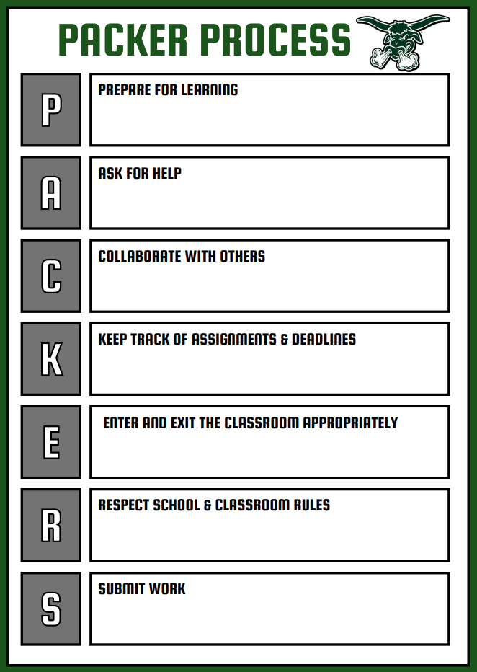
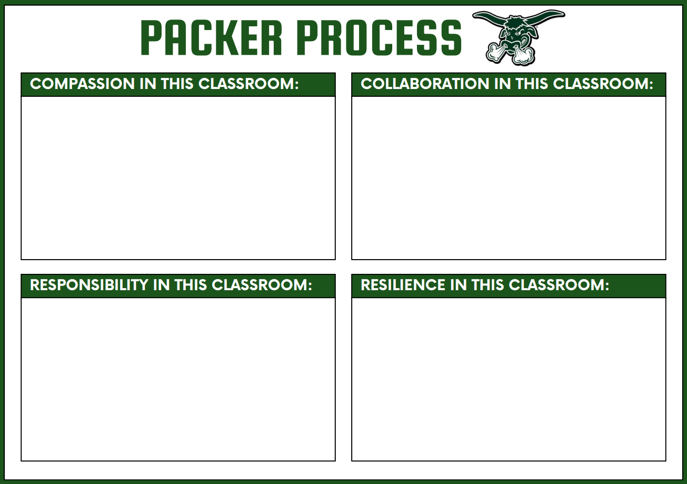
How to be a Packer!
Every teacher will have one or both Packer Process posters in their classroom.
Use these to help you know your teacher's expectations!
Packer Process, syllabi, and teacher bios will be loaded on our website!
Wilson

Slide 14
Supporting YOUR STUDENT’s ACADEMICS
Prioritize attendance, taking care when scheduling appointments and vacations
1
Check Schoology and Infinite Campus to monitor grades, including missing assignments and deadlines
2
Develop a homework/study routine, leveraging study halls, WIN sessions, and the A/B schedule
3
Reach out to your student’s teacher with questions or concerns
4

Slide 15
TESTING INFORMATION:
Required ASVAB testing for all juniors Choice Readiness the week of April 12
  Do not miss school- you will have to take the test!
  Required for all district juniors
WFPS ACT option on April 10, 2027 (hosted at SHS)

Slide 16
WELLNESS
NEED-TO-KNOW
& SUPPORT
Goal for WFHS this year:
Staff and student organizations celebrate the success of the whole school, groups, and individual students.

Slide 17


Slide 18
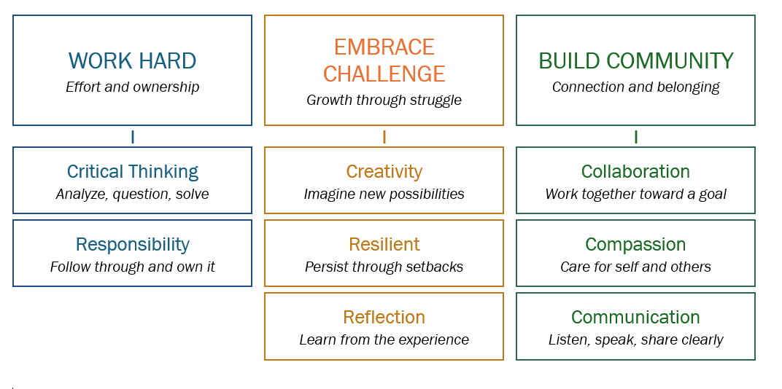
PACKER PRIDE at WFHS
Anchored by the Profile of a Graduate

Slide 19
LET’S CELEBRATE PACKER PRIDE!
If you work hard, embrace challenge, and build community, you have the potential to be recognized in the following ways:
Student of the Quarter (work hard, embrace challenge, build community)
Fine Arts, Athlete, Volunteer (of the quarter)
Honor Roll (2.8 GPA and 4.0+ GPA) at the end of each semester
Top 5% (based on weighted cumulative Semester 1 GPA of senior year) including Valedictorian and Salutatorian (and 8 other students)
Packer Pride cards
Social media shoutouts
Academic Awards (at the end of the year), including department awards

Slide 20

CORDS AT GRADUATION:
National Honor Society
National Technical Honor Society
AVID Senior
Honor Cord (3.5+ GPA)
Commitment to armed forces
2+ years of varsity Packer activities

Slide 21
DRUG USE: TOBACCO, MARIJUANA, ALCOHOL, etc.
First offense: Up to three days of suspension
Second offense: Up to five days of suspension
Third-Fourth Offense: Meeting to consider expulsion
Sharing of vapes will be considered distribution and will be sent for expulsion
Required education modules and partnership with Fargo Cass Public Health throughout

Slide 22
SCHOOL PROCEDURE: CELL PHONES
Learner cell phones, smart watches, and all other personal devices that can send and receive messages are OUT-OF-SIGHT and OUT-OF-USE from 8:25a until 3:35p.
Devices CANNOT be kept on your person (in a pocket, etc.). They must, at a bare minimum, be kept in a CLOSED backpack pocket. Devices can also be left in your car, at home, etc.
Devices CANNOT be utilized or checked during passing times, lunch time, or Open Campus if you chose to remain on campus.
If you choose to leave the classroom to visit the nurse, go to the bathroom, etc., your backpack (with your phone inside) STAYS IN THE CLASSROOM.

Slide 23
SCHOOL PROCEDURES: CELL PHONES
The device is brought to the Main Office, picked up by the student at the end of the student’s day
The device is brought to the Main Office, picked up by the parent/guardian at their earliest convenience not to be returned to the student until the end of the student’s day
The device is brought to the Main Office, picked up by the parent/guardian at their earliest convenience, not to be returned to the student until the end of the student’s day, additional plan assigned to the student
The device is brought to the Main Office, picked up by the parent/guardian at their earliest convenience not to be returned to the student until the end of the student’s day, 1 day ISS
The device is brought to the Main Office, picked up by the parent/guardian at their earliest convenience not to be returned to the student until the end of the student’s day, 1 day OSS
The device is brought to the Main Office, picked up by the parent/guardian at their earliest convenience not to be returned to the student until the end of the student’s day, transition to Virtual Program

Slide 24

Other Notes about the statewide cell phone ban:
The law address personal student devices like cell phones, laptops, and smartwatches. It does NOT include Bluetooth headphones as they do not have the capacity to send and receive messages.
Students with medical notes denoting required access to devices will be placed on special plans.
We encourage all families to utilize email to communicate with learners as they will still have access to their Outlook accounts.
Our Main Office staff is ready to receive and deliver emergency messages for students.
Please facilitate your learner memorizing important phone numbers or recording them in a note within their iPad.
Samson

Slide 25
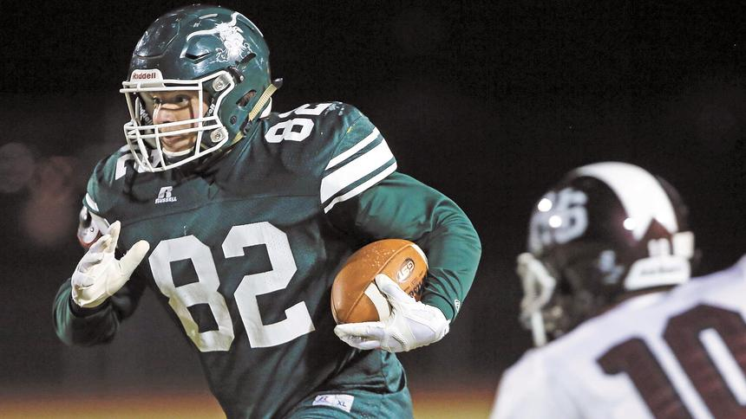
Get involved!
Asprey

Slide 26
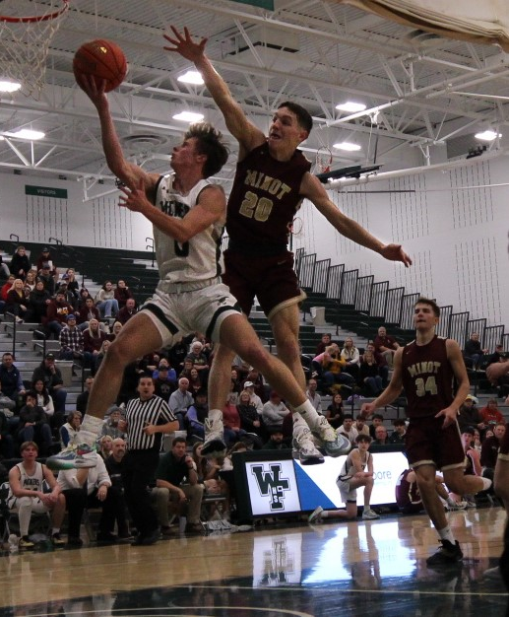
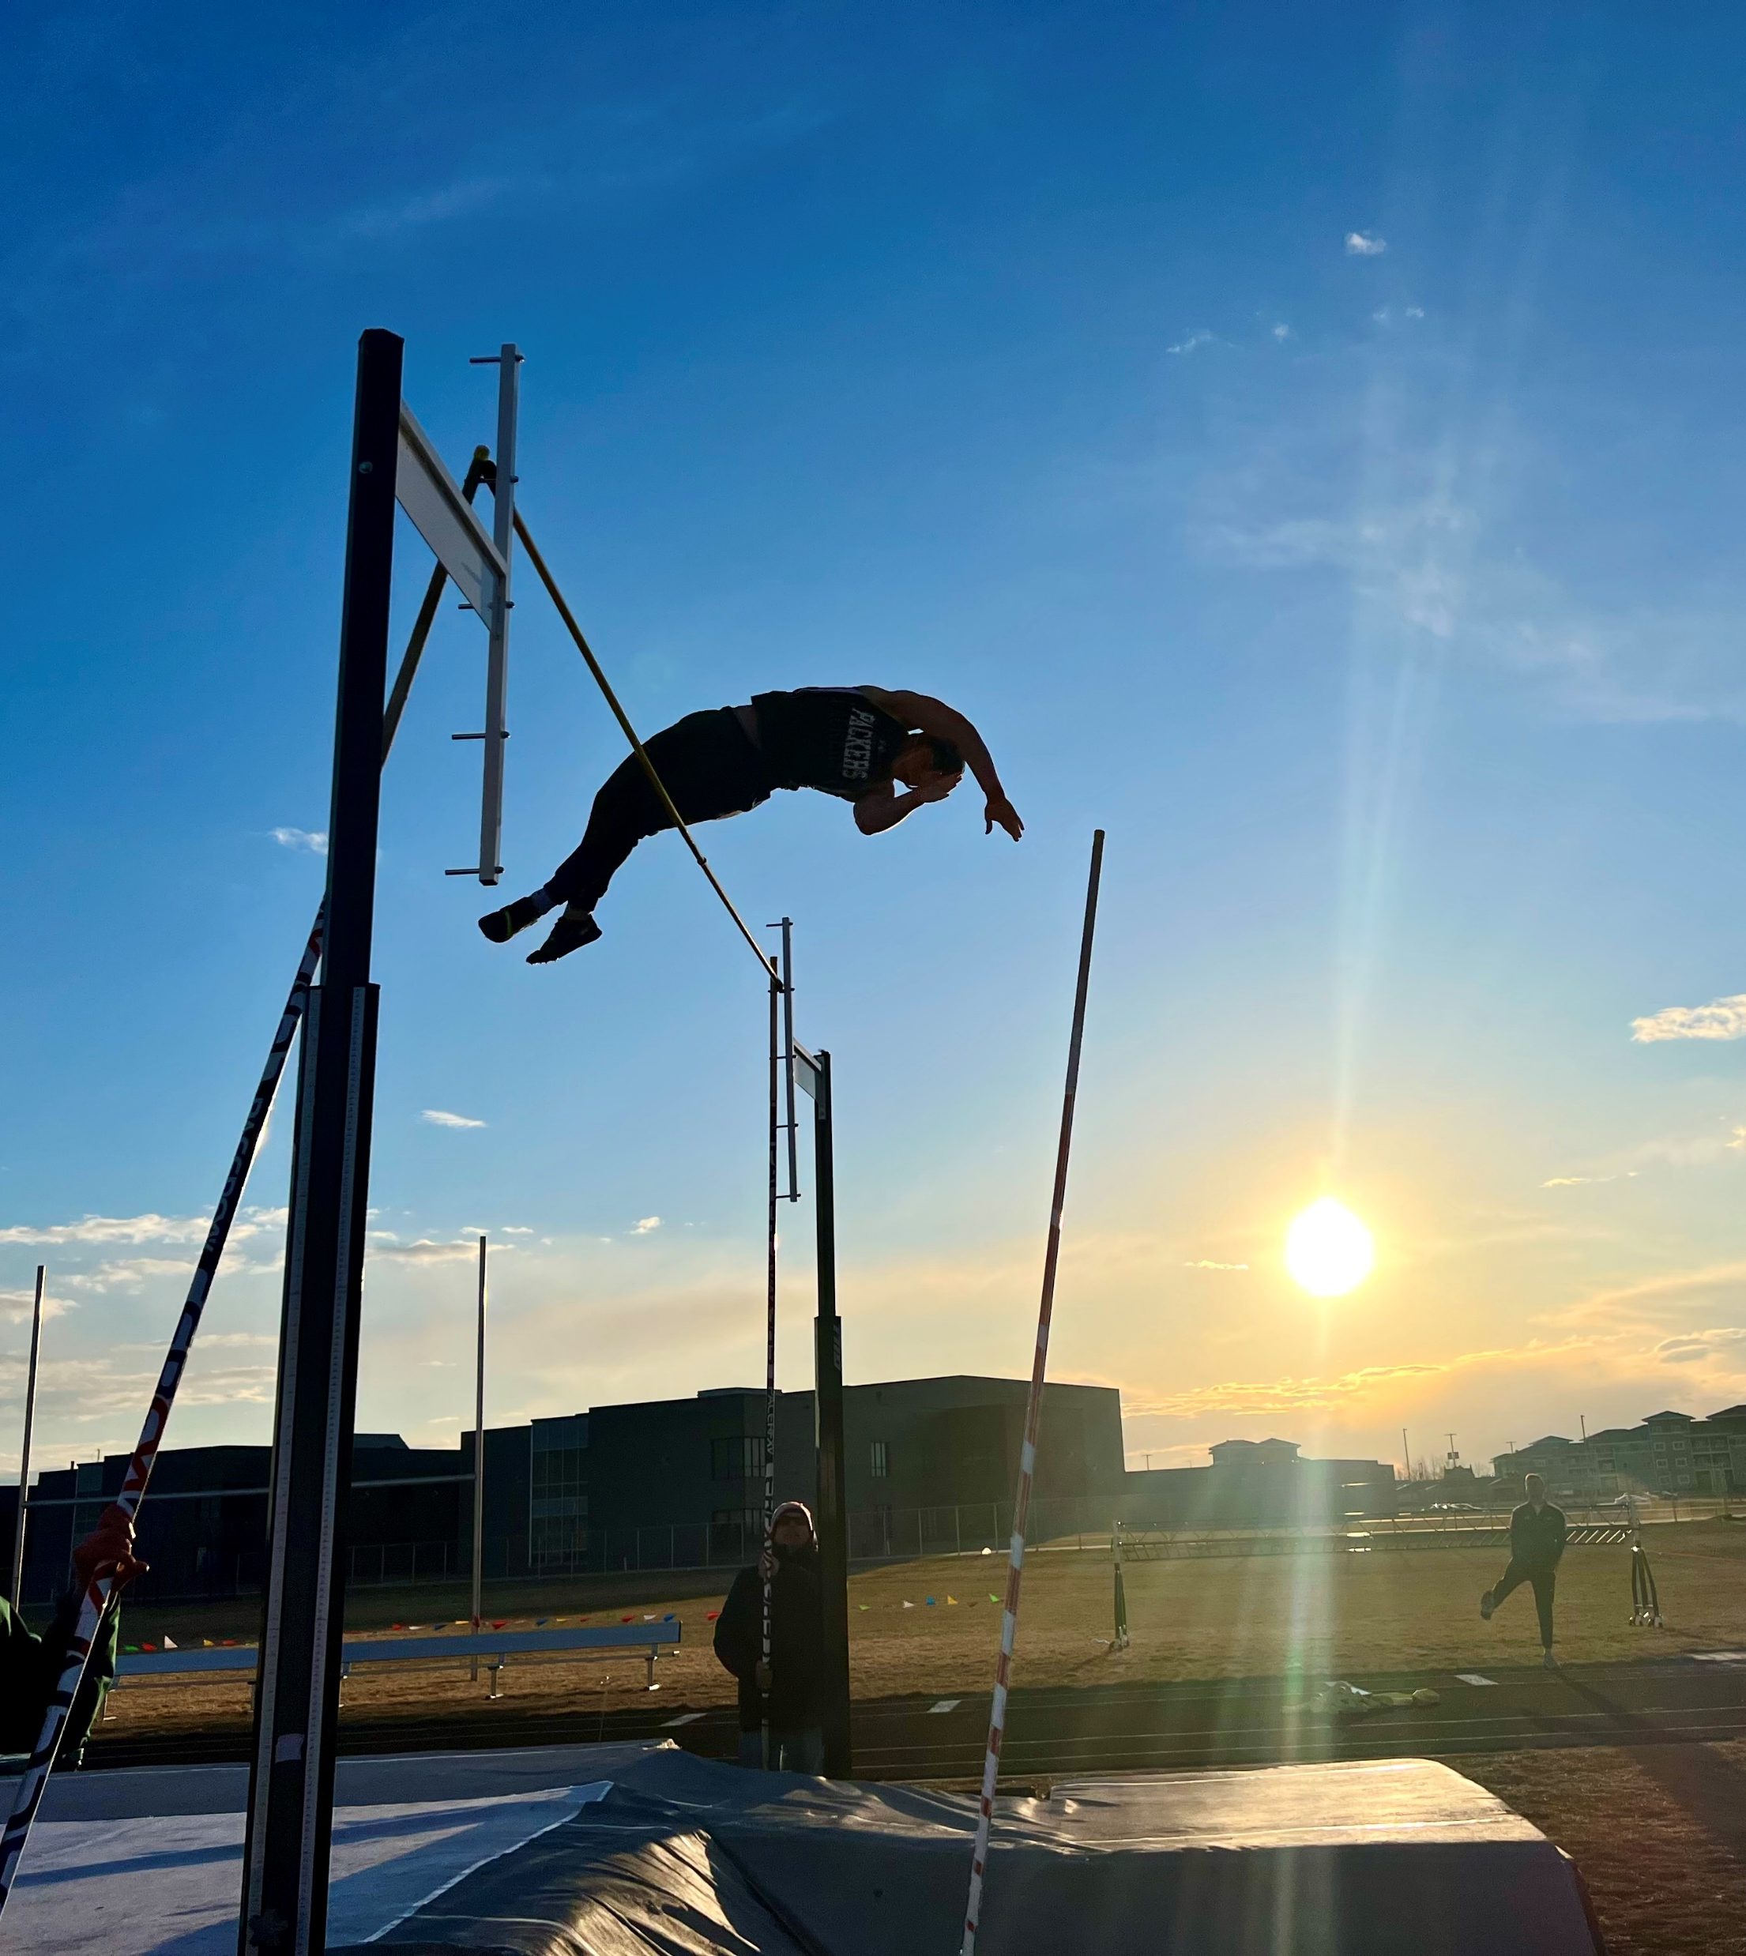
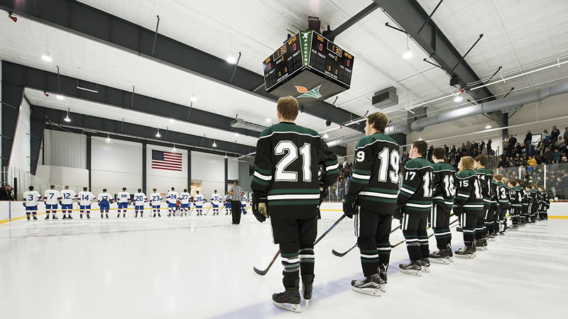
Eligibility
Need to be enrolled in six classes
Can only be failing ONE class
No outstanding detention hours
  Assigned for UTs and UVs
Teachers update grades weekly, and eligibility is pulled on Fridays

Slide 27
MOST COMMON BEHAVIOR CHALLENGES FOR JUNIORS
Skipping class off-campus
Vaping
Drama associated with social media

Slide 28
SCHOOL LOGISTICS AND SAFETY
Don't prop doors!
Door 1 vs. Door 15
Bus riding is a privilege.
Text-a-Tip (701-541-2072)

Slide 29
Supporting YOUR STUDENT’s wellness
Follow research-based guidance about limiting smart phone and social media usage
1
Know your student’s friends and the parents/guardians of your student’s friends
2
Promote healthy device habits, including eliminating access before bed and during sleep
3
Reach out to your student’s administrator or counselor with questions or concerns
4

Slide 30
CHOICE READY
NEED-TO-KNOW
& SUPPORT
Goal for WFHS this year:
ALL students are empowered to become Choice Ready.

Slide 31

NORTH DAKOTA CHOICE READY FRAMEWORK

Slide 32
Grade 11 Advisory:
Cybersecurity

Slide 33
CHECK OUT THE CHOICE READY GRADE 11 CHECKLIST!

Slide 34

Meet our Career Advisor
Career Advisor –Allison Caldwell
  Assist all learners in becoming Choice Ready through
    Exploration
    Planning
    Reflection
  Office 103F (back of library)
  College, Career, and Resource Center – library
Featured Events:
  WIN Sessions (weekly Sept-May)
  Choice Ready Fairs (Oct. / Feb. )
  HTTC Career Fair –Dec. 1
What Can I Help You With?
Post Secondary Readiness
  career and tech training and 2-4+ education programs
Workforce Readiness
  Work based learning opportunities
    Job shadows, events
  Personal marketing materials
    Resumes, cover letters
    Interview practice
Military Readiness
  WIN sessions
  Connection to representatives
Volunteer Opportunities
Metz
Notes:
Caldwell

Slide 35
Supporting YOUR STUDENT in becoming choice ready
Promote their involvement in one or more school activities
1
Emphasize the importance of community service and volunteerism
2
Attend West Fargo High School events! (all HS student IDs are activity passes)
3
Become familiar with the Choice Ready framework, including the scholarship, to know next steps
4
Metz

Slide 36
OTHER IMPORTANT NOTES
Please encourage your learner to wear their glasses if they have them!
Backpacks are allowed at WFHS. Lockers are available upon request only (talk to Jess in the Main Office).
  Tardies and forgotten school materials decreased significantly at WFHS when students utilized backpacks instead of lockers.
  These decisions were made in consultation with School Resource Officer Jason Balvik to ensure student safety.
We have a full-service food pantry at West Fargo High School.
  Frozen foods
  Non-perishables
  Hygiene products
  Clothes
  School supplies
Notes:
Rachel

Slide 37
IMPORTANT DATES
First Day of School: Thursday, August 27
  We are running special schedule. All students need to be on campus by 8:25a!
Second Day of School: Friday, August 28 (B-Day)
School Pictures:​ Thursday, August 27
Homecoming Week: Monday, September 28-Friday, October 2
Quarter 1 Family Conferences: Thursday, October 8 (4:00-7:30p)
West Fargo Public Schools ACT Option: April 10, 2027 (tentative)
ASVAB Test (required): Week of April 12, 2027
Notes:
Rachel

Slide 38


STAY INFORMED!
@WFHighPackers
@wfhs.pack
https://www.west-fargo.k12.nd.us/wfhs
Notes:
Rachel

Slide 39

It’s always a great day to be a Packer!
Questions?
Notes:
Rachel

