Slide 1
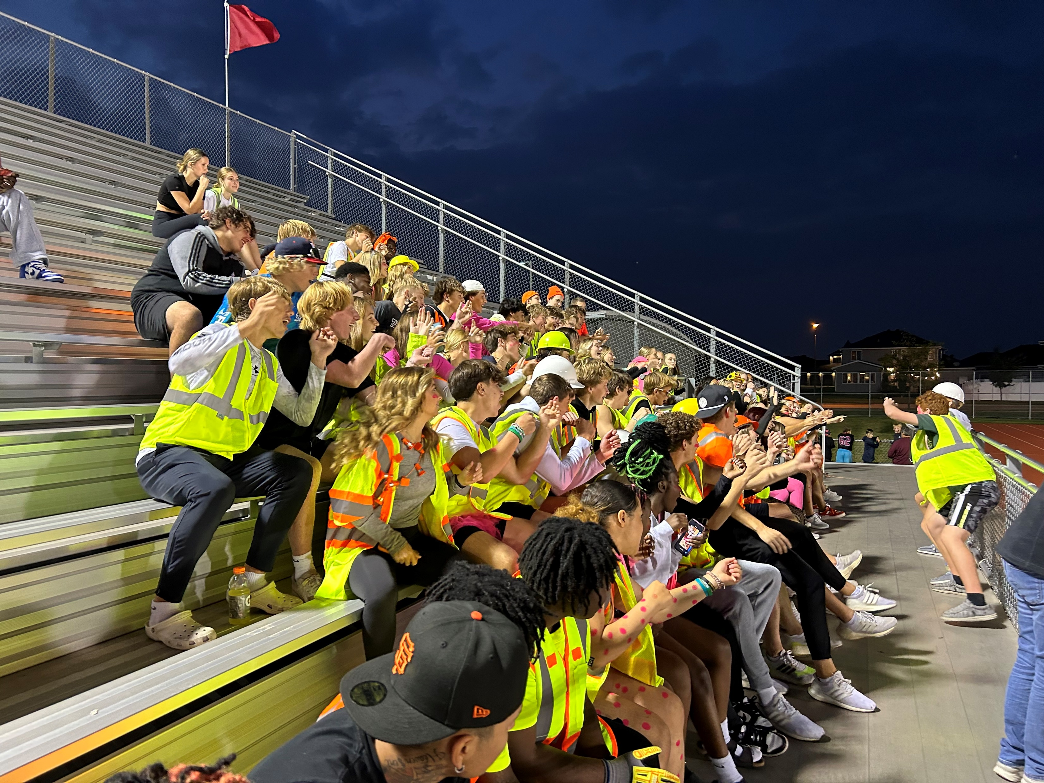

Welcome to WFHS!
Wilson
Notes:
Rachel

Slide 2
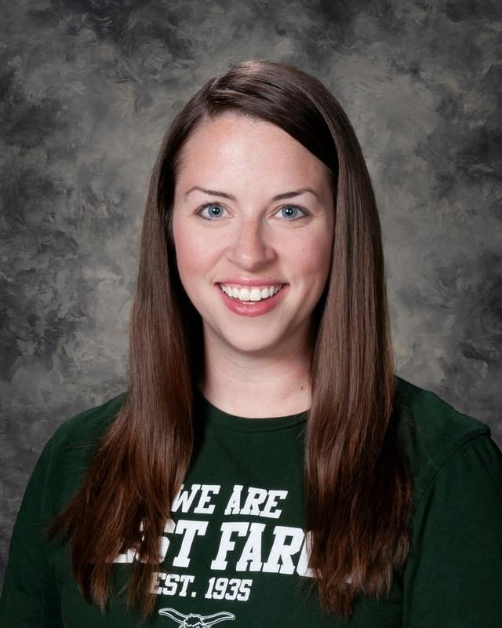

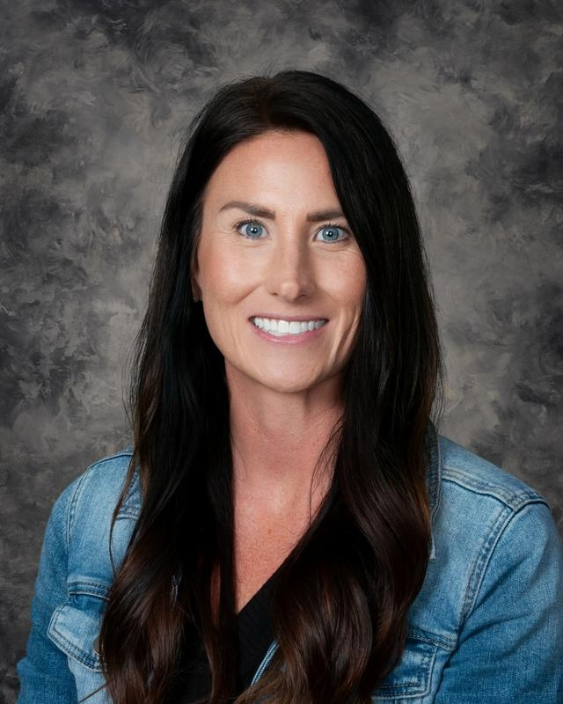
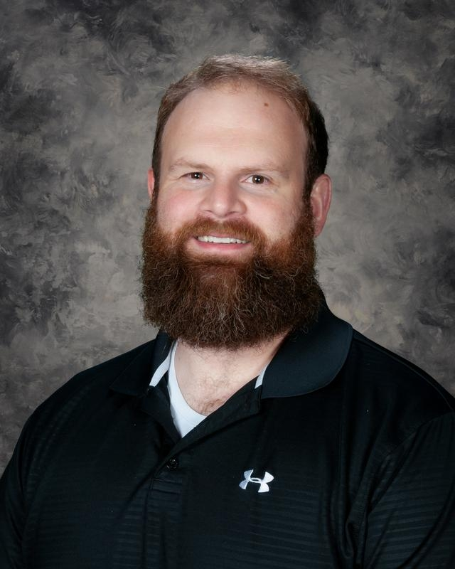
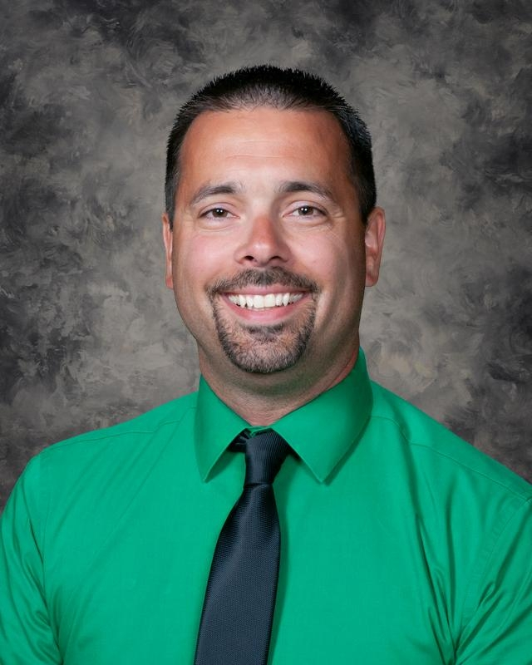
ADMINISTRATIVE TEAM
Dr. Bachmeier
Mr. Asprey
A-G
Mrs. Metz:
H-N
Dr. Samson:
O-Z
Mr. Wilson: Grade 9

Slide 3
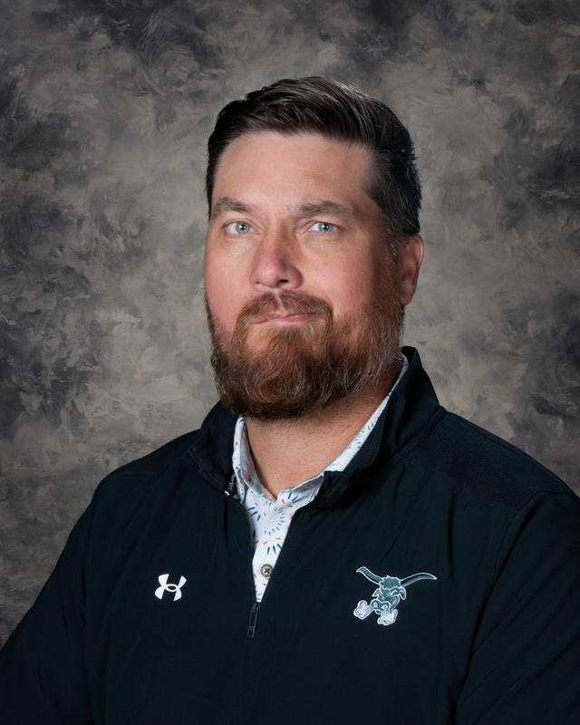
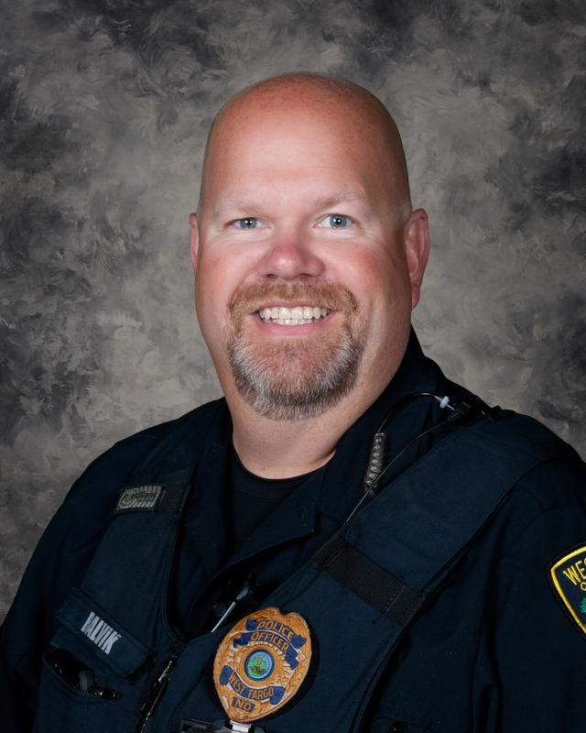
ADMINISTRATIVE TEAM
Mr. Behm
SRO Balvik

Slide 4
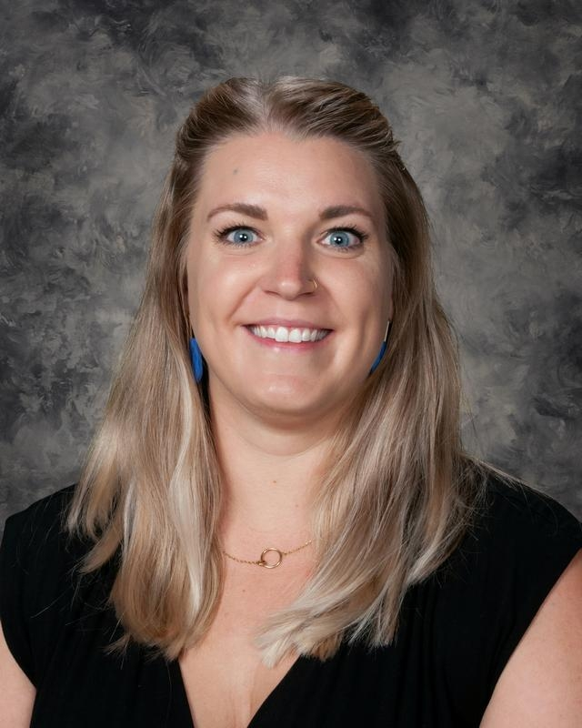
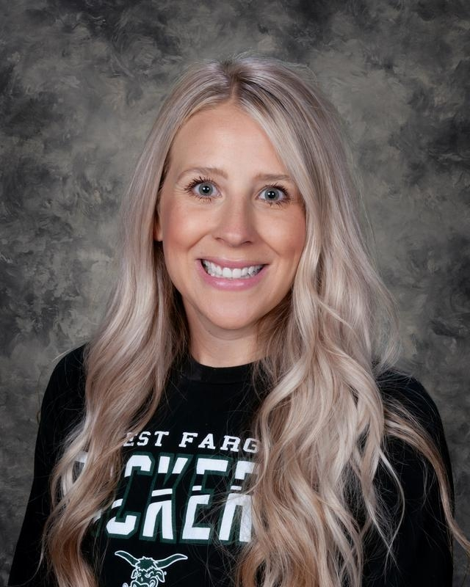
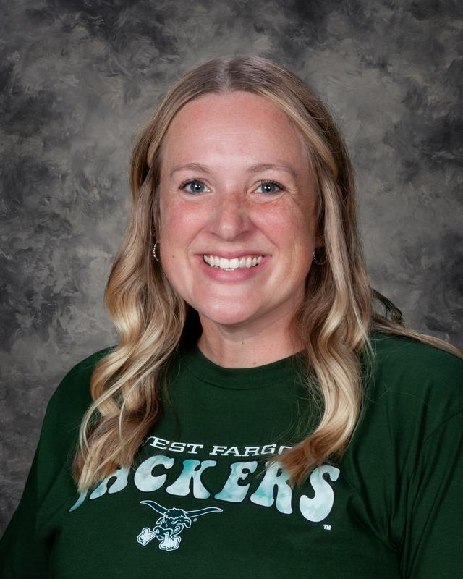
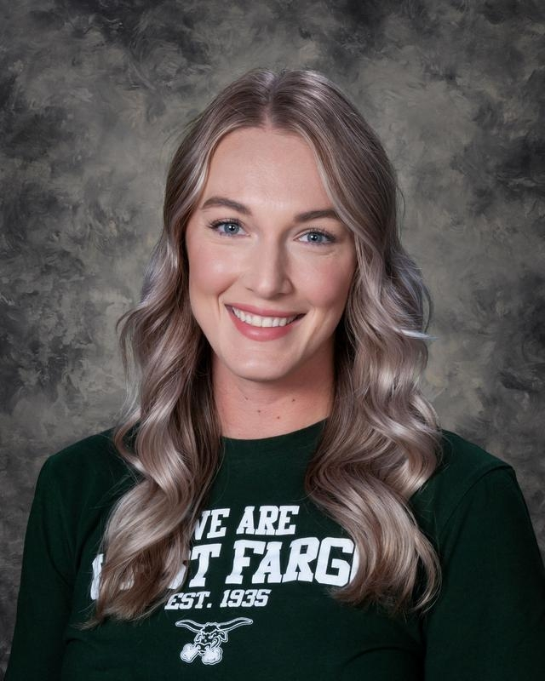
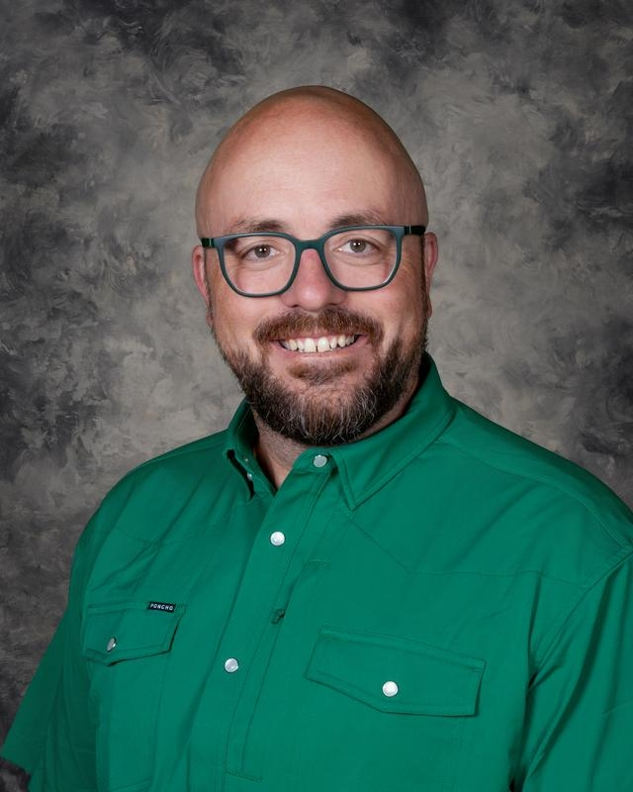
COUNSELING TEAM
Ms. Quist:
A-E
Mrs. Rosendahl:
F-Le
Mrs. Cowden:
Lf-Rh
Mrs. Roberts:
Ri-Z
Mr. Zuel:
Grade 9

Slide 5



The importance of grade 9
This is YOUR chance and fresh start for your education- you got this!
Grades matter: 1 F in Grade 9 decreases the likelihood of graduation by 30%​
2 Fs in Grade 9 decrease the likelihood of graduation by 50%​
Nearly 90 percent of freshmen who miss less than a week of school per semester graduate, regardless of their 8th grade test scores. ​
Freshmen who miss more than two weeks of school flunk, on average, at least two classes—no matter whether they arrive at high school with top test scores or below-average scores. ​
Rachel
Wilson

Slide 6
Tonight’s Purpose:
Wellness Support
Choice Ready Support
Q&A
Academic Support
Important Dates
Wilson

Slide 7

PACKER PRIDE: LEGACY LIVES HERE
Work Hard
Show up
Be prepared
Embrace Challenge
Try new things
Learn from mistakes
Build Community
Include others
Give your best effort
Manage your time responsibly
Follow through
Own your decisions
Keep improving
Ask for feedback and help
Do more than expected
Step out of your comfort zone
Don’t give up
Set ambitious goals
Zoom out and pivot your mindset
Be flexible
Show school spirit
Listen first
Get involved
Support your teammates and peers
Be kind to everyone
Make a positive impact
Give back through service

Slide 8
ACADEMIC
NEED-TO-KNOW
& SUPPORT
Goal for WFHS this year:
Educators regularly collaborate to address academic achievement and appropriately challenge ALL learners.
Wilson

Slide 9

ATTENDANCE & TARDIES
Attendance is one of the most important factors for student success.
After 8 absences in at least ONE block class, the student will be placed on a contract with an administrator.
After 10 absences in at least ONE block class, the student will no longer to be able to earn credit for assignments and assessments assigned or due in the course on days you are gone.
After 12 absences, you will be dropped from the class as Loss of Credit.
For every FIVE times you are marked UNEXCUSED TARDY (UT), you will receive 90 minutes of detention.
Notes:
Wayne

Slide 10

Student Attendance
Leaving the building for appointments- bring back a note!
    Doctor
    Dentist
    Chiropractor
All absences count TOWARD the limit EXCEPT: medical (those with an official note), school activities, and administrator approval
Absences can only be excused for two weeks after they occur

Slide 11
The purpose of Tardy a Free Week is to promote positive attendance habits, reinforce the importance of being on time to class, and offer learning and reflection opportunities for students who are late. The goal during Tardy Free Weeks is that ALL students are tardy free!
West Fargo High School is committed to running at least TWO Tardy Free Week windows in the fall: September 8-11 and November 5-6
During these weeks, students who are in the hallway without a pass after the bell rings will be redirected to the theatre to review expectations and complete a reflection activity with administration. They will also be assigned thirty minutes of detention, which can be served during lunch.
TARDY FREE WEEKS

Slide 12
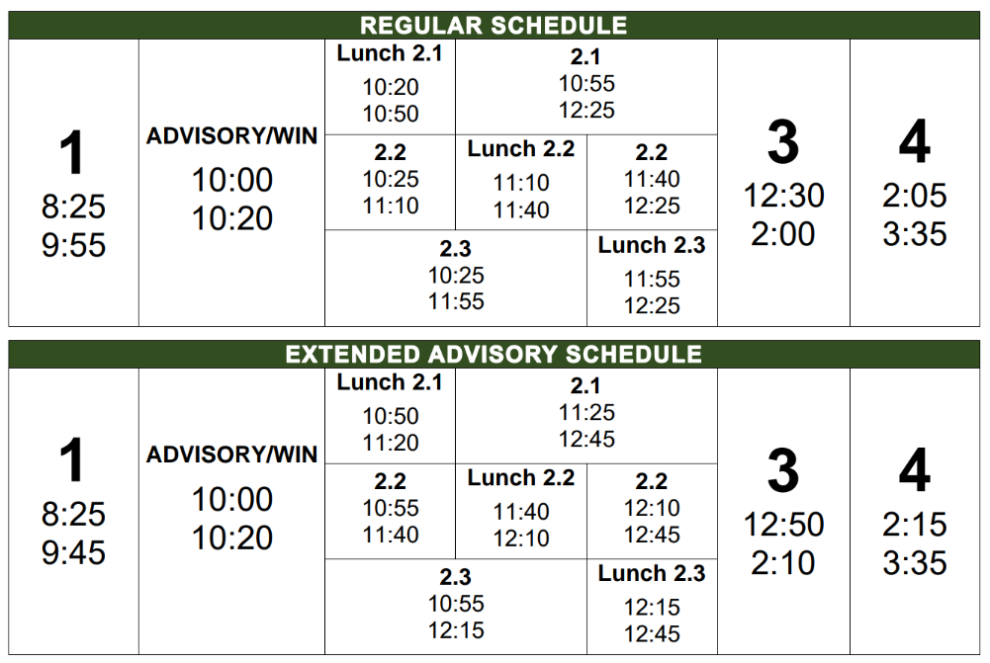
Wilson

Slide 13
OTHER THINGS TO KNOW ABOUT SCHEDULES:
Learners know which lunch they are assigned based on the number of their second block class.​
    2.1= first lunch​
    2.2= second lunch​
    2.3= third lunch​
About study halls:​
  All 9th grade students will be assigned to a study hall. ​
  At this time we plan to have students stay in study hall at least through Semester 1
Wilson

Slide 14
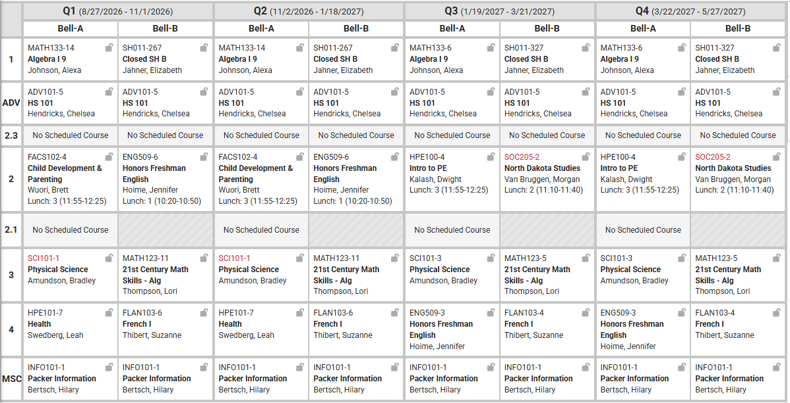
Wilson

Slide 15
MOST COMMON ACADEMIC CHALLENGES FOR FRESHMEN
Missing school
Not understanding the concept of "credit"
Not turning work in (the power of a "0")
Not completing homework
Not studying for tests
Not reaching out for help
Wilson

Slide 16
Academic Supports
Study Halls
WIN Sessions
Peer Tutors
Find your teacher!
Wilson
Wilson

Slide 17
Schoology Organization
Live lesson plan link
OR
Weekly folders
  Week 0
  Week 1
  Week 2
  etc.
Schoology is your go-to spot to know what to expect for upcoming lessons, find assignments, turn in work, plan ahead for deadlines, etc.!
Parents/guardians can have access to Schoology!
NOTE: ALL GRADES ARE ON Infinite Campus!
Wilson

Slide 18
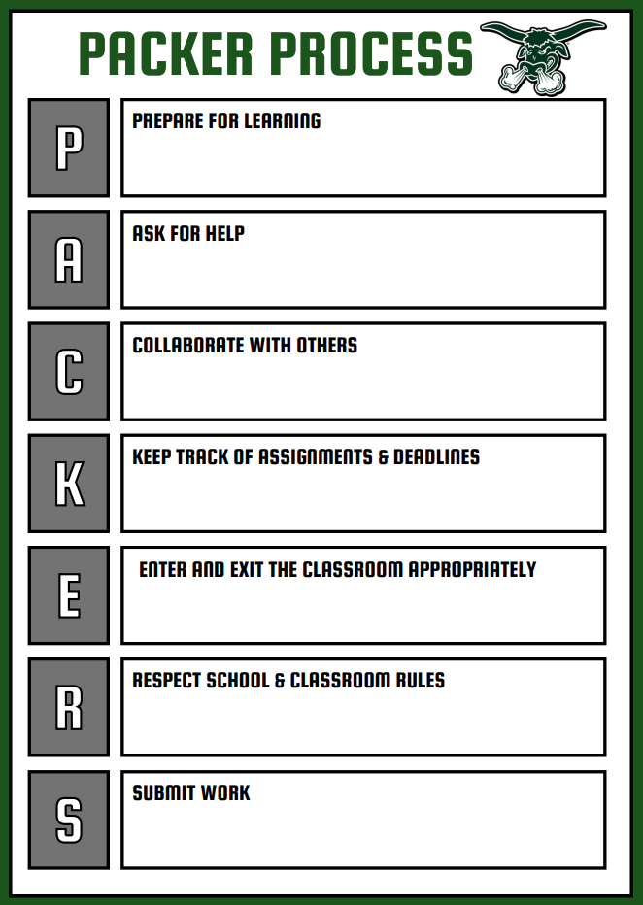
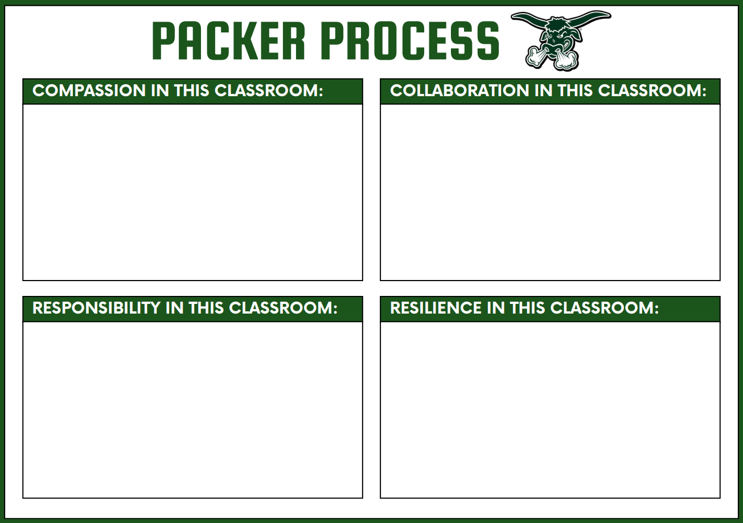
How to be a Packer!
Every teacher will have one or both Packer Process posters in their classroom.
Use these to help you know your teacher's expectations!
Packer Process, syllabi, and teacher bios will be loaded on our website!
Wilson

Slide 19
Supporting YOUR STUDENT’s ACADEMICS
Prioritize attendance, taking care when scheduling appointments and vacations
1
Check Schoology and PowerSchool to monitor grades, including missing assignments and deadlines
2
Develop a homework/study routine, leveraging study halls, WIN sessions, and the A/B schedule
3
Reach out to your student’s teacher with questions or concerns
4
Wilson

Slide 20
WELLNESS
NEED-TO-KNOW
& SUPPORT
Goal for WFHS this year:
Staff and student organizations celebrate the success of the whole school, groups, and individual students.
Asprey

Slide 21

Asprey

Slide 22
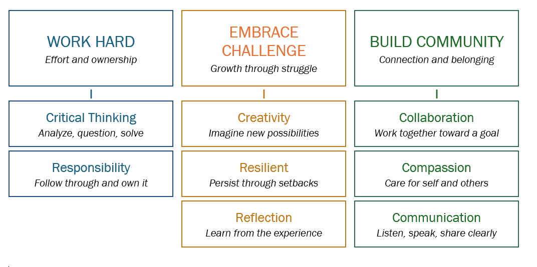
PACKER PRIDE at WFHS
Anchored by the Profile of a Graduate

Slide 23
LET’S CELEBRATE PACKER PRIDE!
If you work hard, embrace challenge, and build community, you have the potential to be recognized in the following ways:
  Student of the Quarter (work hard, embrace challenge, build community)
  Fine Arts, Athlete, Volunteer (of the quarter)
  Honor Roll (2.8 GPA and 4.0+ GPA) at the end of each semester
  Packer Pride cards
  Social media shoutouts
  Academic Awards (at the end of the year)
Asprey

Slide 24
DRUG USE: TOBACCO, MARIJUANA, ALCOHOL, etc.
First offense: Up to three days of suspension
Second offense: Up to five days of suspension
Third-Fourth Offense: Expulsion hearing
Sharing of vapes will be considered distribution and will be sent for expulsion
Required education modules and partnership with Fargo Cass Public Health throughout

Slide 25
SCHOOL PROCEDURE: CELL PHONES
Learner cell phones, smart watches, and all other personal devices that can send and receive messages are OUT-OF-SIGHT and OUT-OF-USE from 8:25a until 3:35p.
Devices CANNOT be kept on your person (in a pocket, etc.). They must, at a bare minimum, be kept in a CLOSED backpack pocket. Devices can also be left in your car, at home, etc.
Devices CANNOT be utilized or checked during passing times, lunch time, or Open Campus if you chose to remain on campus.
If you choose to leave the classroom to visit the nurse, go to the bathroom, etc., your backpack (with your phone inside) STAYS IN THE CLASSROOM.
Asprey

Slide 26
SCHOOL PROCEDURES: CELL PHONES
The device is brought to the Main Office, picked up by the student at the end of the student’s day
The device is brought to the Main Office, picked up by the parent/guardian at their earliest convenience not to be returned to the student until the end of the student’s day
The device is brought to the Main Office, picked up by the parent/guardian at their earliest convenience, not to be returned to the student until the end of the student’s day, additional plan assigned to the student
The device is brought to the Main Office, picked up by the parent/guardian at their earliest convenience not to be returned to the student until the end of the student’s day, 1 day ISS
The device is brought to the Main Office, picked up by the parent/guardian at their earliest convenience not to be returned to the student until the end of the student’s day, 1 day OSS
The device is brought to the Main Office, picked up by the parent/guardian at their earliest convenience not to be returned to the student until the end of the student’s day, transition to Virtual Program
Asprey

Slide 27

Other Notes about the statewide cell phone ban:
The law address personal student devices like cell phones, laptops, and smartwatches. It does NOT include Bluetooth headphones as they do not have the capacity to send and receive messages.
Students with medical notes denoting required access to devices will be placed on special plans.
We encourage all families to utilize email to communicate with learners as they will still have access to their Outlook accounts.
Our Main Office staff is ready to receive and deliver emergency messages for students.
Please facilitate your learner memorizing important phone numbers or recording them in a note within their iPad.
Samson

Slide 28
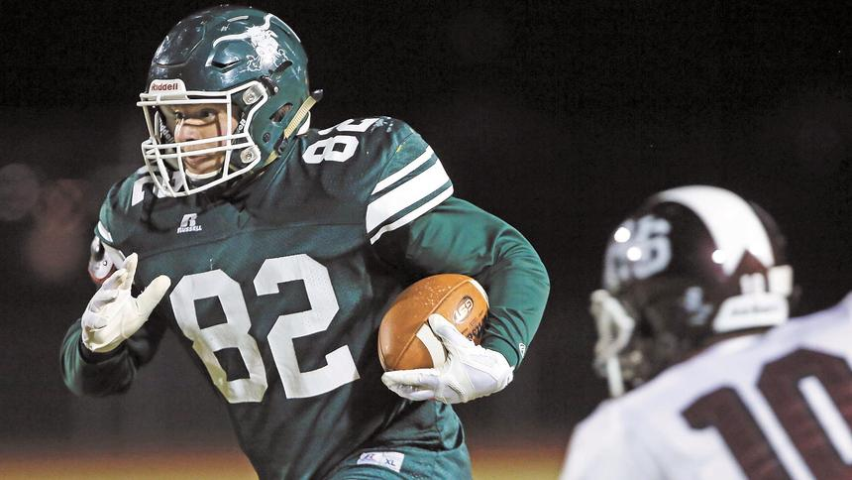
Get involved!
Samson
Asprey

Slide 29
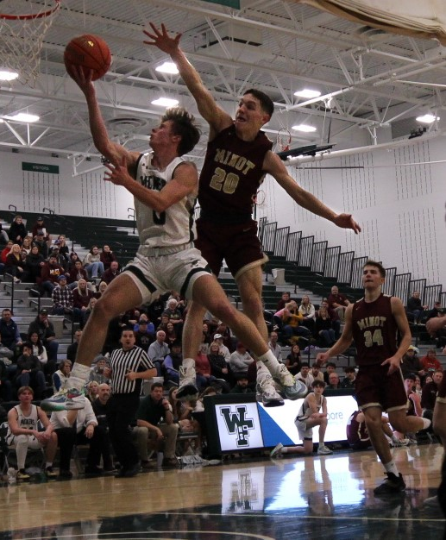
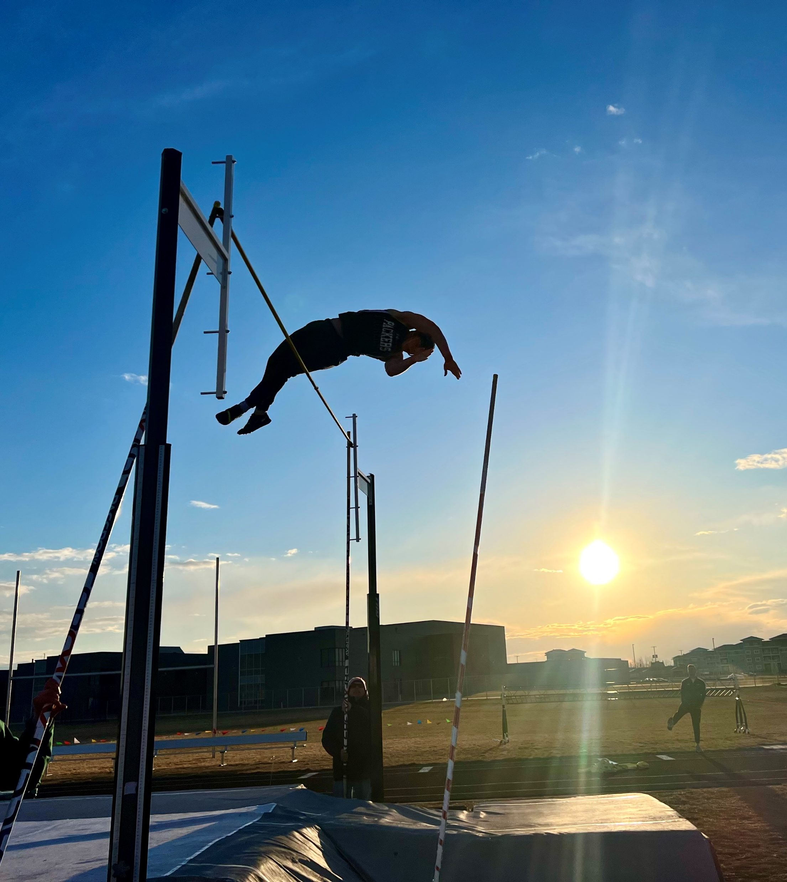
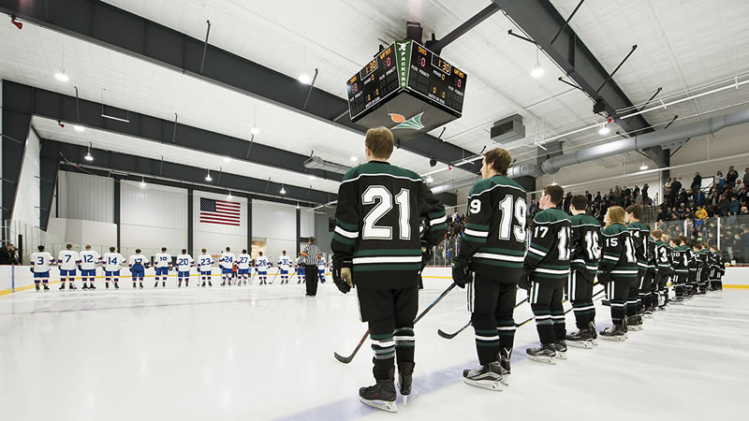
Eligibility
Need to be enrolled in six classes
Can only be failing ONE class
No outstanding detention hours
  Assigned for UTs and UVs
Teachers update grades weekly, and eligibility is pulled on Fridays
Samson

Slide 30
MOST COMMON BEHAVIOR CHALLENGES FOR FRESHMEN
Keeping hands to themselves
Lunch concerns:
Cleaning up the space
Returning trays and silverware
Not playing with food
Vaping
"Splatter guns" in the springtime
Samson

Slide 31
SCHOOL LOGISTICS AND SAFETY
Don't prop doors!
Door 1 vs. Door 15
Bus riding is a privilege.
Text-a-Tip (701-541-2072)
Samson

Slide 32
Supporting YOUR STUDENT’s wellness
Follow research-based guidance about limiting smart phone and social media usage
1
Know your student’s friends and the parents/guardians of your student’s friends
2
Promote healthy device habits, including eliminating access before bed and during sleep
3
Reach out to your student’s administrator or counselor with questions or concerns
4
Metz

Slide 33
CHOICE READY
NEED-TO-KNOW
& SUPPORT
Goal for WFHS this year:
ALL students are empowered to become Choice Ready.
Metz

Slide 34

NORTH DAKOTA CHOICE READY FRAMEWORK

Slide 35
Grade 9 Advisory:
HS 101
Metz

Slide 36
CHECK OUT THE CHOICE READY GRADE 9 CHECKLIST!

Slide 37
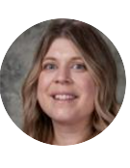
Meet our Career Advisor
Career Advisor –Allison Caldwell
  Assist all learners in becoming Choice Ready through
    Exploration
    Planning
    Reflection
  Office 103F (back of library)
  College, Career, and Resource Center – library
Featured Events:
  WIN Sessions (weekly Sept-May)
  Choice Ready Fairs (Oct. / Feb. )
  HTTC Career Fair –Dec. 1
What Can I Help You With?
Post Secondary Readiness
  career and tech training and 2-4+ education programs
Workforce Readiness
  Work based learning opportunities
    Job shadows, events
  Personal marketing materials
    Resumes, cover letters
    Interview practice
Military Readiness
  WIN sessions
  Connection to representatives
Volunteer Opportunities
Metz
Notes:
Caldwell

Slide 38
Supporting YOUR STUDENT in becoming choice ready
Promote their involvement in one or more school activities
1
Emphasize the importance of community service and volunteerism
2
Attend West Fargo High School events! (all HS student IDs are activity passes)
3
Become familiar with the Choice Ready framework, including the scholarship, to know next steps
4
Metz

Slide 39
OTHER IMPORTANT NOTES
Please encourage your learner to wear their glasses if they have them!
Backpacks are allowed at WFHS. Lockers are available upon request only (talk to Jess in the Main Office).
  Tardies and forgotten school materials decreased significantly at WFHS when students utilized backpacks instead of lockers.
  These decisions were made in consultation with School Resource Officer Jason Balvik to ensure student safety.
We have a full-service food pantry at West Fargo High School.
  Frozen foods
  Non-perishables
  Hygiene products
  Clothes
  School supplies
Metz
Notes:
Rachel

Slide 40
IMPORTANT DATES
First Day of School: Thursday, August 27
  We are running special schedule. All students need to be on campus by 8:25a!
Second Day of School: Friday, August 28 (B-Day)
School Pictures:​
  Grade 9: Friday, August 28
    During their study hall, lunch, or before school!
Homecoming Week: Monday, September 28-Friday, October 2
Quarter 1 Family Conferences: Thursday, October 8 (4:00-7:30p)
Career Fair: Tuesday, December 1
Metz
Notes:
Rachel

Slide 41


STAY INFORMED!
@WFHighPackers
@wfhs.pack
https://www.west-fargo.k12.nd.us/wfhs
Metz
Notes:
Rachel

Slide 42

It’s always a great day to be a Packer!
Questions?
Metz
Notes:
Rachel

