Slide 1
La Vega High School
P-TECH/CTE

Slide 2
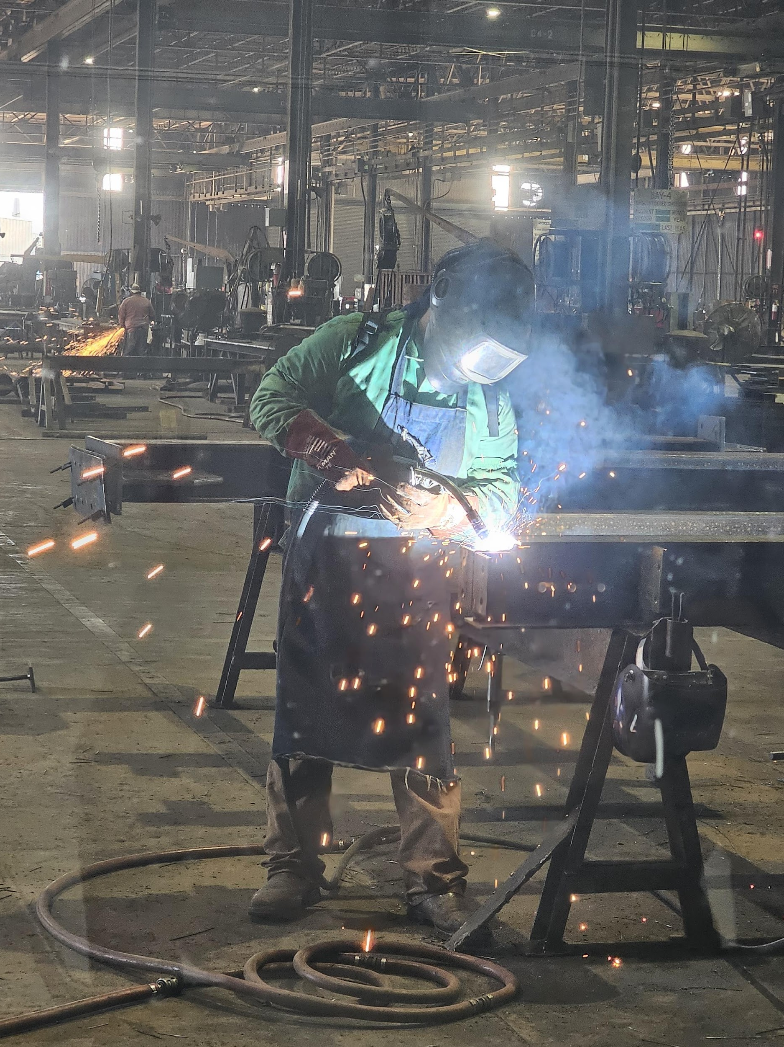
TSTC 2025-2026
Current Dual Credit P-TECH Pathways
  72 Total Students at TSTC
  Welding = 61
  Precision Machining = 8
  Plumbing = 1
  HVAC = 2 (first students)

Slide 3
Cohort Size
 | Welding | Manufacturing Technology | HVAC | Plumbing | Industrial Maintenance | Undecided or CTE Only
2026 (12) | 12
2027 (22) | 15 | 5 |  |  |  | 2
2028 (22) | 15 | 3 | 2 | 2
2029 (18) | 16 | 2
2030 (39) | 22 | 2 | 2 | 4 | 4 | 5

Slide 4
Advisory Board Meetings
PTECH and CTE advisory boards met in November to discuss
  upcoming facilities and recommended equipment
  Spring 2026 work-based learning opportunities IMEG Engineering, Caterpillar,CTIW, Capstone Mechanical, Lochridge-Priest and Sturdisteel
  March - Met with Waco Chamber of Commerce, Waco ISD and Midway ISD to discuss industry workforce demands and promotional opportunities
  CTE Summer Grant Application submitted ($50,000 for paid summer internships)

Slide 5
END

Slide 6
CCMR/Industry Based Certifications
All programs are aligned to a TEA recognized Industry Based Certification
38% of LVHS students earned an IBC for 2024-2025
Students earned 405 total certifications last year
CCMR Growth:
  Class of 2022=51% Class of 2023=67% Class of 2024=74%
  Projected Class of 2025=84%

Slide 7
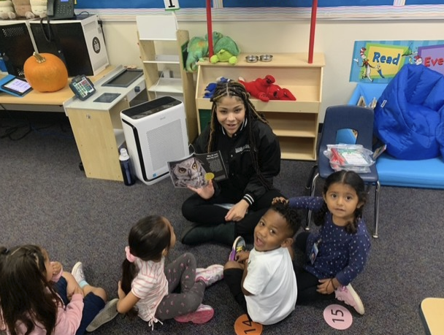
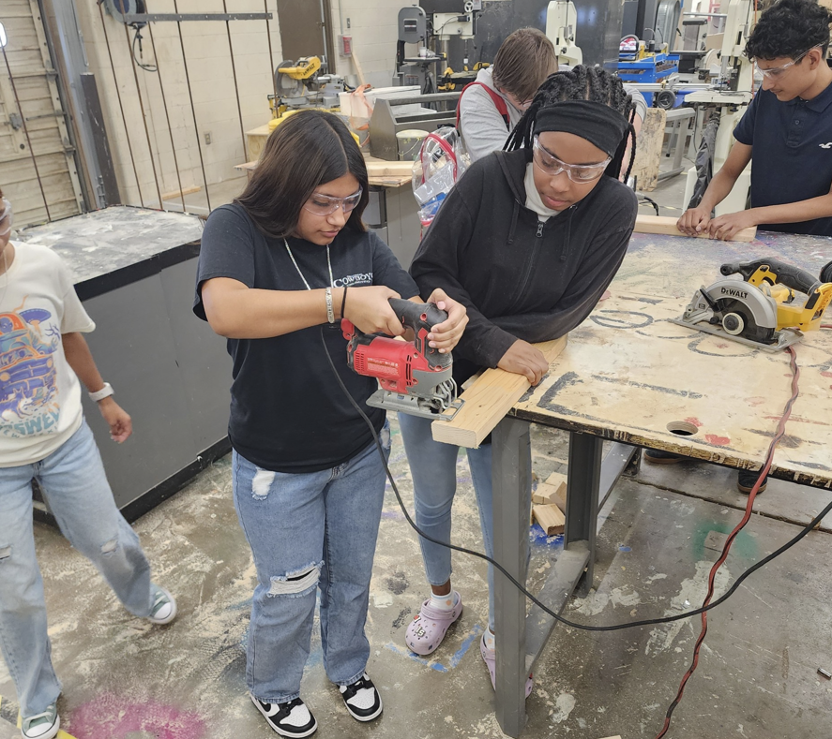
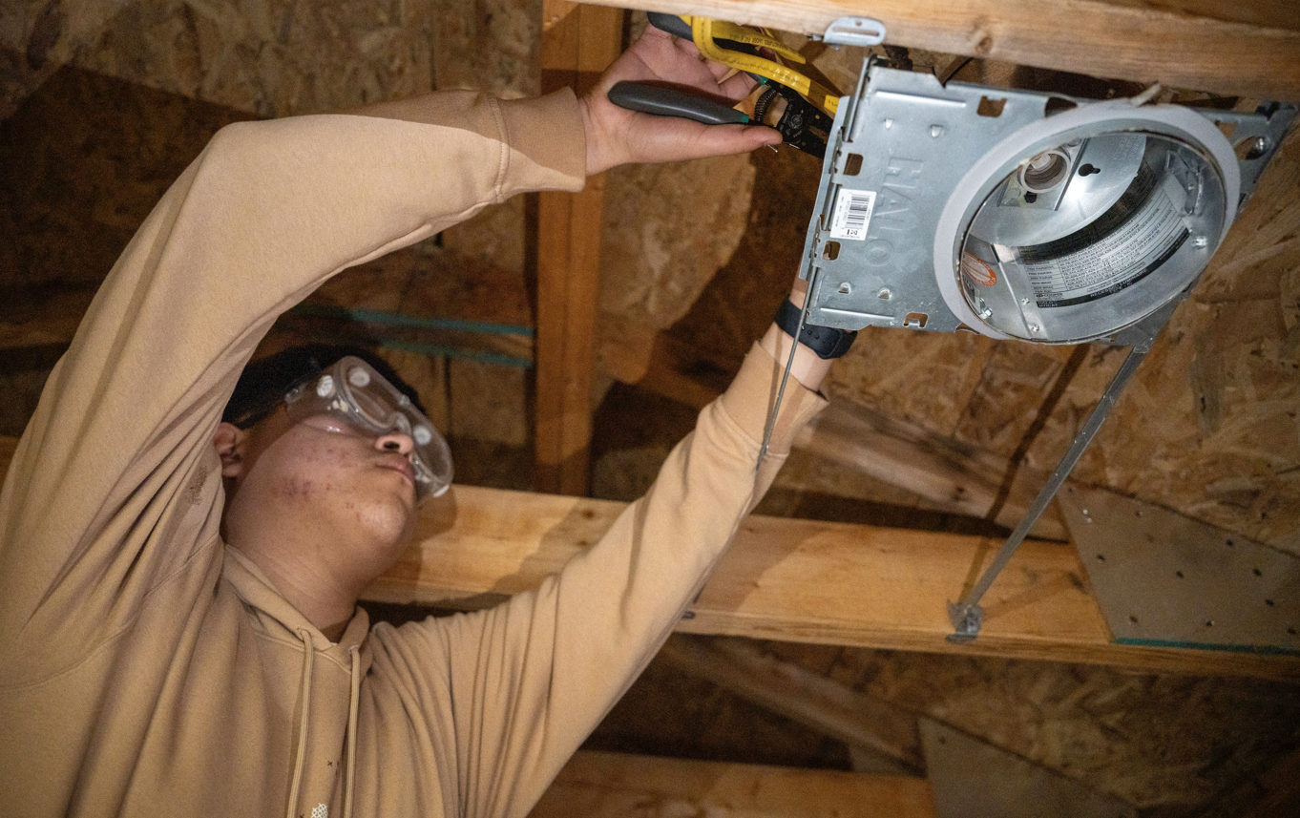
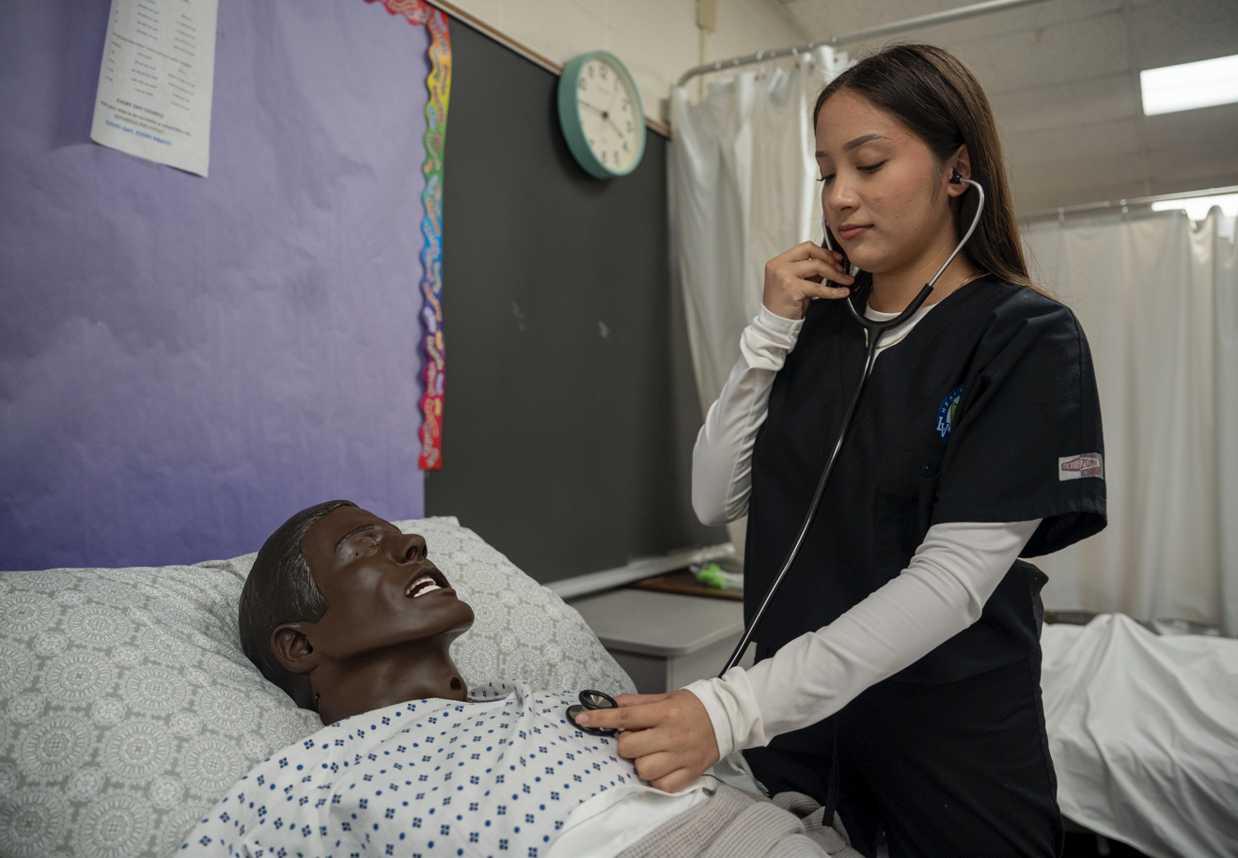
Work Based Learning
Collaboration with the Waco Chamber of Commerce for multiple programs
Teaching and Training Carpentry Electrical Nursing

Slide 8
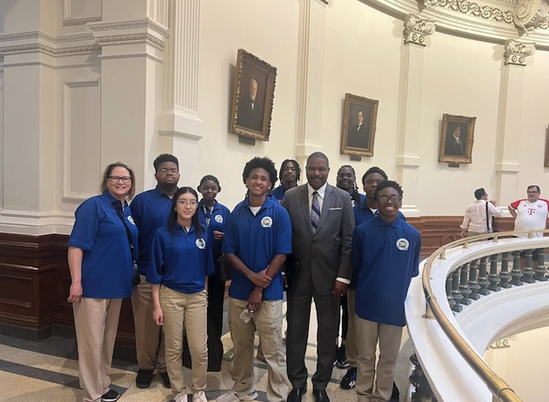

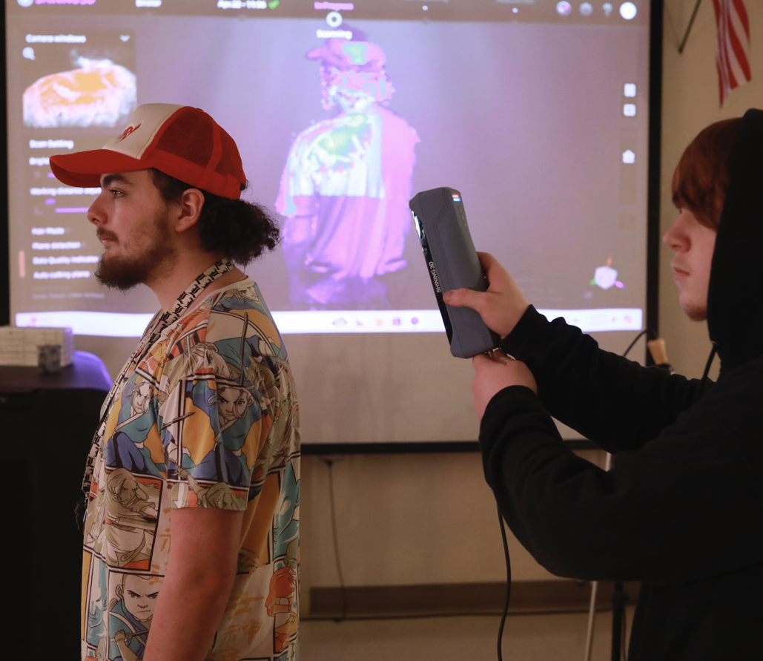
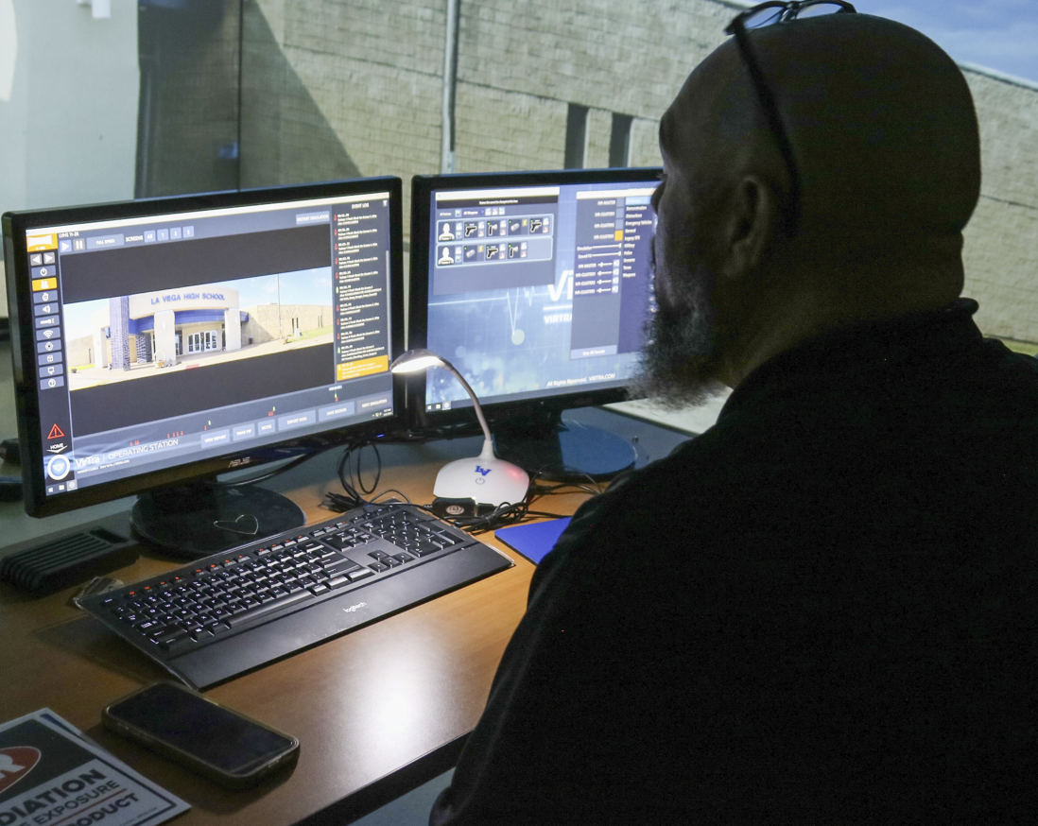
Work Based Learning
Accounting Digital Communication Graphic Design Law Enforcement
  La Vega received the CTE Summer Grant (2nd consecutive year)
  Paid summer internships for La Vega and other area students
  Internships included Audio Visual and Welding jobs

Slide 9
ECHS

Slide 10
Overview
189 Students enrolled at MCC for dual credit
12th and 11th at MCC only except for extracurricular activities
10th grade attend MCC half day in the afternoon
9th grade have the MCC professor come to LV campus
Dual credit professor in each core content
Mentor program with Tarleton
14 Students enrolled in UT-OnRamps Math

Slide 11
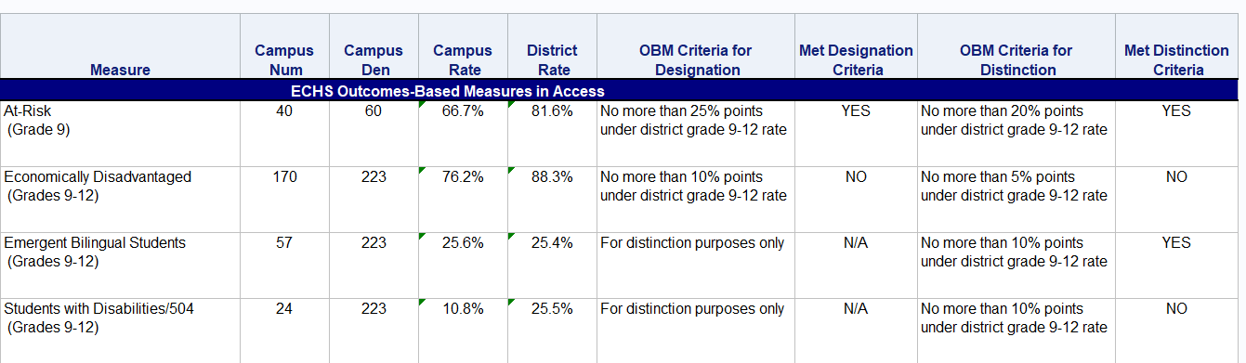
Access

Slide 12
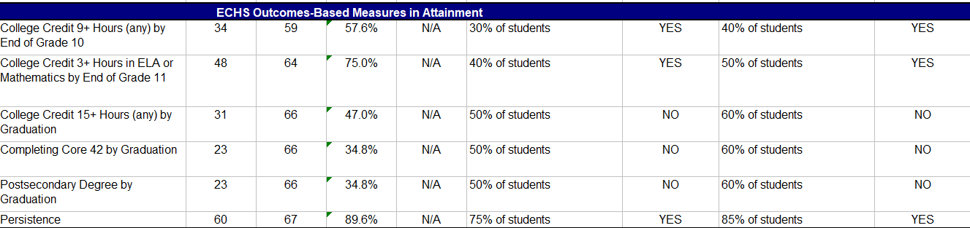
Attainment

Slide 13
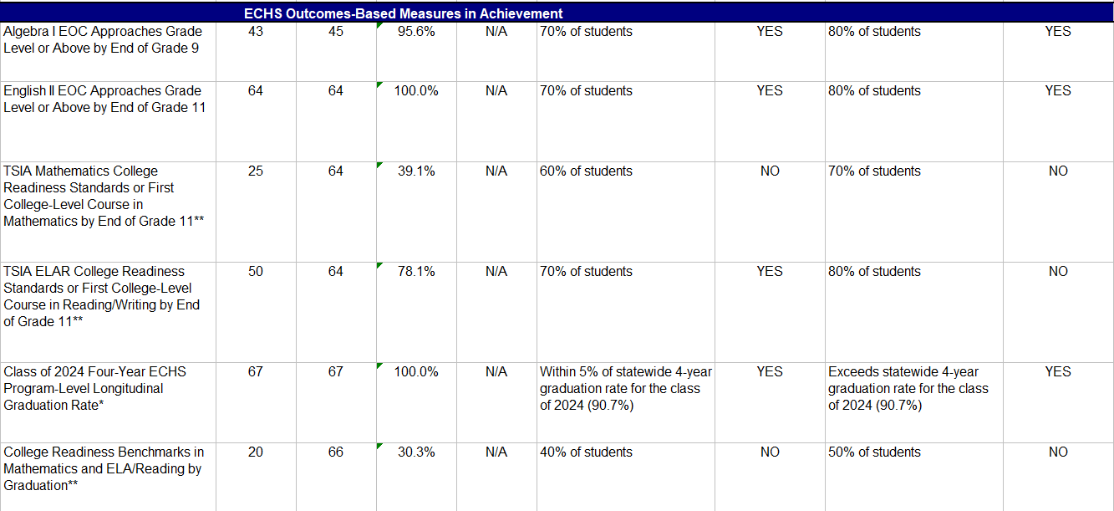
Achievement

Slide 14
LVHS

Slide 15
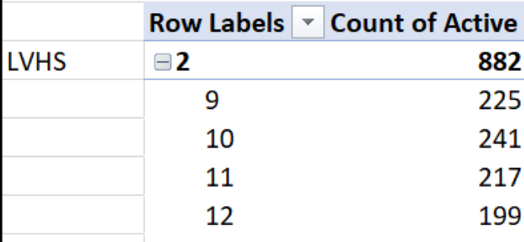
Numbers

Slide 16
Last Year
CCMR Push
  ACT testing- 132 seniors
  PSAT/SAT testing- Approximately 700 students
  LEAD Mentors

Slide 17
Update
CCMR Push
  This years projection is 84%
  PSAT/SAT testing- Approximately 700 students
  LEAD Mentors

Slide 18
Update
Attendance
  Overall trend up 95.3% 1st grading period
  Had a one day attendance rate of 97%
  Incentive program launched providing small prizes for classes with 100% attendance in 3rd period. (Mrs. Edwards)

Slide 19
Update
Achievement
  Trend of ELA 1 Interim assessment up from last year
  iReady platform being used for intervention for ELA and Math
  First Saturday school on 10-18 had approximately 25 students attend

Slide 20
