Slide 1

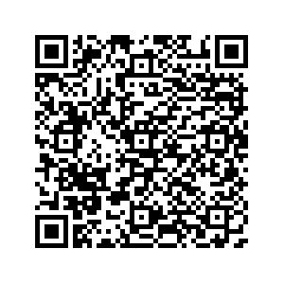
La Vega ECHS/PTECH
In Our Element
IMPORTANT ELEMENTS ABOUT ECHS AND PTECH

Slide 2


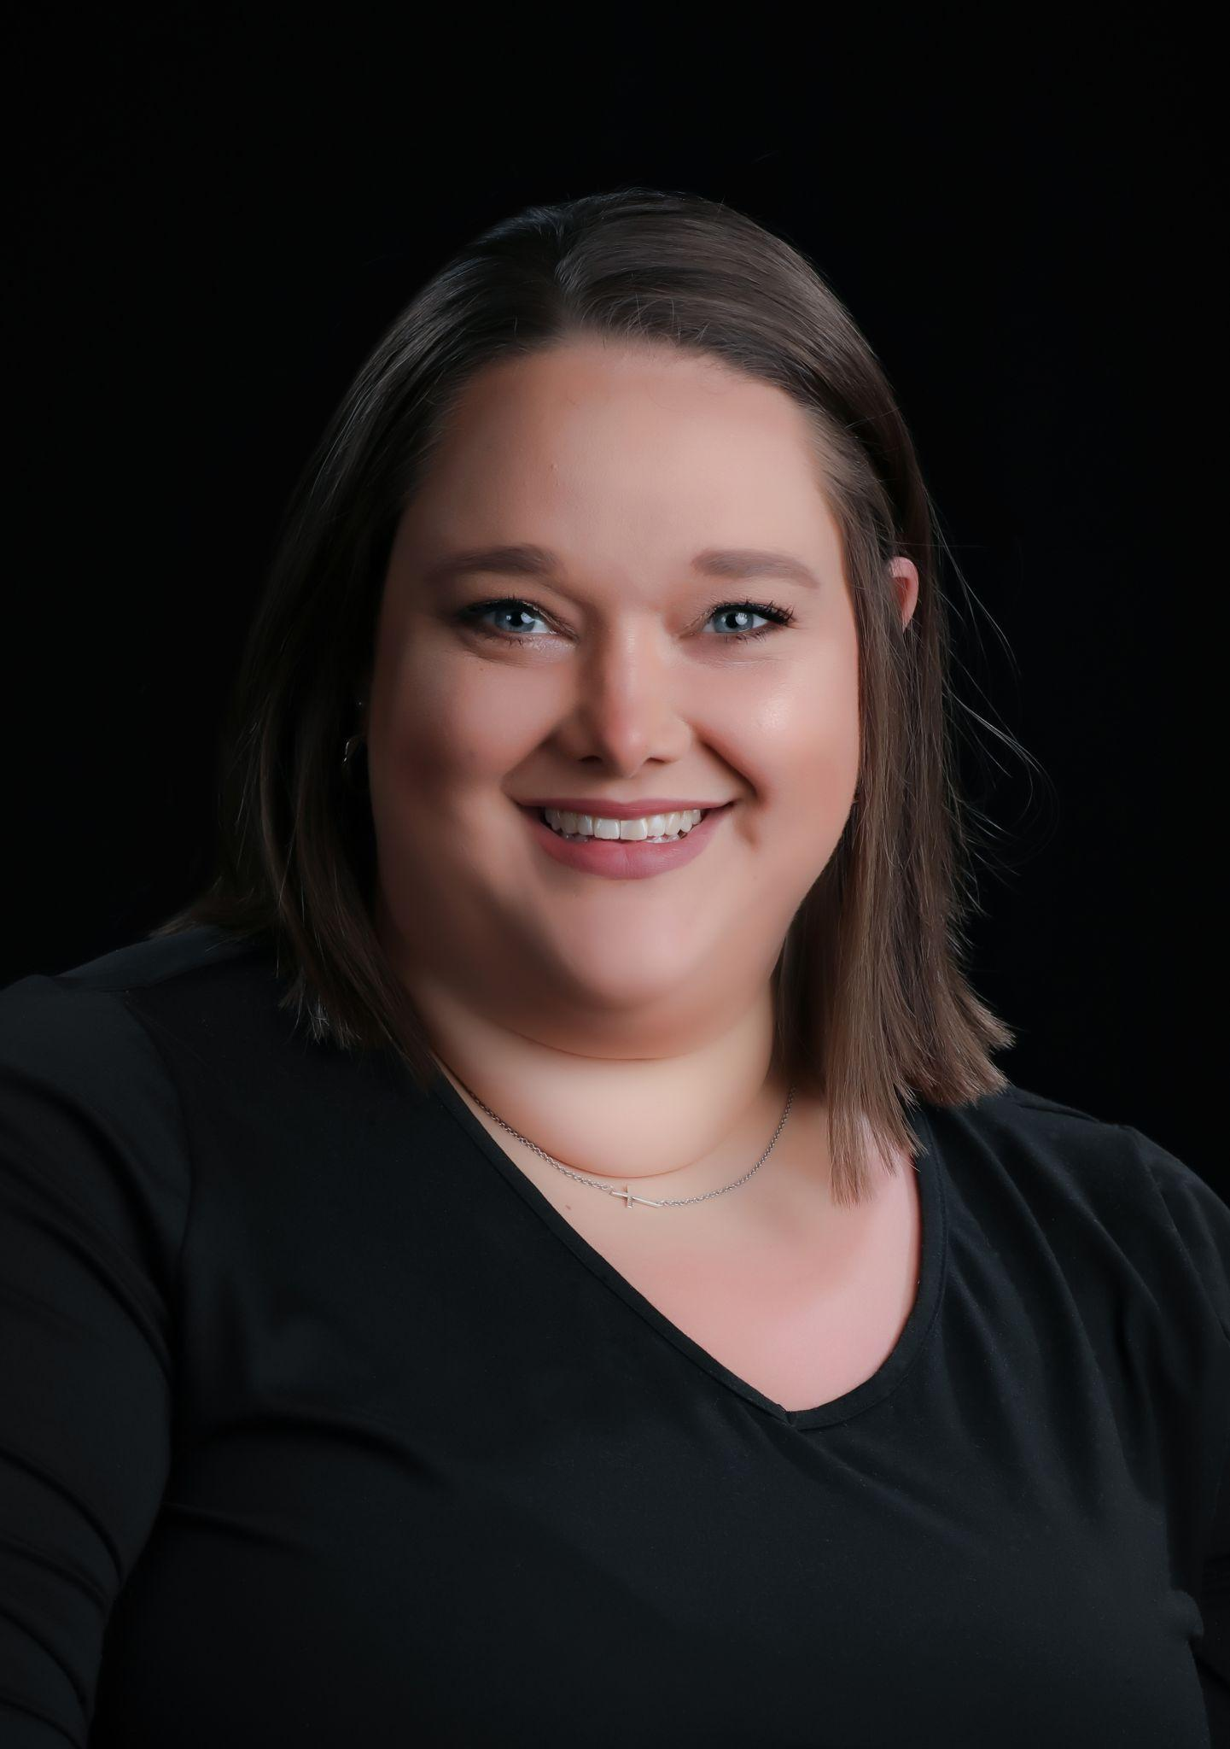
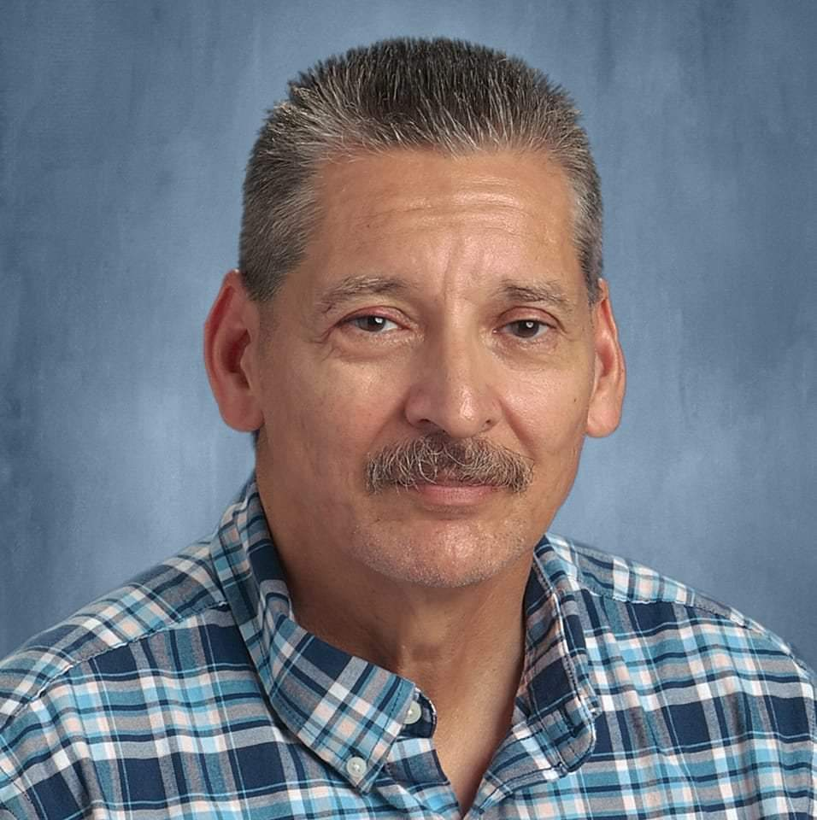
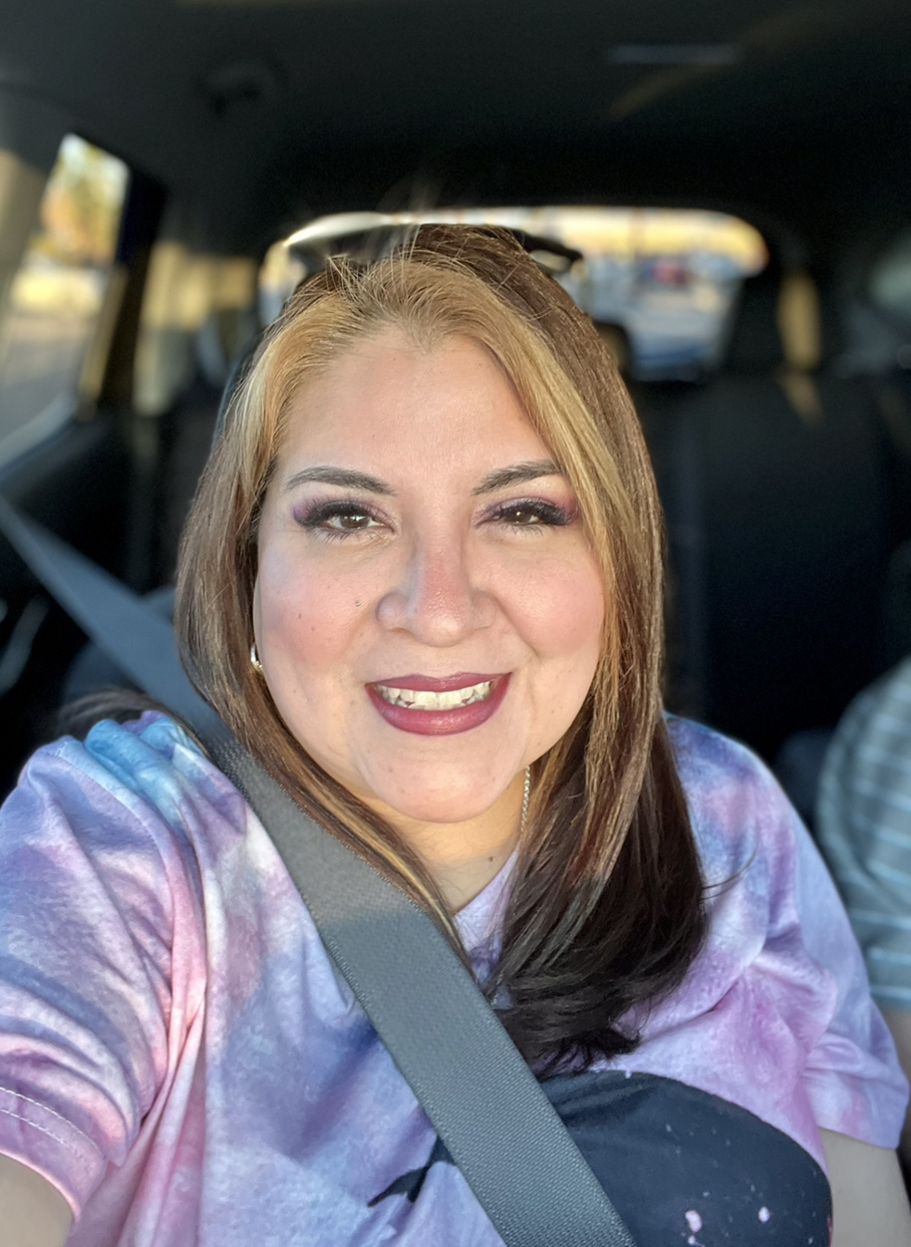


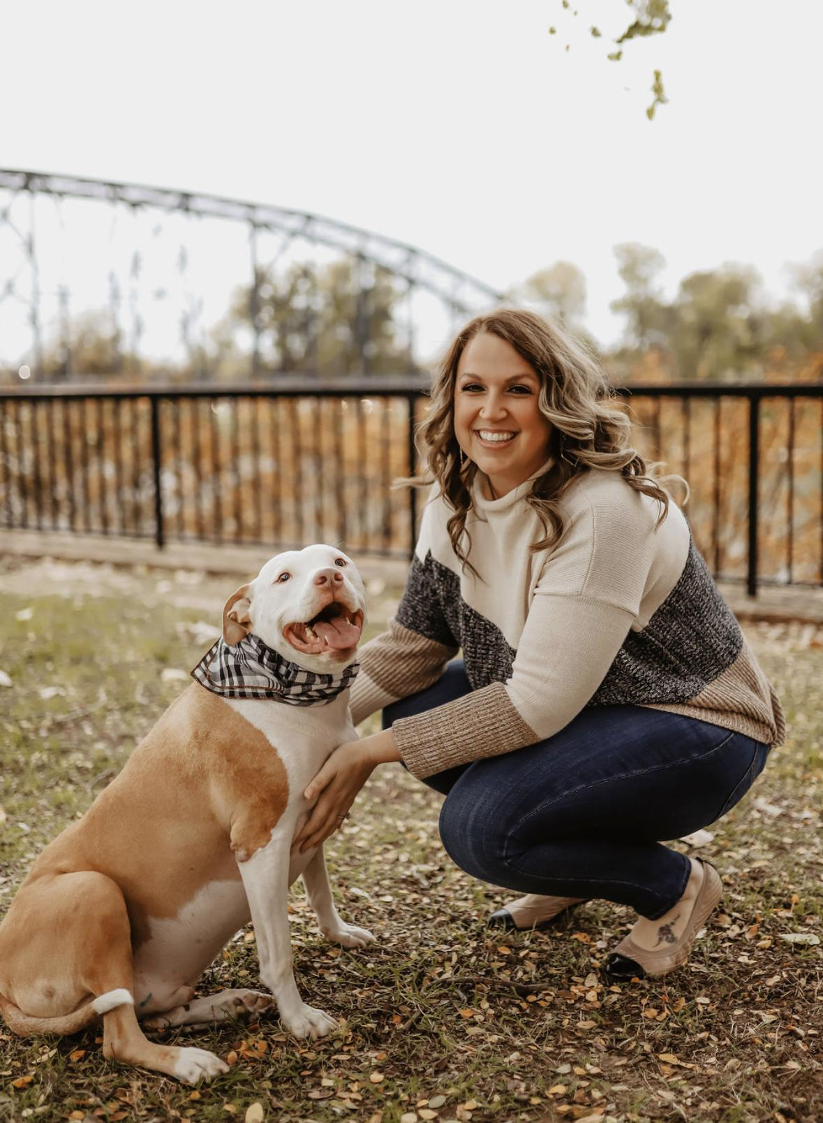
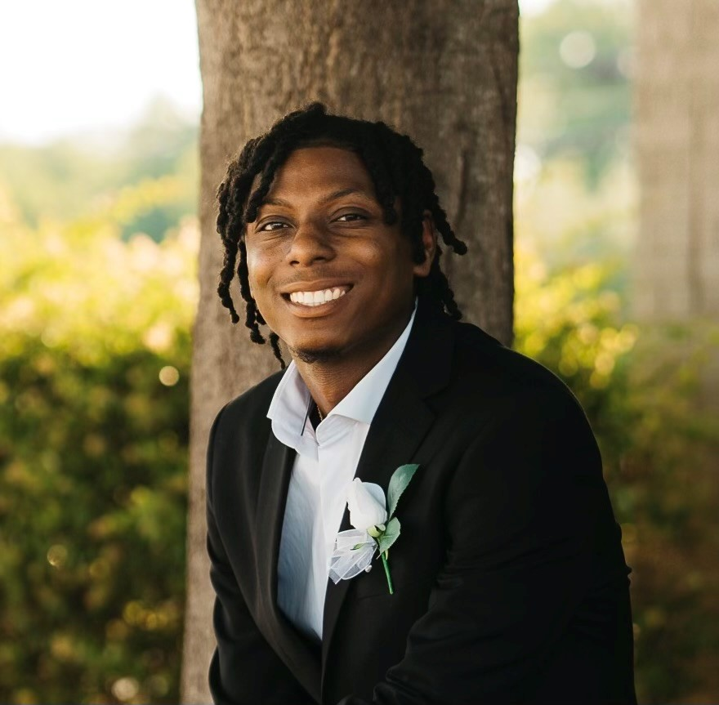
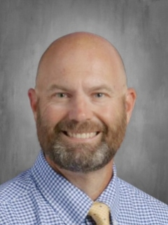
Stephanie Trammell
Associate Director-MCC
Who we are
Sal Acosta
ECHS/PTECH Counselor
Jeanne Gravitt
Dean of Advanced Studies
Byron Pyburn
Dual Credit Liaison
Christie Hollingsworth
Administrative Assistant
Chris Ward
PTECH Coordinator

Slide 3
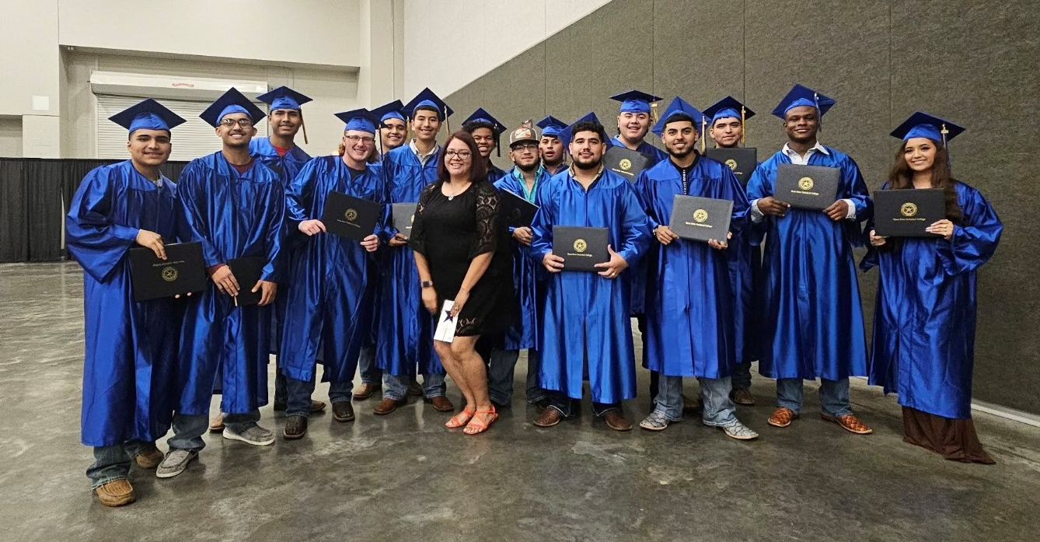


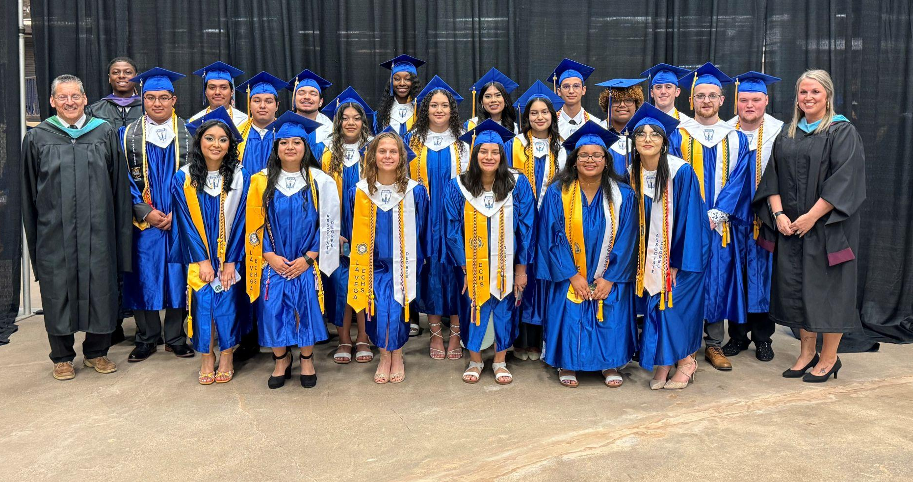


Hot Topics
TSTC Grads
School Management
Climate and Culture
TSIA 2.0
Scheduling and Structure
MCC Grads
"The race of excellence has no finish line"
-Mohammed bin Rashid Al Maktoum
Important Elements

Slide 4










School Management
PLC/CTM
Location
Cross-curricular
Departments
Frequency
SWS Model
“Guest of the college”
Roles
Partners
Leader
Counselor
Dual Credit Liaison
Teachers
PATH/AVID
CTE
Community College
Industry
Community
Mentoring

Slide 5
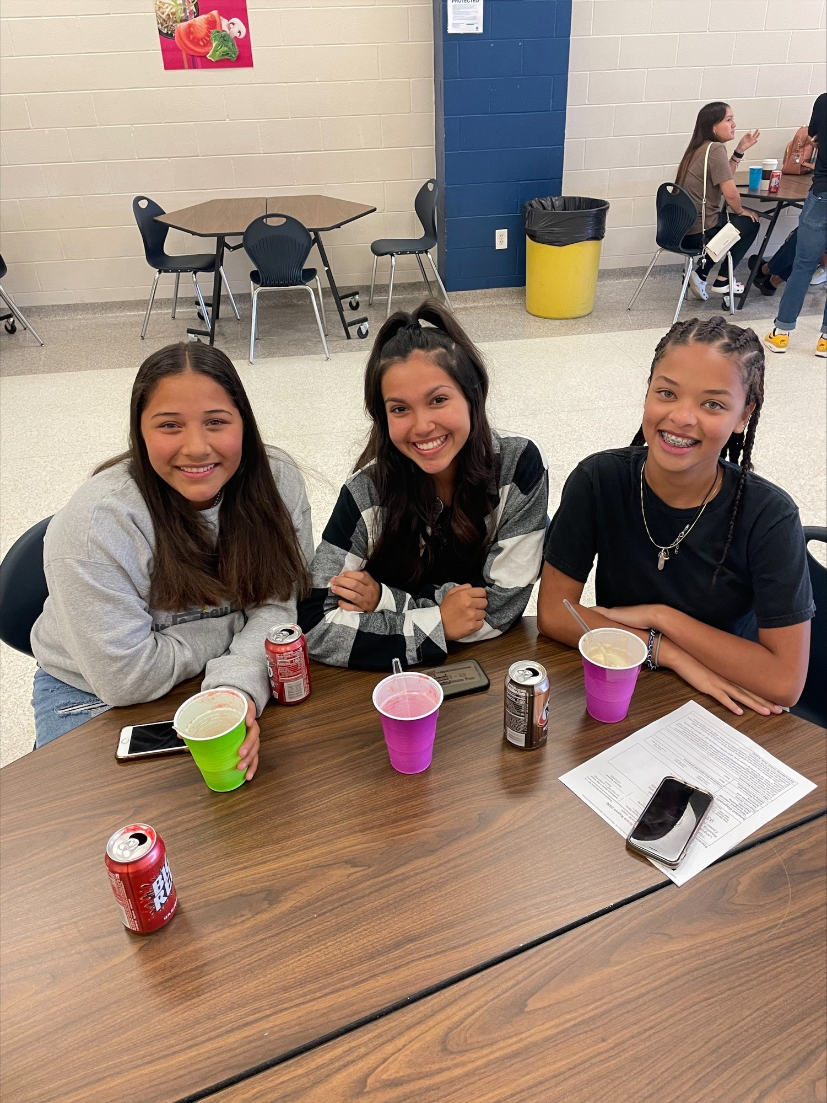



Climate and Culture
Breaking the stigma
  “having the good kids”
Morale
  Staff
  Student
  Testing
High school vs College
“Act as what you do makes a difference. It does.”
-William James

Slide 6
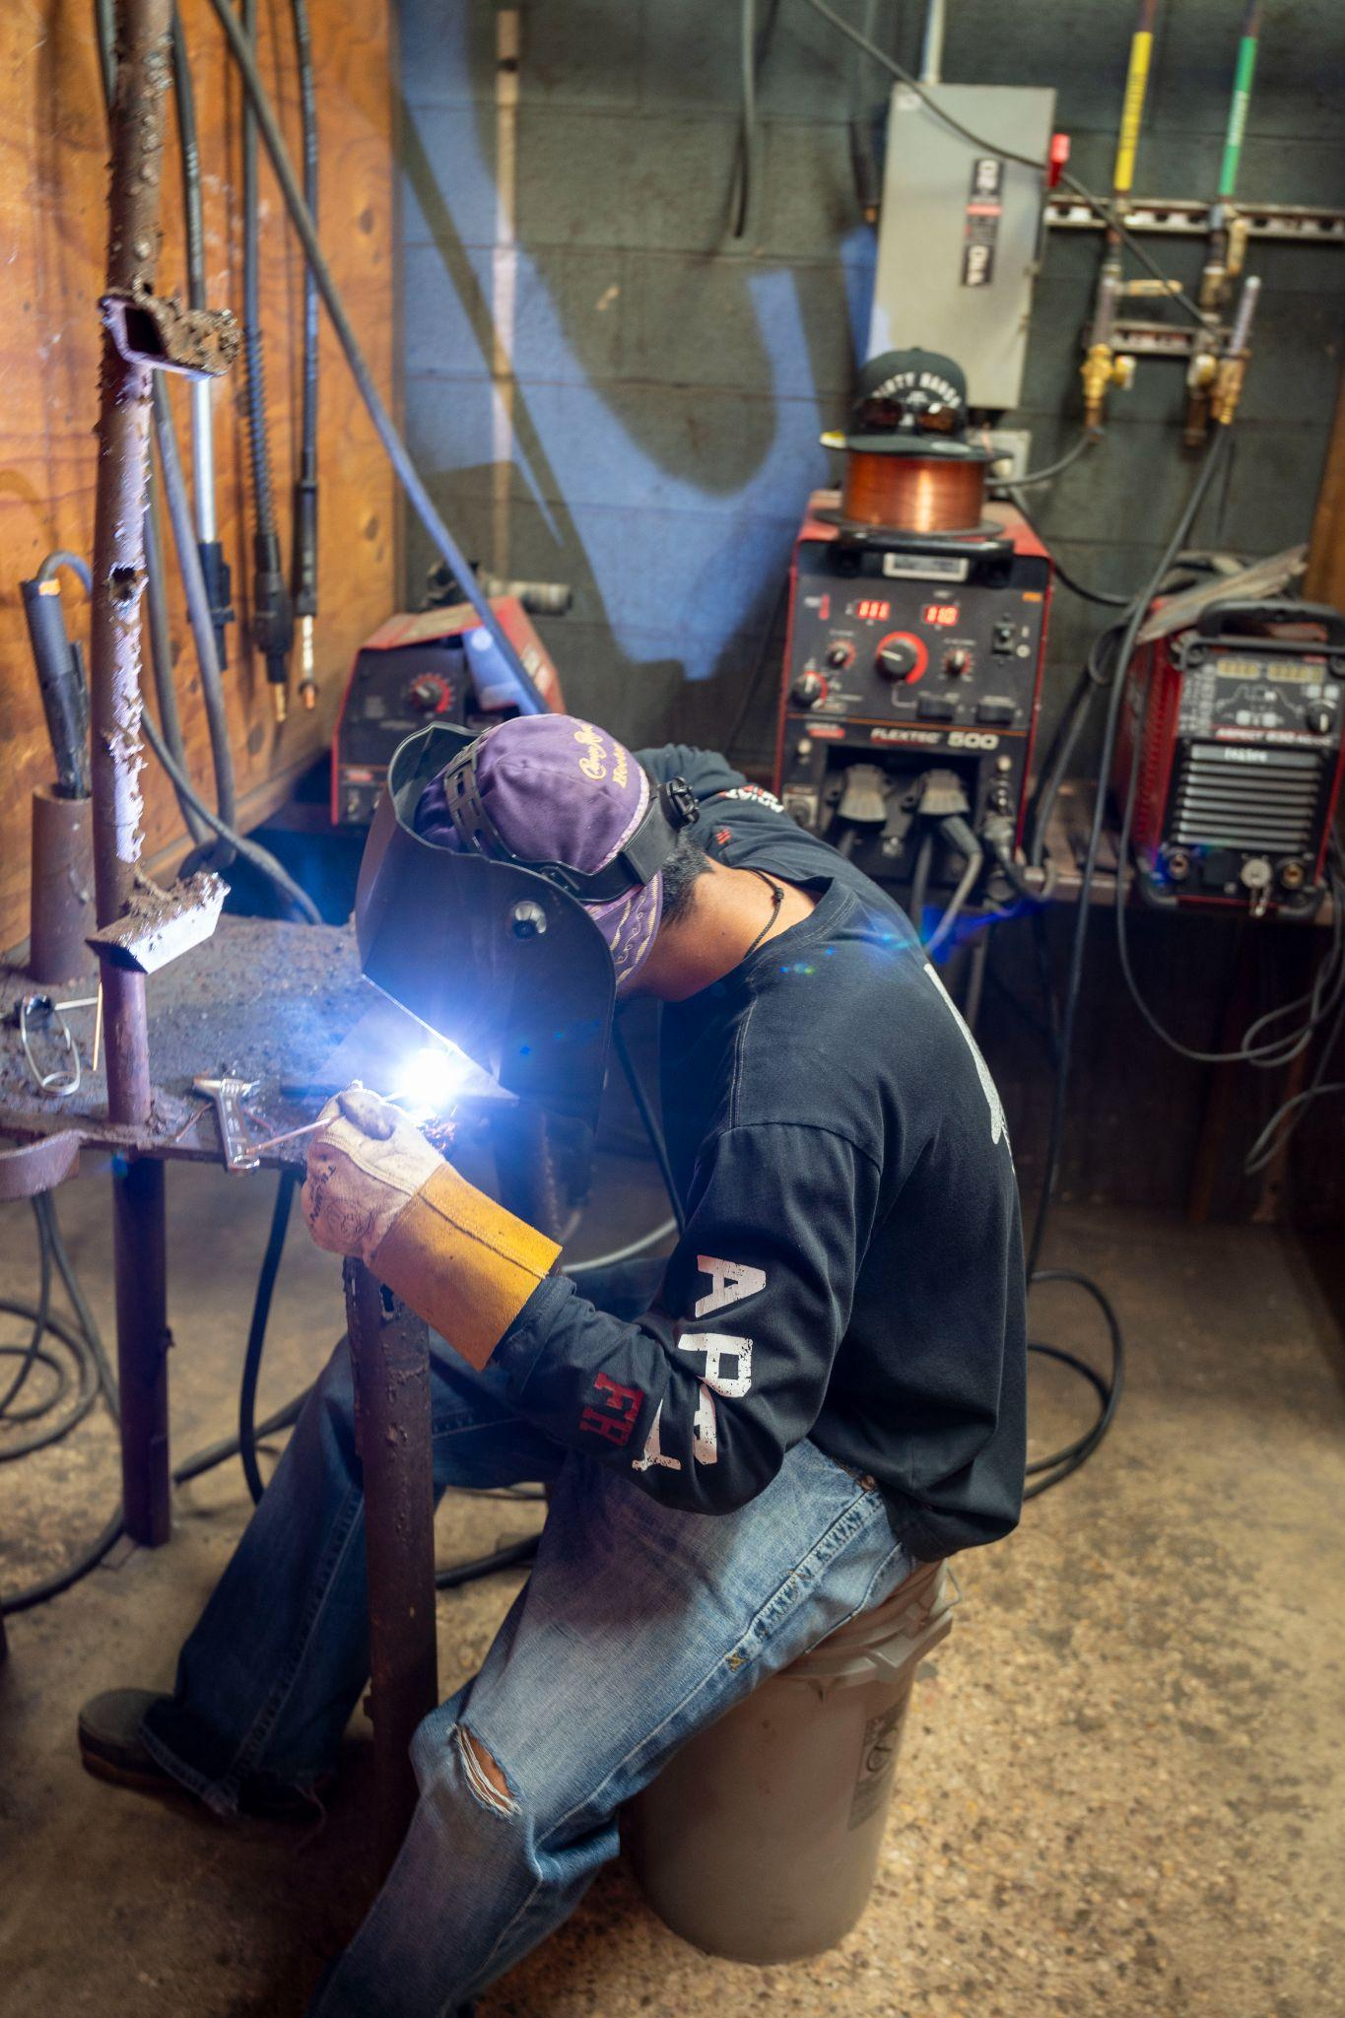




Scheduling
Non-negotiables
Acceleration
Open communication with HS and IHE
Sharing is caring
Flexibility and thinking outside the box
  What Box?
Summer Bridge
  P-TECH Summer Bridge

Slide 7
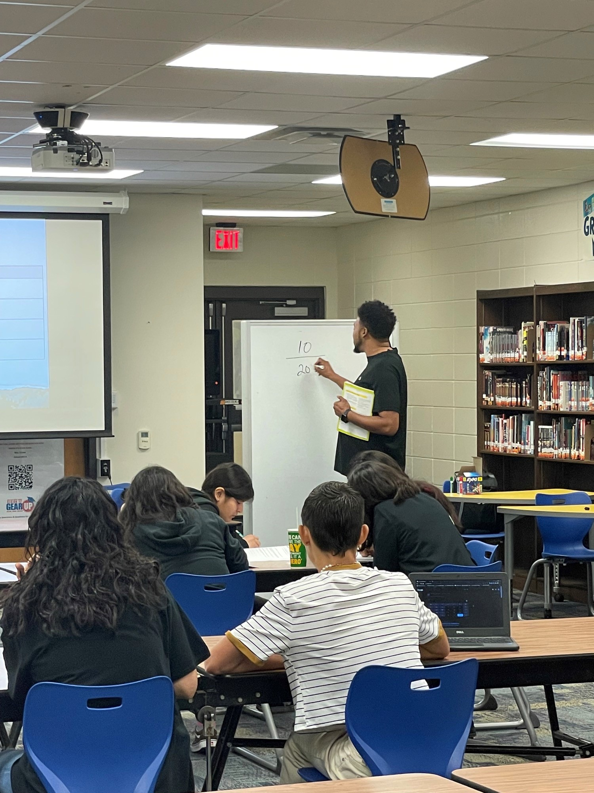

TSIA 2.0
Curriculum
  MasteryPrep
  EdReady
Devoted Time
  AVID/PATH
Struggles
  Math Sequence
Successes
  Eng II EOC
  Testing Environment
“Believe you can and you’re halfway there”
-Theodore Roosevelt

Slide 8
Tips and Tricks
The stuff we love
ECHS and PTECH
Tracking | CTE/ECHS/PTECH Collaboration | Grants
Signing Ceremony | Parent Engagement Events / Community “Buy In” | College Training (ECT)
8th grade TSIA | Celebrations | Transportation
“Babysitting” | College Transition Events | OnRamps
CTE- Program of Study | Industry Partnerships | Summer Bridge

Slide 9


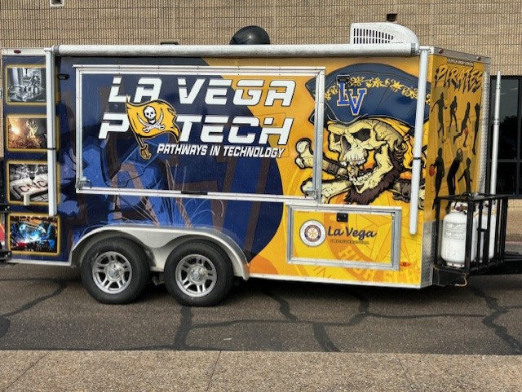

CTE/ECHS/PTECH Collaboration
Utilize AV and Graphic Design Teams
Promotion/Advertisement
Posters on every campus
Brochures for parents/partners
  English and Spanish
Videos to highlight program
  Copy of _PTECH_Final_1min_NEW.mp4

Slide 10
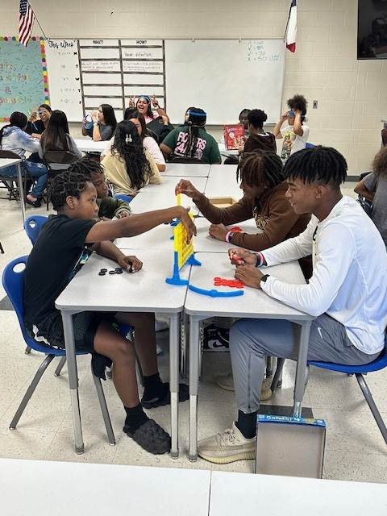
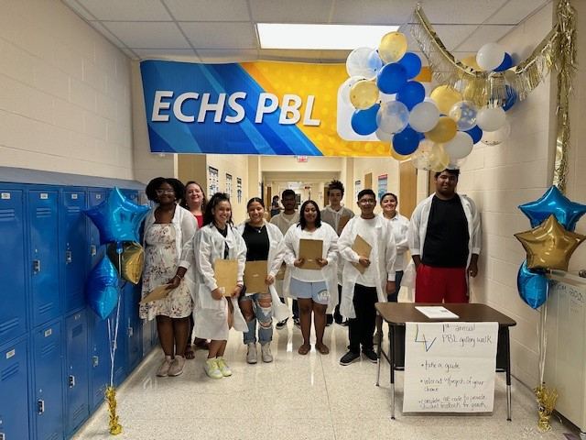
Parent/Student Engagement Events
Gallery Walk
Signing Ceremony
Interviews and Reviews
Lunch Bunch (Mentoring)
Early College Training (ECTs)
Shepherd’s Heart Food Distribution
“Be the change that you wish to see in the world.”
-Mahatma Gandhi

Slide 11
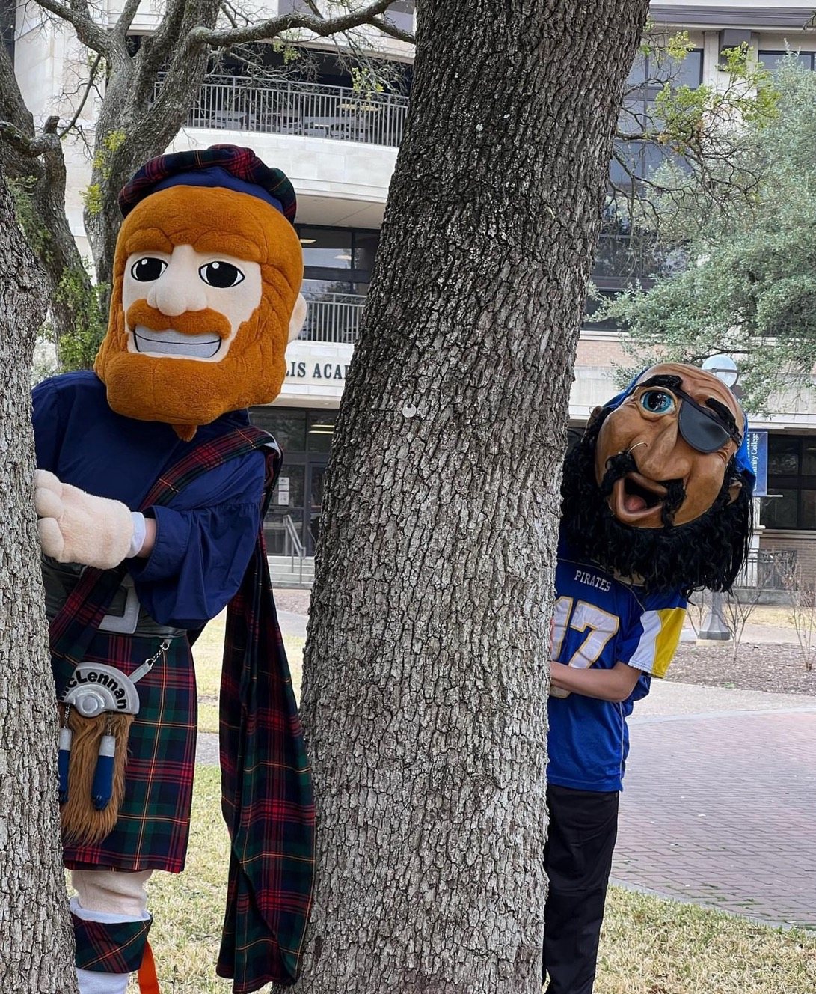
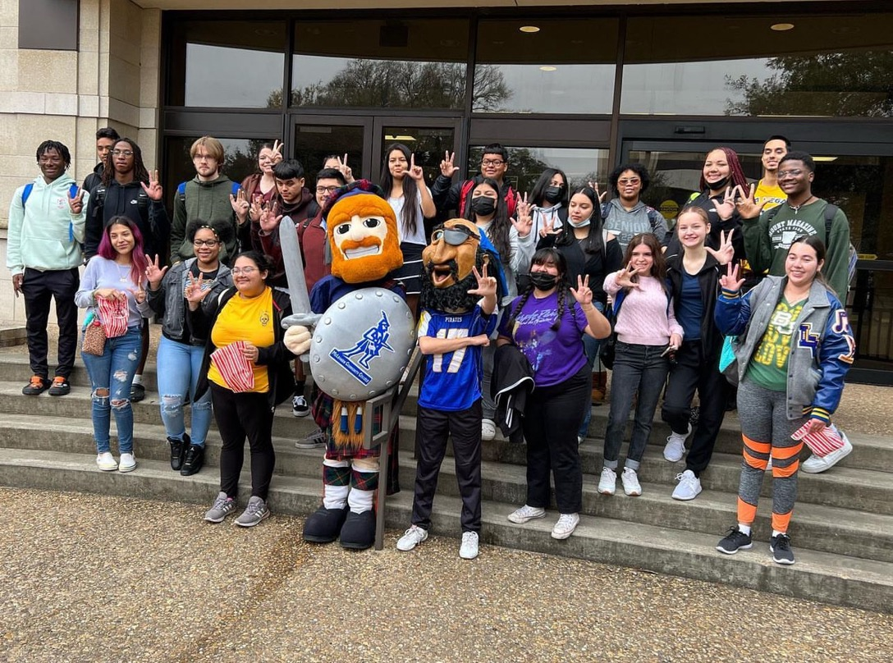
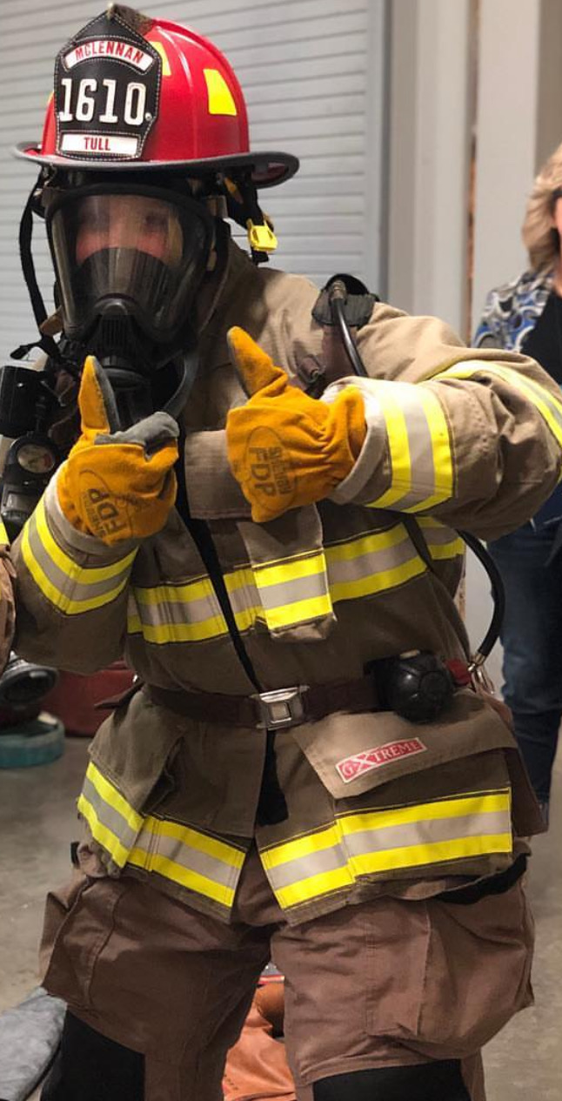
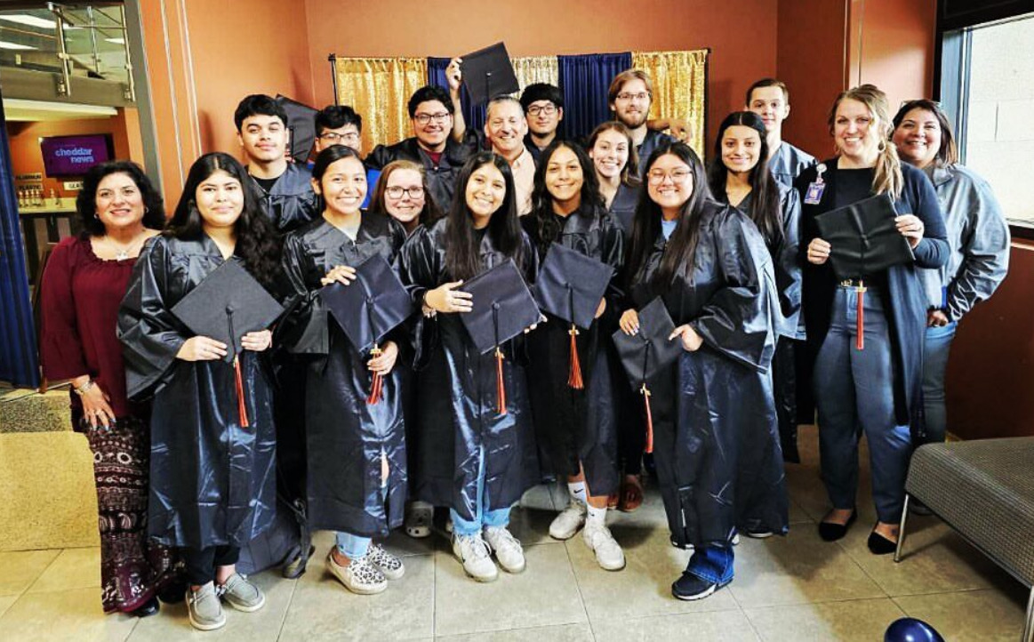
IHE Partnerships/ McLennan Community College
Why it works
We are Partners!
Daily communication is key
We know these students, and they know us!
Dual Credit is immersive
  Students and ISD personnel are at MCC every day
  ISD personnel attend professional development at MCC
  MCC personnel attend events at La Vega
La Vega’s students are valued
  Specific Orientation days
  Student Government representatives
  Highlighted on campus/graduation for success

Slide 12
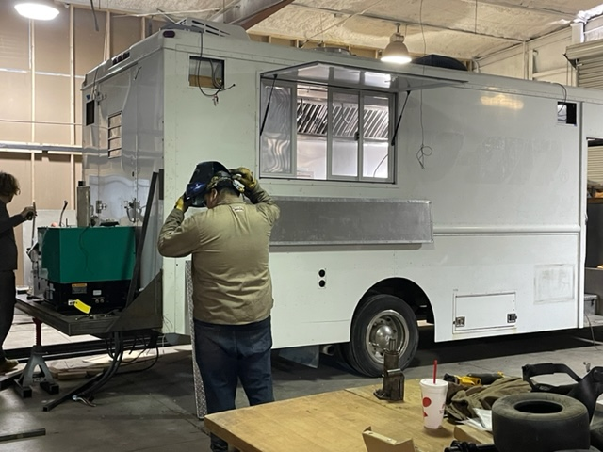
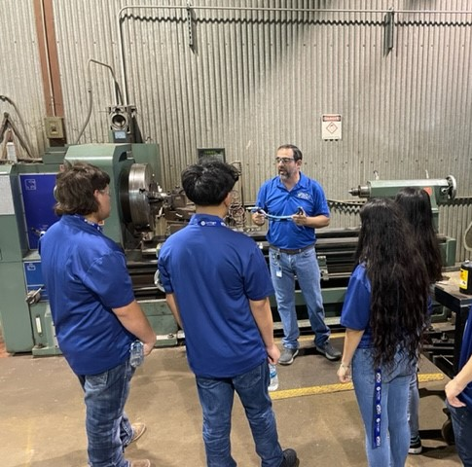
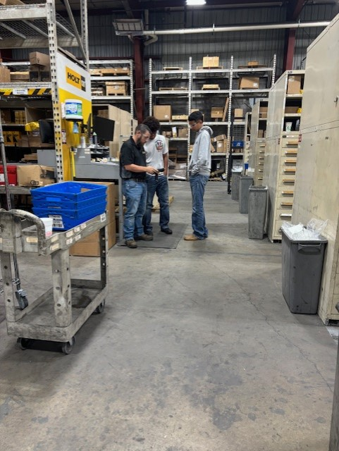
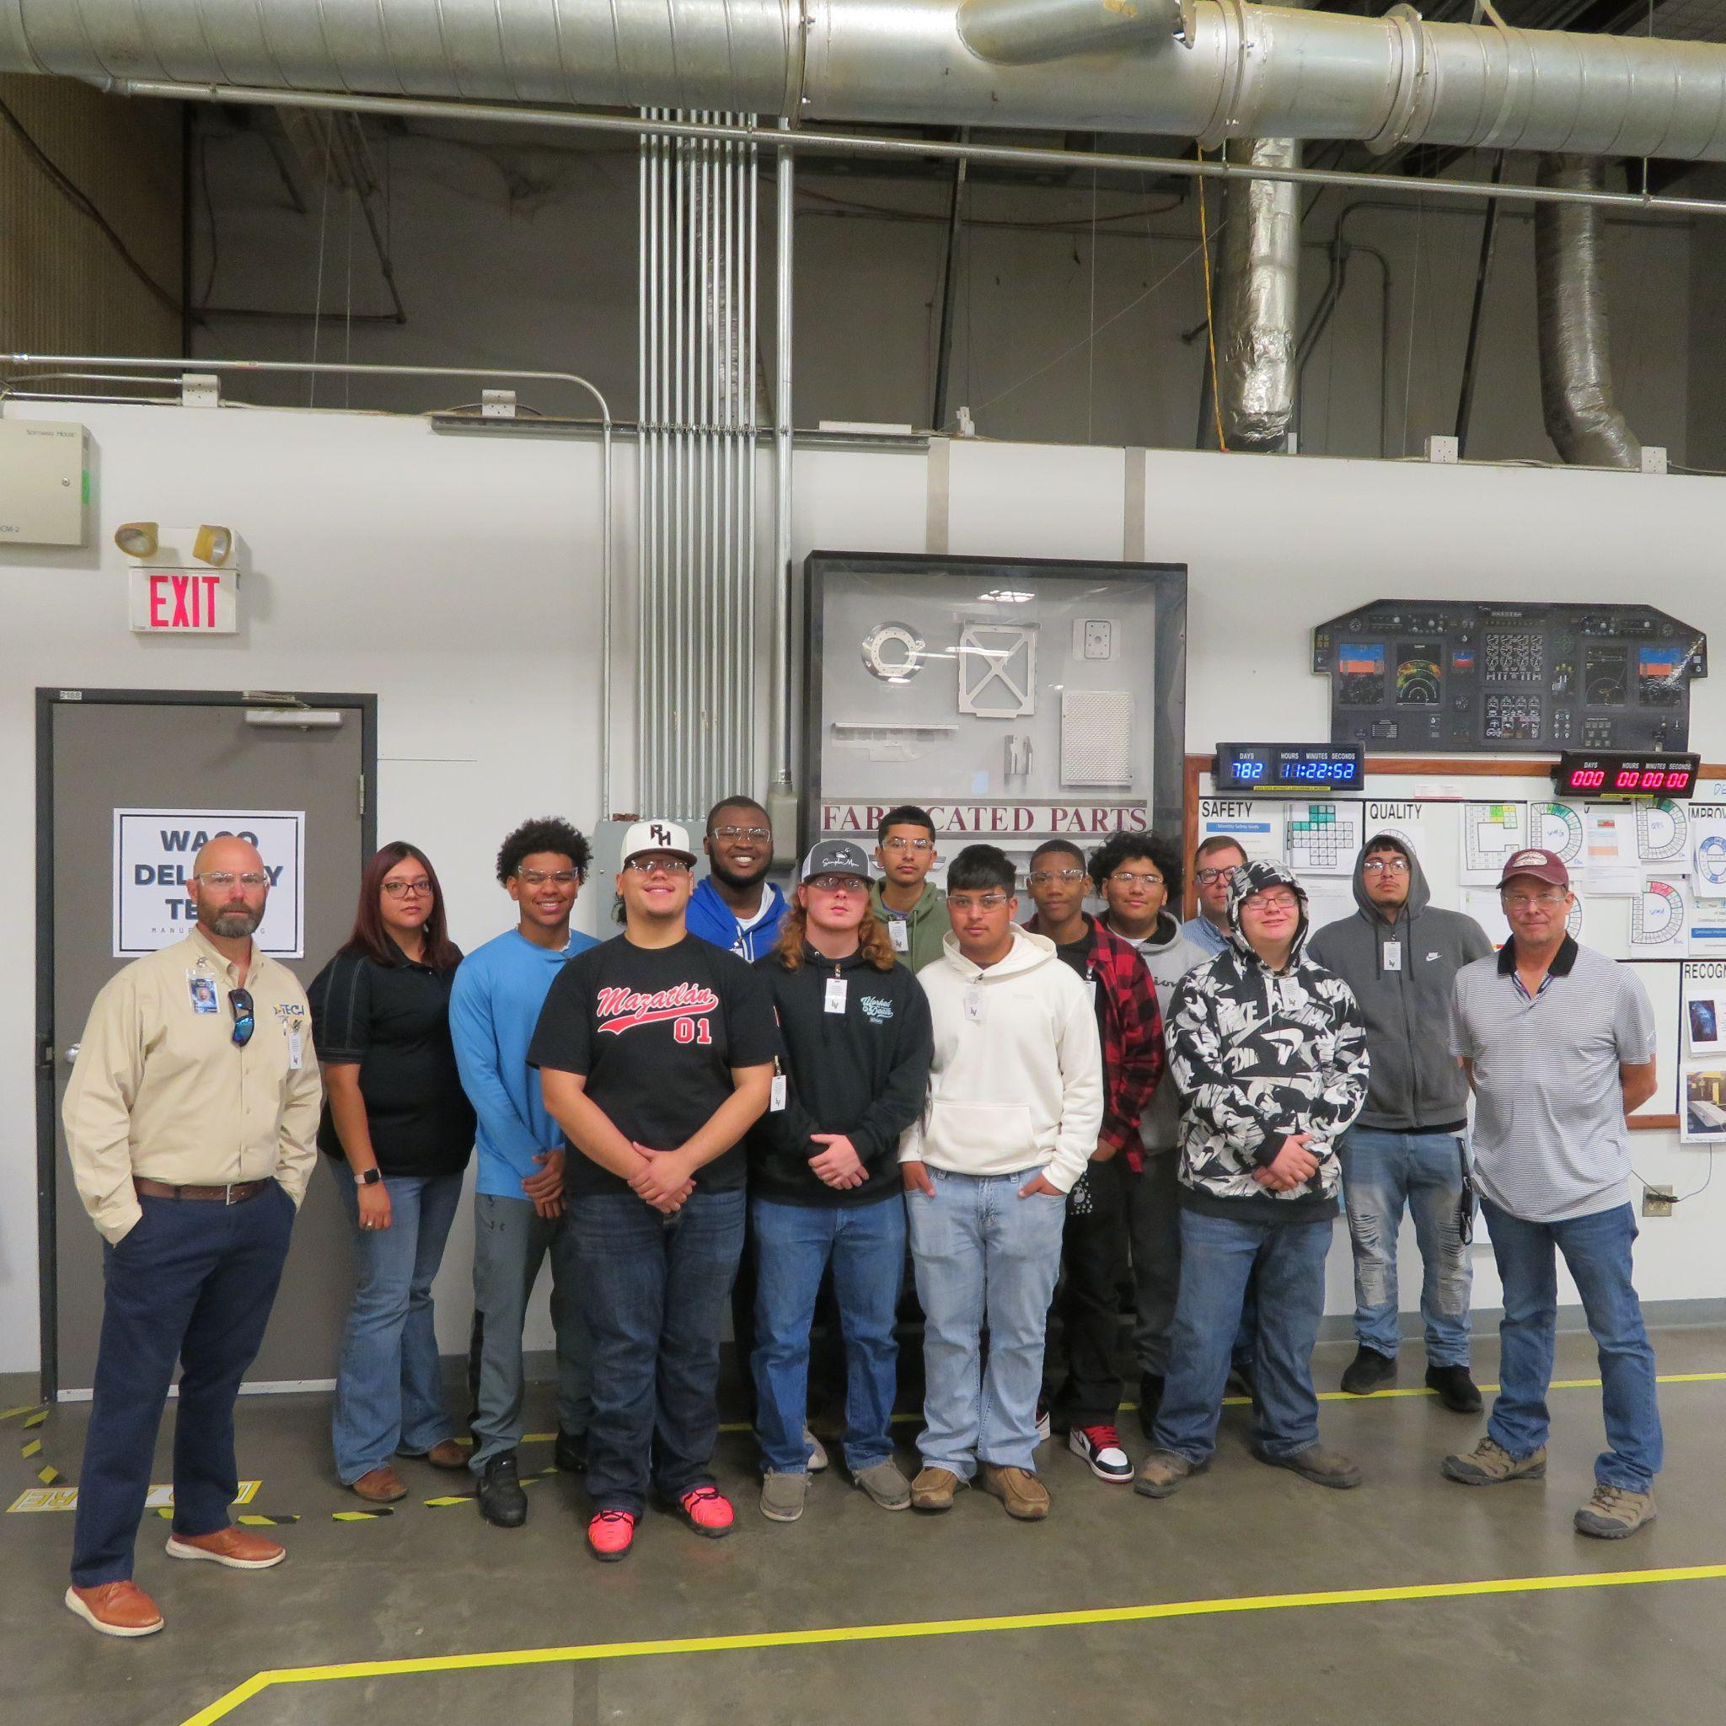
Industry Partners / WBL
Mentorships
Facility Tours
Job Shadowing
  Chamber of Commerce
Internships
  Summer CTE Grant
WBL Calendar

Slide 13
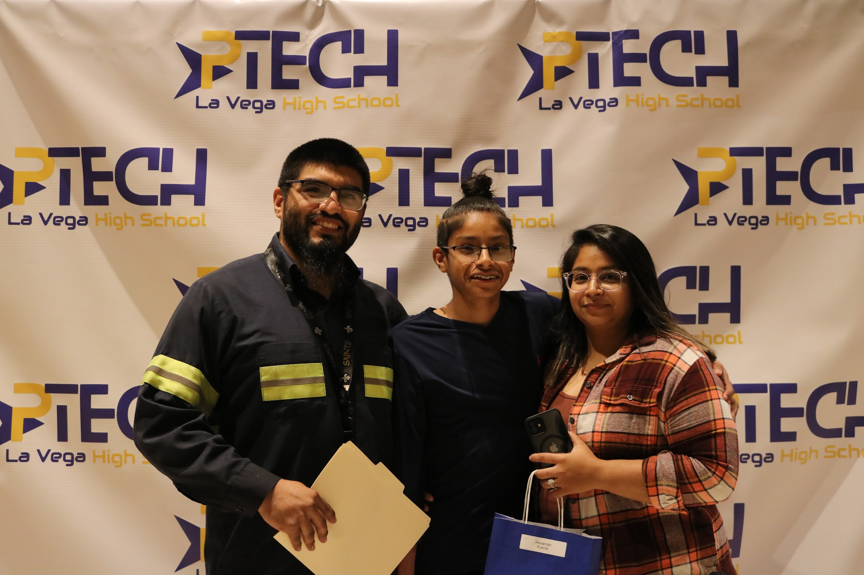
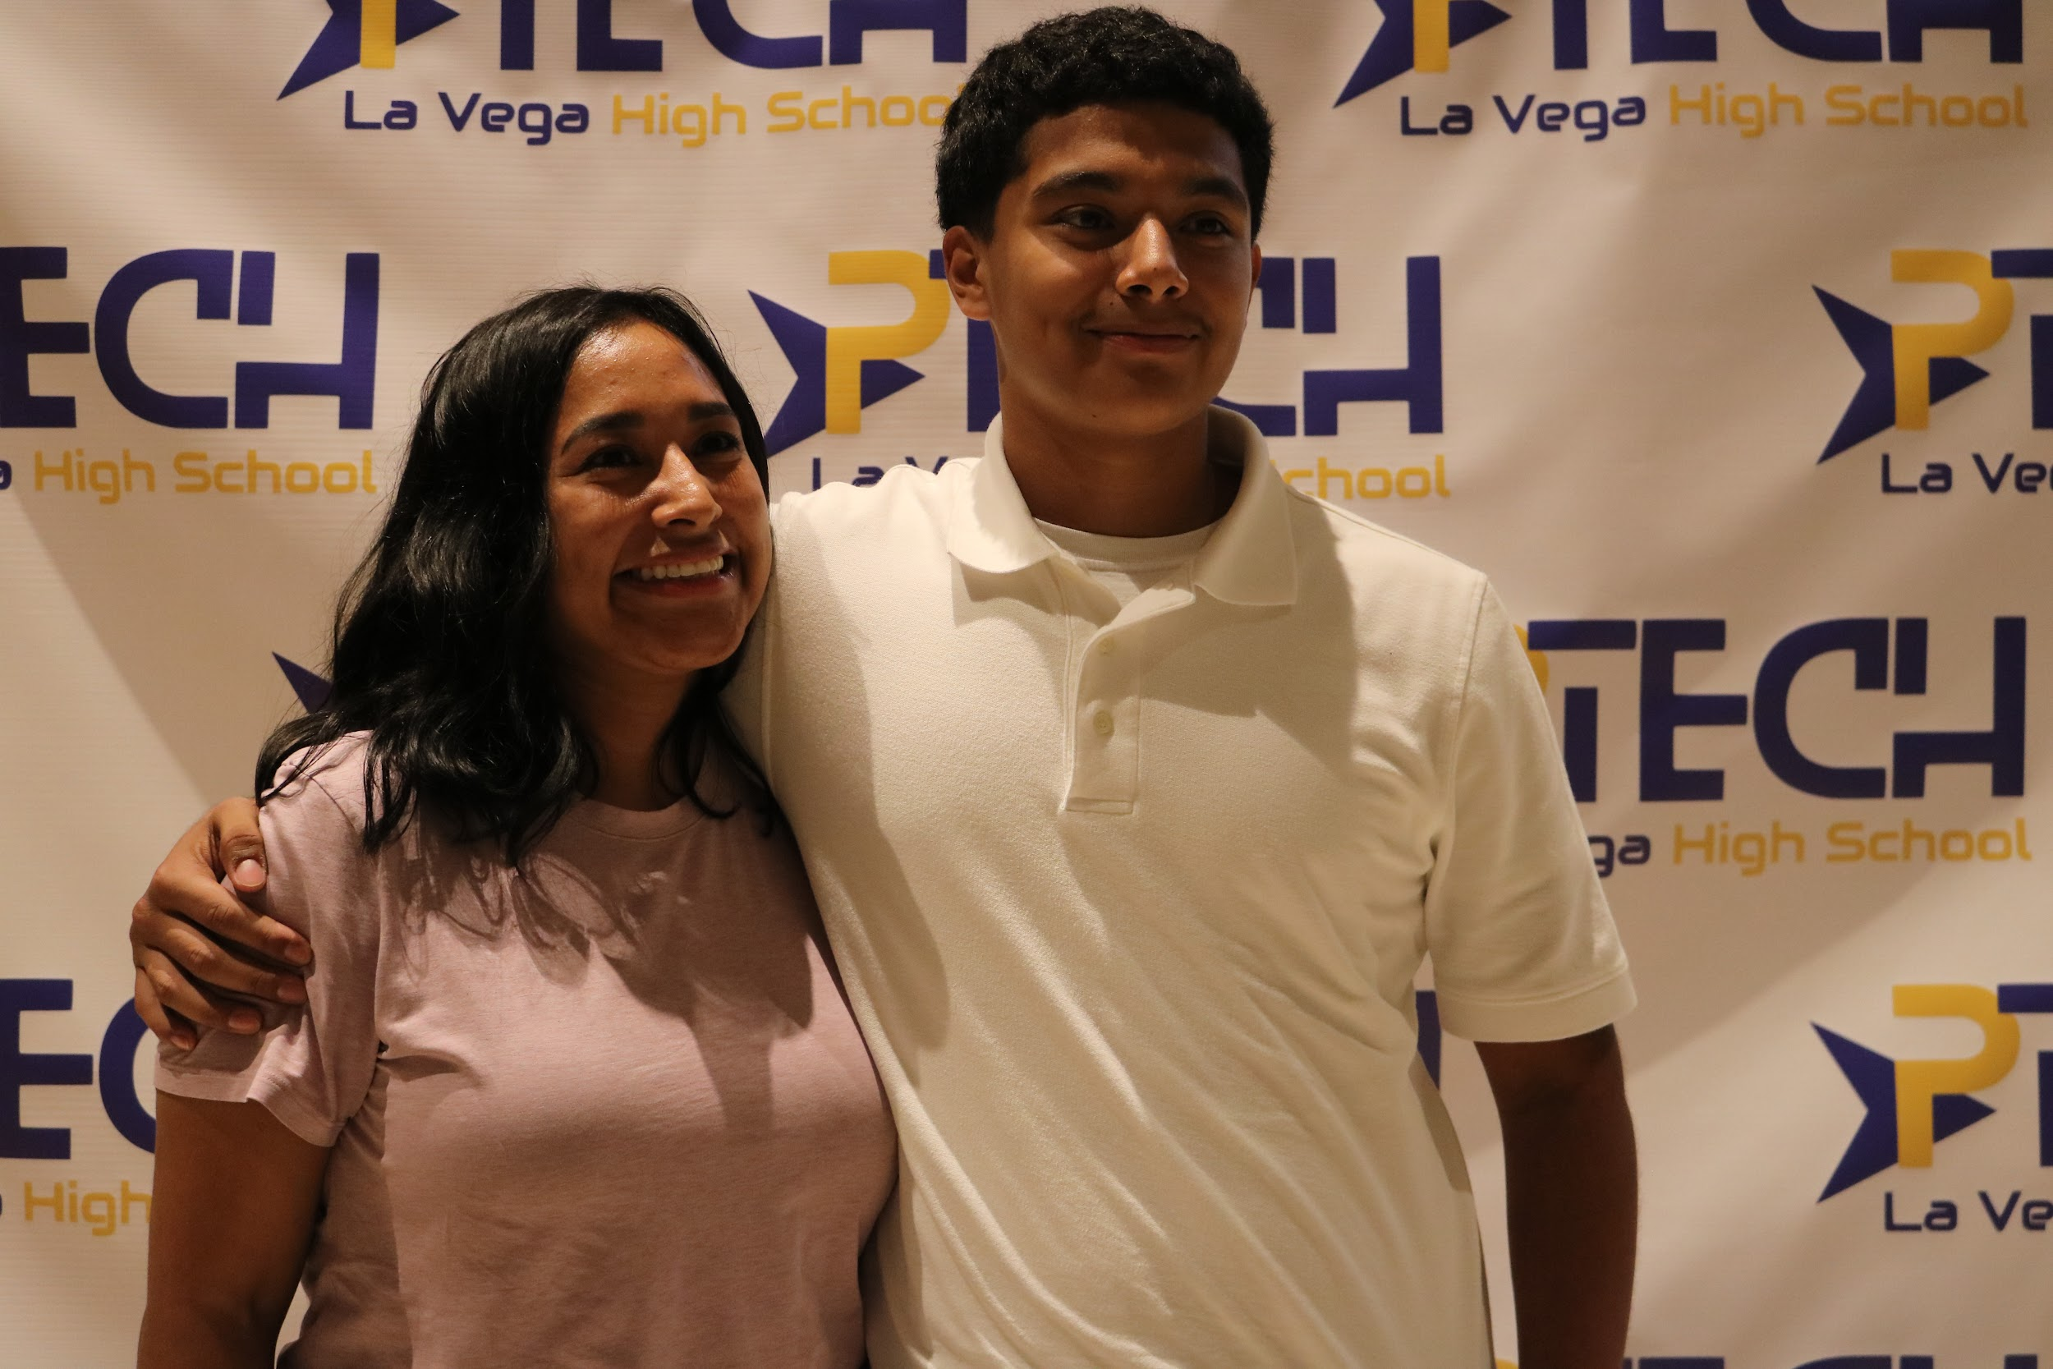
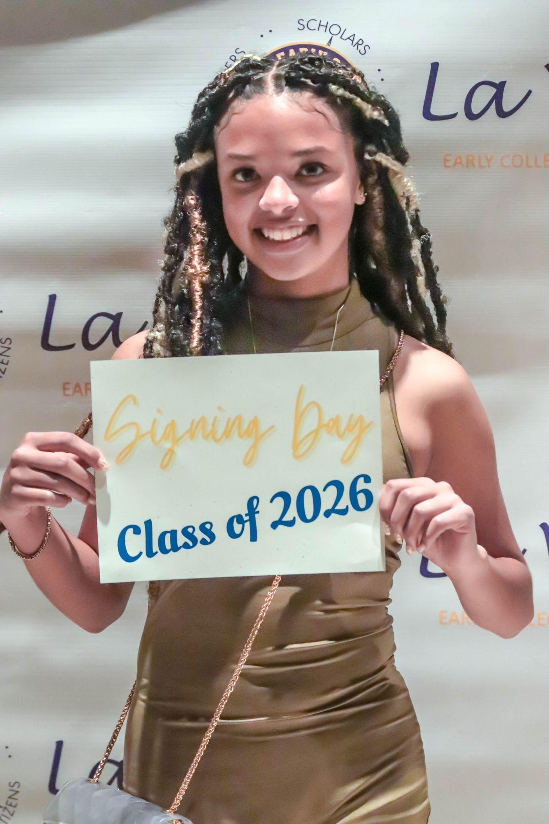
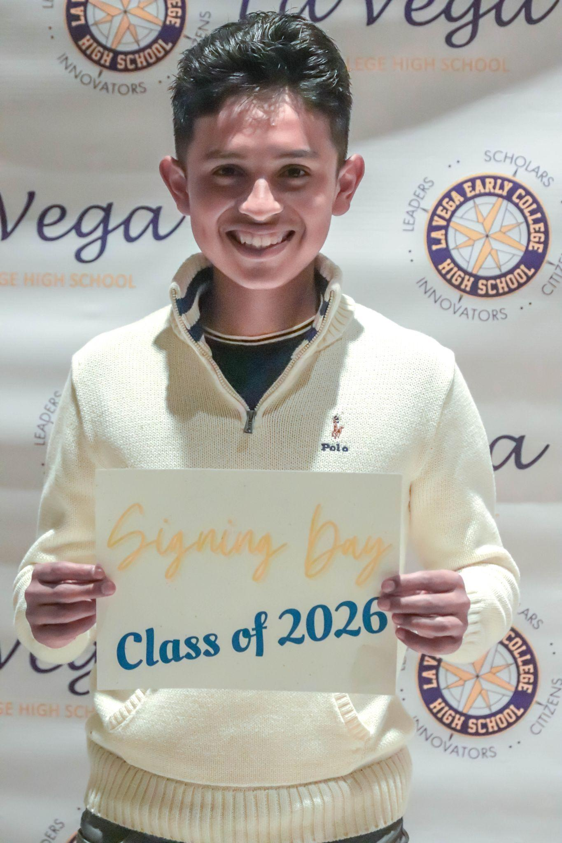
Signing Ceremony
& Celebrations
Highlights
Utilizing your own
Alumni Guest Speaker
Highlights
Include parents
Commitment Contract

Slide 14
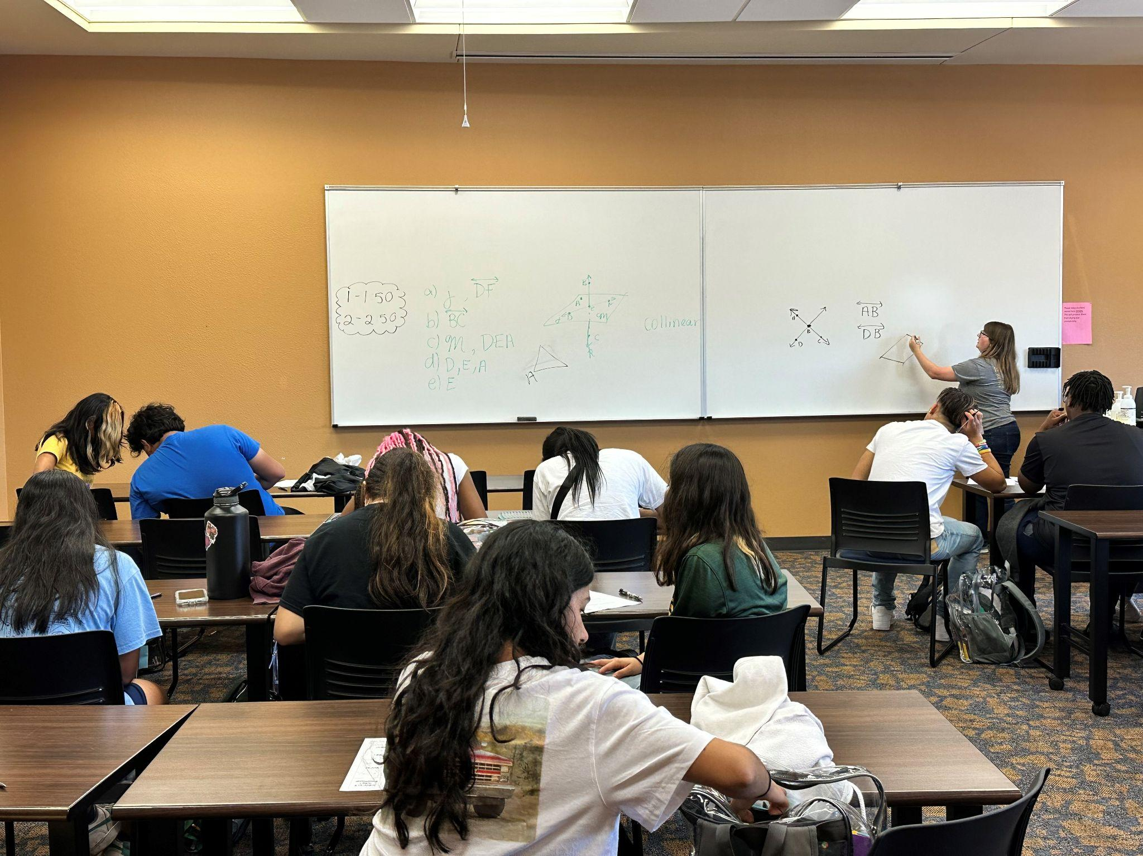


Tracking
Copy for Demo of MCC Tracker Class of 2024 Student Data
8th grade TSIA
Our Process
Our Why
Local Accountability
Our Outcome
P-TECH OBM Tracker

Slide 15
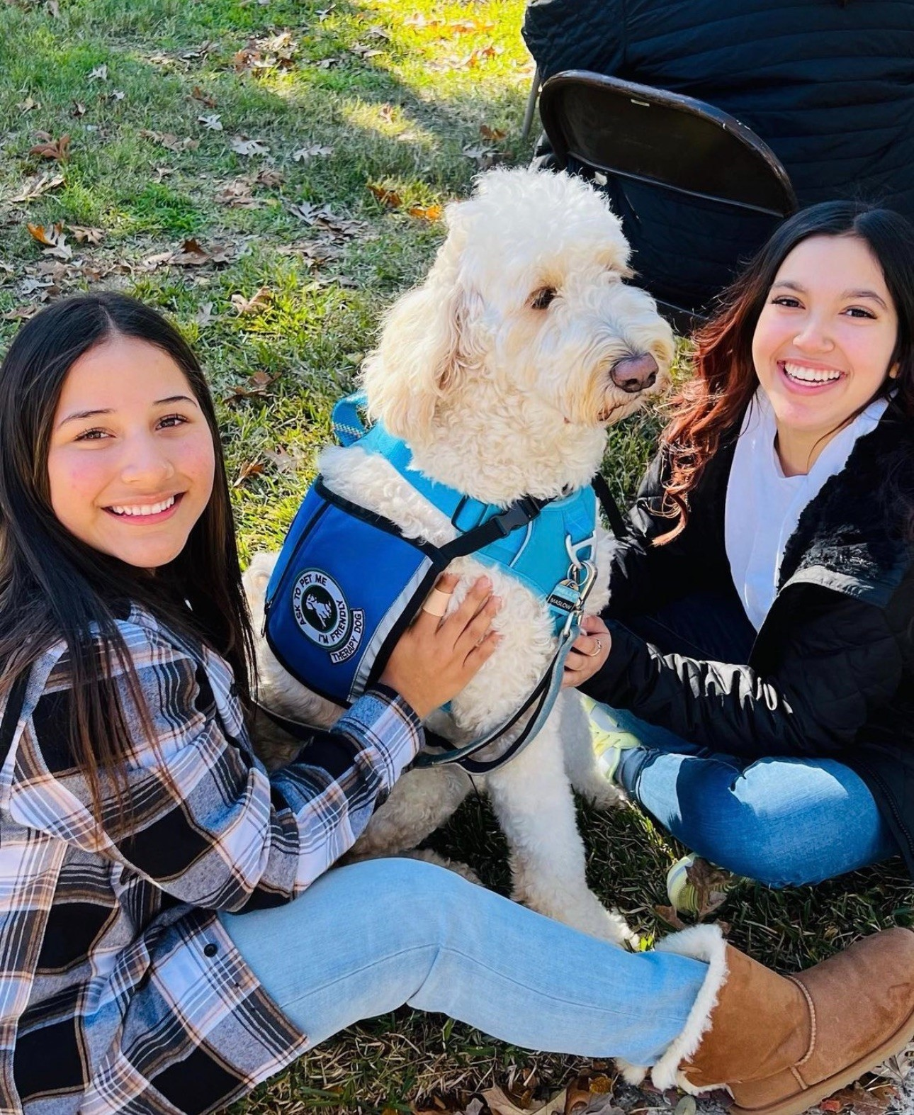
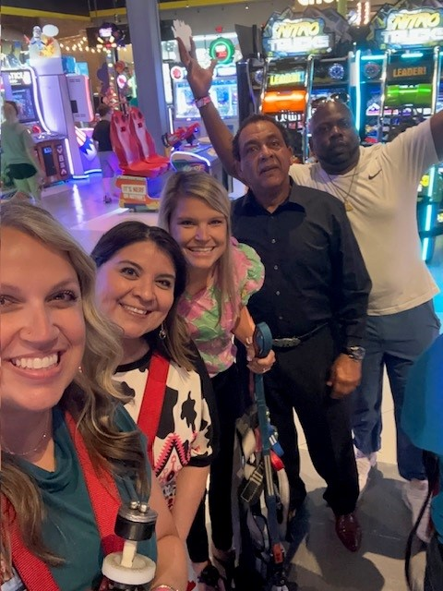
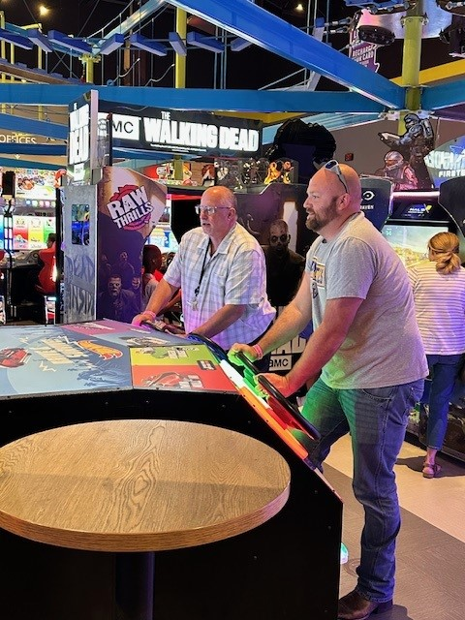
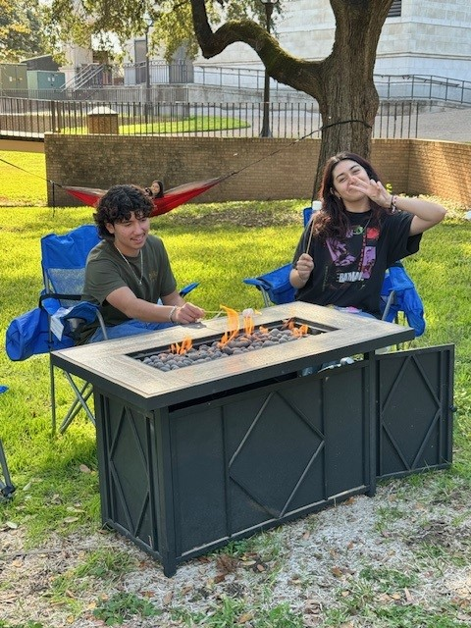
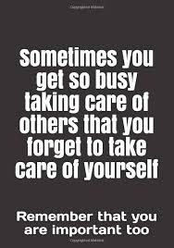
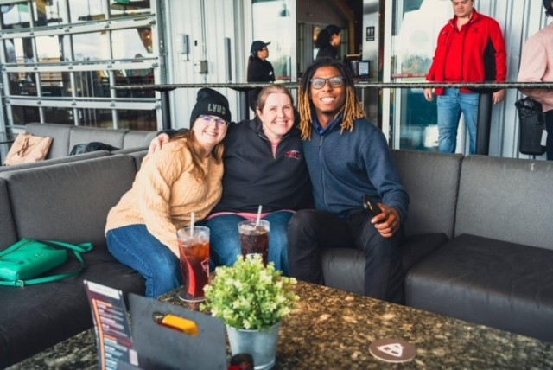
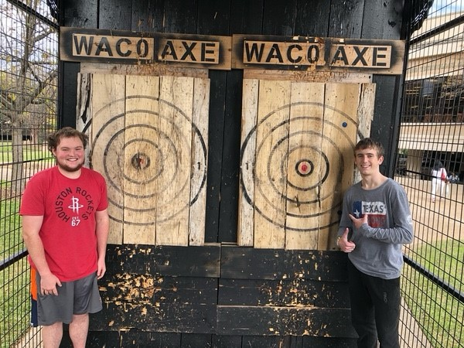

Slide 16
THANK YOU
Network with us tonight!

