Slide 1

Class of 2030
Welcome to EHS!

Slide 2


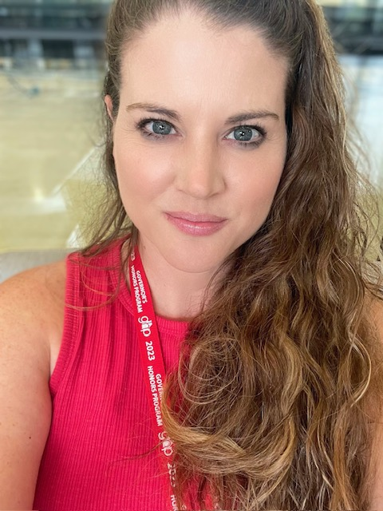

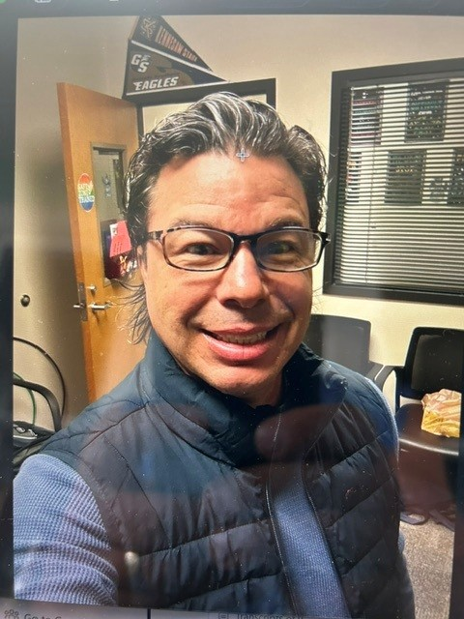
Counseling Staff
Whitney Morberg A-Cre
Sharon Gustafson
Her-Mil
Lauren Watkins
Sab-Z
Alayna Petersen
Cri-Hen
Travis Schmid
Mir-Ruz

Slide 3
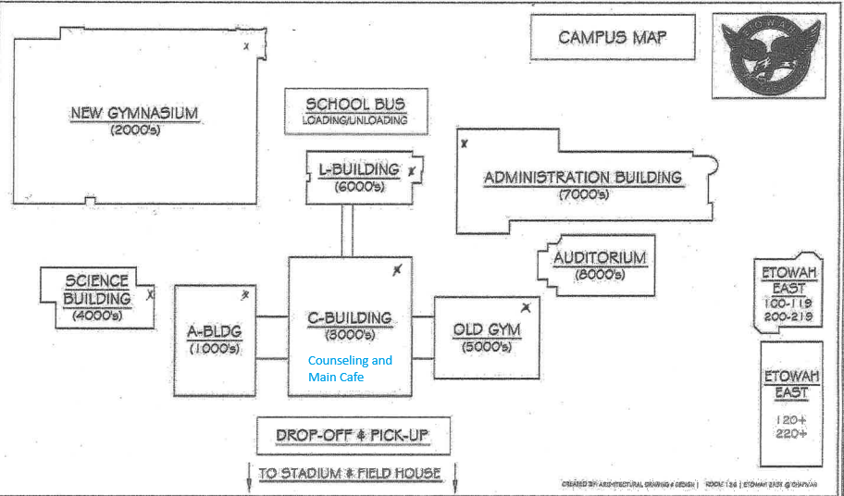
EHS MAps

Slide 4
Requirements for 2030 Graduates
Core Course Requirements
Elective Requirements
4 Units of Literature
4 Units of Math
4 Units of Science
Must include Biology, Physical Science or Physics, and Earth, Environmental, or Chemistry
3 Units of Social Studies
1 Unit of Health (.5) and Personal Fitness (.5)
World Language, Fine Arts and/or Career/Technical
4 Units of miscellaneous electives
TAA provides potential .5 credit Pass or Fail grade
3 Units of required electives
23 total units are required for graduation
Honor Graduates: cumulative weighted NGA of 90 or above
Notes:
Specify which Lit, Math, and SS classes are required

Slide 5
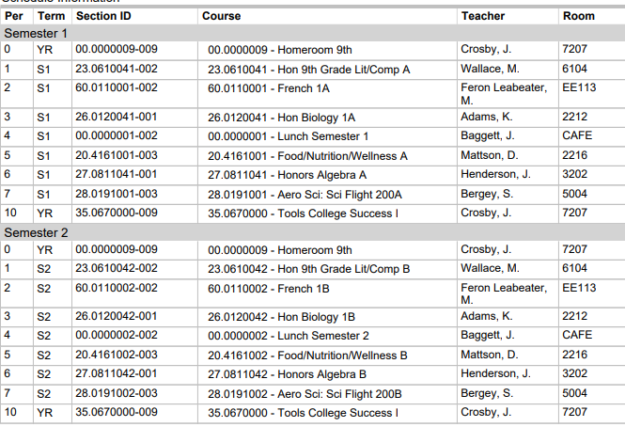
Sample Schedule

Slide 6
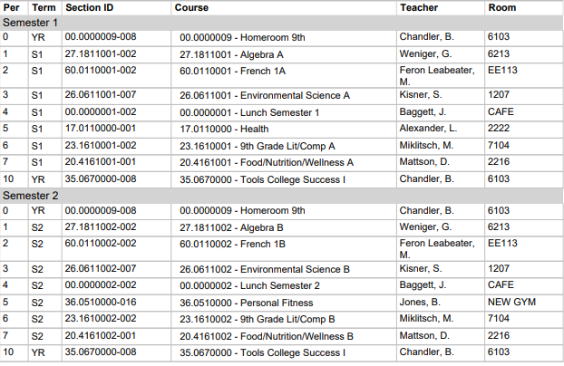
Sample Schedule #2

Slide 7
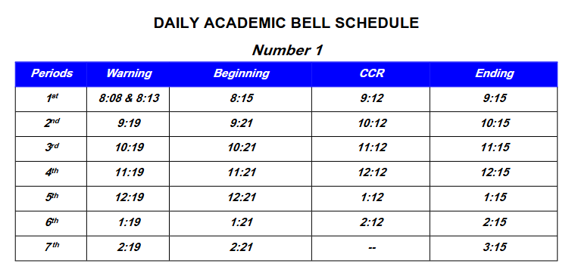
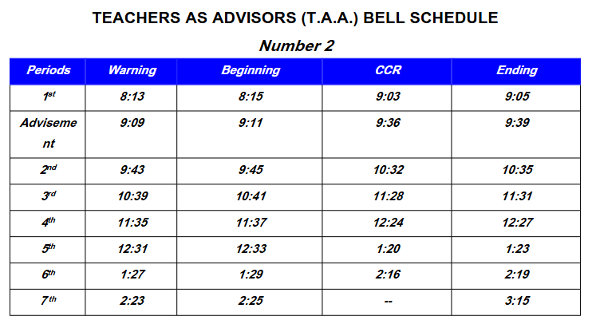
Bell schedule

Slide 8
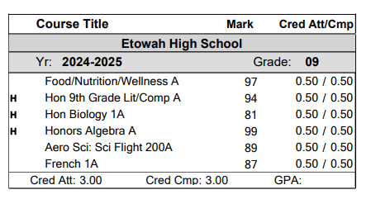
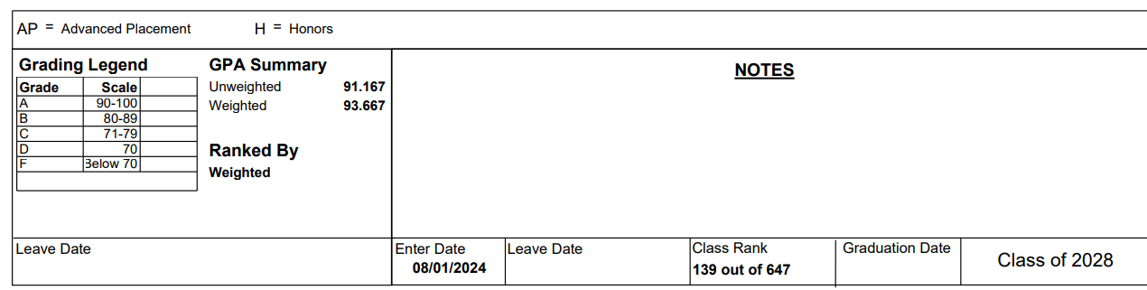
Sample Transcript

Slide 9
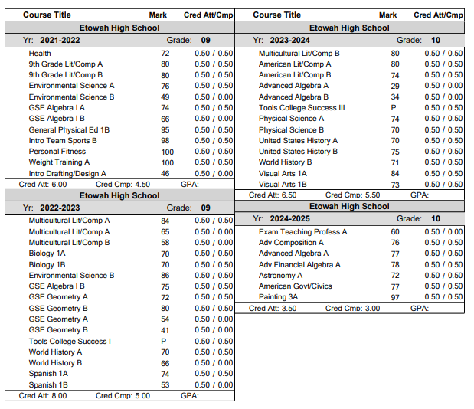

Sample Transcript #2

Slide 10
FOCUS On Your Future:
Technical, 4-year College, Military, Work Force
Military​
Recruiters visit school​
Take the ASVAB offered at EHS; Must Be 16
4 Year College:​
Each college determines their minimum entrance requirements; 2 Years of Language​
Minimum GPA​
ACT or SAT scores​
Georgia 4-year colleges require:​
  College Preparatory Curriculum requirements (2 years world language)​
  Freshman Index requirement​
  Minimum results on Test Scores
Technical College and 2 Year School:​
SAT/ACT not required. Use Accuplacer exam to determine placement​
Qualifies for HOPE Grant​
Chattahoochee Tech is nearby​
Nearby 2-year schools: Georgia Highlands & GSU Perimeter College
Work Force​
Apprenticeship opportunities​
Talk to your counselor, WBL teacher, or CTAE teacher
Notes:
FRESHMAN INDEX NUMBER: The University System of Georgia colleges and universities use a standardized calculation to determine appropriate college placement for students in the state of Georgia. This is known as the Freshman Index Number. The Freshman Index is calculated by combining the core high school grade point average (GPA on a 4.0 scale) with the highest earned SAT or ACT test scores. The high school GPA is calculated from the grades earned in the 17 Required High School Curriculum (RHSC) courses for those students graduating 2012 or later.
The following formulas are used to calculate a student's freshman index:
Formula for SAT Test Takers
Freshman Index =
(500 x High School GPA)
+ SAT Critical Reading + SAT Math
Formula for ACT Test Takers
Freshman Index =
(500 x High School GPA)
+ (ACT Composite score x 42) + 88
Type of Institution
Minimum Freshman Index (FI)
Research Institutions
Georgia Tech, UGA , GA State, Emory
2500
Regional Universities
Georgia Southern, Valdosta State
2040
State Universities
GCSU, KSU, SPSU, UWG, NGCSU
1940
State Colleges
Gainesville State, Georgia Gwinnett College
1830
Two-Year Colleges
No FI Requirement

Slide 11
HOPE and Zell Miller Scholarship
1. HOPE:
3.0 Core GPA (AP classes weighted +.5 up to 4.0)
Students must maintain a 3.0 GPA in college
HOPE GPA IS NOT ROUNDED! 2.9999 is ineligible!!!
To apply for HOPE/Zell, FAFSA or GSFAPP
*HOPE/Zell Application
2. Zell Miller:
3.7 Core GPA (add .5 weighting for AP courses up to 4.0)
Students must maintain a 3.3 GPA in college
Students who drop below the college 3.3 GPA can earn Regular HOPE if their college GPA remains above 3.0
NOT ROUNDED: 3.6999 will receive HOPE, not Zell Miller
You must submit your SAT or ACT scores to the GA Student Finance Commission for Zell
*Test Score Submission Information

Slide 12

Clubs and sports
Etowah Clubs SY24-25
https://ehs.cherokeek12.net/athletics
https://ehs.cherokeek12.net/student-services

Slide 13
Skills for success
Time management
Organization
Balance
Tutoring
Communicate with your teachers
Check your Canvas and Office 365 Email
Read school Eagles Mountain Messenger and Website
Notes:
*East Wing tutoring services

Slide 14
9th Grade Common FAQs
1. Is a world language required to graduate from high school?
No, a world language is not required to graduate from high school. Two consecutive years of a world language is a requirement to attend a 4-year college.
2. If a student takes a world language in middle school, does it count toward the 2 consecutive years of a world language required by 4-year colleges?
Yes, Spanish 1 or any world language taken in middle school for high school credit does count toward the consecutive 2-year language requirement for college. A 3rd year of a language is not required for the HOPE Scholarship. Other rigor courses are available to meet HOPE Rigor requirements.
https://www.gafutures.org/hope-state-aid-programs/hope-zell-miller-scholarships/hope-scholarship/eligibility/
3. If a student is in a language in 8th grade, will they automatically be placed in the next level freshman year?
Yes, the student will automatically roll into the next level of the language.

Slide 15
9th Grade Common FAQs
4. Is computer science considered a world language?
The University System of Georgia recognizes Computer Science as a world language. Students must complete 2 courses from the Computer Science pathway. The introductory course – Introduction to Digital Technology/Introduction to Software is not included in these courses. They must be upper level courses beyond the introductory level. For more information, please visit:
https://www.usg.edu/student_affairs/assets/student_affairs/documents/Staying_on_Course.pdf

Slide 16
9th Grade Common FAQs
5. When will my student have their schedule?
Schedules are usually emailed to students the week prior to school starting.
6. Does my student have to stay in the same elective all year? Yes, with very few exceptions, once a selection is made, the student is committed for the year.
7. Does my student have to complete a CTAE pathway?
Completing a pathway is not a graduation requirement.
8. Are elective choices guaranteed?
No, students need to select up to 3 alternates in case their first choice is full.
9. What AP (advanced placement – college level) courses are available to freshmen?
AP Human Geography which is a social studies elective. Freshmen are invited to enroll in the course based on academic requirements.

Slide 17
9th Grade Common FAQs
10. Should a student take Health/Personal Fitness over the summer?
Summer school information is not available yet. Freshmen will take English, Math, Science, Health/Personal Fitness, and 2 electives. Elective choices will determine the need to take summer school classes. An example – a freshman who would like to take band, language, and AP Human Geography. There is a cost to summer school. If a student takes 3 years of ROTC, they do not need to take health/personal fitness.
11. Can my student take weight training in place of personal fitness?
No, the course must be personal fitness.

Slide 18
Rising 9th grade elective fair
TBD

