Slide 1
The Dangers of Sexually Transmitted Infections
A presentation by: Angie Earley

Slide 2
Anyone Can Get An STI
Everyone who has sex needs to know about sexually transmitted infections (STIs), regardless of sexual preferences.
Definition of STI: Sexually Transmitted Infection
STIs can be passed from one person to another through intercourse (sex)
Some STIs can be passed through kissing and intimate touching
Some STIs are passed through sharing needles for injecting drugs, steroids, body piercing or tattoos
There are over 25 different types of STIs HIV transmission.

Slide 3
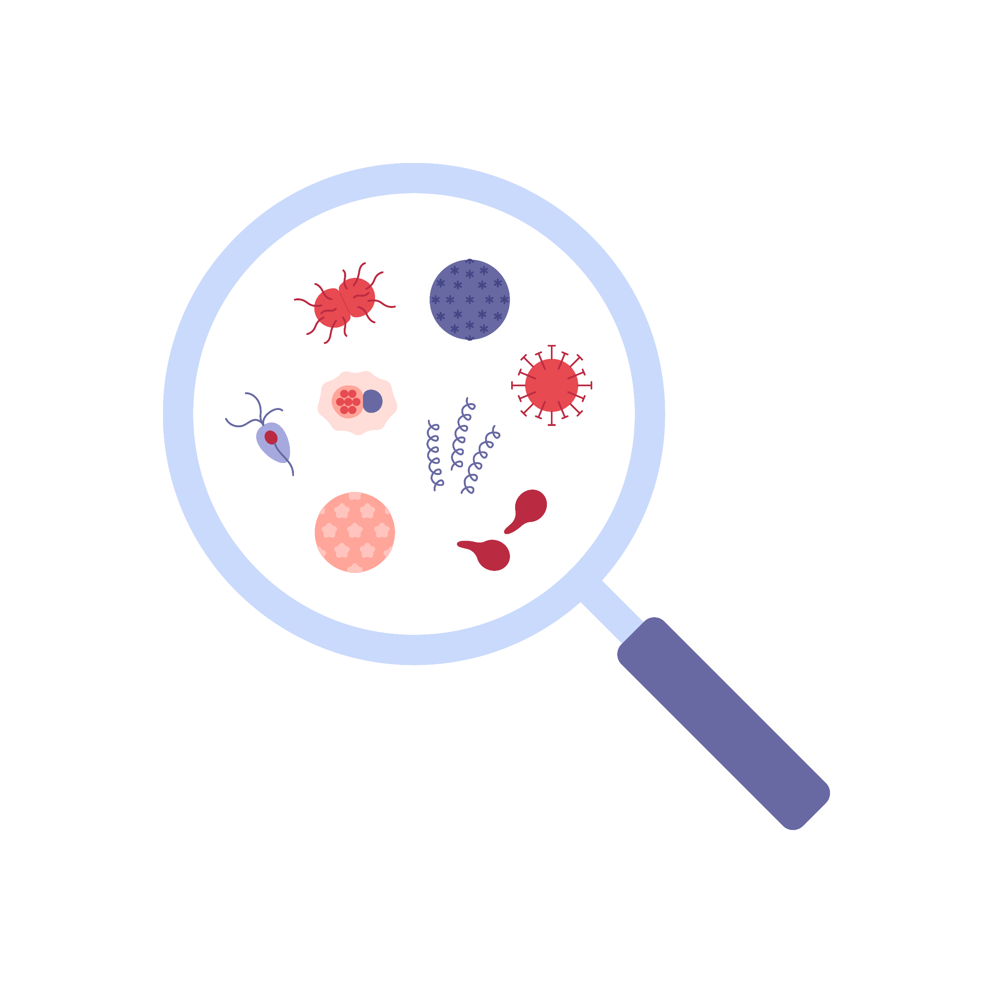
Bacteria or Virus?
Bacterial STI’s
Gonorrhea
Chlamydia
Syphilis
An STI that is caused by bacteria can be treated with antibiotics.
Bacterial STI’s can be cured, but they can also be re-acquired if safer sex practices are not followed.
Viral STI’s
Herpes
HPV
Hepatitis B
HIV
An STI that is caused by a virus cannot be cured. This means that the infection – and the risk of spreading the virus – lasts a lifetime.
At least 68 million people are believed to be infected with an STI. That is one in five Americans!

Slide 4
Who gets infected?
Young people between the ages
of 15 and 24 are the highest risk
of contracting an STI. More than
20 million new STI cases are diagnosed each year in the U.S.
Approximately fifty percent of these infections occur among teenagers. That means:
10,000,000 teens
every year
27,000 teens every day
1,141 teens every hour
19 teens every sixty seconds

Slide 5
Abstinence
The only 100%
risk-free behavior
is abstinence.

Slide 6
Chlamydia
The fastest growing STI in the U.S. is chlamydia
Most people with chlamydia don’t have symptoms
Some symptoms include: an unusual discharge and burning
while urinating
Chlamydia is treated and cured with antibiotics
If not treated, chlamydia can cause sterility in both women
and men

Slide 7
Hepatitis B
Hepatitis B can be passed by having unprotected
sex and sharing needles
Symptoms of hepatitis B include fever, achy muscles,
nausea with vomiting and diarrhea
Hepatitis B usually clears up within a few months.
Some people stay chronically ill.
Hepatitis B can cause serious liver damage

Slide 8
Herpes
Herpes can be spread through unprotected sex, intimate touching and sometimes through kissing
Symptoms include an itching and burning sensation and oral and genital blisters
Herpes symptoms often go away, but will come back later
Symptoms can be helped and sometimes controlled with medications
Herpes can NOT be cured, the virus stays in your body forever
Condoms do NOT give reliable protection against herpes

Slide 9
Syphilis
Syphilis can be passed through unprotected sex and sometimes through kissing
An early sign of syphilis are painless sores in or around the genitals or mouth
If not treated, syphilis can cause serious health problems, including damage to the brain and nervous system
If treated early, syphilis can be cured with antibiotics

Slide 10
HPV
The human papilloma virus or HPV, causes genital warts
The virus causes small bumps in the genital area.
They sometimes look like little cauliflowers
Genital warts can increase the risk of cervical and other cancers
They can be removed, but they may come back

Slide 11
HIV/AIDS
HIV is the virus that causes AIDS
You can’t tell by looking if someone has HIV
HIV is passed by having unprotected sex and sharing needles
HIV is not passed through casual contact, like shaking hands, hugging
or sneezing
Having another STD increases your risk of getting HIV
AIDS is the most advanced stage of HIV

Slide 12
Gonorrhea
Gonorrhea is passed through unprotected sex
An early sign of gonorrhea is a genital discharge, burning
during urination
If un-treated, gonorrhea can lead to infertility, blindness
and PID
Gonorrhea is usually curable with antibiotics, but the damage done to internal organs may be irreversible.

Slide 13
Pubic Lice
Pubic lice – also know as “crabs” – are small, wingless insects
Pubic lice are passed through close sexual contact, but can also be passed by sharing towels, sheets or clothes with someone who is infected
Symptoms include redness, swelling and itching in the genital area
Using a condom will NOT protect against pubic lice
Lice don’t stay confined to the pubic region. They can move to other parts
of the body.
These parasites can be killed with an insecticide lotion.

Slide 14
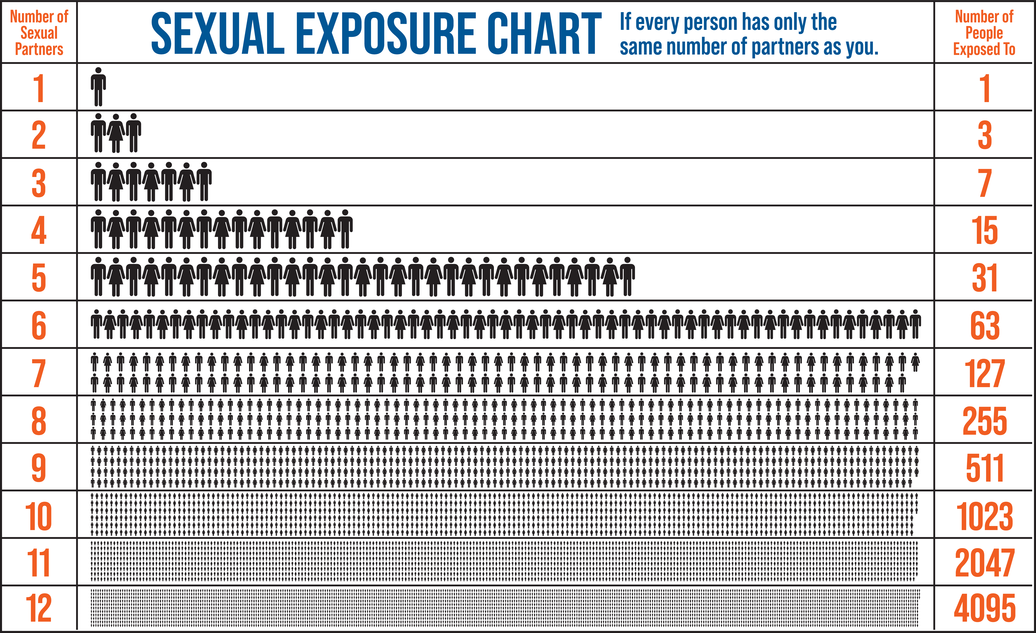

Slide 15
Thank You!

