Slide 1

Beginning Teacher Support
Beaufort County Schools

Slide 2
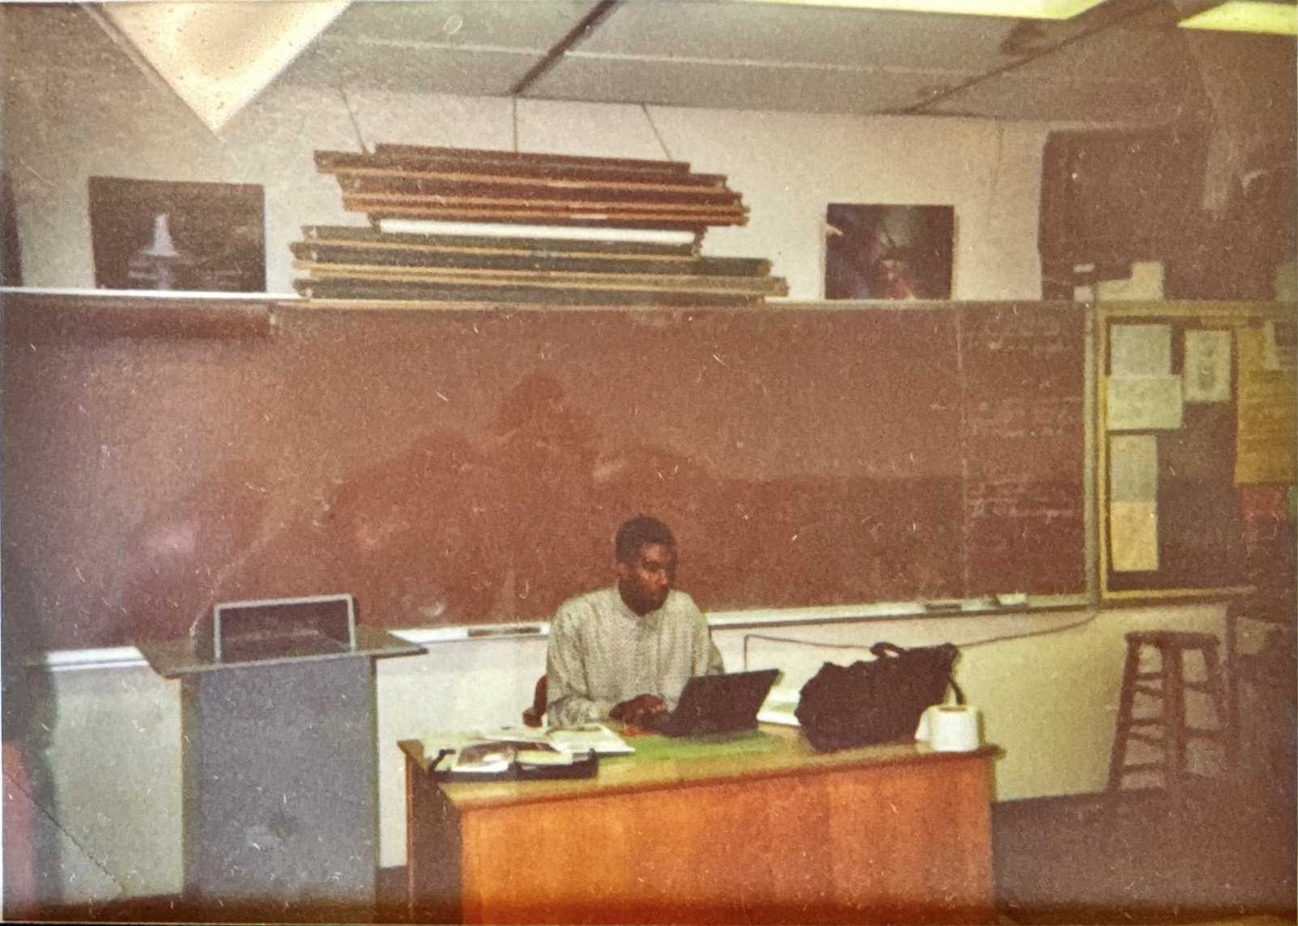
Dr. Norris Parker
Chief Administrative Officer

Slide 3
NC Policies for BT Support Program (TCED-016)
  Induction (Aug. 10th – 12th) Goals
  Orientation Requirement
  Beginning Teacher Support Plan (BTSP)
  Optimum working conditions for BTs
  Quick Overview of Observations, Evaluations, PDPs
  Mentor Assignment & Guidelines for Selection
  Mentor Training
  Licensure Conversion Process
  Ongoing Support and BT Responsibilities
  Professional Checklist – BCS Policies

Slide 4
Goals of Beginning Teacher Induction
Develop highly effective classroom teachers.
Increase beginning teacher confidence and competence.
Improve student achievement.
Ensure teachers meet the North Carolina Professional Teaching Standards.
Encourage teachers to remain in the profession and become future teacher leaders, administrators, and mentors.

Slide 5
Orientation Requirements
    BTs should be provided an orientation that is conducted prior to the arrival of students that includes:
    Overview of school district policies/procedures (HR)
    NC Standard Course of Study/Curriculum Goals (C & I)
    State Licensure Requirements (HR)
    Teacher Evaluation Process (HR)

Slide 6
Orientation &
Assignment/Experience Requirement
    Initial Professional License issued by the state to teachers with fewer than 3 years of teaching experience
    Offer ongoing support to teachers within their first three years of teaching-provided by district, school and mentor
    Beginning Teachers will be assigned in their area of licensure
    Three years of teaching experience are required to complete the BT Support Program
    Beginning Teacher Support Plan (BTSP)

Slide 7
Optimum Working Conditions
    To ensure that BTs can develop into capable teachers, the following are strongly recommended:
    Mentor support (In) vs. Coaching (Out)
    Induction that Details Expectations
    Limited class preparations
    Limited non-instructional duties
    ***No extra-curricular assignments unless requested in writing by the BT

Slide 8
Teacher Evaluation Process (Quick Guide)
  Teacher Evaluation Process:
  Self-assessment/orientation;
  Professional development plan (initial, mid-year and final review);
  Four 45-minute observations-three by administration and one by a peer (formal pre-conference to proceed the first observation); post-observation conference after all observations;
  Summative Evaluation

Slide 9
Mentor Assignments/BT Support Timetable/
Licensure Conversion
    BCS Mentor Support & Buddy Teachers; Grade Level & District Support
    BT Support Program -three years
    Initial Provisional License converts to Continuing License after successful teaching experience and completion of the BT Support Program

Slide 10
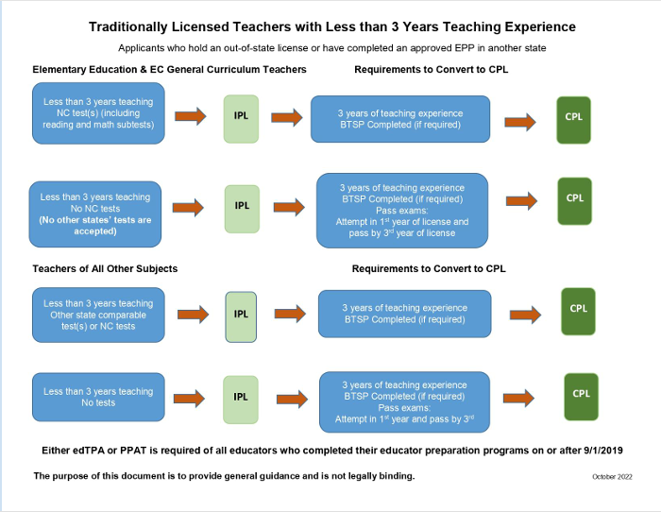
Licensure Conversion

Slide 11
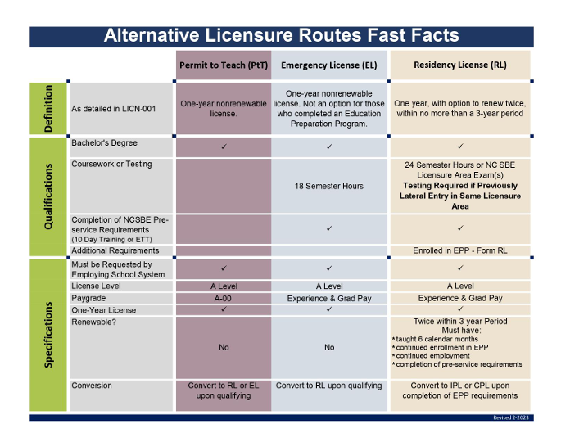
Licensure Conversion

Slide 12
Ongoing Beginning Teacher Support
District-wide support from various departments (Curriculum, HR, Accountability, EC, ESL, etc.)
BT meetings held during the year to offer targeted professional development
BT Newsletter (C & I)
BCS Beginning Teacher Webpage

Slide 13
Responsibilities of Beginning Teachers
Actively participate in orientation and induction activities.
Collaborate regularly with their mentor.
Complete required professional development.
Maintain a Professional Development Plan (PDP).
Participate in all required evaluations.
Demonstrate continuous professional growth.
Seek feedback and apply it to improve instructional practice.

Slide 14
Professionalism Checklist

Slide 15
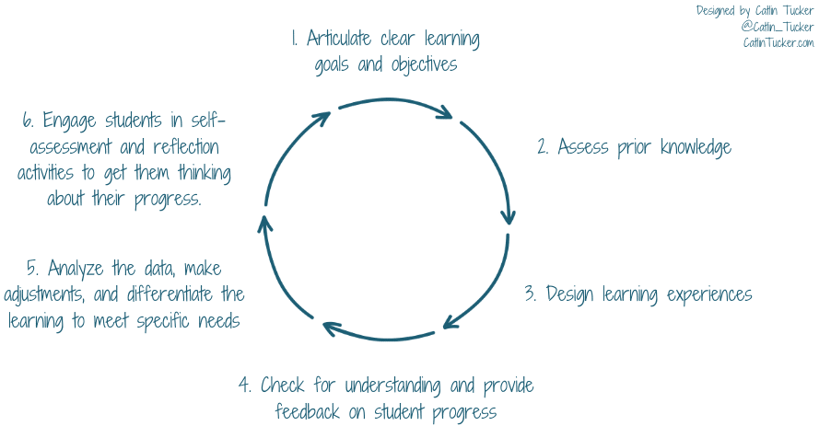
3 Questions + 3 Practices = 1 Outcome
Safety
Relationships
Facilitate Teaching & Learning
Effective Planning, Relevant Content, and Appropriate Rigor
Classroom Management
Effective Use of Student Data/Assessments

Slide 16
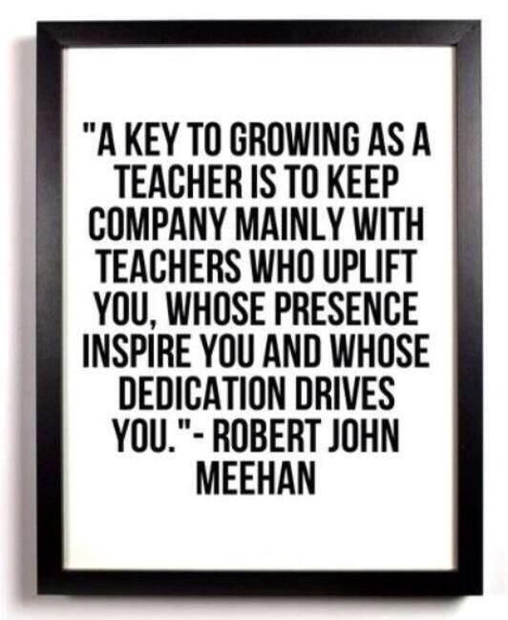
Conclusion
You are not alone!
Ask questions!
Ask for help!
Keep a great
attitude!
Place students first!

