Slide 1

Calla High School
Orientation
Class Hours- M/T/R/F
8:30 AM-1:55 PM
W
8:30 AM- Noon
Dennis L. Foster, CAA
Principal

Slide 2

How to succeed at Calla?
Attend school every day on time and stay the whole day
Complete ALL assignments in EACH class
Participate in non-academic activities- Leadership events, sports, clubs, Prom
Be willing to ask for help
Take advantage of this opportunity

Slide 3

Calla High School Academic Structure
  Fall Block 1, 2, 3
  Spring Block 4, 5, 6
Six week grading term (Blocks)
6 academic classes daily
45 min academic classes
20 min Directed Studies
Lunch-11:57 AM-12:22 PM M/T/R/F
Brunch 10:39 AM- 10:55 AM W
No homework

Slide 4
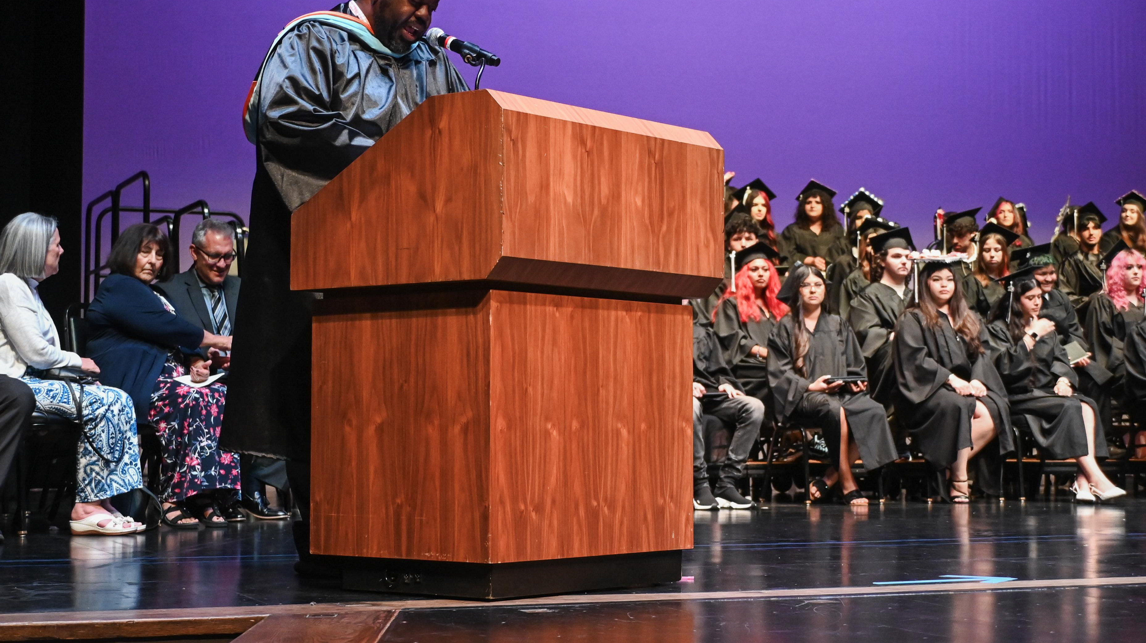
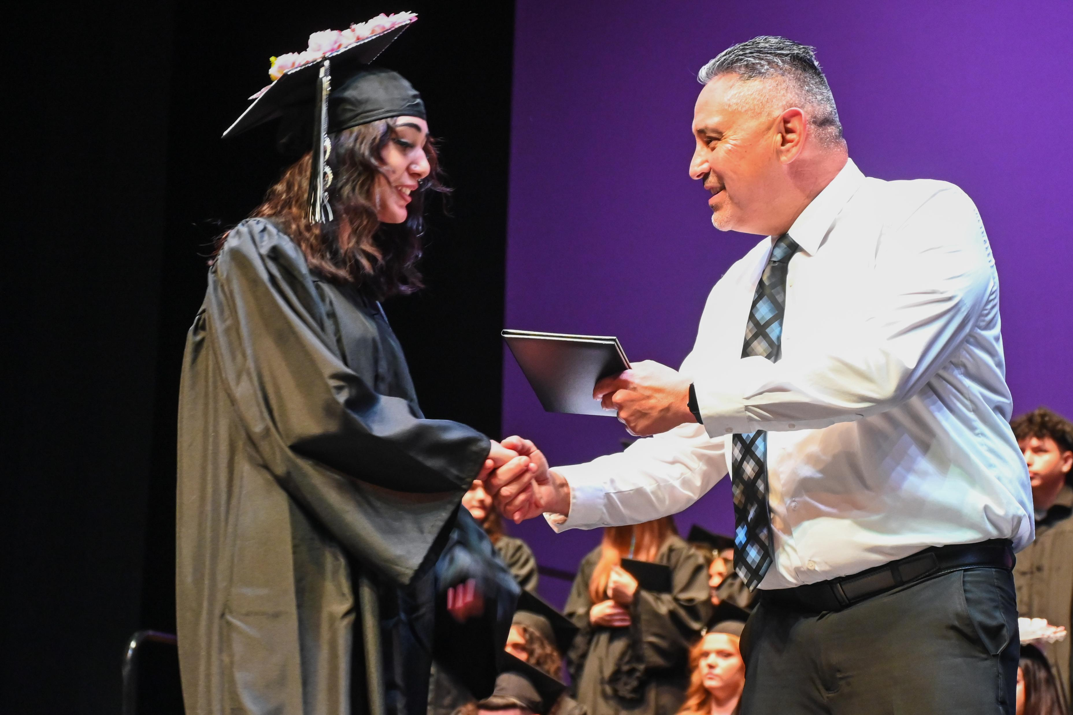
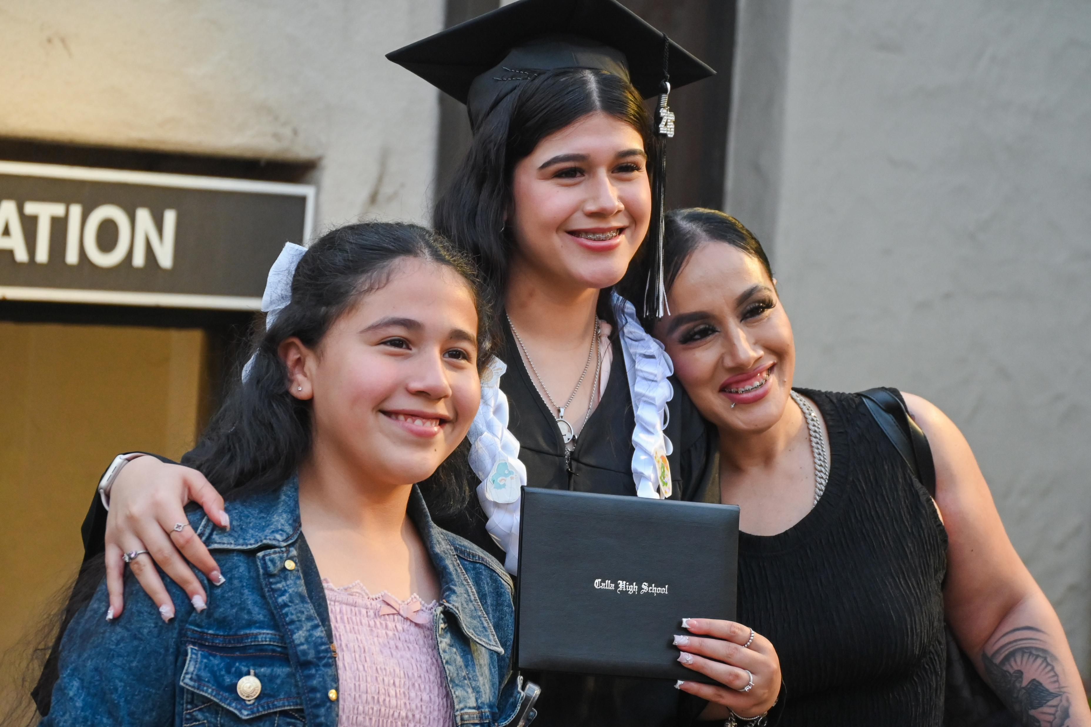
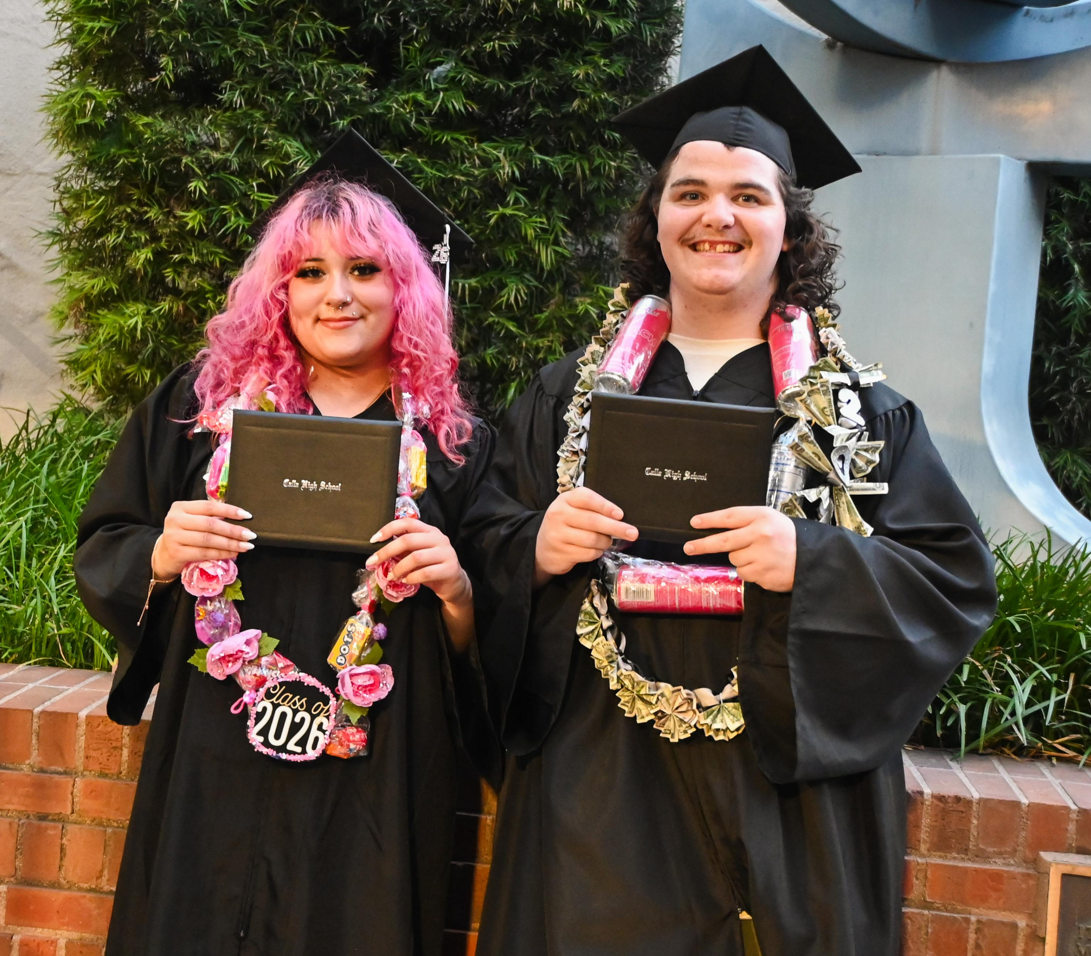
Calla High School
Graduation Requirements

Slide 5
Subjects | Graduation Requirements-225
English | 40 credits
Mathematics | 30 credits (10 in Alg 1)
Social Science | 30 credits US His, World His and Gov/Econ
Science | 20 credits Life and Physical Science
Fine Art Electives PE Health | 10 credits 70 credits 20 credits 5 credits
Total | 225

Slide 6
Potential Yearly Credits
Terms-grading terms Block-six weeks
Block 1 20 credits 1st period 3 credits
Block 2 20 credits 2nd period 3 credits
Block 3 20 credits 3rd period 2 credits (DS class)
Block 4 20 credits 4th period 3 credits
Block 5 20 credits 5th period 3 credits
Block 6 20 credits 6th period 3 credits
120 total 7th period 3 credits
20 total

Slide 7

Where can you go from here?
Correct answer is: ANYWHERE!
Options include:
Community College or Trade School (typically two year programs)
College or University after lower division classes are completed
Your diploma from Calla is NOW fully WASC accredited, so it is equivalent to a comprehensive high school diploma!

Slide 8



Return to
Home High School
Request through counselor
Requests taken only for August or January
Must be making satisfactory progress on attendance, credits and behavior
Counselor may recommend or decline
Goal is high school diploma

Slide 9
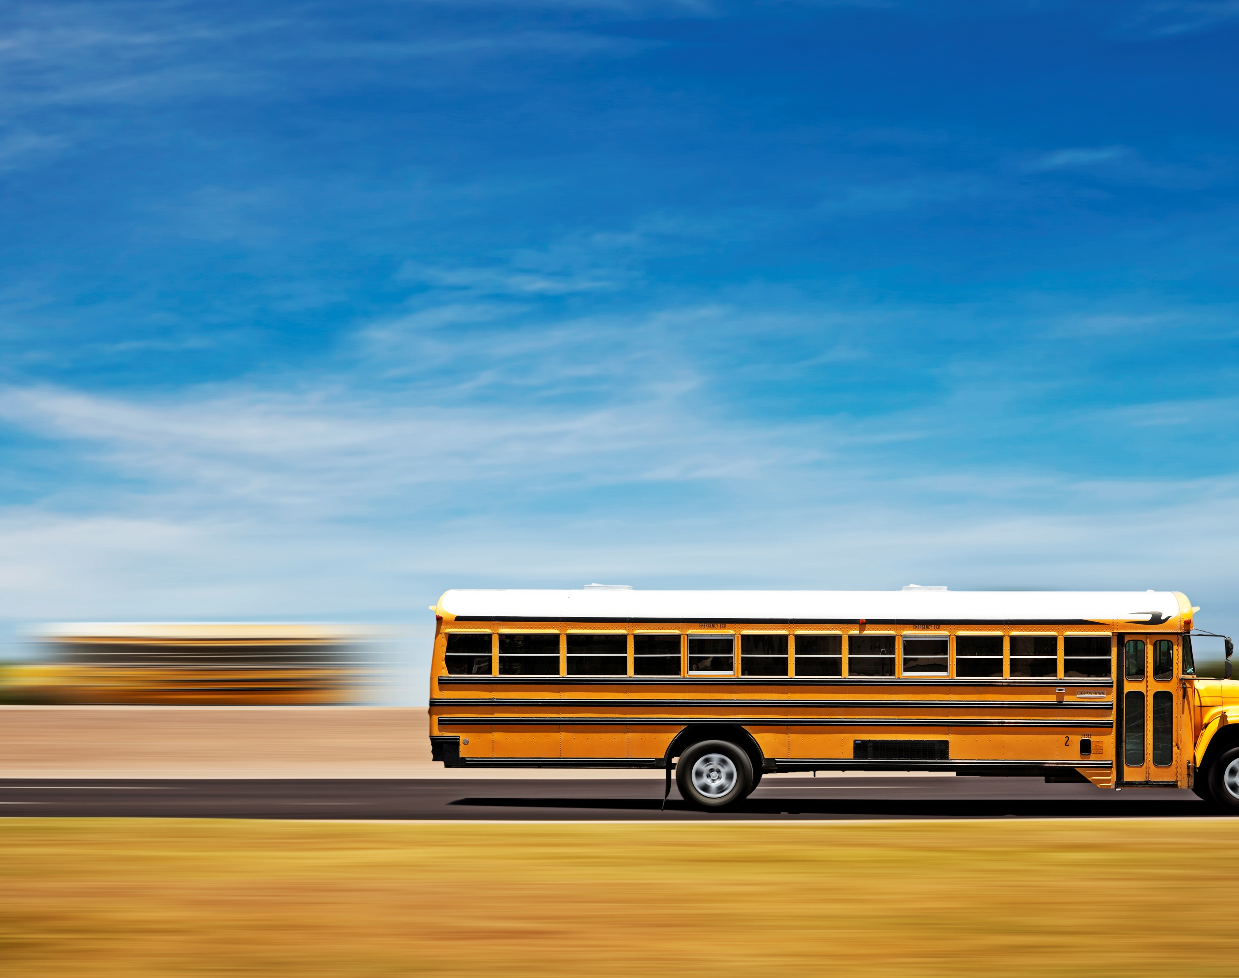
Attendance Policy
SHOW UP TO SCHOOL
Court dates and/or doctor appointments with documentation are the only excused absences
Documentation needs to be provided within 7 calendar days- NO EXCEPTIONS
Parents/Guardians should still call into office to document the absence for the particular day/time

Slide 10

Attendance Matters
Calculations
Each block
5+ absences= -1 credit
Each class
5+ tardies= -1/2 credit
Each class
<15 credits= Academic Probation

Slide 11

Calla High School Culture
WE ARE CALLA
No clothing that displays and/or encourages the use of drugs, alcohol, and/or smoking
Remainder of dress code is in accordance with MUSD policies, which include staff discretion- if found in violation, student will be asked to change clothes
Closed campus- once students set foot on campus, they cannot leave and we allow no visitors
Violations will result in progressive discipline

Slide 12

Calla High School Mobile Phone Policy
Students are NOT allowed to have mobile phones during instructional time starting at 830a until the end of the school day either noon or 155p
Students who bring their mobile phones to school turn them into their 7th period teacher prior to 1st period
Students pickup their laptop devices in their 7th period class prior to 1st period
Students turn in their devices at the end of 7th period and have their mobile phones returned to them for dismissal

Slide 13

Good Start, Good Day
Busing from several locations throughout the city of Manteca
Schedule on next slide
Free breakfast and lunch for all students
Breakfast is 8:00 AM to 8:25 AM daily
Lunch is 11:57 AM to 12:22 PM M/T/R/F
Brunch is 10:39 AM to 10:55 AM W

Slide 14

CALLA HIGH SCHOOL
S
CAFETERIA
E
W
15
N
7
BOYS R.
14
6
STUDENT PARKING
GIRLS R.
4
3
13
12
SS
10
D
2
11
8
5
9
1
A
OFFICE
SL
B
STORAGE
C

Slide 15
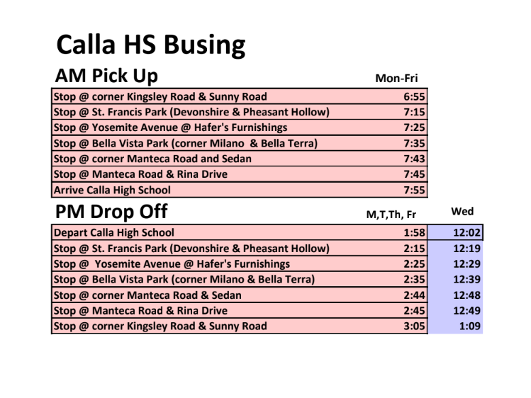

Slide 16

Counseling
Academic counseling
School- based intervention mental health services
Post high school guidance
Work permits
Financial aid applications
Scholarship applications
College/University/Trade School /Military/Work force Support

Slide 17

Sports
Soccer- Fall
Football- Fall
Volleyball- Fall/Winter
Basketball- Winter
Softball- Spring
Dodgeball- Spring

Slide 18

Instagram Link for Leadership

Slide 19

QUESTIONS AND COMMENTS

