Slide 1
2026 Annual PTO/Booster Club Meeting

Slide 2
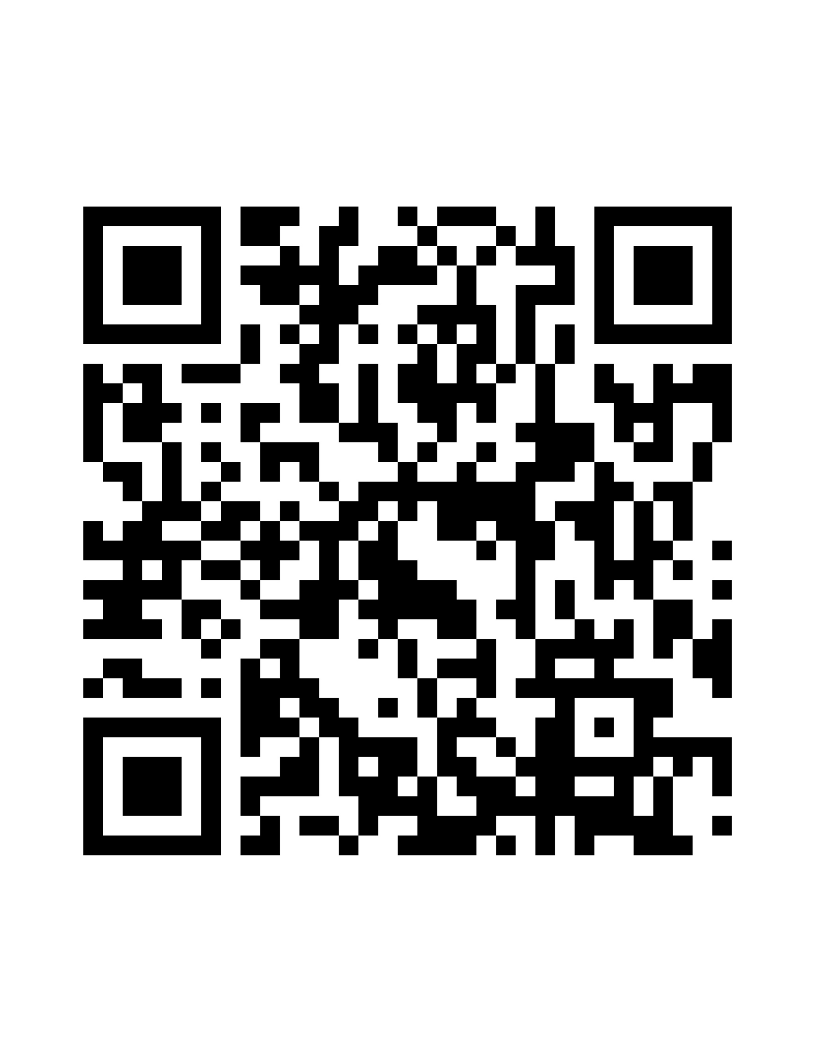
Let us know what campus you're representing

Slide 3
Serenity Lemond
Internal Auditor
FBISD Business & Finance
(281) 634-2812 serenity.lemond@fortbendisd.gov

Slide 4
Department of Collaborative Communities
Payal Pandit Talati, MPH
August 1, 2026

Slide 5
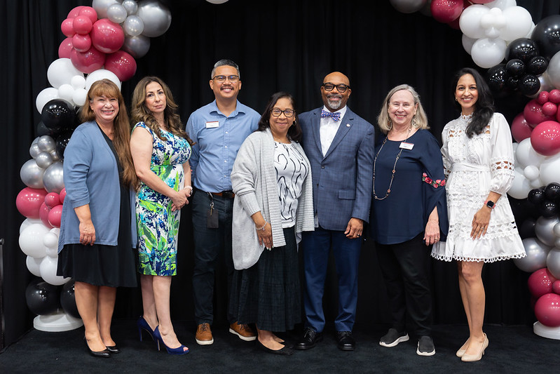
About Collaborative Communities
Primary Goal: Build connections across the community by forming mutually beneficial partnerships and collaborations that provide enrichment and support to our students.
Connecting Community to Student Success.

Slide 6
What You Need to Know
Background Checks
  Safety is a priority; needs to be completed annually after July 1
  Encourage parents who plan to volunteer to complete the process early
Campus Support
  Connect with your campus to make sure all parent organization and booster donations are being reported to the district
Volunteer Hours
  Work with your VIPS Campus Coordinator to track and report off-campus volunteer hours
  Volunteer hours help demonstrate community engagement and support district reporting efforts

Slide 7
District Engagement
Shared Dreams Program
  Give back to your school district and equip students with basic needs items.
Mentoring
  Become a mentor or partner with us to start or strengthen a mentoring program at your campus.
Faith Network
  Join the Network and share opportunities with your faith community to support students and partner with the District.
Central Application Platform
  Apply to participate on a District stakeholder committee.
Guest Speaker/Event Judge
  Share your expertise by serving as a guest speaker or event judge, or help spread the word to others

Slide 8
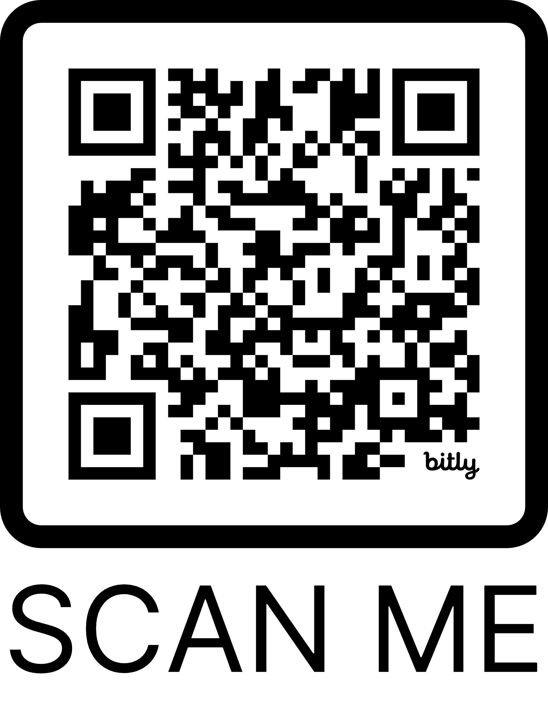
Important Links
Volunteer Background
Volunteer Hours
Mentor Interest Form
Career Day Speaker Database
Central Application Platform

Slide 9

Connect with Us!
Website: fortbendisd.gov/CollaborativeCommunities
Email: collaborativecommunities@fortbendisd.gov
Phone: 281-634-1109
Social:
Facebook.com/FBISDCollaborativeCommunities

Slide 10
BUILDING STRONG PTO & BOOSTER ORGANIZATIONS
PRESENTED BY : SARAU BECERRA & JAIME HUMPHREY

Slide 11

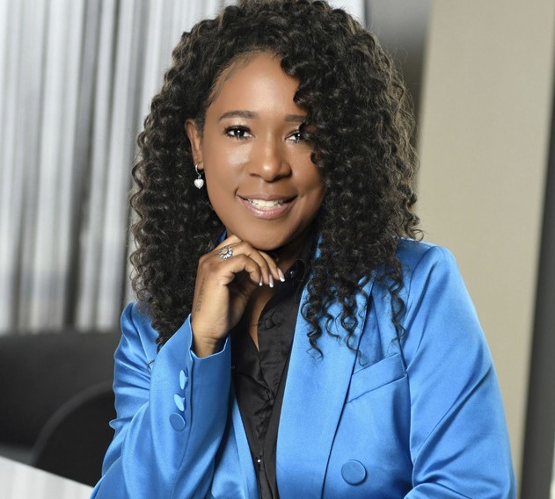
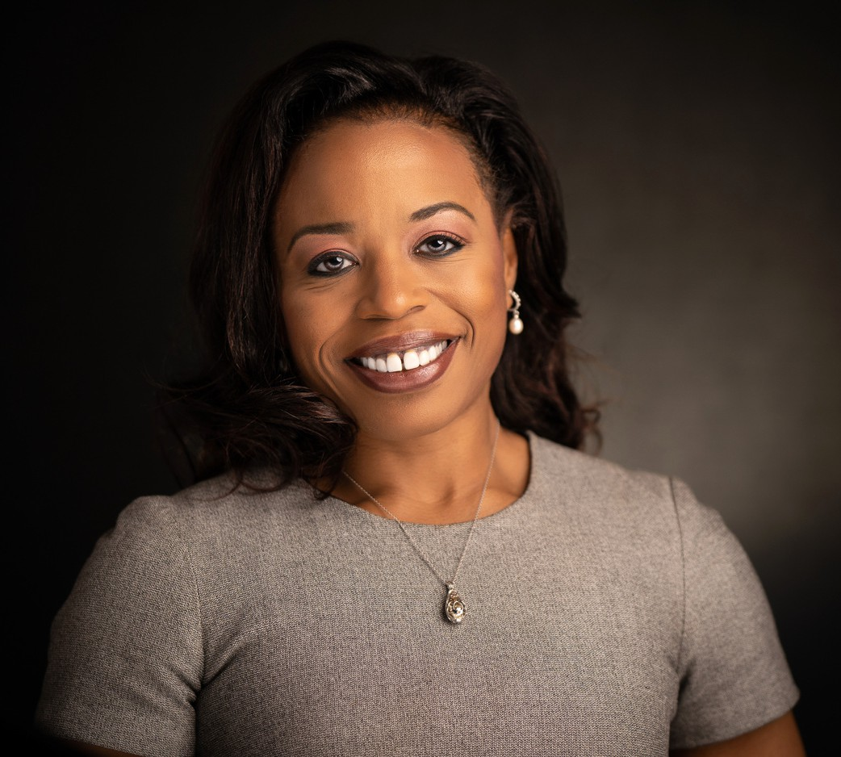

MEET YOUR PRESENTERS
Sarau Becerra
Jaime Humphrey
Certified Public Accountant | Nonprofit Tax & Compliance
Strategic Advisor | Nonprofit Governance & Financial Stewardship

Slide 12


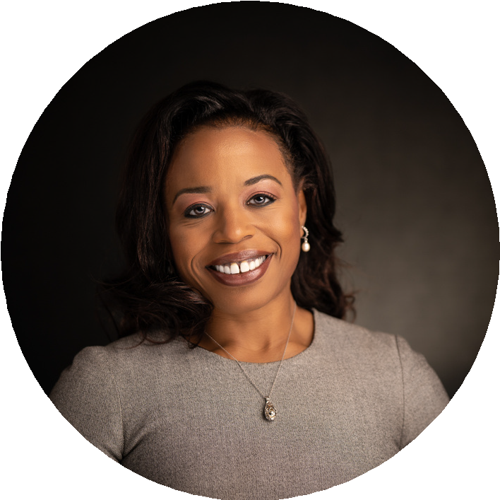

SESSION FOCUS
Governance
Lead well through effective governance.
Transparency
Operate with clarity and accountability.
Internal Controls
Protect your organization, volunteers, and financial resources.
STAYING COMPLIANT
Regulations, Form 990, Texas nonprofit requirements, and CPA best practices.

Slide 13






WHY YOUR ROLE MATTERS
STEWARDSHIP LEADERSHIP
LEGACY

Slide 14

YOUR BOARD IS MORE IMPORTANT THAN YOU MAY THINK:
TRUST

Slide 15

WHO IS COUNTING ON YOUR LEADERSHIP THIS YEAR?
Donors
Volunteers
School Community
Students
Future Leaders

Slide 16




BOARD RESPONSIBILITIES
LEADERSHIP BEYOND THE MEETING
What is the most important responsibility of a PTO or Booster Club board member

Slide 17



BOARD RESPONSIBILITES
Lead with Integrity
Making decisions in the best interest of the organization
Protecting Resources
Ensure transparency and proper financial controls.
Provide Direction
Follow bylaws and policies. Future Planning
3 Questions to Ask at Your Next Meeting

Slide 18

3 QUESTIONS
Are we making decisions that align with our mission?
Are we protecting every dollar entrusted to us?
Are we leaving the organization stronger for the next board?
The questions you ask before every board meeting shape the decisions you make.

Slide 19


PROTECING THE ORGANIZATION
Strong organizations rely on systems—not individuals
If your Treasurer or President resigned tomorrow, what systems would ensure your organization could continue operating with confidence?

Slide 20

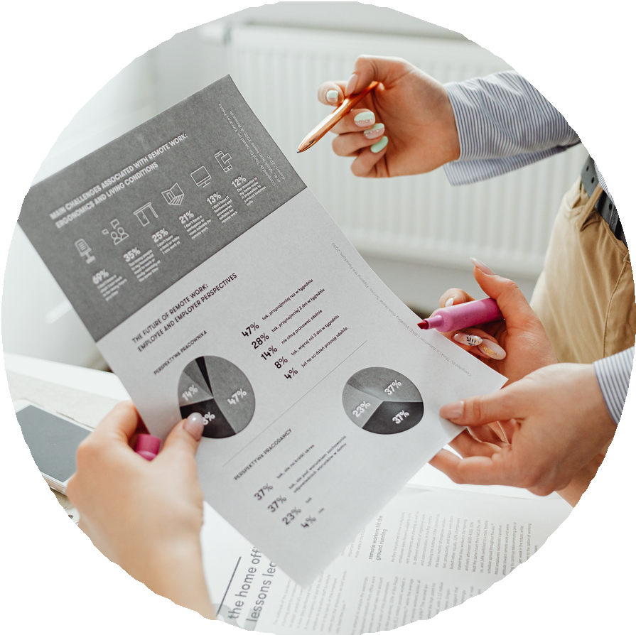


INTERNAL CONTROLS AND ACCOUNTABILITY
Secure Financial Access
Document Every Decision
Prepare for Leadership Transition
Build Shared Oversight
Before your next board meeting, ask:
If a new officer stepped into our organization tomorrow, would our systems provide them with everything they need to lead successfully and responsibly?

Slide 21



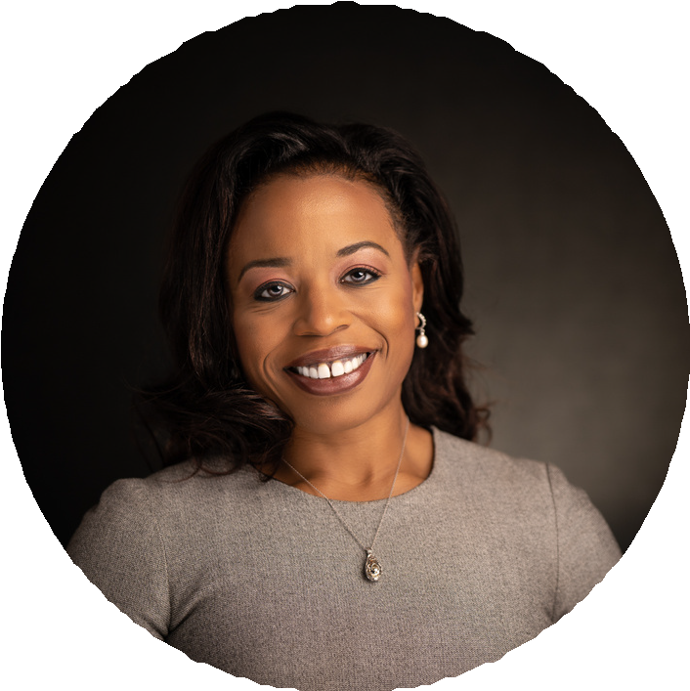
LEADING WITH
CONFIDENCE
Lead with Purpose. Serve with Confidence.
Thank you for choosing to serve.
Write down one commitment you'll make to your PTO or Booster Club this year.
Next Up Jaime Humphrey

Slide 22


JMH
FORT BEND ISD · PTO & BOOSTER CLUB MEETING
Staying Compliant:
The CPA Perspective
IRS requirements, Form 990 reporting, Texas tax compliance, and financial best practices for parent & booster organizations.
IRS 501(c)(3)
Form 990 Series
Texas Sales & Franchise Tax
Best Practices
JMH
Jaime M. Humphrey, CPA
Presented for FBISD Parent & Booster Organizations
Notes:
Welcome & Introduction
Welcome everyone. I'm Jaime Humphrey, a CPA who works with school-support organizations here in Texas. Over the next 15 minutes I'll give you the technical CPA view of running a compliant PTO or booster club — the IRS side, Form 990, Texas state rules, and the money-handling habits that keep your board out of trouble. Set the tone: this is practical, not scary. Note there is a QR/handout at the end.

Slide 23
WHAT WE'LL COVER
Agenda — 15 minutes
01
02
03
Why It Matters
Two Separate Hurdles
Form 990 Reporting
The stakes of getting compliance right for your organization and your board.
Federal 501(c)(3) recognition vs. Texas state exemption — not the same thing.
Which annual return you file and when it is due.
04
05
06
The 3-Year Trap
Texas Sales Tax
Financial Controls
Automatic revocation — how good clubs lose their status.
Permits, tax-free sale days, and what fundraisers are taxable.
The treasurer’s playbook to protect volunteers and funds.
JMH
Jaime M. Humphrey, CPA
Agenda
Notes:
Agenda
Quick roadmap so you know where we're headed. We'll cover why compliance matters, the two separate approvals every group needs (federal AND state), the annual Form 990 filing, the single biggest trap — automatic revocation — then Texas sales tax and the two tax-free days, and finish with financial controls your treasurer should be running. Tell them: keep questions for the end, and there's a one-page summary to take home.

Slide 24
THE STAKES
You are running a real tax-exempt entity
WHY THIS IS ON YOU
WHAT’S AT RISK
Your club is a separate legal & tax entity — not covered by the school district.
Loss of tax-exempt status — and the tax bill that follows.
Boards turn over yearly; today’s lapse becomes next year’s crisis.
Personal exposure for officers if funds are mishandled.
Donor trust — families give to organizations they can rely on.
Volunteers, not accountants, are signing the checks and the filings.
The good news: compliance is a short, repeatable checklist — not a full-time job.
JMH
Jaime M. Humphrey, CPA
Why it matters
Notes:
Why Compliance Matters
Frame the 'why.' A PTO or booster club is a real tax-exempt entity — the IRS and the Texas Comptroller treat it like any other nonprofit corporation. The people at risk are volunteers: parents who rotate off the board every year or two. When paperwork lapses, the NEXT board inherits the problem. Emphasize the three real consequences: losing exempt status (donations no longer deductible, you may owe tax), personal exposure for officers who mishandle funds, and reputational damage that dries up donations. Reassure: compliance is very doable with a simple routine — that's what today is about.

Slide 25
THE CORE CONCEPT
Two separate approvals — federal and state
1 · FEDERAL — IRS
2 · STATE — TX COMPTROLLER
501(c)(3) recognition
Sales & franchise tax exemption
Apply on Form 1023 or 1023-EZ (Pay.gov + fee).
Booster clubs file Form AP-204 + IRS letter.
An EIN alone is NOT exemption — it’s just an ID number.
PTOs/PTAs file Form AP-207 (educational).
Federal 501(c)(3) does not auto-exempt you in Texas.
Apply within 27 months of forming for retroactive status.
Neither PTOs nor booster clubs are covered by the school’s exempt status — every group must apply on its own.
JMH
Jaime M. Humphrey, CPA
Federal vs. State
Notes:
Federal vs. State: Two Approvals
This is the #1 misunderstanding. Getting an EIN from the IRS does NOT make you tax-exempt — an EIN is just an account number. And your federal 501(c)(3) letter does NOT automatically exempt you from Texas taxes. These are two separate applications to two separate agencies. Walk left to right: Federal — apply to the IRS for 501(c)(3) recognition. Then State — apply to the Texas Comptroller for sales and franchise tax exemption, using your IRS determination letter. Booster clubs are explicitly NOT covered by the school's exempt status; PTOs and PTAs are not automatically exempt either. Everyone must apply. We'll take each in turn.

Slide 26
FEDERAL — STEP BY STEP
Becoming a 501(c)(3) with the IRS
STEP 1
STEP 2
STEP 3
Get your EIN
Apply for exemption
Keep the letter
File Form SS-4 — required even with no employees. It’s your ID, not your exemption.
Form 1023-EZ (streamlined, most small clubs) or full 1023, filed on Pay.gov with a user fee.
Store the IRS determination letter permanently — you’ll need it for the state and the next board.
WATCH THE CLOCK
Apply within 27 months of forming to have exemption apply retroactive to your formation date. Wait too long and you may owe tax for the gap.
JMH
Jaime M. Humphrey, CPA
Federal exemption
Notes:
Getting Federal Exemption
Here's the practical federal path. Step one: form the entity and get an EIN on Form SS-4 — even with zero employees. Step two: apply for 501(c)(3) recognition. Most small clubs qualify for the streamlined Form 1023-EZ, which is faster and cheaper; larger or more complex groups use the full Form 1023. Everything is filed online through Pay.gov with a user fee. Step three: keep your IRS determination letter forever — the next treasurer will need it, and Texas will ask for it. The 27-month rule matters: apply within 27 months of formation and your exemption is retroactive to day one. Miss it and there can be a gap where you were technically taxable.

Slide 27
TEXAS — COMPTROLLER
State sales & franchise tax exemption
HOW TO APPLY
TWO THINGS TO REMEMBER
Booster clubs → Form AP-204 + IRS determination letter.
Franchise tax applies until you’re approved — file until the exemption is granted.
PTOs / PTAs → Form AP-207 (educational organization).
Lose your federal status and your Texas exemption ends automatically.
Form the entity via Certificate of Formation with the TX Secretary of State.
Notify the Comptroller of any change in purpose or activities.
JMH
Jaime M. Humphrey, CPA
Texas exemption
Notes:
Texas State Exemption
Now the Texas side, with the Comptroller. Two taxes matter to you: sales tax and franchise tax. A booster club that holds a federal 501(c)(3) or (4) letter is eligible for exemption from BOTH — apply on Form AP-204 with a copy of your IRS letter. PTOs and PTAs apply as educational organizations on Form AP-207. Critical point on franchise tax: it applies to every taxable entity regardless of nonprofit status UNTIL the Comptroller grants your exemption — so if you haven't been approved yet, you're technically required to file. Also form the entity correctly: file a Certificate of Formation with the Texas Secretary of State and keep a registered agent. And remember — if the IRS ever revokes your federal status, your Texas exemption ends automatically.

Slide 28
FEDERAL ANNUAL REPORTING
Which Form 990 do you file?
SMALLEST
MID-SIZE
LARGEST
990-N
990-EZ
990
e-Postcard
Short form
Full return
Gross receipts ≤ $50,000. Online only, free, 8 basic items.
Receipts < $200,000 and assets < $500,000.
Receipts ≥ $200,000 or assets ≥ $500,000.
DEADLINE
Due the 15th day of the 5th month after your fiscal year-end. Calendar-year clubs (Dec 31) → May 15. Most PTOs & booster clubs file the 990-N or 990-EZ.
JMH
Jaime M. Humphrey, CPA
Form 990 reporting
Notes:
Form 990 Annual Reporting
This is the heart of the CPA talk. Every exempt organization must file an annual return in the 990 series — which one depends purely on size. Walk the three tiers: if your gross receipts are normally $50,000 or less, you file the 990-N e-Postcard — it's online, free, and only eight pieces of basic information. If receipts are under $200,000 AND assets under $500,000, you file the 990-EZ. At or above $200,000 in receipts OR $500,000 in assets, you file the full Form 990. Due date is the 15th day of the 5th month after your year-end — for a calendar-year club that's May 15. Stress: most PTOs and booster clubs land in the 990-N or 990-EZ tier, so this is very manageable — but it is NOT optional, and that leads directly to the next slide.

Slide 29
THE BIGGEST RISK — AND IT’S AVOIDABLE
Miss 3 years → automatic revocation
WHAT HAPPENS
HOW CLUBS AVOID IT
Fail to file for 3 consecutive years = status revoked automatically.
Put the 990 deadline on a shared calendar every year.
Hand off the IRS login & records at every officer change.
No warning required; effective on the 3rd year’s due date.
File even a $0 e-Postcard in quiet years — it still counts.
Donations stop being deductible; you may owe tax; Texas exemption falls too.
Reinstatement means re-applying and paying the fee again — far harder than a 10-minute filing.
JMH
Jaime M. Humphrey, CPA
Automatic revocation
Notes:
The Automatic Revocation Trap
This is the single most important slide — please slow down here. The IRS automatically revokes tax-exempt status if an organization fails to file its required 990, 990-EZ, or 990-N for three consecutive years. Revocation is automatic — no warning letter is required, and it takes effect on the third year's due date. This is exactly how well-meaning booster clubs die: a treasurer moves away, nobody files the little e-Postcard for a couple of years, the new board doesn't know, and suddenly the club is no longer exempt, donations aren't deductible, and you may owe tax. Getting reinstated means re-applying to the IRS and paying the fee again. The fix is dead simple: put the filing on a calendar, and formally hand off the login and records at every officer transition.

Slide 30
FUNDRAISING IN TEXAS
Sales tax, permits & two tax-free days
THE RULE
THE PERK
THE LIMITS
Collect & remit
2 tax-free days
Know the edges
Taxable sales generally need a sales tax permit; collect and remit tax.
Two one-day tax-free sales/auctions per calendar year — can be back-to-back (48 hrs).
Not for a for-profit fundraiser (they’re the seller) or items over $5,000.
OFTEN ALREADY NONTAXABLE
Bake-sale baked goods; concession food at school-sanctioned events; food & candy sold during the school day.
Membership dues; PTA/PTO reading materials — yearbooks, directories, newsletters.
JMH
Jaime M. Humphrey, CPA
Texas sales tax
Notes:
Texas Sales Tax & Tax-Free Days
Fundraising has its own Texas sales-tax rules. General rule: on taxable items you sell, you generally need a sales tax permit and must collect and remit sales tax. Big exception you'll love: once you have your state sales-tax exemption, you get TWO one-day tax-free sales or auctions per calendar year — and they can run back-to-back for up to 48 hours. Important limits: the tax-free day doesn't apply when you're just selling for a for-profit fundraising company — in that case the company is the seller and collects the tax — and it doesn't apply to items over $5,000 unless you made or were donated the item. Then the practical good news: a lot of what you already do is naturally nontaxable — bake-sale baked goods, concession-stand food at school-sanctioned events, food and candy sold during the school day, membership dues, and PTA/PTO reading materials like yearbooks and directories.

Slide 31
TECHNICAL WATCH-OUTS
UBIT, public disclosure & private benefit
UBIT
PUBLIC
INUREMENT
Unrelated income
990 is open
Individual credit
$1,000+ from an unrelated trade/business → file Form 990-T, tax may be due.
Your 990 is public — never list SSNs; assume donors may read it.
Crediting funds to a specific child’s account can be private benefit — a real exemption risk.
Keep fundraising proceeds pooled for the group’s exempt purpose — not individual accounts.
JMH
Jaime M. Humphrey, CPA
Watch-outs
Notes:
Two Compliance Watch-Outs
Two more technical items that trip up clubs. First, Unrelated Business Income Tax — UBIT. If your organization earns $1,000 or more of gross income from a trade or business that isn't related to your exempt purpose — think regularly renting out equipment or running an ongoing commercial operation — you must file Form 990-T and may owe tax even though you're exempt. Normal school fundraisers usually don't trigger this, but it's worth flagging. Second, your Form 990 is a PUBLIC document — anyone can request it, and it's posted online. Two implications: never put Social Security numbers on it, and treat it as a reflection of your organization that donors and grantmakers may read. Also flag the classic booster-club danger: 'individual fundraising credit,' where money a family raises is credited to their own child's account. That can look like private benefit and jeopardize your exemption.

Slide 32
THE TREASURER’S PLAYBOOK
Financial controls that protect volunteers
01
02
03
Separate funds
Dual controls
Cash handling
Own bank account & EIN. Never commingle with personal or school money.
Two signatures on large checks; split who receives, records, and reconciles.
Count with two people, pre-numbered receipts, deposit promptly.
04
05
06
Monthly reporting
Annual review
Records & insurance
Treasurer’s report + bank reconciliation reviewed by the board each month.
Audit/review committee at every officer transition.
Keep records 7 yrs (990s permanently); carry liability, bond & D&O.
JMH
Jaime M. Humphrey, CPA
Best practices
Notes:
Financial Best Practices
Now the money-handling controls — this is what protects your volunteers personally. Six habits. One: separate everything — own bank account and EIN, never commingle with personal or school funds. Two: dual controls — two signatures on checks over a threshold, and separate the duties so the person who receives cash isn't the same person who records it or reconciles the account. Three: count cash with two people present, use pre-numbered receipts, deposit promptly. Four: the treasurer gives a written report and the board reviews a bank reconciliation every month. Five: at each officer transition, run an annual financial review or a small audit committee. Six: keep records seven years, keep the 990s and determination letter permanently, and carry insurance — liability, a fidelity bond, and D&O. These aren't bureaucracy; they're what let a volunteer sleep at night.

Slide 33
JMH
IN SUMMARY
Three things to remember
1
2
3
Two approvals
File every year
Control the cash
Federal 501(c)(3) and Texas exemption. An EIN is not exemption.
Your 990 is due annually — three misses = automatic revocation.
Separate accounts, dual signatures, monthly reconciliations.
Thank you — questions welcome.
Jaime M. Humphrey, CPA
•info@jhumphreycpa.com
•(713) 840-9050
JMH
Jaime M. Humphrey, CPA
info@jhumphreycpa.com · (713) 840-9050
Notes:
Key Takeaways & Questions
Land the plane with the three things to remember. One: you need TWO approvals — federal 501(c)(3) AND Texas state exemption — an EIN is not exemption. Two: file your 990 every single year without fail — three misses and you're automatically revoked. Three: run simple financial controls — separate accounts, dual signatures, monthly reconciliations — to protect your volunteers. Thank them, offer the one-page handout, and open the floor for questions. Give your contact information.

Slide 34
Important Sales Tax Info
Presented by: Krupa Shrinivas
Enforcement Officer
State Comptroller’s Office
Laxmikrupa.Shrinivas@cpa.texas.gov
(713)426-8200 Ext: 42627

Slide 35
PTO/BOOSTER CLUB LEADERSHIP EXCHANGE

Slide 36

Board Leadership

Slide 37
Board Leadership​
What's one thing your board does really well?
How do you recruit new board members?
How do you prevent the same people from serving year after year?
How do you keep volunteers engaged after their first event?

Slide 38




Fundraisers

Slide 39
Fundraisers
What has been your most successful fundraiser?
What fundraiser didn't go as planned, and what did you learn?
Has anyone tried a new fundraiser that exceeded expectations?
How do you decide whether a fundraiser is worth doing?

Slide 40

Financial Best Practices

Slide 41
Financial Best Practices
What's one financial process your organization couldn't live without?
How do you keep your board informed about finances?
What internal control has made the biggest difference for your organization?

Slide 42

Volunteer Recruitment

Slide 43
Volunteer Recruitment
How do you recruit volunteers who have never been involved before?
What's your favorite volunteer appreciation idea?
How do you make volunteering manageable for busy parents?

Slide 44

Sharing Resources

Slide 45
Sharing Resources
What's an app, website, or tool your organization uses that you'd recommend?
Does anyone have a great sponsorship packet they'd be willing to share?
Has anyone created a volunteer handbook or board notebook?

Slide 46

Lessons Learned

Slide 47
Lessons Learned
What's one mistake you made that helped you become a better leader?
If you could go back to your first board meeting, what advice would you give yourself?

Slide 48

Lightning Round

Slide 49
Lightning Round
Finish this sentence...
  "The key to a successful PTO is..."
  "The best fundraiser is..."
  "Every treasurer should..."
  "Every president should..."
  "One thing every board should stop doing is..."
  "One thing every board should start doing is..."

Slide 50
What's one piece of advice you'd give every PTO or Booster Club leader in this room?

Slide 51
Theft Prevention in School Organizations
Presented by: Michael Rios
Investigator
FBISD Police Department
Uniform Services Division
Michael.Rios@fortbendisd.gov
(281) 634-5000

Slide 52


What Types of Organizations?
PARENT-TEACHER ORGANIZATIONS
    PTO’s
    PTA’s
    PTE’s
BOOSTER CLUBS
    Band
    Athletic
    FFA
    ROTC
    Orchestra
    Drama

Slide 53




Types of Fundraisers
Holiday Gift Sales
Dinners & Banquets
Concessions
Cookie Dough
Athletic Apparel
College Theme Mats
Silent Auctions

Slide 54

116 Parent Organizations in FBISD
2024/2025 alone, these clubs generated
  $8,147,814.83 in revenues and
  $7,583,472.47 in expenditures
Some Elementary Schools raised in excess of $150,000
Some High Schools raised in excess of $500,000

Slide 55

Why Do People Steal From Children?
MOTIVE: Large amount of money, “They won’t miss just a little.” Financial Distress
OPPORTUNITY: Created by intimidation, extreme trust, no safeguards, inadequate safeguards, failure to implement safeguards, improper accounting

Slide 56
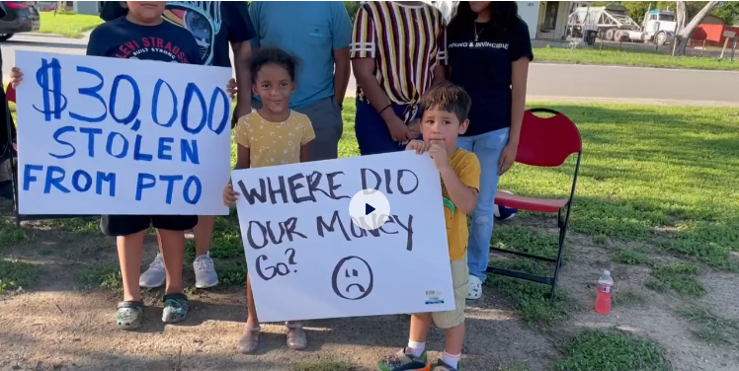
News Media – Avoid it!

Slide 57




USING CASHLESS PAYMENT APPS
COMMON RISKS
  Lack of documentation (no invoices, receipts)
  Personal accounts used for organization funds
  Transfers without dual authorization
  No oversight or reconciliation with bank statements
  No transaction history saved or backed up

Slide 58

EXAMPLES OF FRAUD W/ CASHLESS APP
Booster Club Treasurer transfers funds to their personal Cash App account and deletes the app.
Funds raised via Zelle sent to a parent’s personal account with no receipt or record.
A fake vendor invoice paid via Venmo, later discovered to be a relative of the Treasurer.
Reimbursement requests paid via Cash App without validating original expense.

Slide 59
HOW TO PREVENT FRAUD W/ CASHLESS APPS
Restrict App Access
  Limit login access to Treasurer and one other designated officer.
Require Approval Process
  Pre-approve all reimbursements or outgoing payments in writing.
Set Digital Controls
  Turn on notifications for every transaction.
  Export monthly summaries from the app for the audit file.
Educate & Monitor
  Train all officers on secure handling of digital payments.
  Review app use in every meeting.
Use Only Official Organizational Accounts
  Never allow use of personal Cash App, Venmo, or Zelle accounts for school-related funds.
Enable Dual Authentication
  Require two officers (e.g., President & Treasurer) to approve electronic payments.
Keep All Receipts & Documentation
  Screenshots of transactions + backup documents (invoices, fundraiser logs).
Reconcile Regularly
  Match app transactions to the Treasurer’s Report and monthly bank statements.

Slide 60



RECOMMENDED APPS W/ BETTER CONTROLS
PayPal for Nonprofits
Square
Zelle for Business (if supported by your bank)

Slide 61

Handling Cash
Always have two members count cash
Verify cash receipts to the deposit slips and bank statement
Address fundraiser shortages immediately
Do NOT make checks payable to CASH!
Utilize Bank/Credit Cards Properly…Keep Receipts and Provide them for Accounting Purposes

Slide 62


How to Prevent Problems?
DO NOT PRE-SIGN CHECKS! PLEASE!
Develop and apply the appropriate By-Laws for each organization, submit updates to Internal Audit annually
Require a Treasurer’s Report immediately after the reading of the minutes from previous meeting
Complete a Financial Recap after a Fundraising event takes place. Reconcile the cash and inventory.
Reconcile Online Purchases and Sales

Slide 63

How to Prevent Problems?
Require proper backup: receipts, service orders, invoices, receiving slips etc.
Reconcile the bank statement
Be transparent about accounting records
Multiple signers on checks
Do not deviate from procedures set out in the By-Laws

Slide 64

New AI Risks for Parent Groups
Voice Cloning Scams: Scammers use short audio clips of a school principal or PTO president to generate fake phone calls. They trick treasurers into wiring funds or releasing checkbooks during fake emergencies.
Phishing and Fake Invoices: Generative AI writes flawless, highly personalized emails. Fraudsters pose as regular vendors, regional suppliers, or board members to request sudden changes to direct-deposit details
Synthetic Documentation: Bad actors can fabricate digital receipts, tax documents, or audit logs to mask missing funds or sneak unauthorized expenses past volunteer boards.

Slide 65

Protecting Your PTO from AI Fraud
Establish Verbal Callbacks: If a board member or vendor sends an urgent email asking to change payment methods, call them back using a known, trusted phone number—never the number in the new request.
Block Out-of-Band Text Requests: Explicitly ban the use of SMS, WhatsApp, or personal messaging apps for any financial approvals or payment requests.
Use View-Only Bank Access: Give non-signing board members read-only access to bank portals so multiple eyes can spot unusual transactions in real time.
Publish Monthly Ledgers: Share a simplified cash-flow report at every public meeting to maintain absolute transparency and catch internal digital tampering early.

Slide 66
Internal Controls
Separation of Duties
  Split Financial Tasks: The person who writes the checks or initiates digital transfers must never be the person who approves the expense or reconciles the bank statement.
  Rotate Financial Roles: Require a different board member to lead the monthly bank reconciliation process each quarter to ensure fresh eyes review the ledger.
  Require Independent Audits: Appoint a two-person audit committee of parents who are not on the executive board to review all financial records twice a year.
  Count Cash in Pairs: Require at least two volunteers to count and sign off on cash receipts immediately at the conclusion of any school event or fundraiser.
    Deposit Cash Immediately: Mandate that all event cash be deposited into the bank account within 24 hours of collection, rather than sitting in a volunteer's home.
    Match Invoices Directly: Never sign a check or approve a payout without a matching, itemized receipt or vendor invoice physically attached to the request.

Slide 67

Checking Accounts
Protect your checkbooks at all times
Reconcile bank account with receipts and invoices (match them up)
Be aware of checking account scams and Craig’s List scams
Report any suspected fraud or scam attempt to Ft. Bend ISD Police 281-634-5500
Consider “Positive Pay” or other similar service (Electronic Register Confirmation)

Slide 68
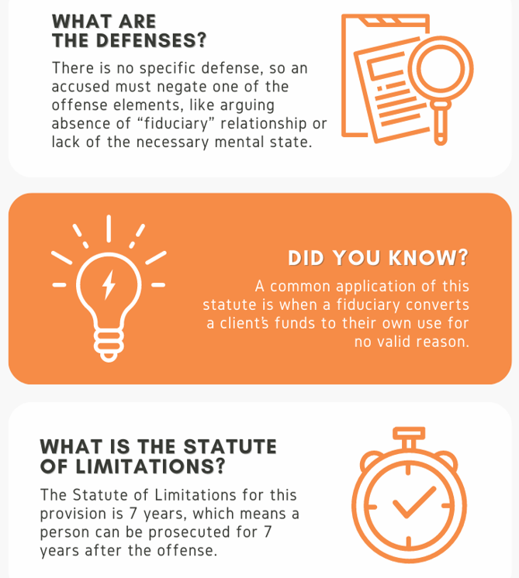
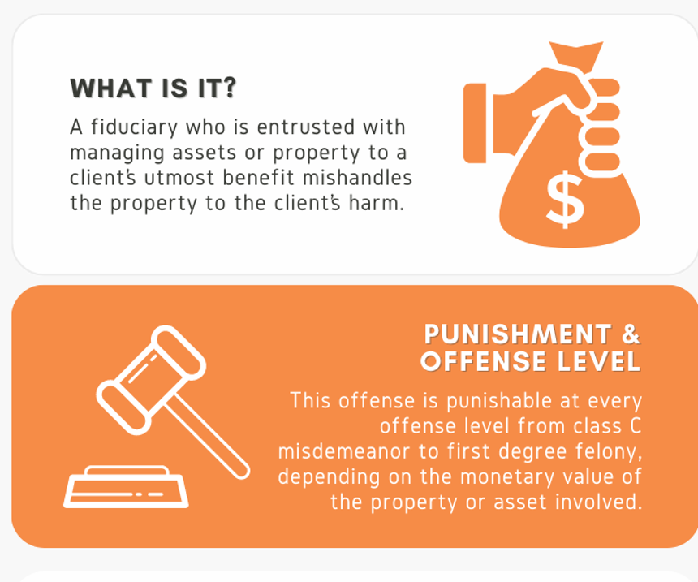
Misapplication of Fiduciary Property

Slide 69

Protect Yourself, Protect Your School
Demand integrity and proper accounting
Provide integrity and proper accounting
Participate in the process
Ask others to participate
Be transparent
When a problem is discovered, don’t wait, notify the Principal, Internal Audit and the Police if necessary 281-634-5500

Slide 70
Facility Rentals & Advertisements
Presented by: Genyne Jackson
Director
FBISD Enterprise funds
Genyne.Jackson@fortbendisd.gov
(281) 634-3327

Slide 71
Facility Rentals

Slide 72
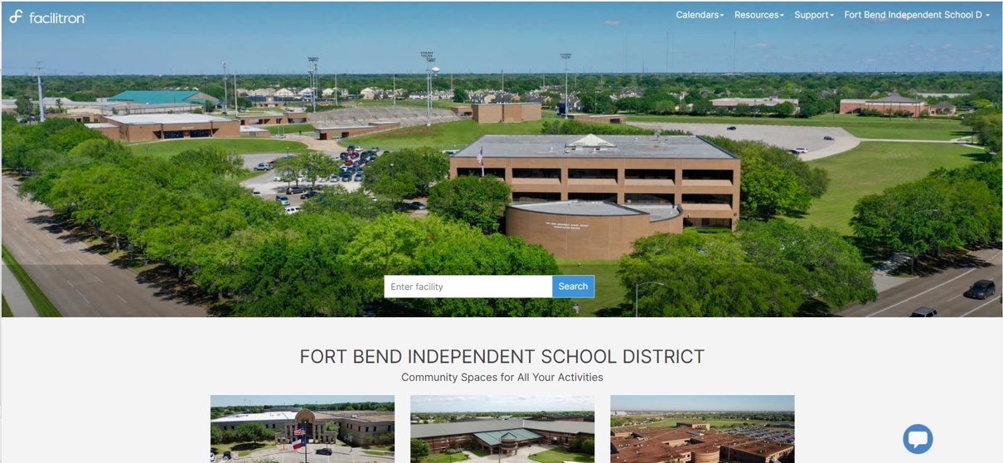
Facility Reservation Platform

Slide 73
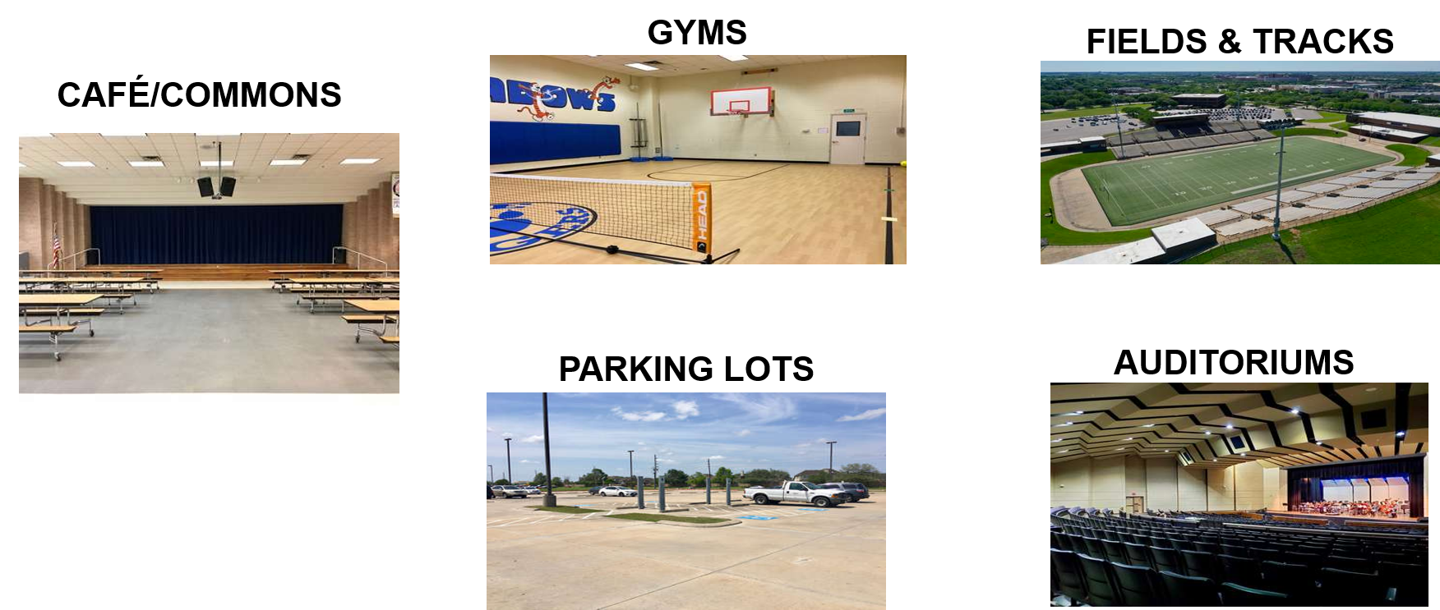
Available Spaces Permitted

Slide 74
Reservation Approval Process
1st - Campus/District Facility Reviews
Approve or Decline
2nd - Facility Rental Coordinator Reviews
Checks for Conflicts
Review fees
3rd – District Final Approver Reviews
Approves if all is in order
Declines if conflict exist

Slide 75
PTO/PTA & Booster Club Fees
Weekday Events
  No fees charged during the week
  Custodial fees apply if event ends after 8 PM for some schools and 8:30 PM for others
Weekend Events
  PTO/PTA & Booster Clubs are in the Expanded District rate category
  Only custodial and PD fees will apply
Fees
  Based on details of your event your fees if applicable will vary.
  Facilitron will provide an estimate

Slide 76
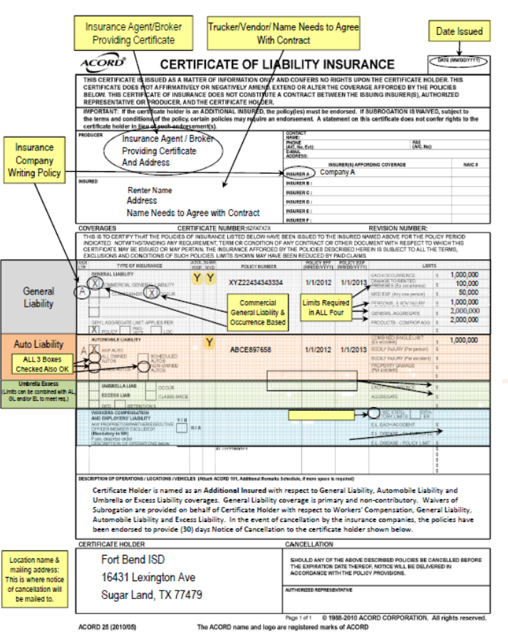
Facility Rentals – Insurance
Certificate of Insurance (COI)
  Required for every event
  Must upload to reservation
  General Aggregate amount is $2M
    All other renters is $3M
Valid / Verified on Facilitron
  All PTO/PTA organizations can upload the COI that they provide to the district
  If marked invalid by Facilitron just send us a note on reservation and we will fix it on our end

Slide 77

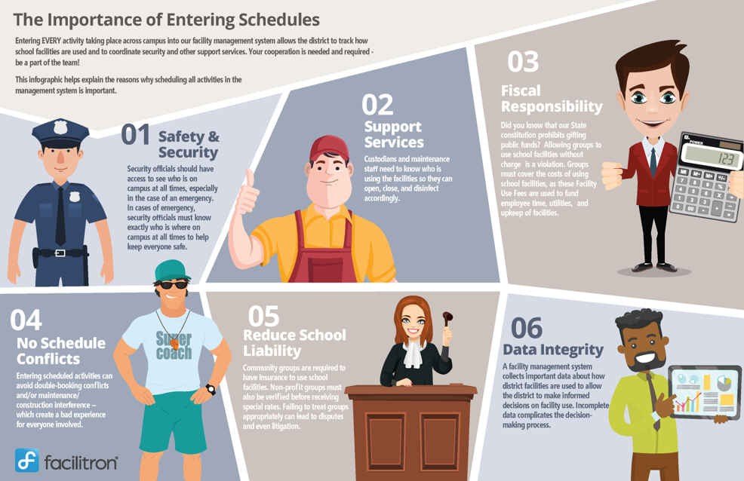
Why Facilitron is Important
All PTO/PTA and Booster Clubs should create an account and enter their facility use request. This SHOULD NOT be done by the campus EA.
#1 – Safety & Security
#2 – Support Services
#3 – Fiscal Responsibility
#4 – No Schedule Conflicts
#5 – Reduce School Liability
#6 – Data Integrity

Slide 78

Things to Remember...
Every event must be put into Facilitron
Campus staff SHOULD NOT submit a request on behalf of the PTO/PTA in Facilitron
For large events (50 or more), FBISD police must be contacted
Weekend fees apply for custodians and PD
Your rate group should be listed as "District Expanded"

Slide 79
Advertising

Slide 80

Valued Partners
PTO/PTA's and Booster Clubs are valued partners, and your fundraising often touches advertising — selling banners, lining up sponsors, or recognizing donors on district property.

Slide 81

District Advertising Program
Enterprise Funds has launched its Advertising program, which consists of these offerings...
  Venue Signage - banners at our stadiums & field houses
  Digital Scoreboard - logos and commercial spots on the video boards
  Audio & PA Reads – In-venue announcements
  Bus Ads – mobile exposure on the road
  Magazine Ads – digital magazine
  Athletic & District Event Sponsorships – tournaments, programs & events
  Naming & Category – exclusive naming and category rights

Slide 82
District Advertising Guidance for PTO/PTAs
Always reach out to Enterprise Funds when selling ads
Artwork must be approved by the district for all advertisements before installing on district property
All advertisements must meet the requirements in Board policy GKB
All district brand standards must be strictly followed to include logos on t-shirts, banners, signs, etc.
  Placement, sizing, design, and approvals should follow FBISD brand standards

Slide 83
Why Go Through Enterprise Funds
The goal for the District is revenue generation and creating lasting connections with the community and businesses
We do that by...
  Being consistent
  Protecting contracts in place, not double selling
  Capturing, tracking, and reinvesting back into students and programs
  Maintaining a culture of compliance and ensuring brand standards
Our intention is for PTO/PTAs & Booster clubs, and district sponsorship efforts to co-exist and both have great successes

Slide 84
Coming Soon!
FBISD
District Spirit Store w/stores for each campus
Stay Tuned!

Slide 85
Any Questions?
For Facility Rentals Contact:
Carmen Torres
Facility Rentals Coordinator
mariad.torres@fortbendisd.gov
For Advertising Contact:
Gabrielle Moon
Assistant Director Enterprise Funds
Gabrielle.moon@fortbendisd.gov

Slide 86
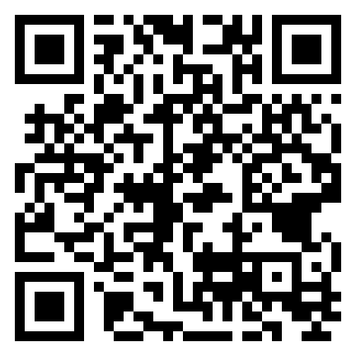
Thank you for your time and attention today. Your support is much appreciated.
Let us know how we did today by using the QR code to complete our Post-Event Survey

