Slide 1

2026-2027
Extended Day Program In-service
This Photo by Unknown author is licensed under CC BY-NC.

Slide 2
AGENDA
Guest Speakers
Important Dates
Training
Fee Schedule & Fee Policies
Salary Schedules
Policy Revisions
Financial Statement Changes
2025-2026 School Year Survey Discussion
Policy Reminders
  Links
  Q&A

Slide 3
Guest speakers
Johnethia Bellard
Shelly Dilks
Federal Programs Coordinator
Johnethia.Bellard@cpsb.org
Solutions EAP
Shelly@solutions-eap.org
Jay Bergeron
  Risk Manager
  Jay.Bergeron@cpsb.org

Slide 4
Important dates

Slide 5
Important due dates
The following is due to Internal Auditing no later than Thursday, August 20th:
1. Salary Information
2. Site Information Form
3. Emergency Plan (complete plan except for student information sheets)
4. Emergency Plan Acknowledgement
5. Staff in-service agenda/sign-in sheet (you create your own)
6. Policies and Procedures Manual Sign off sheet (for Site Director, Assistant Site Director, and Bookkeeper)

Slide 6
New Site Director and Bookkeeper training
All new Site Directors and/or Bookkeepers will need to attend the EDP Policies and Procedures manual on Friday, August 7th from 1:00-4:00 in the Internal Auditing Department's conference room.

Slide 7
MEDICATION TRAINING
Each Extended Day site must have at least two employees who are medication certified in addition to the Site Director. The site MUST have at least one medication certified and one CPR certified employee present at all times.
An Initial Medication Training will be offered on Monday, August 10, 2026, at the Ralph Wilson Center for Opportunities.
Any employee needing medication certification should contact Megan Foreman at megan.foreman@cpsb.org to register for the training.

Slide 8

Cpr training

Slide 9
2026-2027 edp fee schedule and fee policies
The Fee Schedules and Fee Policies are in your folder.
The monthly rates have increased $5.
The drop-in fees have increased $1.
The non-school drop in fee has increased by $5.
(See fee policies for updated pro-rated amounts for students that register mid-month.)

Slide 10
2026-2027 edp salary schedules
The 2026-2027 EDP Salary Schedules are in your folder.
These salary schedules will take effect the Monday of the first week of school (8/10).
Tier levels are determined by your prior year revenue.
To find out, you can print a Total Summary Primary Accounts Only report for the date rate 7/1/2025-6/30/2026. The total payments amount will determine what Tier level you fall into.
Employees that were hired prior to 3/1/2026 are eligible for an experience level increase this school year. Employees hired after this date will receive the experience level increase next school year.
The support staff pay rate has increased to $10.50
(Support staff rate increases coincide with tuition increases.)

Slide 11
Policy revisions

Slide 12
Policy manual additions
Phone and Communication Requirements (p. 3)
All programs must coordinate with the CPSB Technology Department to implement a parent communication system that will function as the primary source of communication for notifying parents of updates, reminders, closures, and other pertinent information.

Slide 13
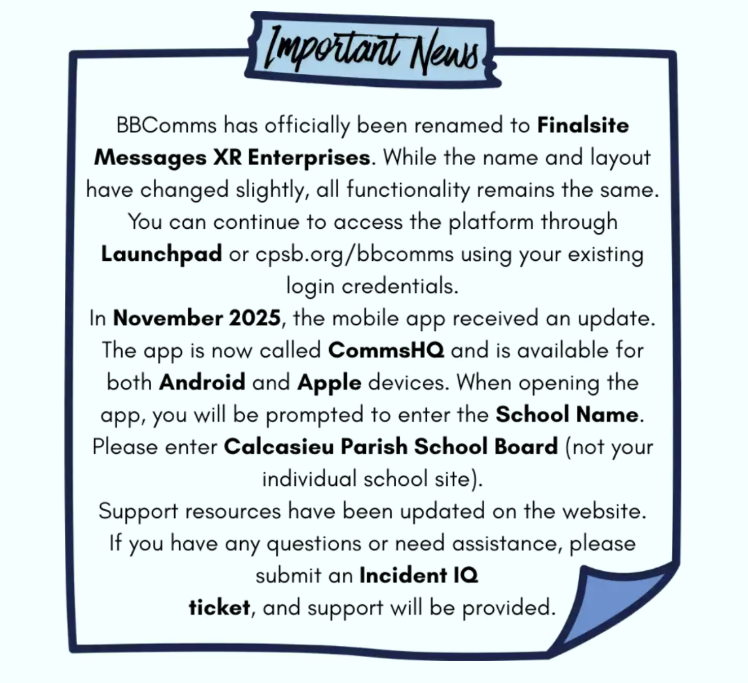
Finalsite Messages xr enterprises
Submit a ticket with the CPSB Technology Department whenever you are ready to get started.

Slide 14
Policy manual revisions
Delinquent Extended Day Balances (p.8)
Extended Day Program fees are required to be paid in advance, and account balances should remain current at all times. To ensure consistent collection efforts, the following collection procedures must be followed for delinquent accounts:
30 Days Past Due (all delinquent balances): The site must contact the parent or guardian by phone and issue a statement reflecting balance due on account.
60 Days Past Due (balances of $50 or more): A Delinquent Account Notice (Appendix A12) must be sent to the parent or guardian via certified mail.
90 Days Past Due (all delinquent balances): The outstanding balance must be added to JCampus, and the account must be flagged in ProCare.
120 Days Past Due (balances of $50 or more): The account must be referred to the School Board Attorney for collection efforts. The referral packet must include a copy of the Customer Statement and the certified letter previously sent to the parent or guardian. A sample attorney referral letter and attorney contact information are provided in Appendix A13.

Slide 15
Policy manual revisions
Delinquent Extended Day Balances (p.8)
All accounts with balances of $50 or more must be included on the Financial Statement Collections Checklist to verify that required collection procedures have been completed. For students who are no longer enrolled at the school, an account may be written off as bad debt in ProCare only after all required collection procedures, including referral to the School Board Attorney, have been completed. Any write-off must have the principal's written approval, and the approval documentation must be maintained on file and submitted with the financial statement for the month in which the write-off is recorded. Written-off accounts must remain flagged in ProCare, and the balance must remain outstanding in JCampus.
If a family subsequently seeks to re-enroll in the Extended Day Program, any bad debt write-off must be voided, and the full outstanding balance must be paid before registration is permitted. Upon payment, the account status in JCampus must be updated to reflect the balance as paid, and any applicable ProCare flags must be removed.
Students with a delinquent Extended Day balance from a prior school year are not eligible to enroll in the summer program or the subsequent school year until the outstanding Extended Day balance has been paid in full.

Slide 16
Policy manual revisions
Conduct Policy and Discipline Procedures (p. 12)
To maintain a positive and respectful environment for children and staff, parents and guardians are expected to conduct themselves in a courteous and professional manner at all times. Disrespectful, aggressive, or inappropriate behavior by a parent or guardian—including verbal abuse, threats, intimidation, or refusal to follow program procedures—may result in dismissal from the Extended Day Program. The safety and well-being of students and staff is our highest priority, and the program reserves the right to take immediate action when necessary. These policies are established to assure a safe, secure, and orderly atmosphere and are established in the best interest of all children. Participants are required to observe conduct regulations at all times.

Slide 17
Policy manual revisions
Emergency Dismissal and School Closing (p. 15)
During the year it may become necessary to dismiss students early or close schools and Extended Day Programs due to an emergency. The primary concern will be to ensure safety for all students. Each Site Director will have on file a plan for emergency situations, including those which may occur during non-school hours/days. The plan shall be approved by the Principal. If Calcasieu Parish Schools are closed due to an emergency, there will not be before or after-school care. In situations where an emergency affects a specific Extended Day Program site, the decision to close that program will be at the discretion of the Principal based on the circumstances and safety considerations. Emergency information on file for each child should be accurate and current. Revisions should be made as information changes.

Slide 18
Policy manual revisions
Summer Program Phone and Communication Requirements (p. 19)
All programs must coordinate with the CPSB Technology Department to implement a parent communication system that will function as the primary source of communication for notifying parents of updates, reminders, closures, and other pertinent information.

Slide 19
Policy manual revisions
Emergency Dismissal and School Closing (p. 20)
During the summer, it may become necessary to dismiss students early, cancel activities, including scheduled field trips, or close the program due to inclement weather, facility issues, transportation concerns, or other emergencies. If an emergency affects a specific summer program site, the decision to modify operations or close that site will be at the discretion of the Principal based on the circumstances and safety considerations. For scheduled field trips, the Principal, in collaboration with the Transportation Department, will determine whether a trip should proceed, be delayed, rescheduled, or canceled. If Calcasieu Parish School Board facilities are closed for any reason, all summer programs will also be closed. Emergency information on file for each child should be accurate and current. Parents/guardians are responsible for updating this information with the program as changes occur.

Slide 20
Policy manual revisions
Activity and Field Trip Collection and Documentation Procedures (p. 23)
Parents/guardians should send payment for field trips or fee-based activities in a sealed envelope clearly labeled with the child’s name on the day of the event or activity. Payments should be submitted in the exact amount required, as staff may not be able to provide change. Fees should not be collected in advance. In accordance with Calcasieu Parish School Board policy, money should never be stored at the school overnight.
Prior to the activity, staff should verify the exact cost per child. Only the actual cost of the field trip or activity may be collected. For field trips, schools are not billed by the Transportation Department for fuel expenses; therefore, no additional amount may be charged for transportation or fuel costs.
For any field trip, special event, or on-site activity involving the collection of money (such as snow cones, ice cream, special presentations, performances, or similar activities), a Reconciliation Form and Participation Roster must be completed and maintained on file. Documentation supporting the total cost of the activity, including a receipt, must be attached.

Slide 21
Policy manual revisions
Activity and Field Trip Reconciliation Form (p. 23)
An Extended Day Program Activity and Field Trip Reconciliation Form (see Appendix B4) must be completed for any field trip or activity in which money is collected. The form must include:
The number of children participating
The amount collected per child
The total amount collected
The total cost of the activity or field trip
Any difference between the amount collected and the total cost must be documented on the Reconciliation Form, along with an explanation for the variance. A receipt from the vendor, venue, or activity provider must be attached to the Reconciliation Form and should verify:
The number of children who participated
The cost per child, if applicable
The total cost of the activity or field trip

Slide 22
Policy manual revisions
Activity and Field Trip Participation Roster (p. 24)
An Extended Day Program Activity and Field Trip Participation Roster (see Appendix B5) must be completed for all field trips and activities. The roster should include the names of all participating children. For any field trip or activity in which money is collected, the roster must be attached to the corresponding Reconciliation Form and retained on file for audit and recordkeeping purposes.

Slide 23
Policy manual revisions
Receipt Procedures (Continued)
If the Extended Day employee that prepared the Extended Day Daily Receipt Record gives the money to another individual to make the deposit, then the person that is given the money should count the money upon receipt while in the presence of the person that prepared the form to verify that the amount counted agrees with amounts listed on the form. Upon verification, this person should record the “Amount Counted” and sign his/her name as “Verified by” on the Extended Day Daily Receipt Record. All money on hand must be secured in a lockbox or locked cabinet and safeguarded at all times. All money collected must be deposited daily. Money should never remain in the school overnight.

Slide 24
Financial statement changes

Slide 25
Financial statement changes
A copy of the Financial Statement Coversheet and related checklists is included in your folder.
The Financial Statement Coversheet has not changed. However, updates have been made to the Financial Statement Checklist, and the Bank Reconciliation Checklist has been discontinued.
Beginning this year, you will submit the following documents:
1. Financial Statement Coversheet
2. Financial Statement Checklist (revised)
3. Financial Statement Collections Checklist (new)
(The Bank Reconciliation Checklist is no longer required and should not be submitted.)

Slide 26
EDP survey discussion topics
There were 207 responses submitted to our surveys sent at the end of the 2025-2026 school year.

Slide 27
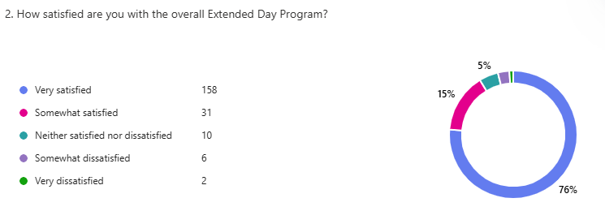

Slide 28
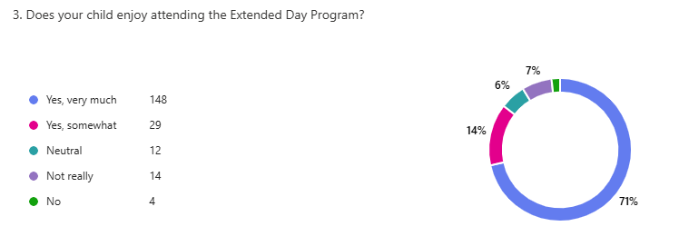

Slide 29
What do you feel is working well in the extended day program?

Slide 30
What improvements would you like to see?

Slide 31
Additional Comments?

Slide 32
Policy reminders

Slide 33

Email requirements
Site Directors and Bookkeepers must have a C.P.S.B. e-mail account that is checked regularly.

Slide 34

Phone requirements
Programs must have a working landline to allow immediate access to employees. In addition to the landline phone, the program must have a pre-paid cell phone. Both phone numbers should be provided to parents and the Internal Auditing Department. The cell phone must be carried when staff is away from the landline phone (ie. outside on the playground.) The pre-paid cell phone will be considered property of the Extended Day Program (not the Site Director) and must be kept at the school. The phone should be used for Extended Day purposes only. Parents should be given the cell phone number as an additional contact number in case they are not able to reach EDP staff on the landline. Pre-paid cell phone expenses will be reimbursable to the school and/or employee as per the Extended Day purchasing policy.

Slide 35
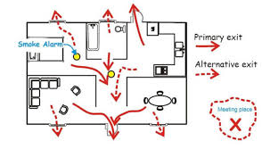
EMERGENCY PLAN
The safety and well-being of the children and staff shall always be first priority. An Extended Day Program Emergency Plan (appendix A26) must be completed by the Site Director and approved by the Principal. At minimum, the plan shall be reviewed annually by the Site Director and updated as needed. The Principal must review and approve the Emergency Plan annually. The Principal shall require staff to demonstrate the Emergency Plan to confirm that it is effective. A copy of the plan must be submitted to Internal Audit at the beginning of every school year (and summer, if the school has a summer program.)
The Emergency Plan includes procedures for the following emergency situations: fire evacuation, shelter-in-place, facility lock-down, and injuries/illnesses. All Extended Day staff should be made familiar with the plan and trained in his/her responsibilities within the plan every school year and summer (if applicable). New employees should receive this review during their training period.

Slide 36

EMERGENCY PLAN ACKNOWLEDGMENT FORM
All programs are required to submit an Emergency Plan Acknowledgment Form (appendix A24) to the Internal Auditing Department at the beginning of each school year (and summer, applicable). The Emergency Plan Acknowledgment Form must be signed by all staff, the Site Director, and the Principal.

Slide 37

DRILLS
The Site Director will hold one fire drill per month and a minimum of two shelter-in-place and two lock-down drills each school year (one in August and another in January). Documentation of drills shall consist of a Drill Report (appendix A25) signed by all staff present during the drill. Immediately following the drill, Drill Reports shall be submitted to the Principal for review and signature. Copies of signed Drill Reports must be maintained on file.

Slide 38

SAFETY/SECURITY
Site Directors should notify the Principal of all security concerns. It is the responsibility of the Principal to ensure the safety and security of the facility. The Site Director should notify the Internal Auditing Department of any unresolved security concerns.
All programs must meet the following minimum safety/security requirements:
1. There must always be a locked door or gate that would prohibit an intruder from accessing children and staff. If necessary, a doorbell or buzzer should be installed.
2. The school must be locked and secure during Extended Day hours.
3. The program must have access to safe lock-down and shelter-in-place locations within the school.
4. The program must have access to the school’s Automated External Defibrillator (AED) during Extended Day hours.
5. There must be sufficient lighting in the areas of the school utilized by the program (drop-off/pick-up locations, restroom areas, etc.)
6. The program must have a landline and pre-paid cell phone to allow for immediate access to employees.

Slide 39

STUDENT/TEACHER RATIO
The staff to student ratio should fall within the range of 1:15 to 1:23. The average number of students who attend regularly will determine the minimum number of employees (Site Director and staff) needed.
There should always be a minimum of two child care staff present during hours of operation when children are present.
*Upon approval of the principal, special situations may warrant employment beyond the numbers cited. Special Education mandates may require specific student/teacher ratios.

Slide 40

1:1 procedures for special needs students
        The Program operates under the Americans with Disabilities Act and does not discriminate against individuals with disabilities.
        If you have family that wants to register a special needs child that you are not sure if you are adequately equipped to accommodate, contact the Special Education Department for guidance.
        Recommendations for 1:1 staffing must be approved by the Special Education Department.
          Recommendations must be forwarded to Internal Audit (via email) documenting the approval.
          Internal Audit must be notified of the name(s) of the employee(s) that will be working in 1:1 capacities for accounting purposes.

Slide 41

Bookkeeping reminders
        Post and make deposits daily.
          Enforce late payment fee policy by billing late payment fees and prohibiting attendance if balance is not paid by the 20th.
          Review financial statement checklist to ensure that all items on checklist are complete.
          Make sure that financial statements and payroll are delivered by the due date on the Important Dates Calendar. Payroll should be in an interoffice envelope addressed to the Payroll Department, and the financial statement should be in an interoffice envelope addressed to the Internal Auditing Department.
          Contract billing must be used to bill monthly students, and formula billing must be used to bill drop in students. (Not optional)

Slide 42
Bookkeeping reminders
Be sure that financial statements are ordered in the order listed on the checklist.
Be sure that the payroll included financial statement is the payroll that was turned in for the month's financial statement you are completing. (Ie. For your August financial statement, you would include the payroll you turned in on 8/11. For your September financial statement, you would include the payroll turned in on 9/1.)
Be sure that all of the supplemental pay sheets are included with your financial statement.
Be sure that monthly statements are given out when the financial statement is done each month.
Be sure that monthly statements are sent to Title X for applicable students. Make a note on the statement with the total due for that month.

Slide 43
Payroll reminders
Be sure to review Overtime Calculation Forms for accuracy prior to completing supplementals.
Review supplementals to check to make sure that the correct pay rates were used, the correct hours were paid, and that overtime was paid correctly.
Remember that employees may not work over 40 hours in Extended Day.

Slide 44
New hire reminders
Routing of New Hire Documentation
The employment application should be routed to payroll. The Payroll Department will forward a copy to the Personnel Department. When the new hire is cleared to work, Personnel will e-mail the Employment Application to the Principal reflecting Personnel’s clearance. The Principal should forward the cleared application to the Site Director. No one is permitted to begin working or training in your program until you have received their cleared application from Personnel.
The Salary Information Form should be routed to the Internal Auditing Department. If the employee is eligible for overtime, Internal Audit will email the overtime rate to the Principal and Site Director.
Copies of all employment applications and salary information forms should be maintained on file at the school. The job description and employee contract must also be maintained at the school.

Slide 45
Policy reminders
Student Attendance
If the authorized pick-up person is not able to check the child out at the check-in computer, staff must manually check out the child on his/her V10 timecard, and the authorized pick-up must sign the child out on a sign-out sheet (including his/her legible signature and time that the child was checked out.)

Slide 46
Policy reminders
Receipt Procedures
An Extended Day employee will be responsible for collecting and receipting payments in a receipt book, and the Extended Day bookkeeper will be responsible for accounting for the payments in ProCare. The establishment of a separation of duties will help to improve the system of controls in the Extended Day Program.
An Extended Day employee (other than the Extended Day bookkeeper) must write receipts in a C.P.S.B. issued receipt book for all Extended Day funds received.
The Extended Day employee that collects money and issues receipts must complete an Extended Day Daily Receipt Record (see appendix D1) which lists all payments received for the day.

Slide 47
POLICY REMINDERS
Receipt Procedures
Receipts should be written at the time payment is made.

Slide 48
Policy reminders
Emergency Plan: General Information
The Children Currently Checked-in Report shall be attached to the cover of the Emergency Binder each day. Students’ names must be highlighted on the Children Currently Checked-in report as they are checked out so that the program always has an accurate list of students present at any given time. This procedure is critical in order to account for all children in the event of an emergency.

Slide 49
Policy reminders
Emergency Plan: Assignment of Responsibilities
The Site Director is responsible for ensuring that children are always under the supervision of staff. Children are not permitted to leave the Extended Day location to go to the restroom or anywhere else in the school without the supervision of staff.

Slide 50
POLICY REMINDERS
Family Registration Form
Authorized pick-ups listed in ProCare must match the most current Family Registration Form.

Slide 51
Starting a new year in procare
Refer to pages 60-61 in the ProCare manual for instructions to close out the summer program and start a new school year in ProCare.
Important reminders:
  For the month of August, the tuition is discounted – so August charges will need to be manually posted to the ledger.
  Billing boxes need to be set up for all monthly and drop in students.
  Authorized pick-ups in ProCare must match the current registration form.
  Be very careful not to set up duplicate accounts. Review the "possible duplicates" screen before adding a new person.
  Make sure that you post registration/insurance fees on the ledgers of all registered students.

Slide 52
links

Slide 53
2026-2027 parent handbook and fee schedule/fee policies
2026-2027 Parent Handbook
2026-2027 Fee Schedule
2026-2027 Fee Policies

Slide 54
2026-2027 salary schedules
2026-2027 Site Director Salary Schedule
2026-2027 Assistant Site Director/Bookkeeper Salary Schedule
2026-2027 Support Staff Salary Schedule

Slide 55
Edp manuals and Training videos
EDP Policy Manual:
Policy Manual Forms:
V10 ProCare Bookkeeping Manual:
V10 ProCare Video Lessons:

Slide 56
Links to forms due on thursday, 8/20:
1. Salary Information
2. Site Information Form
3. Emergency Plan (complete plan except for student information sheets)
4. Emergency Plan Acknowledgement
5. Staff in-service agenda/sign-in sheet (There is no link for this. You create your own.)
6. Policies and Procedures Manual Sign off sheet (for Site Director and Bookkeeper)

Slide 57

Q&a

Slide 58
Have a great year!
https://www.youtube.com/watch?v=_HAFtuJEgKk&pp=ygUpb3ByYWggdG9uaSBtb3JyaXNvbiBkbyB5b3VyIGV5ZXMgbGlnaHQgdXA%3D

