Slide 1
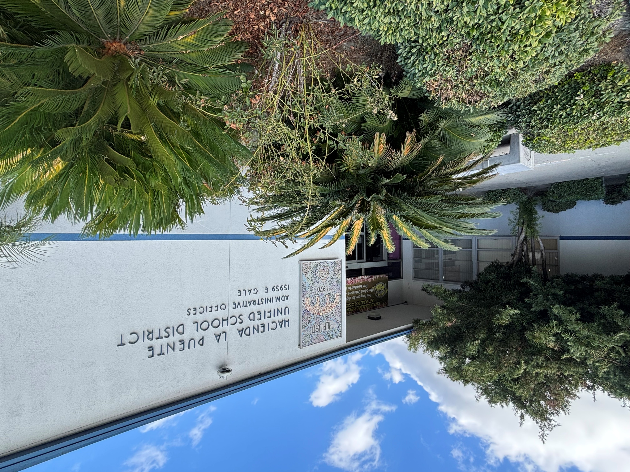

Measure BB Bond
21st Century Classroom Improvements
August 2026

Slide 2
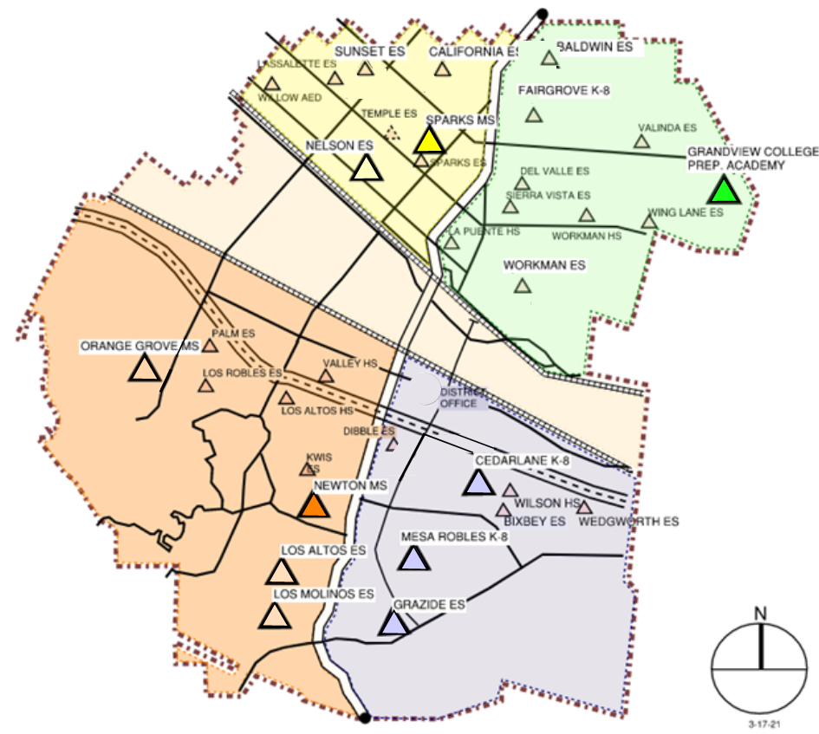

HLPUSD MEASURE BB - SUMMARY
IN PROGRESS
CONSTRUCTION
Valley Alternative School
Orange Grove MS
Bixby K1, K2, & K3
Palm ES
IN DESIGN
Sparks MS II
Bixby Refresh
COMPLETED/SUBSTANTIAL COMPLETION
Baldwin ES
California ES
Lassalette ES
Nelson ES
Sparks ES
Sparks MS
Cedarlane K-8
Mesa Robles K-8
Grandview MS
La Puente HS
Los Altos ES
Los Altos HS
Los Molinos ES
Newton MS
Sierra Vista MS
Stimson EC
Wilson HS
Workman ES
Workman HS
Grazide ES
Kwis ES
Valinda ES
Wing Lane ES
Fairgrove K-8
Palm ES
STIMSON

Slide 3
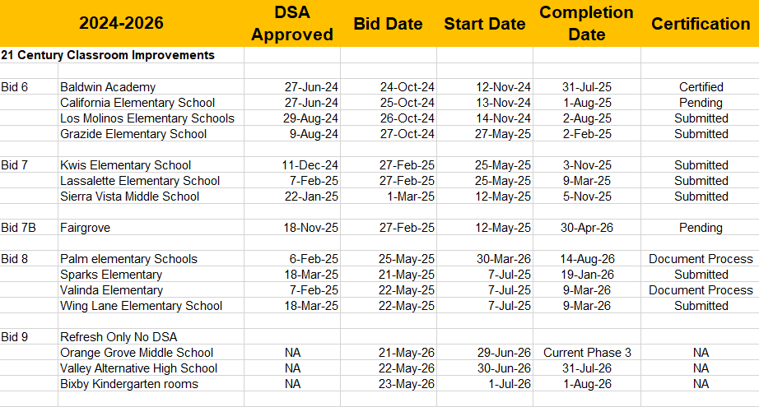
PROJECT STATUS

Slide 4
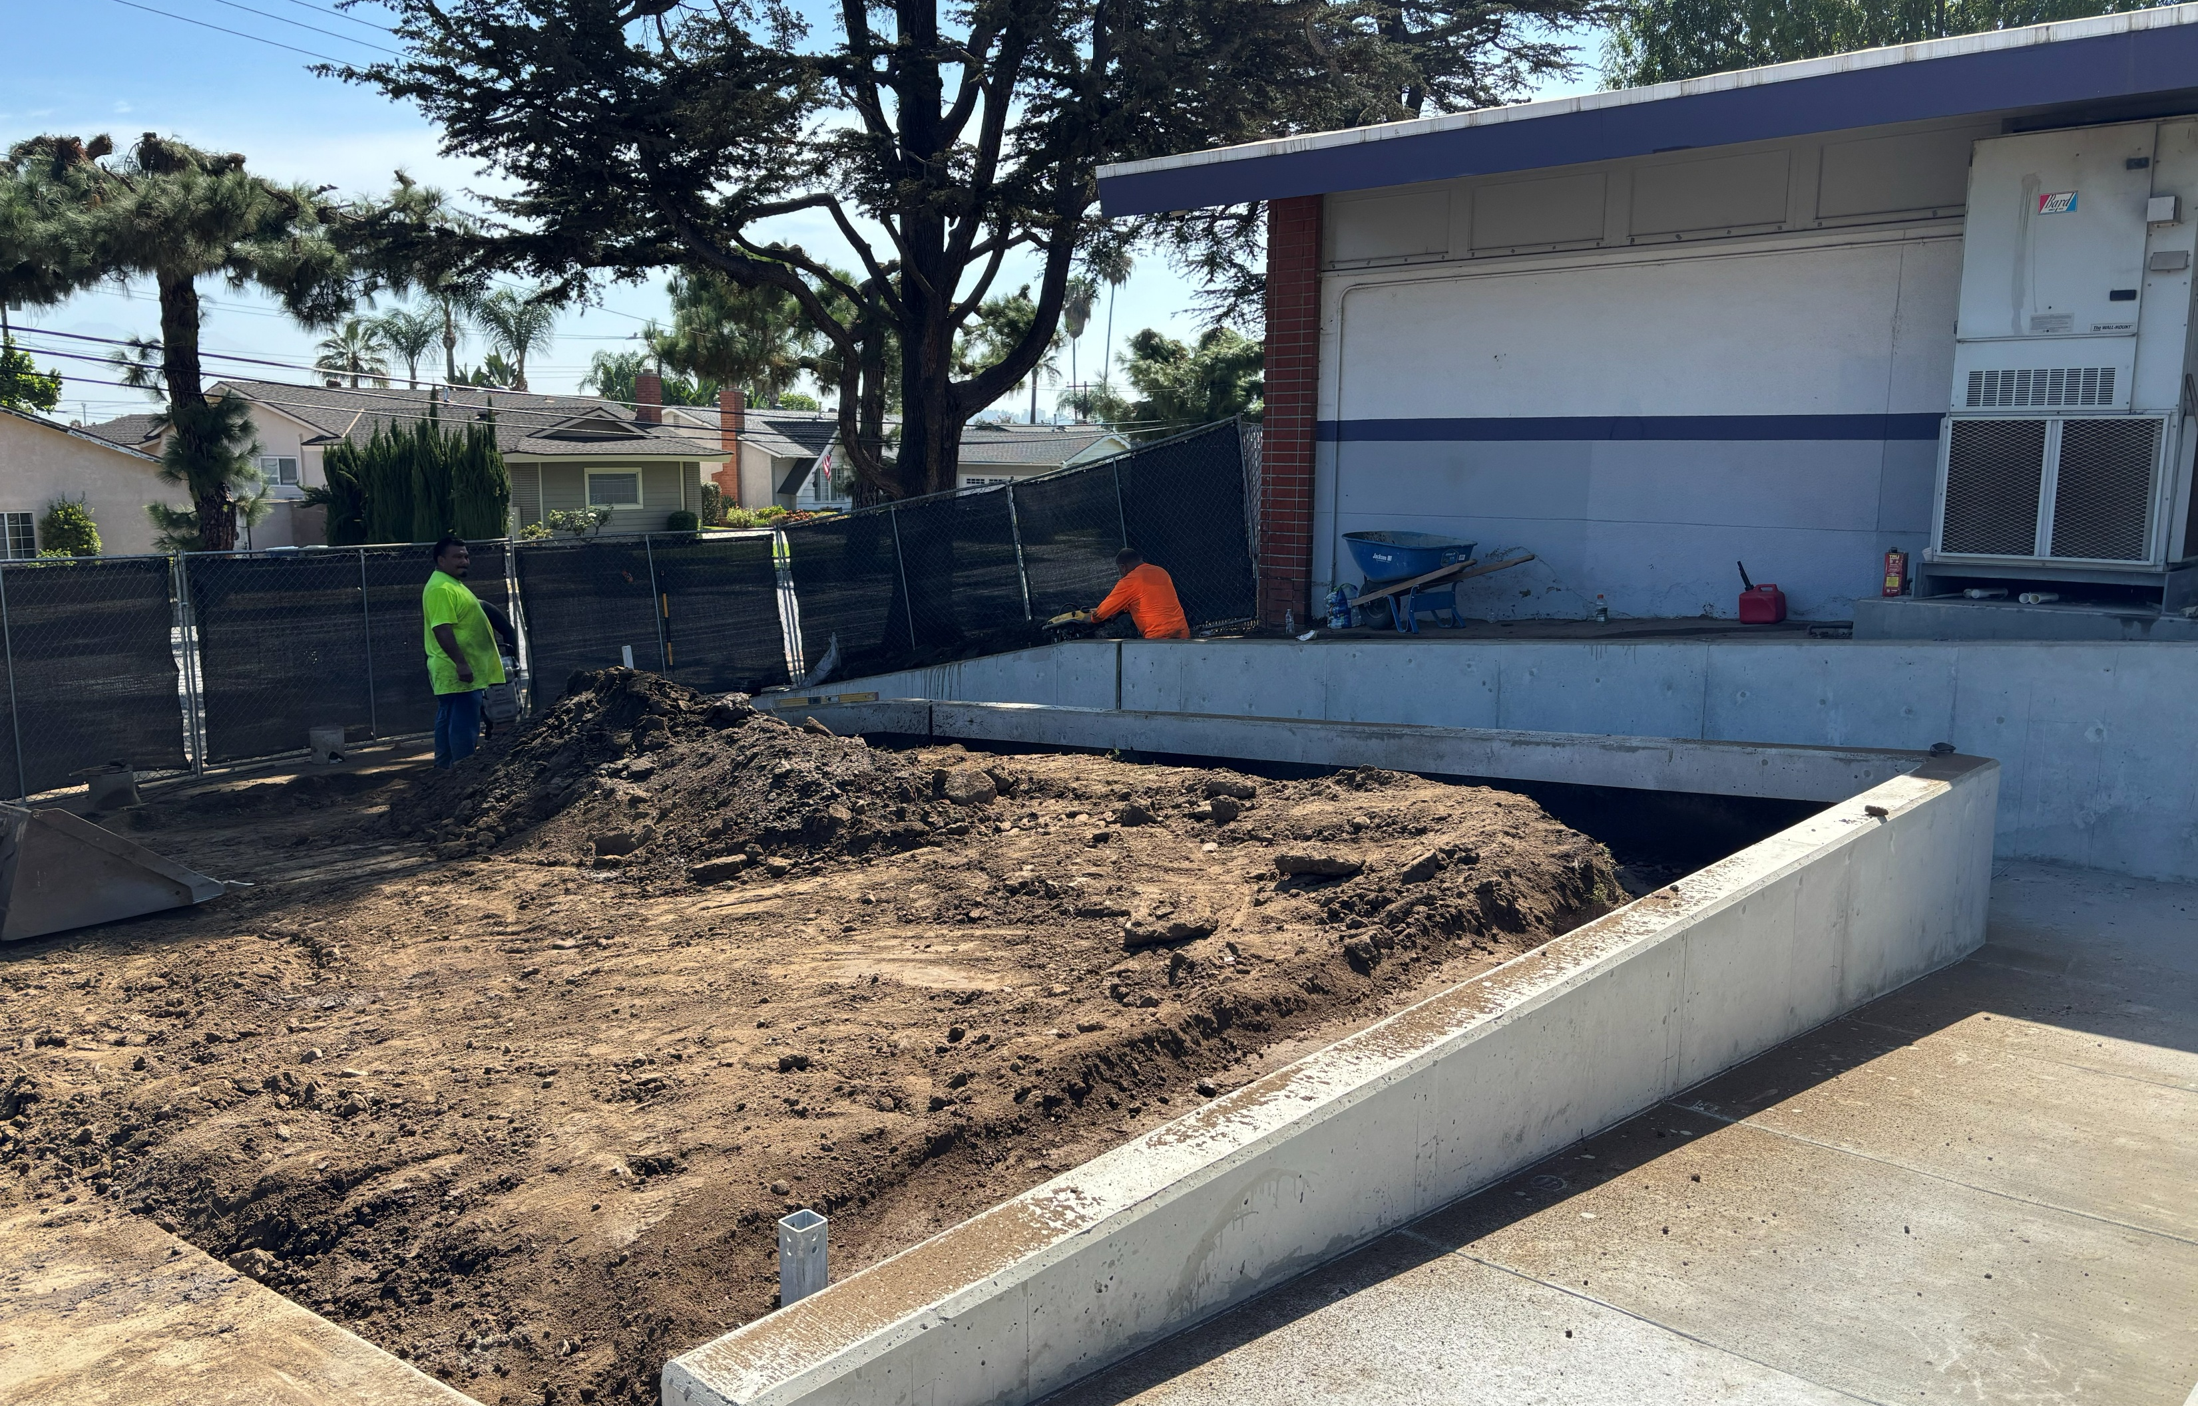
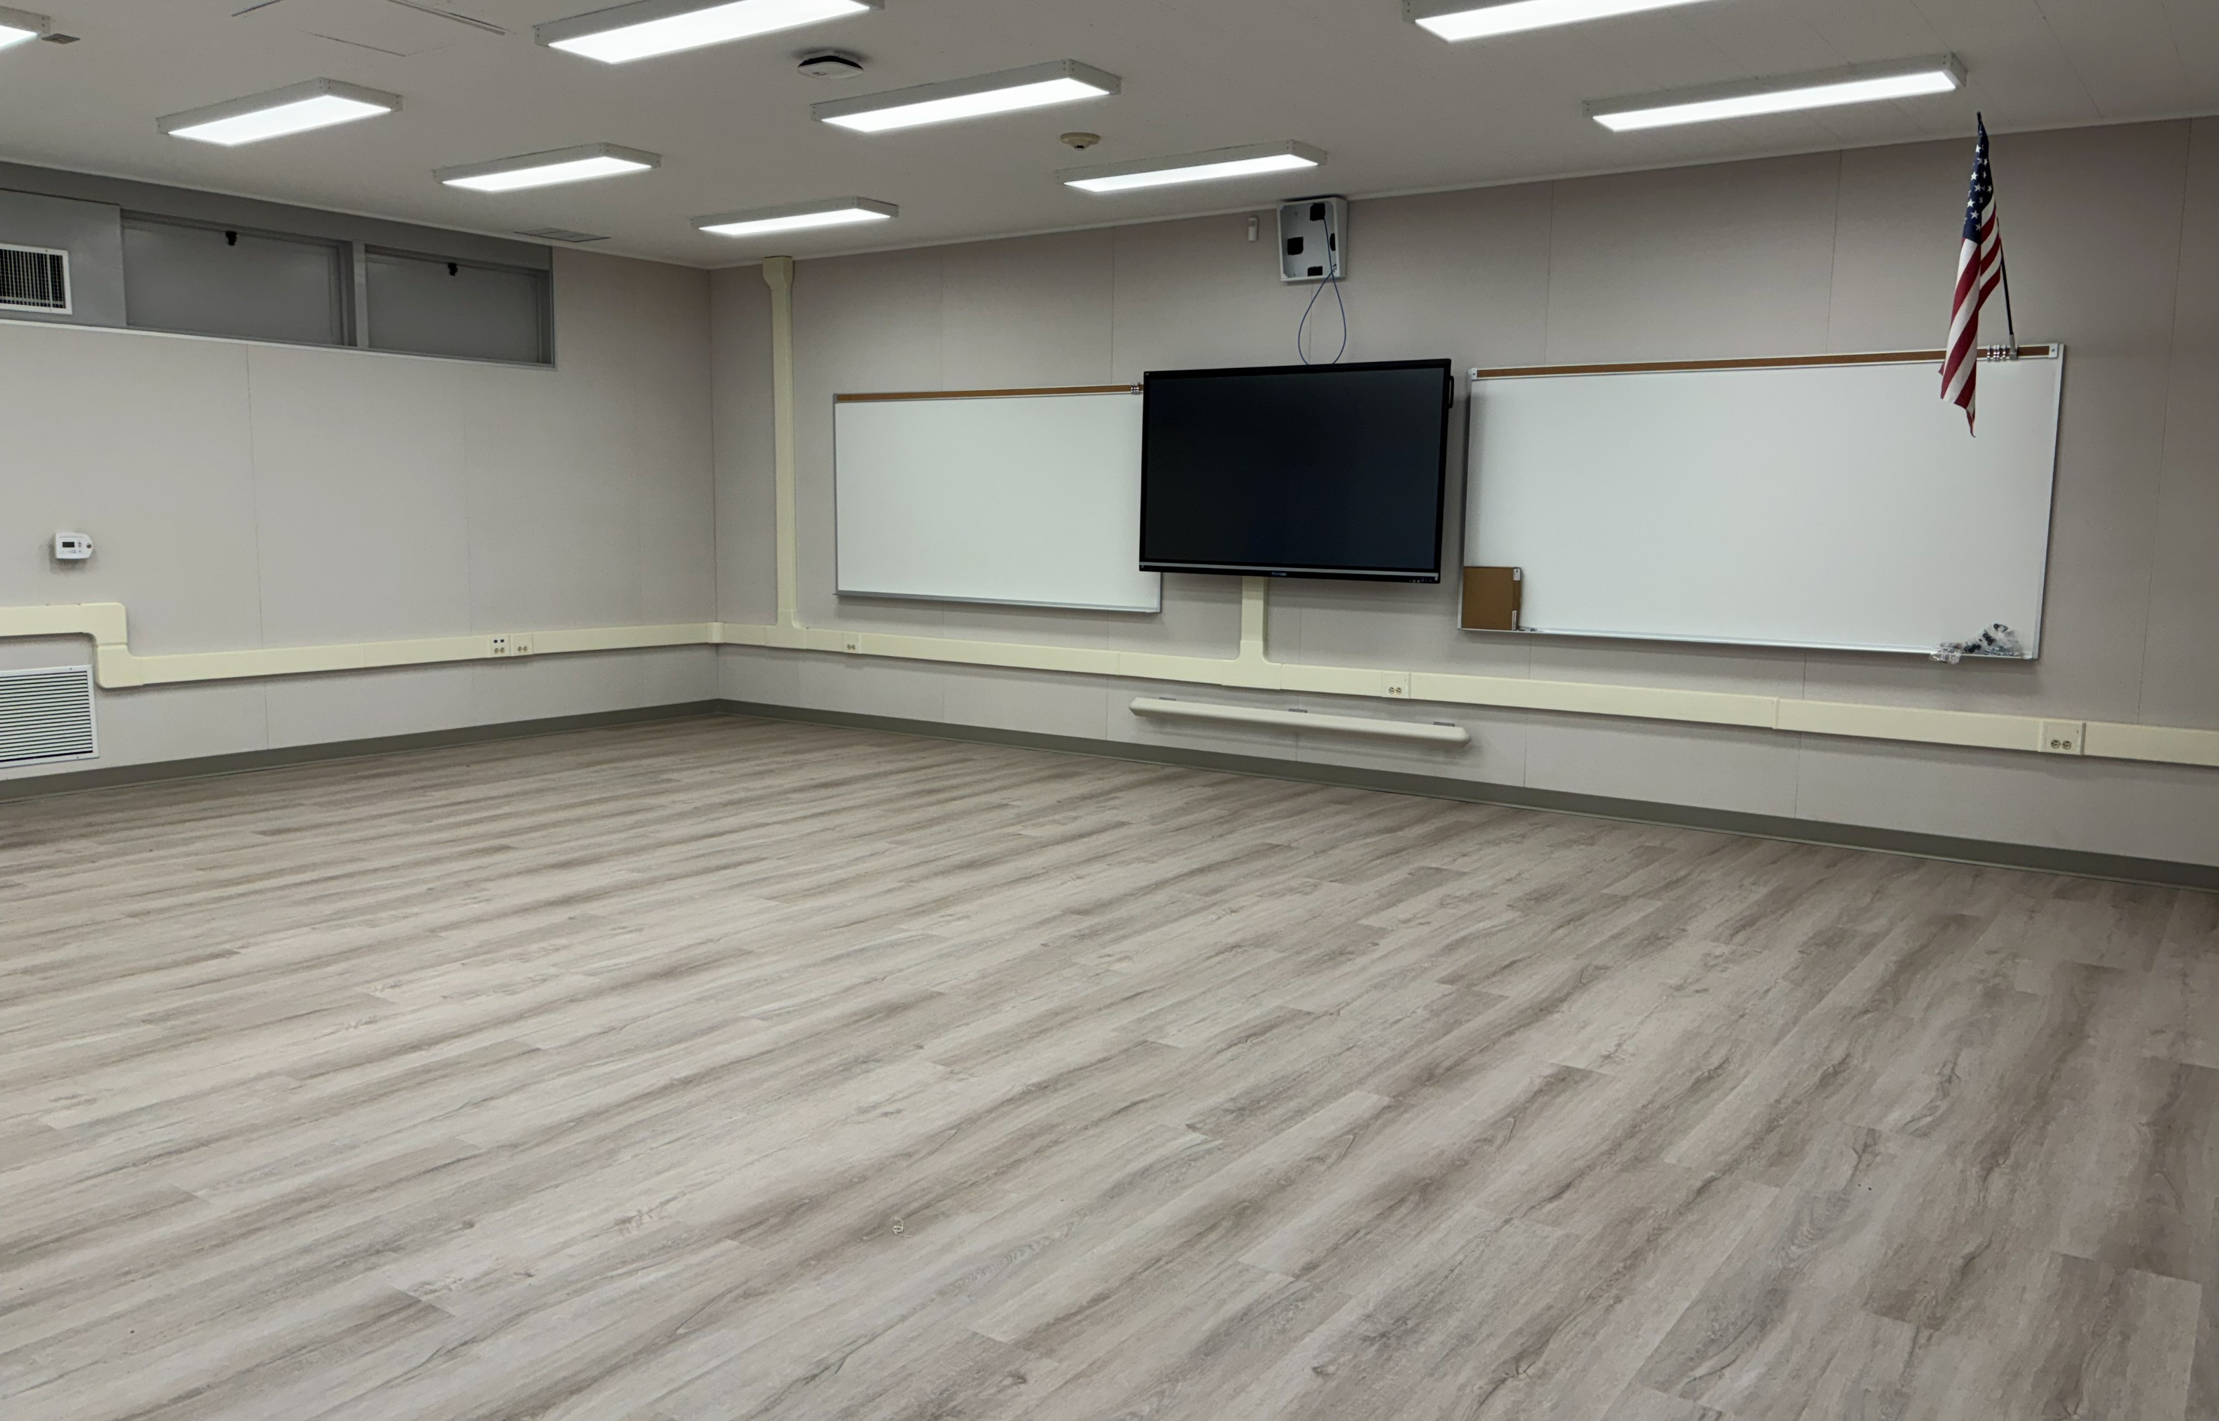
PALM ELEMENTARY
SITE WORK
CLASSROOOM

Slide 5
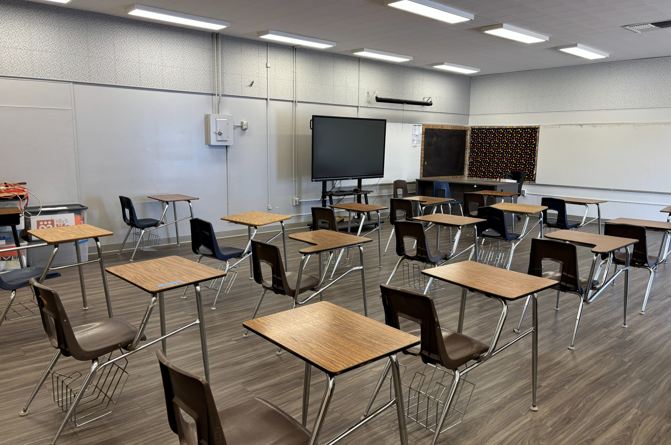
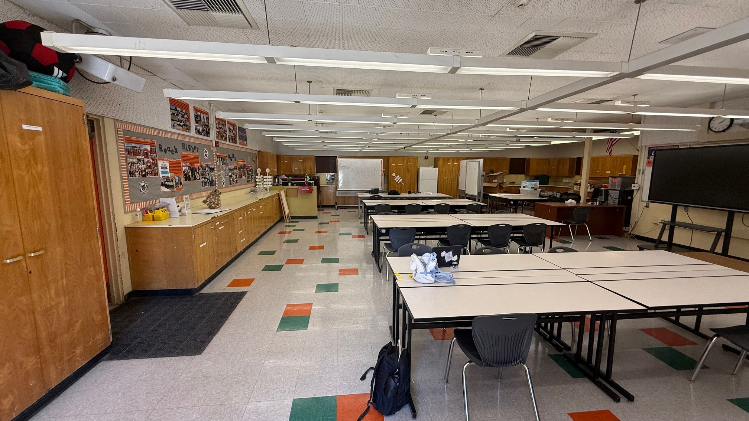
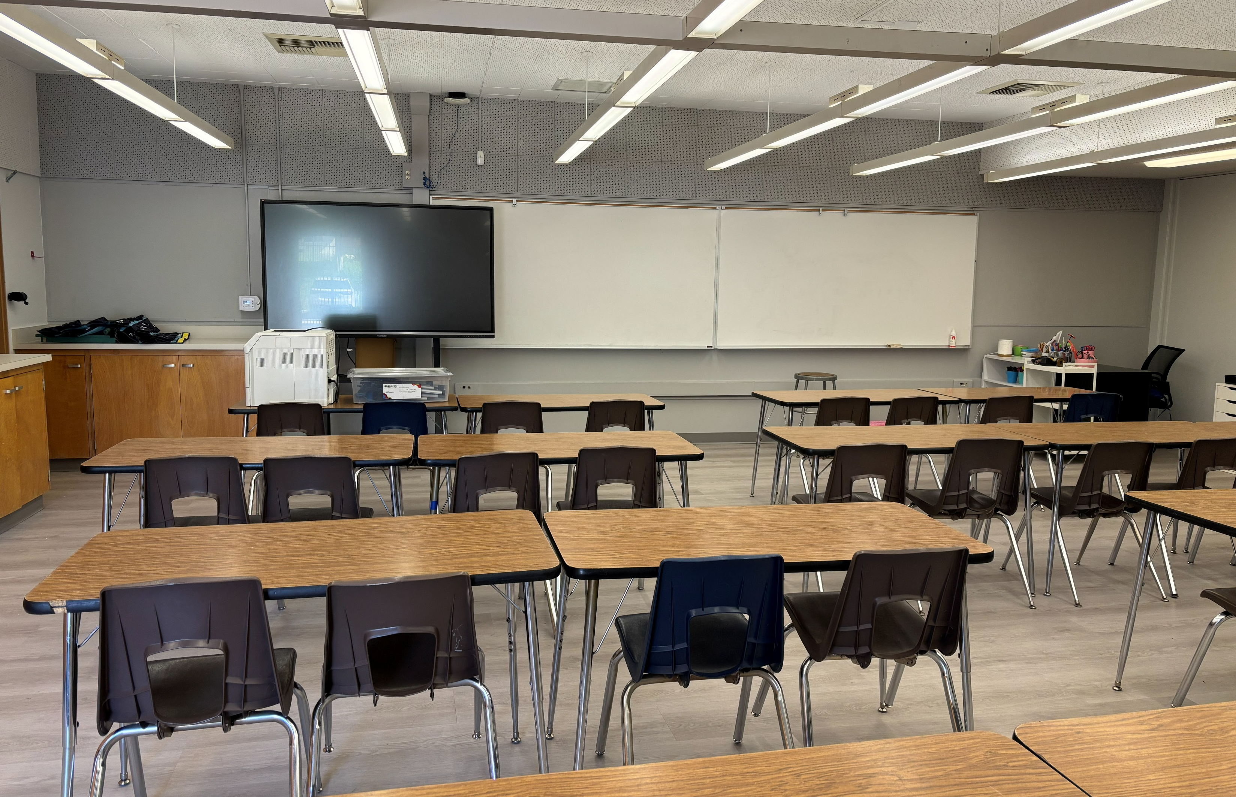
ORANGE GROVE MIDDLE SCHOOL
AFTER
BEFORE

Slide 6
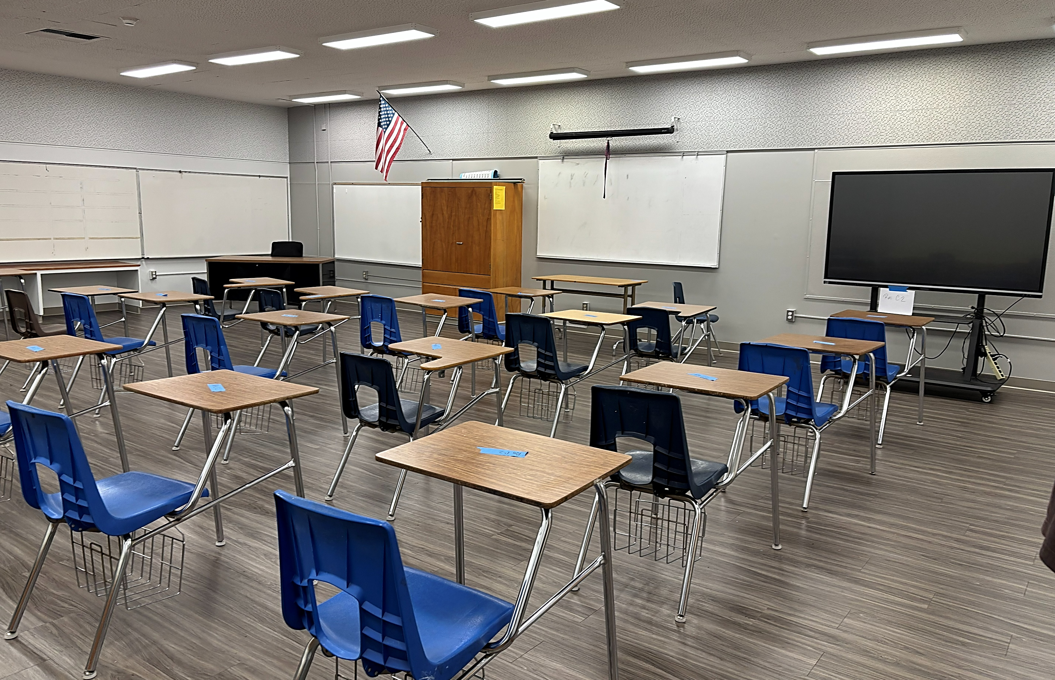

VALLEY ALTERNATIVE
HIGH SCHOOL

Slide 7
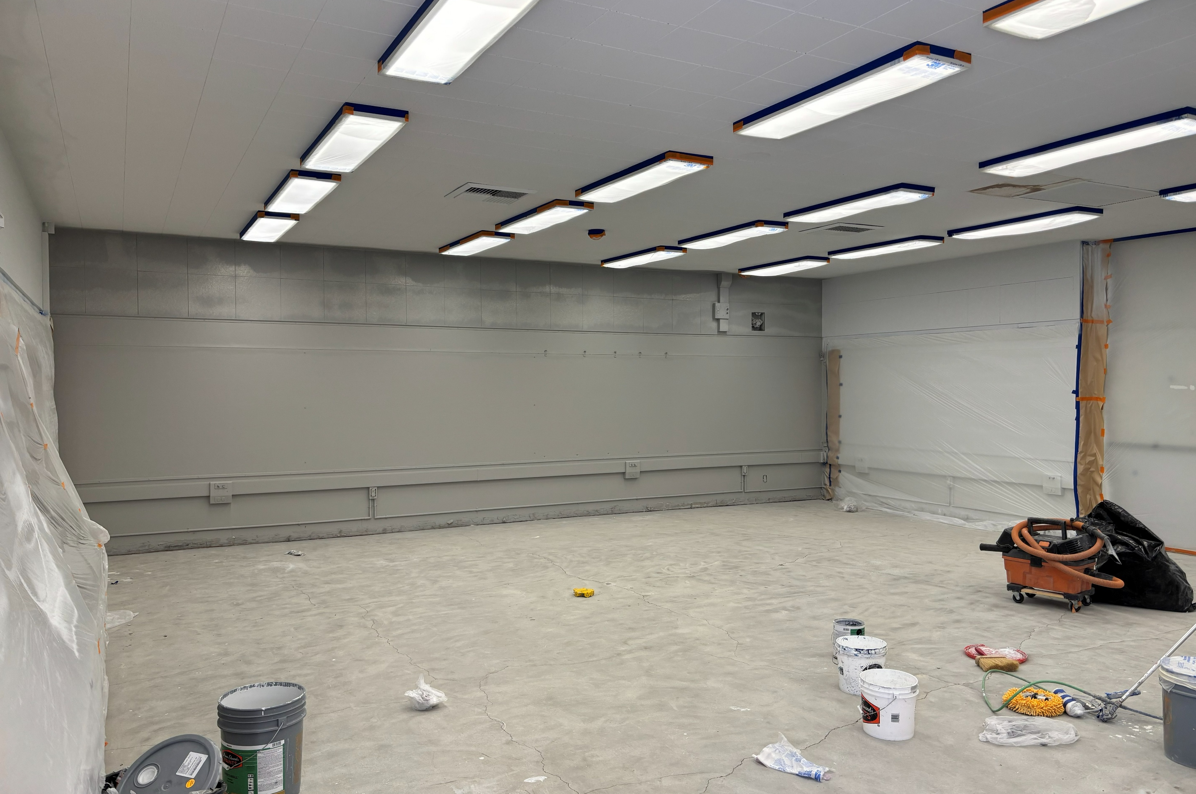
BIXBY TK
IN PROGRESS

Slide 8

QUESTIONS & ANSWERS

