Slide 1

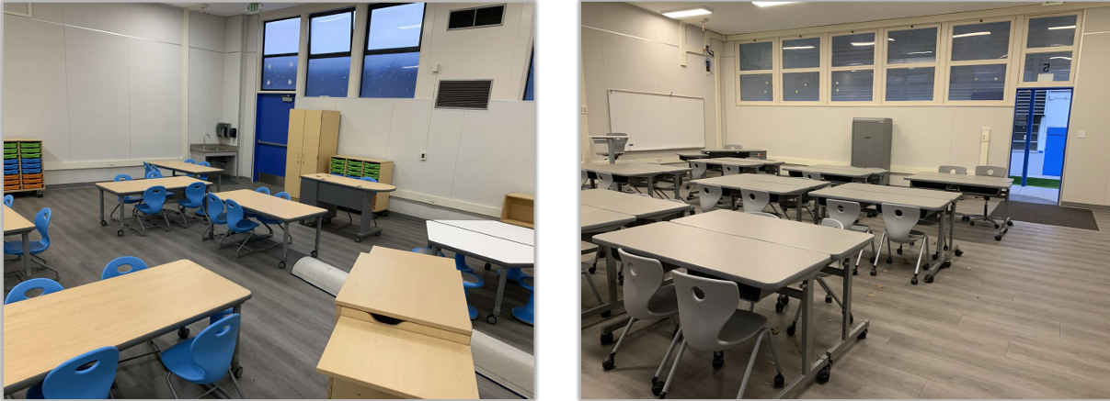
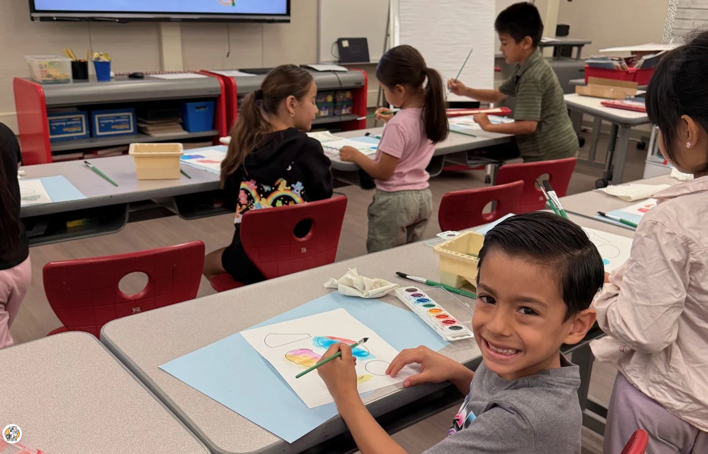
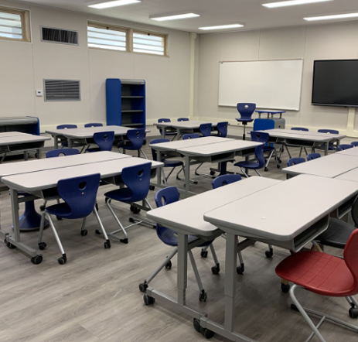
HLPUSD Measure BB Bond
Update to the Board
June 11, 2026

Slide 2
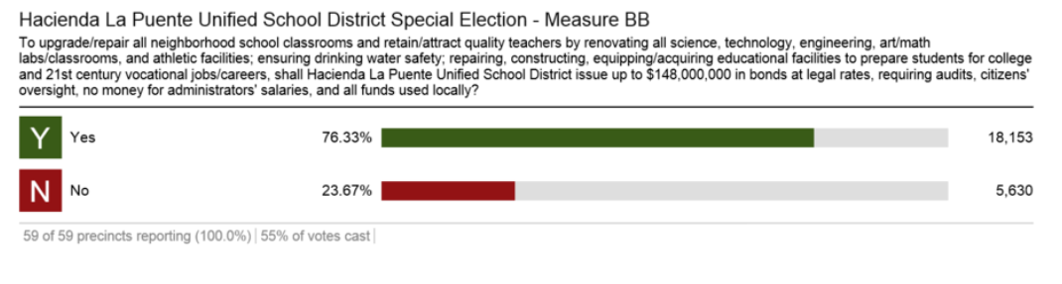
Bond Passed
Nov 8, 2016
ALLOWABLE PROJECTS:
Proceeds of the Bonds will be used to pay costs of issuance of the Bonds and for the purposes specified in the District's bond proposition submitted at the Election, which includes any of the following: providing the facilities and equipment needed for career training, advanced programs in math, science, technology, music, visual and performing arts programs, and technical education classes; Repairing or replacing worn out roofs, floors, plumbing, and electrical systems, providing improved, up-to-date- technology infrastructure and repairing athletic facilities and infrastructure; upgrading and repairing fire alarm systems to automatic systems, fire safety equipment, sprinklers and fire safety doors and security systems including security lighting, fencing, smoke detectors and emergency communications systems; installing energy efficient systems, improving heating, ventilation, air conditioning and lighting systems; upgrading instructional technology, providing and maintaining up-to-date technology including data and communication equipment, wireless systems, telecommunications and Internet and network connections; and upgrading and replacing electrical wiring, data networks and broadband, computers, hardware and infrastructure systems, classroom, and library technology and teaching equipment.

Slide 3
Measure BB Bond – Expense Transfers
2023 – 2024 Expenditures
Fund | Project | Total
14.0 – Deferred Maintenance | School Site Roofing | $4,800,995
Total Expenditures 23-24 |  | $4,800,995
2024 – 2025 Expenditures
Fund | Project | Total
01.0 – General Restricted | School Site Roofing | $2,576,258
14.0 – Deferred Maintenance | School Site Roofing | $5,190,103
01.0 – General Restricted | WOHS Baseball Field/Tennis Courts | $2,648,744
Total Expenditures 24-25 |  | $10,415,105
2025 – 2026 Expenditures
Fund | Project | Total
01.0 – General Restricted | School Site Roofing | $1,418,149
14.0 – Deferred Maintenance | School Site Roofing | $3,412,833
01.0 – General Restricted | WOHS Baseball Field/Tennis Courts | $2,137,103
01.0 – General Restricted | Tech Infrastructure Upgrade | $8,493,159
01.0 – General Restricted | Wilson HS Press Box | $77,507
Total Expenditures 25-26 |  | $15,538,751
Balance remaining
21.0 Building Fund | Current fund balance | $58,481,457
2025-26 Projected Expenses + Encumbrances |  | ($17,184,608)
Remaining balance |  | $41,296,849
2023-24 Expense transfers |  | ($4,800,995)
2024-25 Expense transfers |  | ($10,415,105)
2025-26 Expense transfers |  | ($15,538,751)
Estimated Building Fund total |  | $10,541,998

Slide 4
Upcoming Projects
Project | Sites | Estimate | Status
Roofing | Valley Alt. HS, LPHS, Mesa Robles, Valinda, Newton MS | $3,200,000 | Awarded Beginning Summer '26
Stadium Press Box | Wilson High School | $850,000 | Awarded Beginning Summer '26
Fire Alarm Installations | Baldwin, Grazide ES, Kwis ES | $1,300,000 | Pending Board Award - June
Classroom Renovations | Valley Alt. HS, Orange Grove MS, Bixby | $2,200,000 | Pending Board Award - June
IT Infrastructure | Expansion to Maximize Existing Sites | $2,500,000 | Pending Board Award - June
Gym HVAC-Fire Alarm | WOHS, LPHS, WIHS, LAHS | $250,000 | In Design
Stadium Bleachers & Press Box | Los Altos High School | $8,000,000 | In Design
HVAC Districtwide– Phase I | Multiple | $20,000,000- 30,000,000 | RFQ/P In-Progress
To ensure compliance with applicable laws and regulations, the District consulted with:
Hawkins Delafield & Woods LLP Bond Counsel
Christy White Associates Bond Auditor
Los Angeles County Office of Education (LACOE)

