Slide 1

Migrant Parent Advisory Council
Welcome/ Bienvenidos / Byenveni

Slide 2


Welcome
Virtual Attendees
In Person Attendees
Notes:
Welcome everyone! Tonight, we’re excited to have families joining us in two ways—some of you are here with us in person, and others are tuning in from home. Whether you’re sitting in this room or joining us virtually, you’re an important part of our Parent Institute

Slide 3

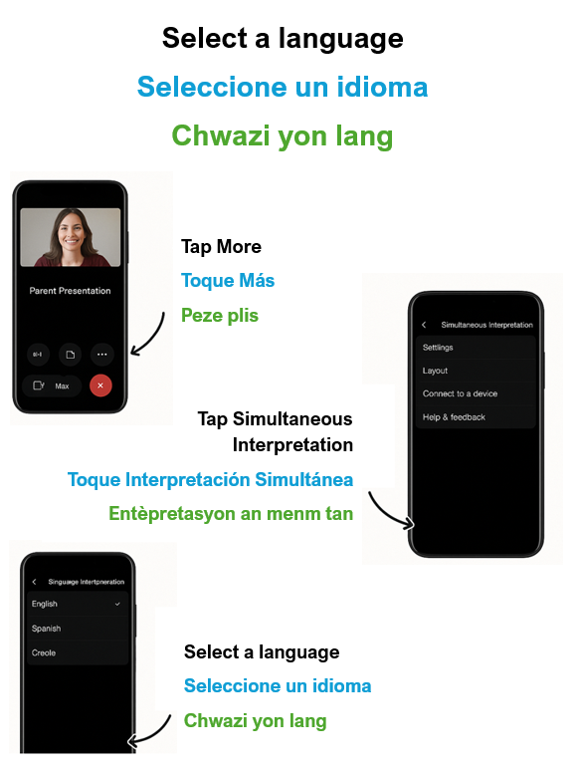
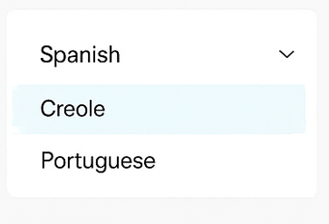
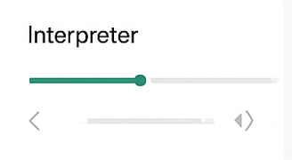
Virtual Attendees - Choose Your Language
Desktop:
Look at the bottom of your Webex screen.
Mira la parte inferior de tu pantalla de Webex.
Gade anba ekran Webex ou a.
2. Find the Interpretation icon and click on it.
Busca el icono de interpretación y hágale un clic.
Jwenn ikòn entèpretasyon an epi klike sou li.
3.Select your language
Seleccione un idioma
Chwazi yon lang
4.Adjust the Volume. Ajuste el volume. Ajiste volim la.
Mobile Device:
Notes:
Friends joining us online, the next several slides are just for you. For those of you here in person, hang tight—we’ll be right back with you.
Before we begin, I’d like to show you how you can listen to tonight’s session in the language of your choice.
If you’re joining on a computer or laptop:
Look at the bottom of your Webex screen. You’ll see a globe icon.
Click on that globe, and you’ll see a list of languages.
Go ahead and select the language you prefer—Spanish, Creole, or Portuguese.
You can also adjust the interpreter’s volume if you’d like the interpreter louder or softer.
If you’re joining on a phone or tablet:
Tap the ‘More’ button on your screen.
Then choose ‘Simultaneous Interpretation.’
From there, you can select your preferred language.
This way, you’ll be able to follow along in whichever language is most comfortable for you.”

Slide 4
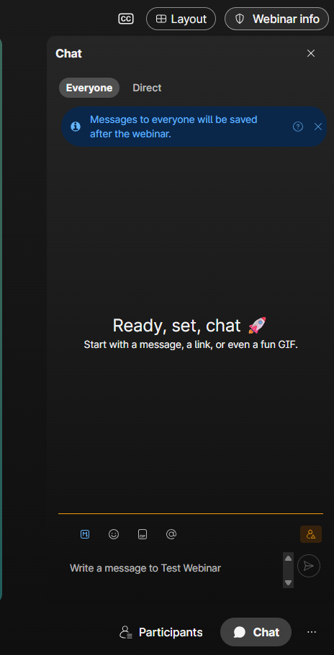


Virtual Training Norms:
What to Expect
Chat box: You may ask questions and communicate with the hosts. Chat is located on the right portion of your screen. (Desktop)
We will have a Q & A session, however you may send us follow up questions after the training.
Notes:
“Before we dive in, let’s go over a couple of norms so you know what to expect during today’s session.
First, you’ll see the chat box on the right-hand side of your screen if you’re on a computer. This is where you can ask questions or share comments with us at any time. Feel free to use it throughout the presentation if something comes up.
Second, we will have a Q & A session toward the end. That’s your chance to ask any questions live. If you think of something later, no problem—you can always send us your follow-up questions after the training, and we’ll make sure to get back to you.
So, use the chat as we go, and know that we’ll have time at the end to cover questions in more detail.”

Slide 5
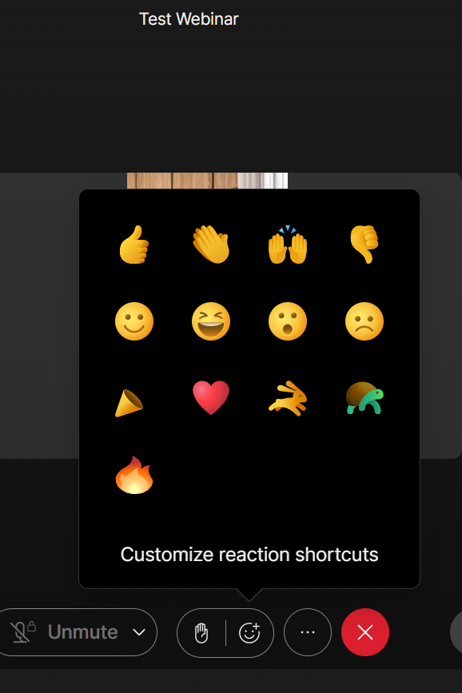


Emojis
Use the emoji reactions in Webex to let us know how you’re feeling as we get started!
👍 if you’re excited
👏 if you’re ready to learn
🙌 if this is your first Parent Institute
❤️ to show support
🐢 Turtle & 🐇 Bunny Slides (During Presentations)
Directions to put on the slides (attendees see):
🐢 Show the turtle emoji if the presenter is speaking too fast — we’ll slow down.
🐇 Show the bunny emoji if you’d like us to pick up the pace.
Notes:
👋 Emoji Slide (Beginning Icebreaker)
“As we get started tonight, we’d love for you to use the emoji reactions in Webex so we know how you’re feeling.
Give us a 👍 if you’re excited.
Use 👏 if you’re ready to learn.
Drop a 🙌 if this is your very first Parent Institute.
And a ❤️ if you want to show your support.
(You can also tell them: “Find the emoji reaction button at the bottom of your screen and click one to join in.”)
🐢 Turtle & 🐇 Bunny Slides (During Presentations)
Directions to put on the slides (attendees see):
Now, during the presentations, we’ll also use emojis to help us adjust our pace.
If the presenter is talking too fast, just click the 🐢 turtle emoji—we’ll slow it down.
If you’d like us to move a little quicker, use the 🐇 bunny emoji, and we’ll pick up the pace.
This is a simple way to keep things interactive and make sure everyone is comfortable as we move through the session.”
For my attendees that are here live go ahead and show your support to our staff by raising your hand if you’re excited, give me a clap if you’re ready to learn, and if this is your first Parent Institute with us, give me a big smile or a wave so we can recognize you.
We want to hear from all of you tonight. So, whether you’re using emojis online or gestures here in person, your feedback helps us make this institute interactive and responsive

Slide 6
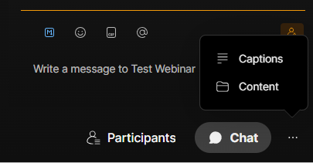
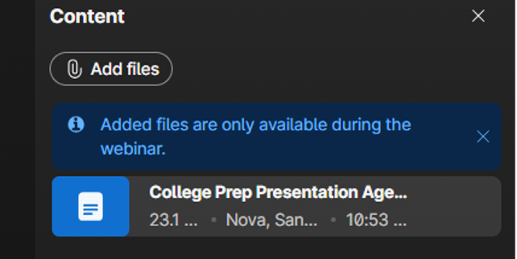
Accessing Files
1. Click on 3 dots
Click on content
Content will appear
Notes:
To our virtual attendees, let’s take a quick moment to show you how to access the files we’ve shared with you during this webinar.
We have uploaded several useful documents you may retrieve for tonight's presentation.
If you’re looking at your Webex screen, go down to the chat box and click on the three dots right next to it.
When you click, you’ll see an option that says Content. Go ahead and select that.
Once you do, a list of the files we’ve uploaded will appear—like the notes you see here.
Remember, files are only available while the webinar is live, so if there’s something you want, make sure to download it before we wrap up tonight.”

Slide 7
Virtual Attendees -Choose Your Language
Desktop:
Look at the bottom of your Webex screen.
Mira la parte inferior de tu pantalla de Webex.
Gade anba ekran Webex ou a.
2. Find the Interpretation icon and click on it.
Busca el icono de interpretación y hágale un clic.
Jwenn ikòn entèpretasyon an epi klike sou li.
3.Select your language
Seleccione un idioma
Chwazi yon lang
4.Adjust the Volume. Ajuste el volume. Ajiste volim la.
Mobile Device:
Notes:
If you’re joining in virtual now, I’d like to show you how you can listen to tonight’s session in the language of your choice.
If you’re joining on a computer or laptop:
Look at the bottom of your Webex screen. You’ll see a globe icon.
Click on that globe, and you’ll see a list of languages.
Go ahead and select the language you prefer—Spanish, Creole, or Portuguese.
You can also adjust the interpreter’s volume if you’d like the interpreter louder or softer.
If you’re joining on a phone or tablet:
Tap the ‘More’ button on your screen.
Then choose ‘Simultaneous Interpretation.’
From there, you can select your preferred language.
This way, you’ll be able to follow along in whichever language is most comfortable for you.”

Slide 8
AGENDA
MPAC (Migrant Parent Advisory Counsel)
  Migrant Secondary Education Parent Institute
  Migrant Education Program Services
  MPAC Elections
  Early Learning Programs
  Questions & Answers
Migrant Parent Institute
Notes:
The first portion of this Parent Institute will focus on MPAC. “Tonight we’ll walk through MPAC, the programs that support your children, upcoming opportunities, and we’ll leave time at the end for questions.”

Slide 9
Migrant Education Program Staff
Abel Jaimes Executive Director, FSCG | (239) 377-0218 jaimesab@collierschools.com
Diana Holden Director, Federal, State & Competitive Grants | (239) 377-6553 HoldenDi@collierschools.com
Dr. Courtney Zmach Director, Grant Development, Research and Evaluation | (239) 377-3581 zmachc@collierschools.com
Angie Cruz Coordinator, ESSA Programs | (239) 377-4578 CruzA1@collierschools.com
Josefina Brea Coordinator, ESSA Programs - Migrant | (239) 377-1967 breaj@collierschools.com
Marlene Dimas Coordinator, ESSA Programs | (239) 377-8582 dimasma@collierschools.com
Annia Bonilla Budget Analyst | (239) 377-0328 bonila@collierschools.com
Maricela Pineda Manager, ESSA Migrant Data | (239) 377-0572 pinedama@collierschools.com
Martha Cuello Compliance Specialist II | (239) 377-0102 cuellm1@collierschools.com
Junice Adame Federal Staffing Specialist II | (239) 377-0577 AdameJu@collierschools.com
Sandra Nova Parent Involvement, TSA | (239) 377-7147 novasa@collierschools.com
Luz Echeverri Compliance Specialist II | (239) 377-0327 EcheveLu@collierschools.com
Brooke Arreguin Federal Grants Specialist I | (239) 377-0560 arregb@collierschools.com
Malinda Fegueroa Federal Grants Specialist I | (239) 377-0573 feguem@collierschools.com
Notes:
“The following three slides show the FSCG staff who support our Migrant families and schools.”

Slide 10
Who are your Migrant Contacts?
Recruitment Specialist who can update your migrant status
Staff Name | Assigned School | Contact Information
Juan Medina Recruitment Specialist ll & Community Outreach | Immokalee / Everglades / Naples Area | (239) 377-6369 MedinaJu@collierschools.com
Lissette Villeda Federal Grants Specialist/Recruiter | Immokalee / Naples Area | (239) 377-0583 ville1@collierschools.com
Garry Severe Federal Grants Specialist/Recruiter | EPE / PCR / Naples Area | (239) 377-9658 severg1@collierschools.com
Priscilla Mendoza Federal Grants Specialist/Recruiter | IHS / HLE / Naples Area | (239) 377-4586 mendop@collierschools.com
Audelia Gomez Federal Grants Specialist/Recruiter | IMS / ICA | (239) 377-0570 gomeza4@collierschools.com
Francis Alvarado Federal Grants Specialist/Recruiter | IHS / VOE / LTE / Naples Area | (239) 377-0560 alvarafr@collierschools.com

Slide 11
Educational Support Staff
Teachers
Staff Member | Title | Phone Number
Ruth Torres | In-Home Literacy, Resource & Pre-K Teacher | 239-377-0560
Carmen Mirabal | Naples Area Migrant Resource Teacher | 239-377-0560
Diana Barcelo | Naples Area Migrant Resource Teacher | 239-377-0560

Slide 12
Migrant Parent Advisory Council (MPAC) Board
Alejandra Lara
  President
Imelda Castillo
  Vice President
Notes:
Our current MPAC board consists of two leaders. A president and vice president.

Slide 13
Migrant Education Secondary Parent Institute
Notes:
“The next few slides will share highlights from our Secondary Parent Institute held last fall.”

Slide 14
2025 Migrant Education Secondary Parent Institute
Fall MPAC
  Monday, October 6, 2025, at IHS and Webex
  Topic : Planning for College and Career
  Presenters:
  College Pathways & Academic Planning
    Presenters : Florida SouthWestern State College
  Career and Technical Education Opportunities
    Presenter: Immokalee Technical College (iTECH)
  Community Resources
    Presenter: Immokalee Foundation
    Presenter: Guadalupe Center
Notes:
The goal of our Fall Parent Institute was to help parents and caregivers better understand how to support their child’s path from high school into college and future careers.
Florida SouthWestern State College (FSW) shared information about why earning a college degree matters and how it can impact long-term earnings. Dr. Harvey gave a helpful overview of the programs offered at FSW and talked about affordability. FSW is one of the most affordable higher education options in Florida, and about 70% of students graduate debt-free.
Representatives from iTECH, Mr. Paquete and Ms. Alfaro, talked about the career programs available at the Immokalee iTECH campus (16 programs) and the Golden Gate campus (4 programs). They highlighted the benefits of iTECH, including that about 90% of students are on scholarships and graduate with no student loan debt. Most programs take two years or less to complete, and iTECH has a school-wide job placement rate of over 93%.
Giselle Nava and Sonia Atiyeh from the Immokalee Foundation shared how their organization supports students starting as early as elementary school through Immokalee Readers. In middle school, students participate in career exploration, and in high school they can take part in career immersion programs in areas such as Engineering and Construction Management, Business Management and Entrepreneurship, Education and Human Services, and Health Care.
We also heard from representatives from the Guadalupe Center—Robert Spano, Daniel Martinez, and Jim Ragusa. They spoke about their after-school tutoring and summer enrichment programs, which currently serve over 750 K–2 students across five elementary schools in Immokalee. They also shared how high school students can work as paid tutors, serving as role models while supporting younger students who need academic help.
Overall, we were very fortunate to have such a wide range of knowledgeable community partners. Their information and guidance provided valuable support to parents of middle and high school students.

Slide 15
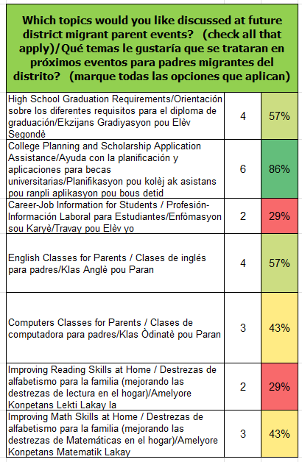
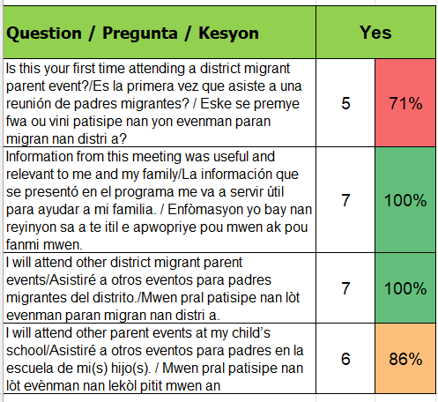
Secondary Parent Institute Survey Results

Slide 16
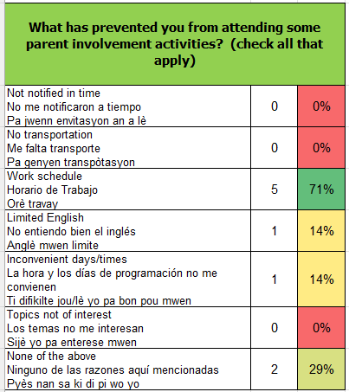
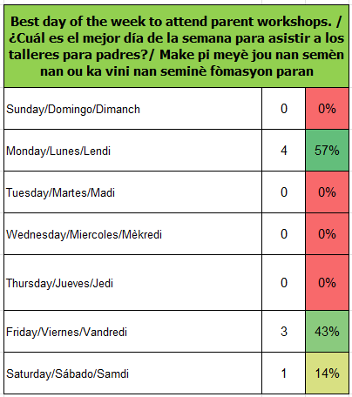
Secondary Parent Institute Survey Results

Slide 17
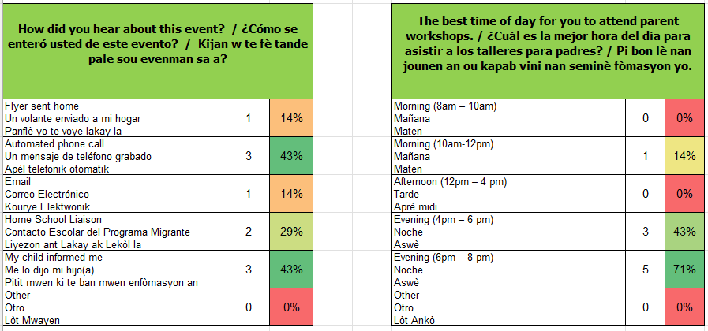
Secondary Parent Institute Survey Results

Slide 18
Migrant Parent Institute Suggestions
Based on parent surveys from the Fall 2025 Migrant Parent:
  Preferred days of the week:
    Monday and Friday
  Preferred time:
    6:00pm – 8:00pm
  Preferred topics are:
    College/Career Planning (Secondary)
    English Classes for Parents
    High School Graduation Requirements
Notes:
According to our parent surveys we collected last fall, families shared that Mondays and Fridays work best, especially in the evening from six to eight. You also told us that on a secondary level, you want more support with college and career planning, English classes for parents, and understanding high school graduation requirements

Slide 19


Input for the 2026-2027 School Year
Suggestions:
The initiatives funded by the Migrant Education Program are based on student needs and data. However, parents, schools and community members have input on the migrant supports. This input helps with planning for our program.
Please continue to attend Migrant Parent Advisory Committee meetings (MPAC) and school parent meetings/events to be active in your child’s learning. The Migrant Program and schools are continuously analyzing data, student needs, and stakeholder input so students are reaching their fullest potential.
Notes:
“We plan based on student needs, but your voice truly matters. Your ideas help us create better support for your child. We encourage you to continue to attend MPAC and parent institutes events and to continue to be active in your child’s learning.

Slide 20
Migrant Education Program Services

Slide 21
Migrant Education Program Supports
All supports are based on student need and data:
  Additional teacher/tutor support in school
  CCPS Learning Express
  Assist with physicals to attend school
  School supplies (based on need)
  IMS/IHS Earn and Learn program
  Summer programs
  In-Home Literacy
  English classes for Out-of-School Youth (16-21)
  Parent trainings (Parent Institutes)

Slide 22
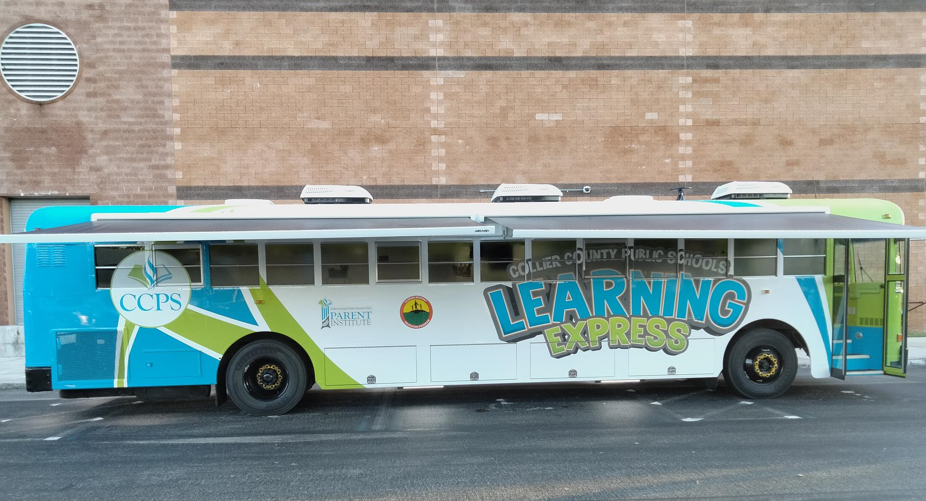
CCPS Learning Express Bus
Notes:
Our Migrant Teachers truly enjoy servicing our students via the Learning Express Bus. “The Learning Express supports families with tutoring, homework help, English classes, technology access, and fun learning activities for children of all ages.”

Slide 23
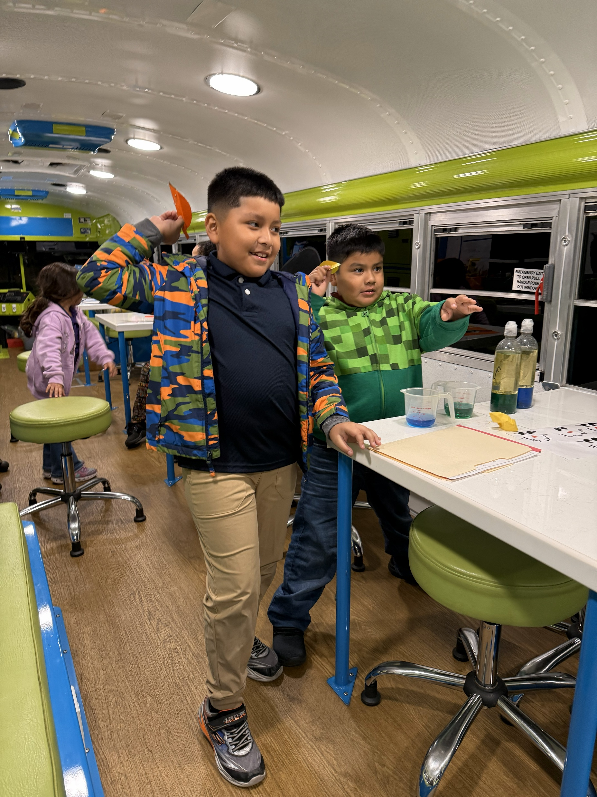
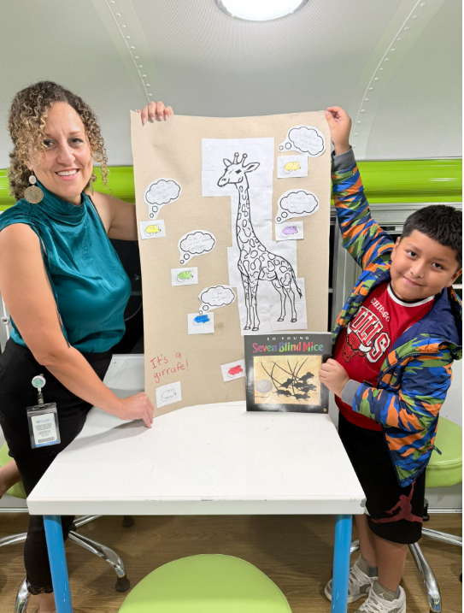
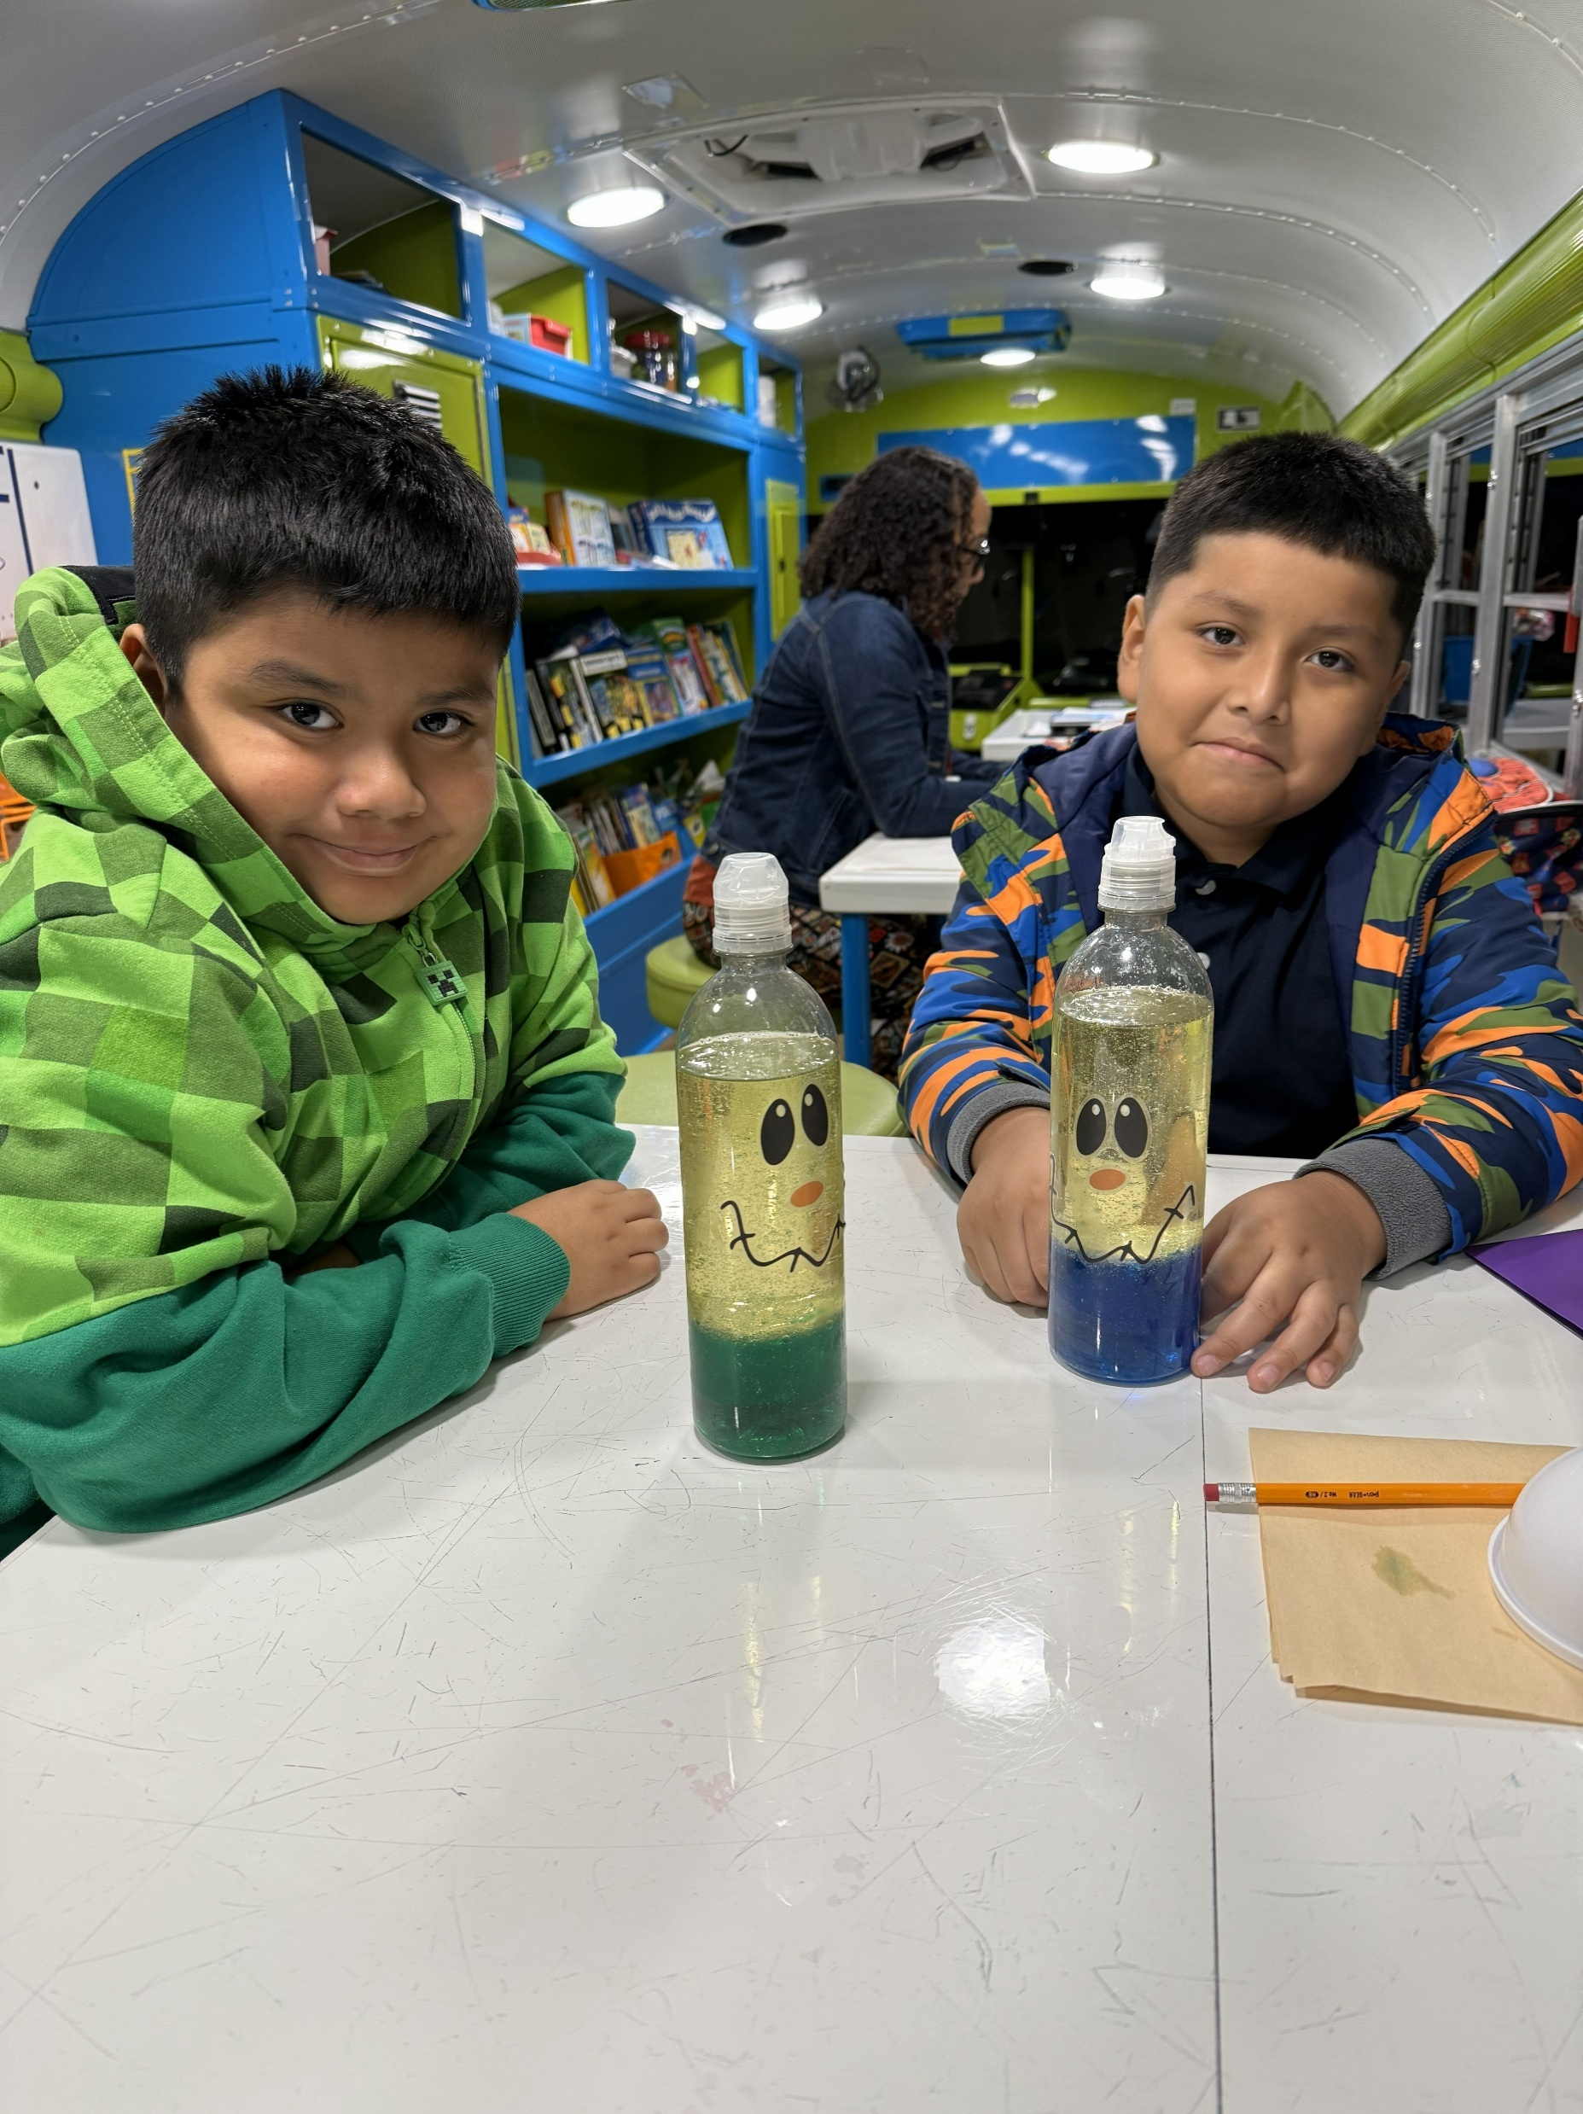
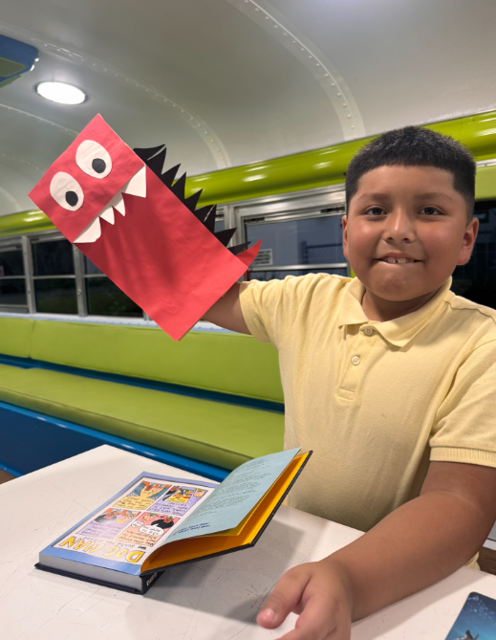
Educational Services in the Mobile Classroom
Notes:
“This is what learning looks like on our Learning Express bus—science experiments, read-alouds, and lots of hands-on fun. We’d love for you to join us Monday through Friday, five to eight, at FSCG on South 5th Street.”

Slide 24
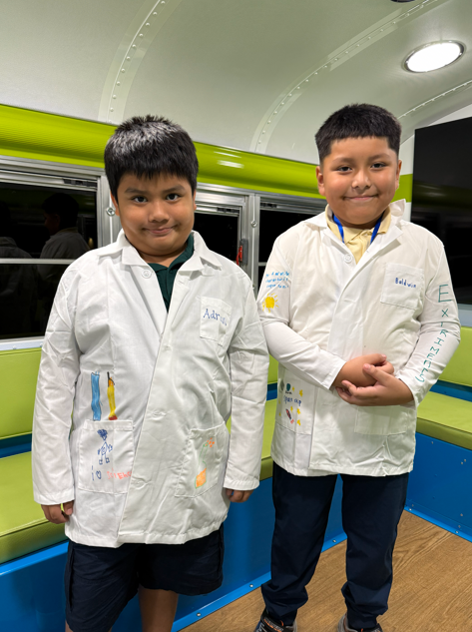
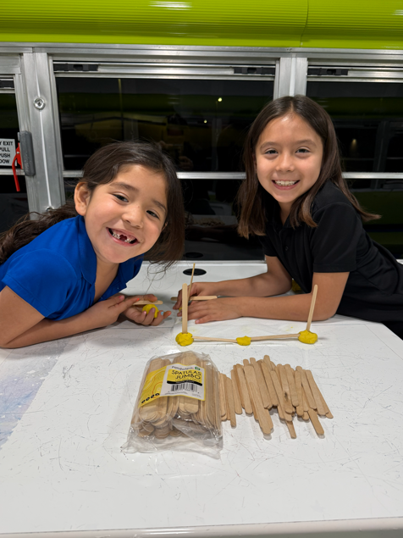
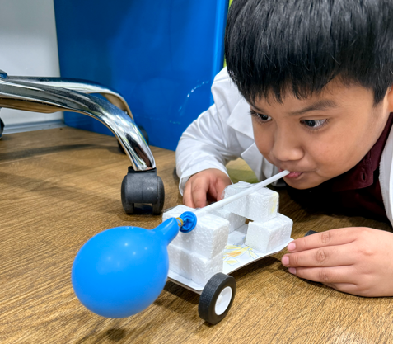
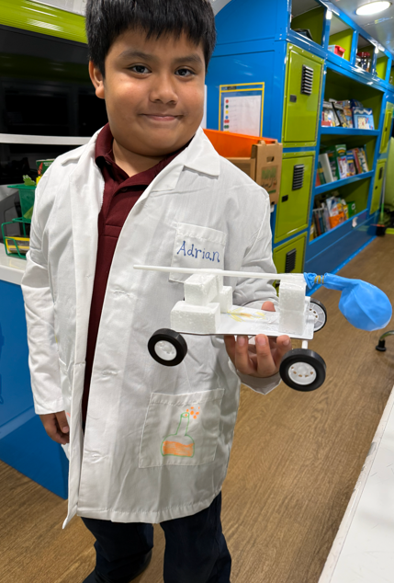
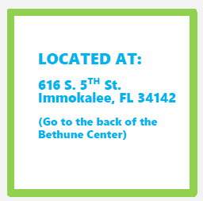
Educational Services in the Mobile Classroom
Notes:
“This is what learning looks like on our Learning Express bus—science experiments, read-alouds, and lots of hands-on fun. We’d love for you to join us Monday through Friday, five to eight, at FSCG on South 5th Street.”

Slide 25
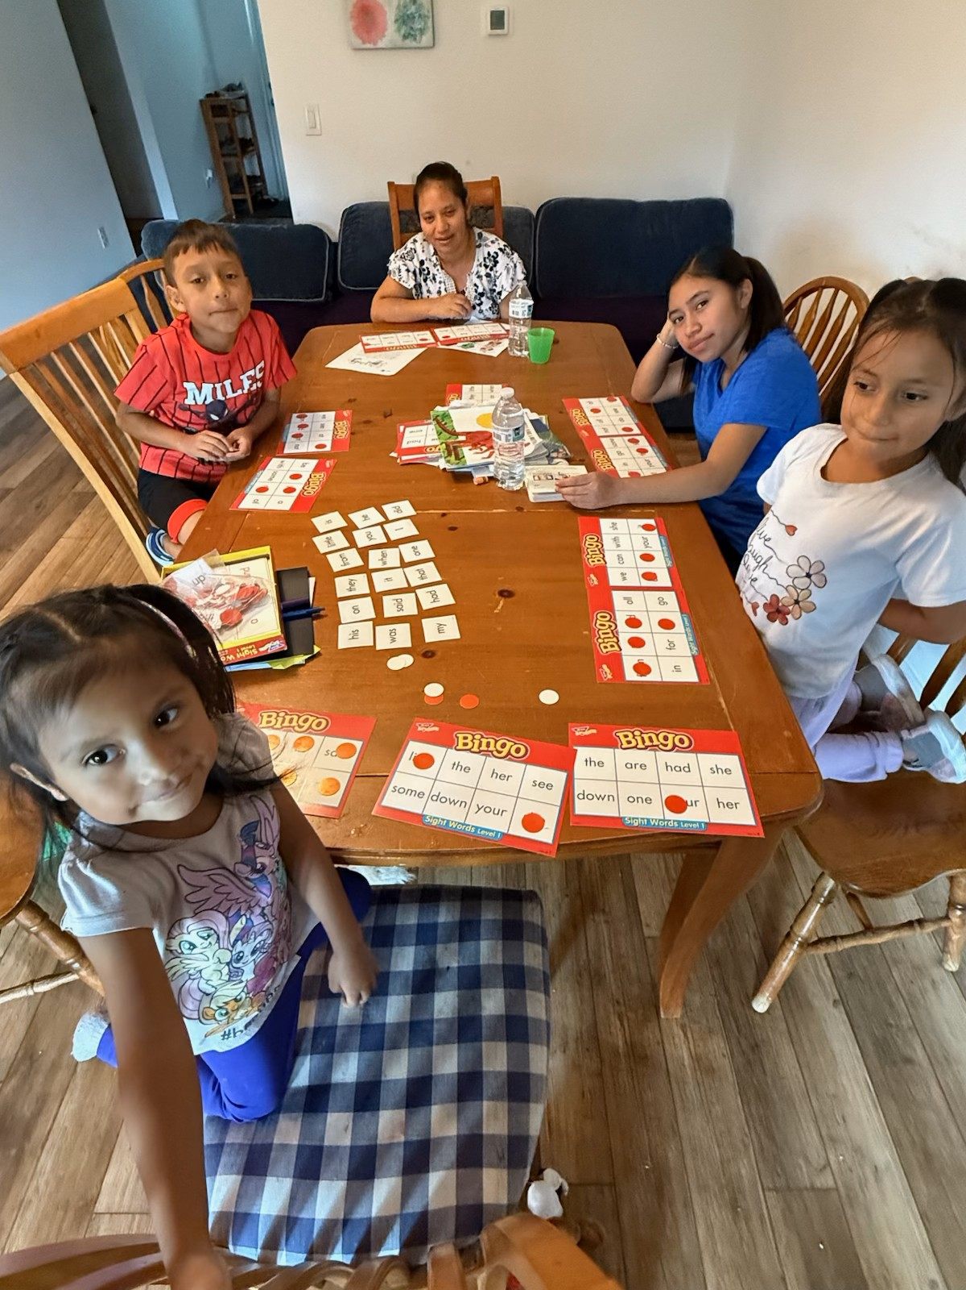
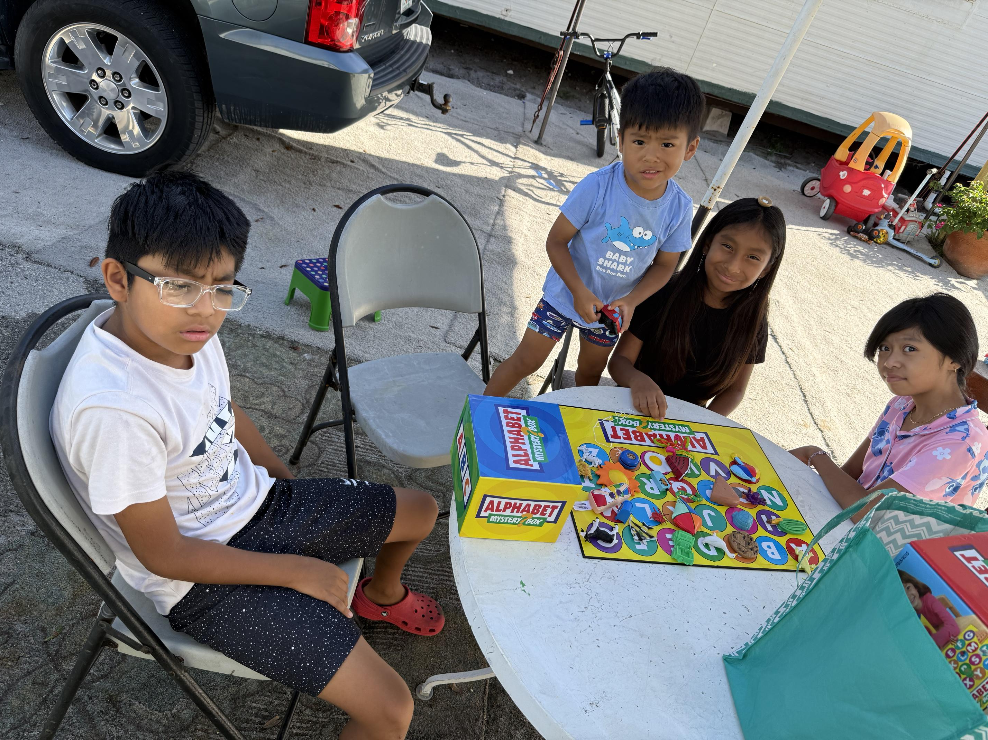
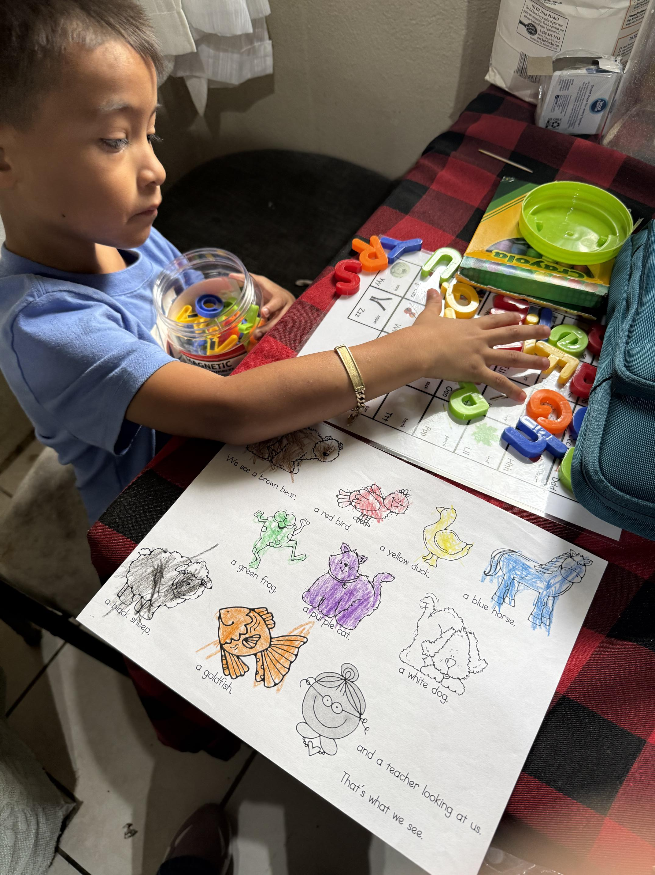
Migrant In-Home Literacy
Our Migrant Resource Teacher; Ruth Torres, works in the homes with parents and their children (ages 3-5). Mrs. Torres teaches the children literacy skills while showing the parent strategies to work with their child at home. The children receive materials they can use at home.

Slide 26
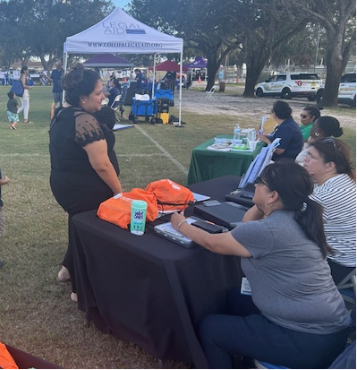
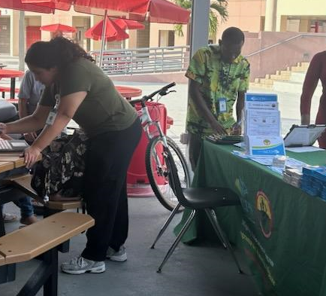
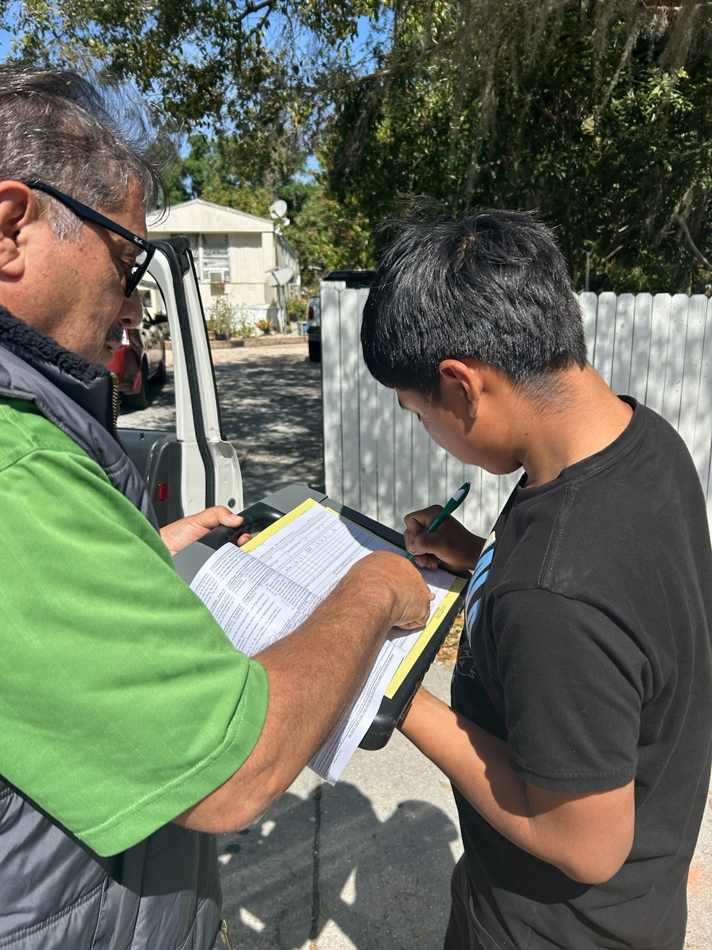
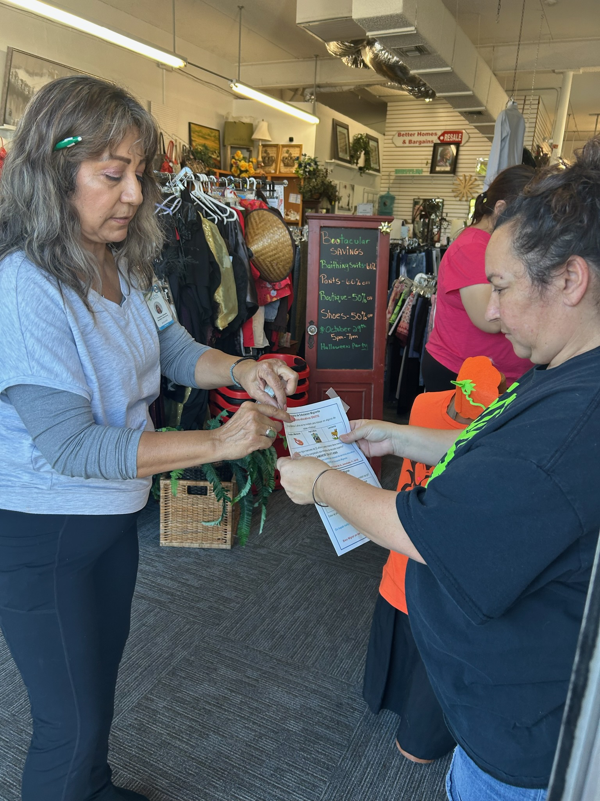
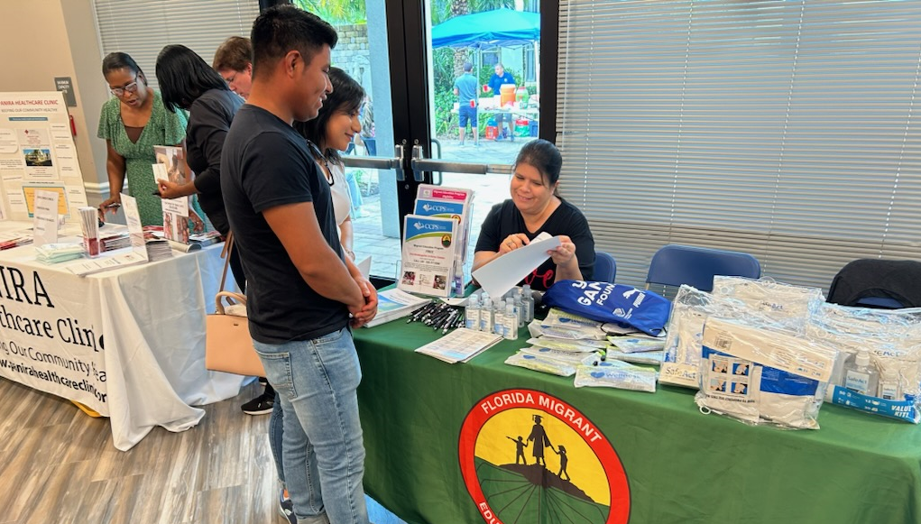
Migrant Recruitment Team

Slide 27
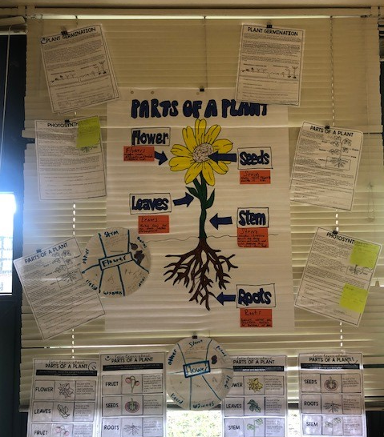
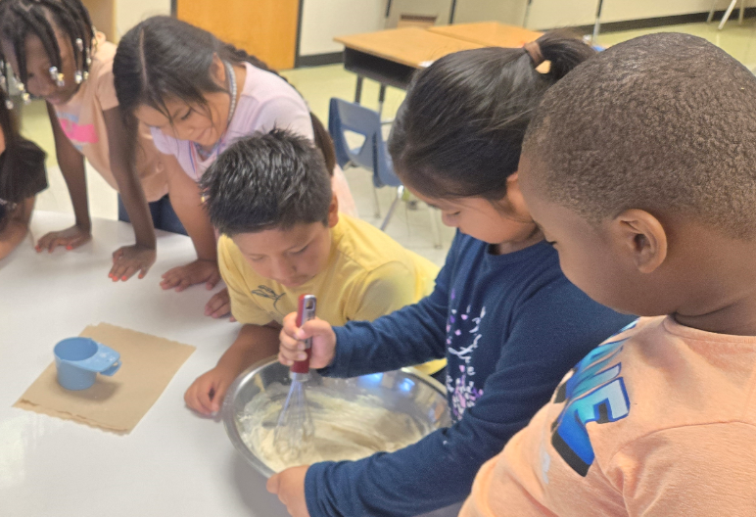
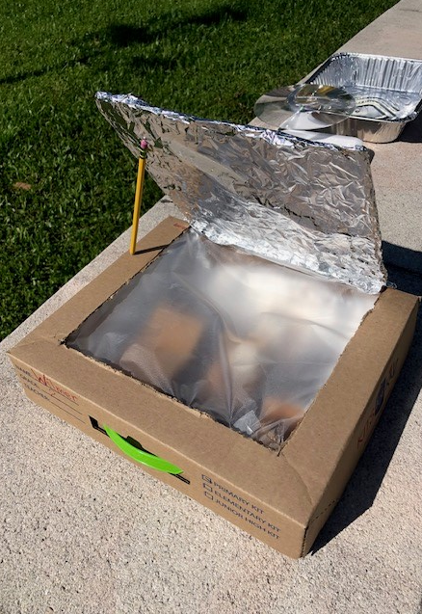


SUMMER PROGRAMS 2026
STREAM - Science, Technology, Reading, Engineering, Arts, and
Mathematics
In-Home Literacy
Rising PK and K

Slide 28
Update Migrant Information
Please call 239-377-0560 the Migrant Education Program office or your recruiter if you make a new move.
The Migrant Education Program must recertify all migrant students annually:
    If you made a new move, please call us as soon as you arrive in Collier County.
Resources and supports are based on eligibility status and need.

Slide 29
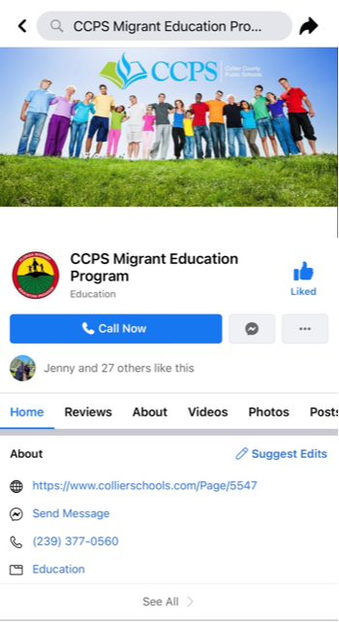

Migrant Facebook Page
Notes:
To scan barcode just open camera on phone like you are going to take a picture and click on the link.

Slide 30
MPAC Elections 2026

Slide 31
MPAC Elections
School year 2026/2027 - Vote on Fall Parent Institute
  3 years
Election Process and Timeline
Roles and Responsibilities
  President
  Vice President
  Secretary
Nomination Form – connect with the MEP for more information. 239-377-0560

Slide 32

Early Learning Programs

Slide 33

Vision:
All students will complete their educational journey prepared for ongoing learning as well as community and global responsibilities.
Benefits of CCPS Early Learning Programs
Multiple program options available
Florida State Certified teachers Highly qualified teacher assistants
Program regularly meet and exceed Florida State Kindergarten Readiness rates
Promotes early language and literacy skills
Parent education and engagement opportunities
Integrated social-emotional wellness curriculum (Conscious Discipline)
Nutritious meals approved by the US Department of Agriculture (USDA)
Allows for seamless transition to Kindergarten

Slide 34
CCPS Early Learning Programs
WHAT ARE YOUR Pre-K OPTIONS?
Head Start - Free full day program for families that qualify
Half a day- 3-hour VPK (No cost to parent)
Full Day VPK Program combined with Parent Pay Option VPK
Pre-School Disabilities/Exceptional Student Education

Slide 35

Head Start
The Head Start program is available to children of disadvantaged families and requires pre-approval. Children in foster care and families experiencing homelessness or house-sharing, receiving public assistance (TANF, SSI, SNAP), or earning below the Federal Poverty Guideline are encouraged to apply. This program is offered at multiple sites.
Full day program for qualified 3- and 4-year-olds
Currently based at 21 schools during the regular CCPS school year
Staff to student ratio 1:10
Program focuses on school readiness for children and requires family involvement for improvement
Some 3- and 4-year-olds with disabilities are served in this environment
Funded by federal Head Start funds

Slide 36



Voluntary Prekindergarten
Florida VPK is a free prekindergarten program for eligible children who turning 3 or 4 years old by September 1st during regular school year or summer before entering kindergarten.
VPK does not require determination for eligibility.
Full day VPK (combined with Parent Pay Option) The full day VPK program is limited to space availability and parents are responsible for additional fees. This program is offered at 23 schools.
Based at 2 schools with VPK only programs, and 21 schools with blended VPK/Head Start/ESE Inclusion classes
Half Day VPK at Sabal Palm Elementary School (NO COST TO PARENT) The 3-hour half day VPK program is limited to space availability and offers morning and afternoon sessions.
Staff to student ratio 1:10
Focuses on school readiness
Funded by Florida Office of Early Learning/Early Learning Coalition of Southwest Florida.

Slide 37

Exceptional Student Education (ESE)
Preschool Disabilities- services available for children with disabilities. Contact Florida Diagnostic & Learning Resource System (FDLRS) to request a free developmental screening.
Full day program for children ages 3-5
Based at 14 schools
Typical staff to student ratio ranges from 1:3 to 1:6
Program focuses on kindergarten readiness
Services funded by Florida FTE funds and federal IDEA funds

Slide 38

Entrance Process: Preschool Disabilities Program

Slide 39
CCPS Pre-K Programs List of Schools
Avalon Elementary School | (239) 377-6200
Ave Maria Elementary School | (239) 377-9400
Bear Creek Elementary School | (239) 377-0001
Calusa Park Elementary School | (239) 377-6400
Corkscrew Elementary School | (239) 377-6500
Eden Park Elementary School | (239) 377-9200
Everglades City School | (239) 377-9800
Fun Time Academy (Head Start only) | (239) 261-8284
Golden Gate Elementary School | (239) 377-6900
Golden Terrace Elementary School | (239) 377-7000
Lake Trafford Elementary School | (239) 377-7300
Lely Elementary School | (239) 377-7500
Manatee Elementary School | (239) 377-7600
Mike Davis Elementary School | (239) 377-9000
Naples Park Elementary School | (239) 377-7700
Osceola Elementary School (VPK Parent Pay option only) | (239) 377-7800
Palmetto Elementary School | (239) 377-9100
Parkside Elementary School | (239) 377-8900
Pelican Marsh Elementary School (VPK Parent Pay option only) | (239) 377-7900
Pinecrest Elementary School | (239) 377-8000
Poinciana Elementary School | (239) 377-8100
Sabal Palm Elementary School (Half Day VPK, Head Start, or VPK Parent Pay options) | (239) 377-8200
Shadowlawn Elementary School | (239) 377-8400
Vineyards Elementary School | (239) 377-8700
Village Oaks Elementary School | (239) 377-8600

Slide 40
School-Community Learning Partnerships
Essential to Expanded Learning Success – Some Partnerships:
Early Learning Coalition of SWFL (ELC)
Florida Diagnostic and Learning Resources (FDLRS)
Early Steps
Early Learning Literacy Model (ELLM)
David Lawrence Centers (DLC)
NAMI- National Alliance on Mental Health
Literacy Collier (LC)
Music Scores Foundation

Slide 41


Navigating Pre-K Enrollment
APPLY NOW!
www.collierschools.com/PreK
(239) 377-0590
Email: PreK@collierschools.com
Notes:
CCPS Pre-K Programs Social Media
Facebook:
@ccpsprek https://www.facebook.com/ccpsprek/
Instagram:
@ccpsprek https://www.instagram.com/ccpsprek/
X:
@CCPS_PRE_K https://x.com/ccps_preK

Slide 42
Upcoming Events
Title I Parent Institute – The Power of Reading: Building Stronger Literacy Skills, One Page at a Time
  March 23, 2025 – Lorenzo Walker Technical College 5:30 pm - 7:00 pm
  March 24, 2025 – Golden Gate High School 5:30 pm - 7:00 pm
  March 25, 2025 – Immokalee High School 5:30 pm - 7:00 pm
  March 26, 2025 – Highlands Elementary School 5:30 – 7:00 pm
Senior Migrant I Dare You Banquet
  May 7, 2026 – iTECH 5:30 pm - 7:00 pm
Notes:
“We have some exciting events coming up, including our Title I Parent Institute in March at several schools, and our Senior Migrant Dare You Banquet in May.”

Slide 43
Questions & Answers
Click on the chat icon
The chat will be on the right portion of your screen (Desktop)
Make sure ‘everyone’ is highlighted
Type your question on the Chat
Notes:
Now we’re moving into our Questions & Answers section!
If you’re joining us virtually, please click on the chat icon at the bottom right of your screen. The chat will open on the right-hand side. Make sure the word ‘Everyone’ is highlighted so your question is seen.
If you’re joining us in person, our staff in each classroom will type your question into the chat for you.
To get us started, I’ll begin with a few questions we gathered from families ahead of time.

