Slide 1


Orientation Video
25-26 school year
Welcome to the Remote K-8 School
216-838-7250
Our goal is to provide an equitable and individualized learning environment so that we can develop well-rounded, confident, and responsible students who strive to reach their full potential.
Notes:
Please show this entire slide deck in order.

Slide 2
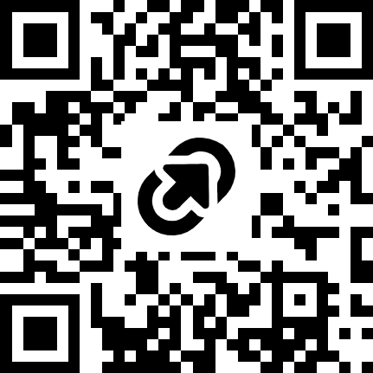
Important Contacts
Principal: Chris Wyland
(216) 838-7250
Christopher.wyland@clevelandmetroschools.org
Family Support Specialist: Shuntaya Howard
showard@sayyescleveland.org
(216)219-1253
Digital Learning Coordinator: Ronisha Jordan
Ronisha.Jordan@clevelandmetroschools.org
(216)838-7257
Secretary: Louise Herrington
louise.herrington@clevelandmetroschools.org
(216) 838-7250
Website - https://remotek8.clevelandmetroschools.org/
Facebook/Instagram - @CMSDRemoteK8
Notes:
Share contact information for all staff on this page.
Inform families that you will discuss more about what Mr. Morris does at the end of the presentation.
Ask them to be sure to bookmark our website and keep the magnet with our information is a visible location in the home.

Slide 3
Good Candidates for our School
Students who excel at independent learning.
  Self-directed and motivated.
Students who can independently engage with learning technology.
  Proficient in navigating a digital learning space and multiple learning platforms and applications.
Students who can manage their own time.
  Maintain schedules.
  Regulate tasks and prioritize their time.
  Organize their physical and mental workspace.
Notes:
Review all characteristics.
Remind families that while we offer a unique program, it may not be best for all students.
Stress that since teachers are not in a physical location with students, we rely heavily on the adults at home to support attendance and engagement.

Slide 4
School Day
  Instructional Day – 8:00 AM to 2:30 PM
  Students will have a formal class schedule that they must follow.
  Tuesday, Wednesday, Thursday, Friday: Synchronous learning (live classes) for at least 175 minutes per day; asynchronous learning (independent, one-on-one, or small group work) for 150 minutes per day.
  Monday: Class Meetings at 8:00am, which is REQUIRED, and then go to class. Day includes family engagement, independent learning, tutoring, office hours, small group instruction, etc. Students stay online completing work until 2:30pm.
  Students must be online, completing learning related tasks for 6 hours each school day.
Notes:
Review the daily and weekly schedule.
Stress that all students must log in every school day by 8:00am.
Clarify that while Monday does not have a full class schedule, students must attend the class or school meeting and stay logged in until at least 2:30pm.

Slide 5
Attendance Requirements
Students are required to attend school 180 days per year. Regular attendance is vital for student success. ALL live classes must be attended each day.
Parent/Guardians are required to call the school (838-7250) in the morning, by 10:00am, if their child will be absent or tardy.
  Classwork missed during unexcused absences may not be able to be made up by the student.
  Appointments should be made before or after school hours whenever possible. Students are expected to report to class before and return to class after all appointments.
For technology related issues, the parent/guardian must contact the school to inform of the issue AND must contact the HelpDesk at 216-838-0440 for technical support. All work missed due to technical issues must be completed by the student.
Notes:
Emphasize attendance is mandated by the State of Ohio.
Share that attendance is logged by the hour and that every hour a student is absent, late or leave early is added up. Once thresholds are met, letters will go home.
Emphasize to call the office by 10:00am each morning for any absent or late student. Share that this is the only what to get an absence excused or changed to a tardy. Compare this to an in person school where a student would be signed into the office.

Slide 6
Engagement Expectations
Students MUST be logged in and attending class and completing work for 6 hours each school day, from 8:00am until 2:30pm.
Cameras must be on at all times. If the camera is not able to be on the following expectations are in place:
  Parent/Guardians must communicate with the classroom teacher the reasons.
    Permissible reasons include, but are not limited to, device issues, medical and mental health reasons, and special education accommodations.
  Please provide an environment that is suitable for learning. Avoid loud, distracting locations and bedrooms and cars if possible.
Classwork for unexcused absence may not be able to be made up by students.
Notes:
Explain that camera on and face in the camera is an expectation per the State of Ohio.

Slide 7
Attendance and Engagement
Per the Ohio Department of Education, in order to show proof of attendance and engagement in a Remote School, student must both attend live classes and log-in and complete assignments in Clever/Schoology each day.
In accordance with Ohio Revised Code 3314.261(A-F), each internet or computer-based school shall develop a policy regarding failure to participate in instructional activities. The policy shall state that a student shall become subject to certain consequences, including disenrollment from the school. Therefore, failure to meet attendance and engagement expectations will result in consequences that may require a transition back to a brick-and-mortar school setting or an alternative setting, such as the
Virtual Academy.
Notes:
Clarify that administration will be making follow-up phone calls based off this State Law.

Slide 8
In- Person Engagement Expectations
Per the Ohio Department of Education and CMSD, certain assessments MUST be completed in person. Students will be required to come to John Adams to complete these assessments. Students who fail to do so maybe removed from the Remote School. These assessments include, but are not limited to:
  Ohio State Tests.
  English Language Proficiency Assessments.
  Gifted Assessments.
  Alternative Assessments.
Technology issues may require in person support at John Adams or the Arnold Pickney East Professional Center.
Notes:
Clarify that administration will be making follow-up phone calls based off this State Law.

Slide 9
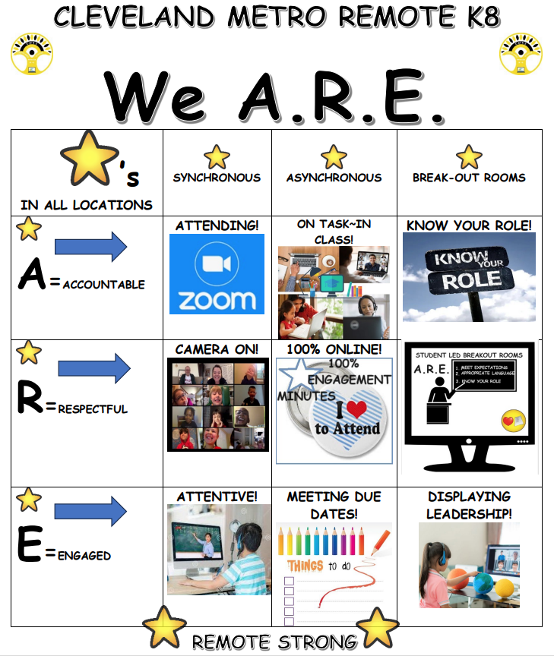
PBIS
Notes:
Share that PBIS stands for Positive Behavioral Interventions and Supports and is also a State Law.
Share that we ARE stands for our school rules of Accountable, Respectful and Engaged.
Reminder families and students that we have prizes that will be mailed home each week and month for students who are modeling this expectations.

Slide 10
Behavior Expectations
All students are expected to behave in a manner that is in alignment with the CMSD Student Code of Conduct. This includes, but is not limited to:
  Use appropriate language, text, images, and body motions during all school related activities and functions.
  Attend to school-wide PBIS expectations.
  Refrain from opening and joining non-school initiated Zoom or other virtual rooms/meetings.
  Refrain from sending inappropriate or threatening emails, chats, messages, etc.
All family members are expected to refrain from interrupting/disrupting classroom instruction at all times.
  Minimize disruptive noises, such as televisions and radios. Please be aware that the class and students may be able to see and hear household environments.
  Allow and encourage students to complete their own work to the best of their abilities.
  Refrain from asking questions of staff during instructional time. Utilize email or other forms of communication for such requests.
  Call the school office to address any outstanding concerns.
Notes:
Clarify that administration will be making follow-up phone calls based off this State Law.

Slide 11

Behavior Expectations
  Monday Morning Meetings –
    Join the meeting via the link posted in the Schoology Recent Activities page by 8:00am Monday morning.
    Enter their First and Last name as the meeting participant.
    Enter questions in the chat.
    Stay logged in until the end of the meeting.
    Join their classroom teacher’s Zoom link directly after the meeting.
Notes:
Clarify that administration will be making follow-up phone calls based off this State Law.

Slide 12
Behavior Expectations
FIRST 5 minutes–
•The student will log into class at or before the designated time.
•The student will type their first and last name into the Zoom participant field in a manner that accurately reflects who they are.
•The student will have their camera on and their face in the camera.
•Upon entering the classroom, the student will come off mute and respond to the teacher’s welcome by responding verbally.
•As the student waits for the teacher to welcome students and take attendance, they will gather/open all required materials and attend to the Do Now.
Notes:
Clarify that administration will be making follow-up phone calls based off this State Law.

Slide 13
Behavior Expectations
LAST 5 minutes –
•The student will submit any classwork and exit slip as designated by the classroom teacher. If a student is not ready to submit that work, they will verbally confirm with the classroom teacher what asynchronous time they will meet with them that day.
•The student will rate themself on how they met learning intentions and share it in a method determined by the classroom teacher.
•The student will access any materials needed to complete asynchronous work and ask guiding questions from the teacher as needed.
•Any student scheduled for a small group session will verbally confirm with the teacher that they are aware of the time of that session and how to meet.
•The student must stay online to have PBIS Rewards Points assigned to them.
•Prior to logging off, the student will give a farewell message,
either verbally or via chat.
Notes:
Clarify that administration will be making follow-up phone calls based off this State Law.

Slide 14


iReady
  Application in Clever.
  Online program for Reading and Math designed for students in grades K-8.
  Combines Diagnostic Assessments and Personalized Learning Plans for students.
  Students are expected to work within iReady for 45 minutes each week in Reading and 45 minutes each week in Math.
  iReady assessments will take the place of NWEA Map.
  iReady will be used to monitor for the Third Grade Reading Guaruntee.
  All work done within iReady must be completed by ONLY the student.
Notes:
Clarify that administration will be making follow-up phone calls based off this State Law.

Slide 15
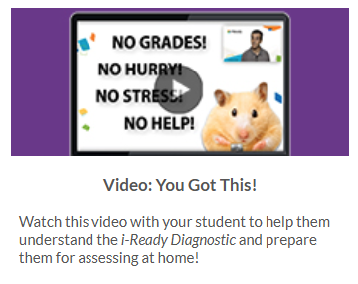
iReady
Notes:
Clarify that administration will be making follow-up phone calls based off this State Law.

Slide 16
Technology
Clever –
  Signal Sign-On
  Access to Schoology, Teacher Pages, Learning Applications
  Students can use their username and password to login to the Clever Learning Portal
Schoology
  All course content is kept
Must use a school provided device
On site IT support, 8:30-3:30, each school day. Please call ahead.
Notes:
Explain the reasoning for using a school device – it has Lightspeed on it which not only allows teachers to better monitor what students are doing on the computer, but is used to pull how much time students were logged in an working. This data is shared with the State of Ohio to determine level of Engagement each day. Without a school device, we cannot access this data.

Slide 17
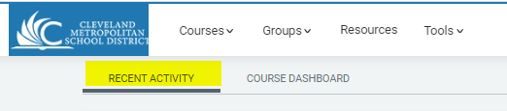

Schoology
Log in 10 minutes prior to the start of the school day – 7:50am.
Always check the Schoology Recent Activities updates to check for substitute teachers and school updates:
Find you class in the Course Dashboard - these can be organized in sequential order by dragging and dropping:

Slide 18
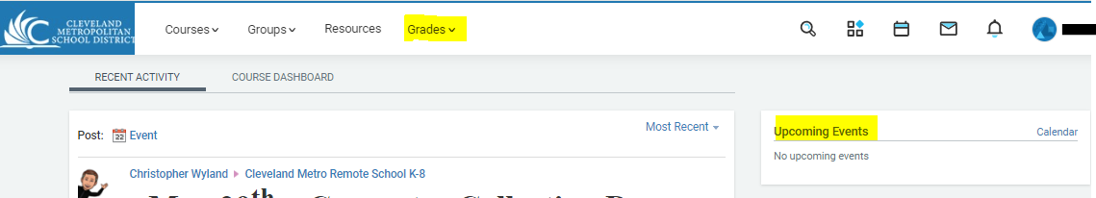
Schoology
Past Due and Upcoming Assignments, along with recent grades, can be seen on the right side of the scholar’s Schoology page, under the Upcoming Events section, when logged in.
Grades can also be accessed by click on ‘Grades’ at the top of the screen.

Slide 19
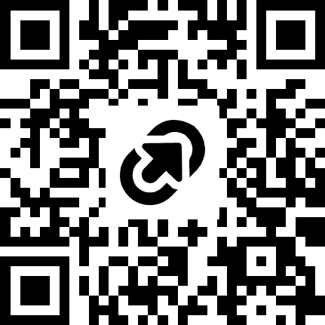
Technology
School devices are for school related work and are the responsibility of the students and parent/guardian.
Please review the District Digital Guidelines around devices with your student.
Set up ground rules for computer usage. These should include:
  Use the device for school related work only.
  Take the device each night and ensure that it is plugged in.
  Keep the computer on a stable surface, such as a desk and not a bed.
  Do not walk around with the computer.
  Keep food and drink away from the computer.
  Keep the computer clean.

Slide 20

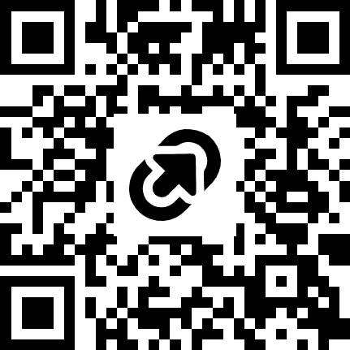
Technology
All technology, including Chromebooks, laptops, chargers, and accessories are property of CMSD and are to be used for educational purposes only.
District device users must follow all CMSD Digital Citizenship and Internet Safety Guidelines.
The students and caregivers are responsible for daily care and maintenance of all CMSD technology.
Students or caregivers will report any technology related need to the school at 216-838-7250 or the CMSD HelpDesk at 216-838-0440 immediately.
The parent/caregiver will be held financially accountable for lost, stolen, or damaged devices at a minimum cost of $25.
  This may include requiring the parent/guardian to watch device care videos.
  Device Replacement Link can be found on our website.
Requested technology will be withheld until any repair or recirculation cost is submitted, which may impact enrollment at the Remote School K8.
Device Replacement Request ->
Notes:
Please emphasize the replacement cost for 2nd or more replacement requests.
Inform families that if the device is broken intentionally it will come with a full replacement cost.

Slide 21

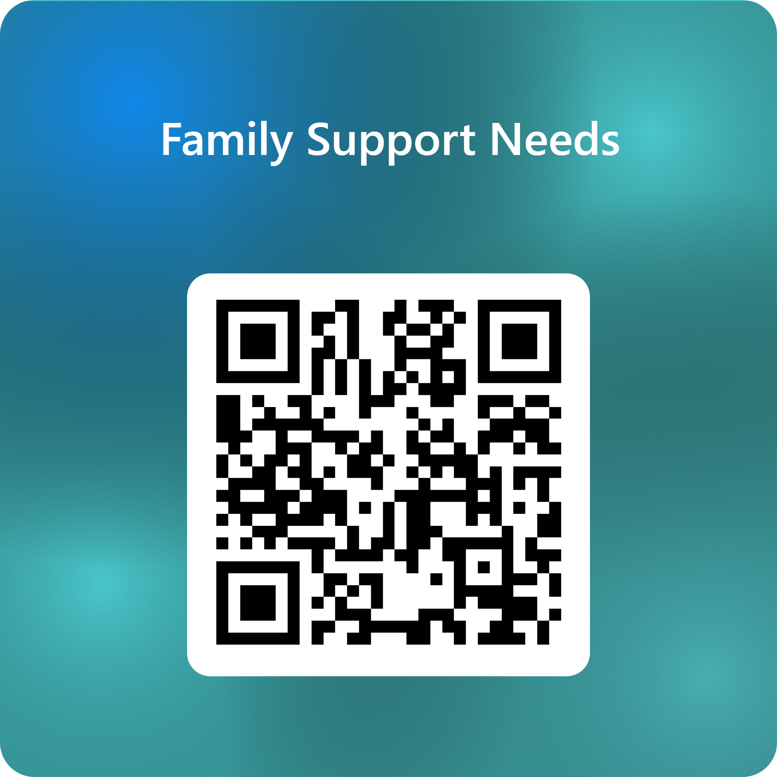
Support Services
A Say Yes Family Support Specialist is assigned to every CMSD school to connect students and families to free support services and resources in our community​
  Mental and physical health services ​​
  Free legal services​​
  Afterschool programming ​
Remote K8 Family Support Specialist is
Shuntaya Howard
Please call the school at 216.838.7250
or 216-838-7256 for her direct line
or fill out the support request form.
Family Support Request Form

Slide 22
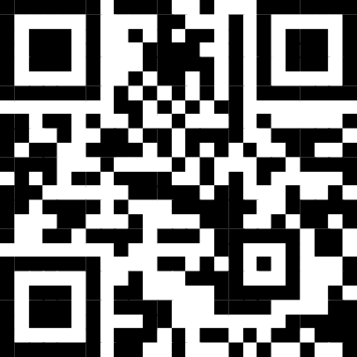
Grading Timelines
Students will have individual assignments and grades entered in PowerSchool every 3, 6 and 9 weeks.
This will replace progress reports, but not Report Cards.
Families will be able to access these grades via MyPowerHub.
Allows for more timely access to student progress in order to encourage home to school communication.
Website - https://tinyurl.com/4b5ktd3f

