Slide 1

Skyline High School:
Student of the Quarter
Spring 2025-2026

Slide 2

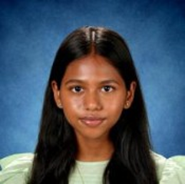
Harshitha Anbukumar
Dr. Sharma nominates Harshitha for thoughtfully evaluating experimental results and lab techniques. Harshitha analyzes the sources of error in their data and actively considers how to refine their approach or improve their conceptual understanding next time.
Supplemental text here

Slide 3
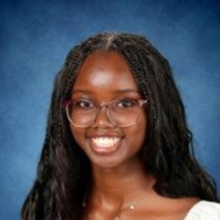
Kayla Kendi Anunda
Dr. Sharma nominates Kayla who is not afraid to step out of their comfort zone, whether that means tackling advanced stoichiometry problems, handling unfamiliar lab equipment, or risking being wrong to propose a unique solution to a problem. They were brave enough to move to a new country and go through all the ups and downs!
Supplemental text here

Slide 4
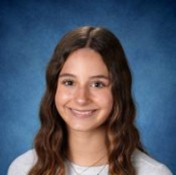
Sienna Lee Belles
Dr. Gouge nominates Sienna who exemplifies the qualities of a knowledgeable inquirer. She continually impressed her block teachers this year with her efforts to keep learning across subjects and content areas. Sienna is always engaged and works hard in and out of the classroom, while also collaborating effectively with others.
Supplemental text here

Slide 5
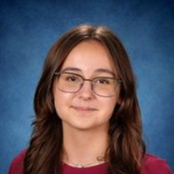
Maya Bonani Bomfim
Dr. Sharma says Maya is "not afraid to step out of their comfort zone, whether tackling advanced stoichiometry problems, handling unfamiliar lab equipment, or risking being wrong to propose a unique solution to a problem." Great work Maya!
Supplemental text here

Slide 6
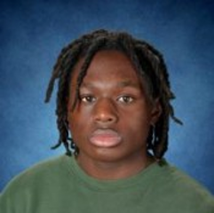
Kaylen Jalani Brown
Mrs. McIlwain nominates Kaylen because he is a respectful and responsible student who demonstrates integrity in his interactions with both peers and staff. He approaches his work with a positive attitude and is willing to put forth effort, even when tasks are challenging. Kaylen is honest about his strengths and areas of need and responds appropriately to feedback and support. He treats others fairly, follows classroom expectations, and takes responsibility for his actions. Kaylen's respectful demeanor and willingness to persevere through difficulties reflect the qualities of a principled learner.
Supplemental text here

Slide 7
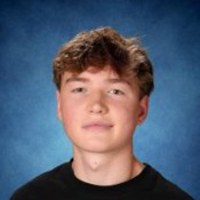
Leo Nicholas Burton
Ms. Yun nominates Leo because he is determined to do well. He advocates for himself and works hard in Geometry and English.
Supplemental text here

Slide 8
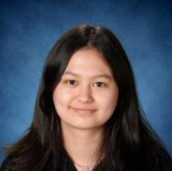
Rowen Bushong
Mrs. Wagstaffe nominates Rowen for their incredible engagement in Skyline's Theatre Department. When faced with a challenge, Rowen sought out and learned new software to optimize our resources and make our plays look beautiful. Rowen's work as a designer highlights not only their technical and creative skills but their willingness to take initiative in pursuit of their passions. Rowen steps up out of a genuine desire to make our theatre community stronger.
Supplemental text here

Slide 9
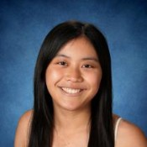
Nicoline Xinyue Cai
Dr. Kamath "Dr. K" nominates Nicoline for her outstanding performance in her chemistry class throughout this year. She is a strong student of the subject demonstrating an in-depth understanding of content over two semesters. Be it analysis on labs or art projects, Nicoline's work always showcases the best we have!
Supplemental text here

Slide 10
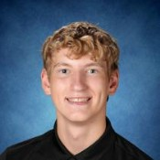
Nathan Alexander Campbell
Dr. Sharma nominates Nathan for exhibiting complete academic integrity in data collection. Nathan never "fudges" numbers to match a theoretical value. Nathan respects strict lab safety protocols, and credits others' ideas during collaborative research.
Supplemental text here

Slide 11
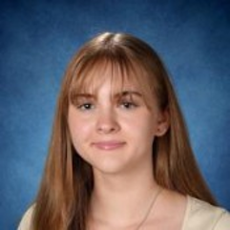
Elizabeth Gail Carroll
Ms. Morales and Ms. Petersen nominate Ella because she is always kind, enthusiastic, and shows genuine caring about her learning and her peers. But wait! There's MORE! Ella is a strong communicator. Not only does she actively communicate with her teachers to plan around her busy equestrian competition schedule, but she also actively contributes to class discussions - the embodiment of an engaged learner. Working with Ella this year fills us with... unbridled joy.
Supplemental text here

Slide 12
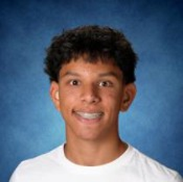
Zane Philip Cherian
Mrs. Webster and Mrs. Cossano nominate Zane for demonstrating strong character and integrity in our classroom. Zane has shown a strong sense of maturity and responsibility for his learning.
Supplemental text here

Slide 13
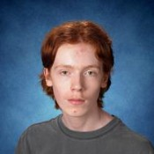
Case Allen Christensen
Mrs. Webster nominates Case for his attentiveness and willingness to collaborate with classmates. Case is up for any challenge with a positive attitude. He is a valuable member of the classroom community.
Supplemental text here

Slide 14
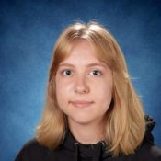
Lauren Taylor Christensen
Mrs. Wagstaffe nominates Lauren for their remarkable ability to balance commitments and excel in all she applies herself to. Between jazz band, vocal jazz, percussion ensemble, and theatre, Lauren's creative endeavors require considerable energy, organization, and diligence. Mrs. Wagstaffe is impressed by Lauren's ability to somehow do it all well and with a smile on her face!
Supplemental text here

Slide 15
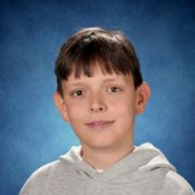
Louis Alexander Johan Cottenier
Mr. McKinzie "Mck" nominates Louis for always focusing on finding the answer, even if it isn't what he originally assumes.
Supplemental text here

Slide 16
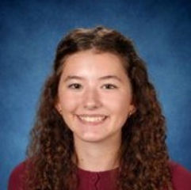
Addison Coyne
Dr. Sharma says Addison doesn't just memorize formulas; Addison asks why reactions happen the way they do. Addison is driven by natural curiosity and looks for patterns. Great work, Addison!
Supplemental text here

Slide 17
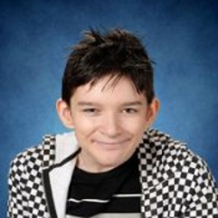
Ryden Cuevas
Ms. Mackonya nominates Ryden who demonstrates the learner profile trait of Balanced. He is an intelligent and remarkable student who has made significant growth this year. Although he was shy at first, Ryden has developed strong social skills and now interacts positively with his peers. He has also learned effective self-regulation strategies that help him manage challenges and stay focused throughout the day.
Supplemental text here

Slide 18
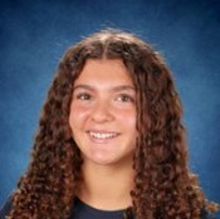
Natalie Culver
Ms. Mackonya nominates Natalie who exemplifies the learner profile trait of Caring. She is a positive role model in the LRC II classroom and is passionate about working with students with disabilities. Natalie has learned how to model appropriate behaviors and provide meaningful support to our students. She is dedicated, flexible, and willingly assists multiple students throughout the day.
Supplemental text here

Slide 19
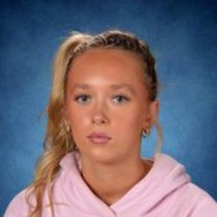
Emmalyn Rita Dahlgren
Ms. Mackonya nominates Emmalyn who demonstrates the learner profile trait of Engaged. Since joining our 7th period class, she has become a positive role model and an outstanding support for our students during vocational activities. Emma takes initiative and does not wait to be told what to do. She independently helps students follow their schedules, guides them through their daily jobs, and ensures tasks are completed successfully
Supplemental text here

Slide 20
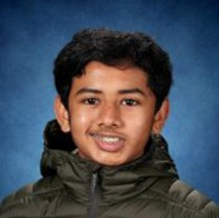
Aditya Anand Dani
Dr. Kamath "Dr. K" nominates Aditya for his outstanding performance in her chemistry class throughout this year. Dr. K says, "Aditya, your engagement, honest effort and dedication to learning are commendable. You are strong student of the subject demonstrating an in-depth understanding of the content over the two semesters. Be it analysis on labs or art projects, your work always showcased the best we have! Good luck and Keep it up!"
Supplemental text here

Slide 21
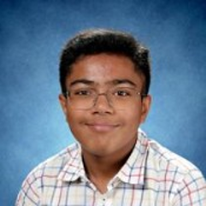
Shirom Dhanuka
Dr. Sharma nominates Shirom for not just memorizing formulas; Shirom asks why reactions happen the way they do. Driven by natural curiosity, Shirom looks for patterns in the periodic table and design experiments to test their own hypotheses.
Supplemental text here

Slide 22
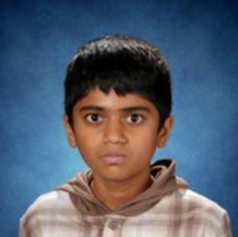
Nimishh Dhodapkar
Rachel Smith nominates Namish for being a wonderful student who is kind and inquisitive. He is always prepared and asks great questions in class. I've only known him for a short time, since I am filling in for Mrs. Stimmel, but I have been impressed with him since the first day I subbed. Thank you Namish for being such a kind, thoughtful and curious student.
Supplemental text here

Slide 23
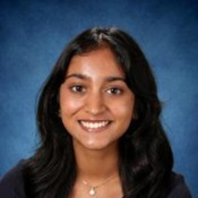
Keerthana Donthireddy
Dr. Sharma nominates Keerthana who prioritizes the safety and well-being of peers during lab work. Keerthana willingly share equipment, help clean up, and patiently support classmates.
Supplemental text here

Slide 24

Aiden Kent Druckenmiller
Mrs. Webster nominates Aiden for his dedication to learning and success. Aiden comes to class everyday prepared and works hard.
Supplemental text here

Slide 25
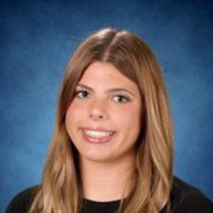
Keirra Grace Eaton
Keirra has Ms. Wince in two different PE classes and is an exemplary student in each class. Ms. Wince nominates Keirra because she is a student who cares for all her peers, is inclusive and inviting, a great leader to new students and just gives off a positive vibe in class that is both refreshing and appreciated. She constantly works hard and is helpful to both her group, class, and Ms. Wince-so, thank you Keirra!
Supplemental text here

Slide 26
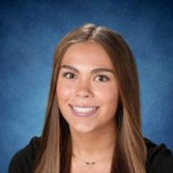
Amy Loree Edwards
Ms. Mackonya nominates Amy who demonstrates the learner profile trait of Courageous. Although she had no prior experience as a peer tutor, Amy embraced the opportunity with enthusiasm and a willingness to learn. She has quickly developed strong skills in supporting students with diverse needs and works exceptionally well with all students in the classroom. Amy is kind, patient, dependable, and always ready to lend a helping hand.
Supplemental text here

Slide 27
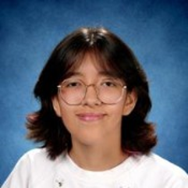
Ana Paula Esquivel Munoz
Kitayama Sensei proudly nominates Ana for her exceptional commitment to learning and active participation in class. She consistently engages in a variety of learning activities to strengthen her Japanese language skills and demonstrates a strong desire to improve. In addition, Ana willingly assists her classmates, helping to create a supportive and effective learning environment for everyone.
Supplemental text here

Slide 28
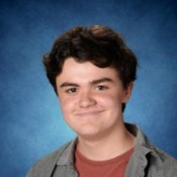
Owen Matthew Farrell
Mrs. Wagstaffe nominates Owen for being a consistently caring and empathetic individual, both in the classroom and in Skyline's Theatre program. If someone is having a hard day, Owen is always there to listen and support. His calm, encouraging presence helps make others feel welcome and validated.
Supplemental text here

Slide 29
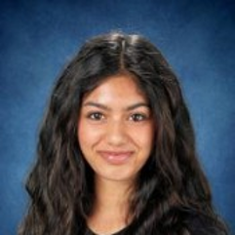
Aaliyah Singh Ghotra
Mrs. Wagstaffe nominates Aaliyah for being a thoughtful and reflective student in Theatre Arts. Aaliyah cares deeply about growing as an artist and receives feedback with humility and a genuine desire to improve. Mrs. Wagstaffe appreciates Aaliyah's enthusiasm and dedication to practicing her craft.
Supplemental text here

Slide 30
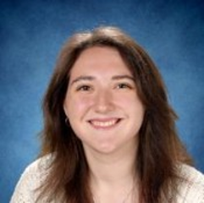
Noa Shiri Gunderman
Mrs. Wagstaffe nominates Noa for being a genuinely open-minded and curious student. Noa is not afraid to speak her mind and willingly and respectfully engages in challenging conversations with peers. Mrs. Wagstaffe admires Noa's tenacity and values her eagerness to question the world around her.
Supplemental text here

Slide 31
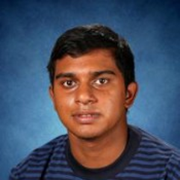
Anish Gupta
Ms. Mackonya nominates Anish who exemplifies the learner profile trait of Caring. He is a kind and helpful student who always maintains a positive attitude. Anish is quick to support classmates who may be struggling and treats everyone with patience and respect. His calm demeanor and willingness to help others make him a valued member of our classroom community.
Supplemental text here

Slide 32
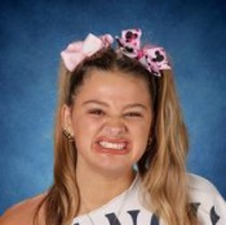
Adeline Mary Gurr
Ms. Mackonya nominates Addie because she exemplifies the learner profile trait of Principled. She is a dedicated Teaching Assistant who plays a key role in supporting our vocational skills program and community-based instruction activities. Addie consistently demonstrates responsibility, reliability, and a strong work ethic. She knows the students' schedules well, takes initiative, and can be trusted to complete tasks independently. Her commitment to helping students succeed makes her an invaluable member of our classroom team.
Supplemental text here

Slide 33
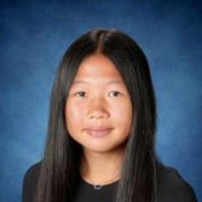
Olivia Han
Dr. Kamath "Dr. K" nominates Olivia for her enthusiastic and consistent participation in her first period class. Dr. K says, "I always enjoyed your cheerful presence and eagerness to share answers even at 8 a.m. which motivated your peers. As an athlete, you perfectly balanced both school and sports throughout the year. I wish you luck for the rest of your high school years and hope that you continue to grow and spread that positivity you brought to my class each day."
Supplemental text here

Slide 34
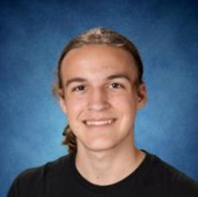
Finnian Jaymes Harmon Hardy
Dr. Sharma nominates Finnian who masters core chemical concepts, symbols, and theories, and successfully applies that foundational understanding to unfamiliar contexts and complex, overarching scientific themes. Great work Finnian!
Supplemental text here

Slide 35
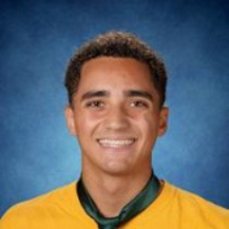
Nicolas Paul Horal
Dr. Sharma nominates Nicolas who actively participates in every lesson. Nicolas takes a hands-on approach to lab work, drives group discussions, and looks for connections between classroom chemistry and real-world environmental or industrial issues.
Supplemental text here

Slide 36
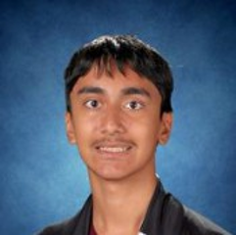
Ayan Hussain
Ms. Rieke nominates Ayan for his reflective nature. Ayan has shown courage in his ability to think critically about his own personal growth, goals and balancing work.
Supplemental text here

Slide 37
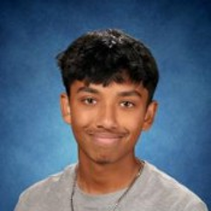
Faiyad Imam
Ms. Mackonya nominates Faiyad for being courageous. When he joined our classroom, he had little experience working with students with disabilities, but he embraced the opportunity to learn and grow. Through patience, dedication, and a willingness to try new strategies, he has developed effective skills to support students. Faiyad is calm during challenging situations and helps students regulate their emotions, making him a valued and dependable peer tutor.
Supplemental text here

Slide 38
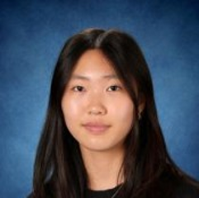
Ivy Jang
Mr. McKinzie, "Mck" nominates Ivy because she always helps the people around her to find the right direction. Thanks for everything you do!
Supplemental text here

Slide 39
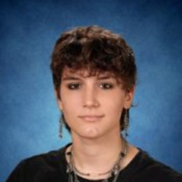
Ash Kabelitsky
Mrs. Wagstaffe nominates Ash for their noteworthy engagement and leadership during the spring student-directed one act plays. When a crew head and designer backed out halfway through the process, Ash stepped up and took on more responsibilities in addition to co-directing one of the plays. Ash's ability to stay calm and positive and model resiliency to younger students makes them an invaluable member of our theatre community.
Supplemental text here

Slide 40
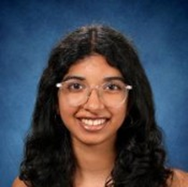
Nikita Reddy Kadasani
Dr. Sharma nominates Nikita who actively participates in every lesson. Nikita takes a hands-on approach to lab work, drives group discussions, and looks for connections between classroom chemistry and real-world environmental or industrial issues.
Supplemental text here

Slide 41
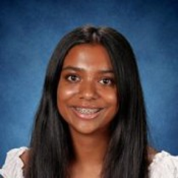
Sreenavya Kasireddy
Mr. Hiatt nominates Navya because she consistently supports her classmates with accounting applications, demonstrating both strong subject knowledge and a willingness to help others succeed. Her dedication, curiosity, and positive contributions make her a valuable member of the class.
Supplemental text here

Slide 42
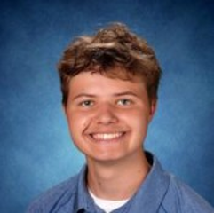
Brian Palmer Kearl
Mrs. Sakthikumar nominates Brian for his excellent academic and extra curricular engagements. He stands out in his efforts to be a strong leader and willingness to be flexible in challenging situations during teamwork. Great work Brian!
Supplemental text here

Slide 43
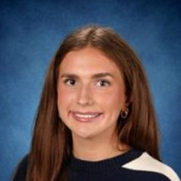
Emma Elizabeth Kell
Ms. Mackonya nominates Emma who demonstrates the learner profile trait of Open-Minded. Although she came to the LRC II classroom with little experience working with students with Autism, she embraced the opportunity to learn, asked thoughtful questions, and quickly developed meaningful connections with our students. Emma is a wonderful peer model who approaches every experience with curiosity and a willingness to grow.
Supplemental text here

Slide 44
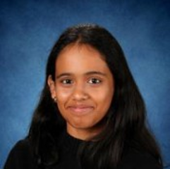
Sakshi Keshav
Mr. Sullivan says, "Sakshi deserves to be student of the quarter for her courageous approach to learning. She experiments with new ideas, offers contributions to the group when others are feeling timid and unsure, and offers encouragement to other students to engage. Her confidence and courage are contagious. I love the atmosphere she creates in my class through her fearless ideas, supportive expression, and generosity toward others. Way to go Sakshi!"
Supplemental text here

Slide 45
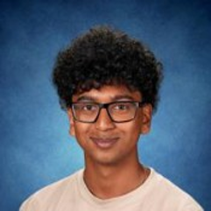
Pavan Khatawkar
Dr. Sharma nominates Pavan who can translate complex scientific data into clear, concise language. Whether writing a formal lab report, drawing molecular structures, or explaining a reaction mechanism to a peer, Pavan expresses ideas accurately.
Supplemental text here

Slide 46
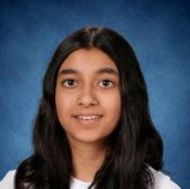
Myla Khurram
Mr. McKinzie "Mck" nominates Myla for being someone who always thinks through their work, striving for the best possible result.
Supplemental text here

Slide 47
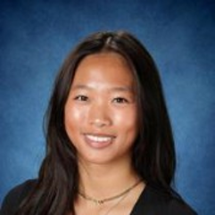
Emma Zhuoen Kong
Dr. Sharma nominates Emma saying, "You have been an amazing TA in my room and always helped me through all lab cleaning and organizing. Thank you for being an amazingly helpful person."
Supplemental text here

Slide 48
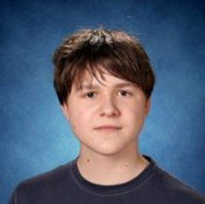
Ivan Kostikov
Dr. Kamath "Dr.K" says: Ivan, I am so happy to have been your teacher this year. You are incredibly curious, intelligent and funny! I loved the tidbits of knowledge you shared with me and the class. I appreciate your thorough content knowledge and ability to connect content across subject areas, such as Forensics and Chemistry. With your innate curiosity, hard work and sharp mind, I am sure you will make us very proud one day! Keep up the good work!
Supplemental text here

Slide 49
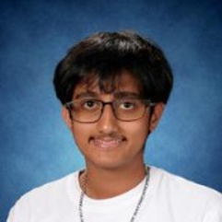
Siddharth Sudhir Kulkarni
Mr. Hiatt nominates Siddharth who demonstrates immense fiscal knowledge and interest through our lengthy conversations on Keynesian systems and the effect of current events on the market.
Supplemental text here

Slide 50
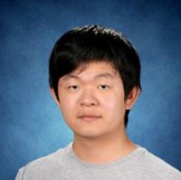
Richard Ruiqi Li
Dr. Sharma nominates Richard for effective time management, and for balancing the heavy cognitive demands of scientific problem-solving and rigorous lab reports with physical well-being and other academic pursuits.
Supplemental text here

Slide 51
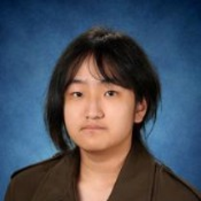
Ryan Lin
Dr. Sharma nominates Ryan who masters core chemical concepts, symbols, and theories, and successfully applies that foundational understanding to unfamiliar contexts and complex, overarching scientific themes. Ryan is also a good problem solver, literally any problem in this world!
Supplemental text here

Slide 52
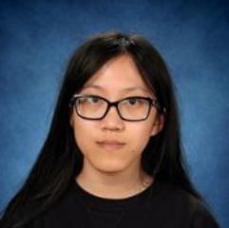
Alyssa Liu
Dr. Kamath "Dr. K" nominates Alyssa for her outstanding performance in her chemistry class throughout this year. She was strong student of the subject demonstrating an in-depth understanding of the content over the two semesters. Be it analysis on labs or art projects, Alyssa's work always showcased the best we have! Good luck and Keep it up!
Supplemental text here

Slide 53

Austin Yuxi Liu
Ms. Toy nominates Austin and says, "Thank you Austin for being such an industrious, hard worker. Your talents are appreciated."
Supplemental text here

Slide 54

Ava Marie Lyman
Dr. Kamath "Dr. K" is immensely proud of Ava for her hard work and persistence in her Chemistry class. Dr. K says, "Ava, I have seen you grow from strength to strength working tirelessly throughout this year. You are a student of extraordinary grit and determination. You are always kind, caring and positive towards everyone around you be it in labs, on test days or during group projects. Your kindness and positivity is infectious and has inspired me on most days! You make the world a better place by being in it! Good luck for your future! Don't forget to take care of yourself just as much as you take care of others!"
Supplemental text here

Slide 55

Frederick Thomas Mahoney
Dr. Louie nominates Fred for being engaged and actively developing positive relationships with peers and teachers to better themselves and others. Fred is engaged in his classwork, class discussions, always greets the teacher and helps his peers.
Supplemental text here

Slide 56

William Nakamura
Dr. Sharma nominates William for being Courageous to be in the higher-level class and asks questions or asks for help when needed.
Supplemental text here

Slide 57

Daniyal Osama
Dr. Sharma nominates Daniyal who applies critical thinking and abstract logic to solve intricate multi-step problems. Daniyal can look at quantitative data, recognize anomalies, and use reason to deduce what occurred at the molecular level. Dr. Sharma says she loved the approach you took to writing your Internal Assessment.
Supplemental text here

Slide 58

Emma Madina Pacifici
Dr. Kamath "Dr. K" nominates Emma for her enthusiastic and consistent participation in her sixth period class. Dr. K says, "I always enjoyed your cheerful presence and eagerness to share answers which motivated your peers. As an athlete, you perfectly balanced both school and sports throughout the year. I wish you luck for the rest of your high school years and hope that you continue to grow and spread that positivity you brought to my class each day.
Supplemental text here

Slide 59

Elliot Junhee Park
Mr. Doran nominates Elliot for his creative and courageous approach to his schoolwork. Be it an argumentative presentation on the perfect baby's name or putting on an entire sock-puppet show of the balcony scene from Romeo & Juliet (complete with hand-crafted stage), Elliot always finds interesting and daring ways to approach his projects that not only reflect a genuine interest in learning but bring joy to the classroom itself!
Supplemental text here

Slide 60

Subin Park
Dr. Kamath "Dr. K" nominates Subin for her enthusiastic and consistent participation in her first period class. Dr. K says, "I always enjoyed your cheerful presence and eagerness to share answers which motivated your peers. I wish you luck for the rest of your high school years and hope that you continue to grow and spread that positivity you brought to my class each day."
Supplemental text here

Slide 61

Harishankar Plackada
Mrs. Toy nominates Harishankar and says, "The teacher appreciation ceremony you held for us was very special. You are a great person!"
Supplemental text here

Slide 62

Mateo Porras Corona
Ms. Mackonya nominates Mateo who exemplifies the learner profile trait of Caring through his patience, compassion, and dedication to supporting all students. He has developed a particularly strong connection with a student who often becomes dysregulated and struggles to follow adult directions. Mateo understands the student's needs and effectively uses calming strategies to help the student regulate, refocus, and successfully engage.
Supplemental text here

Slide 63

Keertana Raghavendra
Dr. Sharma nominates Keertana for welcoming different perspectives when designing labs or interpreting ambiguous data. Keertana understands that scientific theories can evolve with new evidence and is willing to revise conclusions when proven wrong. They were reflective of their approach towards their life goal too.
Supplemental text here

Slide 64

Asher Jonathan Roper
Mr. McKinzie "Mck" nominates Asher for being constantly on target with what needs to be done, and using the time given to do it wisely.
Supplemental text here

Slide 65

Jonathan Jung-Doe Salsbury
Ms. Morales nominates Jonathan for being ENGAGED & CARING. She says, "Jonathan truly embodies the whole Spartan Learner Profile, but let's focus on TWO that we see in class on the daily. Jonathan visibly enjoys film. He's not shy about his opinions, either - bravo! Perhaps even more valuable, Jonathan cares about his peers, is collaborative, has a good sense of humor, and includes his table-mates in decision-making. His kindness is invaluable - Kudos, Jonathan!"
Supplemental text here

Slide 66

Meher Sandhu
Mrs. Toy nominates Meher and says, "It is a pleasure to see you everyday. You help others be better.“ Thanks for everything you do!
Supplemental text here

Slide 67

Adwita Satapathy
Ms. Mackonya nominates Adwita because she is a kind, patient, and dedicated Teaching Assistant in the LRC II classroom. She works exceptionally well with a neurodiverse student, helping him stay engaged, follow his schedule, and remain calm throughout the day. Adwita is proactive, dependable, and always willing to support students without being asked. Her compassion and commitment have made a positive and lasting impact on our classroom community.
Supplemental text here

Slide 68

Colten Schearer
Ms. Mackonya nominates Colten who exemplifies the learner profile trait of Communicator. He has a remarkable ability to learn and use multiple languages to connect with others. Colten has also made tremendous progress in attending school consistently and increasing his time at school, demonstrating resilience and determination. We are proud of his growth and the positive example he sets for others.
Supplemental text here

Slide 69

Amelia Pandora Schrupp
Mrs. Sakthikumar nominates Amelia for her extraordinary problem-solving efforts. Amelia produces uniquely creative solutions in her project works. Amelia is a deep thinker, considers all perspectives of problem areas whether it is during individual or group work. Way to go Amelia!
Supplemental text here

Slide 70

Gian Shin
Mr. Sederquist "SederQ" is nominating Gian Shin for her open-mindedness. Gian completed the entirety of the class content far in advance and has been open to and willing to be a peer tutor for many of her classmates. She has been using the past couple weeks to help peer-tutor some of the seniors prepare their final testing material to help them pass the class. She is always open to others and is a great classmate to them. Way to go, Gian!
Supplemental text here

Slide 71

Noah John Stone
Ms. Mackonya nominates Noah for being engaged. He is a dedicated and hardworking student and active Teacher Assistant in the Office. Noah's leadership skills are impeccable, and he confidently steps up to help with the vocational activities program. His initiative, responsibility, and commitment to his school community make him an exceptional role model.
Supplemental text here

Slide 72

Siena Yining Sturman
Mr. Foster is nominating Siena Sturman in the category of Caring. Mr. Foster says, "Siena cares deeply about others and about the world we all share. Thank you Siena for embodying this trait so deeply and with such integrity! Your compassion and empathy make me feel hope for our collective future."
Supplemental text here

Slide 73

Jiya Parthik Teli
Mrs. Sakthikumar nominates Jiya for her above and beyond efforts in building and sharing knowledge resources with fellow classmates. Jiya is always steps ahead in anticipating problems and coming up with workarounds to get tasks completed using the right resources.
Supplemental text here

Slide 74

Jake Robert Torres
Mrs. Webster and Mrs. Cossano nominate Jake for consistently demonstrating outstanding engagement in class by actively participating in discussions, asking thoughtful questions and contributing positively to the learning environment.
Supplemental text here

Slide 75

Alyssa Ito Tragin
Kitayama Sensei nominates Alyssa for her outstanding communication skills and leadership. She serves as an excellent liaison between our class and our sister school in Japan, helping to strengthen international connections and collaboration. In addition, she plays an important role in supporting the Japanese Club, fostering a sense of unity and community among all club members.
Supplemental text here

Slide 76

Yuchen Xia
Mrs. Webster nominates Yuchen for his positive attitude and academic growth. Mrs. Webster has seen tremendous achievement with Yuchen over the past three years. She is so proud of his success in and out of the classroom.
Supplemental text here

Slide 77

Amogh Viraj Yelamaneni
Dr. Sharma nominates Amogh for actively participating in every lesson. Amogh takes a hands-on approach to lab work, drives group discussions, and looks for connections between classroom chemistry and real-world environmental or industrial issues. Amogh also has a good understanding of concepts and was helpful to other students.
Supplemental text here

Slide 78

Selena Yu
Dr. Kamath "Dr. K" nominates Selena for a fantastic year in Chemistry. Dr. K says, "Selena, you aced the content, exceled at the practice problems and throughout all this, you remained kind and helpful to your peers. you were always ready to help. Your cheerful, enthusiastic presence always added joy to the classroom. I wish you luck for the rest of your high school years and hope that you continue to grow and spread that positivity you brought to my class each day."
Supplemental text here

Slide 79

Abigail Louise Yuly
Ms. Mackonya nominates Abbey who demonstrates the learner profile trait of Reflective. She has made tremendous growth this year and continues to show a positive attitude toward learning. Abbey enjoys coming to school and has greatly improved her ability to follow directions and stay focused on her work.
Supplemental text here

Slide 80

Marya Zait
Dr. Kamath "Dr. K" nominates Marya for her intellectual contribution to classroom discussions in her first period class. Dr. K says "I always looked forward to your deep questions and was very proud of the higher order thinking skills you consistently demonstrated. Keep working hard and thinking deep! I wish you luck for the rest of your high school years and hope that you continue your pursuit of knowledge and makes us proud with your curiosity, hard work and dedication."
Supplemental text here

Slide 81

Zhebin Zhang
Mrs. Webster nominates Tom for consistently demonstrating kindness, empathy and concern for others. He is always willing to help classmates, offer encouragement and contribute to a positive and welcoming classroom environment.
Supplemental text here

Slide 82
Thank You!

