Slide 1
the ACT
The ACT is a long assessment that will test not only the skills that you’ve developed in high school but also your endurance. In almost 4 hours, you’ll answer more than 200 questions and write a whole essay!
Here’s what it looks like:
Sequence | Subject | Questions | Passages | Time
1st | English | 75 | 5 | 45 minutes
2nd | Math | 60 | -- | 60 minutes
3rd | Reading | 40 | 4 | 35 minutes
4th | Science | 40 | 7 | 35 minutes
5th | Writing | 1 | -- | 30 minutes
Three Important tips for the entire test:
Don’t leave any answer blank! Always guess and bubble like mad if you run out of time! There’s no plenty for wrong answers!
Don’t spend too long on any one problem/question. If after 30 seconds, you don’t have any clue as to what the answer could be, guess and move on! Time is not your friend on this test!
A lot of the content on this test you know—just by speaking English, reading, and being in high school. Go with your gut and believe in yourself!

Slide 2


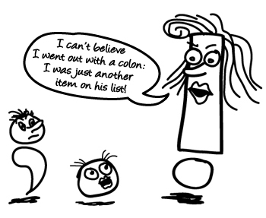
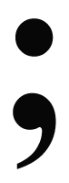

ACT English Tips
5 Passages...75 questions...45 minutes...YIKES!
Tests your knowledge and application of punctuation, grammar and usage, sentence structure,
organization, style, and writing strategy.
Know your COMMAS, semicolons, COLONS, & apostrophes.
You’ll see ?s like should this go here? Where should this go? Which is the best change?
Know about transitions—between sentences and paragraphs.
Pick the choice that is clear and creates fluidity.
Choose answers with correct verb tense.
Make sure your pronouns match!
TIP! Don’t read the passage; you don’t necessarily have to know what it’s about to answer the questions. Only read it for organization questions.
TIP!
NO CHANGE is the answer 15-25% of the time.
TIP! Typically, a shorter, more concise answer is more correct than a longer one.
TIP! Pay attention to the answer choices: sometimes the correct answer is the one that doesn’t match the others.
TIP! Save the questions that ask you to reorder the passage, remove or add sentences, or evaluate for LAST!
Q Between you and I…
R Between you and me…
You can do well!
TIP! If it “sounds” wrong, it usually is!
Stuck? Running of out time? Answer EVERY question. LEAVE NONE BLANK!
*Be ready for

Slide 3
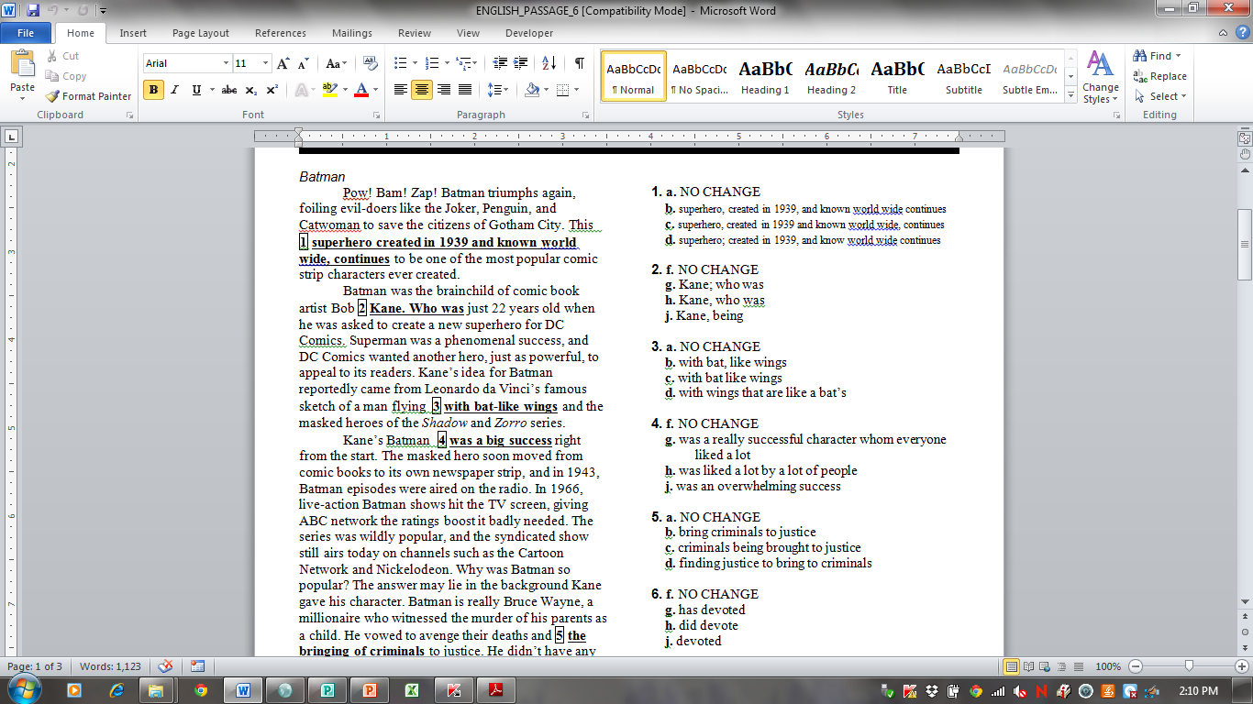
1. a. NO CHANGE
b. superhero, created in 1939, and known world wide continues
c. superhero, created in 1939 and known world wide, continues
d. superhero; created in 1939, and know world wide continues
2. f. NO CHANGE
g. Kane; who was
h. Kane, who was
j. Kane, being
3. a. NO CHANGE
b. with bat, like wings
c. with bat like wings
d. with wings that are like a bat’s

Slide 4
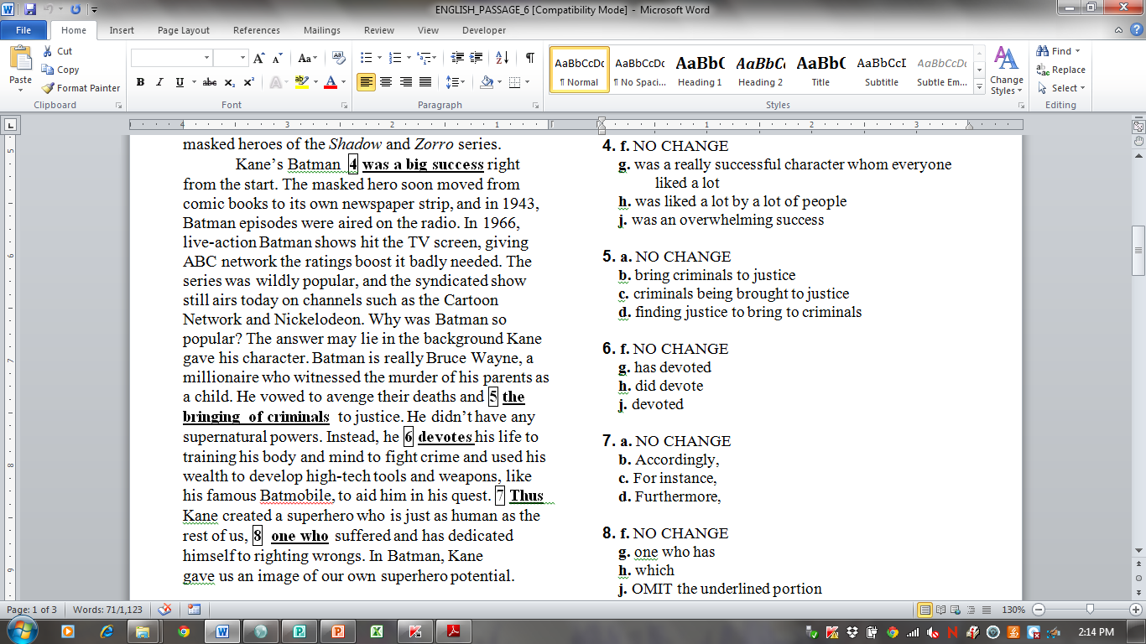
4. f. NO CHANGE
g. was a really successful character whom everyone liked a lot
h. was liked a lot by a lot of people
j. was an overwhelming success
5. a. NO CHANGE
b. bring criminals to justice
c. criminals being brought to justice
d. finding justice to bring to criminals
6. f. NO CHANGE
g. has devoted
h. did devote
j. devoted
7. a. NO CHANGE
b. Accordingly,
c. For instance,
d. Furthermore,
8. f. NO CHANGE
g. one who has
h. which
j. OMIT the underlined portion

Slide 5
9. The writer introduces the passage with “Pow! Bam! Zap!” This is most likely done to:
a. set a light-hearted, silly tone for the essay.
b. demonstrate the effect of onomatopoeia and exclamation points.
c. establish a connection to the topic of a comic book hero.
d. show that in Batman episodes, there was typically a lot of fighting.
10. The author wishes to add the following sentence in order to show why people like Batman and provide readers with more information about the plot of a typical Batman episode: People loved seeing Batman rush in and save the day whenever a villain threatened Gotham City.
In order to accomplish this goal, it would be most logical and appropriate to place this sentence:
f. at the end of paragraph 2.
g. after the first sentence in paragraph 3.
h. after the second sentence in paragraph 3.
j. at the end of paragraph 3.

Slide 6
Answer Key
1. b. The phrase created in 1939 is relevant but not essential information and should be set off by commas.
2. h. The phrase who was just 22 years old must be connected to an independent clause; it is not a complete sentence. A period here makes the sentence a fragment. Semicolons can only go between two independent clauses (two complete thoughts).
3. a. Bat and like work together to form one modifier, so they should be connected by a hyphen. This is also the most concise choice.
4. j. Overwhelming is a more powerful and precise word than big. This version is also more concise than versions g and h.
5. b. This version gives the sentence parallel structure and is the most logical word order.
6. j. This answer gives the sentence consistent verb tense (all verbs in the simple past tense).
7. a. This is the most appropriate transition.
8. g. This version gives the sentence parallel structure and consistent verb tense.
9. c. The introduction uses a comic book convention to make a connection between topic and structure. The tone is light-hearted, but not silly. The introduction does demonstrate the effect of onomatopoeia and exclamation points, but it has a more meaningful purpose. It is not intended to show that there is a lot of fighting in a typical Batman episode, as this is not a theme of the essay.
10. g. In this spot the sentence follows the general statement that Batman was a success; since the sentence Provides a reason why the show was successful, this is a logical place to insert it.

