Slide 1





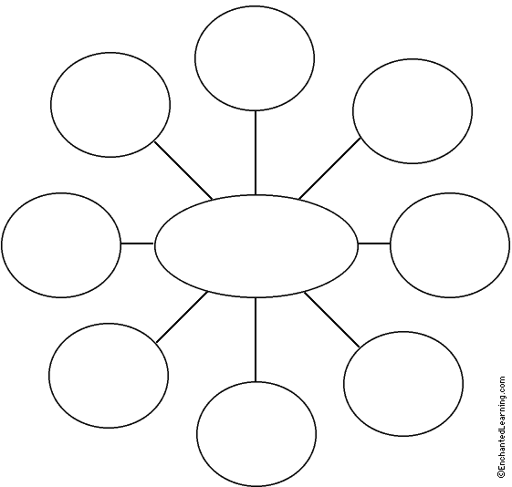


ACT Essay Tips
Timed Writing:
Only 30 minutes!
PROMPT: ARGUMENTATIVE !
The prompt will ask you to take a stance/side on some issue relevant to high school students. The prompt will include some ideas to help with your brainstorming.
2 judges read your essay;
each will give a score of 1-6.
Then their scores are combined.
Scores range from 2-12.
TIP! You must pick a side—you can’t be on the fence!
Elaborate on your reasons with examples from personal experience: show your readers what you’re talking about!
LOOKS LIKE THIS...
Example: Should students wear uniforms?
Stance: NO! D
▪ Reason #1: costs
▪ Reason #2: inhibits student self-expression
¶ Counterargument: Those for uniforms think uniforms decrease behavior issues, but they won’t!
Don’t forget a conclusion!
TIP! You must give examples to support your opinion—Reasons why your opinion is right!
TIP! You should have an introduction, 2-3 body paragraphs, and a conclusion!
TIP! Use as much of the space provided as possible. One page will not get you a good score!
PLAN!! Take 3 minutes to brainstorm and map out your ideas! It will be time well spent!
TIP! To get a higher score, you need to oppose the counterargument: tell why those who think opposite of you are wrong.
*Be ready for

Slide 2
In some states, legislators have debated whether teenagers should be required to maintain a “C” grade average in school before receiving a driver’s license. Some people think this would be a good policy because having passing grades shows that students are responsible enough to be good drivers. Other people think such a policy would not be appropriate because they see no relationship between grades in school and driving skills. In your opinion, should teenagers be required to maintain a “C” average in school before receiving a driver’s license?
P
L
A
NNI
NG
Reasons for “C” requirement | Reasons against “C” requirement
☑ Shows responsibility on the part of the student
☒ Unfair to tie driving to grades; students who struggle in school shouldn’t be denied driving privileges.
☑ Gives an incentive for doing well in school to those who might not have one
☒ Consequences on families who may rely on teenagers having jobs and/or picking up younger siblings
☑ Success in school means success on the roads—smarter kids make smarter driving decisions

Slide 3
Sample Prompt
Recently, several English teachers have decided to teach a certain book to their classes that contains questionable material normally not allowed in schools, including poor language, sexuality, and violence. They claim that the book has many redeeming qualities about it, and also is a great tool for teaching students reading and analytical skills. Many parents, on the other hand, have objected to the use of this book in class, arguing that schools should only include books and topics that are acceptable to everyone, and that students are subjected to too many negative influences already through media outside of school. In your opinion, should these teachers be permitted to teach this questionable book to their students?
In your essay, take a position on this question. You may write about either one of the two points of view given, or you may present a different point of view on this question. Use specific reasons and examples to support your position.

Slide 4
Sample Prompt
Many teachers are reconsidering how they score homework. They believe that if homework is meant as practice for students, then it should not be graded. This, teachers say, will allow students to practice and learn freely without the pressure of getting graded down for making mistakes on knowledge they have hardly had a chance to learn. Students would still receive feedback, but not grades. Other teachers, however, have commented that homework is a responsibility of students, and that grades on it help make sure students do it; plus their scores can be compared to track their progress. In your opinion, should teachers stop grading homework?
In your essay, take a position on this question. You may write about either one of the two points of view given, or you may present a different point of view on this question. Use specific reasons and examples to support your position.

Slide 5
Sample Prompt
YouTube.com is famous for being the world’s largest video website, and it offers millions of videos that could be viewed for learning. However, your school’s administration has decided to block the website because so many students seem to be using it as a distraction: when students go to the library or study hall to work on a computer, they often end up watching videos instead. To limit student distraction, administrators now only allow teachers to use YouTube. While they claim this will help students to focus, many students insist that Youtube in school provides access to learning that should continue to be allowed. In your opinion, should students have access to Youtube in school?
In your essay, take a position on this question. You may write about either one of the two points of view given, or you may present a different point of view on this question. Use specific reasons and examples to support your position.

Slide 6
Sample Prompt
As more technology becomes available for educational purposes, more schools are replacing the traditional textbooks and library books with electronic versions. By providing students with an iPad or e-reader, schools enable students to access digital books instead of the hard covers or paperbacks they have used in the past. According to technology advocates, this saves the school and students money in addition to making easier access to learning materials. Others have claimed, however, that there are certain learning benefits to holding a physical book that cannot be replicated with a digital device. In your opinion, should schools provide students with electronic devices to download their textbooks and reading materials?
In your essay, take a position on this question. You may write about either one of the two points of view given, or you may present a different point of view on this question. Use specific reasons and examples to support your position.

