Slide 1

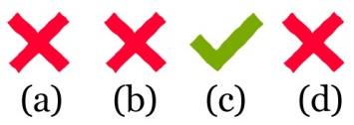





ACT Reading Tips
ACT Reading Tips
4 Passage...4 genres
▪ Prose fiction ▪
▪ Humanities ▪
▪ Social Sciences ▪
▪ Natural Science ▪
10 Questions each = 40 in all!
ONLY 35 minutes!
Time management is crucial!
Eliminate WRONG answers—the answers to all of the questions can be found in the text.
Give yourself 8 minutes per passage—no more! If you haven’t finished, move on.
INFER =
Make an EDUCATED GUESS!
If an answer is half right,
it’s ALL wrong!
Answer EVERY question. LEAVE NONE BLANK!
BE A DETECTIVE!
If an answer isn’t supported by the passage, get rid of it!
Tone = author’s attitude
For vocabulary questions, substitute the answer choices and pick the best fit

Slide 2
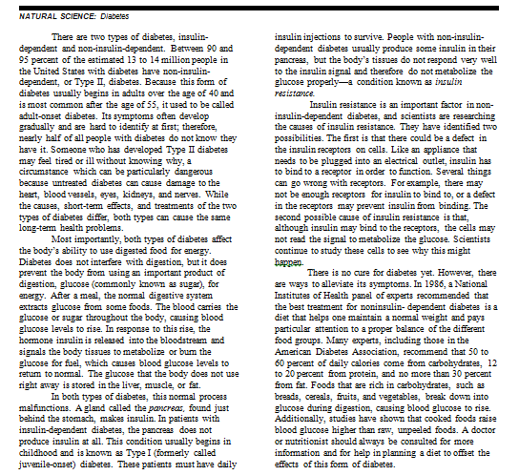

Slide 3
1. According to the passage, the most dangerous aspect of Type II diabetes is:
a. the daily insulin shots that are needed for treatment of Type II diabetes.
b. that Type II diabetes may go undetected and, therefore, untreated.
c. that in Type II diabetes, the pancreas does not produce insulin.
d. that Type II diabetes interferes with digestion.
2. The author of the passage compares Type I and Type II diabetes and states which of the following are the same for both?
f. treatments
g. long-term health risks
h. short-term effects
j. causes
3. According to the passage, one place in which excess glucose is stored is the:
a. stomach.
b. insulin receptors.
c. pancreas.
d. liver.
4. A diet dominated by which of the following is recommended for non-insulin-dependent diabetics?
f. protein
g. fat
h. carbohydrates
j. raw foods
5. Which of the following is the main function of insulin?
a. It signals tissues to metabolize sugar.
b. It breaks down food into glucose.
c. It carries glucose throughout the body.
d. It binds to receptors.

Slide 4
6. Which of the following statements best summarizes the main idea of the passage?
f. Type I and Type II diabetes are best treated by maintaining a high-protein diet.
g. Type II diabetes is a distinct condition that can be managed by maintaining a healthy diet.
h. Type I diabetes is an insidious condition most harmful when the patient is not taking daily insulin injections.
j. Adults who suspect they may have Type II diabetes should immediately adopt a high-carbohydrate diet.
7. Which of the following is mentioned in the passage as a possible problem with insulin receptors in insulin-resistant individuals?
a. Overeating causes the receptors not to function properly.
b. There may be an overabundance of receptors.
c. A defect causes the receptors to bind with glucose.
d. A defect hinders the receptors from binding with insulin.
8. According to the passage, in normal individuals which of the following processes occur immediately after the digestive system converts some food into glucose?
f. The glucose is metabolized by body tissues.
g. Insulin is released into the bloodstream.
h. Blood sugar levels rise.
j. The pancreas manufactures increased amounts of insulin.
9. Based on the information in the passage, which of the following best describes people with Type I diabetes?
a. They do not need to be treated with injections of insulin.
b. It does not interfere with digestion.
c. Their pancreases do not produce insulin.
d. They are usually diagnosed as adults.
10. As it is used in line 44, what is the closest meaning of the word offset in the final sentence of the passage?
f. counteract
g. cure
h. move away from
j. erase

Slide 5
ANSWER KEY
1. B: “someone who has developed Type II diabetes may feel tired or ill without knowing why.”
2. G: “Both types can cause the same long-term health problems”
3. D: “The glucose that the body does not use right away is stored in the liver, muscle, or fat.”
4. H : “recommend that 50 to 60 percent of daily calories come from carbohydrates.”
5. A: “insulin is released…and signals the body tissues to metabolize…the glucose”
6. G: f is wrong; h & I are details (too specific to be main ideas).
7. D: “a defect in the receptors may prevent insulin from binding.”
8. F: signals the body tissues to metabolize…the glucose…which causes blood glucose levels to return to normal”
9. C: “in patients with insulin-dependent diabetes, the pancreas does not produce insulin at all.”
10. F: offset = counteract; G is wrong (no cure); H makes no sense; J is wrong (cannot erase/cure).

