Slide 1

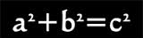

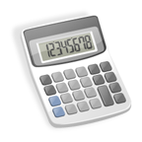



1) Math Concepts Tested:
—Pre-algebra (23%)
—Elementary algebra (17%)
—Intermediate algebra (15%)
—Coordinate geometry (15%)
—Plane geometry (23%)
—Trigonometry (7%)
ACT Math Tips...
2) You’ll need to memorize your formulas—they aren’t given to you.
You’ll need these:
5) Answer all the questions—LEAVE NONE BLANK! If you run out of time, guess!
3) The questions are generally ordered by level of difficulty; the higher the number, the harder the question.
Volume of cubes, pyramids, cylinders | Area of squares, rectangles, circles, triangles
Pythagorean Theorem | Special right triangles
Trig. Functions: Sine, Cosine, & Tangent (SOHCAHTOA | Perimeter & Circumference
6) Technically, all questions can be answered without a calculator. Use it wisely and don’t make silly mistakes!
4) 60 questions in
60 minutes; that’s one minute per question.
7) If you’re guessing, always guess the same letter: a/f or b/g or c/h or d/j or e/k. DON’T BE RANDOM!
Try this:
spend 30 seconds on the first 20 questions
spend 1 minute on the middle 20 questions
spend 1 ½ minutes on the last 20!
8) Read word problems carefully! Sometimes the hardest part is making sure you know what the question is asking you to find.
9) No idea how to do the problem? Try to plug in the answer choices and eliminate the choices that don’t make sense.
*Be ready for

Slide 2
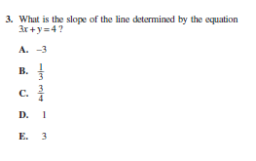
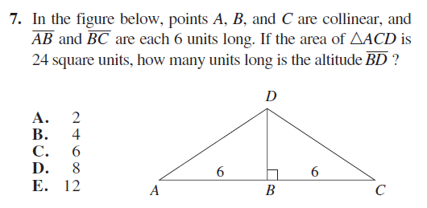
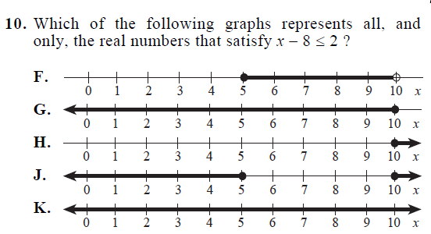
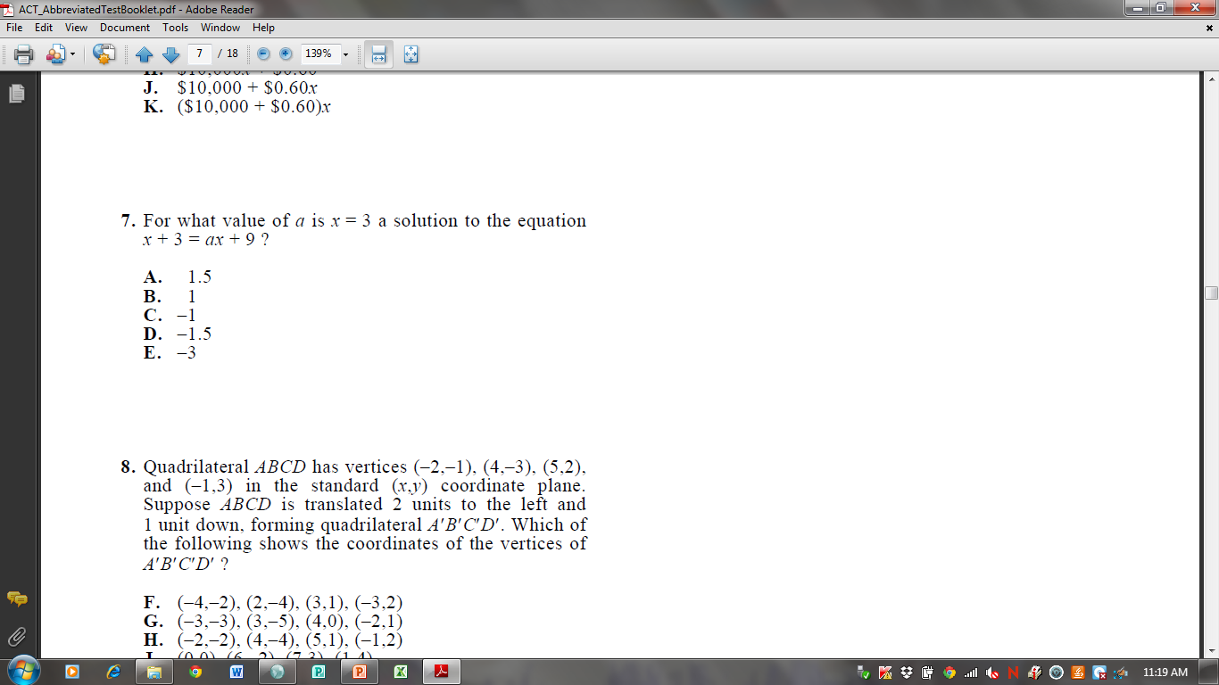
Math Problems

Slide 3
Answer Key
3) A; students must remember the slope-intercept form of a line (y=mx +b where m is the slope). Solve for y and the m is -3.
7) C; plug 3 in for x, and solve for a. (3) + 3 = a(3) + 9. a = -1. Students could also have substituted the answer choices to see which one worked.
7) B; students need to know the formula for area of a triangle (A = ½ bh) and that the altitude of that triangle is the same as the height. 24 = ½ (12) h. The answer is 4.
10) G; for inequalities, less than or equal to means the circle on the number line is closed. Solving the equation yields x < 10, so any number less than or equal to 10 is a solution.

