Slide 1
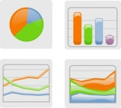

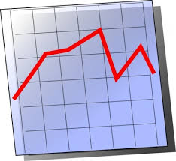
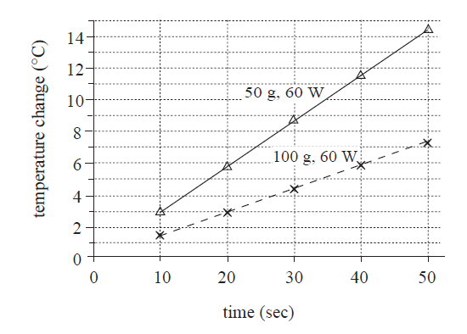



ACT Science Tips
3 types of sections: ① Data Representation ② Research Summaries ③ Conflicting Viewpoints
②Research Summaries
These sections require you to analyze studies and experiments and make conclusions about the findings. These also have charts and graphs, but you may find yourself comparing information in two or more of them.
① Data Representation
This is all about interpreting charts and graphs. Notice trends—what goes up? Down? Stays the same? Do the numbers double? Triple? Half? Stay the same? What’s the variable?
③ Conflicting Viewpoints
This is really a reading comprehension section. Pay attention and look for how the scientists differ in their opinions.
40 questions...35 minutes!
¶ Move Quickly ¶
Don’t spend more than 5 minutes on each science passage!
Read answer choices carefully: if 2 answer choices are OPPOSITES, chances are 1 of those 2 is the answer!
A. temperatures rose
B. temperatures dropped
Don’t know the answer? Running out of time? GUESS! NEVER LEAVE AN ANSWER BLANK!
*Be ready for

Slide 2
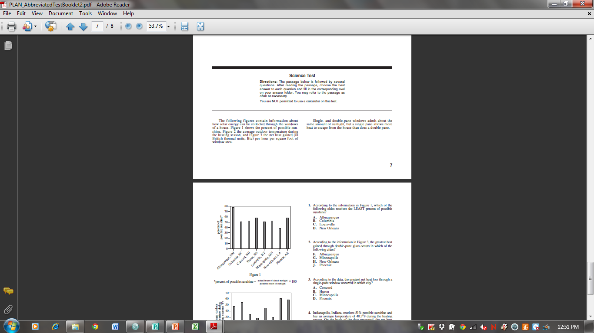
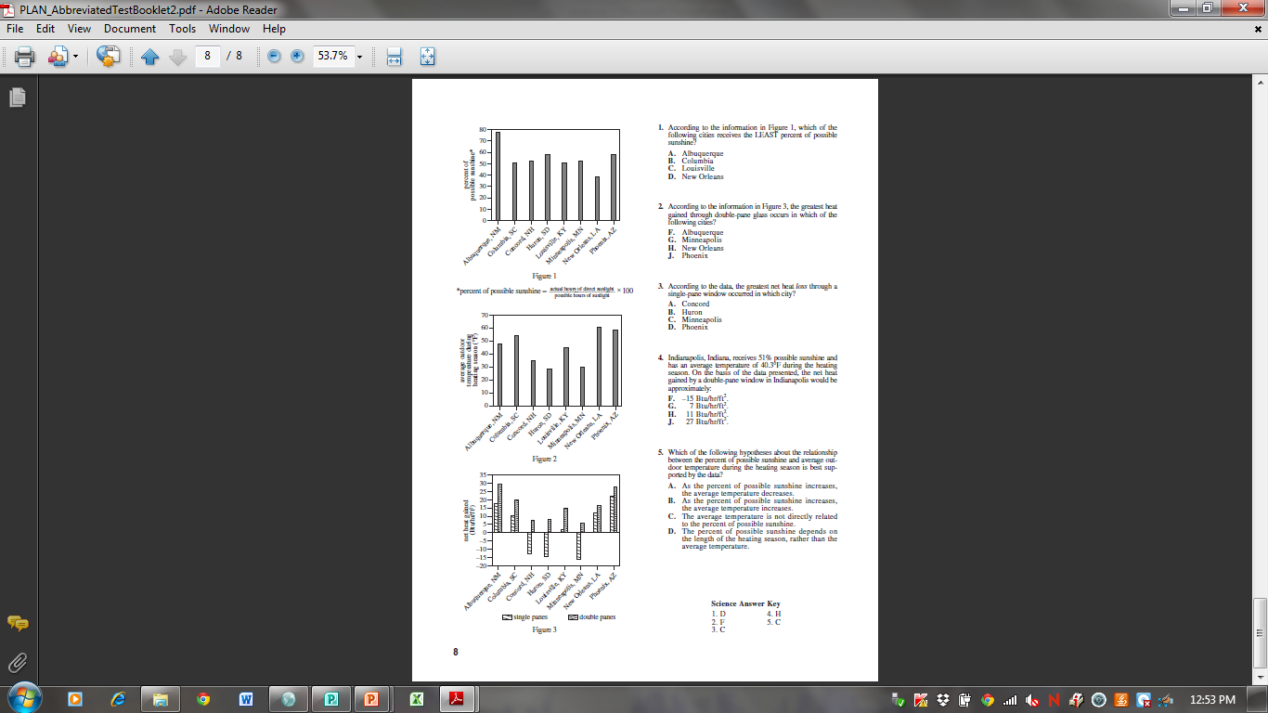

Slide 3
According to the information in Figure 1, which of the following cities receives the LEAST percent of possible sunshine?
  Albuquerque
  Columbia
  Louisville
  New Orleans
2. According to the information in Figure 3, the greatest heat gained through double-pane glass occurs in which of the following cities?
  F. Albuquerque
  G. Minneapolis
  H. New Orleans
  J. Phoenix

Slide 4
According to the data, the greatest net heat loss through a single-pane window occurred in which city?
  Concord
  Huron
  Minneapolis
  Phoenix
4. Indianapolis, Indiana, receives 51% possible sunshine and has an average temperature of 40.3 F during the heating season. On the basis of the data presented, the net heat gained by a double-pane window in Indianapolis would be approximately:
F. -15 Btu/hr/ft².
G. 7 Btu/hr/ft².
H. 11 Btu/hr/ft².
J. 27 Btu/hr/ft².

Slide 5
Which of the following hypotheses about the relationship between the percent of possible sunshine and average outdoor temperature during the heating season is best supported by the data?
  As the percent of possible sunshine increases, the average temperature decreases.
  As the percent of possible sunshine increases, the average temperature increases.
  The average temperature is not directly related to the percent of possible sunshine.
  The percent of possible sunshine depends on the length of the heating season, rather than the average temperature.

Slide 6
Answer Key
1) D—New Orleans has the lowest percent of sunshine.
2) F—looing at figure 3, double-paned data is the second bar. The highest double-pane is Albuquerque.
3) C—looking at figure 3, net loss is portrayed as below 0. The city with the greatest loss, (-15) is Minneapolis.
4) H—students must determine the number of hours of sunlight to make this prediction, which can be done by setting the 51% possible sunshine equal to x/24 (possible hours of sunshine). The best answer choice is H, 11.
5) C—there is no connection between Figures 1 and 2. You cannot see any trends that show that as one variable goes up, the other does the same or the opposite. Therefore, the best choice is C.

