Slide 1
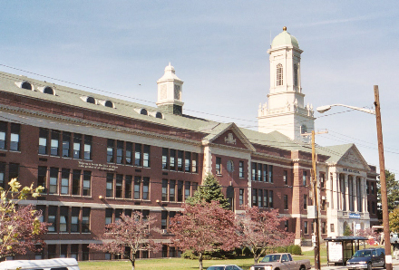




PHASE 4A PROJECTS
SBC MEETING
5.26.2026 | PROVIDENCE, RI

Slide 2
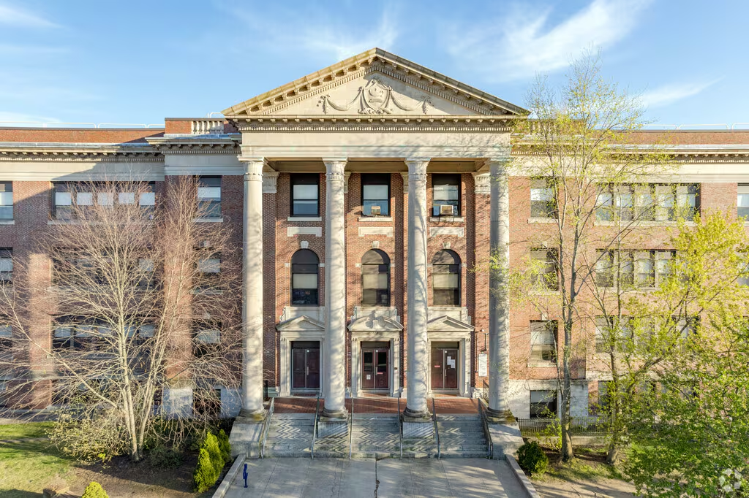
Agenda
Ongoing Work
Stakeholder Engagement
Feasibility Study Presentation
  Vartan Gregorian
  Carnevale
  DelSesto
  Hope High School
  MLK
Next Steps
Notes:
AC

Slide 3
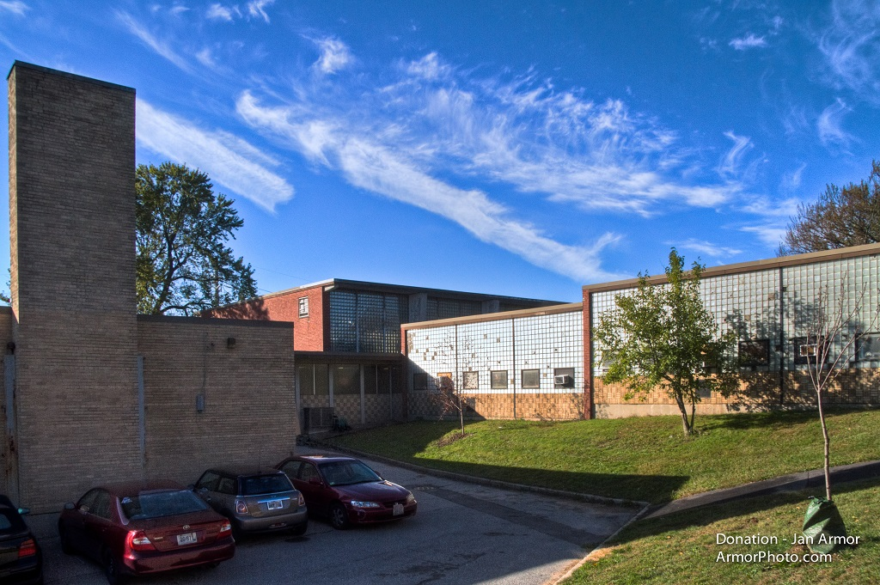
Phase 4A: Ongoing Work
Feasibility Studies
Project Management
  Hazardous Materials Investigation
  MEP Existing Conditions Analysis & Documentation
  Risk Register / Management
  Program Tools Development
Budget/Schedule Planning
  Cash Flow Forecasting
  MOA Alignment
  Refine Individual Project Baseline Budgets & Schedules
AHJ Engagement
  Department of Environmental Management
  Rhode Island Historic
  City of PVD Planning
  Rhode Island Department of Education
Design
  Roger Williams Historical Analysis
  Schematic Design
  Phase I Environmental Studies
School | G.L. | Feasibility
RW / YW | PK-8 Campus | 3.26.2026
DR. MLK JR | PK-5/8 | 3.26.2026
Nat Greene | PK-8 | 4.16.2026
Carnevale | PK-8 Campus | 4.16.2026
Vartan | K-5 | 4.30.2026
Delsesto | PK-8 Campus | 4.30.2026
Hope HS | 9-12 | 4.30.2026
Complete; Schematic Design
Complete; Presenting 5.26.2026
Complete; Phase 4B
Complete; Presenting 5.26.26
Notes:
AC

Slide 4
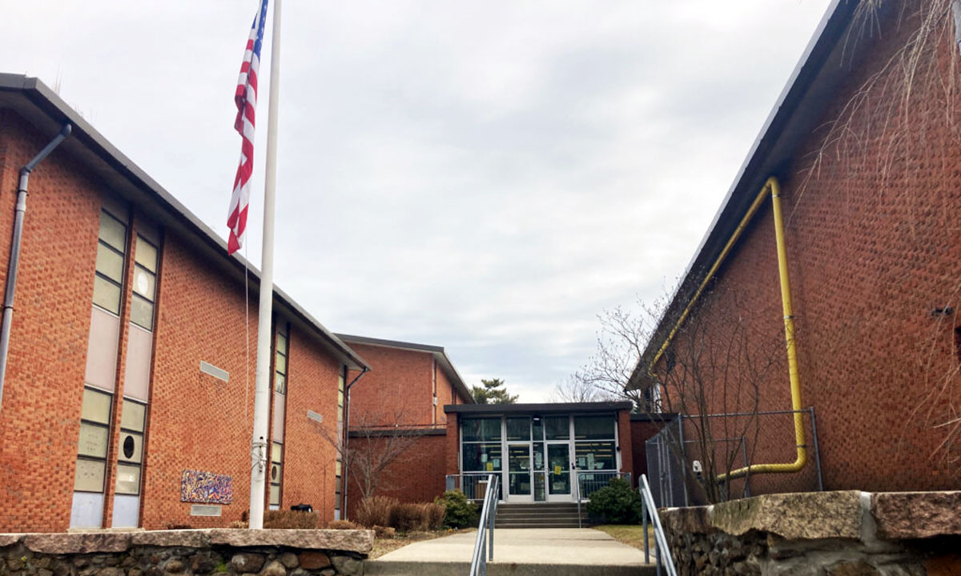
Phase 4A: Vartan Gregorian
Snapshot:
Design: Enrollment model remains unchanged; Project will seek to address both ‘Warm, Safe, & Dry’ projects, as well as Educational Programming spaces. Current priorities include addressing ADA code improvements, structural systems, building envelope, early learning bathrooms, full mechanical system overhaul, and updating educational programming spaces.
Logistics: Project is dependent on swing space availability for any major work; ‘summer slam’ projects would not be advised for cost/schedule implications
Schedule: Target start is 7/1/2027; construction duration dependent on project selection.
Environmental: Hazardous materials present, but do not pose any imminent risk in state/location.
Site: Site work will be required to address ADA issues.
Budget: Approved MOA is $30M; Consideration of MOA realignment to increase scope depending on project selection.
Historical: Project is not under any formal jurisdiction, but should require coordination as a best practice
Notes:
AC

Slide 5
Phase 4A: Carnevale
Snapshot:
Design: Project is being studied for conversion from current enrollment model to a combined Carnevale/Del Sesto Pre-K-8 campus model; Building has major settlement issues affecting structural and other building systems;
Logistics: Project is dependent on swing space availability for any major work; ‘summer slam’ projects would not be advised for cost/schedule implications
Schedule: Target start is 7/1/2027; construction duration dependent on project selection.
Environmental: Site has environmental monitoring – will include a cost premium for any work required ‘in-ground’
Site: Site work will be required to address settlement issues
Budget: Approved MOA is $13M; Requirements of structural work and associated civil work will bring tremendous pressure on project budget, potentially limiting ability to prioritize further projects during this phase.
Historical: No concern at this time; outreach has been ongoing.
Notes:
AC

Slide 6
Phase 4A: Hope High School
Snapshot:
Design: Enrollment model remains unchanged; Project will seek to address both ‘Warm, Safe, & Dry’ projects, as well as Educational Programming spaces. Current priorities include addressing thermal comfort, completing code upgrades, and student centered educational programming spaces
Logistics: Project has opportunities to sequence work while school is in session, providing more value/reduced timelines
Schedule: Tentative start of 3/1/27; 18-month construction duration
Environmental: Hazardous materials present, but do not pose any risk in state/location.
Site: No major scope identified.
Budget: Full renovation (all identified scope) is $75M; Approved MOA is $25M; May be MOA realignment to increase scope depending on project selection.
Historical: Location is under jurisdiction; select scopes of work may require Historical approvals.
Notes:
AC

Slide 7
Phase 4A: Del Sesto
Snapshot:
Design: Project is being studied for conversion from current enrollment model to a combined Carnevale/Del Sesto Pre-K-8 campus model; Building has ‘excess capacity’ – opportunities to provide educational spaces without increasing the building footprint. Major projects to be considered include conversion of underutilized spaces to ed programming areas (locker rooms), interior finishes, space reconfiguration, security film, and the replacement of portions of the HVAC systems
Logistics: Project is dependent on swing space availability for any major work; will require coordination across multiple design/build teams
Schedule: Target start is 7/1/2027; 24-month construction duration
Environmental: Site has environmental monitoring – will include a cost premium for any work required ‘in-ground’
Site: Site Improvements may be required – see environmental.
Budget: Approved MOA is $11.5M; Consideration of MOA realignment to increase scope depending on project selection. Current MOA does not allow for a full renovation or new build.
Historical: No concerns at this time.
Notes:
AC

Slide 8
Phase 4A: Dr. MLK Jr.
Snapshot:
Design: Project approved during Stage II and by City Council for a new construction, Pre-K – 5 model. District vision for PK-8 school communities prompted the project team to re-evaluate the scope against updated educational programming needs. The project team evaluated 7 major options.
Logistics: For 4 options, swing space would be a requirement; 3 options proposed to build on an adjacent lot not under care and control of the school department.
Schedule: Target start is 7/1/2027; construction duration is 24 months.
Environmental: Hazardous materials present, but do not pose any imminent risk in state/location.
Site: Site work will be required for all options.
Budget: Approved MOA is $48M; MOA realignment will be required to move forward with all options.
Historical: Project is not under any formal jurisdiction, but should require coordination as a best practice.
Cultural: Existing facility is a neighborhood resource and has strong ties to the community. Robust engagement will be required to ensure the option chosen will continue to serve
Notes:
AC

Slide 9
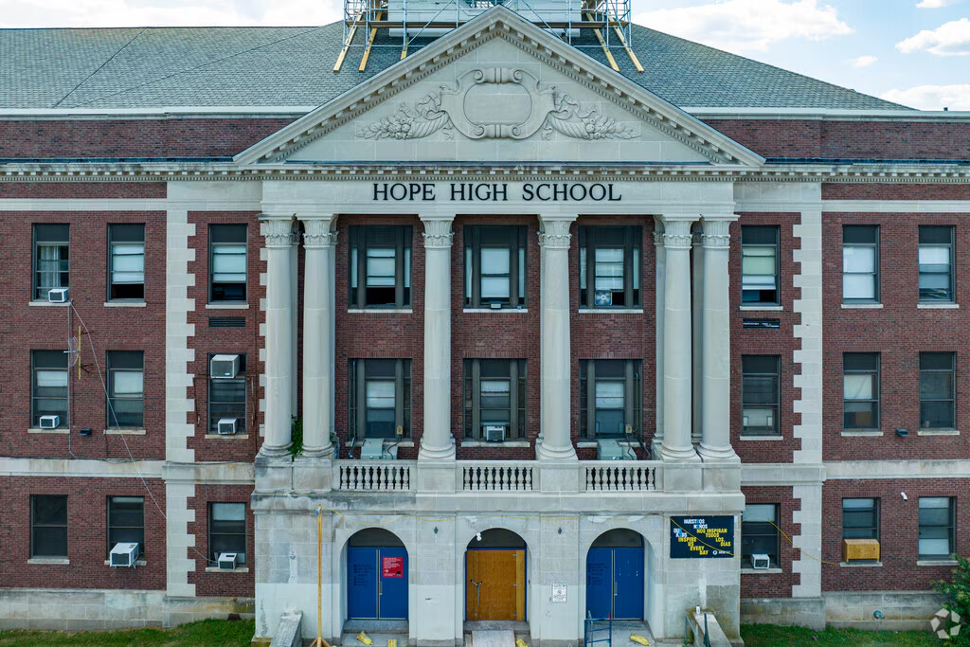
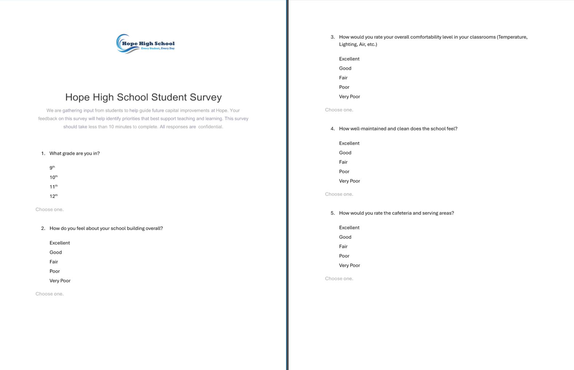
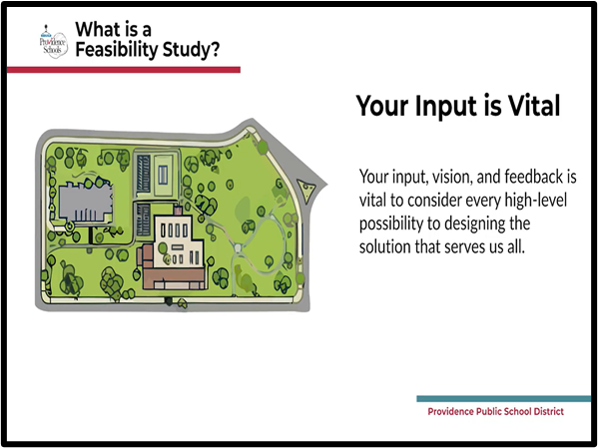
Phase 4A: Stakeholder Engagement Update
March 15 – April 15 : Process Definition - COMPLETE
Video Development & Cadence
Kick-off w/ PPSD Communications
Building Walkthroughs w/ PPSD Ops
April 15 – June 15: Preliminary Engagement - ONGOING
PPSD Leadership Teams
Educator / Administrator / Staff
Outreach to Community Stakeholder Orgs
Public Meetings / Forums
Community Events
Release Videos / Surveys
June 15 – Aug 30: Schematic Design
Incorporate engagement feedback into design
Targeted engagement to clarify scope
RIDE-SBA SD Design Deliverables
As Needed: Approvals
SBC / School Board / City of PVD / RIDE CX
Incorporate additional feedback into next iteration in Design Development
Notes:
AC

Slide 10
Next Steps
Project Management
  Refine Budgets / Schedules
  Develop 4A Dashboard / Program Tools
  MEP Existing Conditions Analysis & Documentation
  Consultant Procurements
  Risk Register / Management
AHJ Engagement
  Department of Environmental Management
  Rhode Island Historic
  City of PVD Planning
  RIDE-SBA
Design
  Options Selection
  Schematic Design
  Stakeholder Engagement
  Implementation
Notes:
AC

