Slide 1





PHASE 4A PROJECTS
SBC MEETING
4.28.2026 | PROVIDENCE, RI

Slide 2
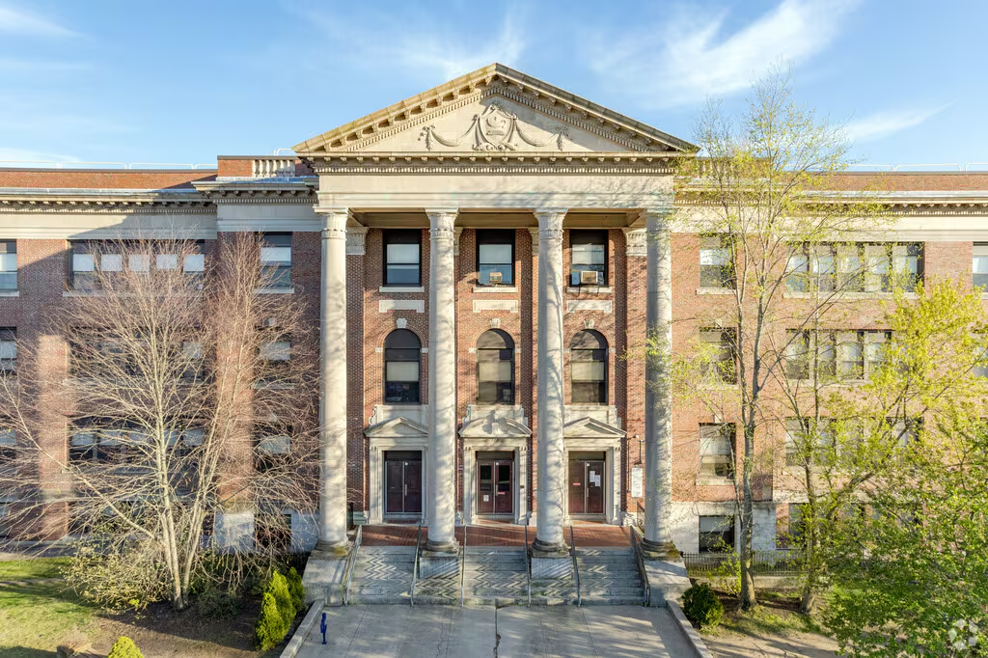
Agenda
New Team Member Introduction
Ongoing Work
Feasibility Study Update
Stakeholder Engagement Update
Next Steps
Notes:
AC

Slide 3
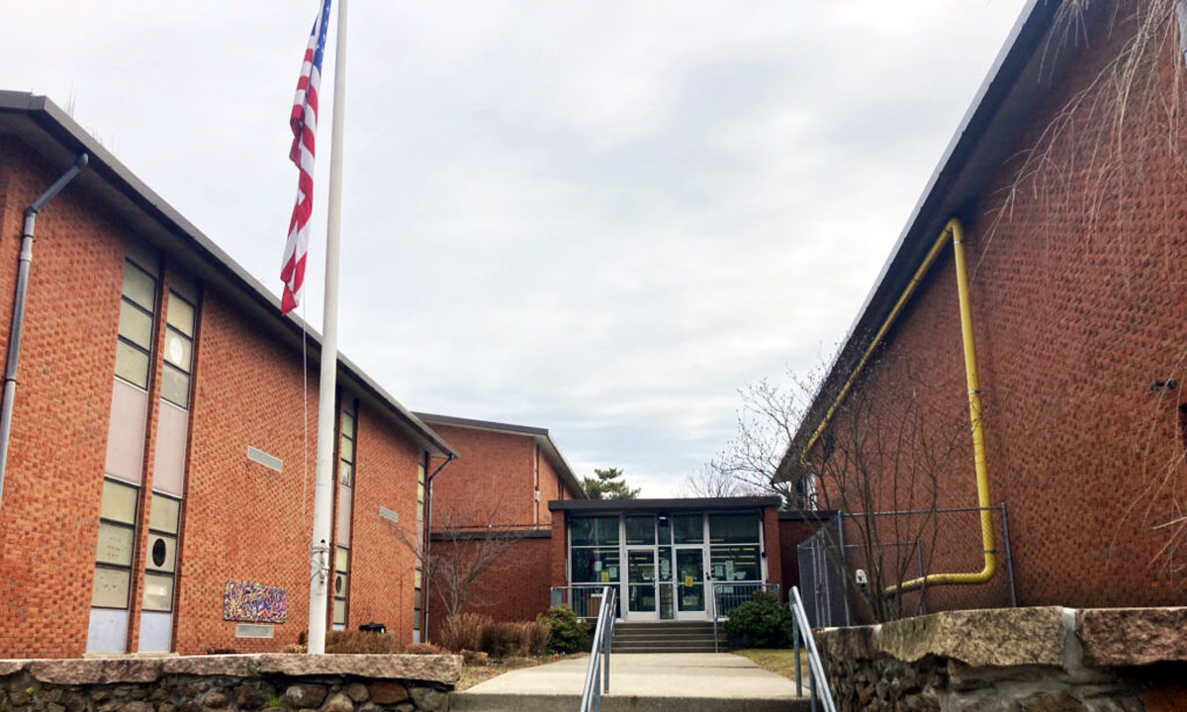

Introductions
Lilliana Smith
Project Manager
Notes:
AC

Slide 4
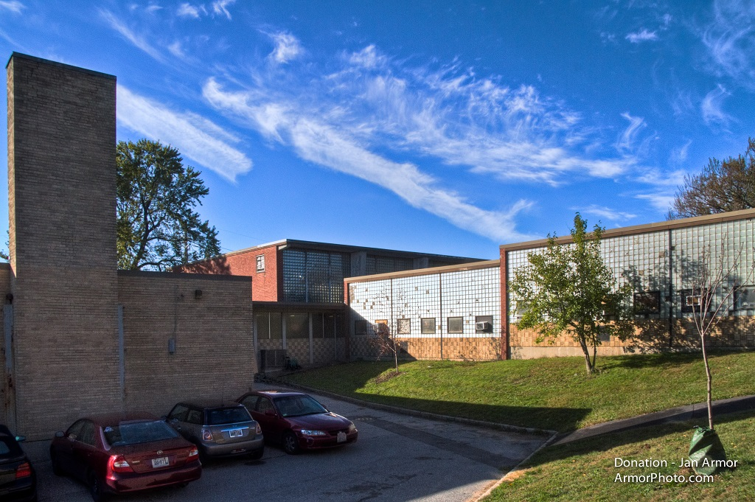
Phase 4A: Ongoing Work
Feasibility Studies
Project Management
  Hazardous Materials Investigation
  MEP Existing Conditions Analysis & Documentation
  Risk Register / Management
  Program Tools Development
Budget/Schedule Planning
  Cash Flow Forecasting
  Refine Individual Project Baseline Budgets & Schedules
AHJ Engagement
  Department of Environmental Management
  Rhode Island Historic
  City of PVD Planning
  Schematic Design Proposals
Design
  Schematic Design Proposals
  Laser Scanning
School | G.L. | Feasibility
RW / YW | PK-8 Campus | 3.26.2026
DR. MLK JR | PK-5/8 | 3.26.2026
Nat Greene | PK-8 | 4.16.2026
Carnevale | PK-8 Campus | 4.16.2026
Vartan | K-5 | 4.30.2026
Delsesto | PK-8 Campus | 4.30.2026
Hope HS | 9-12 | 4.30.2026
Complete; Attached
Complete; In Review
In Progress
Notes:
AC

Slide 5
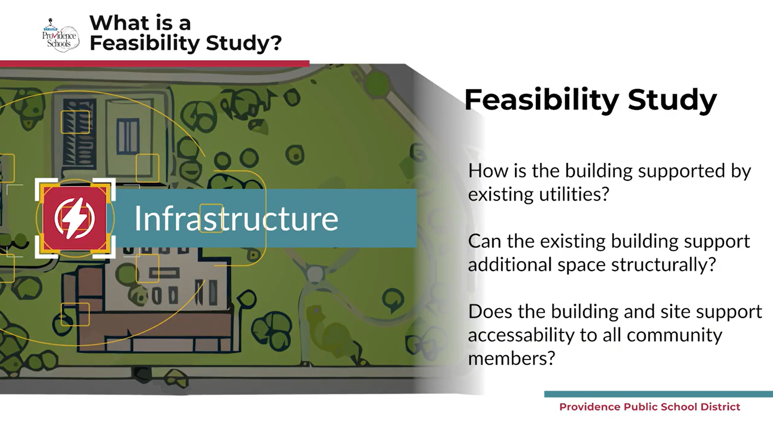
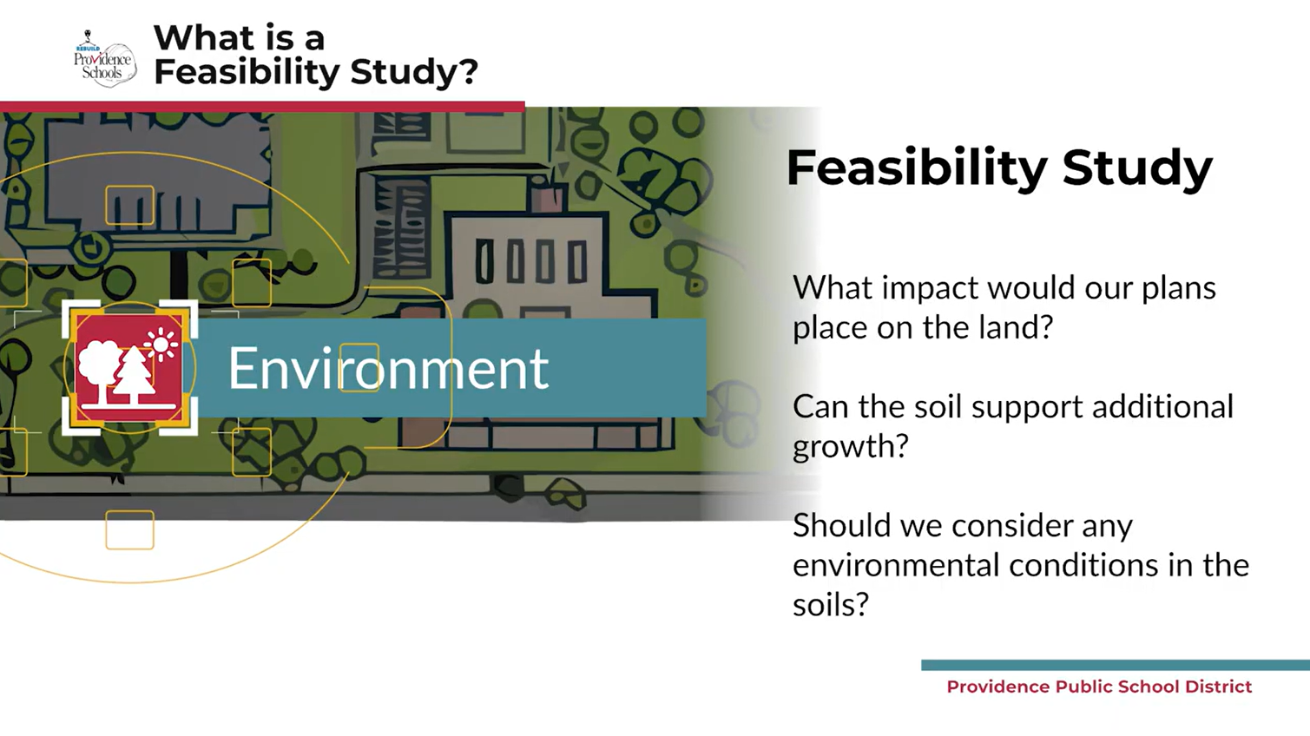
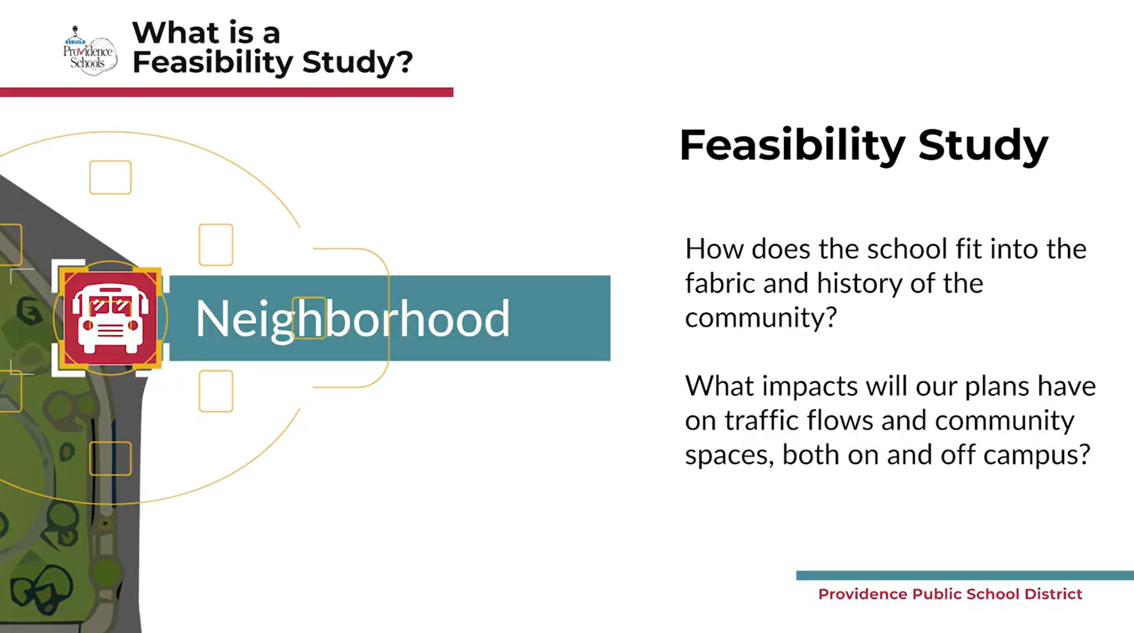
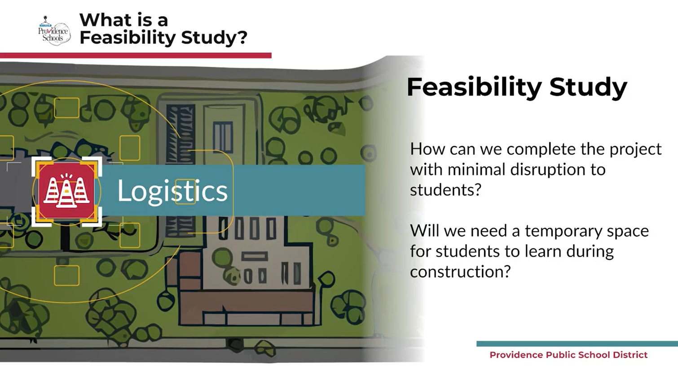
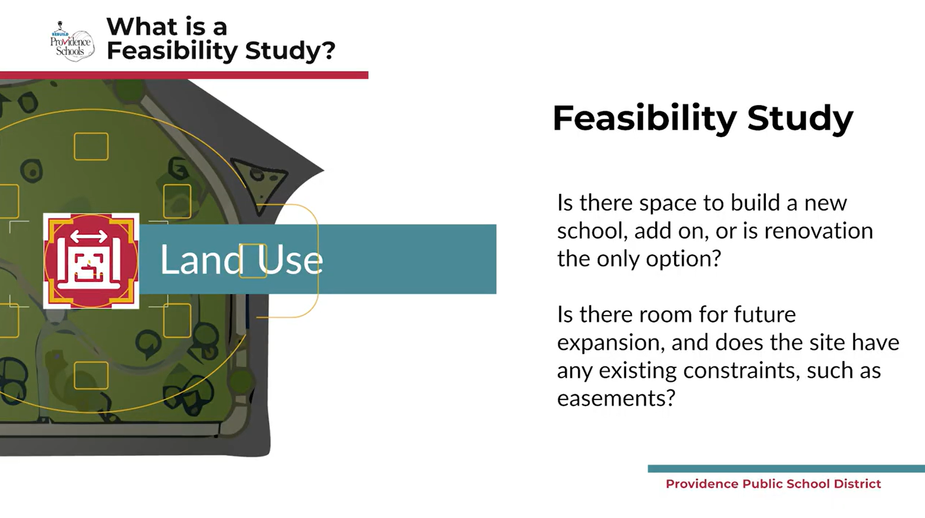
Phase 4A: Feasibility Study Update
Feasibility Studies serve the program by:
Evaluating the movement of project requirements from the Stage II submission
Systematically and holistically evaluating what potential architectural solutions best align with project requirements and program constraints
Notes:
AC

Slide 6

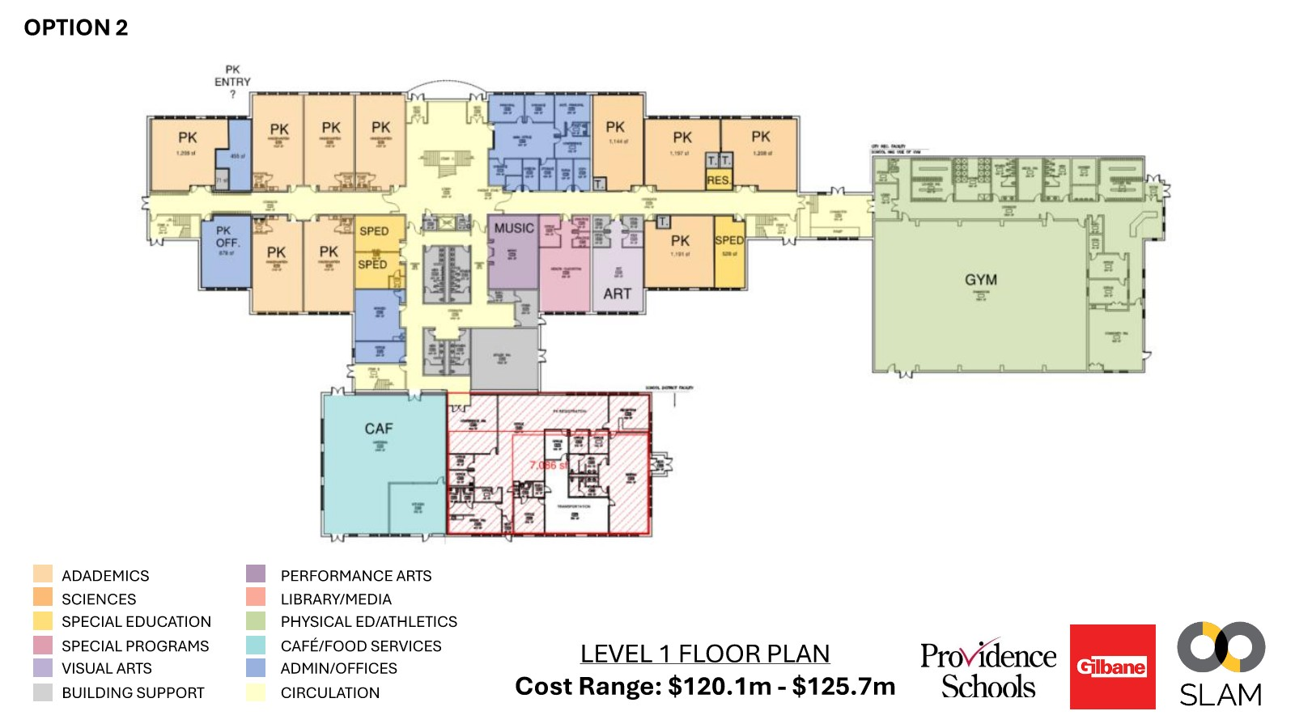
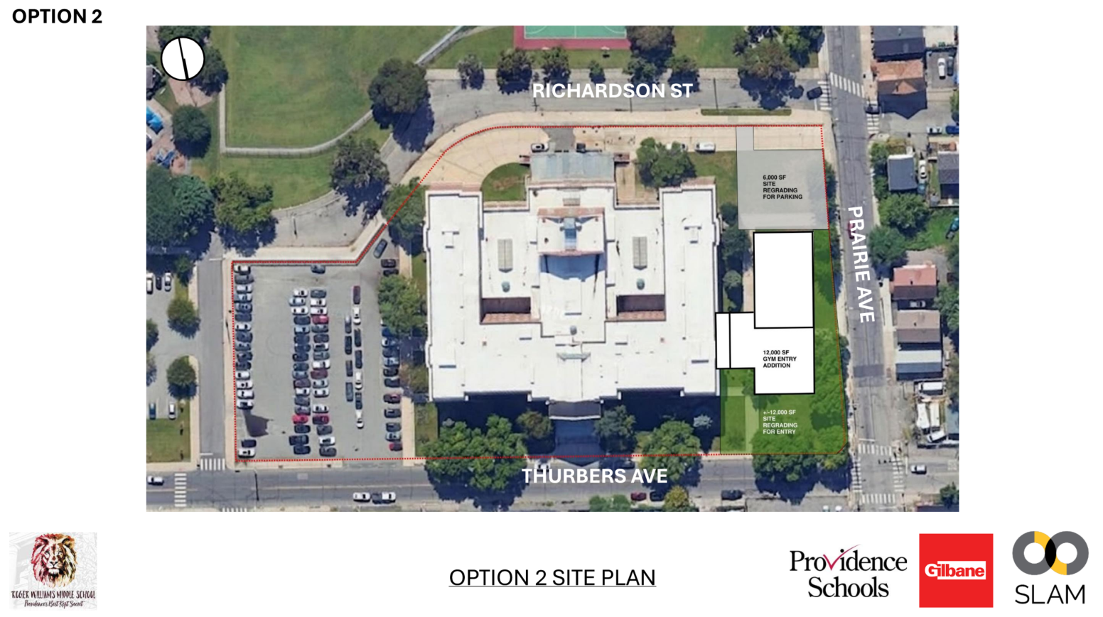
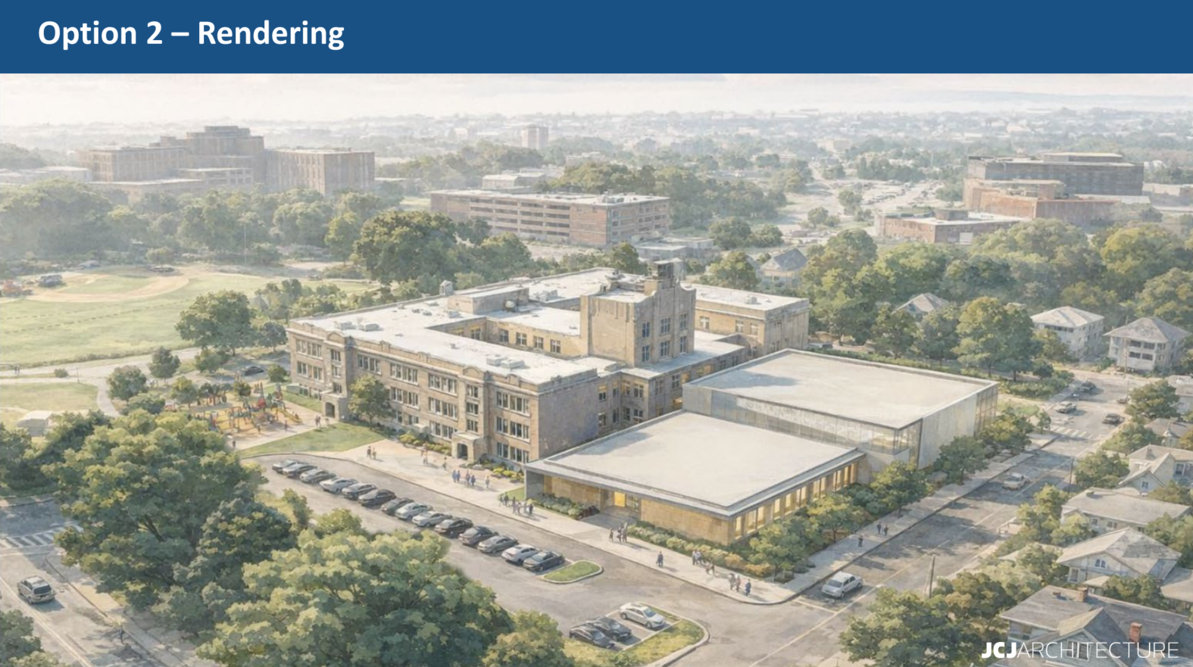
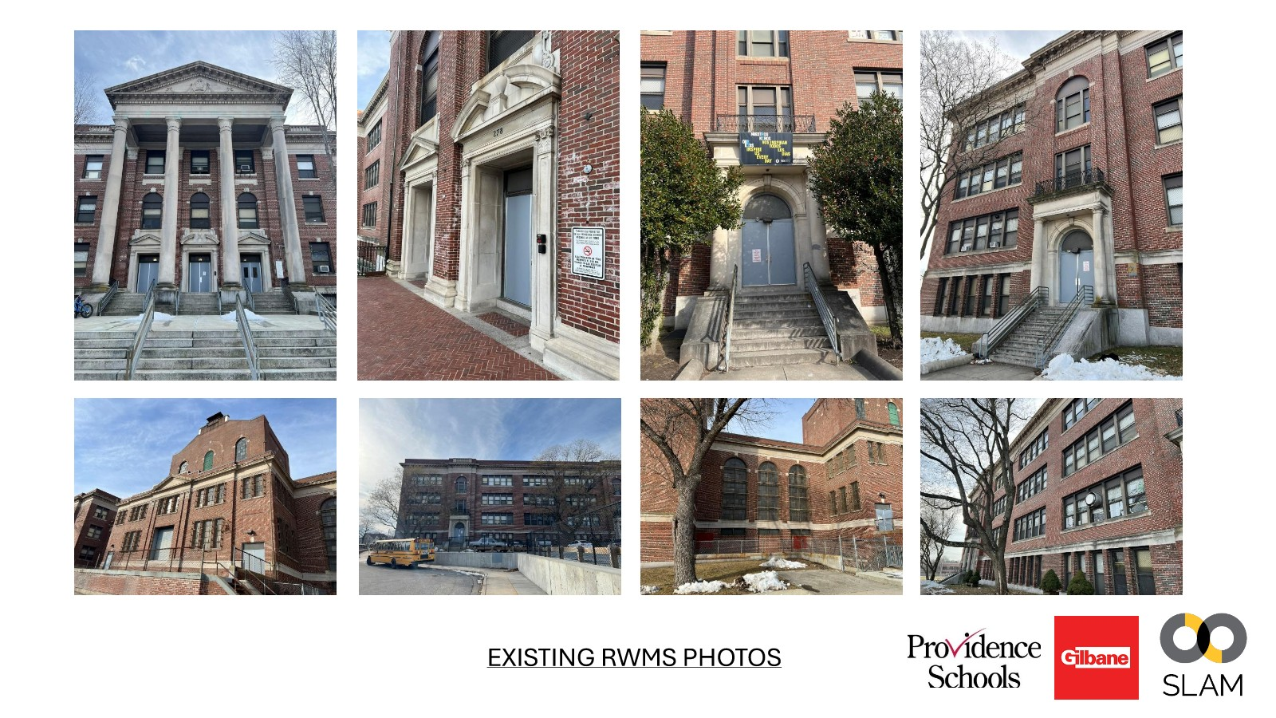
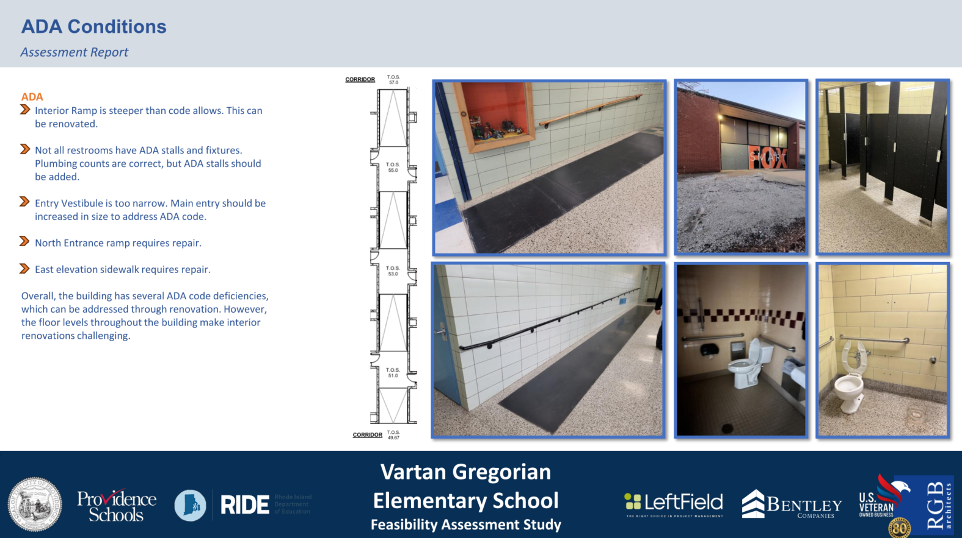
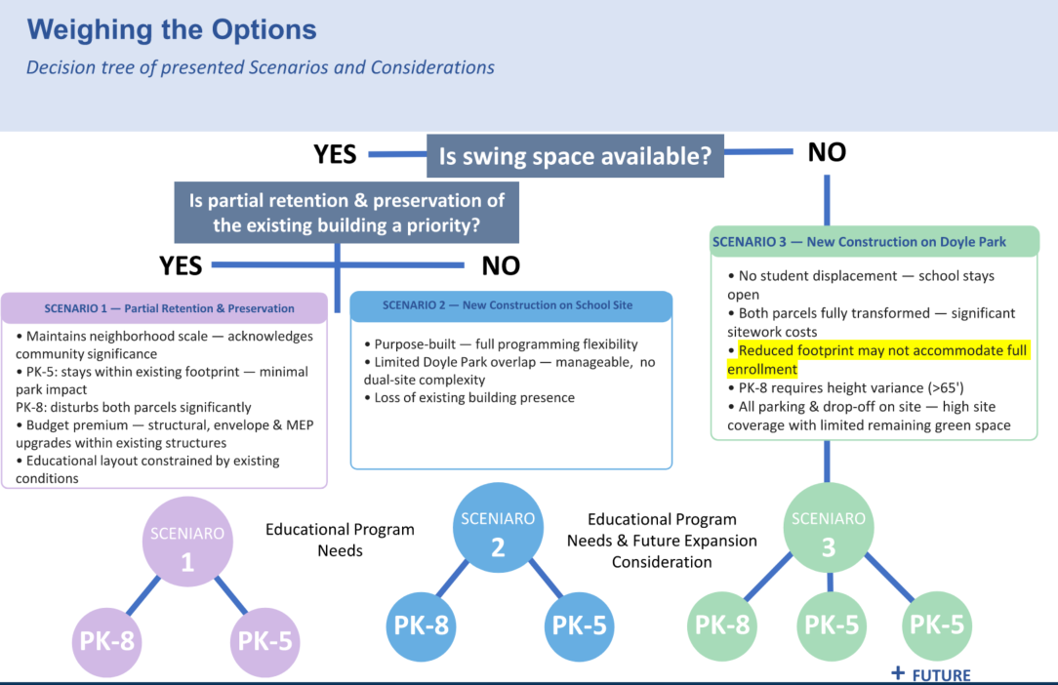
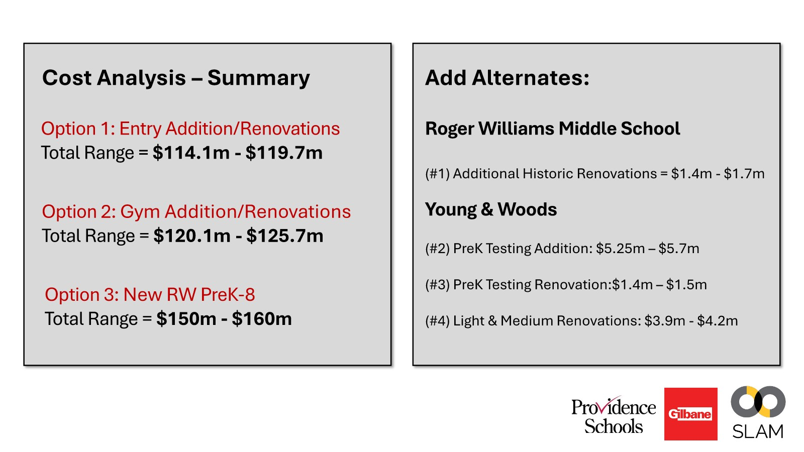
Phase 4A: Feasibility Study Update
Typical Deliverables
- Existing Conditions - Decision Trees - Site Conditions Analysis - Renderings
- Historical Analysis - Massing Studies - Alignment Floorplans - ROM Budget
Notes:
AC

Slide 7

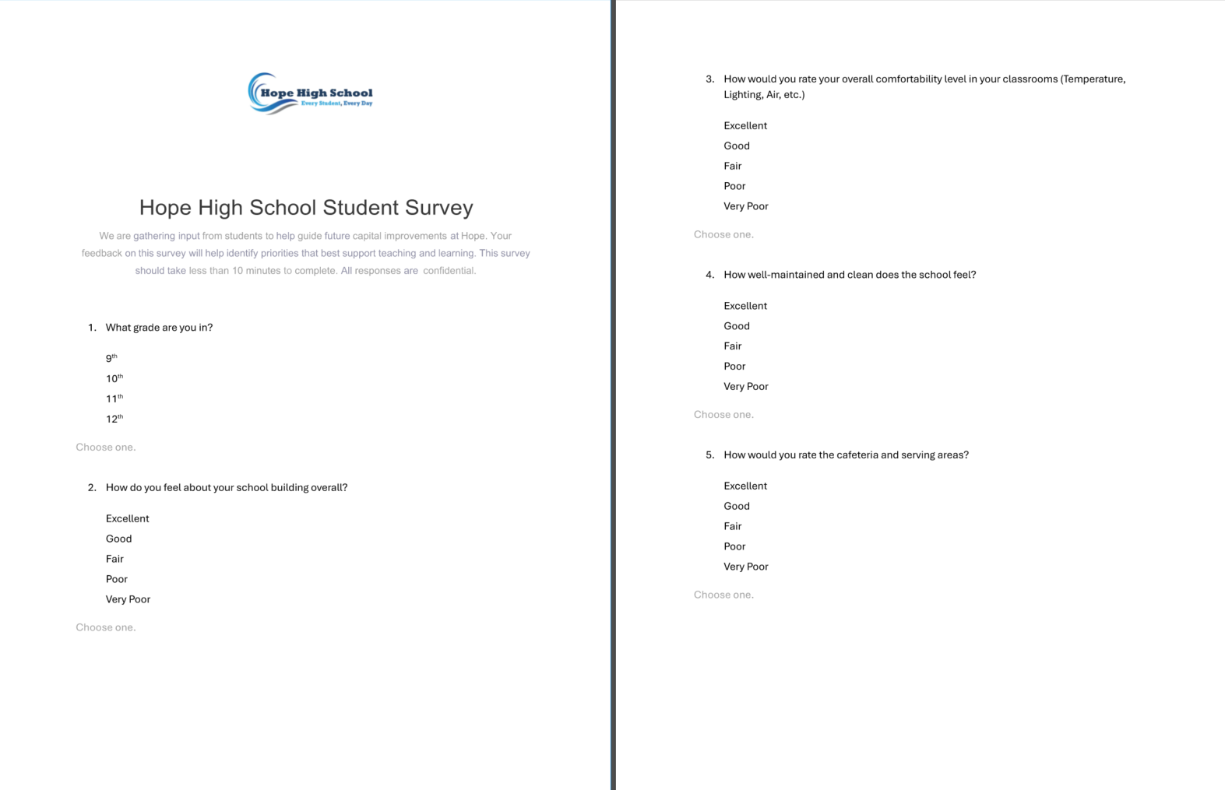
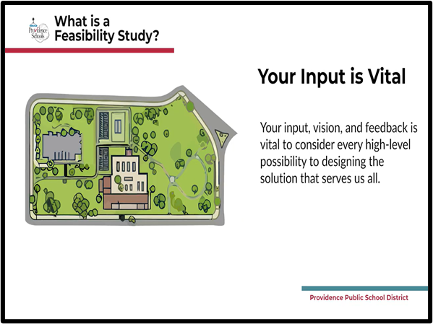
Phase 4A: Stakeholder Engagement Update
March 15 – April 15 : Process Definition - COMPLETE
Video Development & Cadence
Kick-off w/ PPSD Communications
Building Walkthroughs w/ PPSD Ops
April 15 – June 15: Preliminary Engagement - ONGOING
PPSD Leadership Teams
Educator / Administrator / Staff
Outreach to Community Stakeholder Orgs
Public Meetings / Forums
Community Events
Release Videos / Surveys
June 15 – Aug 30: Schematic Design
Incorporate engagement feedback into design
Targeted engagement to clarify scope
RIDE-SBA SD Design Deliverables
As Needed: Approvals
SBC / School Board / City of PVD / RIDE CX
Incorporate additional feedback into next iteration in Design Development
Notes:
AC

Slide 8
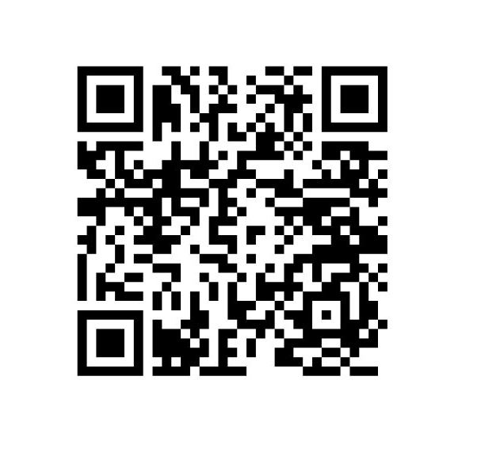
Phase 4A: Stakeholder Engagement Update
Short Form Video
https://vimeo.com/1183430927/5df57e2c52?fl=pl&fe=cm#t=2m40s
INSERT VIDEO INBED LINK HERE
Notes:
AC

Slide 9
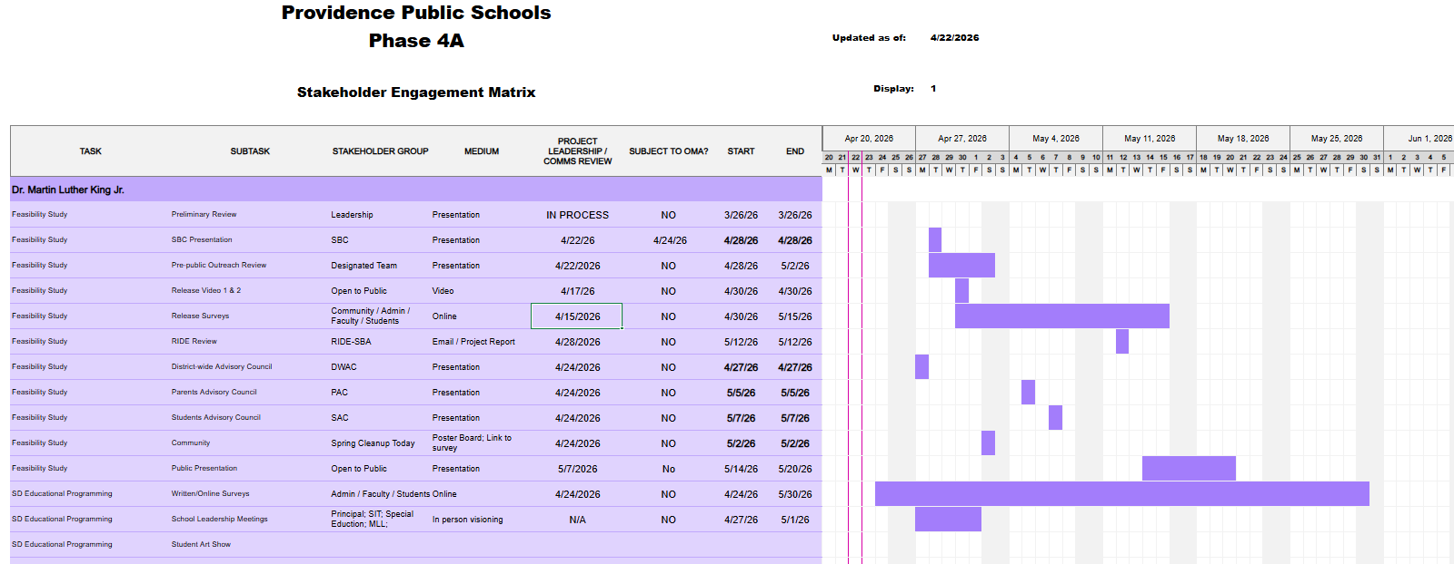
Phase 4A: Stakeholder Engagement Update
DRAFT
IN REVIEW
Notes:
AC

Slide 10
Next Steps
Project Management
  Refine Budgets / Schedules
  Develop 4A Dashboard / Program Tools
  MEP Existing Conditions Analysis & Documentation
  Consultant Procurements
  Risk Register / Management
AHJ Engagement
  Department of Environmental Management
  Rhode Island Historic
  City of PVD Planning
Design
  Options Selection
  Schematic Design
  Stakeholder Engagement
  Implementation
Notes:
AC

