Slide 1

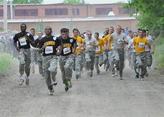


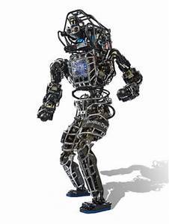
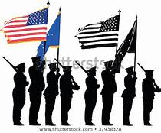
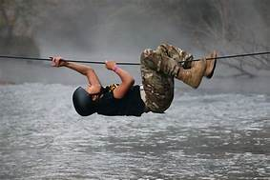

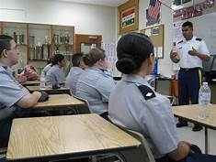
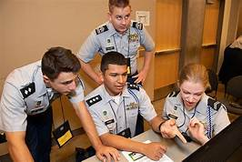
DRILL
RAIDER
ARCHERY
MARKSMANSHIP
ROBOTICS
COLOR GUARD
Team Captain –
Co- Captain –
X
X
X
X
X
X
X
X
X
X
X
X
X
X
X
X
X
X
X
X
X
X
X
X
X
X
X
X
X
x
Team Captain –
Co- Captain –
X
X
X
X
X
X
X
X
X
X
X
X
X
X
X
X
X
x
Team Captain –
Co- Captain –
X
X
X
X
X
X
X
X
X
Team Captain –
Co- Captain –
X
X
X
X
X
X
x
Team Captain –
Co- Captain –
X
X
X
X
X
x
Team Captain –
Co-Captain
X
X
X
X
X
x
JLAB-LEADERSHIP
JLAB-ACADEMICS
Team Captain –
x
X
X
X
Team Captain –
x
X
X
X

Slide 2




BN SASAI
MAJ Jarmon
BN CDR
LTC Bain
BN CSM
CSM Nower
HARNETT CENTRAL HIGH SCHOOL
ARMY JROTC TROJAN BATTALION
ORGANIZATION CHART
HONOR GUARD
DEPUTY OPS
MAJ Bartlett
DEPUTY TRN
MAJ Borrego
COLOR GUARD
FLAG/EVENT DETAIL
BN XO
MAJ Capra
BN S1
MAJ Perez-Perez
BN S2
CPT C Ogren
BN S3
MAJ R-Jimenez
BN S4
1LT Dela Rosa
BN S5
SFC D Cunningham
BN S6
SSG Southers
BN S1
1LT Keppilinger
S2 NCOIC
BN S3 SGM
SFC W Clark
S5 NCOIC
S6 NCOIC
BN S4 Assistant
SFC M Williams
S1 Awards Spec
S2 Security
S3 TRN Officer
CPT I Covington
S4 Supply Spec
BN OPS Officer
CDR: T. Rhyne
1SG:
XO:
1PL: Feliciano
PSG: L. Taylor
2PL: K. Ledbetter
PSG: O. Leslie
CDR: 2LT O Haney
1SG:
XO:
1PL: C. Rodriguez
PSG: X. Brown
2PL:
PSG:
3PL:
PSG: M. Blue
CDR: T. Reeves
1SG:
XO:
1PL: T Nelson
PSG:
2PL: J. Soriano
PSG: I. Paige
3 PL: D. Saucedo
PSG: S. Hine
CDR: 2LT L. Jenkins
1SG: SFC S Gayle
XO:
1PL:
PSG: Y. Allam
2PL:
PSG: T. James
3PL:
PSG: W. Jasinski

Slide 3
ALPHA ALLIGATORS
Company Executive Officer
T. Rhyne
Company First Sergeant
1st Platoon Leader
M. Feliciano
2nd Platoon Leader
K. Ledbetter
1st Platoon Sergeant
L. Taylor
2nd Platoon Sergeant
O. Leslie
1st Squad
SL: A. Morales
E. Lawson
J. Loy
Matthews
M. Inguanza
L Lopez
2nd Squad
SL: J. Cerda
J. Pipkin
M. Plummer
S. Raya
J. Joyce
3rd Squad
SL: S. Reyes
A. Varela
T. Williams
K. Barden
1st Squad
SL: B. Linz
I. Pilkington
D. Speare
A. Brower
J. Vasquez
2nd Squad
SL: J. Pendleton
L. Giles
J. Lopez
C. Rathbone
3rd Squad
SL: R. Van Winkel
D. Cavallini
C. Ennis
E. Figueroa

Slide 4
BRAVO BEARS
Company Commander
2LT O. Haney
Company Executive Officer
vacant
Company First Sergeant
1st Platoon Leader
C. Rodriquez
2nd Platoon Leader
vacant
3rd Platoon Leader
vacant
1st Platoon Sergeant
X Brown
2nd Platoon Sergeant
E Ballard
3rdPlatoon Sergeant
M. Blue
1st Squad
A. Vargas
D. Barrera
L. Bell
A. Zuniga
2nd Squad
G. Cruickshank
J. Davis
G. Duffany
N. Faulk
3rd Squad
L. Gonzalez
S. High
J. Hill
R. Jerrido
1st Squad
O. Davis
J. Hernandez
M. Jordan
E. Perez
2nd Squad
J. Judd
Z. Leach
M. Norris
3rd Squad
E. Reynolds
Swancey
E. Wallace
1st Squad
V. Mckoy
Peterson
J. Saldana
J. Simmons
2nd Squad
N. Espinal
G. Watson
E. Womack
I . Belanger
3rd Squad
B. Hoggard Brown
Davis
C. Davis

Slide 5
CHARLIE CROCODILES
Company Commander
T. Reeves
Company Executive Officer
vacant
Company First Sergeant
1nd Platoon Leader
T. Nelson
2nd Platoon Leader
J. Soriano
3rd Platoon Leader
D. Saucedo
1st Platoon Sergeant
N Wasserman
2nd Platoon Sergeant
I. Paige
3rd Platoon Sergeant
S. Hines
1st Squad
S. Baker
K. Chance
B. Collins
3rd Squad
A. Doti
M. Allen
2nd Squad
C. Haynes
H. Hekel
J. Herrara
3rd Squad
Y Mantero
K. McCullers
D. McNeill
1st Squad
B. Miller
Chels Rodriguez
D. Rollins
2nd Squad
P. Sutton
J. Tomlinson
C. Mejia
3rd Squad
A. Plummer
J. Wiggins
C. Dye
2nd Squad
E. Vazquez
T. Nelson
J. Roark
1st Squad
Flores
Snead
A Taylor

Slide 6
DELTA DAWGS
Company Commander
2LT L. Jenkins
Company Executive Officer
Company First Sergeant
SFC S. Gayle
1st Platoon Sergeant
Y. Allam
2nd Platoon Sergeant
T. James
3rd Platoon Sergeant
W. Jasinski
1st Squad
SL: S Gayle
R. Jones
E. Ramirez
Vazquez
2nd Squad
SL: Y. Saravia
D. Parks
Z. Patrick
B. Plumer
3rd Squad
SL: B. Huner
C. Rodriguez
A. Torres
R. Schackart
1st Squad
SL: N Oakley
H. Simon
J. Thomson
C. Wichlacz
2nd Squad
SL: D Levangie
J. Becker
M. Francois
A. Gerald
3rd Squad
L. Guzman
C. Jones
L. Moreno
1st Squad
S. Boyd
D. Brower
A. Cerda
2nd Squad
Gonzalez
J. Harris
A. Jarmon
3rd Squad
A. Turrubiartes
J. Wood
H. Stultz

