Slide 1
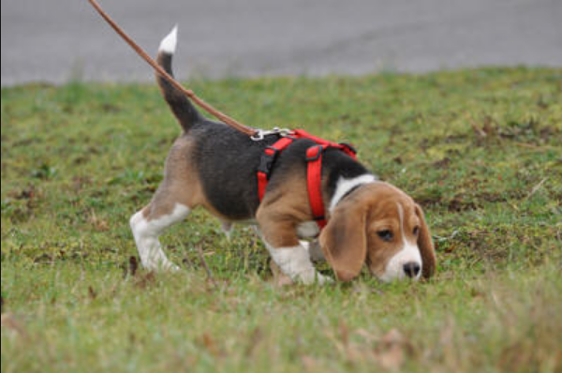
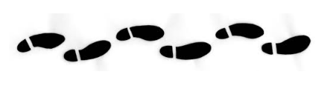
Tracking Lessons

Slide 2
Tracking
1. Tracking is a sport where the dog follows a “track” that has been walked by a person. (The person “lays a track” and leaves a glove at the end. Later the dog follows the same path (track) and finds the glove)
2. The dog wears a long leash/lead and walks ahead of the handler sniffing to find the track. The handler does NOT pull on the leash or show the dog where to go. The dog uses scent to find the path. If the dog is way off track the handler can just stop and let the dog figure out where to go.
3. When the dog is first learning, the track layer walks heavily, scuffing his feet and dropping treats in his footsteps. Later, fewer and fewer treats are dropped and the dog just follows the scent of the track layer’s footprints.
4. Tracks become more complex and “older” – meaning the track layer lays a track and the dog doesn’t follow for 15 minutes up to 2 hours (!)

Slide 3


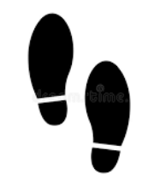
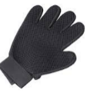


Lesson 1 – stomp a square, put 4 treats in the square. Step in a straight line, put a treat in each footstep – 3 treats under and 3 treats on top of the glove

Slide 4
Lesson 2: Make a longer track – put treats every other footstep. 3 treats under and 3 treats on top of the glove

Slide 5
Lesson 3: Make a “wavy” track – treats every other footstep
3 treats under and 3 treats on top of the glove

Slide 6
Lesson 4: Right turn and left turn

Slide 7
Lesson 5 – Full track

