Slide 1
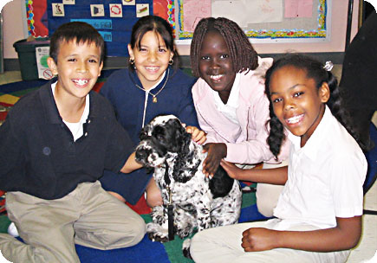
Humane Education
The word ‘humane’ actually means the things that are considered the best qualities of human beings
Humane Ed is teaching those qualities
Humane Ed has come to encompass animal issues, as well as environmental and human rights issues

Slide 2
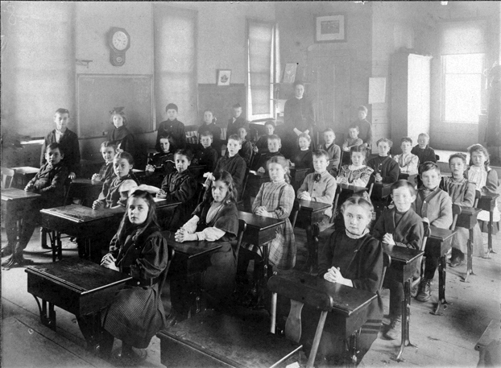
“Ever since I introduced the subject of kindness to animals into my school, I have found the children less disorderly and more gentle and affectionate toward each other.”
Mr. De Sailly
Eminently respected teacher
France in the 1880’s

Slide 3
Valuable Character Lessons
If children are taught to be nice to and respect animals, they are more likely to treat people with respect and kindness.
Jalongo 2006
1st graders self-reported empathy toward animals significantly increased after they participated in an in-class HE program.
Nicoll, Trifone, and Samuels 2000
Even a year after HE program was implemented, increased empathy in children toward animals was present. Ascione & Weber 1993

Slide 4
Golden Era
1829 – NYS anti-cruelty statute passed
1882 – Angell organized Bands of Mercy
1886 – HE mandates introduced in MA
1889 – Angell founded AHES to promote BOM
1902 – AHA promotes publication/guidelines for texts w/ humane ideals
1905 – NYHEC formed to advance state HE requirements
1916 – ASPCA helps schools implement HE
1922 – 22 states passed laws requiring HE in schools
1924 – President of NEA endorsed HE at annual AH meeting

Slide 5
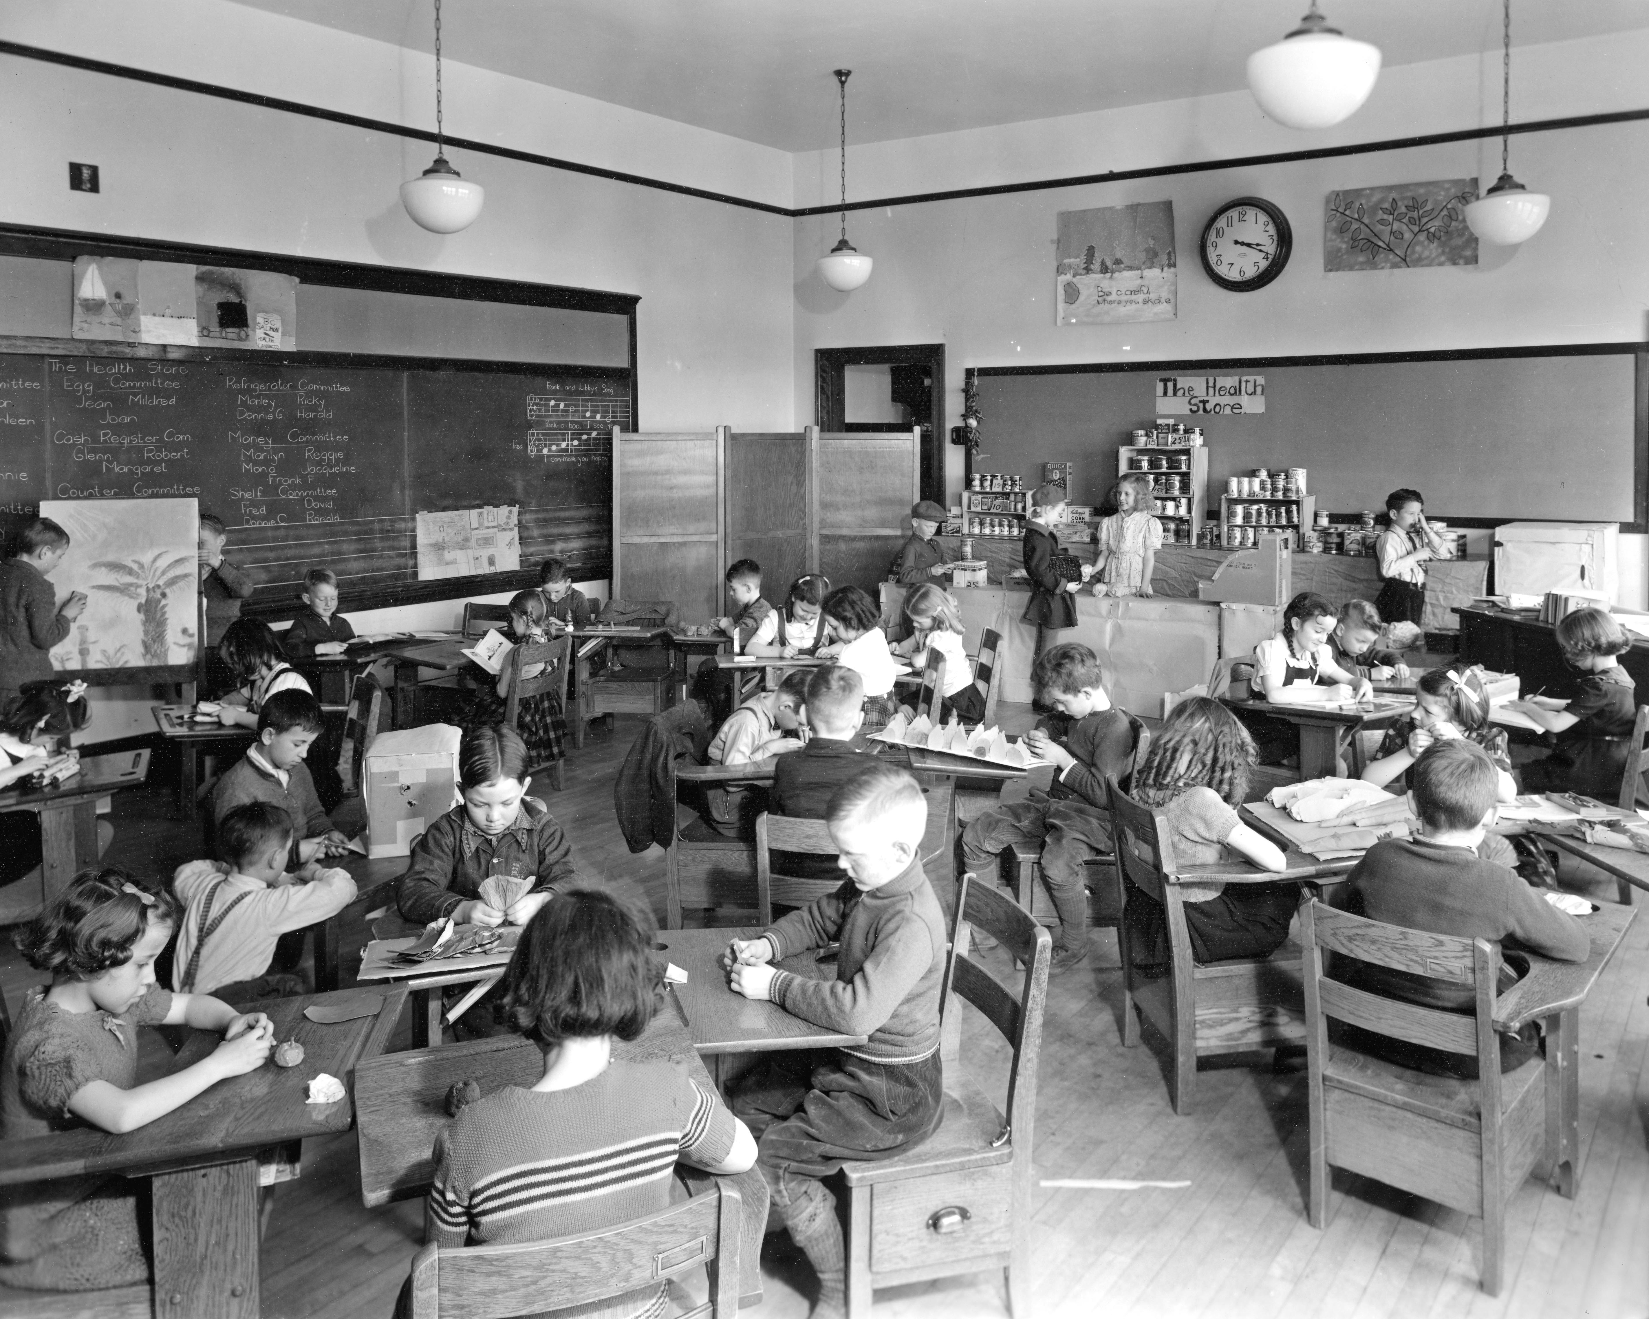
Historic Moment in 1933
National PTA Congress
position statement
“Children trained to extend justice, kindness, and mercy to animals become more just, kind and considerate in their relationships with each other. Character training along these lines will result in men and women of broader sympathies; more humane, more law-abiding - in every respect more valuable citizens.”

Slide 6
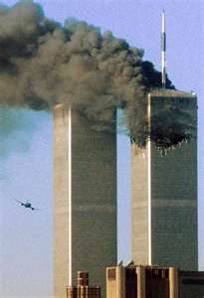
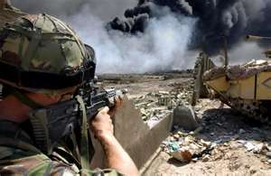
The New Millennium
September 11th
Stock market unsettled & problems abroad
The mid-east problems
Troops to the middle east and war
Unsettled economy/rising oil prices
“No Child Left Behind” implemented

Slide 7
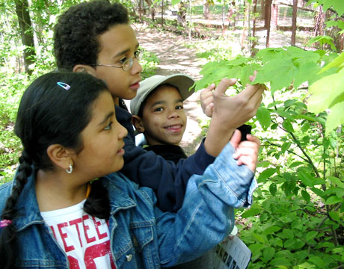
What is Humane Education Now?
Attempts to create a more humane society by educating individuals on the injustices of the world and awakening the power within them to create change.
Incorporates human rights, environmental protection, and animal protection (interconnected)
4 Components to Humane Education:
    Providing accurate information (knowledge)
    Fostering curiosity, creativity, and critical thinking
    Instilling reverence, respect, and responsibility
    Offering positive choices (empower)
(Institute for Humane Education, n.d.)

Slide 8
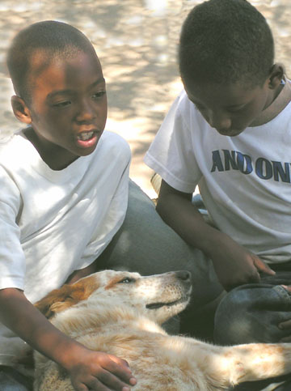
Benefits of Humane Education
Enhanced empathy (Ascione, 1992, as cited in Beck & Katcher, 2003).
Increased prosocial behaviors (decrease in aggression) (Kotrschal & Ortbauer, 2003).
Increased self-esteem (Henderson, 1997)
Encourages critical thinking and increased knowledge
Promotes responsibility and positive change
Works to create active and engaged citizens and community members

Slide 9
What Happened to HE?
Great Depression, 2 World Wars, poverty, homelessness, hunger, stock market crash
Focus on rebuilding America
Vietnam, civil rights, assassinations, political unrest and social upheaval
Humane Education relegated to a low priority
Is there a connection between loss of programs, tough economic times,
war and social flux?

Slide 10
“No Child Left Behind”
Created Multiple Changes to Education
Classrooms under pressure to perform at improved levels
Lacked funding to support changes
High stakes testing
Teacher evaluations → Student performance
Results…..
Class time so structured → reduced opportunities for additional curriculum activities

Slide 11

The Impact
Humane Educators reported:
Unable to get into classrooms
Unable to get out of classrooms
Cuts in funding
Cuts in staffing
Nationally:
ASPCA cuts Humane Education Department
AHA cuts Humane Education Department

Slide 12
What We Stand to Lose
Summer camps
Endangered Species
Introduction to Pet Care
Pet Meets Baby
Native Wildlife
Anti-Bullying
Pet Responsibility
Animal Adaptations
Exotic Pets
Spay/Neuter
Pet Overpopulation
Dog Bite Prevention
Humane Farming
Conservation
Animal Welfare and the Law
Animal Facilitated Therapy
Working Dogs
Egg-cellent Eggs
Eureka!
Dogs, cats & the Chesapeake Bay
Earth Day
Scouting workshops
Mentoring projects
Civic engagement
Social Justice
Community Service
Animals in film
Animal Adaptations
Animal Adjectives
Lunch and Learns
Intro to Pet Training
How Science Relates to Pet Care
What do Zoos Do?
Icky to Awesome
And MANY more…

Slide 13
References
Ascione, F. R. (1992). Enhancing Children’s Attitudes Toward the Humane Treatment of Animals: Generalization to Human-Directed Empathy. Anthrozoos, 5(3), 176-191.
Beck, A. M. & Katcher, A. H. (2003). Future Directions in Human-Animal Bond Research. American Behavioral Scientist, 47, 79-93.
Greenslate, C. (2007). Social Justice and Language Arts. Green Teacher, 80, 28-32.
Henderson, K. (1997). Beetles, Beechnuts, and Behavior: Using Nature-based Activities to Develop Social Skills. CEC Annual Convention. Salt Lake City.
Institute for Humane Education. (n.d.) What is Humane Education? Retrieved March 6, 2009, from http://www.humaneeducation.org
Kotrschal, K. & Ortbauer, B. (2003). Behavioral Effects of the Presence of a Dog in a Classroom. Anthrozoos, 16(2), 147-159.
Pelletier, A. (2006, July/August). Is Compassion the New Black? Teaching Kindness Could Be All the Rage in Your Child’s School. The Brooklyn Rail: Critical Perspectives on Arts, Politics, and Culture.
Weil, Z. (2007, April/May). Changing the World Through Education. Satya, 47. Retrieved March 6, 2009, from http://humaneeducationorg/sections/view /publications

