Slide 1
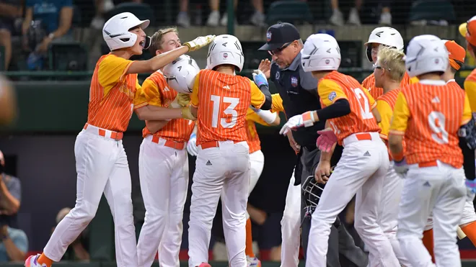


Future Progamming Focus Group
BRAINSTORMING MEETING
MARCH 20, 2025

Slide 2
Welcome
The Charge / The Norms
Recap – Mtg. # 1 & 2
Presentation of Tours
Rotating Table Discussion
Questions / Look Ahead
Exit Ticket

Slide 3
Welcome
The Charge / The Norms
Recap – Mtg. # 1 & 2
Presentation of Tours
Rotating Table Discussion
Questions / Look Ahead
Exit Ticket

Slide 4
The Future Programming Focus Group (FPFG) is:
Composed of invested BISD staff who are focused on the future of Boerne ISD
A source of insight and feedback about the future of educational programming and how facilities enhance these current and potential future needs
Committed to open and meaningful dialogue to propel the sharing of ideas and solutions
We applaud your dedication to Boerne ISD.

Slide 5
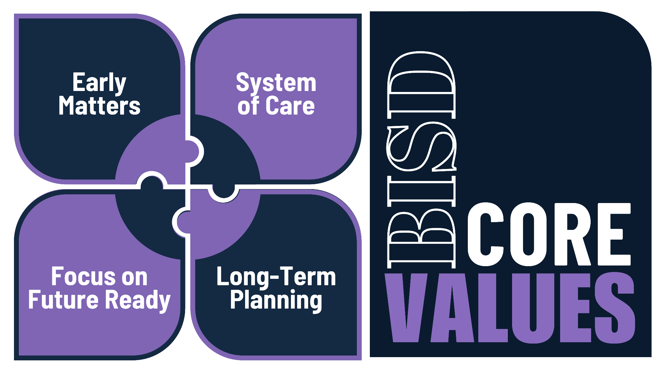
Notes:
How will you bring the BISD Core Values into the new school year?

Slide 6
Welcome
The Charge / The Norms
Recap – Mtg. # 1 & 2
Presentation of Tours
Rotating Table Discussion
Questions / Look Ahead
Exit Ticket

Slide 7
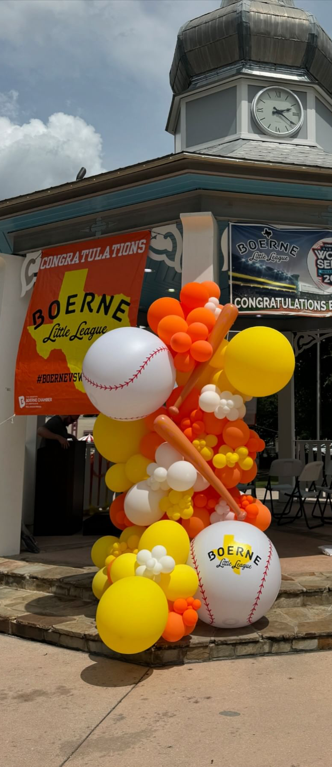
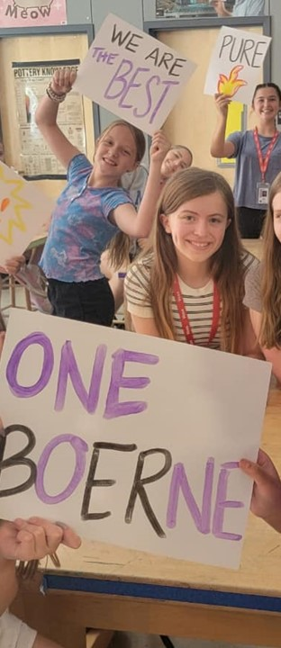
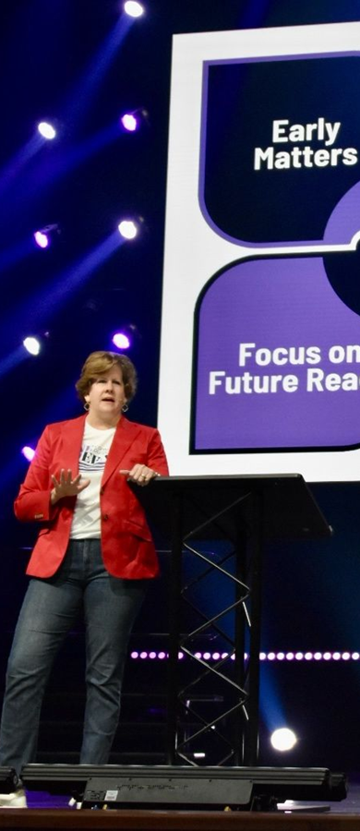
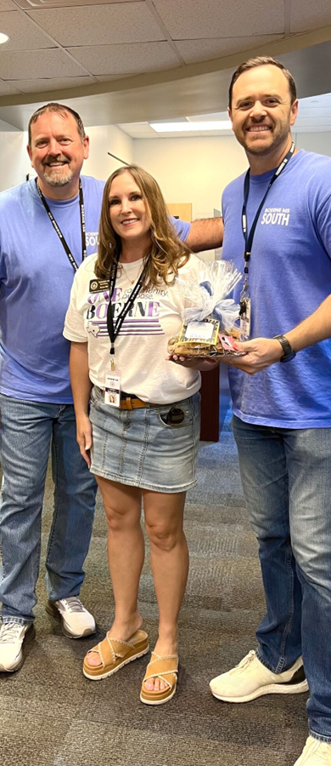
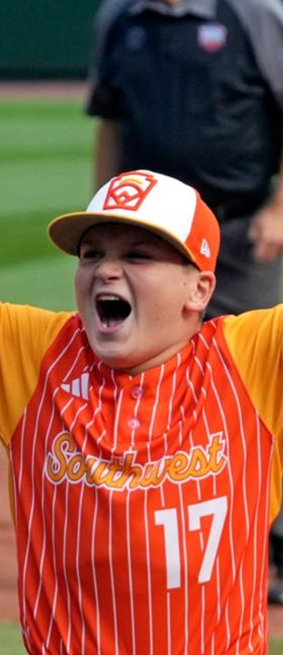
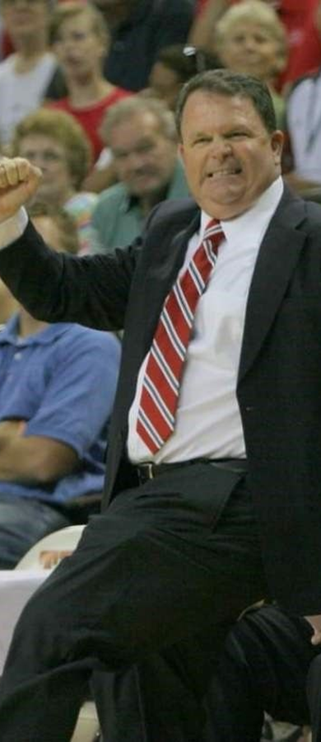
SEQUENCE:
A REVIEW OF
BOERNE ISD
BRAIN-
STORMING
SYNTHESIS &
CONCURRENCE
SFPFG RECAP
TOURS
REPORT OUT
DEC. 2024 – MAR. 2025
MAR. 20, 2025
APR. 2, 2025
OCT. 8, 2024
NOV. 4, 2024
TBD
MAY 12, 2025
Notes:
RECAP OF MTG. # 1

Slide 8
SEQUENCE:
A REVIEW OF
BOERNE ISD
BRAIN-
STORMING
SYNTHESIS &
CONCURRENCE
SFPFG RECAP
TOURS
REPORT OUT
DEC. 2024 – MAR. 2025
MAR. 20, 2025
APR. 2, 2025
OCT. 8, 2024
NOV. 4, 2024
TBD
MAY 12, 2025
Notes:
RECAP OF MTG. # 1

Slide 9
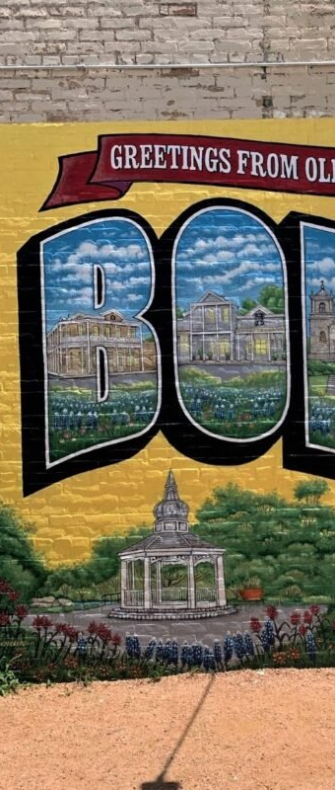
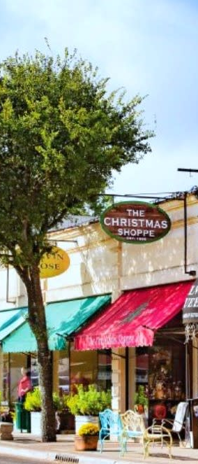
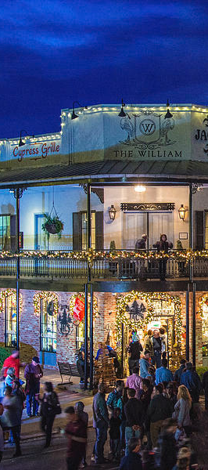
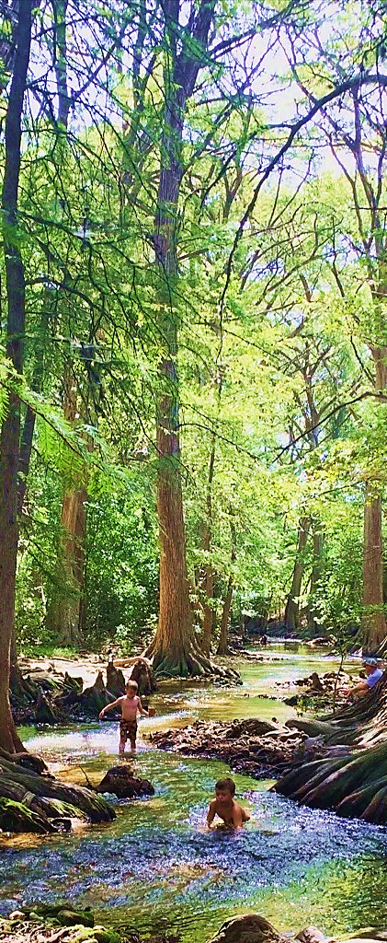
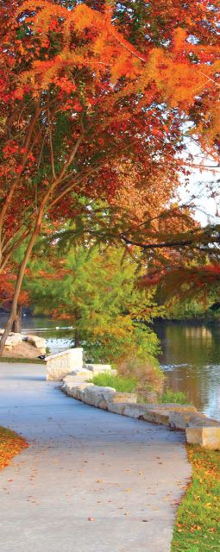
SFPFG RECAP:
PARITY
POLICY
RECAP
EXISTING
FACILITIES
FUTURE
FACILITIES
Nov. 6, 2023
Dec. 2023
Feb. 7, 2024
Mar. 6, 2024
Apr. 17, 2024
Notes:
RECAP OF MTG. # 1

Slide 10
Explore simpler schools (not magnets)
Address the Stadium ASAP
Begin engaging the Community
Discuss more about what BMSN / Specialized Campus might be…
Start a Long-Range Planning Effort, with potential Bond Timelines
Notes:
RECAP OF MTG. # 1

Slide 11
REGARDING EDUCATION OVERALL, WHAT DO YOU WANT TO KNOW ABOUT?
Notes:
RECAP OF MTG. # 1

Slide 12
REGARDING EDUCATION IN BOERNE, WHAT DO YOU WANT TO KNOW ABOUT?
Notes:
RECAP OF MTG. # 1

Slide 13
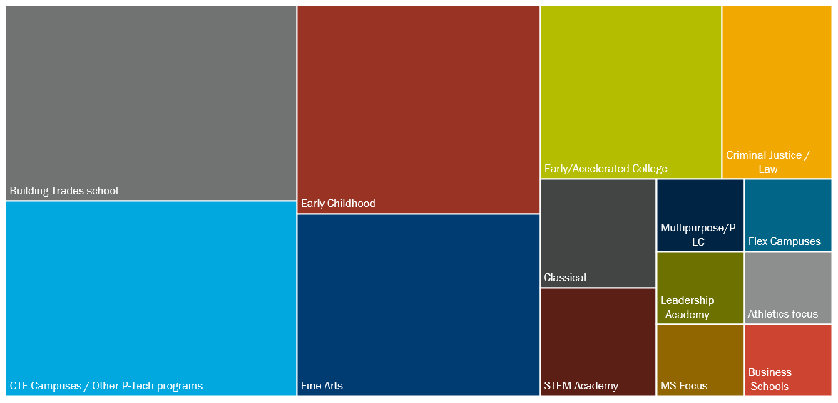
WHAT PROGRAMS ARE YOU INTERESTED IN LEARNING MORE ABOUT?
Notes:
RECAP OF MTG. # 1

Slide 14

INSTRUCTIONAL FOCUS

Slide 15





Highlighted
Early Learning
Middle School
CTE
Post Secondary

Slide 16
EXIT TICKET:
Rank your preference on types of programs to visit.
Early Childhood
Enhanced Academics
Fine
Arts
Early College
Career &
Technical Education
Community/ Admin.
Standalone
PK 3-4
Includes Classical Studies & IB
College or university &
P-TECH

Slide 17
Rank your preference on types of programs to visit.
1
2
3
4
5
6
Career &
Technical Education
Early Childhood
Early College
Enhanced Academics
Fine
Arts
Community/ Admin.
Standalone
PK 3-4
College or university &
P-TECH
Includes Classical Studies & IB

Slide 18














TEA has defined 14 CTE Programs of Study
Agriculture, Food, Nat. Resources
(Animal Science)
Architecture & Construction
Arts, AV Technology & Communications
Business, Marketing, Finance
Education & Training
Energy
(Oil & Gas, Renewable)
Health Science
Hospitality & Tourism
(Culinary)
Human Services
(Cosmetology, FCS)
Information Technology
Law & Public Service
(Fire, Legal Studies)
Manufacturing
(Welding, Robotics)
Engineering
(Mech. & Aerospace, Electrical & Civil, Drone)
Transportation, Distribution, Logistics
(Automotive, Aviation)

Slide 19
Hands-on/Skillset-based vs. Technology-based
Agriculture, Food, Nat. Resources
(Animal Science)
Architecture & Construction
Arts, AV Technology & Communications
Business, Marketing, Finance
Education & Training
Energy
(Oil & Gas, Renewable)
Health Science
Hospitality & Tourism
(Culinary)
Human Services
(Cosmetology, FCS)
Information Technology
Law & Public Service
(Fire, Legal Studies)
Manufacturing
(Welding, Robotics)
Engineering
(Mech. & Aerospace, Electrical & Civil, Drone)
Transportation, Distribution, Logistics
(Automotive, Aviation)

Slide 20
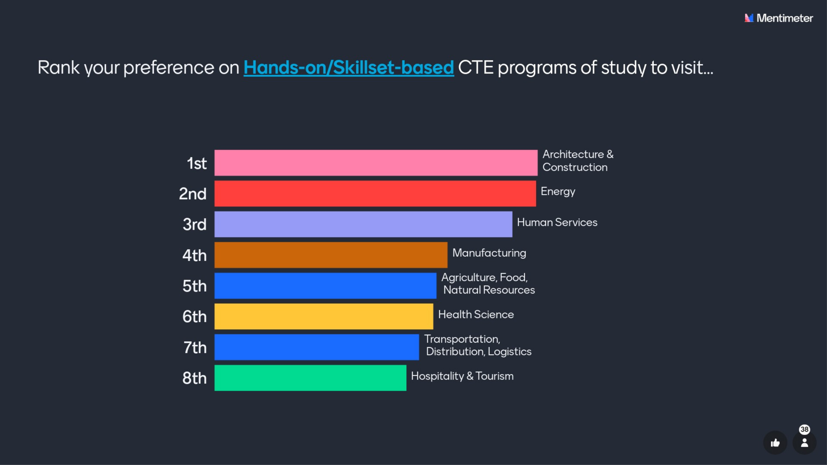

Slide 21
EXIT TICKET:
Hands-on/Skillset-based vs. Technology-based
Agriculture, Food, Nat. Resources
(Animal Science)
Architecture & Construction
Arts, AV Technology & Communications
Business, Marketing, Finance
Education & Training
Energy
(Oil & Gas, Renewable)
Health Science
Hospitality & Tourism
(Culinary)
Human Services
(Cosmetology, FCS)
Information Technology
Law & Public Service
(Fire, Legal Studies)
Manufacturing
(Welding, Robotics)
Engineering
(Mech. & Aerospace, Electrical & Civil, Drone)
Transportation, Distribution, Logistics
(Automotive, Aviation)

Slide 22
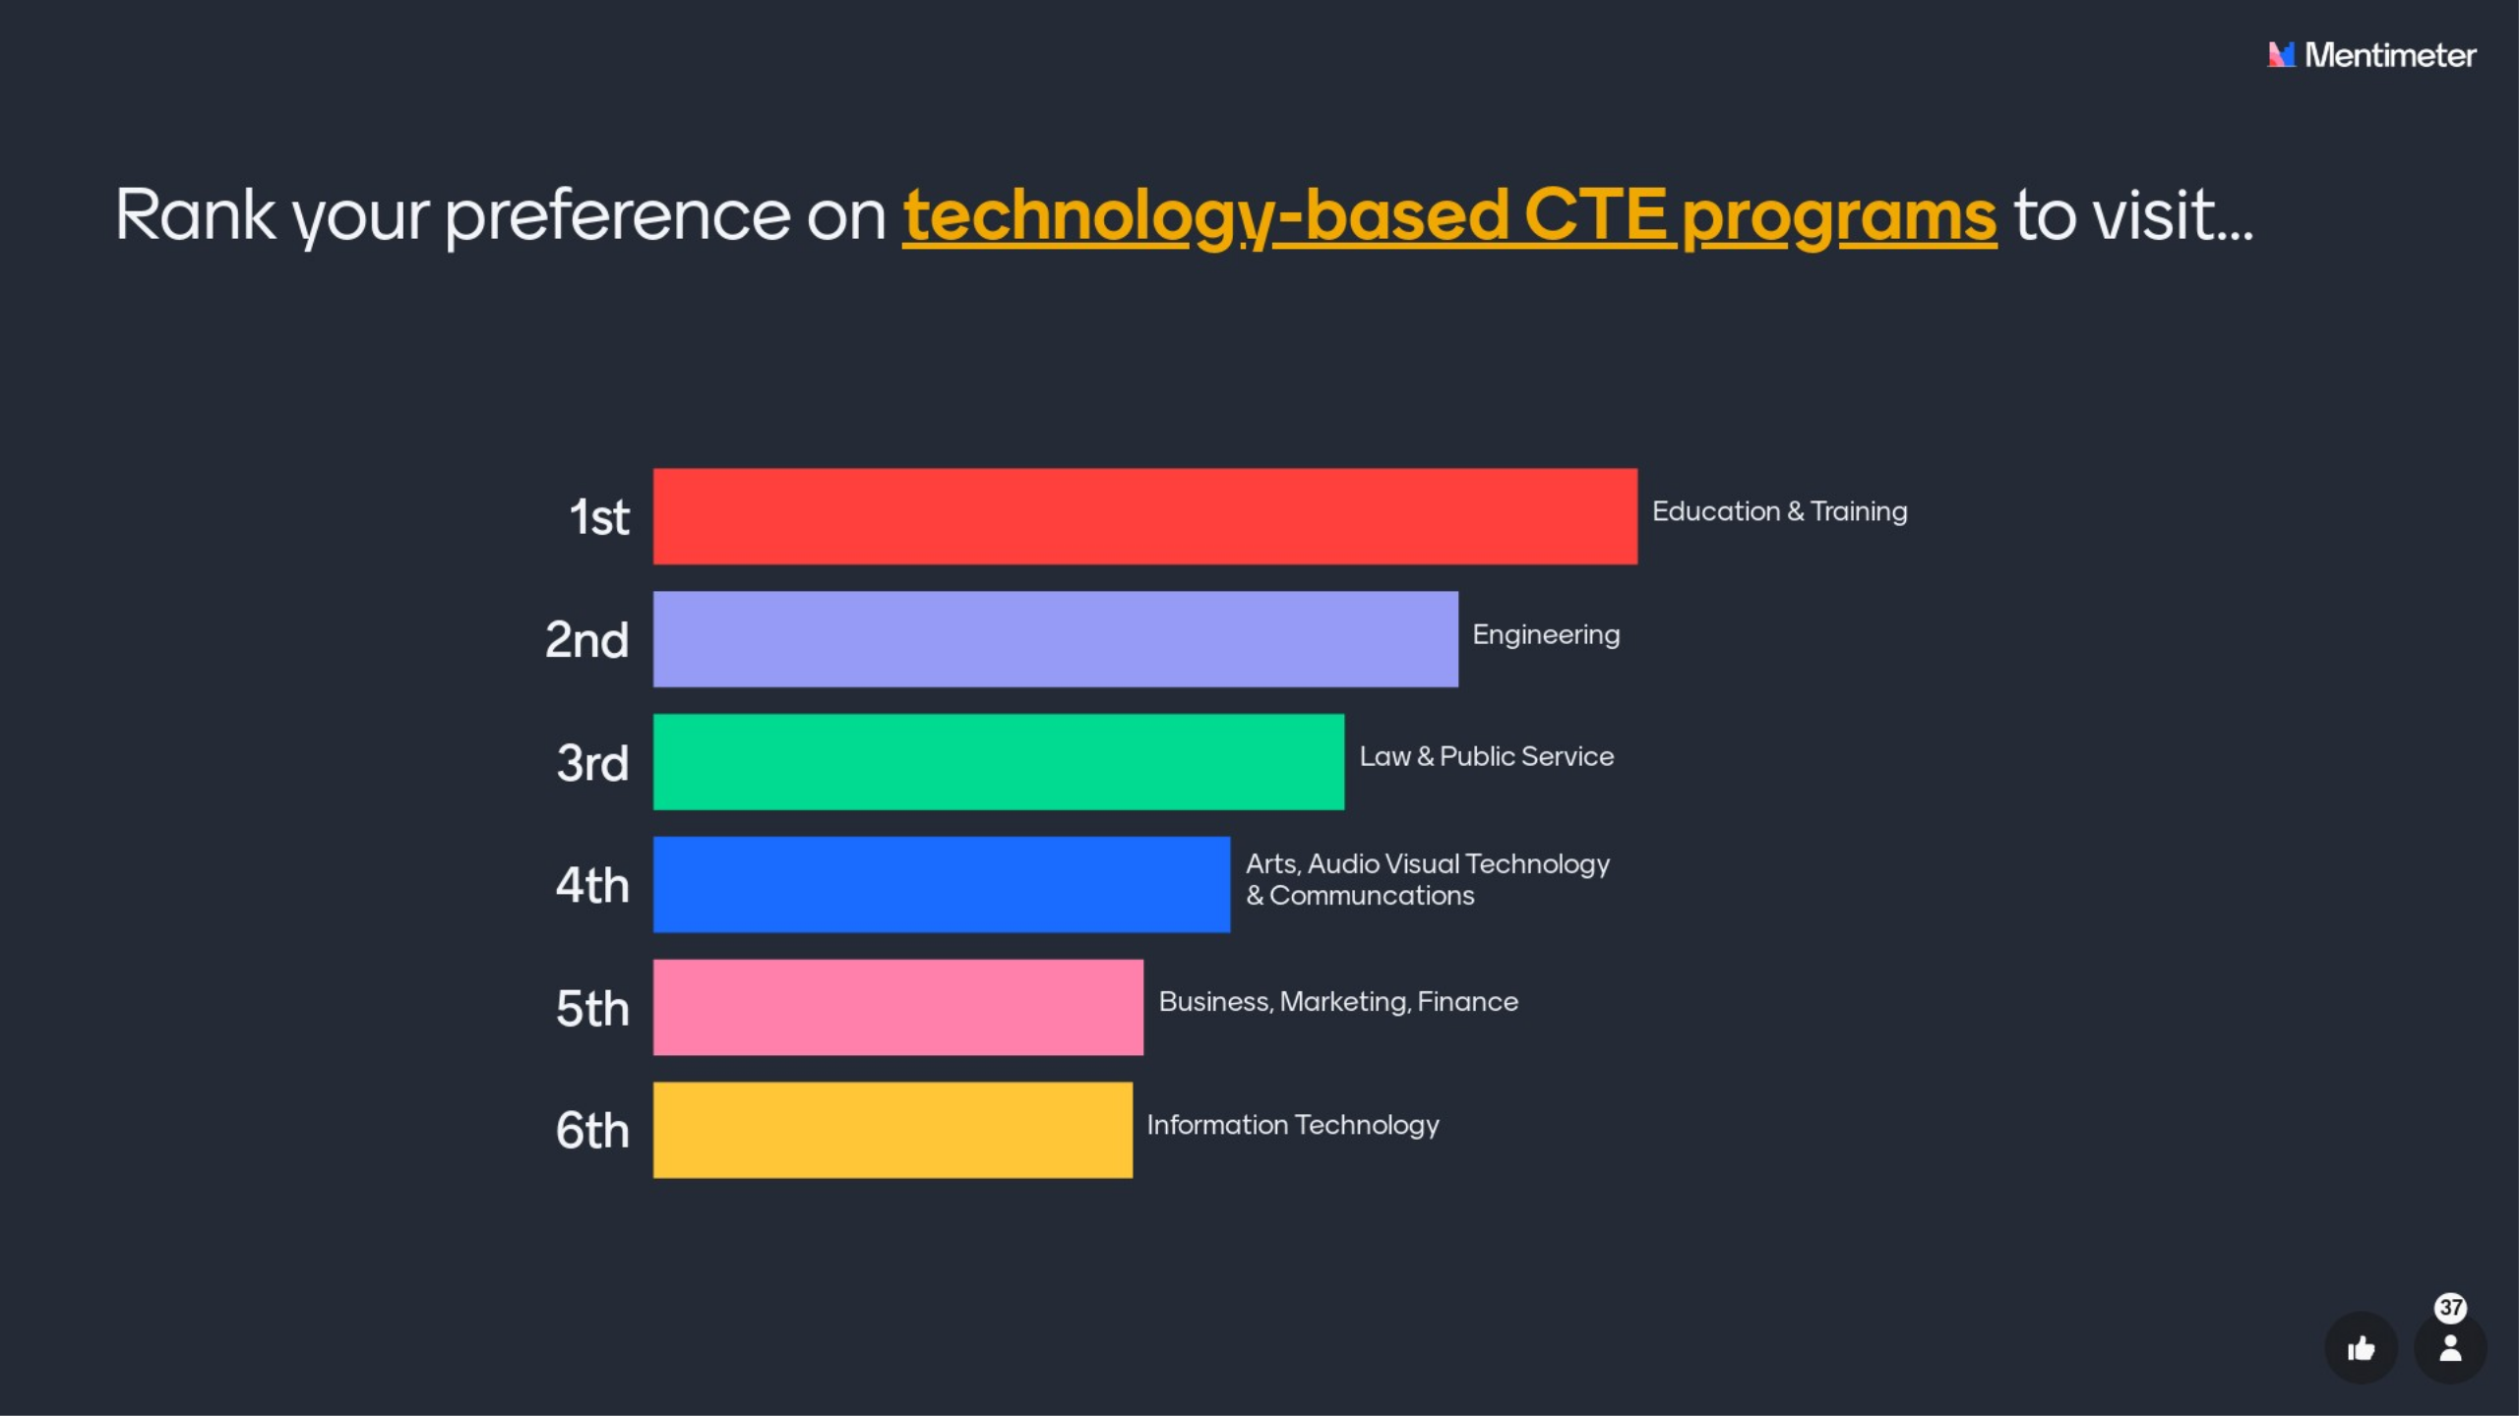

Slide 23
Goal/Priority for Each Tour
If Convenient + Time Permitting
Min. 1
Min. 1
Min. 1
Career &
Technical Education
Early Childhood
Early College
Enhanced Academics
Fine
Arts
Community/ Admin.
Standalone
PK 3-4
College or university &
P-TECH
Includes Classical Studies & IB

Slide 24
NISD Health Careers + CCA
NEISD STEM
Science Mill
Georgetown FRLC
Bellville Learning Ctr.
Katy STEAM Ctr.
Katy Career & Tech. Ctr.
Tomball IC
Stuart Career Tech. HS
Mansfield STEM
Allen STEAM
Forney OC
17 TOURS!
Georgetown Hammerlun Ctr.
Bellville Learning Ctr.
Tomball IC
HCC Collaboratorium
Forney OC
Alief ECHS
Tomball IC
Forney OC
COSA PreK4SA
Forney OC
Georgetown FRLC
Career &
Technical Education
Early Childhood
Early College
Enhanced Academics
Fine
Arts
Community/ Admin.
Standalone
PK 3-4
College or university &
P-TECH
Includes Classical Studies & IB

Slide 25
Welcome
The Charge / The Norms
Recap – Mtg. # 1 & 2
Presentation of Tours
Rotating Table Discussion
Questions / Look Ahead
Exit Ticket

Slide 26
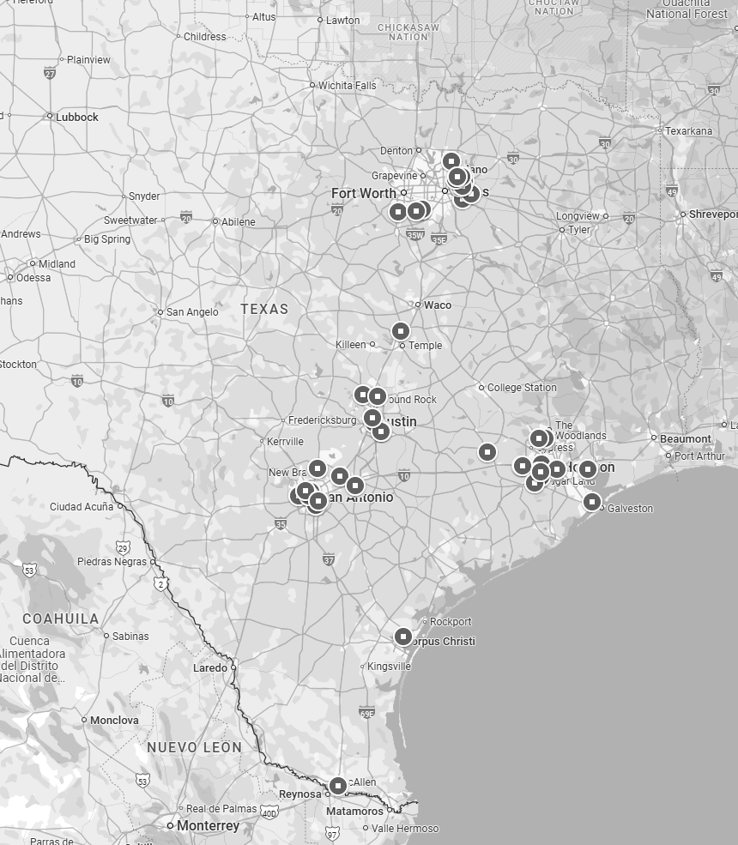
DFW-Area Tours
Austin-Area Tours
SA-Area Tours
Houston-Area Tours

Slide 27
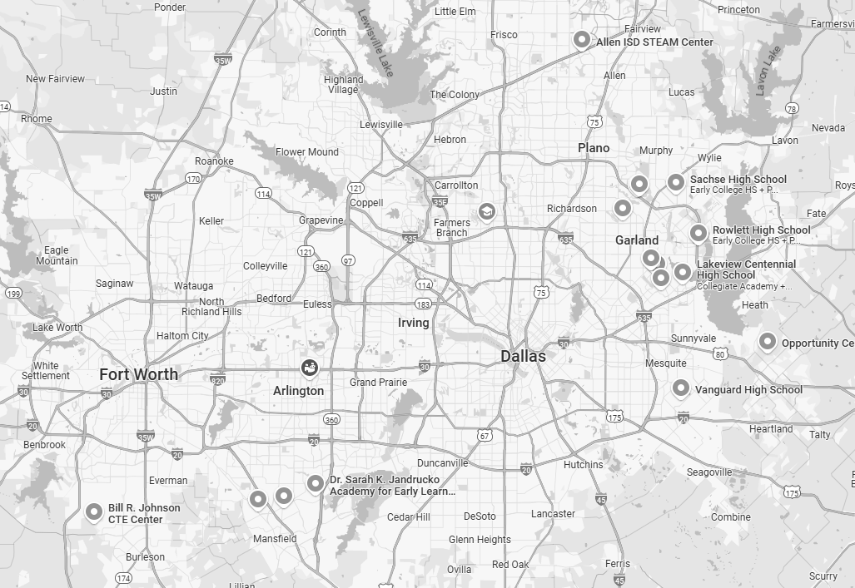
DFW-Area Tours:
CTE: Allen ISD STEAM Center
CTE: Forney ISD Opportunity Center
CTE: Mansfield ISD Knight STEM Academy
1/23-24: Mansfield ISD + Forney ISD + Allen ISD

Slide 28
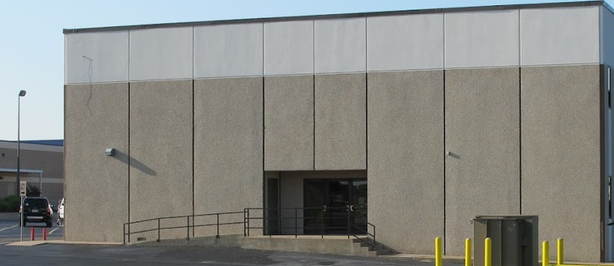
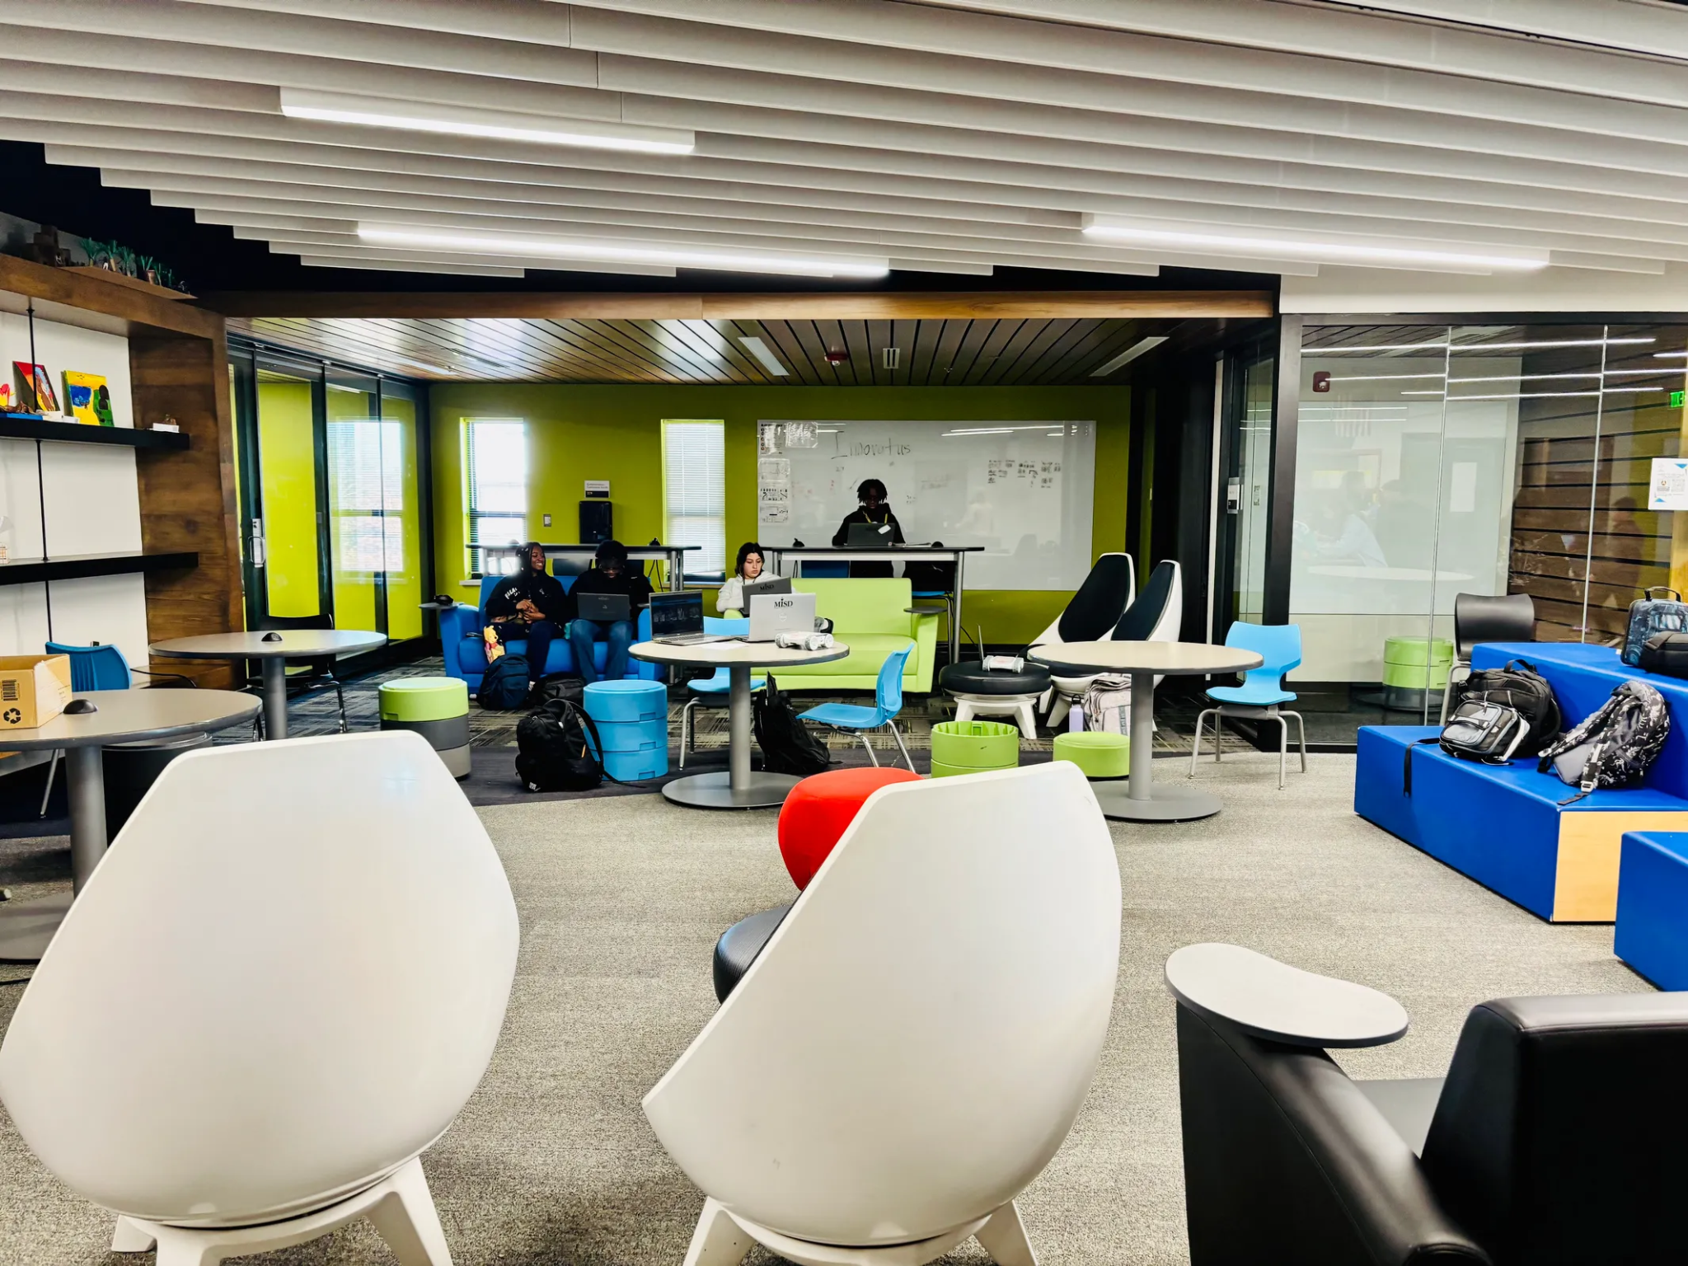
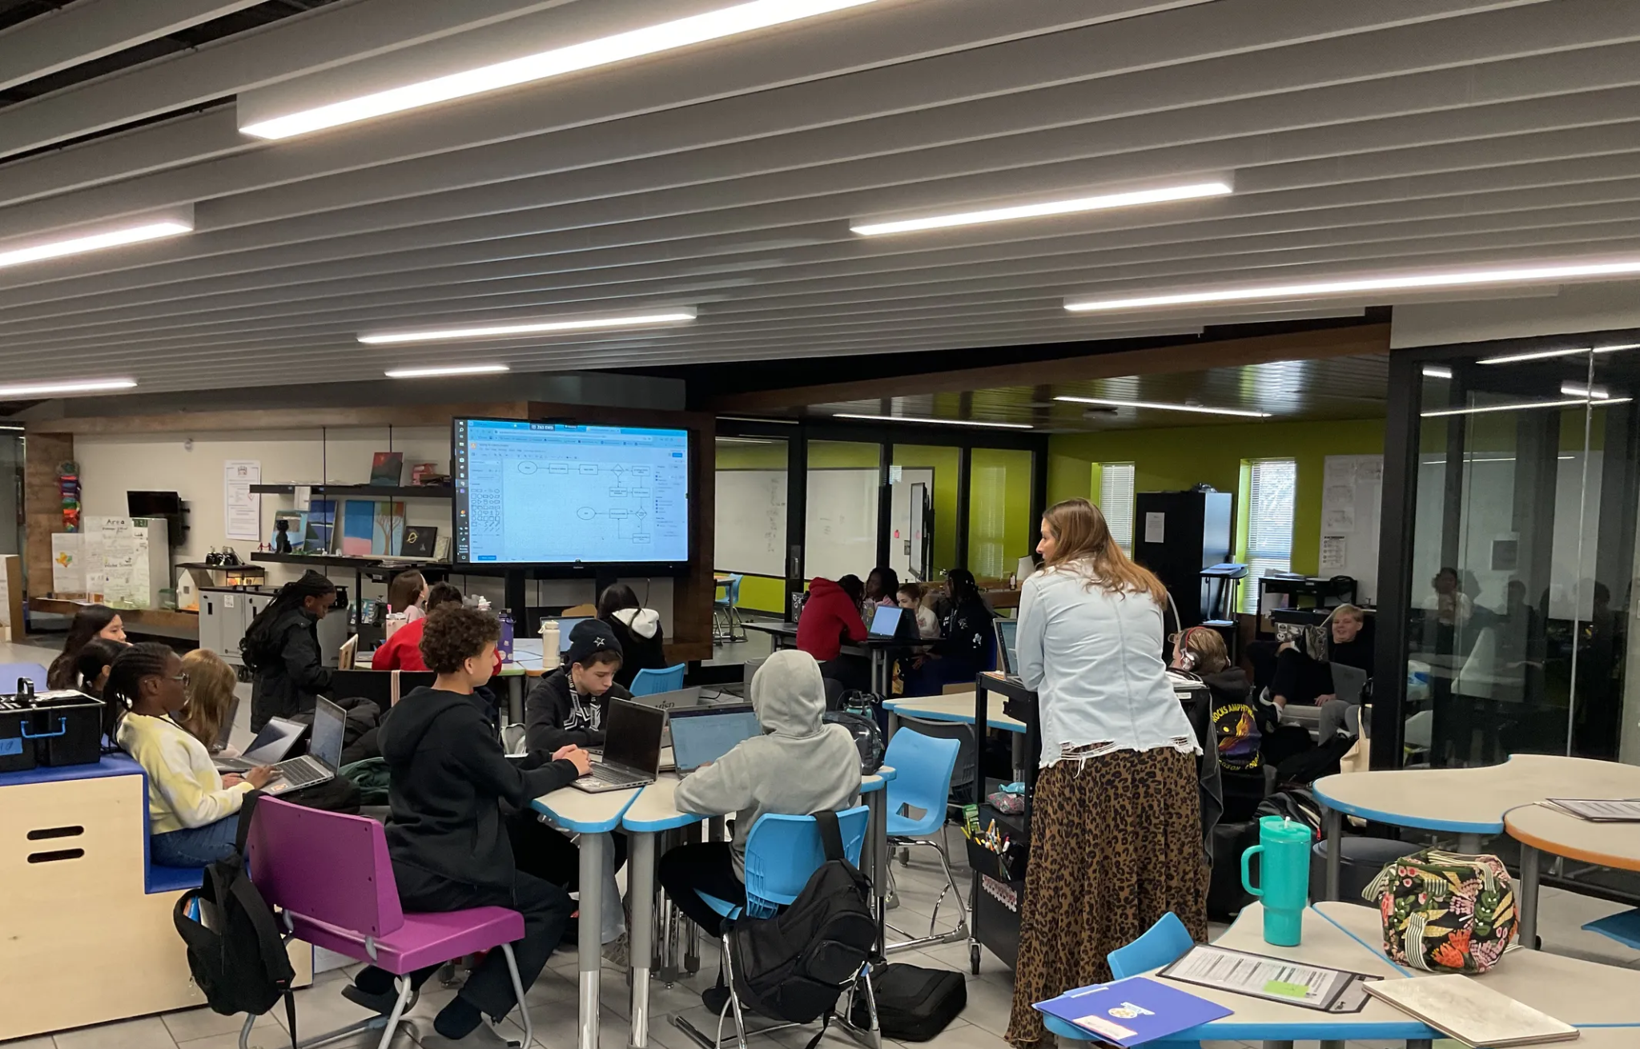
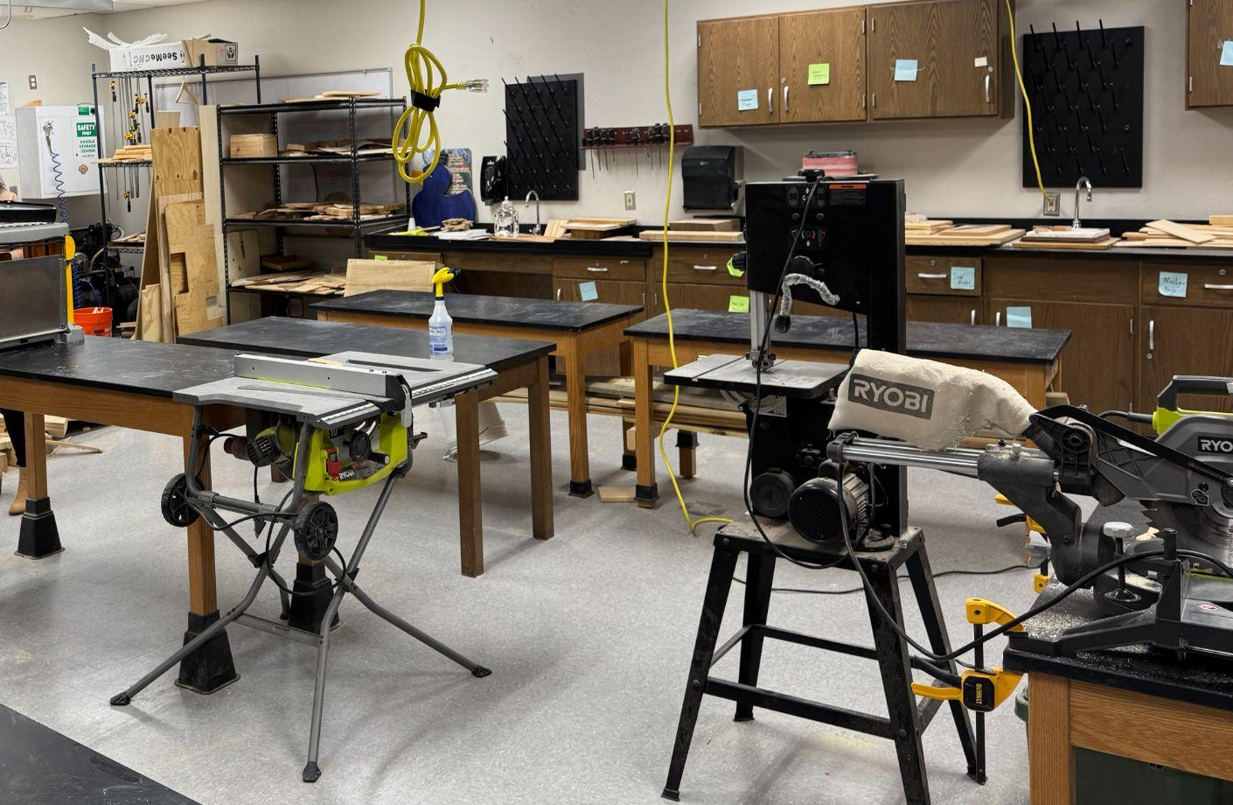
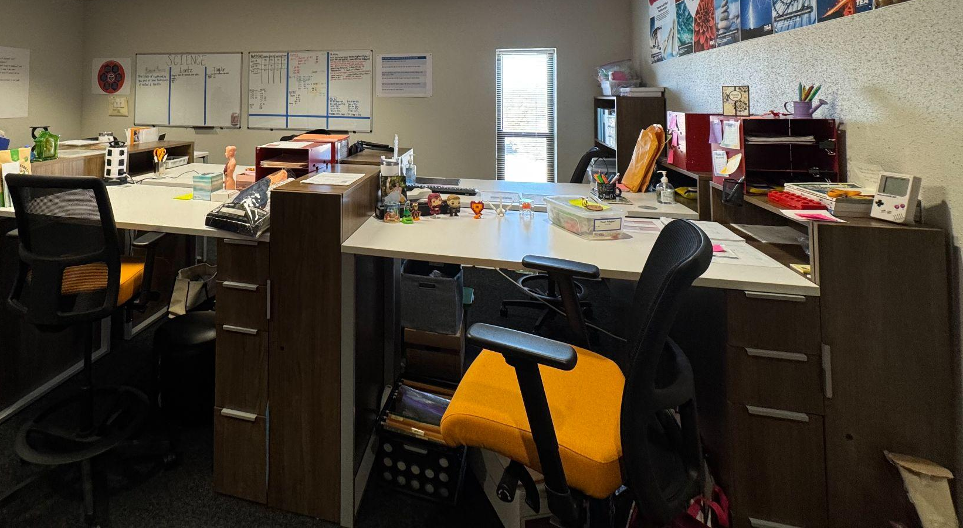
DFW - Mansfield ISD-Jerry Knight STEM Academy
Knight STEM Academy is a repurposed facility focused on STEM-based instruction (labs, collaborative spaces, makerspaces, etc.)
MS Honors “learners” eligible to attend
“Designers” teach not only STEM courses, but core content as well leading to consistent cross-curricular instruction.
  “Designers” do not have specific classrooms, instead they share planing spaces.
Notes:
Repurposed in 2017 from a building on the campus of the Brooks Wester MS-remodeled for the labs/makerspaces/collaborative spaces. Flexible furniture choices as well as repurposing existing furniture (lab tables, storage, etc.)

Slide 29
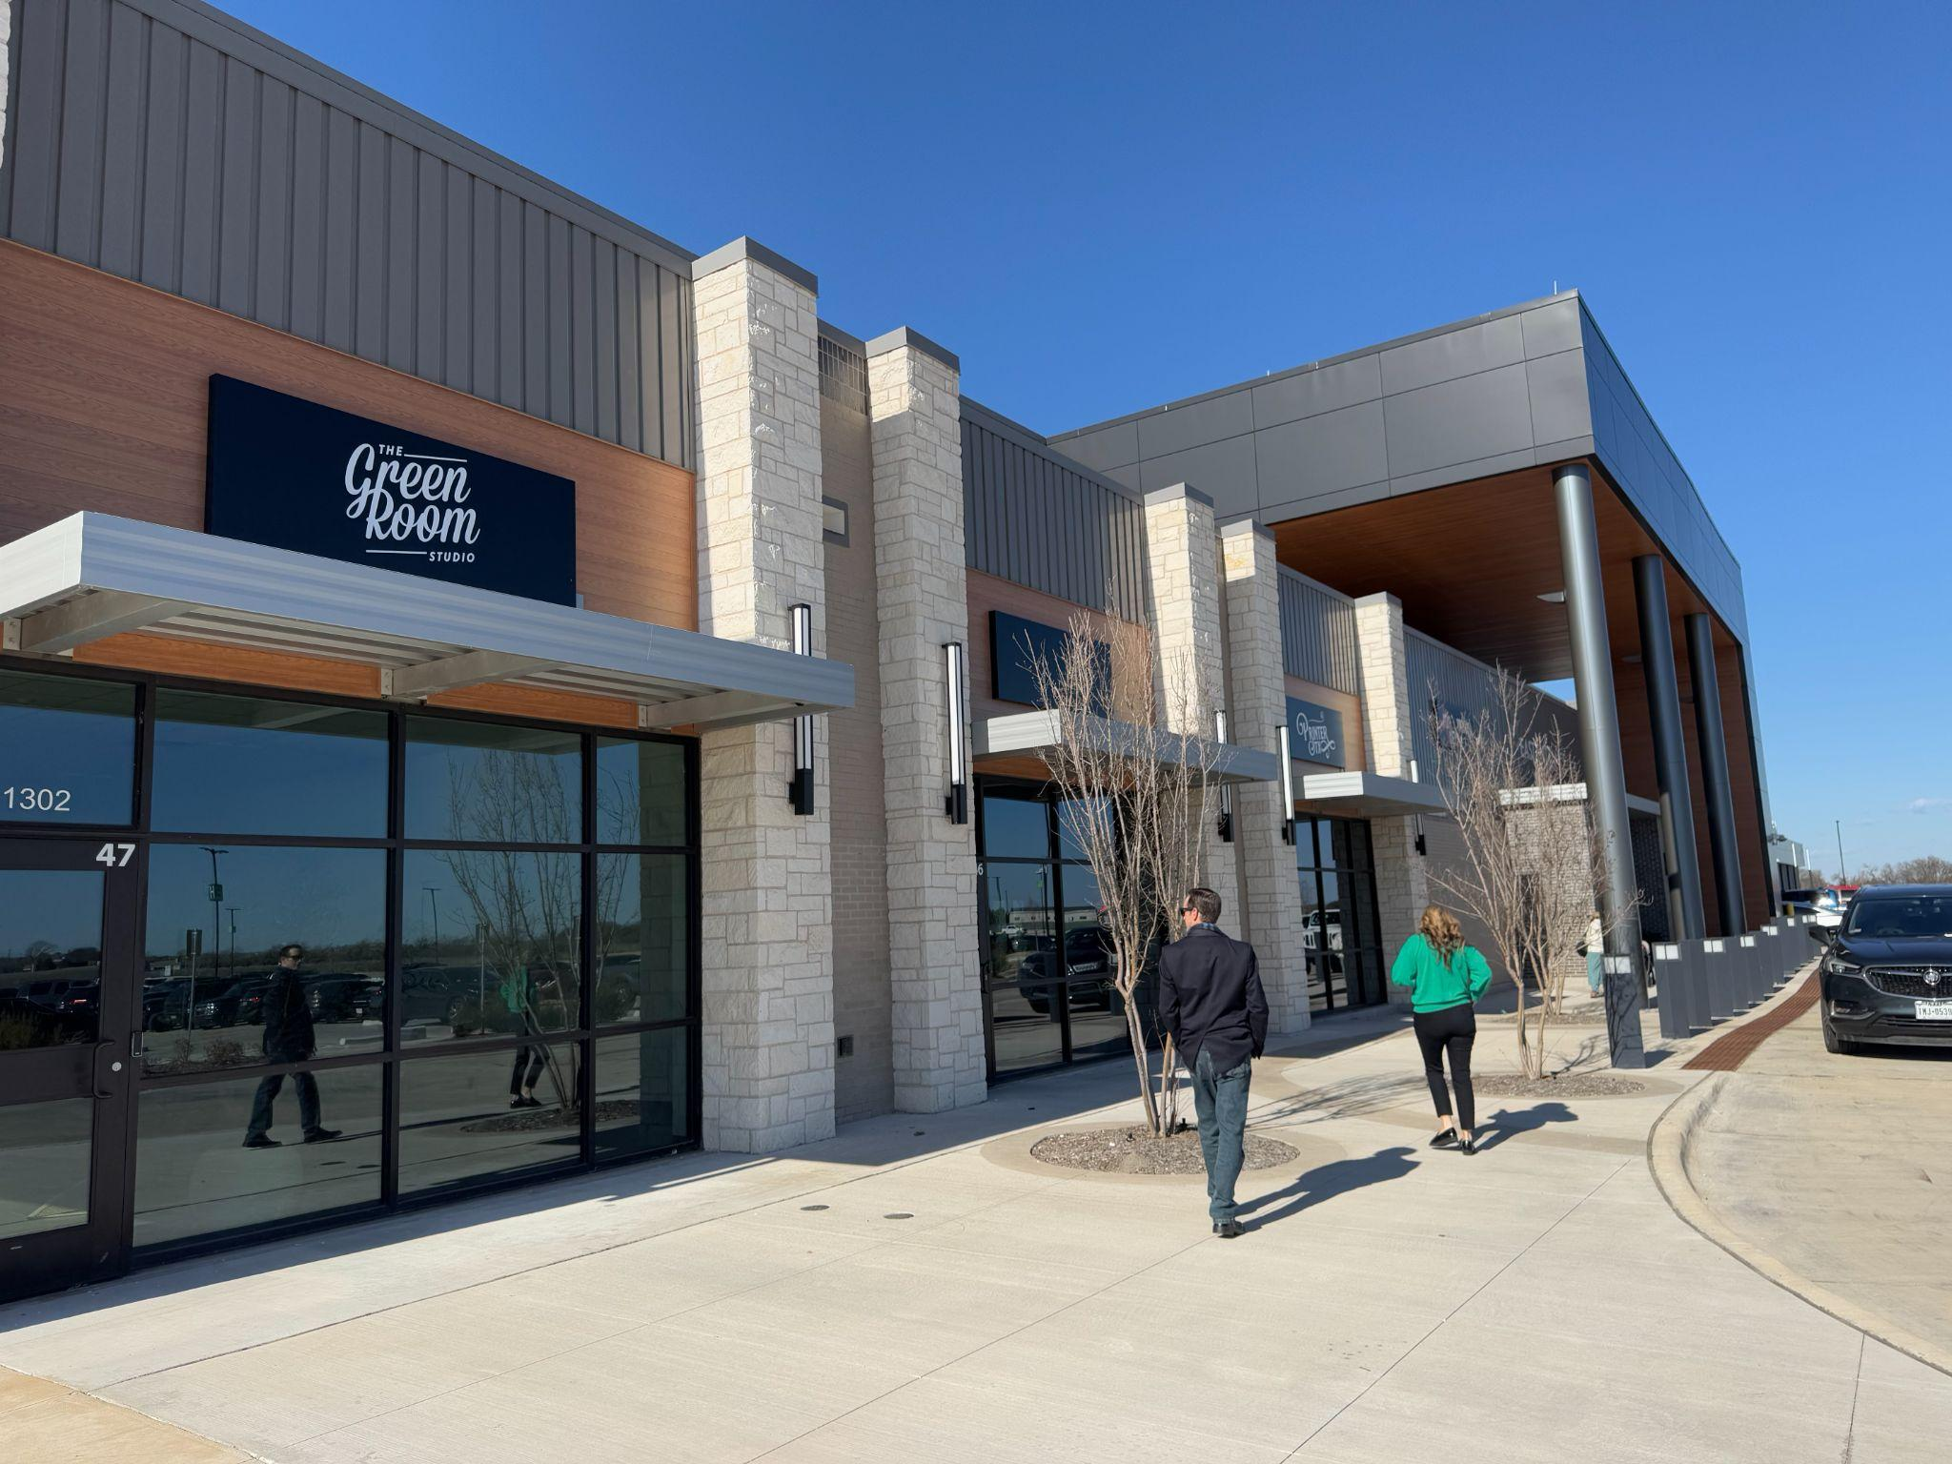
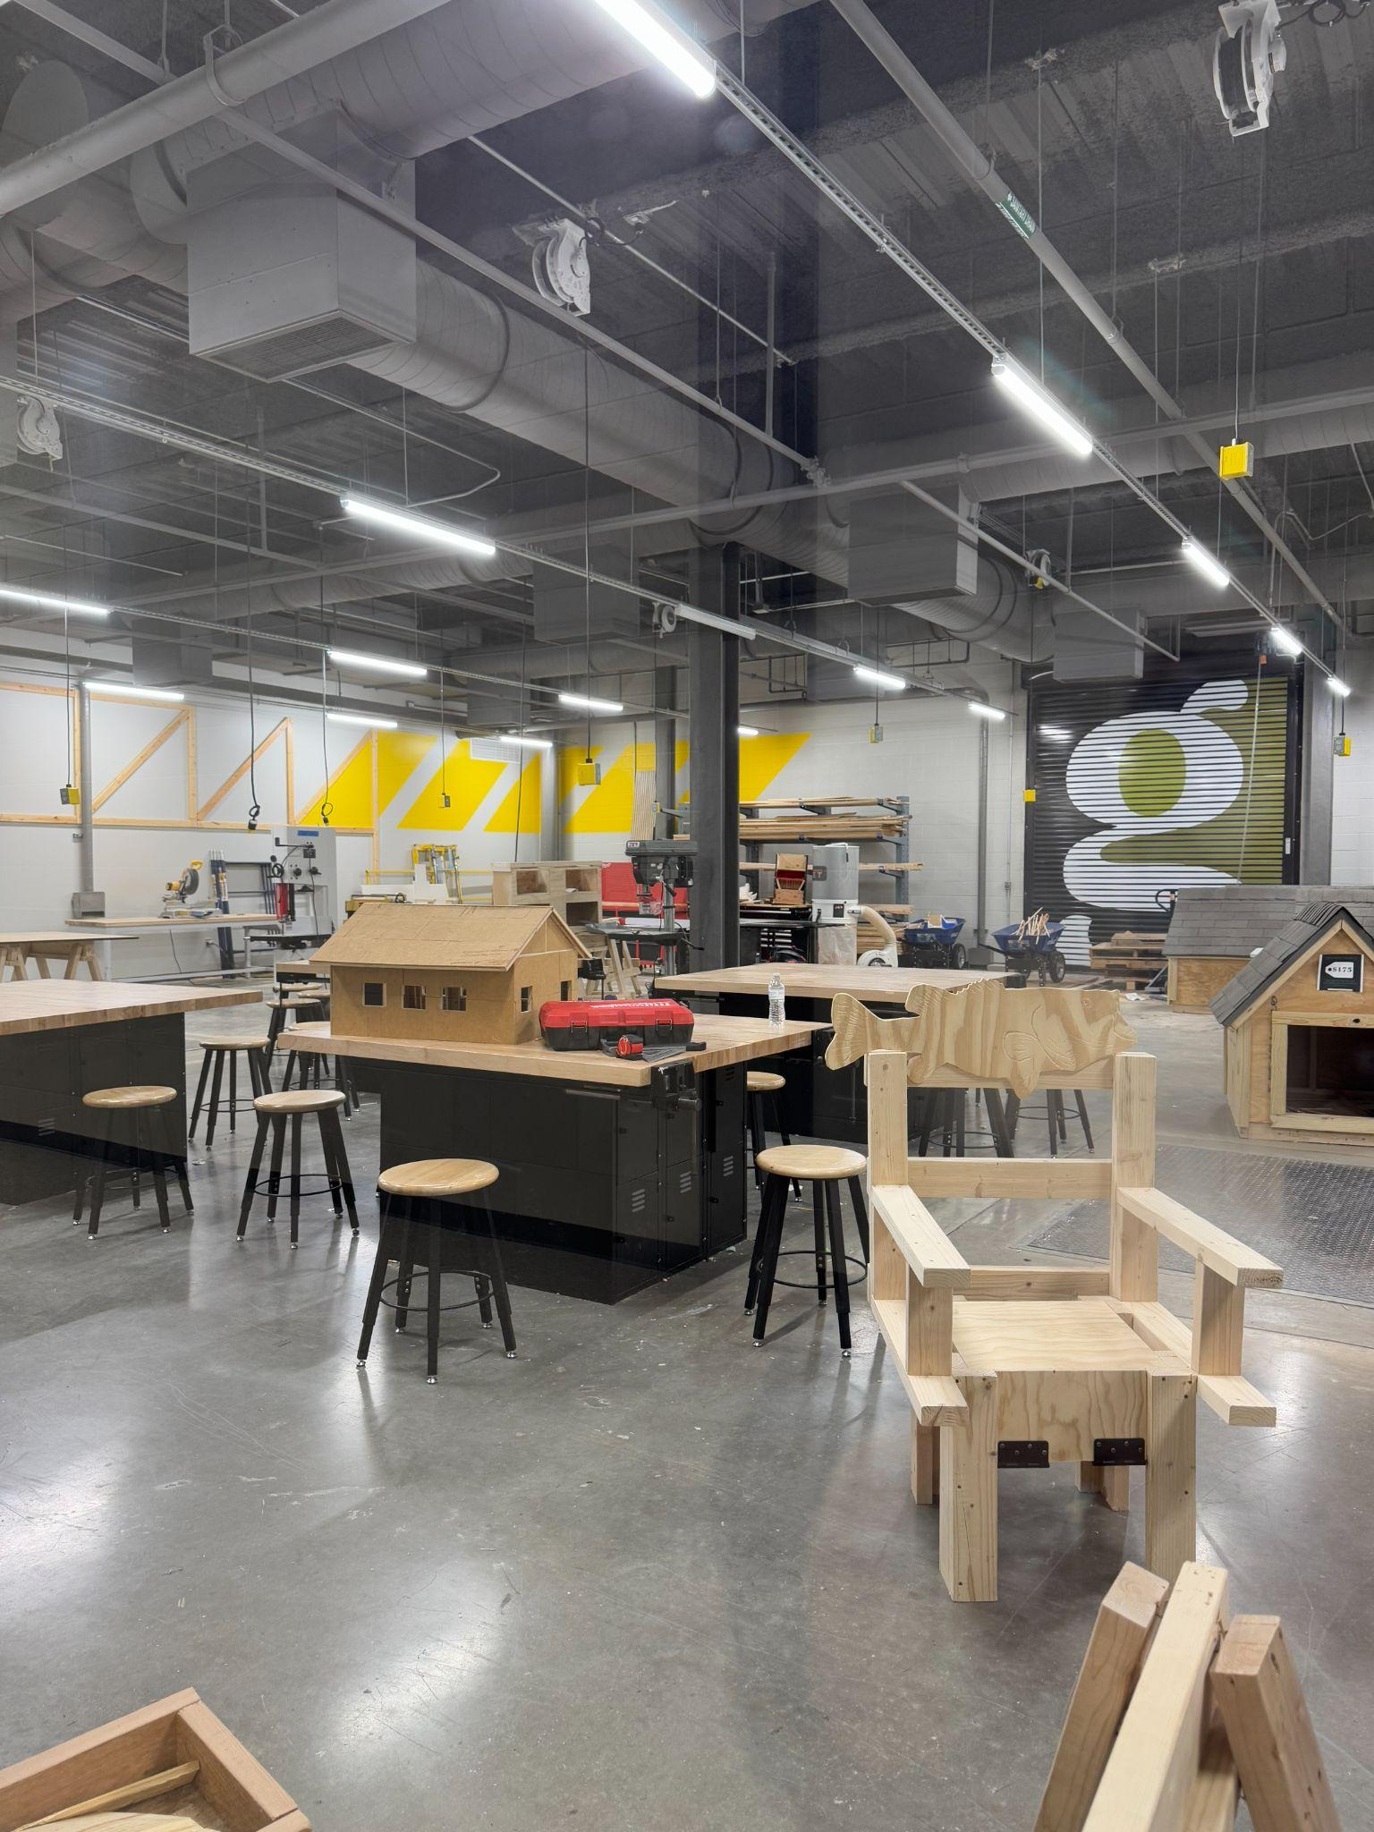
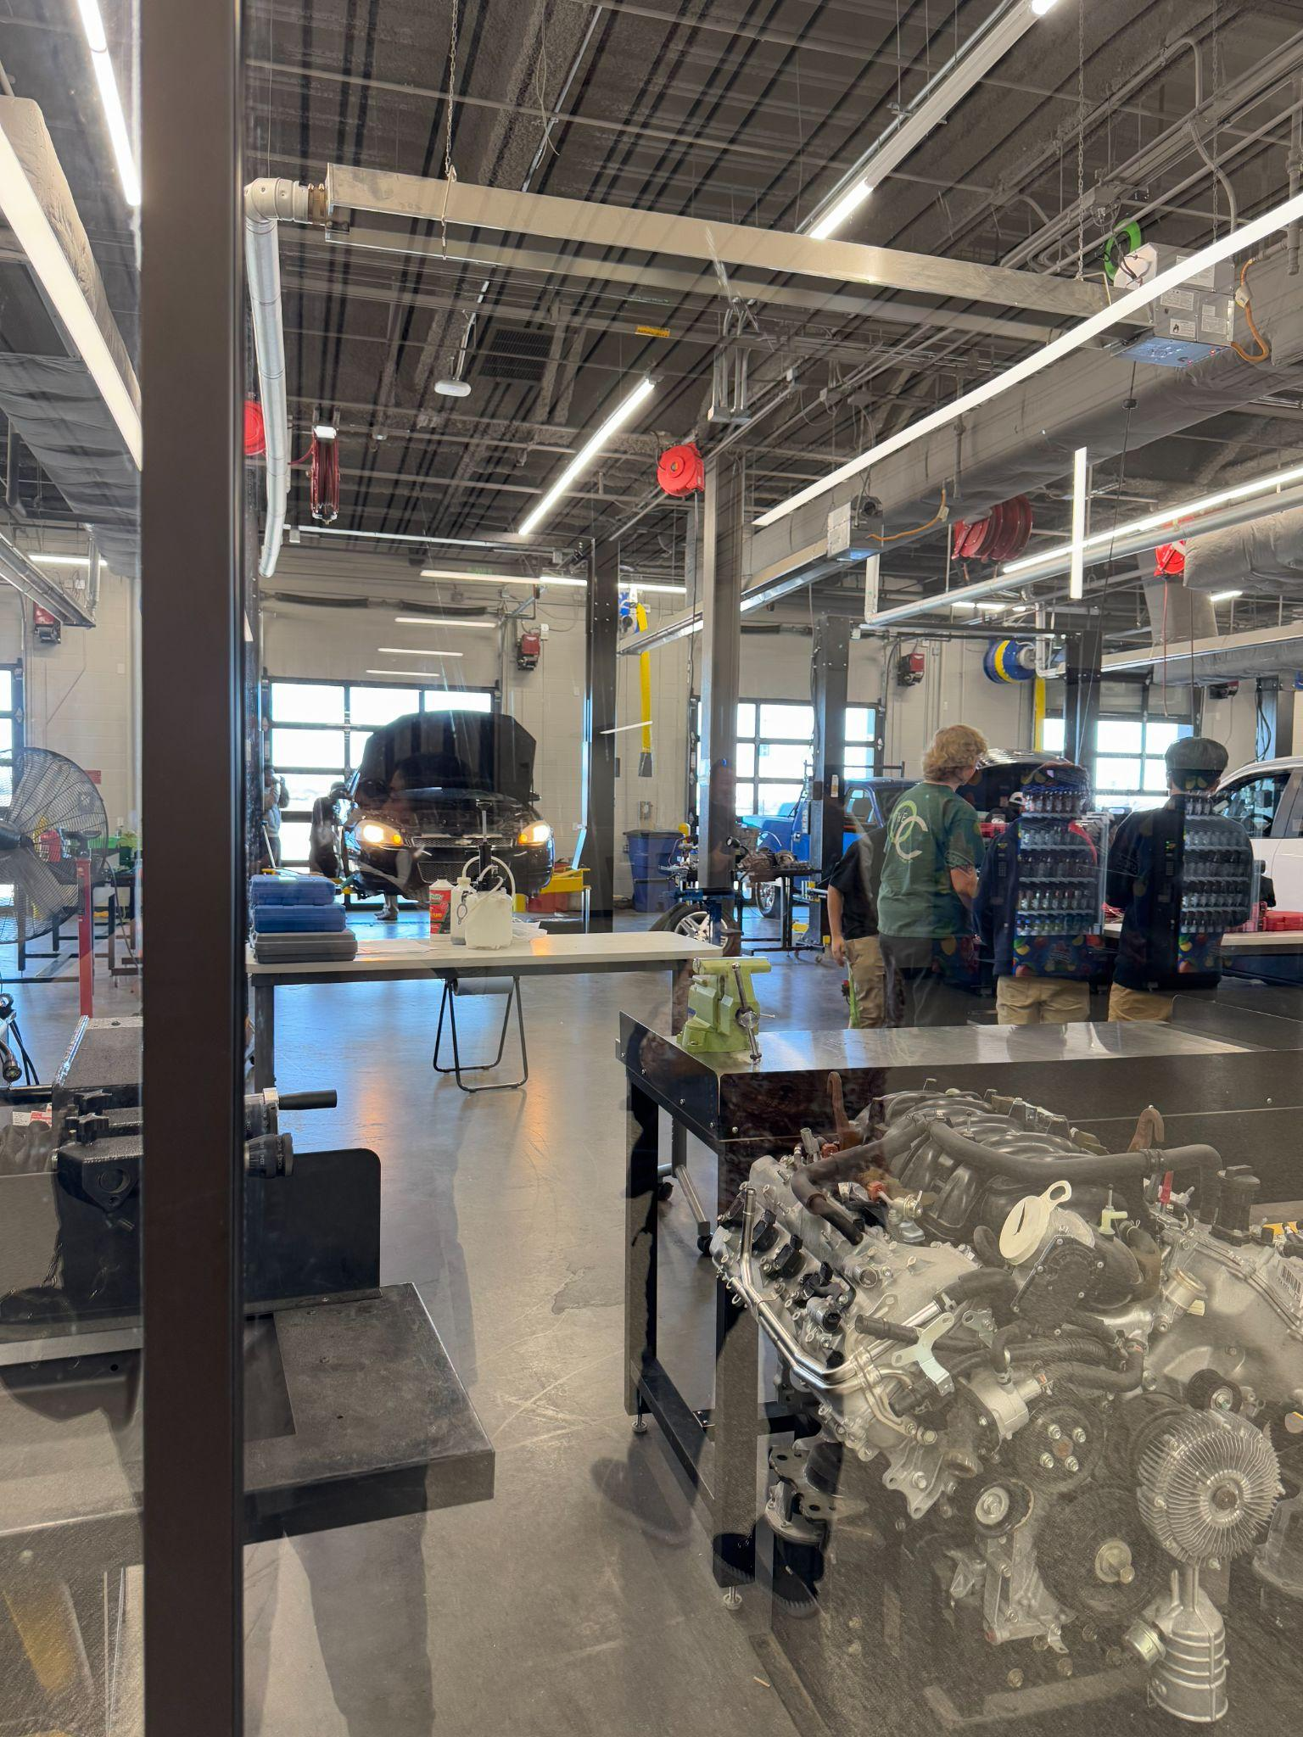
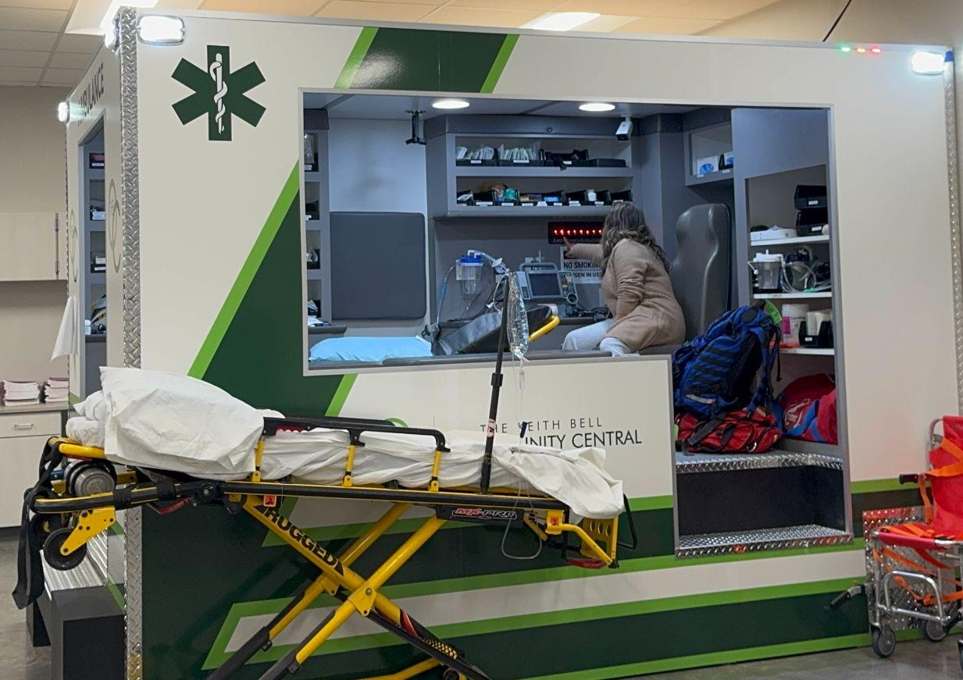
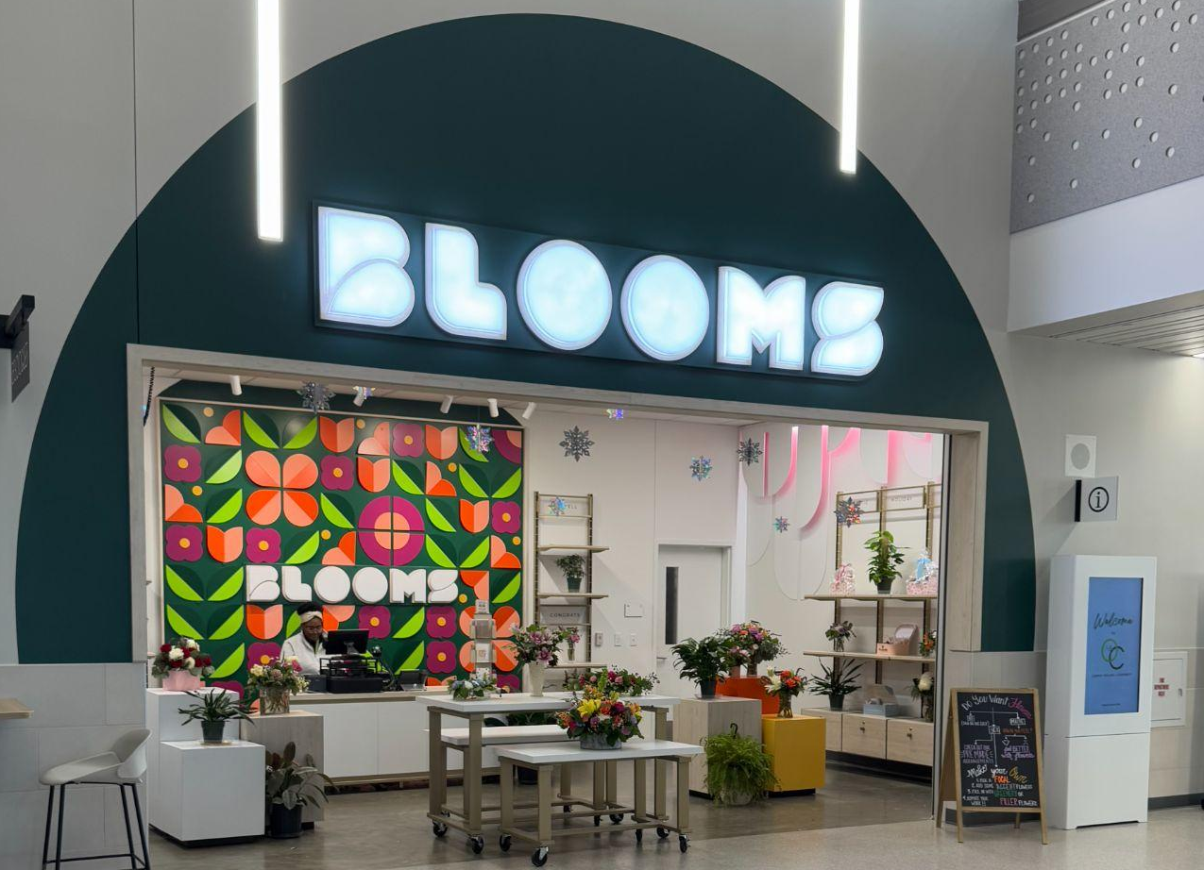
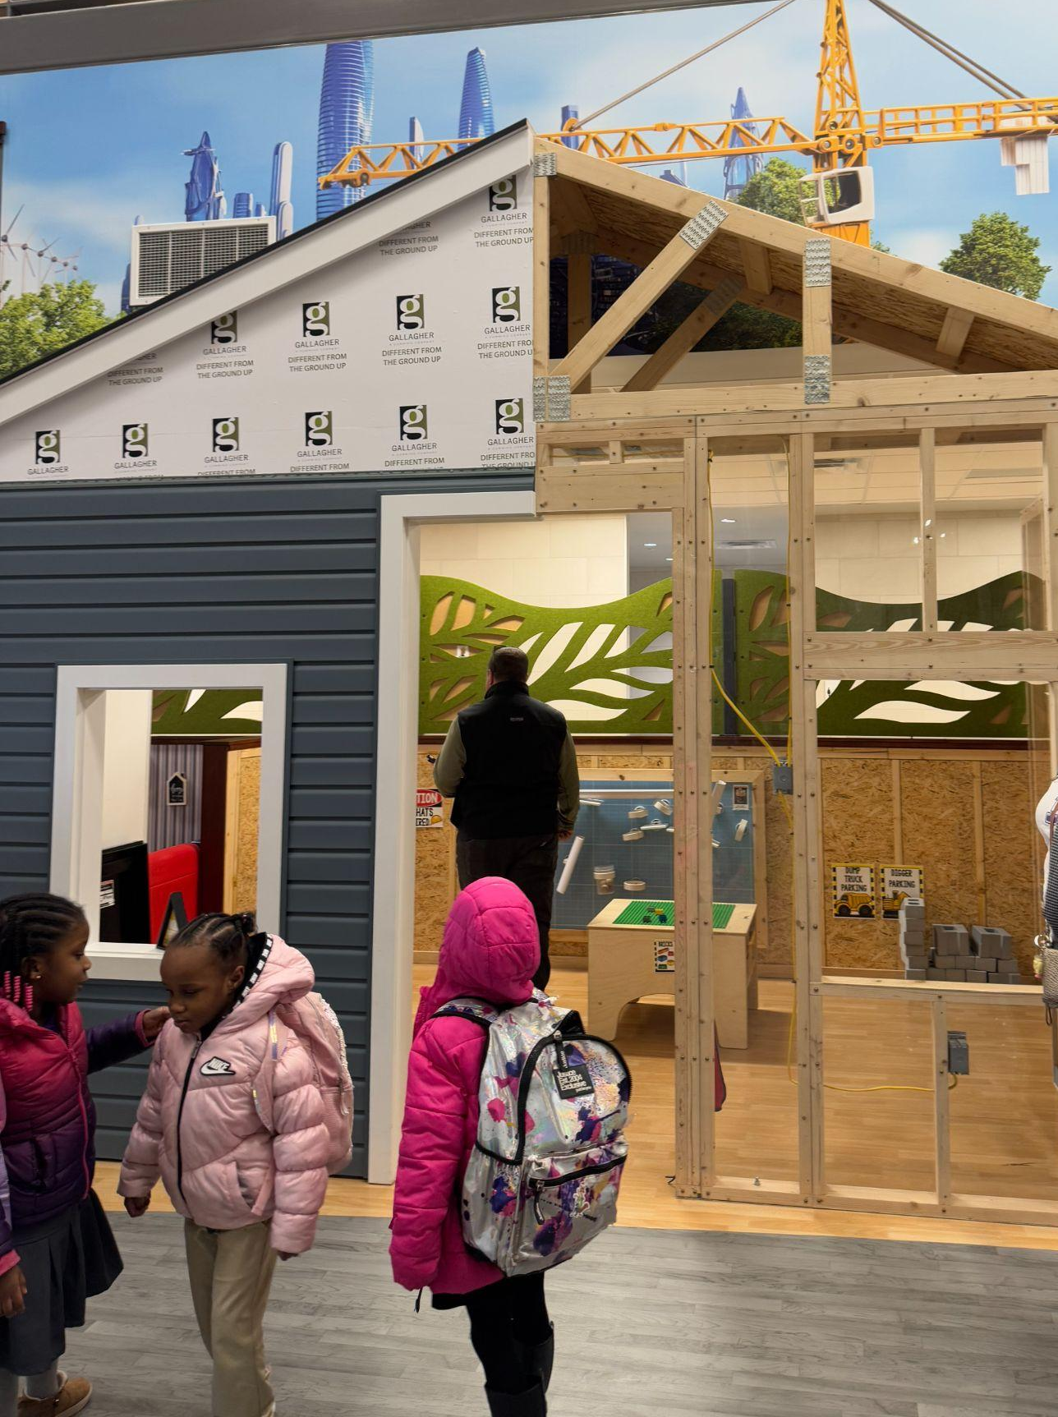
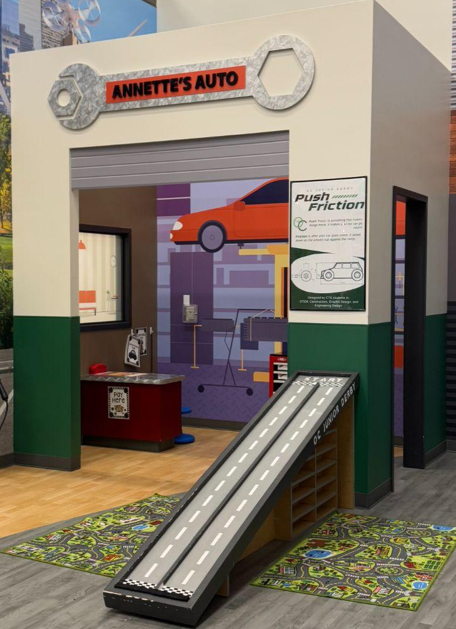
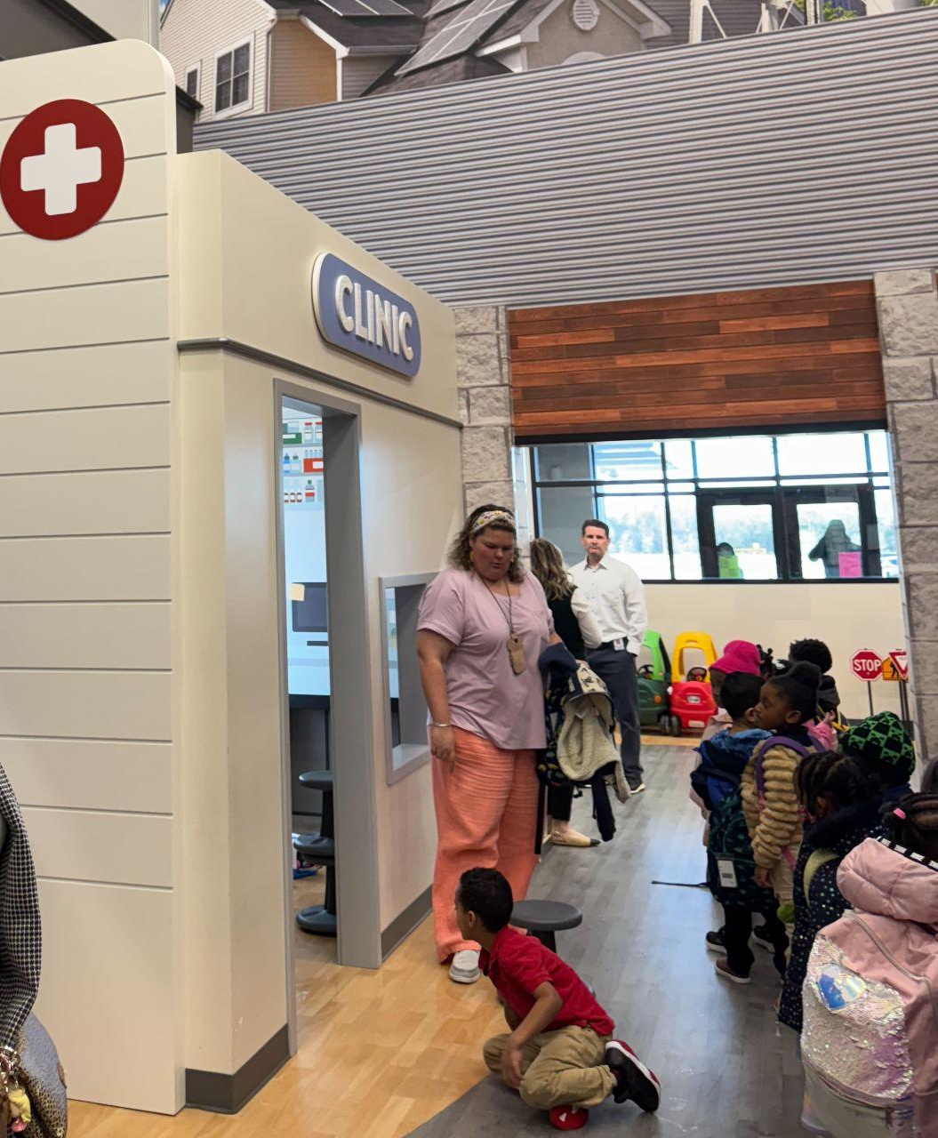
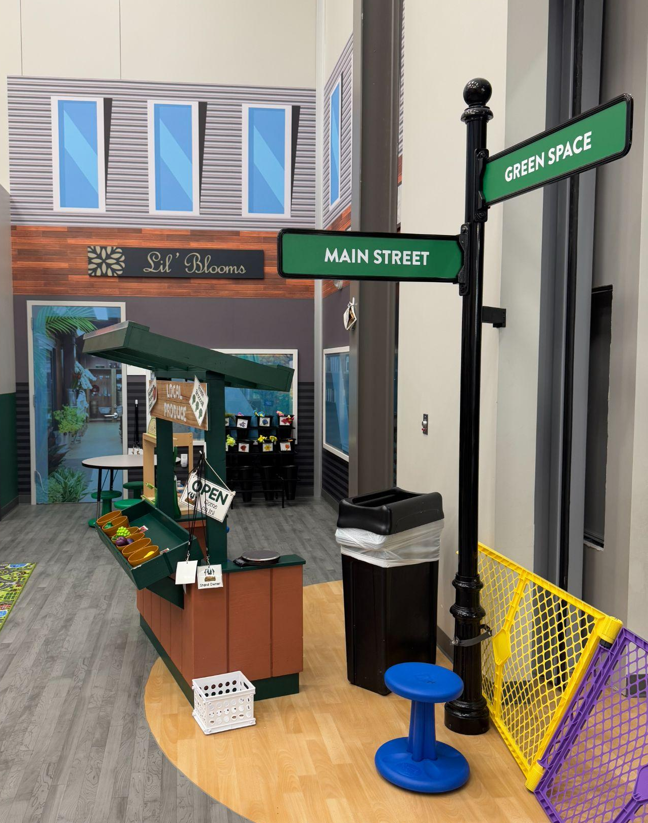
DFW - Forney ISD-The Keith Bell Opportunity Central (The OC)
FISD The OC is a community-centered facility with elements open to the public (shopping, restaurants, events spaces, tech spaces).
  College campus “feel”/Shopping mall “feel”
  High school CTE labs, makerspaces, and classrooms
    CTE students work at the shops of business partners and students fully run Blooms, the flower shop.
    Many CTE programs have a public-facing retail element.
  OC Junior-PK program-Entrepreneurial play areas replicate The OC’s high school CTE programs.
Notes:
350,000 square foot facility from 2019 bond.

Slide 30
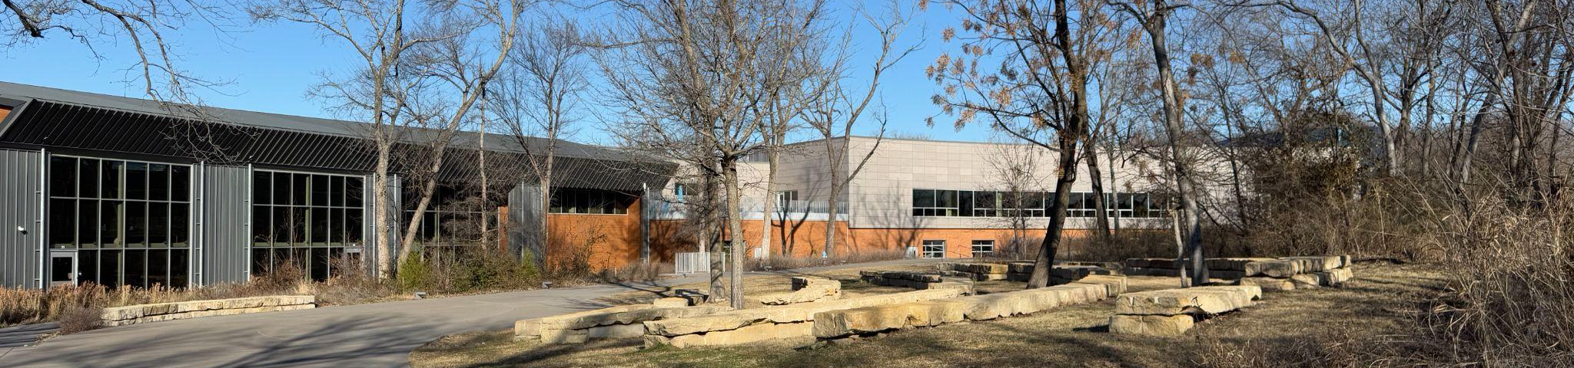
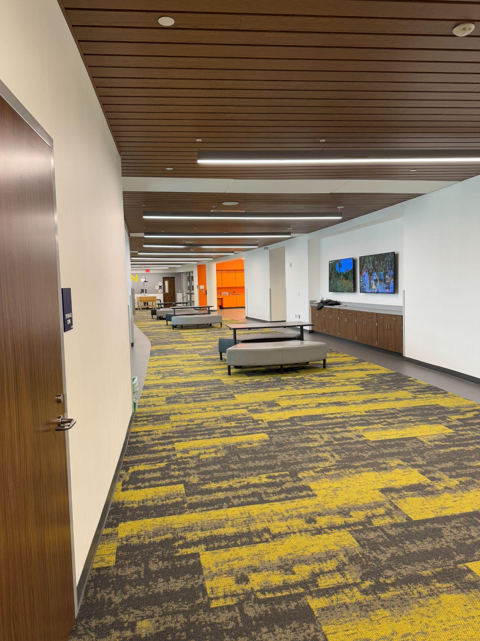
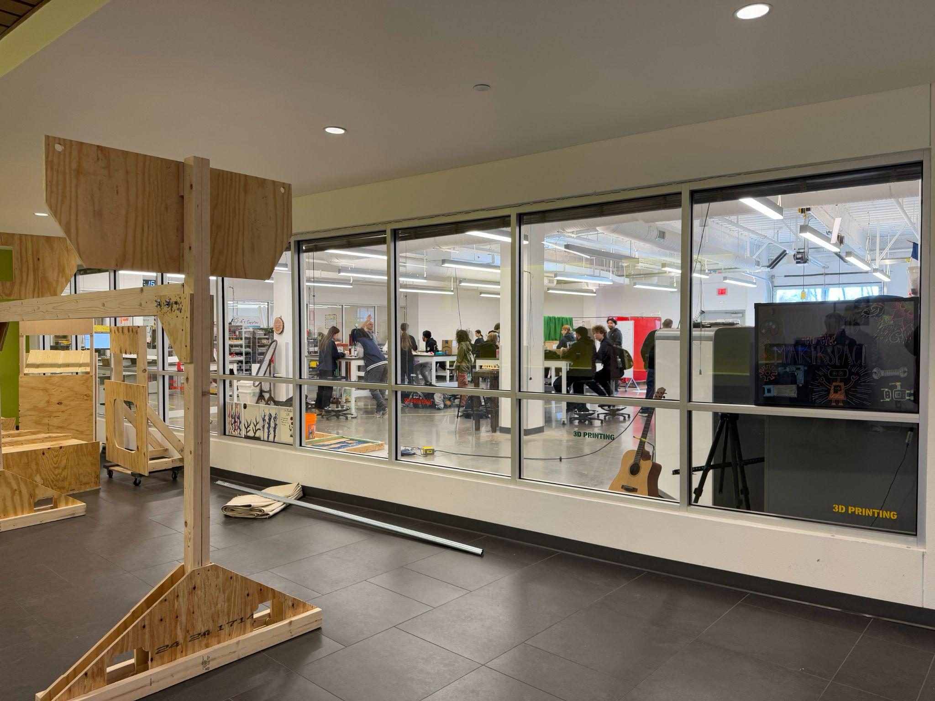
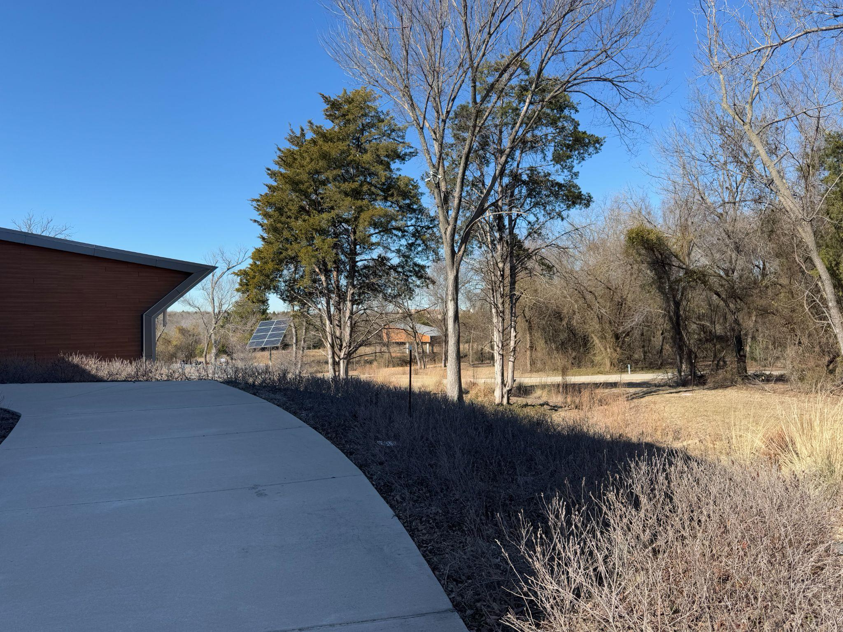
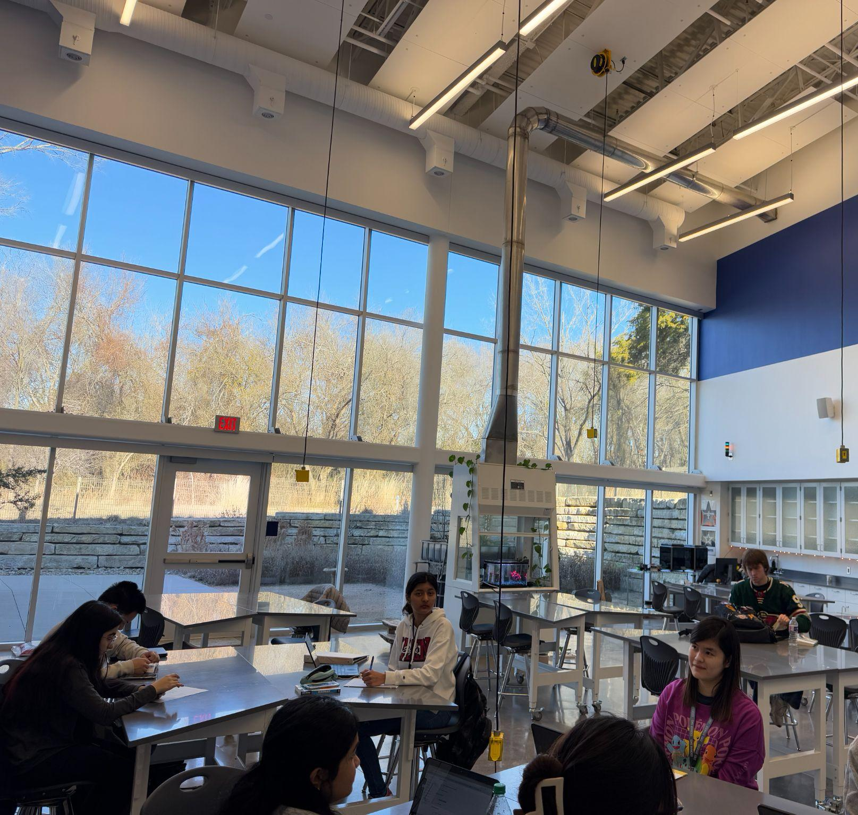
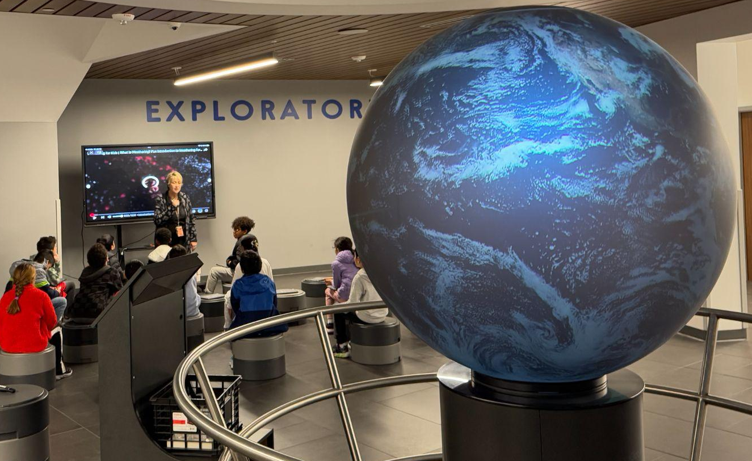
DFW - Allen ISD STEAM Center
AISD’s STEAM Center is a multi-purpose facility combining HS STEAM classrooms/labs/makerspaces with destination field experiences for ES and MS.
  Highly flexible indoor and outdoor learning spaces
  College campus “feel”
    High school students shuttle to attend classes at the center.
      The center can accommodate up to 500 students per class period.
  Field experience center-every school day hosts a single grade from an ES or MS campus for a day of STEAM learning.

Slide 31
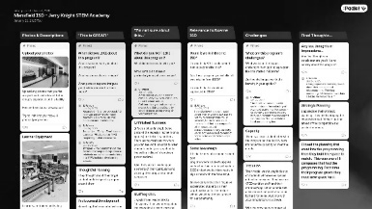
THIS IS GREAT!
Designers, not teachers
I’M NOT SURE ABOUT THIS
Exclusive to a specific population
RELEVANCE TO BOERNE
Magnet-type program where students apply could work
Aspects could work, but not this exact model
CHALLENGES
FINAL THOUGHTS
Too exclusive, designed around 1 type of learner
Very few extra-curriculars
Appreciate the strategic planning
Importance of professional development
Focused their design model around a specific learner
Utilized an existing building
Facility design a bit lacking
Population served was small
Too small, needs to benefit more students
Mansfield ISD / Jerry Knight STEM Academy
Notes:
Photos & Descriptions

Slide 32
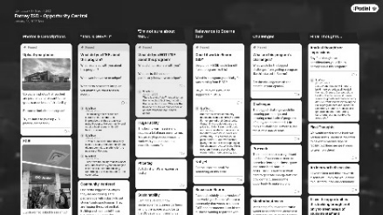
THIS IS GREAT!
One-of-a-kind facility
I’M NOT SURE ABOUT THIS
Very large & expensive facility
RELEVANCE TO BOERNE
Similar communities with businesses/ industry looking for ways to contribute towards student success
CHALLENGES
FINAL THOUGHTS
Securing partnerships
Would this be an option to increase capacity at ES and secondary schools?
Highly flexible
Focused on community
Directly connecting industry + education
Requires a lot of staff
Long-term viability with rental retail spaces?
OC scale is too big
Location of BMSN might be an issue (businesses need traffic to make this financially attractive)
Security of outside patrons
Love the connection between local business/ industry and the students
Forney ISD / Opportunity Central
Notes:
Photos & Descriptions

Slide 33
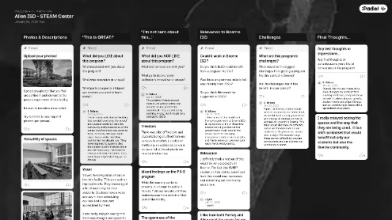
THIS IS GREAT!
The natural setting
Student autonomy & choice
I’M NOT SURE ABOUT THIS
Shuttling aspects
Student freedom/ choice
RELEVANCE TO BOERNE
Connection to every student in the district
Could provide some capacity relief
CHALLENGES
FINAL THOUGHTS
Potentially a hefty price tag (would require a bond)
A definite shift in mindset
Integration of K-8 population
Connection to community college
Security issues with such an open campus
Dual-credit location
Bond = needs a clearly defined vision & connection to all students
Highly flexible = learning spaces were generalized and intentional at the same time
Allen ISD / STEAM Center
Notes:
Photos & Descriptions

Slide 34
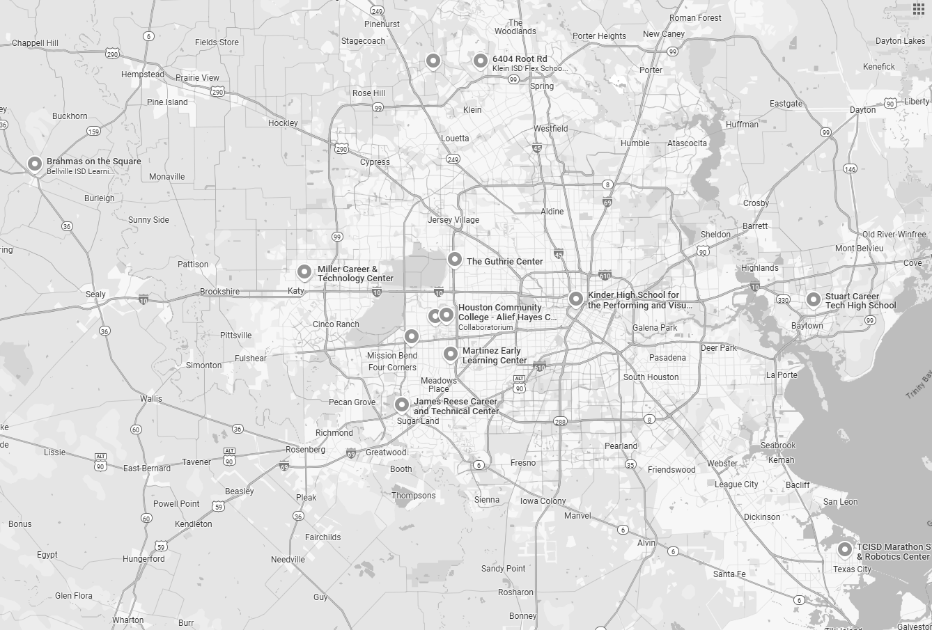
Houston-Area Tours:
CTE: Bellville Learning Center
CTE: Katy ISD Shaw STEAM Center & Miller Career & Tech. Center
Early College: Alief ISD ECHS
2/3-4: Bellville ISD + Katy ISD + Alief ISD

Slide 35
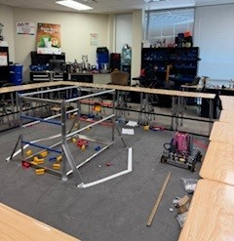
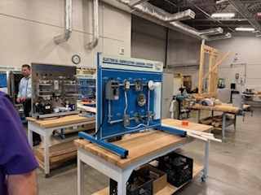
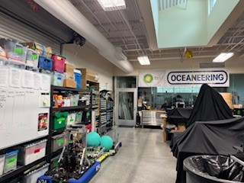
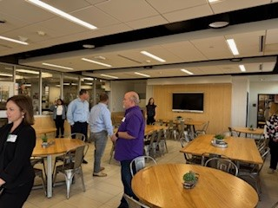
Houston - Alief ISD, Katy ISD, Bellville ISD
Highlights:
Bellville community space
STEM/Robotics Katy ISD
Culinary serving spaces KISD and BISD
Quality instruction happens in a variety of spaces.
Spaces to support and serve partners and the greater community would benefit Boerne ISD.

Slide 36
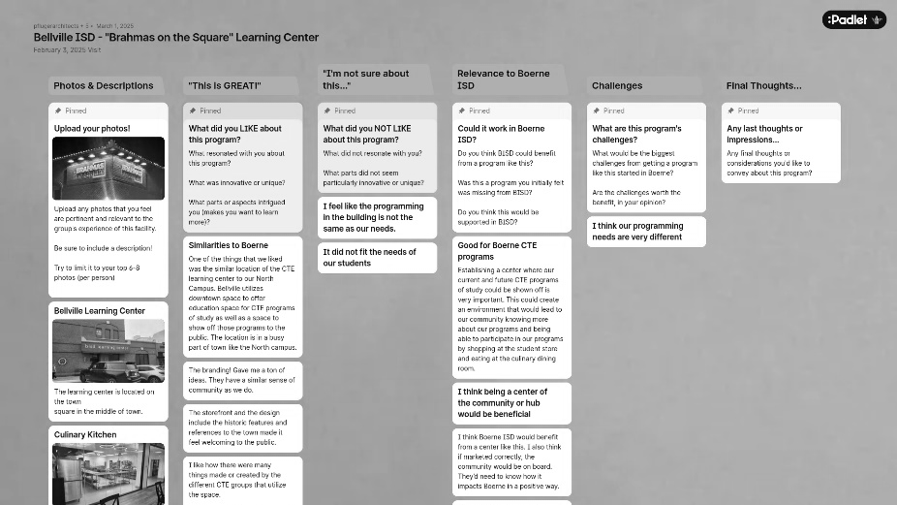
THIS IS GREAT!
Welcoming to the public (signage & historic features)
Student work and branding on display
I’M NOT SURE ABOUT THIS
Doesn’t align with the needs of BISD students
RELEVANCE TO BOERNE
Similar location & similar community
Like the idea of a space to put CTE on “display” – creates community awareness
CHALLENGES
FINAL THOUGHTS
Would need to align more with BISD student needs
BMSN location is uniquely poised to provide a similar experience/ exposure opportunity
Right in the middle of town
Bellville ISD / “Brahmas on the Square” Learning Center
Notes:
Photos & Descriptions

Slide 37
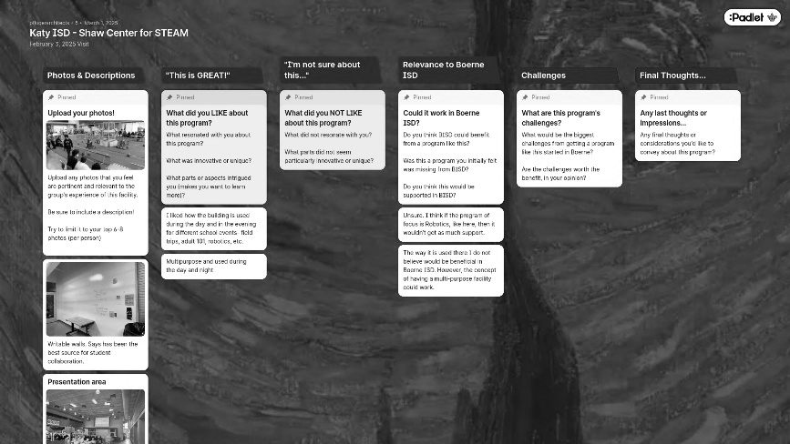
THIS IS GREAT!
Full day use
Highly flexible & multi-purpose
I’M NOT SURE ABOUT THIS
Focused on such a specific program (Robotics)
RELEVANCE TO BOERNE
Concept of a multi-purpose facility would be beneficial
CHALLENGES
FINAL THOUGHTS
Would have to be a program-of-study that is well-received and in-demand
Multi-purpose aspect and full-day usage are appealing
Katy ISD / Shaw Center for STEAM
Notes:
Photos & Descriptions

Slide 38
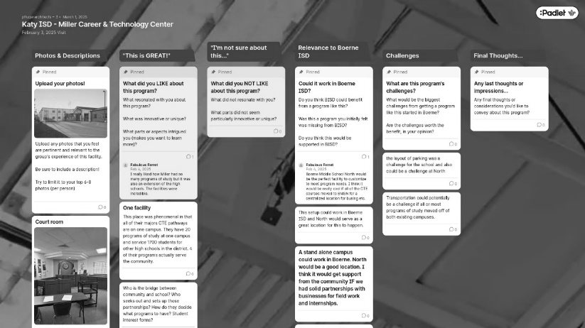
THIS IS GREAT!
20 programs of study at one campus
I’M NOT SURE ABOUT THIS
How do they determine what programs to offer?
Who establishes partnerships with local businesses?
RELEVANCE TO BOERNE
Location of BMSN would be great for this type of a facility
CHALLENGES
FINAL THOUGHTS
Parking challenges for BMSN
Bussing or other trans-portation could be a challenge
Centralized location of BMSN make this type of a collective CTE facility attractive
Serve 1700 students
4 programs also serve the community
Katy ISD / Miller Career & Technology Center
Notes:
Photos & Descriptions

Slide 39
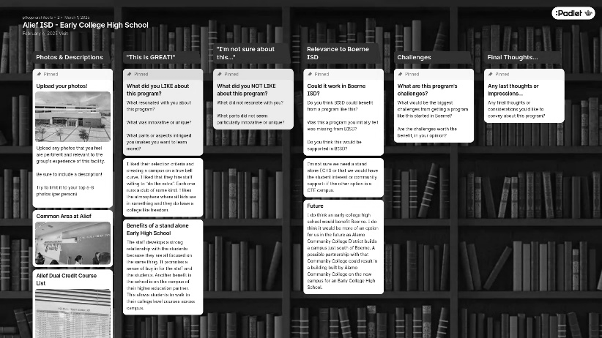
THIS IS GREAT!
Staff that is willing to do “the extra”
Campus on a true bell curve
I’M NOT SURE ABOUT THIS
Would need to find staff that is bought in to this model
RELEVANCE TO BOERNE
HE partner could be found in ACD (campus forthcoming south of Boerne)
CHALLENGES
FINAL THOUGHTS
Is an ECHS more needed/ wanted than a CTE facility?
Like the strong connection between staff and students
Physical proximity to their higher education partner
With ACD coming to Boerne, would an ECHS make more sense closer to that campus?
Alief ISD / Early College High School
Notes:
Photos & Descriptions

Slide 40
Houston-Area Tours:
Comm./Admin.: Tomball ISD Innovation Center
CTE: GCCISD Stuart Tech. HS
Admin.: HCC Collaboratorium
2/19-20: HCC Collaboratorium + Tomball ISD + GCCISD

Slide 41



Houston - Tomball ISD, Goose Creek CISD, HCC Collaboratorium
Highlights:
Tomball ISD-Tomball Innovation Center (repurposed building)
​The Tomball Innovation Center, part of the Tomball Independent School District (TISD), offers specialized Career and Technical Education (CTE) programs that are exclusively available at this dedicated facility. The exclusive programs at the Tomball Innovation Center include:
Aviation Pilots, Aviation Maintenance, Electrical Technology,
Robotics, Law Enforcement.
Goose Creek CISD CTE Programs (repurposed building)
The district offers CTE courses at various high schools and dedicated facilities, such as: Stuart Career Tech High School – A standalone campus focused on career and technical training.
HCC Collaboratorium West Houston Institute high-tech space designed for collaboration, innovation, and problem-solving.
It features interactive technology, flexible workspaces, and expert facilitation for strategic planning, workshops, and networking events.
It includes a large interactive Nureva Wall, breakout rooms, and gathering spaces to enhance teamwork and creativity.
Available for HCC and external organizations, it provides a dynamic environment for brainstorming and developing actionable solutions.
Notes:
Goose Creek CISD’s Career and Technical Education (CTE) programs are spread across multiple campuses and specialized academies rather than being housed in a single building. The district offers CTE courses at various high schools and dedicated facilities, such as:
Stuart Career Tech High School – A standalone campus focused on career and technical training.
Tomball ISD’s Career and Technical Education (CTE) program is not housed on all campuses but is strategically offered across multiple locations, including:
Tomball Star Academy and Tomball Memorial High School – Offering a variety of CTE courses within their campuses.
Tomball Innovation Center – A dedicated facility providing specialized CTE programs and hands-on learning experiences.
Industry and Higher Education Partnerships – Some students participate in internships, dual credit programs, and workforce training outside of school facilities.
While all high schools provide access to CTE, specific programs and industry-based certifications are concentrated in select campuses and specialized centers.
The Collaboratorium at HCC’s West Houston Institute is a high-tech space designed for collaboration, innovation, and problem-solving. It features interactive technology, flexible workspaces, and expert facilitation for strategic planning, workshops, and networking events. The facility includes a large interactive Nureva Wall, breakout rooms, and gathering spaces to enhance teamwork and creativity. Available for HCC and external organizations, it provides a dynamic environment for brainstorming and developing actionable solutions.

Slide 42

THIS IS GREAT!
Intentional for students to receive certifications and/or credentials
I’M NOT SURE ABOUT THIS
Facility design issues (narrow hallways)
RELEVANCE TO BOERNE
Ideal roadmap for Boerne ISD to use
CHALLENGES
FINAL THOUGHTS
Space and land – is BMSN big enough for this type of program?
“This is the premier standard, in my opinion…”
Immersive environment
Creative use of an existing facility
Will the community support it?
Tomball ISD / Innovation Center
Notes:
Photos & Descriptions

Slide 43

THIS IS GREAT!
Focused on collaboration
Flexibility
I’M NOT SURE ABOUT THIS
Makerspace was only geared for one pathway
Staffing for the makerspace
RELEVANCE TO BOERNE
Great as an idea to promote collaboration between the district and community college
CHALLENGES
FINAL THOUGHTS
Cost
Would be nice to have in Boerne
Would need to be flexible and adaptable – not designed around a specific type of technology
Makerspace integration was great
Logistics of traveling to/from this type of facility
Houston Community College / Collaboratorium
Notes:
Photos & Descriptions

Slide 44

THIS IS GREAT!
Lots of great programs that are relevant to Boerne
I’M NOT SURE ABOUT THIS
Program was still growing at GCCISD
Some classes were not fully utilized
RELEVANCE TO BOERNE
How would this work with the “shuttle model” we use?
An existing former ES was utilized for this
CHALLENGES
FINAL THOUGHTS
Cost of independent campus vs. supplement campus
Really enjoyed seeing how other districts are tackling the same problems/ issues that Boerne ISD has
Goose Creek CISD / Stuart Career Technical High School
Notes:
Photos & Descriptions

Slide 45

Austin-Area Tours:
Community/Admin.: Georgetown ISD Hammerlun Center for Leadership & Learning
Enhanced Academics: Georgetown ISD Future Ready Learning Complex
3/3: Georgetown ISD Future Ready Learning Complex + Hammerlun Center

Slide 46





Austin - Georgetown ISD - Future Ready Complex & EC Center
Highlights
Variety of CTE Programs: Advanced Engineering, Automotive, Aviation, Cosmetology, Culinary Arts, Drones, Health Science, Rocketry
Facility for Advanced CTE Courses
Multi-Use (also houses 18+ & Alternative)
EC Learning Center on the same property (CTE learning opportunities)
Notes:
Almost 14K students
20 CTE certifications
3.1% annual growth
11 elementary campuses, 4 MS, 3 HS
GISD has 28 future subdivisions with over 19,000 lots in the planning stages
Groundwork is underway on more than 2,900 lots within 10 subdivisions
Charter school opening to impact enrollment fall 2025 (~350 students)
Georgetown ISD is forecasted to enroll nearly 16,300 students by 2029/30 and more than 19,900 by 2034/35
Boerne ISD is forecasted grow from 11K+ this year to 15K+ by 2033/34

Slide 47



Georgetown ISD - Hammerlun Center for Leadership & Learning
Highlights
Originally built in 1917
Repurposed for Professional Learning, Central Office & Board Room
Flexible Collaborative Areas, Walls and Usage

Slide 48

THIS IS GREAT!
Planned for future growth
Open to community
I’M NOT SURE ABOUT THIS
Seemed underutilized
Building design issues (lack of electrical outlets)
RELEVANCE TO BOERNE
Multiple pathways in one facility is great
CHALLENGES
FINAL THOUGHTS
Transport to and from the home campuses
Renovating an existing facility (versus building a new one) will have limitations
Flexible spaces and building components
Multi-use spaces
Students not using the facility for a full day
Keeping students interested in their pathway + engaged in the full sequence
Strong recruiting is needed
Georgetown ISD / Future Ready Learning Complex
Notes:
Photos & Descriptions

Slide 49

THIS IS GREAT!
Re-use of historic building
Designed for collaboration
I’M NOT SURE ABOUT THIS
Staff naturally using semi-private areas vs. the large open collaborative areas
Doesn’t “look” like it’s related to schools
RELEVANCE TO BOERNE
Re-use of an existing facility
CHALLENGES
FINAL THOUGHTS
Creating a variety of collaborative spaces that users will utilize
Might be some good lessons here about re-use of an existing building, but perhaps not much more
Flexible
Lack of storage
Unlikely that BMSN will be 100% allocated towards a PD program like this
Georgetown ISD / Hammerlun Center for Leadership & Learning
Notes:
Photos & Descriptions

Slide 50

SA-Area Tours:
CTE: The Science Mill
CTE: NEISD STEM Academy
CTE: NISD Construction Careers
2/26: NEISD STEM Academy
2/27: NISD Construction Careers Academy + PreK4SA + Science Mill
Early Childhood: PreK4SA

Slide 51





San Antonio - Northeast ISD, Northside ISD, Pre-K 4SA, Science Mill
Highlights:
Construction Careers Academy
Pre-K 4SA South- closing the facility/ moving to new location
Science Mill- Johnson City
NEISD STEM Academy
  NEISD- middle school- same struggle with space
Both indoors and outdoor learning areas and creative learning environments
Notes:
The San Antonio group traveled to NEISD, NISD, Pre-K 4SA south campus, and the Science Mill in Johnson City.
NISD- Construction Careers Academy which is a separate building on the campus of Warren High School. Students to go back and forth between the CCA campus and the main Warren campus for core classes. This is a neat facility, the shops designed for each path (plumbing, electrical, HVAC, etc.)
One of their obstacles is finding outside placement for their students. Due to that limitation, the workshops on site allow them to offer in house practicums vs placing students at external sites. Lots of hands on work space. One of the many interesting things they do is build tiny homes and sell them to community members and veterans. Have to build to SA building codes.
Pre-K 4SA- indoor and outdoor learning activities. very intentionally planned out. all furniture in the classroom must be for students- no teacher desks or teacher areas.
Science Mill- creative use of space- very hands on and creative learning environments
NEISD- STEM academy- magnet program (housed at NIMITZ middle school and at LEE High School). Students are admitted as early as middle school via a lottery system. They are facing facility limitations as well. Core content classrooms teach their curriculum through a STEM focus to provide cross curricular support.
Each of these facilities had both indoor and outdoor learning areas and creative learning environments

Slide 52

THIS IS GREAT!
Focus on community & collaboration
Did the best with the facilities they have
I’M NOT SURE ABOUT THIS
Crowded and cluttered
Storage space needed
RELEVANCE TO BOERNE
Similar pathway at Boerne already
CHALLENGES
FINAL THOUGHTS
Space and storage issues
Support from 6-12th grade is great
Facilities were not special
Expansion issues (landlocked)
BISD is already ahead of this program
North East ISD / STEM Academy
Notes:
Photos & Descriptions

Slide 53

THIS IS GREAT!
This is a program not currently offered in Boerne
Great that students don’t have to “leave” to get hands-on experience
I’M NOT SURE ABOUT THIS
Nothing!
RELEVANCE TO BOERNE
This type of program is absolutely relevant to Boerne
Would align with needs of other programs as well (i.e. Robotics)
CHALLENGES
FINAL THOUGHTS
Many partnerships would be needed
Love this program!
Will our community support a “trades-specific” pathway?
Truly innovative
Could unify our district to further close the gaps between ES, MS and HS
Northside ISD / Construction Careers Academy
Notes:
Photos & Descriptions

Slide 54

THIS IS GREAT!
Loved how students were interacting
I’M NOT SURE ABOUT THIS
Concerned about student-to-teacher ratio that would be needed
RELEVANCE TO BOERNE
Similar program in Boerne
CHALLENGES
FINAL THOUGHTS
Funding sources
Great program but our district has probably other priorities
Prioritization of hands-on and outdoor learning
Well planned
Would be great to expand to early childhood teacher preparation
Staffing needs
Limitations of the existing BMSN campus
Is a program this robust really a need for our community?
PreK4SA / South Education Center
Notes:
Photos & Descriptions

Slide 55

THIS IS GREAT!
Combination of science + history + art + modern
Hands-on learning
I’M NOT SURE ABOUT THIS
Neat and fun, but probably not applicable to Boerne
RELEVANCE TO BOERNE
Might have some relevance, with adjustments
CHALLENGES
FINAL THOUGHTS
Need to be adapted to Boerne’s needs
Opportunity to create a really innovative program (summer camps?)
Need to send our teachers here for some inspiration!
The Science Mill
Notes:
Photos & Descriptions

Slide 56
SA-Area Tours:
CTE: NISD Health Careers
3/6: NISD Health Careers HS

Slide 57



San Antonio - Northside ISD Health Careers
Opened 1984; CTE Wing 2020
Only stand alone magnet in NISD, only HS on block schedule to allow for practicum blocks of 3 hrs
900 students, grades 9-12
Students accepted from within and outside NISD with passing STAAR
Fine Arts - Orchestra, Band, Choir, Art
Lifetime sports - golf, swimming, water polo, tennis
Certifications - CNA, Phlebotomy, Pharmacy Technician, Sterile Processing, Registered Dental Assistant
Program is geared to students not needing additional supports

Slide 58

THIS IS GREAT!
Current equipment
Real world experience for students
I’M NOT SURE ABOUT THIS
Geared towards high-achieving students only
Limited collaborative interaction (outdated classroom technology)
RELEVANCE TO BOERNE
BISD’s current P-TECH program feels more innovative
CHALLENGES
FINAL THOUGHTS
Logistics of student movement between home campus and a more distant specialized campus?
How would BMSN support a specialized CTE program – just 1 program or multiple programs?
Not as much hands-on learning
Northside ISD / Health Careers High School
Notes:
Photos & Descriptions

Slide 59
“Sometimes if we look outside the box, amazing opportunities can happen!”
“…it takes more than an innovative building to create a useful learning space for students…professional development and student voice are equally essential to creating effective learning…”
“Overall, this trip and these visits have changed my mindset from building additional, comprehensive schools to addressing our growth, student needs and preparedness, and our community’s needs…”
Notes:
Photos & Descriptions

Slide 60
Welcome
The Charge / The Norms
Recap – Mtg. # 1 & 2
Presentation of Tours
Rotating Table Discussion
Questions / Look Ahead
Exit Ticket

Slide 61
ROTATING TABLE DISCUSSIONS:
Each table will focus on a specific proposed program type.
Each group will discuss the possibilities/challenges related to this program type. Consider the information presented by the tour groups in your discussions.
Each person will fill out a Compass Point worksheet at each table:
  North (N): What do you NEED to know more about this?
  West (W): What is WORRISOME about this?
  East (E): What EXCITES you about this?
  South (S): What is your STANCE on this?
A “group” Compass Point sheet is at each table for the Facilitator/Scribe to document significant points of conversation
Rotate to the next group.
Repeat for all four program types!

Slide 62


Notes:
Print on 11x17

Slide 63
Facilitators:
Renee Munn
Sami Jo Gillette
Denise Baker
THE TABLES:
# 1
Early Childhood
# 2
CTE
# 3
Early College
# 4
Comm./
Admin.
Facilitators:
John O’Hare
Natalie Benke
Rotating
Small Group Discussion
Facilitators:
Heather Willis
Triana Fontecha
Kim Stewart
Facilitators:
Crissy Poulis
Jayne Burton
Lisa Reeh
Notes:
Photos & Descriptions

Slide 64
Welcome
The Charge / The Norms
Recap – Mtg. # 1 & 2
Presentation of Tours
Rotating Table Discussion
Questions / Look Ahead
Exit Ticket

Slide 65
LOOK AHEAD:
A REVIEW OF
BOERNE ISD
BRAIN-
STORMING
SYNTHESIS &
CONCURRENCE
SFPFG RECAP
TOURS
REPORT OUT
DEC. 2024 – MAR. 2025
MAR. 20, 2025
APR. 2, 2025
OCT. 8, 2024
NOV. 4, 2024
TBD
MAY 12, 2025
Notes:
RECAP OF MTG. # 1

Slide 66
Welcome
The Charge / The Norms
Recap – Mtg. # 1 & 2
Presentation of Tours
Rotating Table Discussion
Questions / Look Ahead
Exit Ticket

