Slide 1

INSTRUCTIONAL FOCUS

Slide 2





Highlighted
Early Learning
Middle School
CTE
Post Secondary

Slide 3
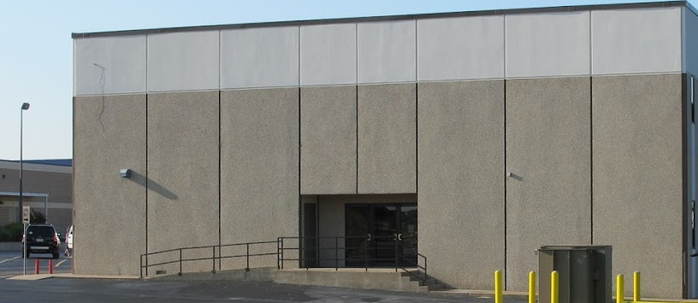
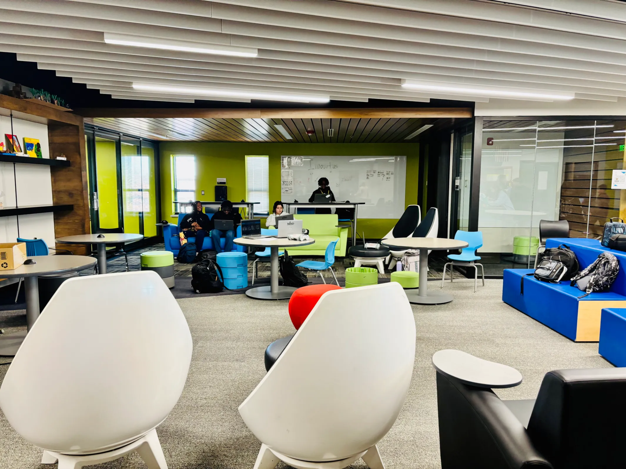
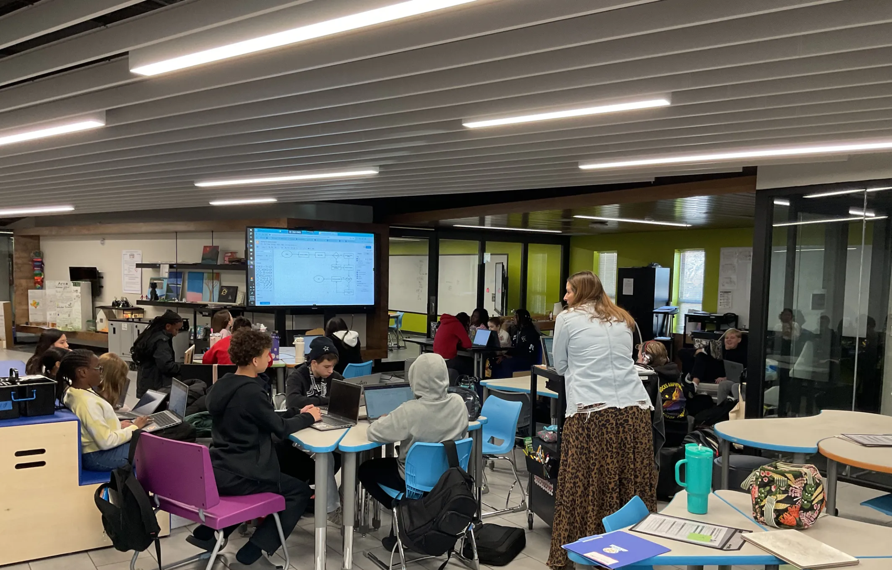
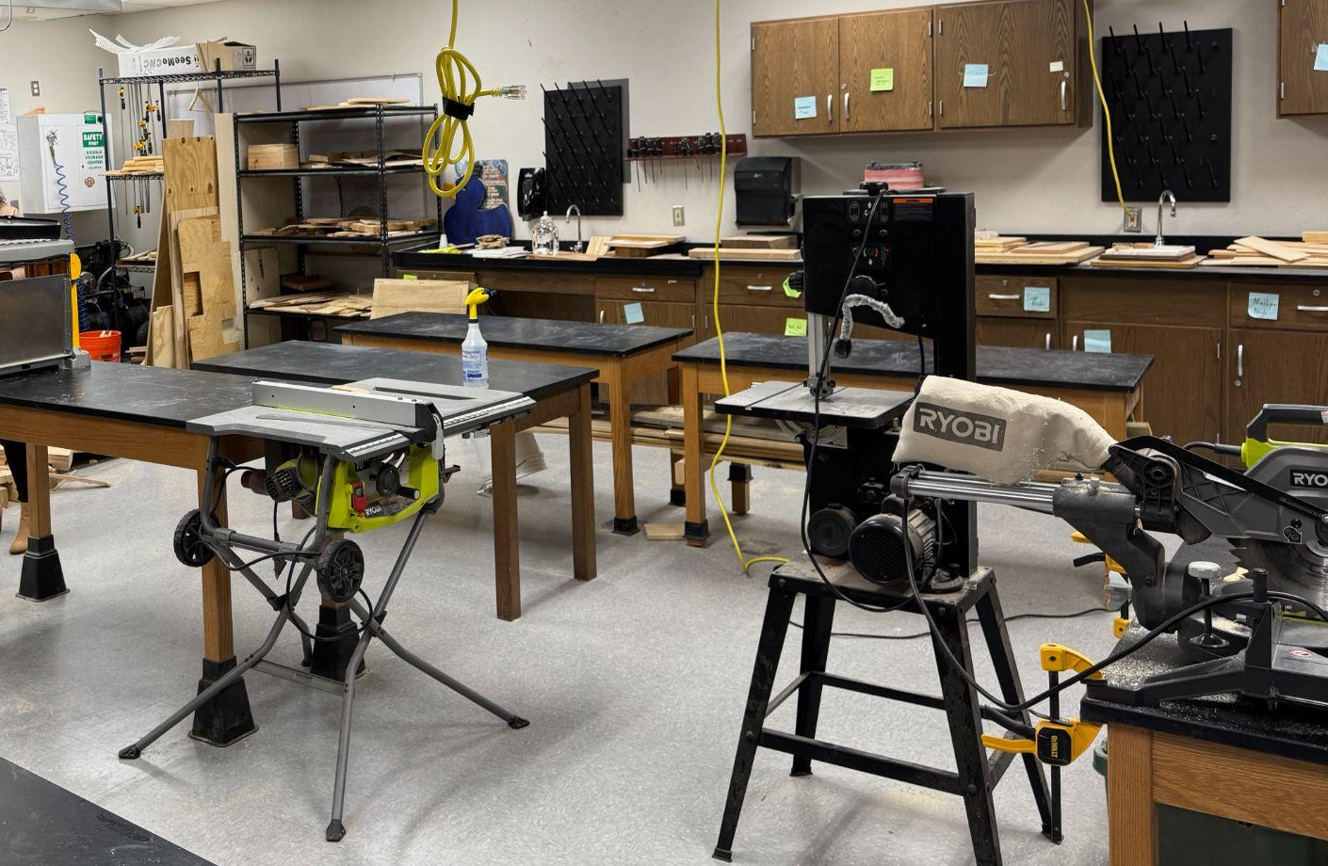
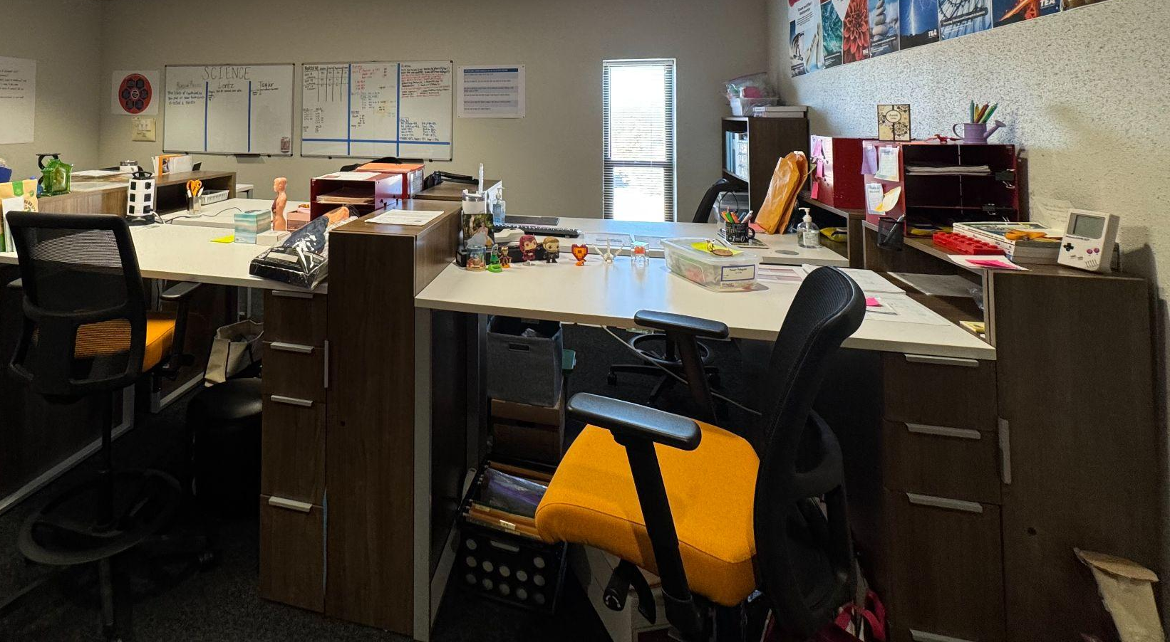
DFW - Mansfield ISD-Jerry Knight STEM Academy
Knight STEM Academy is a repurposed facility focused on STEM-based instruction (labs, collaborative spaces, makerspaces, etc.)
MS Honors “learners” eligible to attend
“Designers” teach not only STEM courses, but core content as well leading to consistent cross-curricular instruction.
  “Designers” do not have specific classrooms, instead they share planning spaces.
Notes:
Repurposed in 2017 from a building on the campus of the Brooks Wester MS-remodeled for the labs/makerspaces/collaborative spaces. Flexible furniture choices as well as repurposing existing furniture (lab tables, storage, etc.)

Slide 4
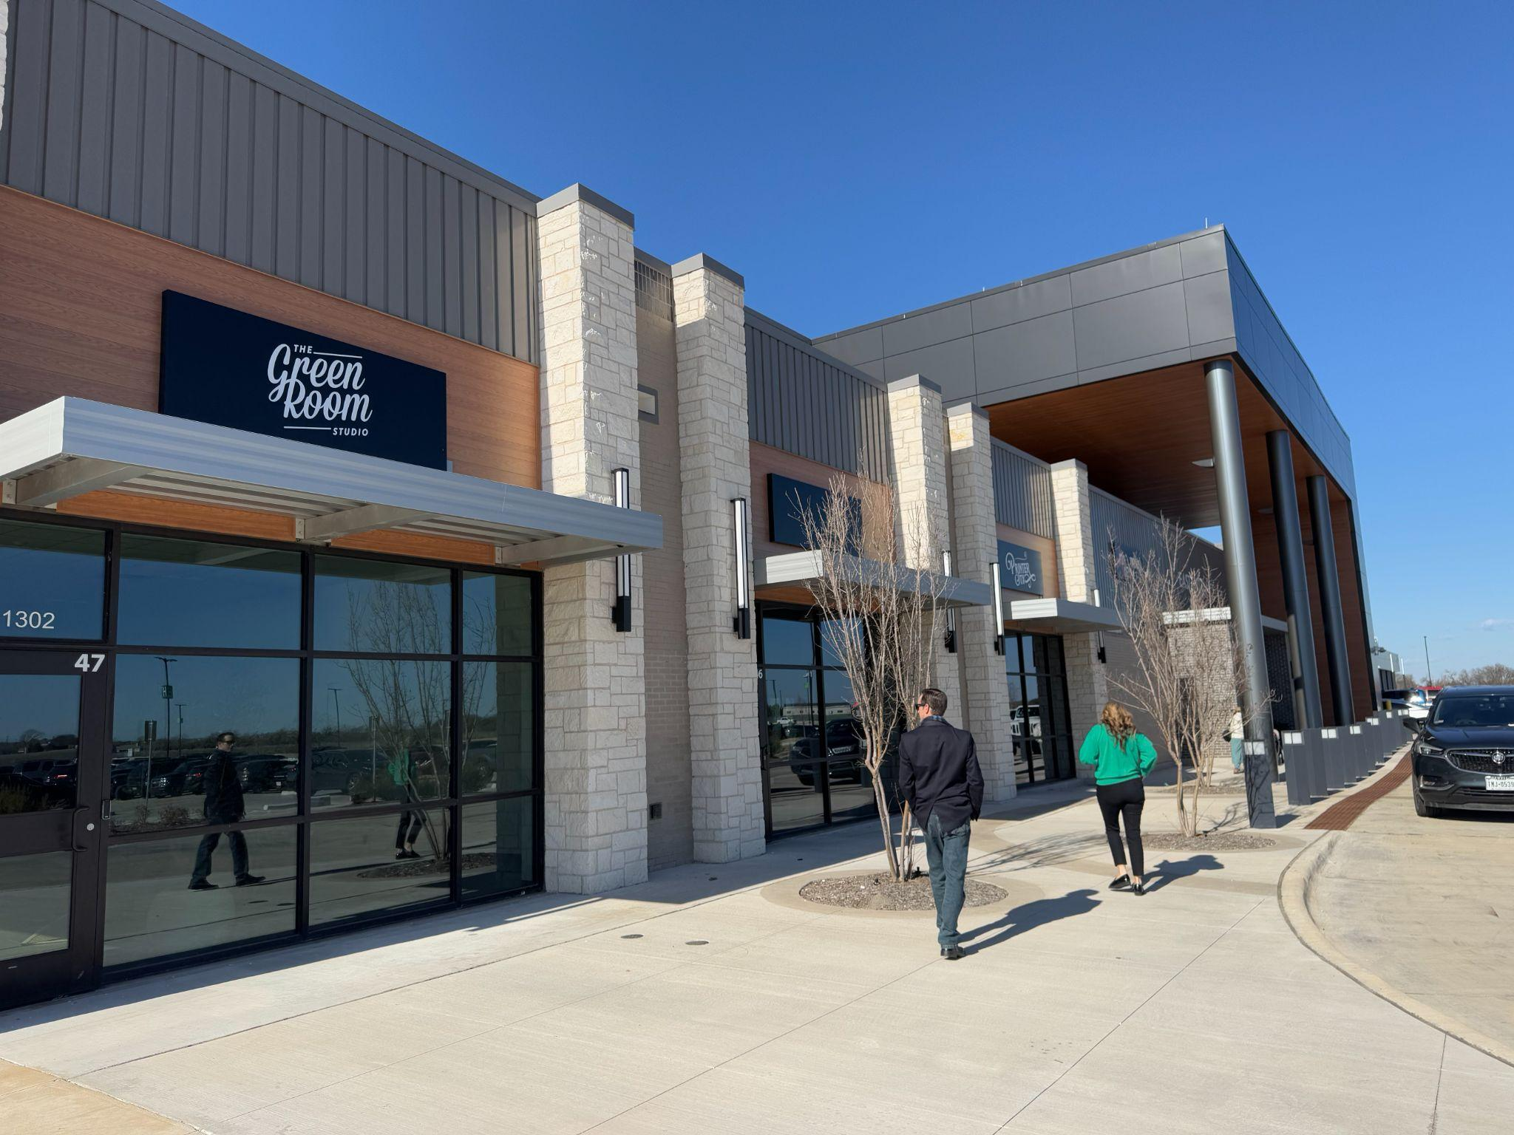
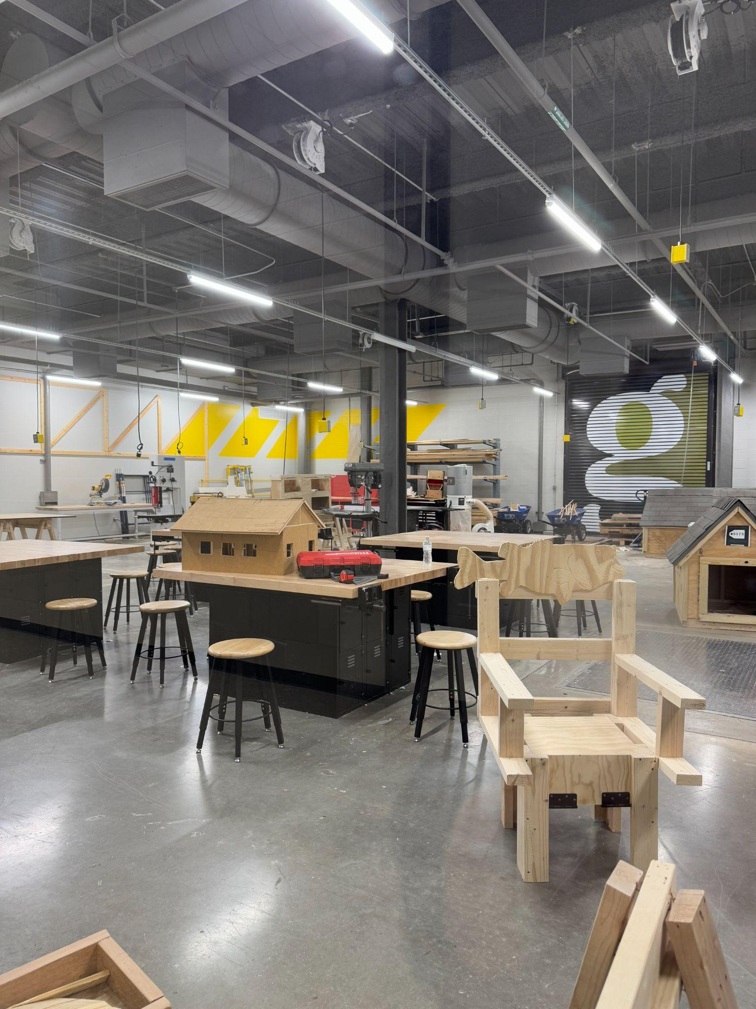
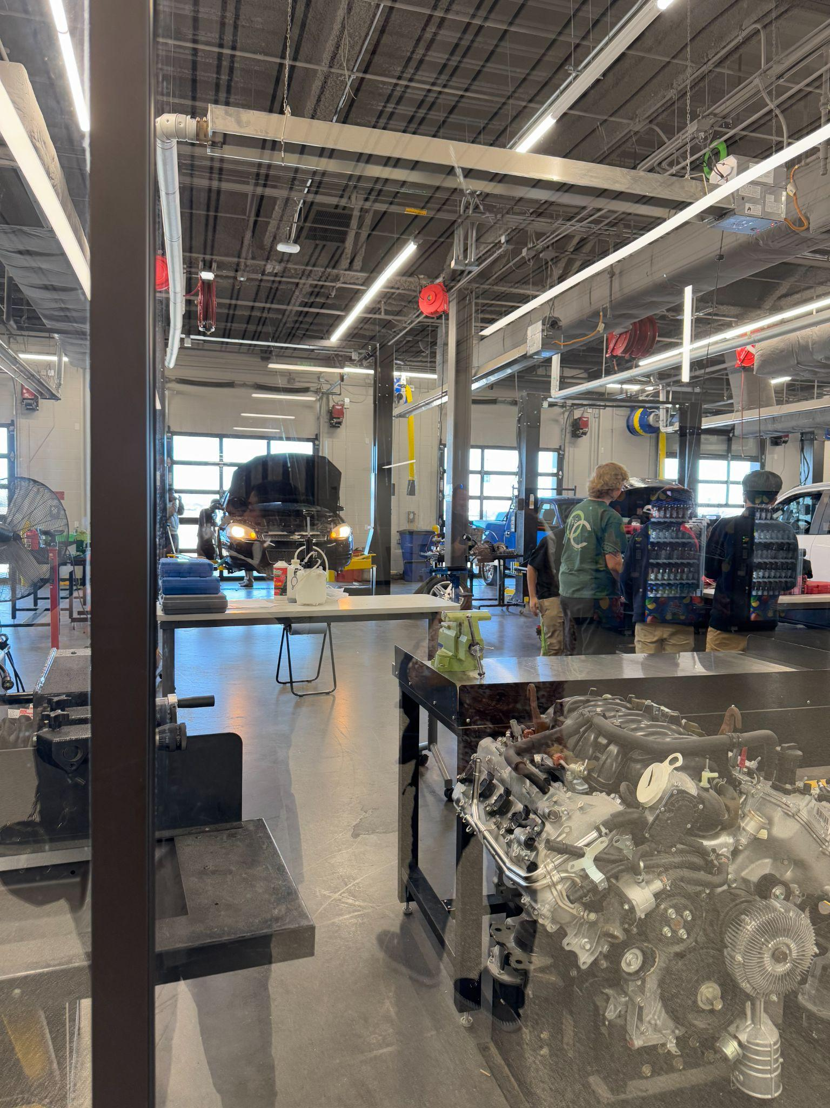
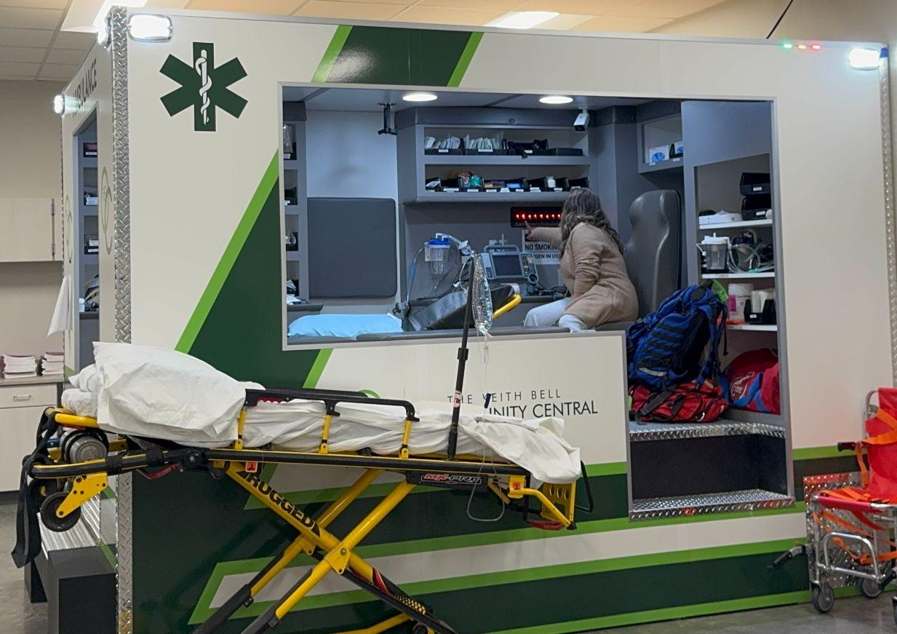
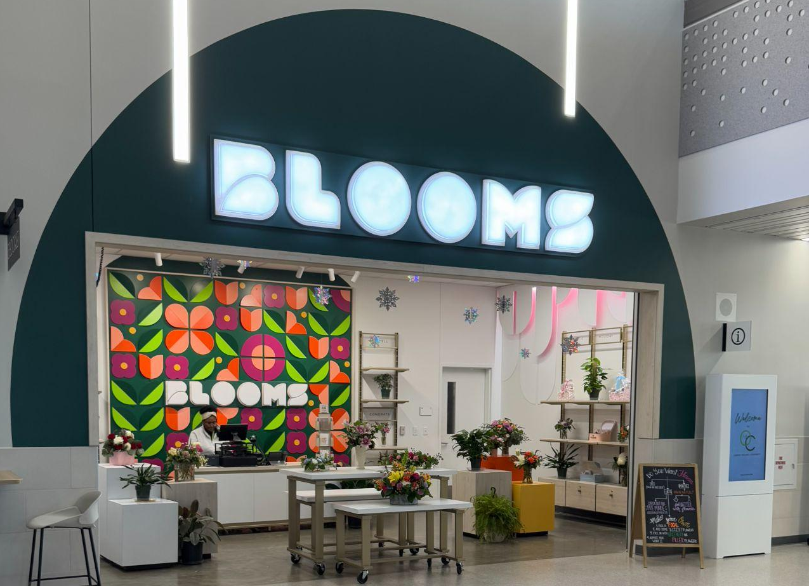
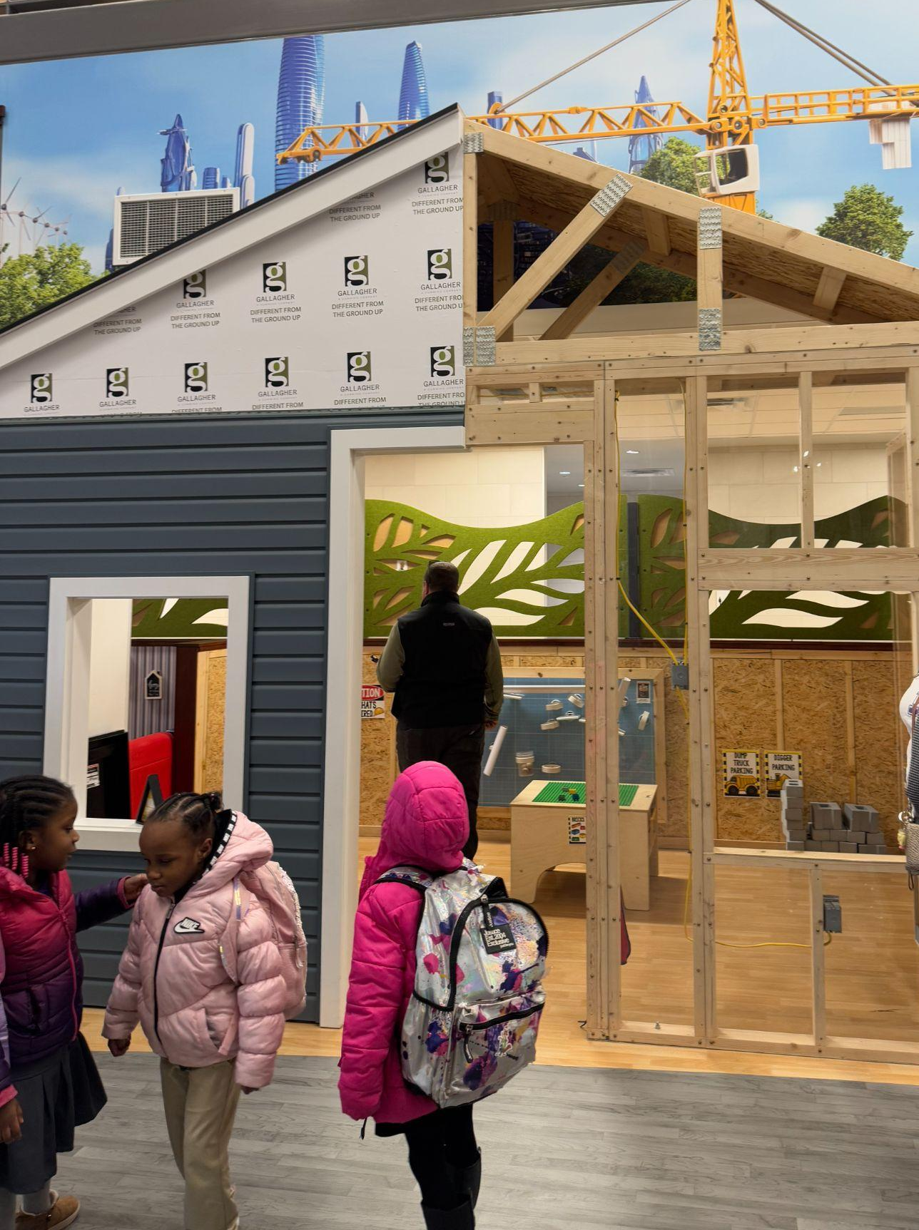
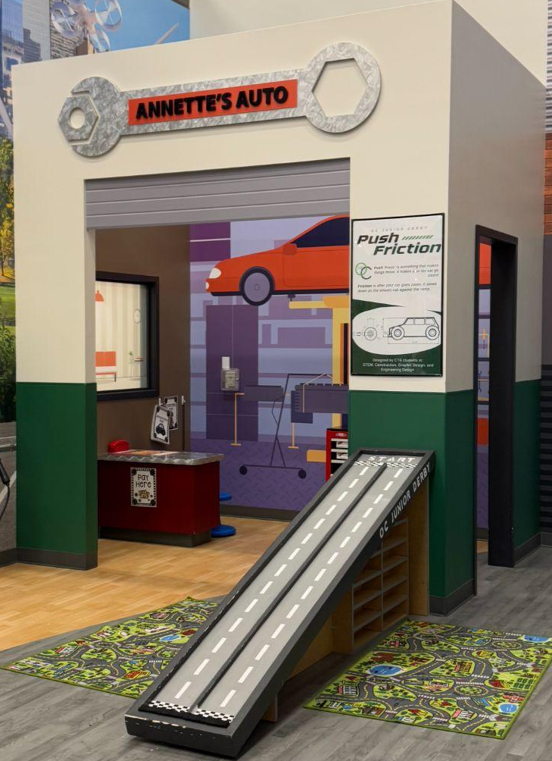
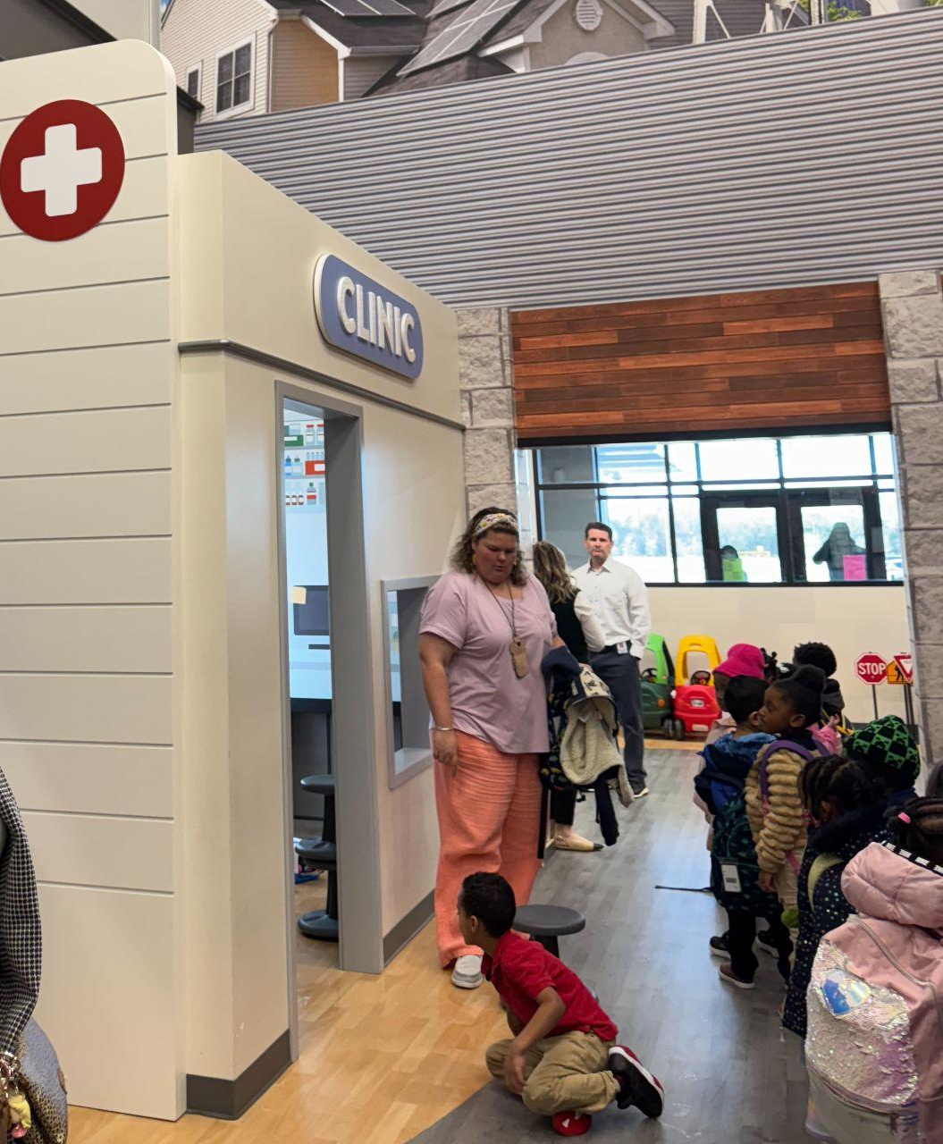
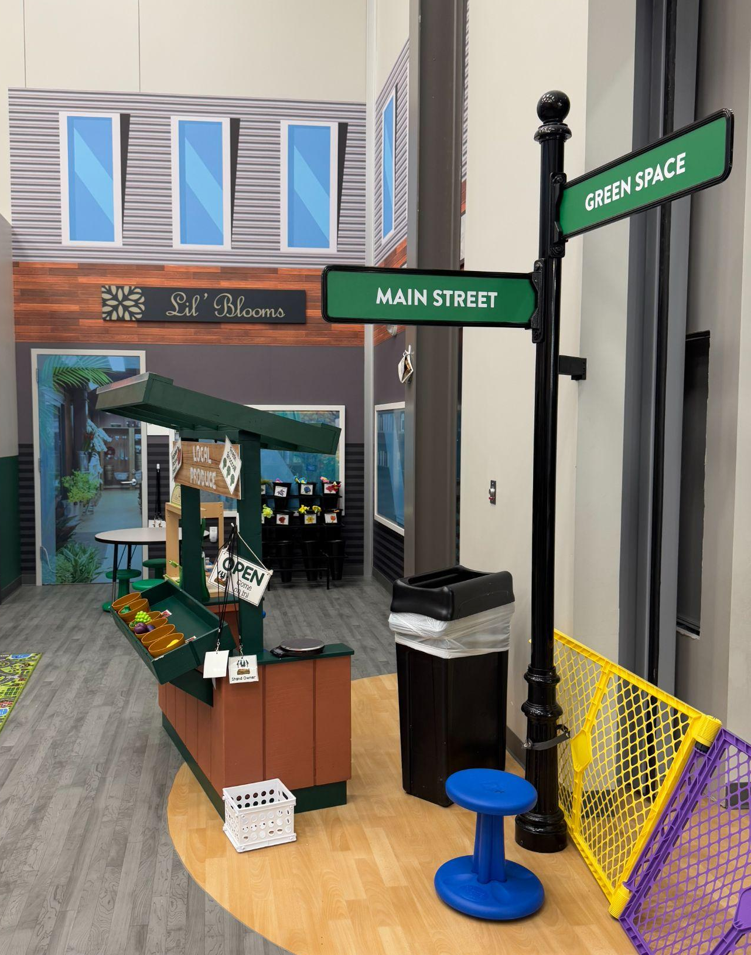
DFW - Forney ISD-The Keith Bell Opportunity Central (The OC)
FISD The OC is a community-centered facility with elements open to the public (shopping, restaurants, events spaces, tech spaces).
  College campus “feel”/Shopping mall “feel”
  High school CTE labs, makerspaces, and classrooms
    CTE students work at the shops of business partners and students fully run Blooms, the flower shop.
    Many CTE programs have a public-facing retail element.
  OC Junior-PK program-Entrepreneurial play areas replicate The OC’s high school CTE programs.
Notes:
350,000 square foot facility from 2019 bond.

Slide 5
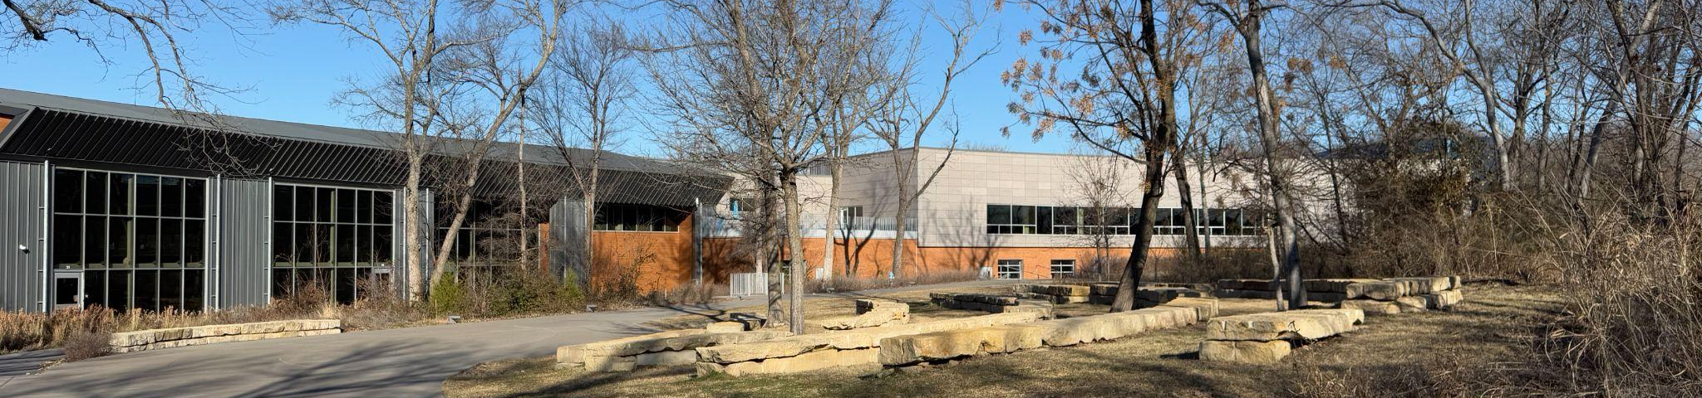
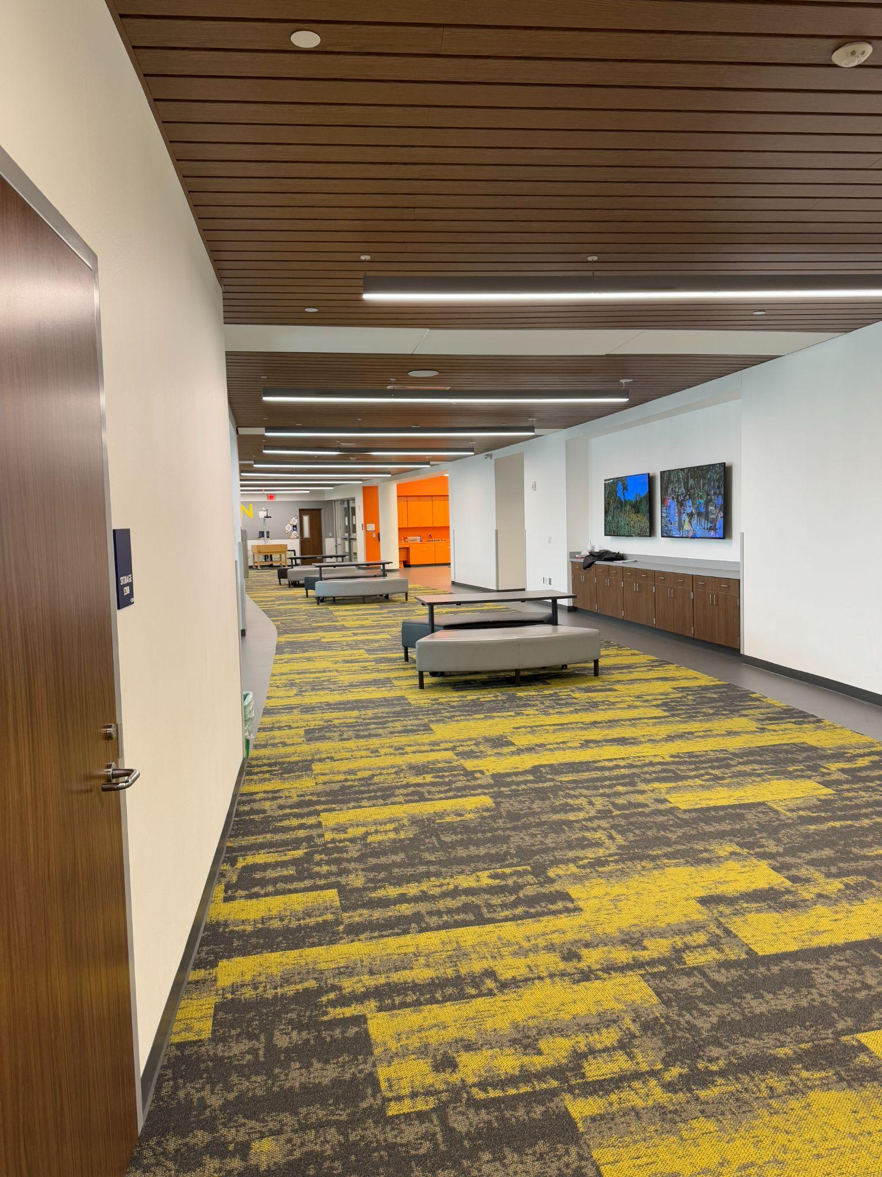
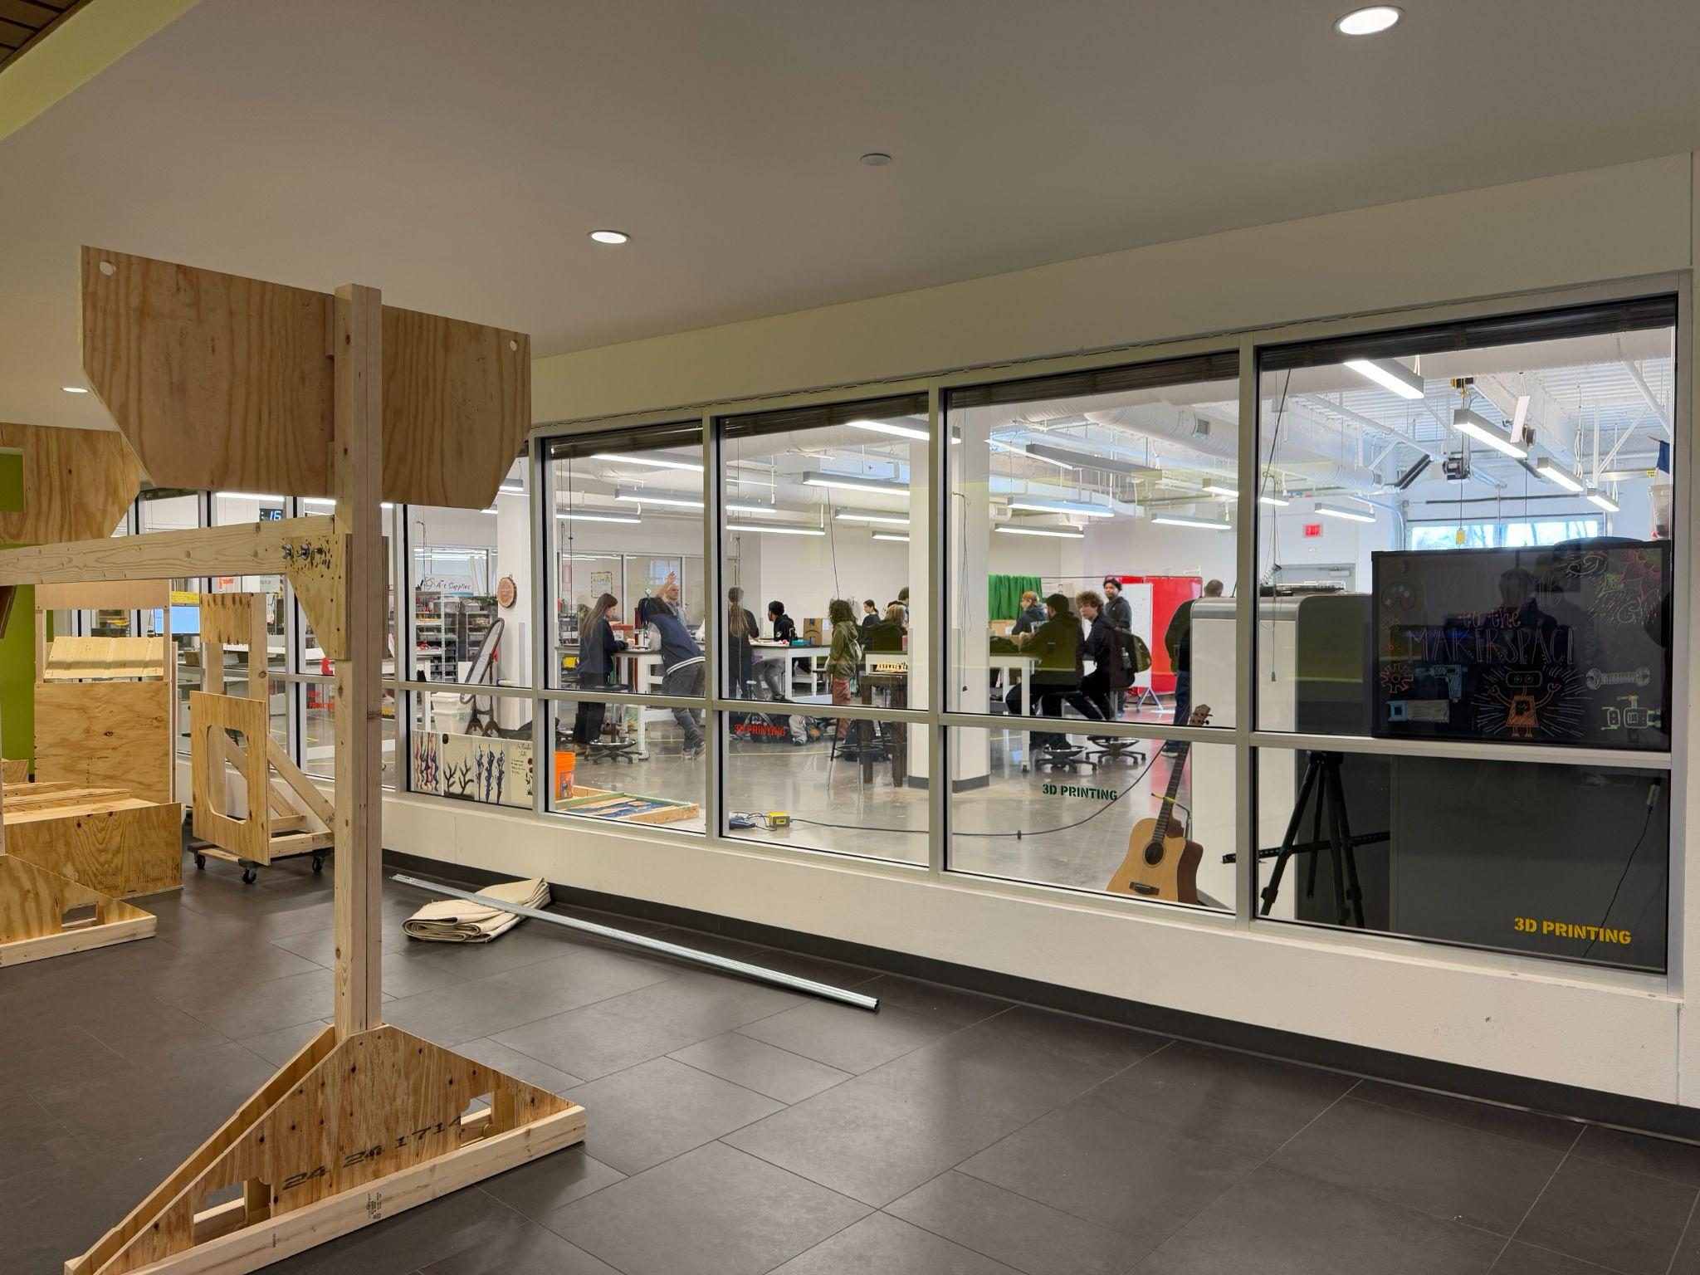
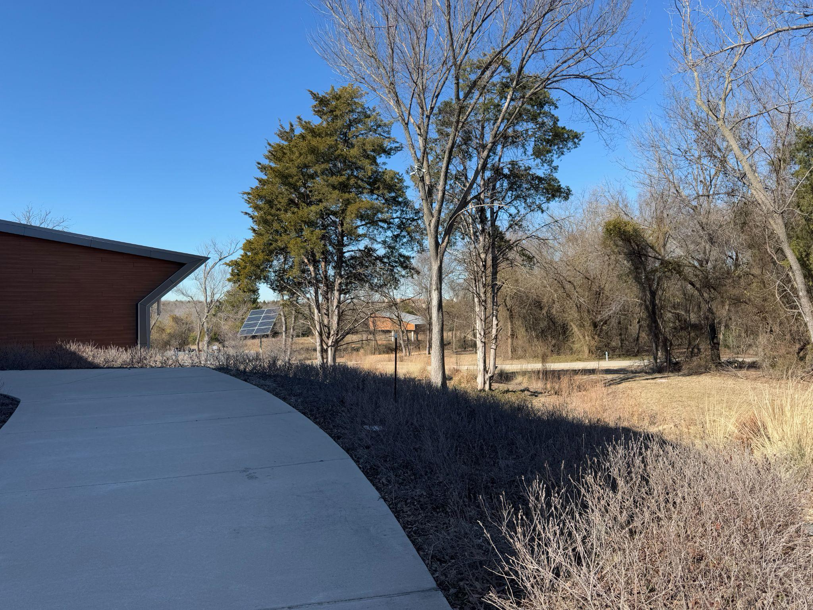
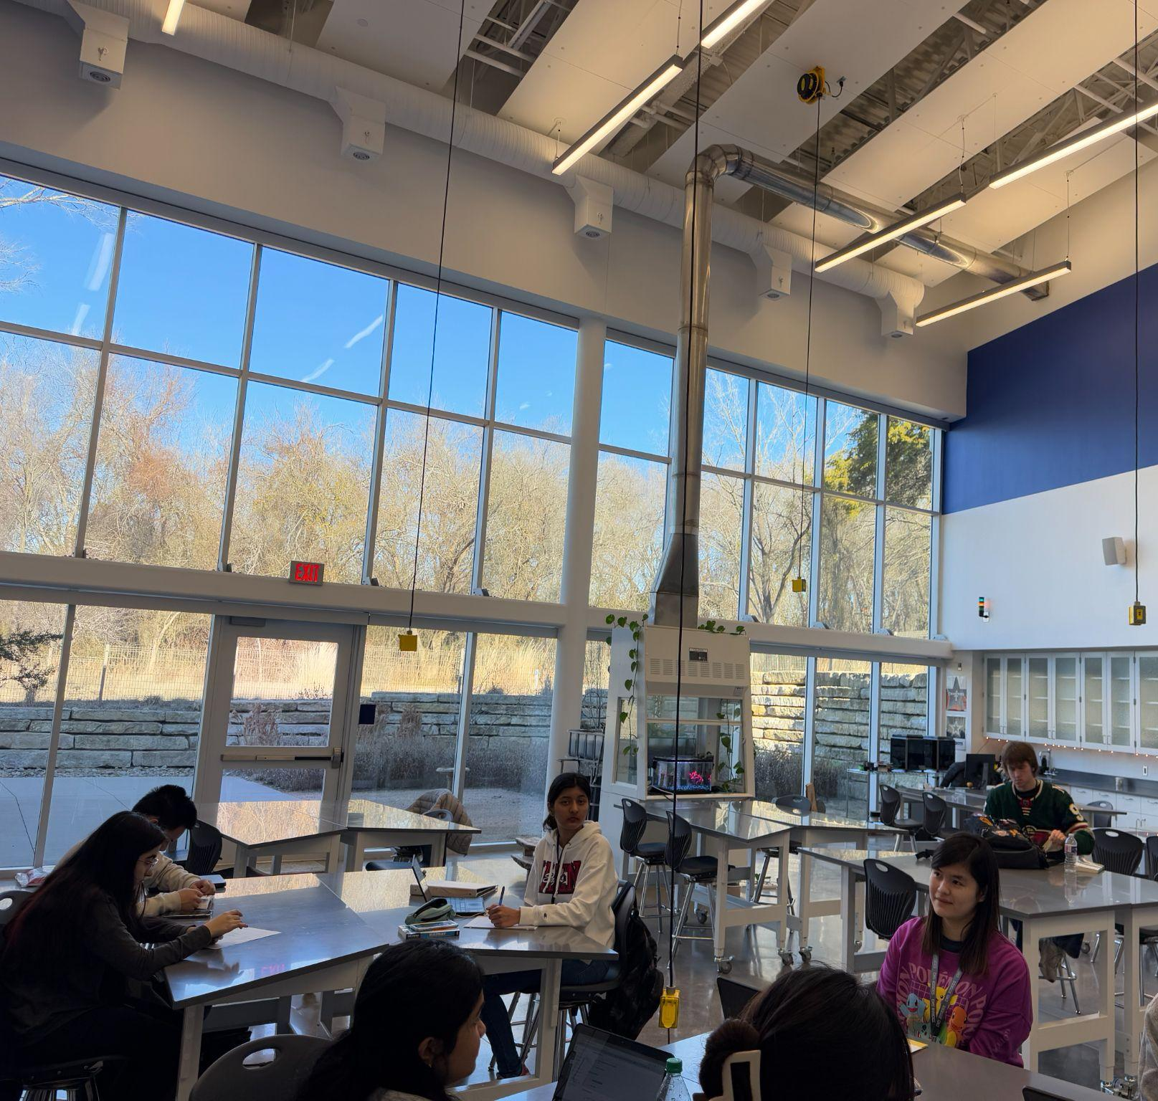
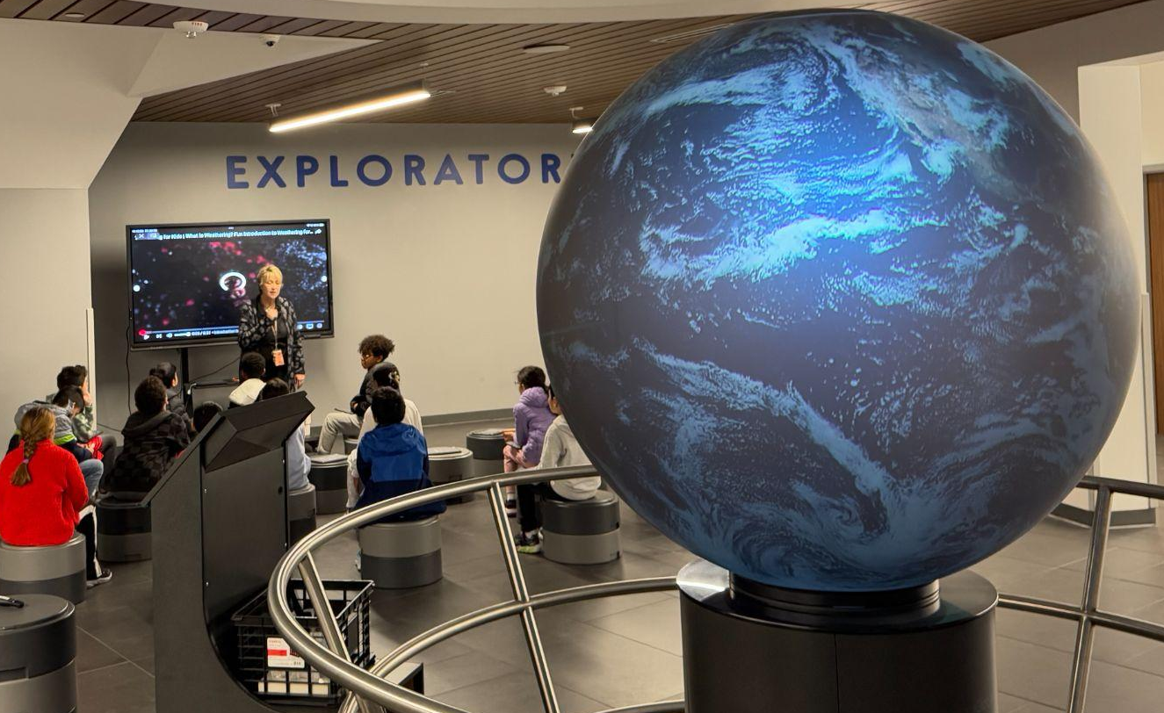
DFW - Allen ISD STEAM Center
AISD’s STEAM Center is a multi-purpose facility combining HS STEAM classrooms/labs/makerspaces with destination field experiences for ES and MS.
  Highly flexible indoor and outdoor learning spaces
  College campus “feel”
    High school students shuttle to attend classes at the center.
      The center can accommodate up to 500 students per class period.
  Field experience center-every school day hosts a single grade from an ES or MS campus for a day of STEAM learning.

Slide 6
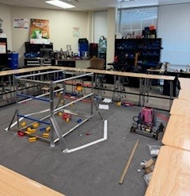
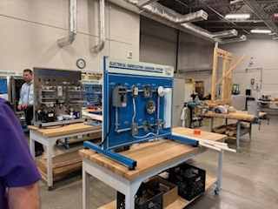
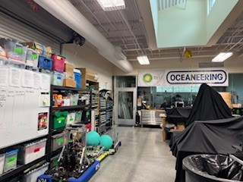
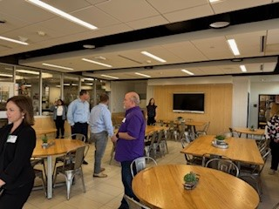
Houston - Alief ISD, Katy ISD, Bellville ISD
Highlights:
Bellville community space
STEM/Robotics Katy ISD
Culinary serving spaces KISD and BISD
Quality instruction happens in a variety of spaces.
Spaces to support and serve partners and the greater community would benefit Boerne ISD.

Slide 7
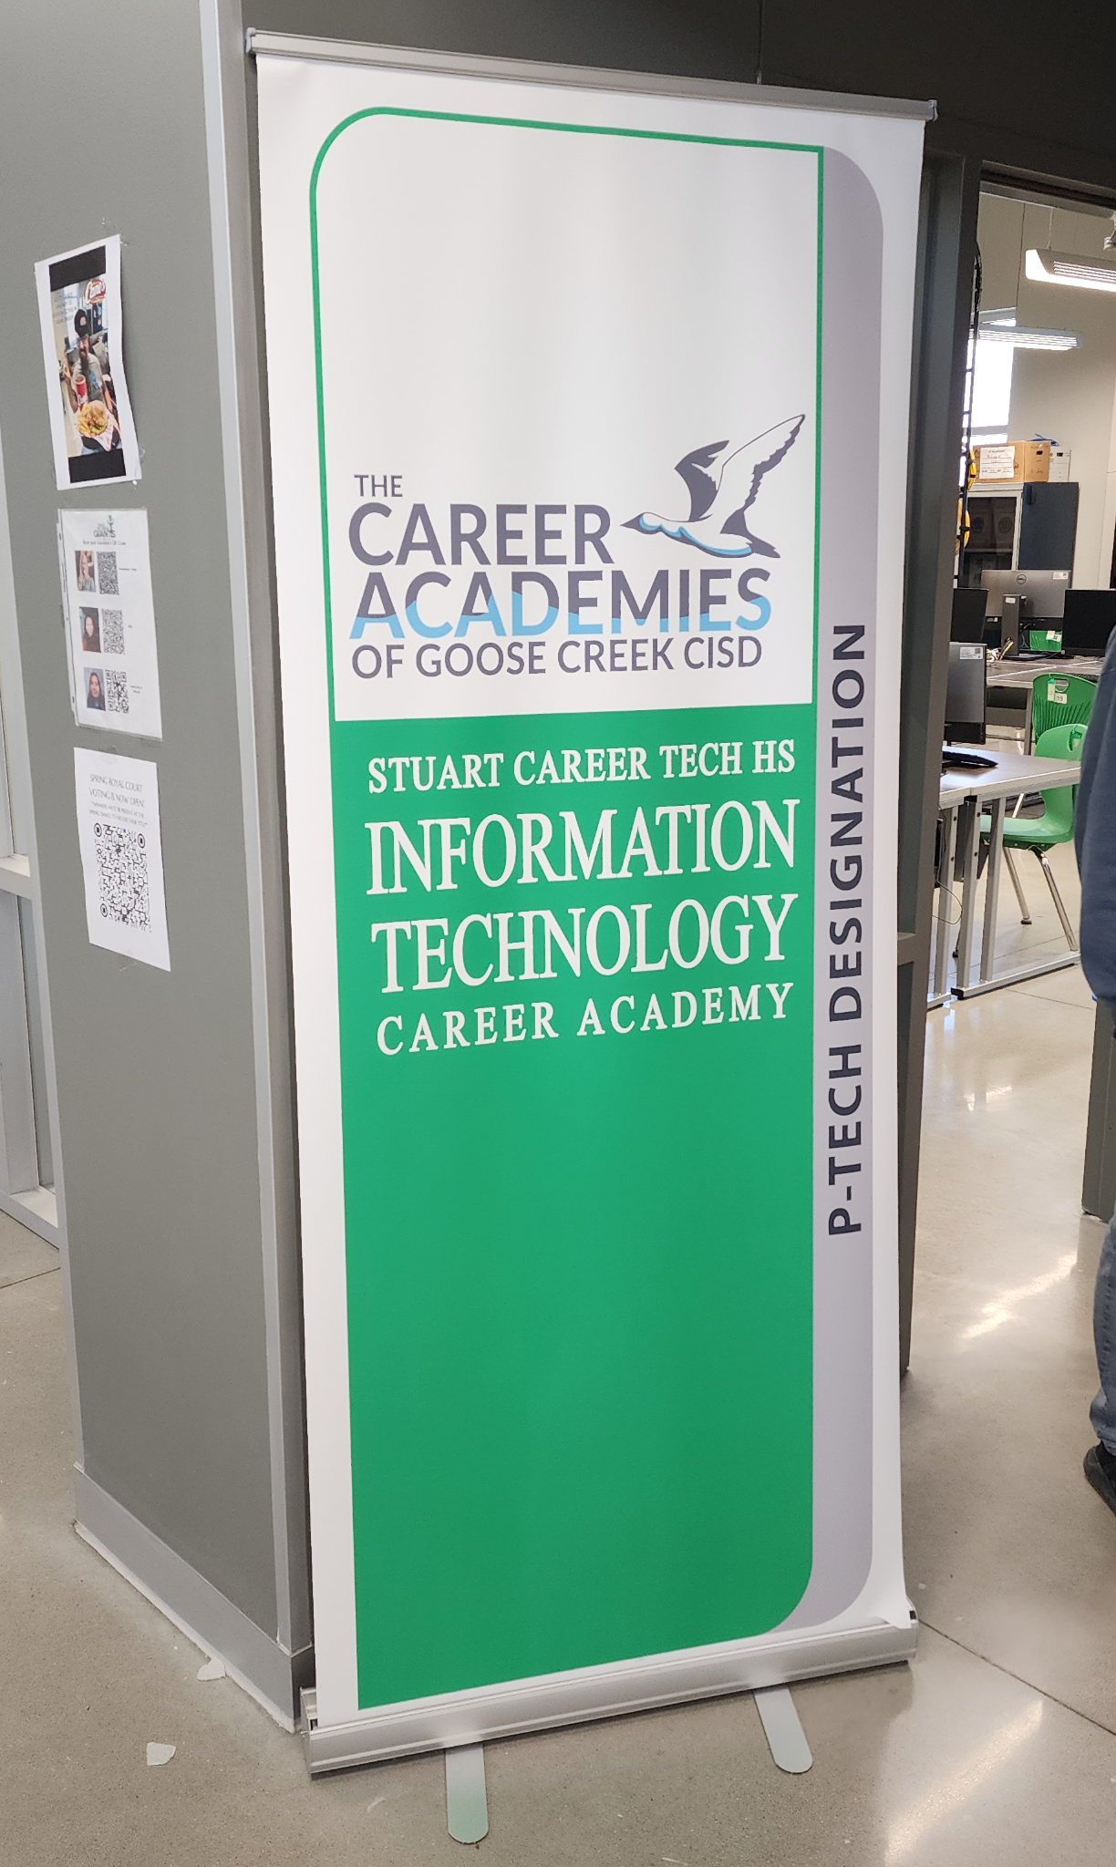
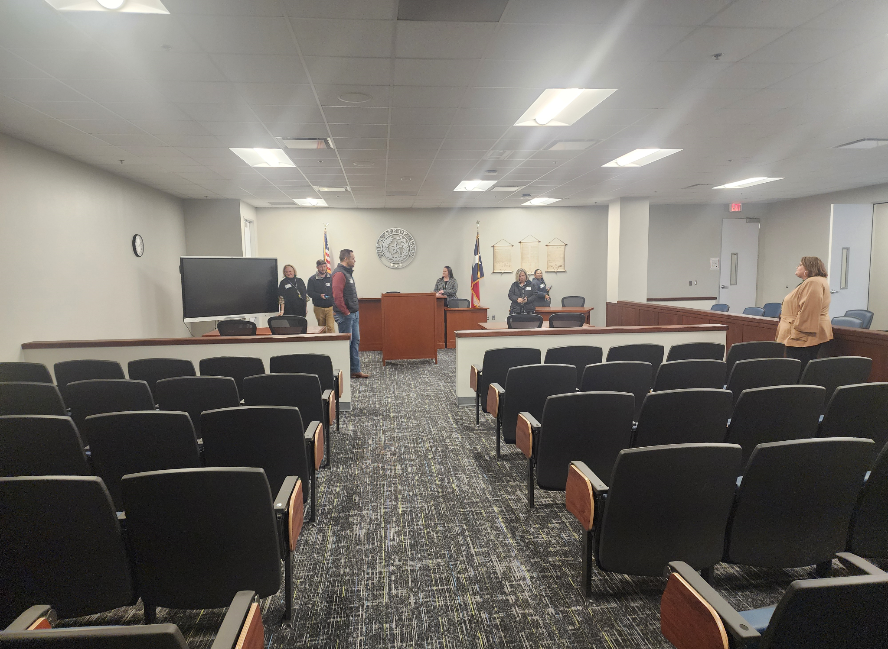
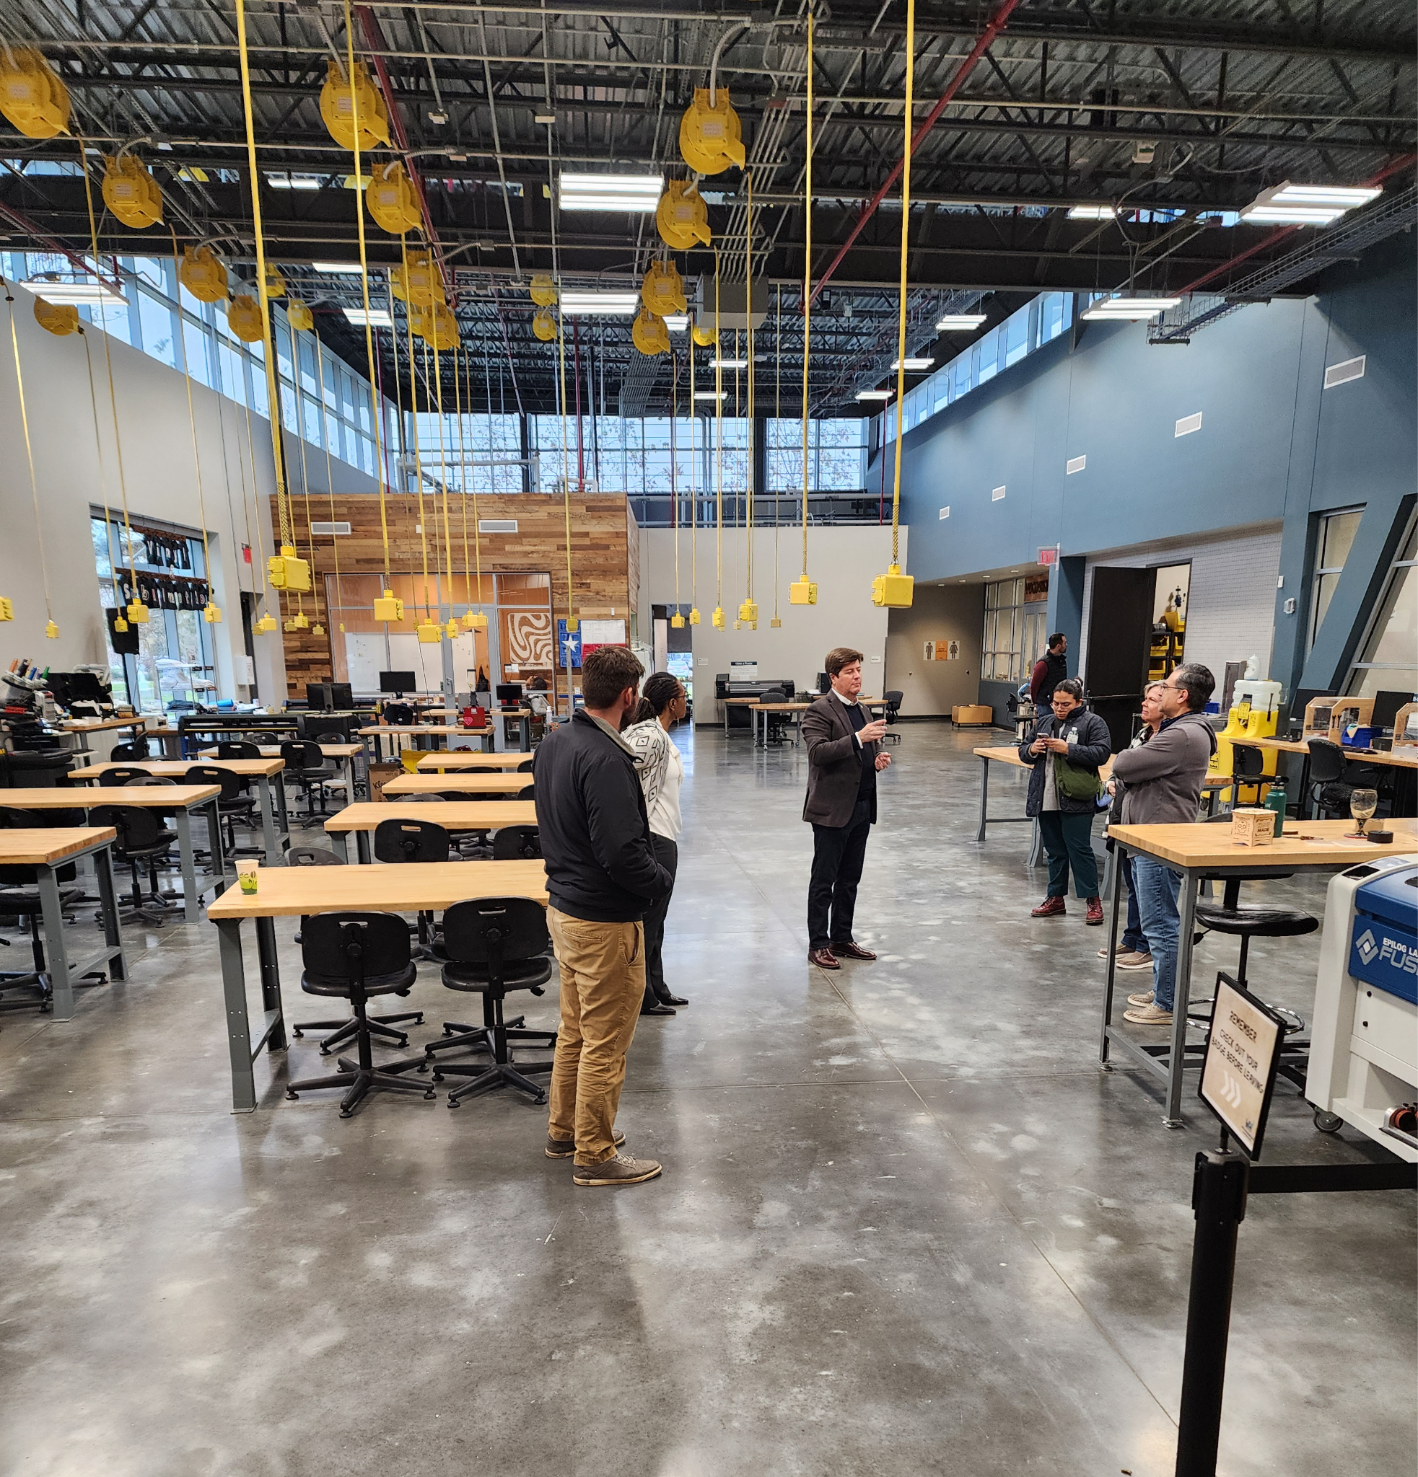
Houston - Tomball ISD, Goose Creek CISD, HCC Collaboratorium
Highlights:
Tomball ISD-Tomball Innovation Center (repurposed building)
​The Tomball Innovation Center, part of the Tomball Independent School District (TISD), offers specialized Career and Technical Education (CTE) programs that are exclusively available at this dedicated facility. The exclusive programs at the Tomball Innovation Center include:
Aviation Pilots, Aviation Maintenance, Electrical Technology,
Robotics, Law Enforcement.
Goose Creek CISD CTE Programs (repurposed building)
The district offers CTE courses at various high schools and dedicated facilities, such as: Stuart Career Tech High School – A standalone campus focused on career and technical training.
HCC Collaboratorium West Houston Institute high-tech space designed for collaboration, innovation, and problem-solving.
It features interactive technology, flexible workspaces, and expert facilitation for strategic planning, workshops, and networking events.
It includes a large interactive Nureva Wall, breakout rooms, and gathering spaces to enhance teamwork and creativity.
Available for HCC and external organizations, it provides a dynamic environment for brainstorming and developing actionable solutions.
Notes:
Goose Creek CISD’s Career and Technical Education (CTE) programs are spread across multiple campuses and specialized academies rather than being housed in a single building. The district offers CTE courses at various high schools and dedicated facilities, such as:
Stuart Career Tech High School – A standalone campus focused on career and technical training.
Tomball ISD’s Career and Technical Education (CTE) program is not housed on all campuses but is strategically offered across multiple locations, including:
Tomball Star Academy and Tomball Memorial High School – Offering a variety of CTE courses within their campuses.
Tomball Innovation Center – A dedicated facility providing specialized CTE programs and hands-on learning experiences.
Industry and Higher Education Partnerships – Some students participate in internships, dual credit programs, and workforce training outside of school facilities.
While all high schools provide access to CTE, specific programs and industry-based certifications are concentrated in select campuses and specialized centers.
The Collaboratorium at HCC’s West Houston Institute is a high-tech space designed for collaboration, innovation, and problem-solving. It features interactive technology, flexible workspaces, and expert facilitation for strategic planning, workshops, and networking events. The facility includes a large interactive Nureva Wall, breakout rooms, and gathering spaces to enhance teamwork and creativity. Available for HCC and external organizations, it provides a dynamic environment for brainstorming and developing actionable solutions.

Slide 8
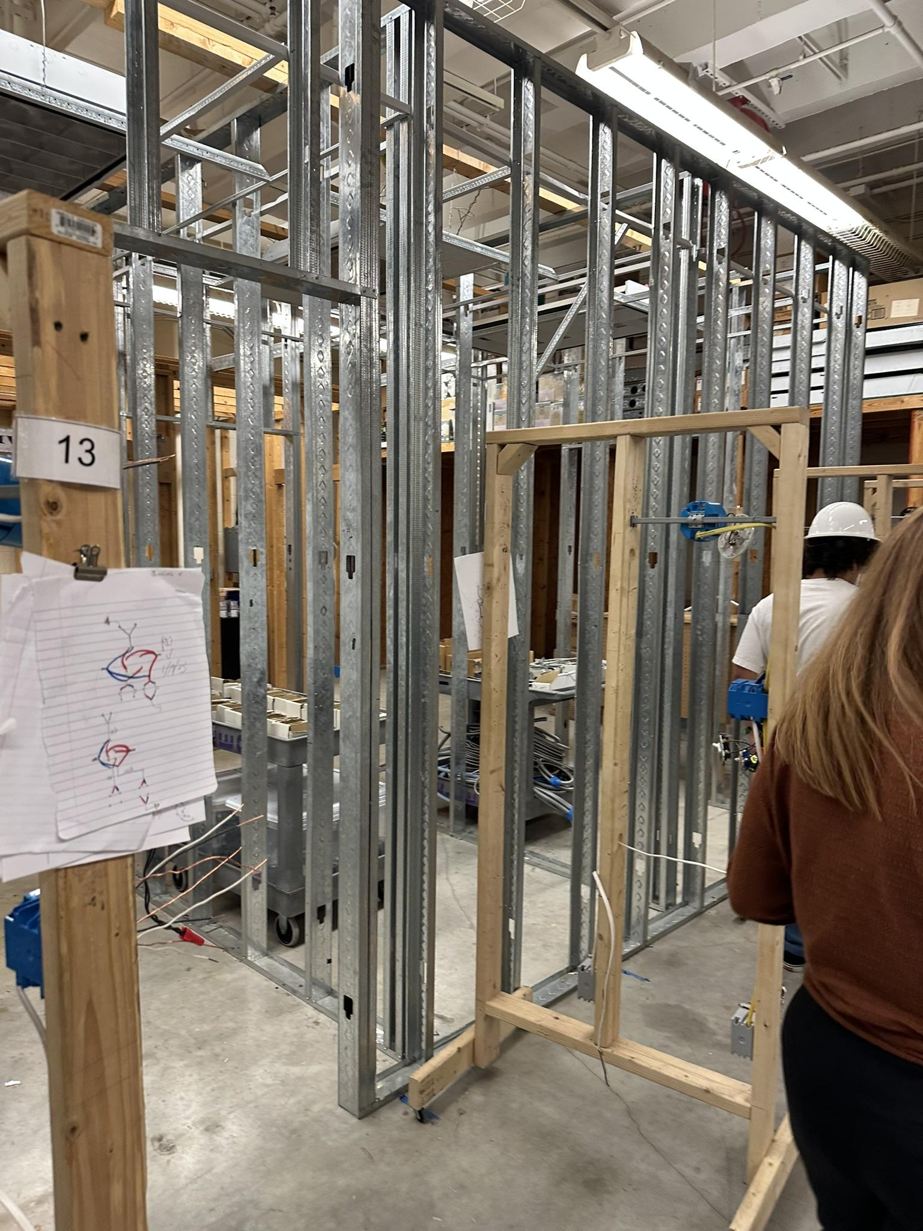
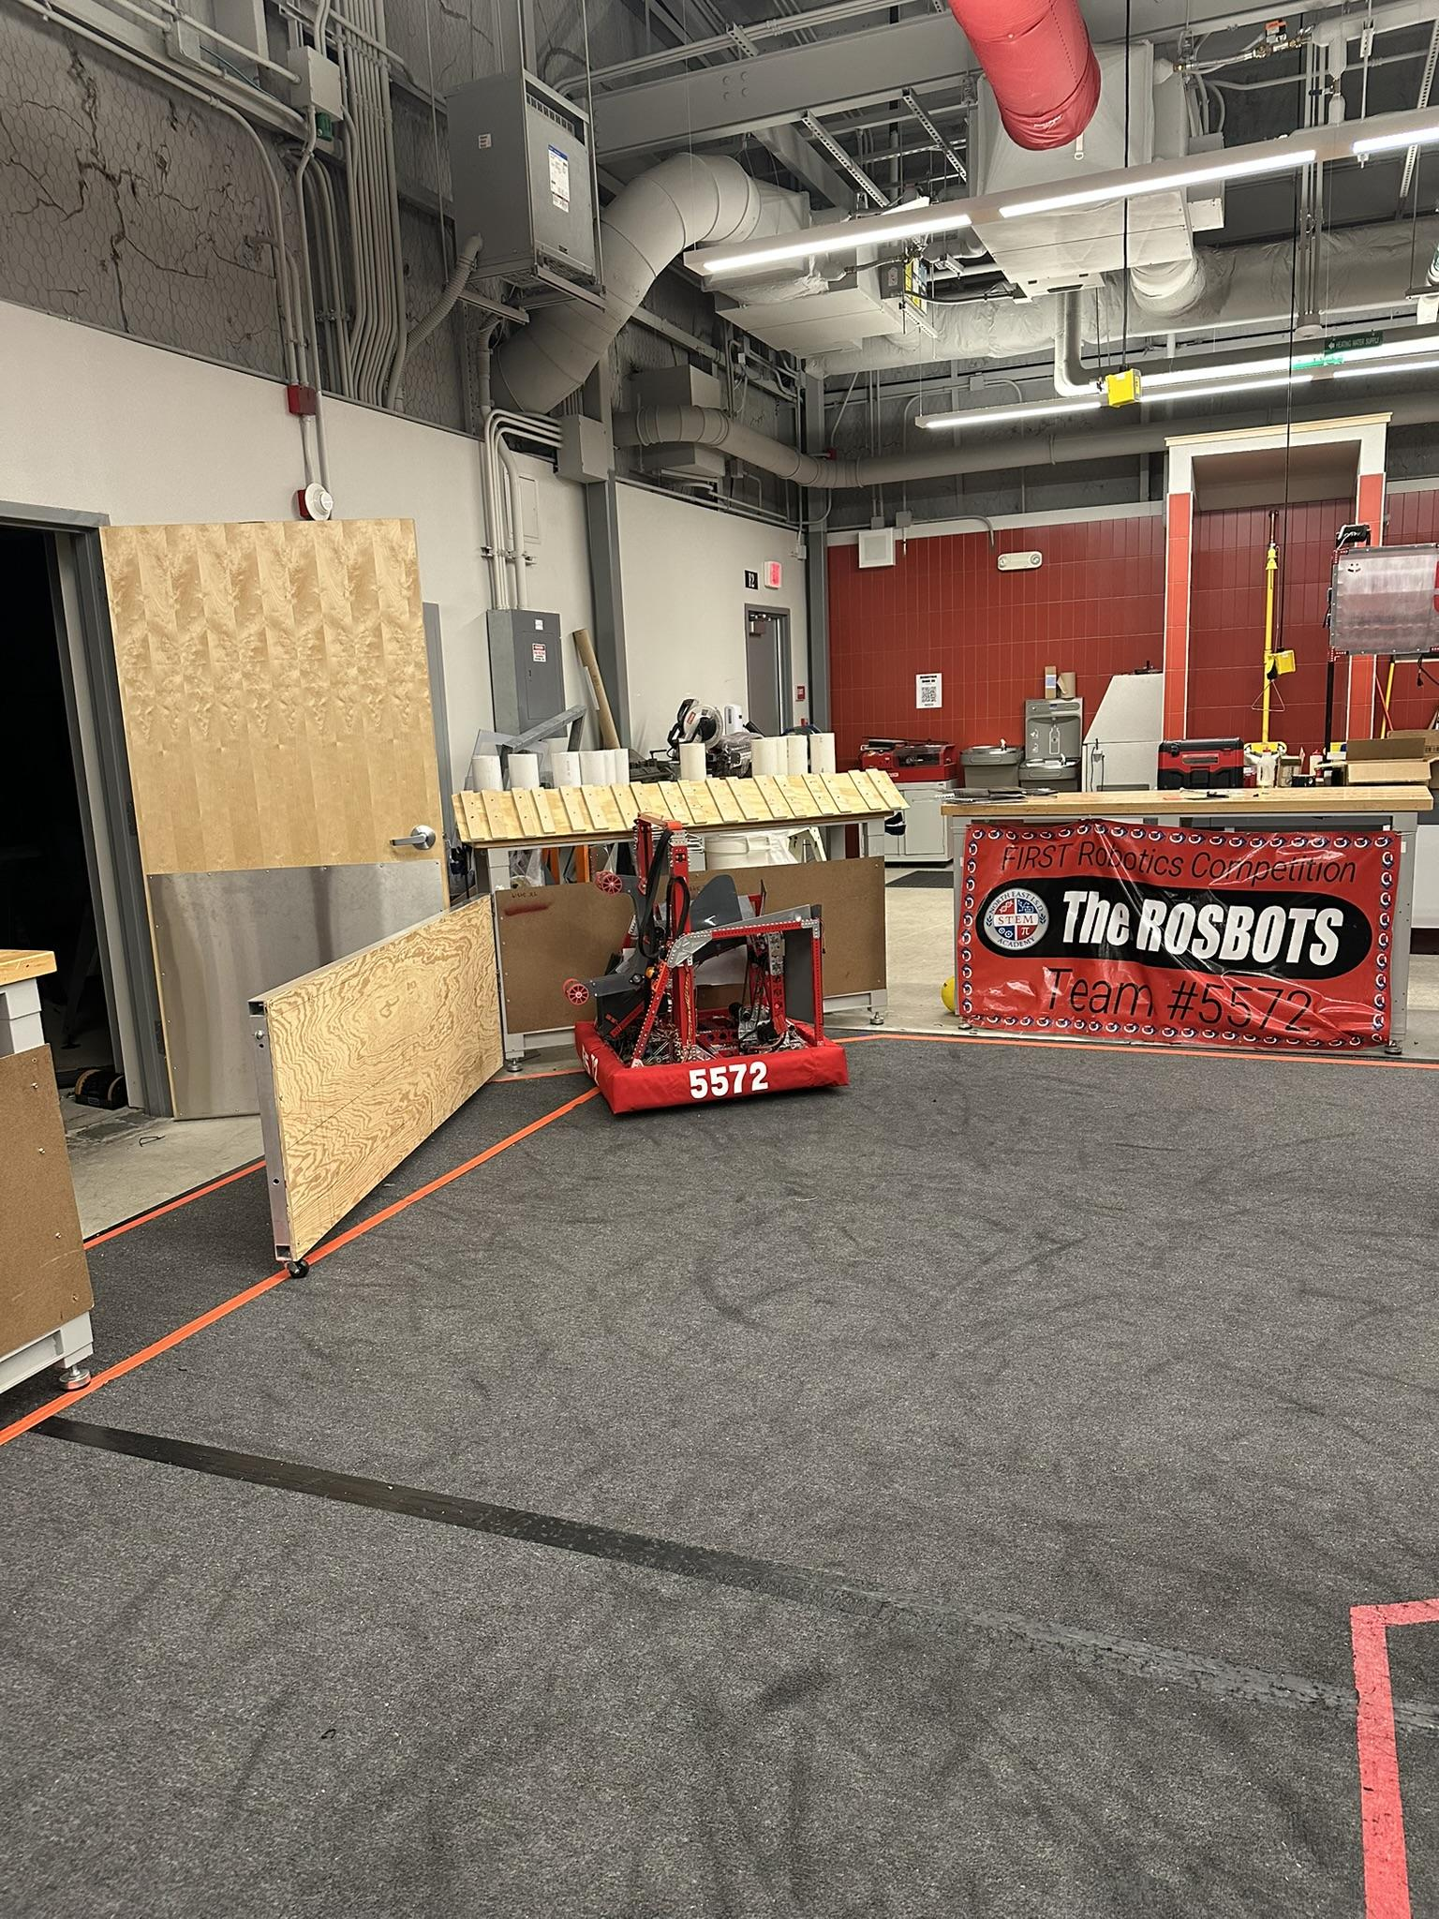
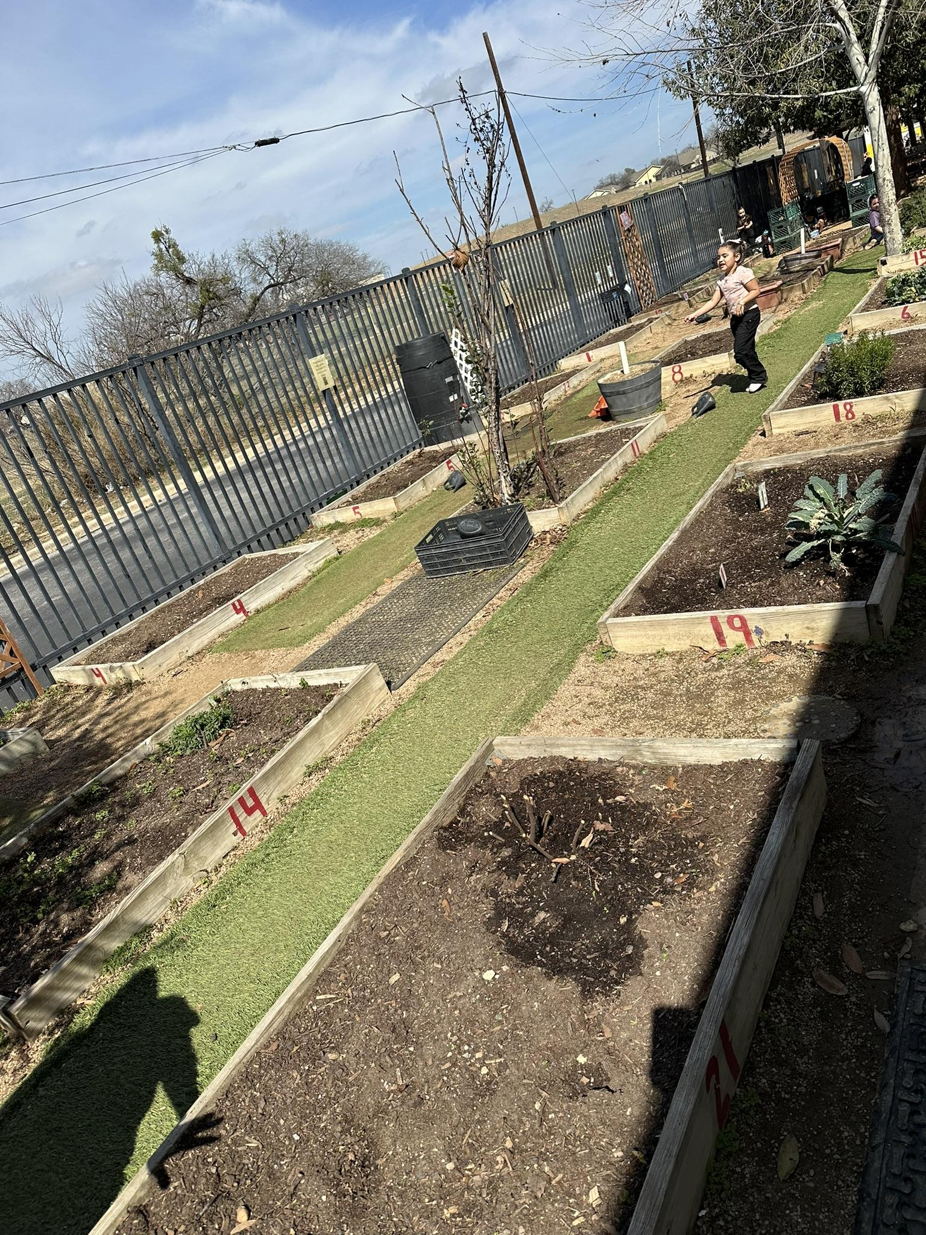
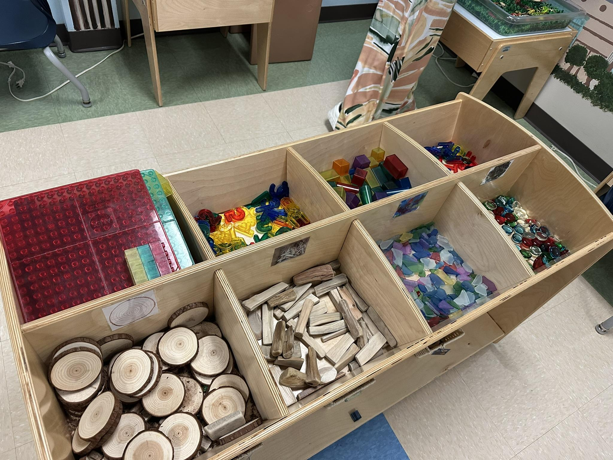
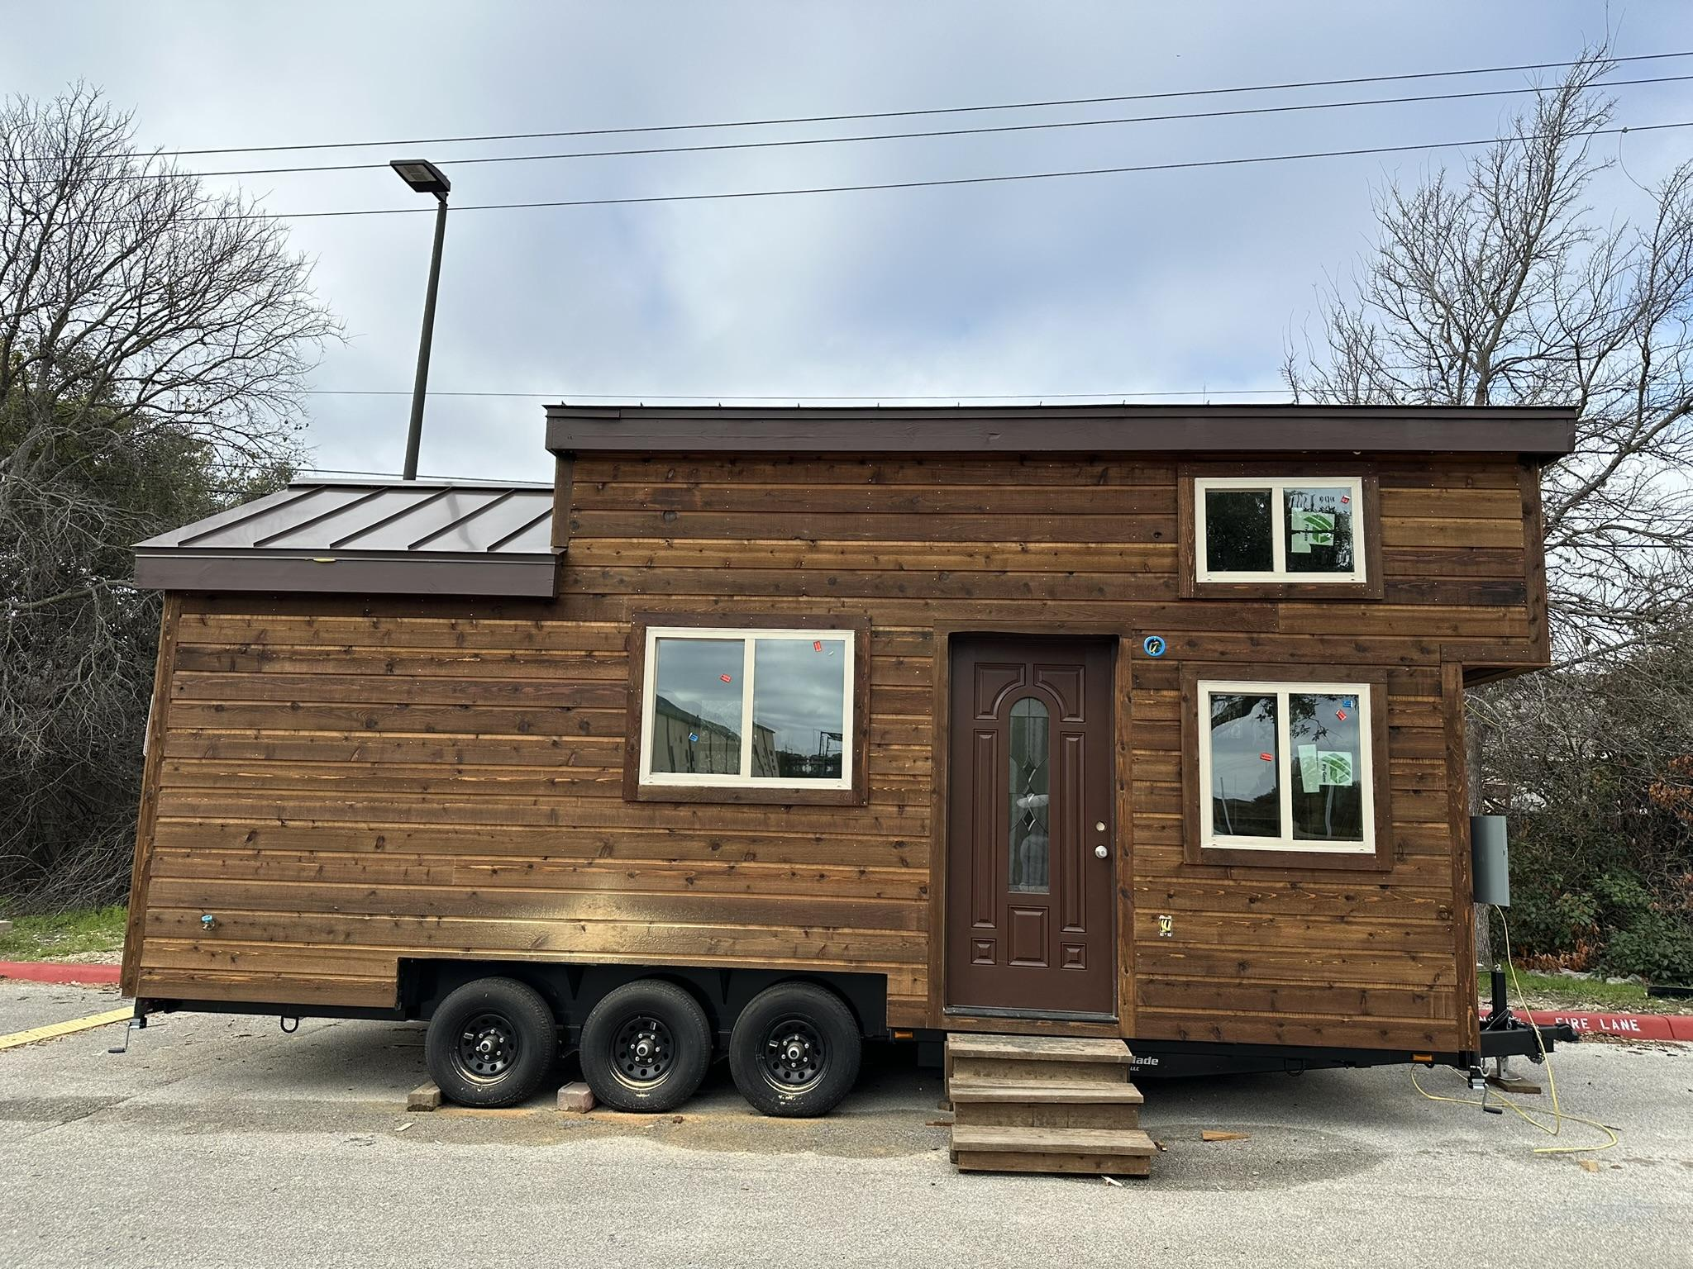
San Antonio - Northeast ISD, Northside ISD, Pre-K 4SA, Science Mill
Highlights:
Construction Careers Academy
Pre-K 4SA South- closing the facility/ moving to new location
Science Mill- Johnson City
NEISD STEM Academy
  NEISD- middle school- same struggle with space
Both indoors and outdoor learning areas and creative learning environments
Notes:
The San Antonio group traveled to NEISD, NISD, Pre-K 4SA south campus, and the Science Mill in Johnson City.
NISD- Construction Careers Academy which is a separate building on the campus of Warren High School. Students to go back and forth between the CCA campus and the main Warren campus for core classes. This is a neat facility, the shops designed for each path (plumbing, electrical, HVAC, etc.)
One of their obstacles is finding outside placement for their students. Due to that limitation, the workshops on site allow them to offer in house practicums vs placing students at external sites. Lots of hands on work space. One of the many interesting things they do is build tiny homes and sell them to community members and veterans. Have to build to SA building codes.
Pre-K 4SA- indoor and outdoor learning activities. very intentionally planned out. all furniture in the classroom must be for students- no teacher desks or teacher areas.
Science Mill- creative use of space- very hands on and creative learning environments
NEISD- STEM academy- magnet program (housed at NIMITZ middle school and at LEE High School). Students are admitted as early as middle school via a lottery system. They are facing facility limitations as well. Core content classrooms teach their curriculum through a STEM focus to provide cross curricular support.
Each of these facilities had both indoor and outdoor learning areas and creative learning environments

Slide 9
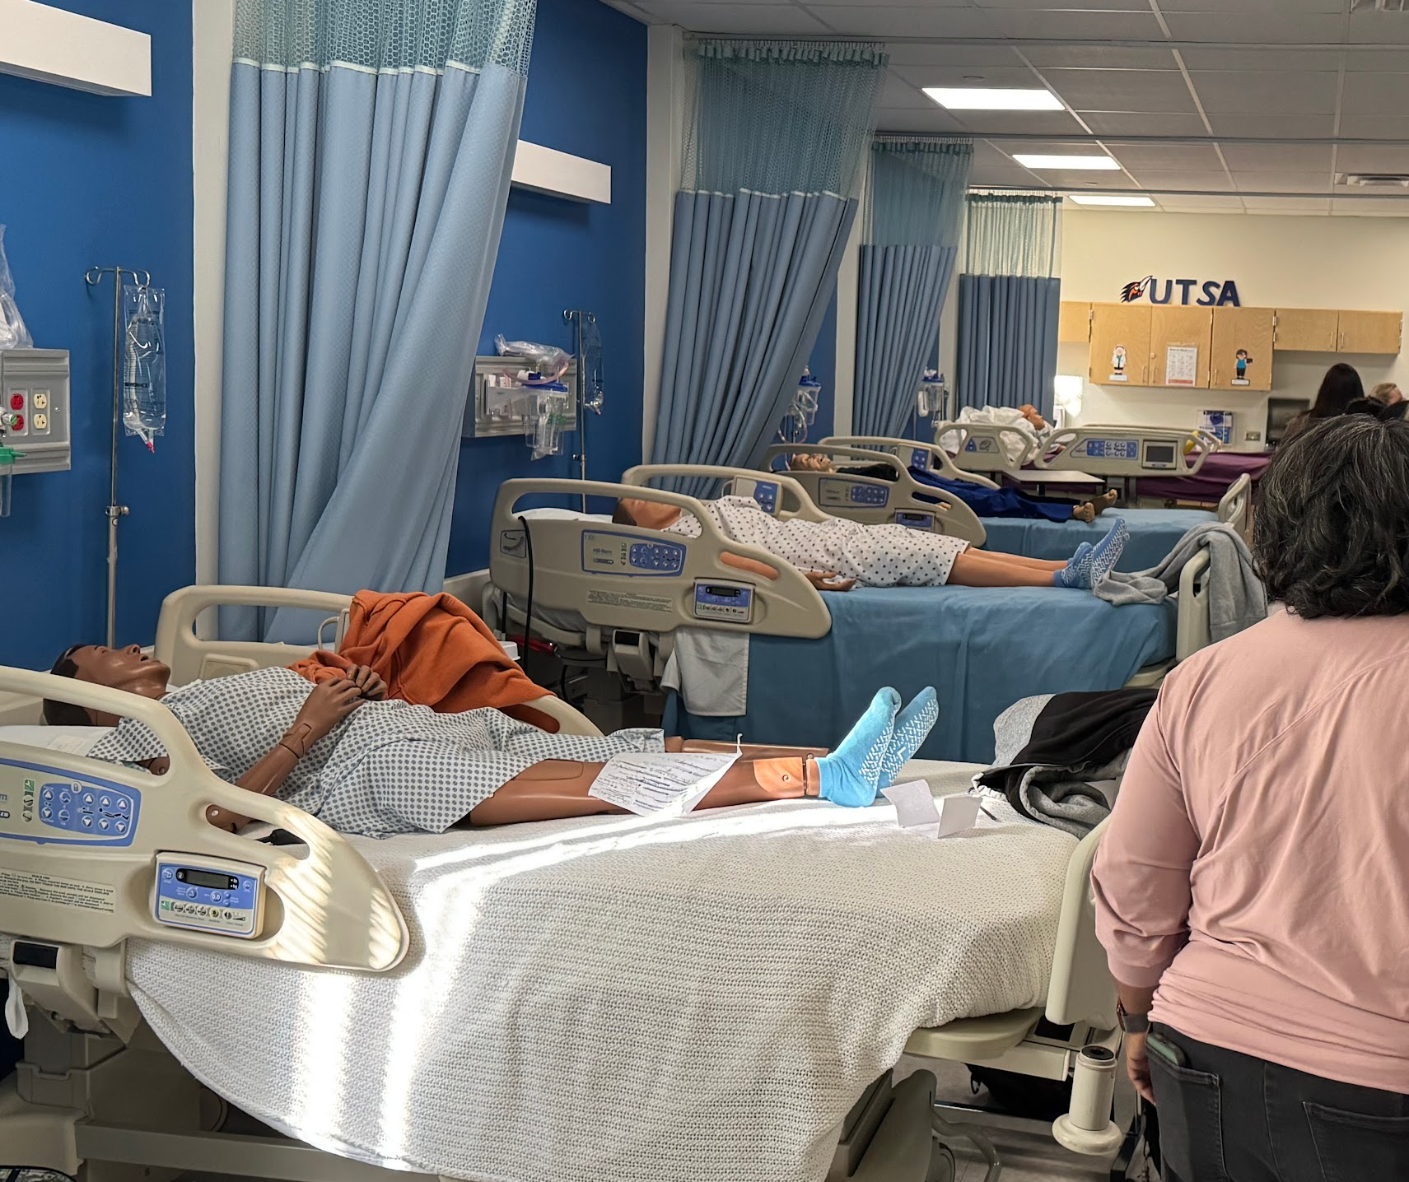
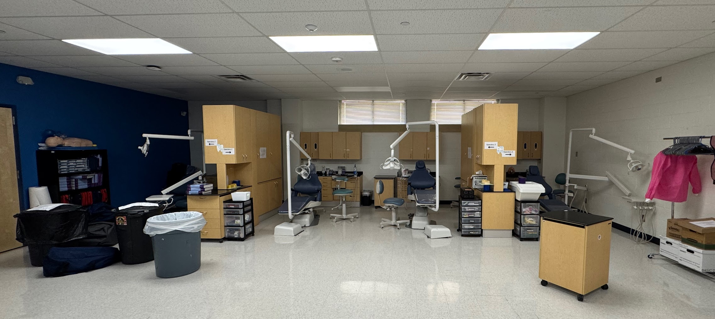
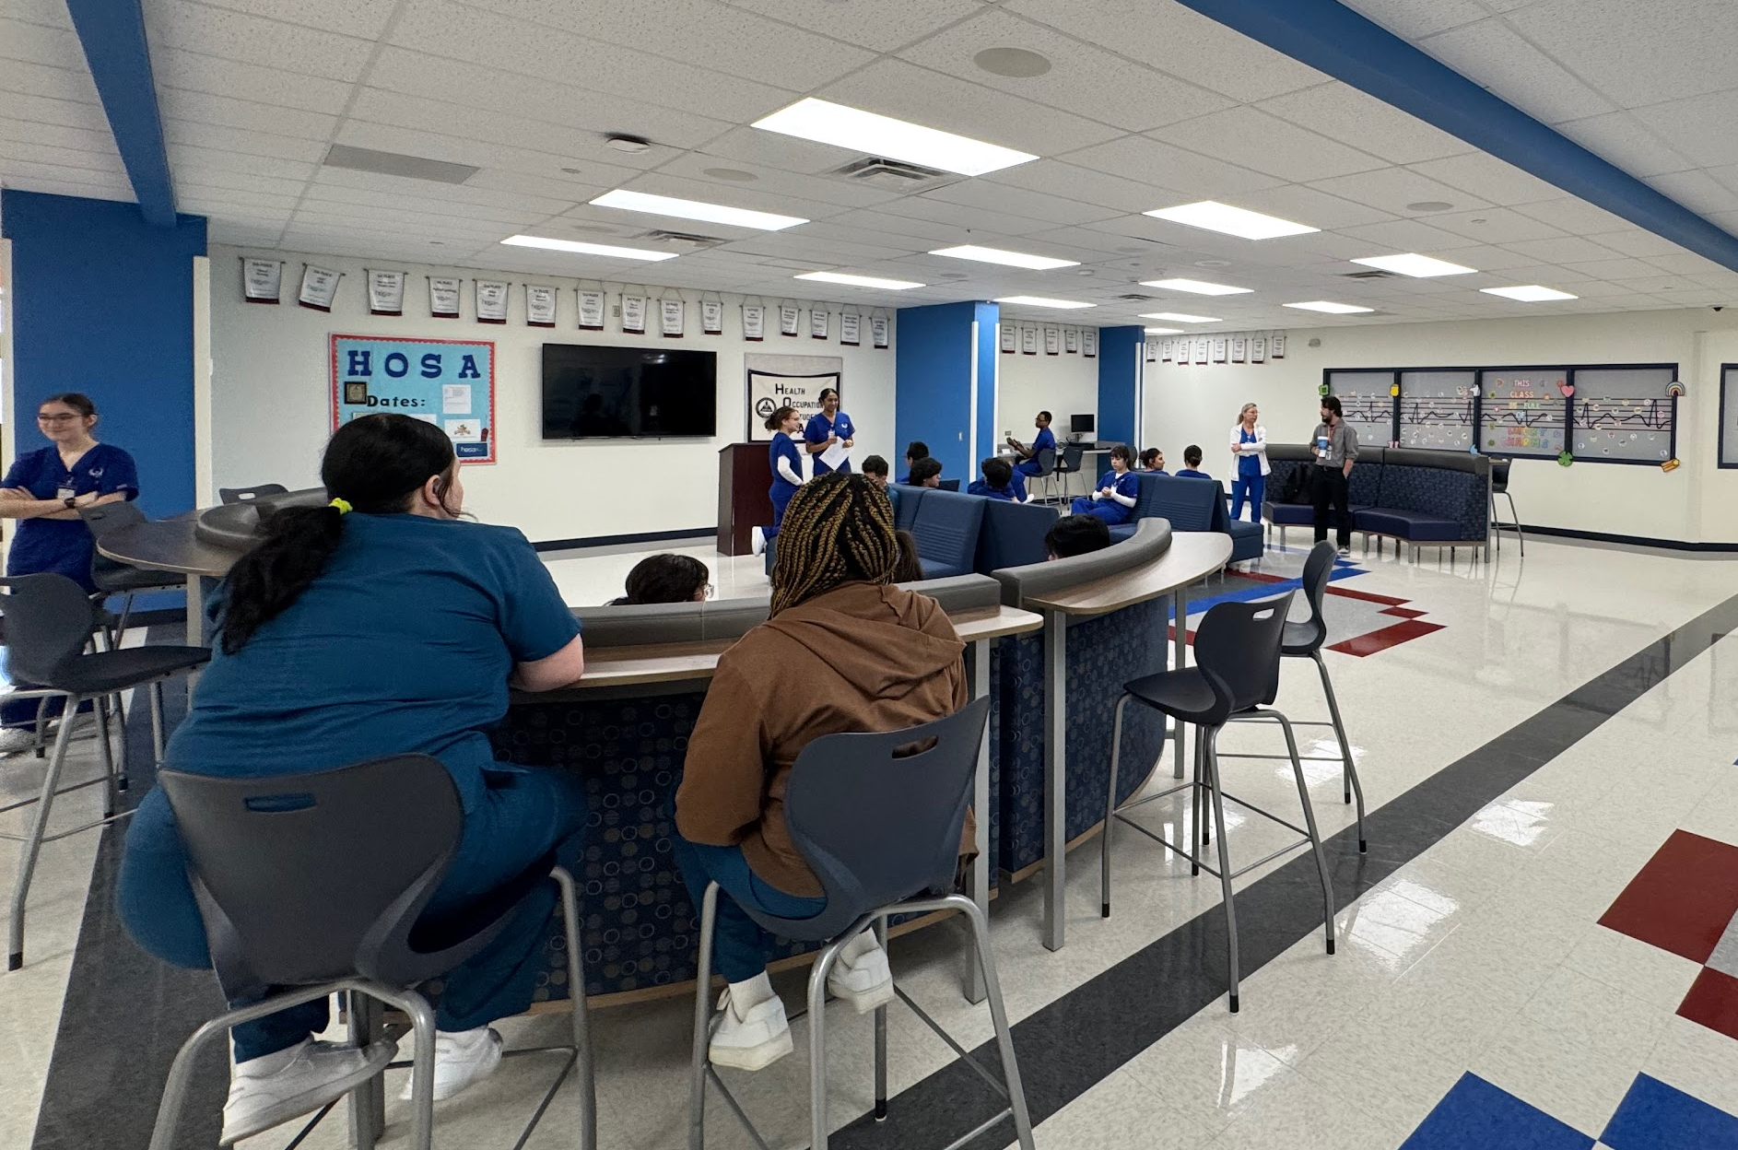
San Antonio - Northside ISD Health Careers
Opened 1984; CTE Wing 2020
Only stand alone magnet in NISD, only HS on block schedule to allow for practicum blocks of 3 hrs
900 students, grades 9-12
Students accepted from within and outside NISD with passing STAAR
Fine Arts - Orchestra, Band, Choir, Art
Lifetime sports - golf, swimming, water polo, tennis
Certifications - CNA, Phlebotomy, Pharmacy Technician, Sterile Processing, Registered Dental Assistant
Program is geared to students not needing additional supports

Slide 10
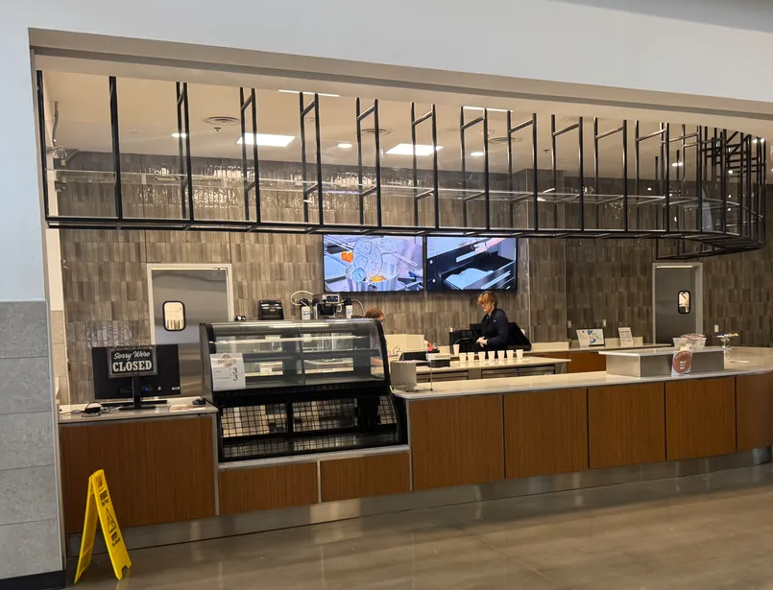
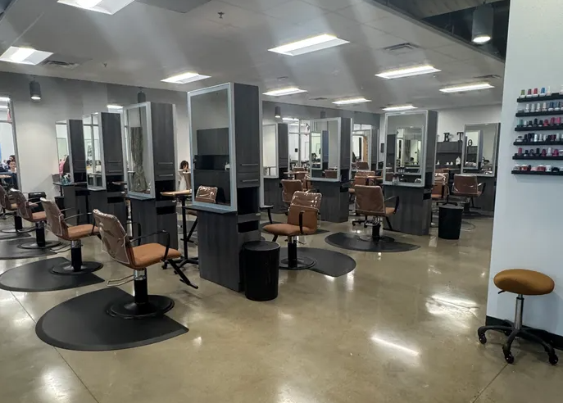
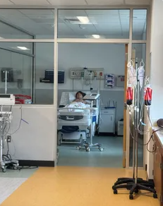
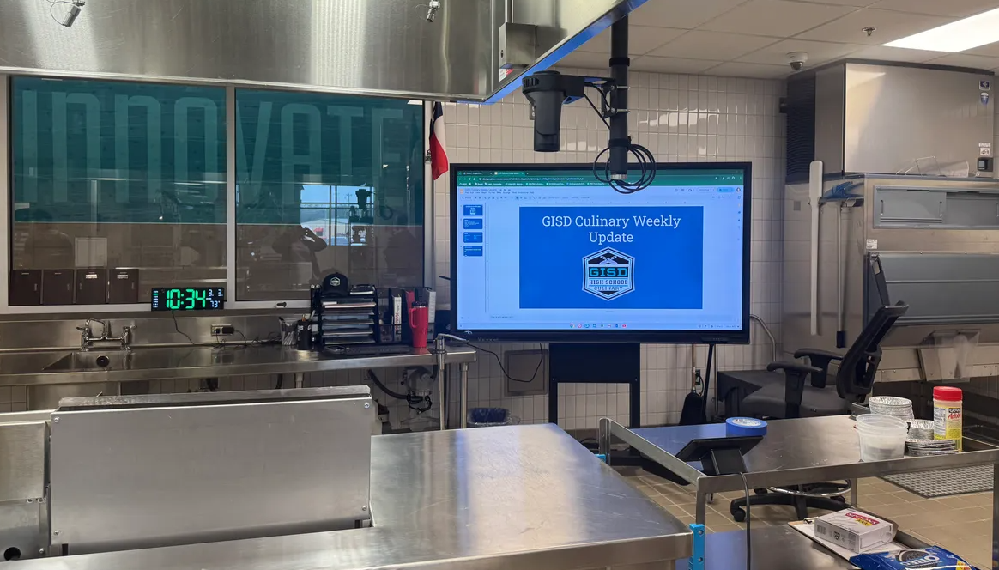
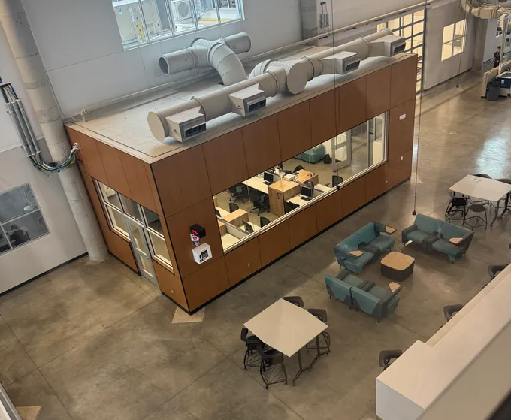
Austin - Georgetown ISD - Future Ready Complex & EC Center
Highlights
Variety of CTE Programs: Advanced Engineering, Automotive, Aviation, Cosmetology, Culinary Arts, Drones, Health Science, Rocketry
Facility for Advanced CTE Courses
Multi-Use (also houses 18+ & Alternative)
EC Learning Center on the same property (CTE learning opportunities)
Notes:
Almost 14K students
20 CTE certifications
3.1% annual growth
11 elementary campuses, 4 MS, 3 HS
GISD has 28 future subdivisions with over 19,000 lots in the planning stages
Groundwork is underway on more than 2,900 lots within 10 subdivisions
Charter school opening to impact enrollment fall 2025 (~350 students)
Georgetown ISD is forecasted to enroll nearly 16,300 students by 2029/30 and more than 19,900 by 2034/35
Boerne ISD is forecasted grow from 11K+ this year to 15K+ by 2033/34

Slide 11
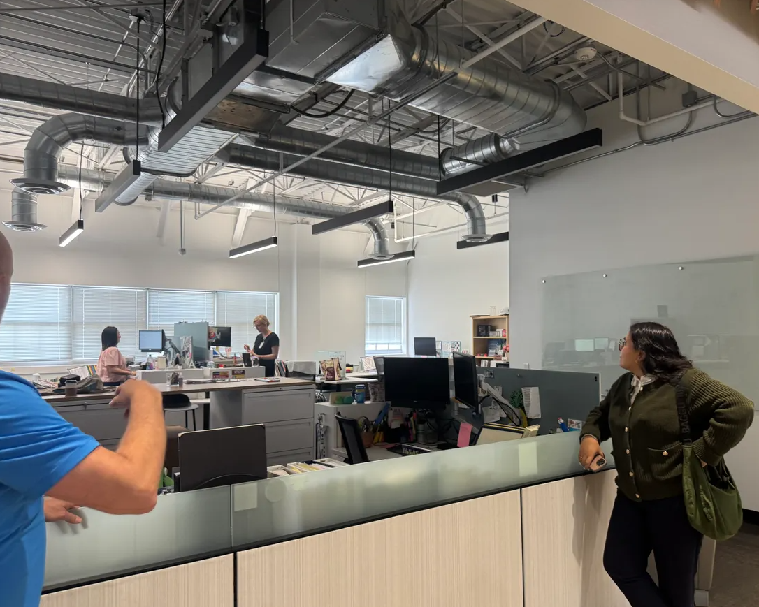
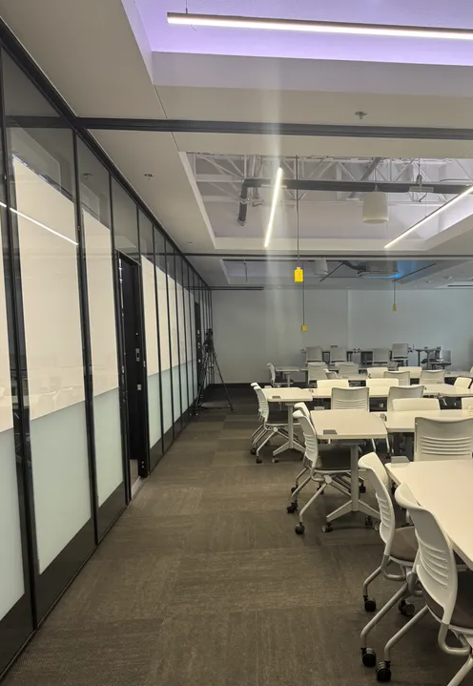
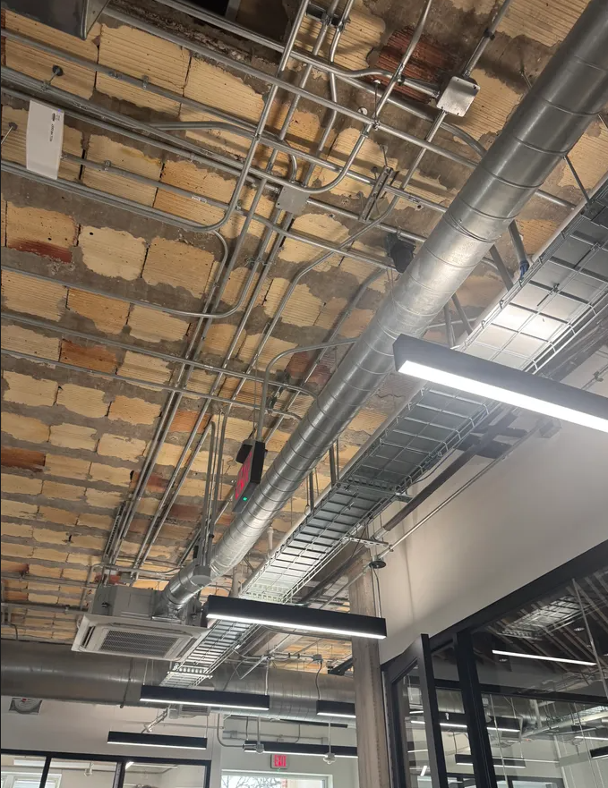
Georgetown ISD - Hammerlun Center for Leadership & Learning
Highlights
Originally built in 1917
Repurposed for Professional Learning, Central Office & Board Room
Flexible Collaborative Areas, Walls and Usage

