Slide 1


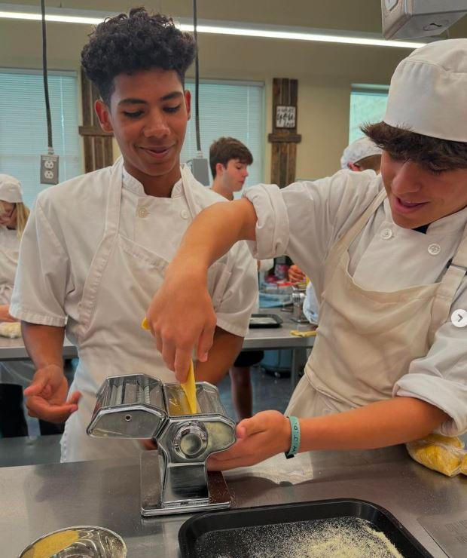


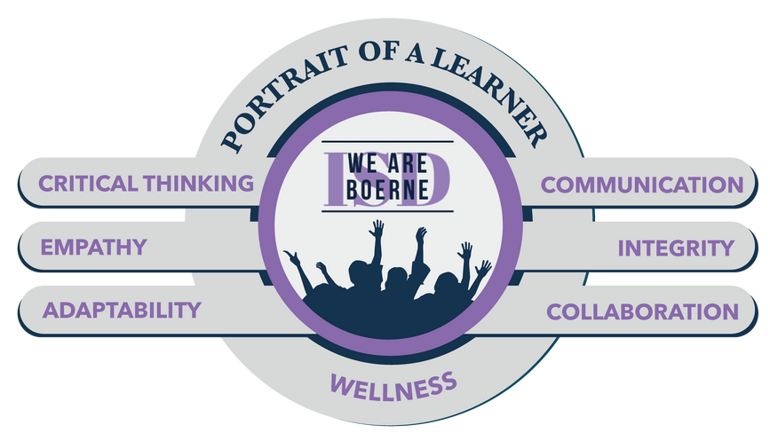
Boerne ISD
Instructional Programming
November 4, 2024

Slide 2


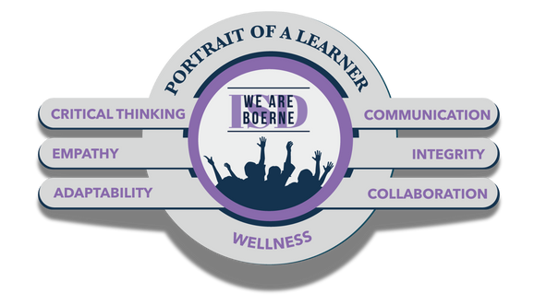


DISTRICT SCORECARD
STUDENT SUCCESS
TALENT
By 2028, 100% of Boerne ISD students will engage in innovative learning experiences so they are college, career, and/or military ready.
By 2028, 100% of the Boerne ISD employee experience will prioritize opportunities to perform at and aspire to the highest level of professional performance growth.
FISCAL RESPONSIBILITY
FAMILY &
COMMUNITY ENGAGEMENT
By 2028, Boerne ISD will maximize funding and efficiencies so our budget funds 100% of our identified needs.
By 2028, 100% of Boerne ISD stakeholders will be a part of a culture of trust where they feel engaged and valued.
Notes:
Scorecard - These are Boerne ISD’s long-term, strategic goals. We focus on four areas, Student Success, Talent, Fiscal Responsibility, and Family & Community Engagement.

Slide 3

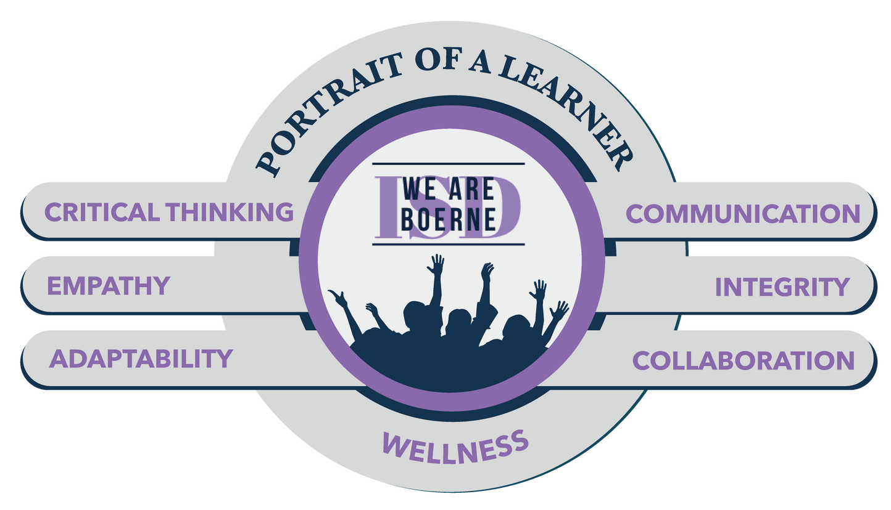
DISTRICT SCORECARD
STUDENT SUCCESS
By 2028, 100% of Boerne ISD students will engage in innovative learning experiences so they are college, career, and/or military ready.
Notes:
Student Success - [Read the goal]
We are a student-centered district; everything we do ties back to the student. Through professional learning, we are building educator capacity to directly influence outcomes and achievements.

Slide 4

INSTRUCTIONAL FOCUS

Slide 5
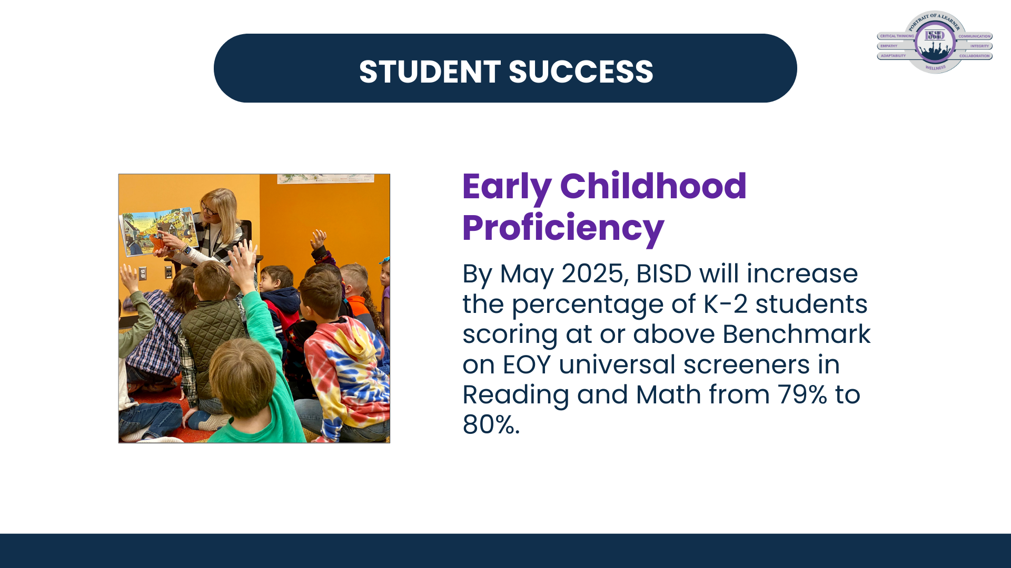
Notes:
An explanation of the discrepancy between math and RLA is that the MAP math test is has text to speech for all students as it is testing their math proficiency, not their reading skills. It is a more visual screener with many numbers, pictures, charts and graphs which tends to be easier for K-2 students to understand than a text based question.

Slide 6


Building Skills
LANGUAGE
READING
MATH

Slide 7
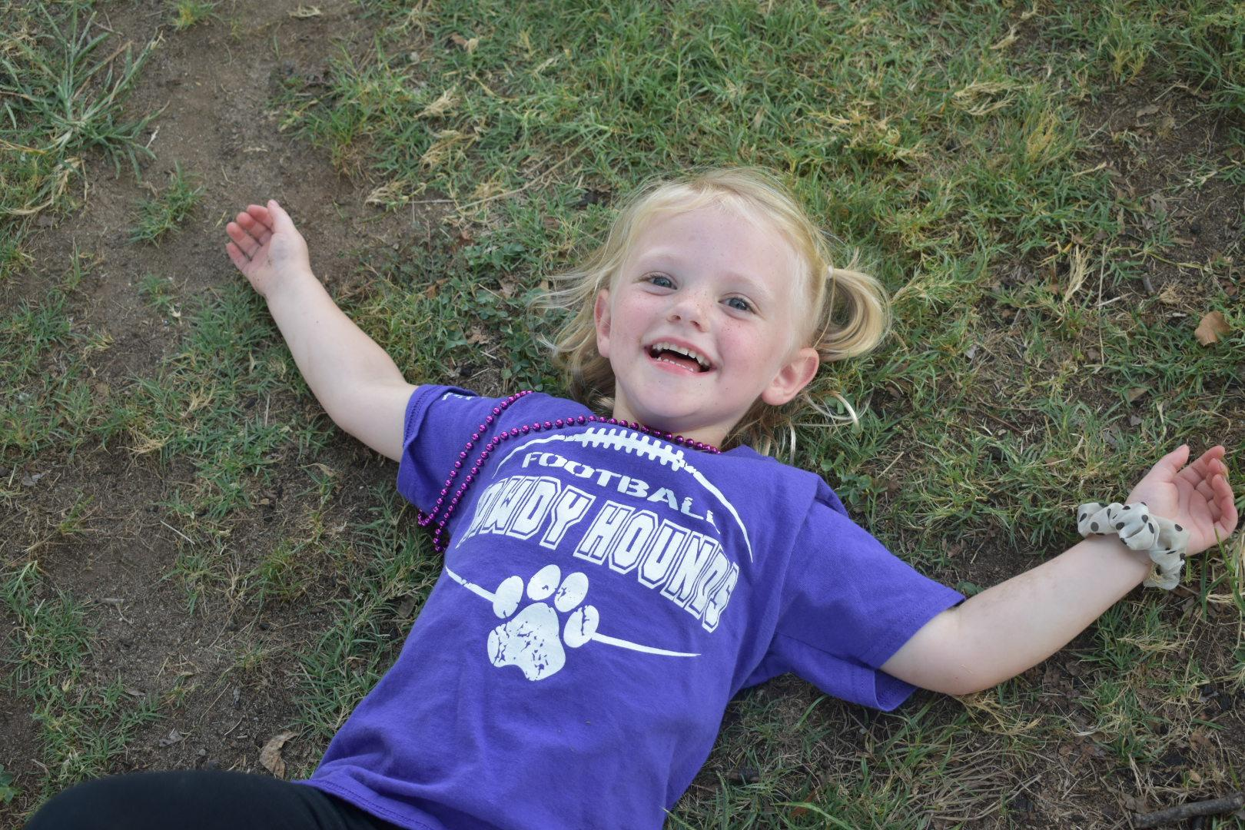
Prekindergarten

Slide 8
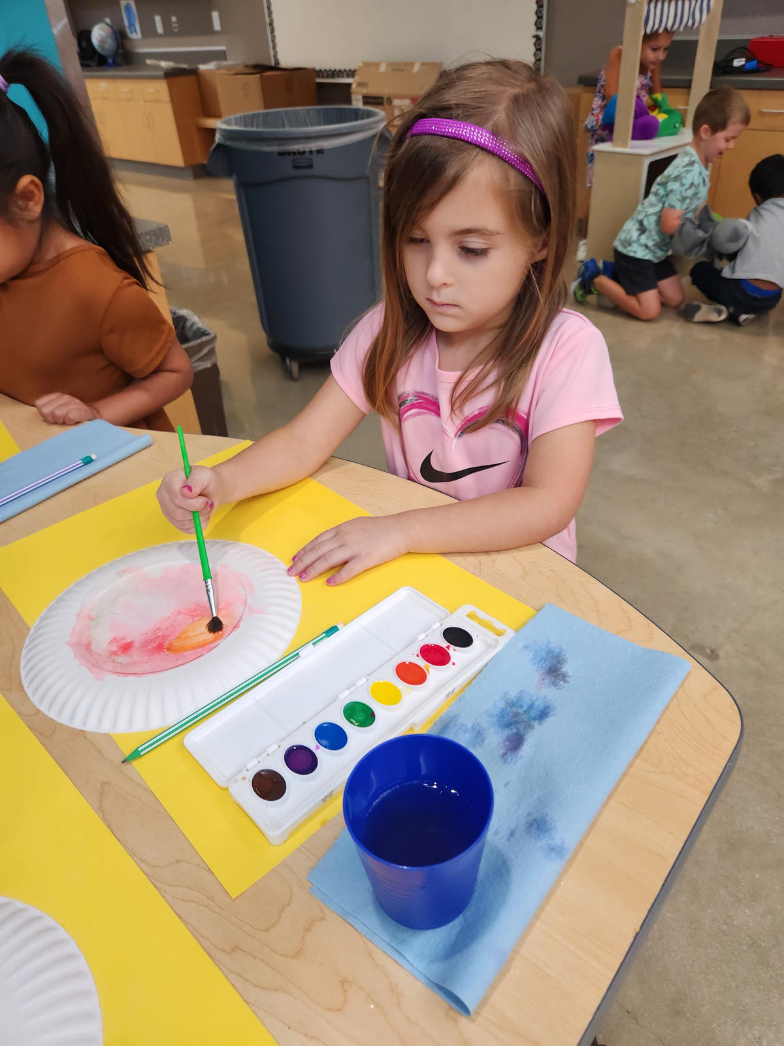


Prekindergarten
UNITS
13 English; 4 Spanish
PROGRAMMING
  State Eligible PK (4 years old)
  Early Childhood Special Education (3 & 4 years old)
  Employee Childhood Collaboration Tuition Based (3 & 4 years old)

Slide 9
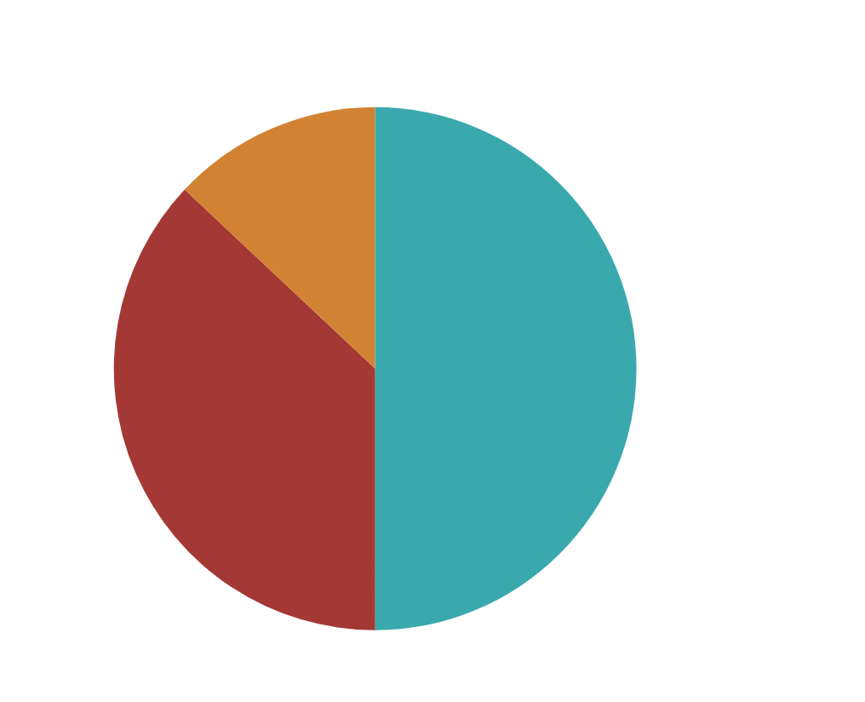



Enrollment:
271
Program Goals:
Aiming to prepare young learners for academic success through inquiry and play based learning
State Qualified
ECSE
ECC
Foster, Homeless, Economically Disadvantaged, Military, Emergent Bilingual
Early Childhood Special Education
Employee Childhood Collaboration

Slide 10


Early Matters
Learning Environment
Physical Space
Inquiry Based Learning
Interactions in the Learning Environment
Inclusivity

Slide 11



What If?
Early Learning
&
CTE: Education & Training
Specialized Early Learning
Outdoor Learning

Slide 12
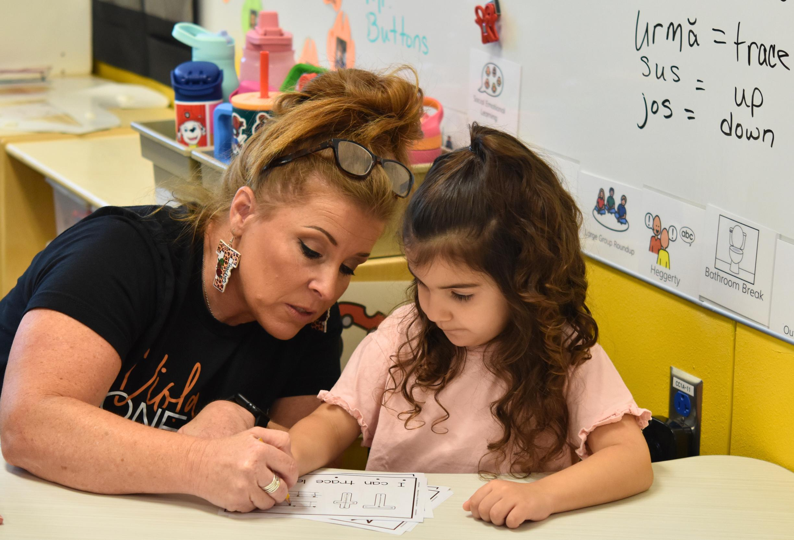
Early Learning

Slide 13
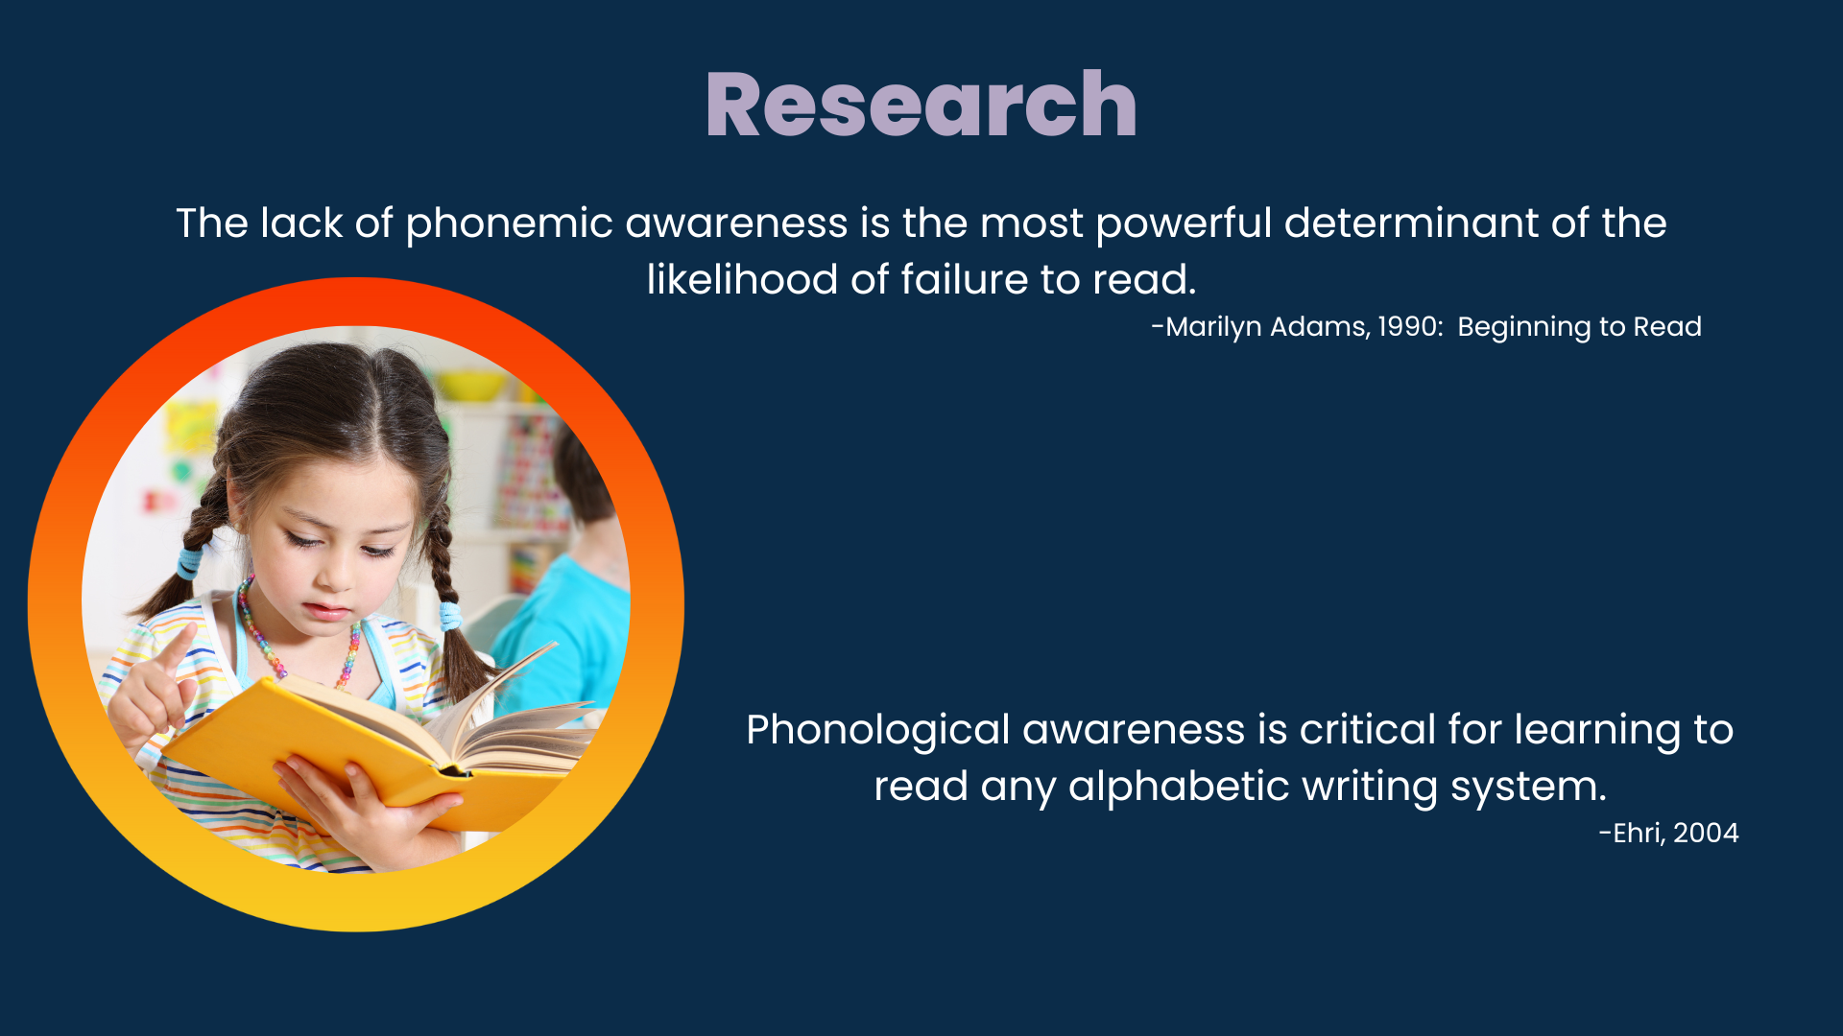

Slide 14
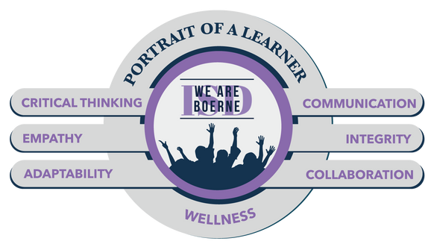
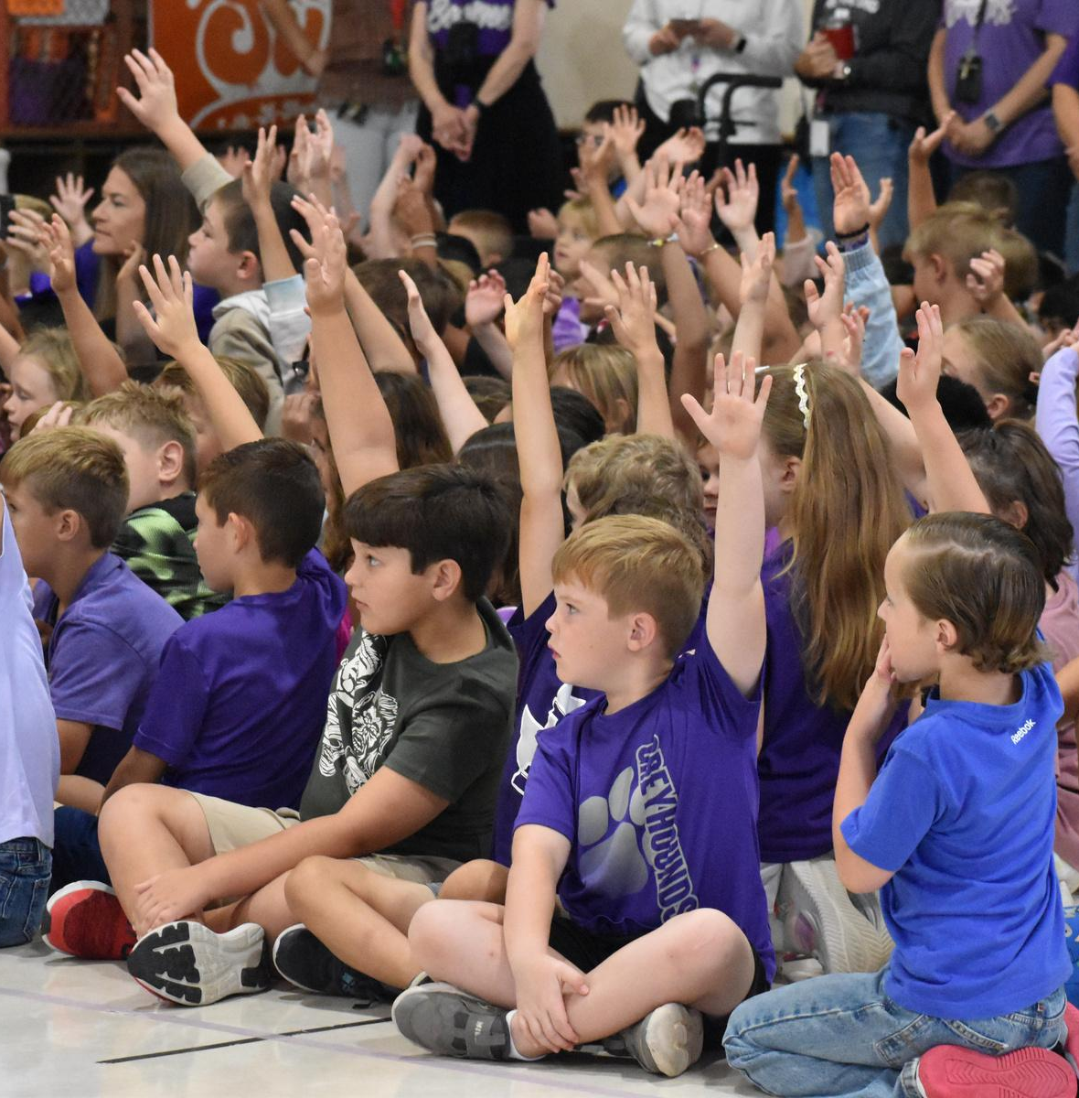
STUDENT SUCCESS
STAAR Meets & Masters
By 2025, BISD will increase the level of STAAR Meets performance levels from 70% to 72% and STAAR Masters performance levels from 36% to 38% in all grades and subject areas.

Slide 15
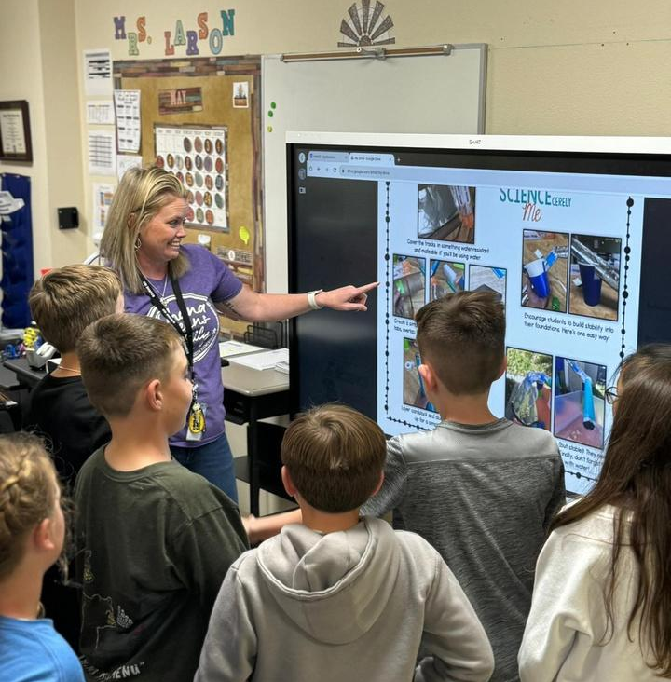
STUDENT SUCCESS
Academic Growth
By 2025 BISD will use MTSS processes to increase the % of students who make academic growth on STAAR Reading & Math by 2%.

Slide 16

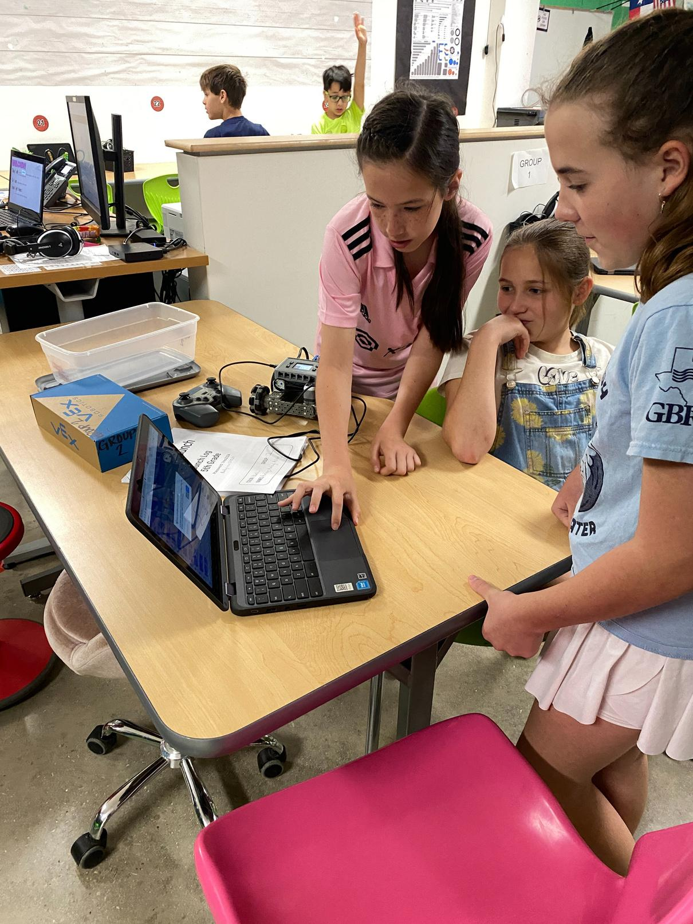
PROJECT LEAD THE WAY
2023-24 - 5th Grade
2024-25 - 4th Grade
2025-26 - 3rd Grade

Slide 17


Turn & Talk
  What are some key takeaways from what you just learned ?
  I used to think _________________ about PreK, but now I know____________________________.
  I was clueless about ______________________ but now I know _________________________.

Slide 18
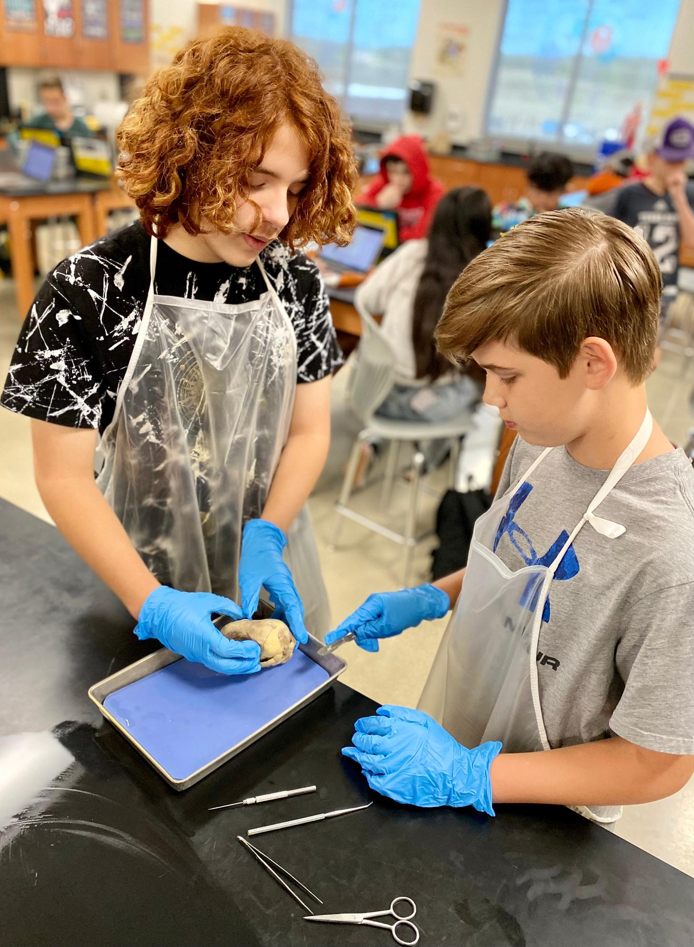
Middle School

Slide 19
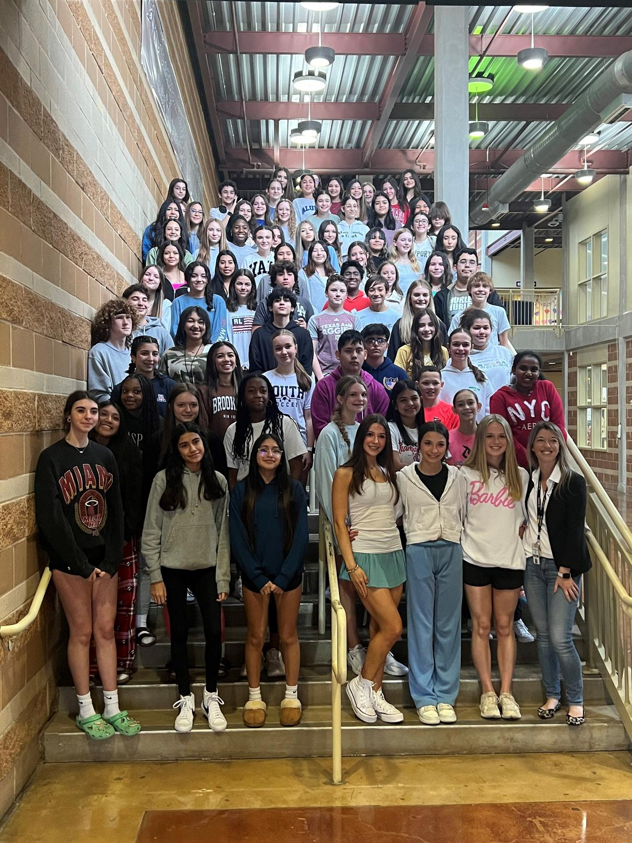



Electives
STUDENT LEADERSHIP
TECHNOLOGY APPLICATIONS
COLLEGE, CAREER READINESS
PRINCIPLES COURSES LEVEL 1

Slide 20
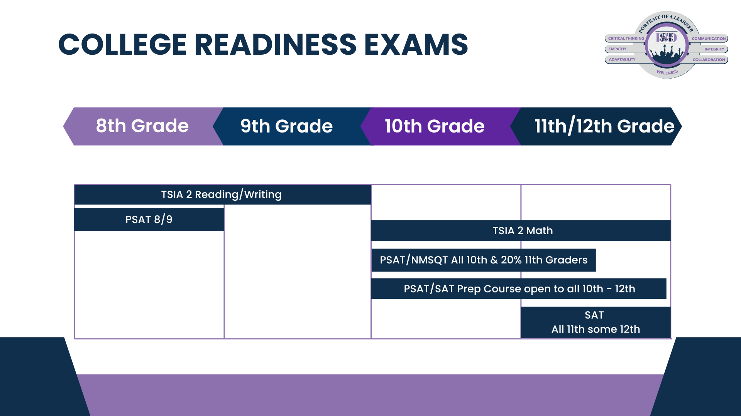
Notes:
In preparing students for these advanced classes.
Our college readiness testing starts in 8th grade with the TSI. The TSI is a college placement test that determines if a student is college-ready in English, Writing, and Math. In 8th grade, students are given the English and the essay part of the TSI.
8th graders are also given the PSAT 8/9 in October.
In October, all 10th graders and about 25% of juniors take the PSAT NMSQT.
Spring of junior year, students take the SAT School Day.
High school students in grades 9-12 can take the TSI.

Slide 21
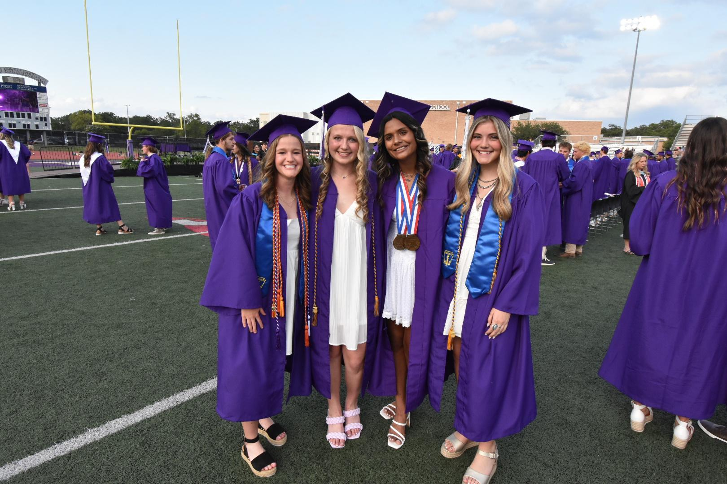
College Ready
Notes:
CCMR has two components- college readiness and career readiness.

Slide 22
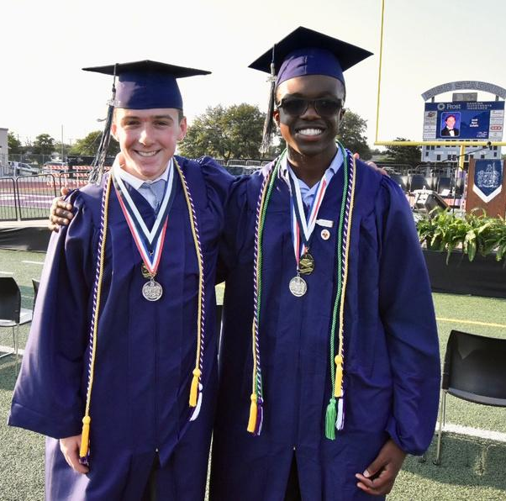
STUDENT SUCCESS
Advanced Academics
The yearly student retention rate for all advanced courses and programs and all aspects of being College Ready will be maintained at 95%.
Notes:
We know it is important that our students not only enroll in advanced courses but stay in advanced courses. This course work prepares students for their post secondary goals.and retention in these classes are vital to district goals.

Slide 23







P-TECH
Associate Degree Attainment
Core Complete
Level 1 & 2 Certificates
Industry Based Certifications
CCMR
Notes:
We now offer 2 PTechs, one in cyber and one in health science. Both PTechs offer students the opportunity to earn an associate degree, various IBCs in their field of study and ultimately to become CCMR.

Slide 24
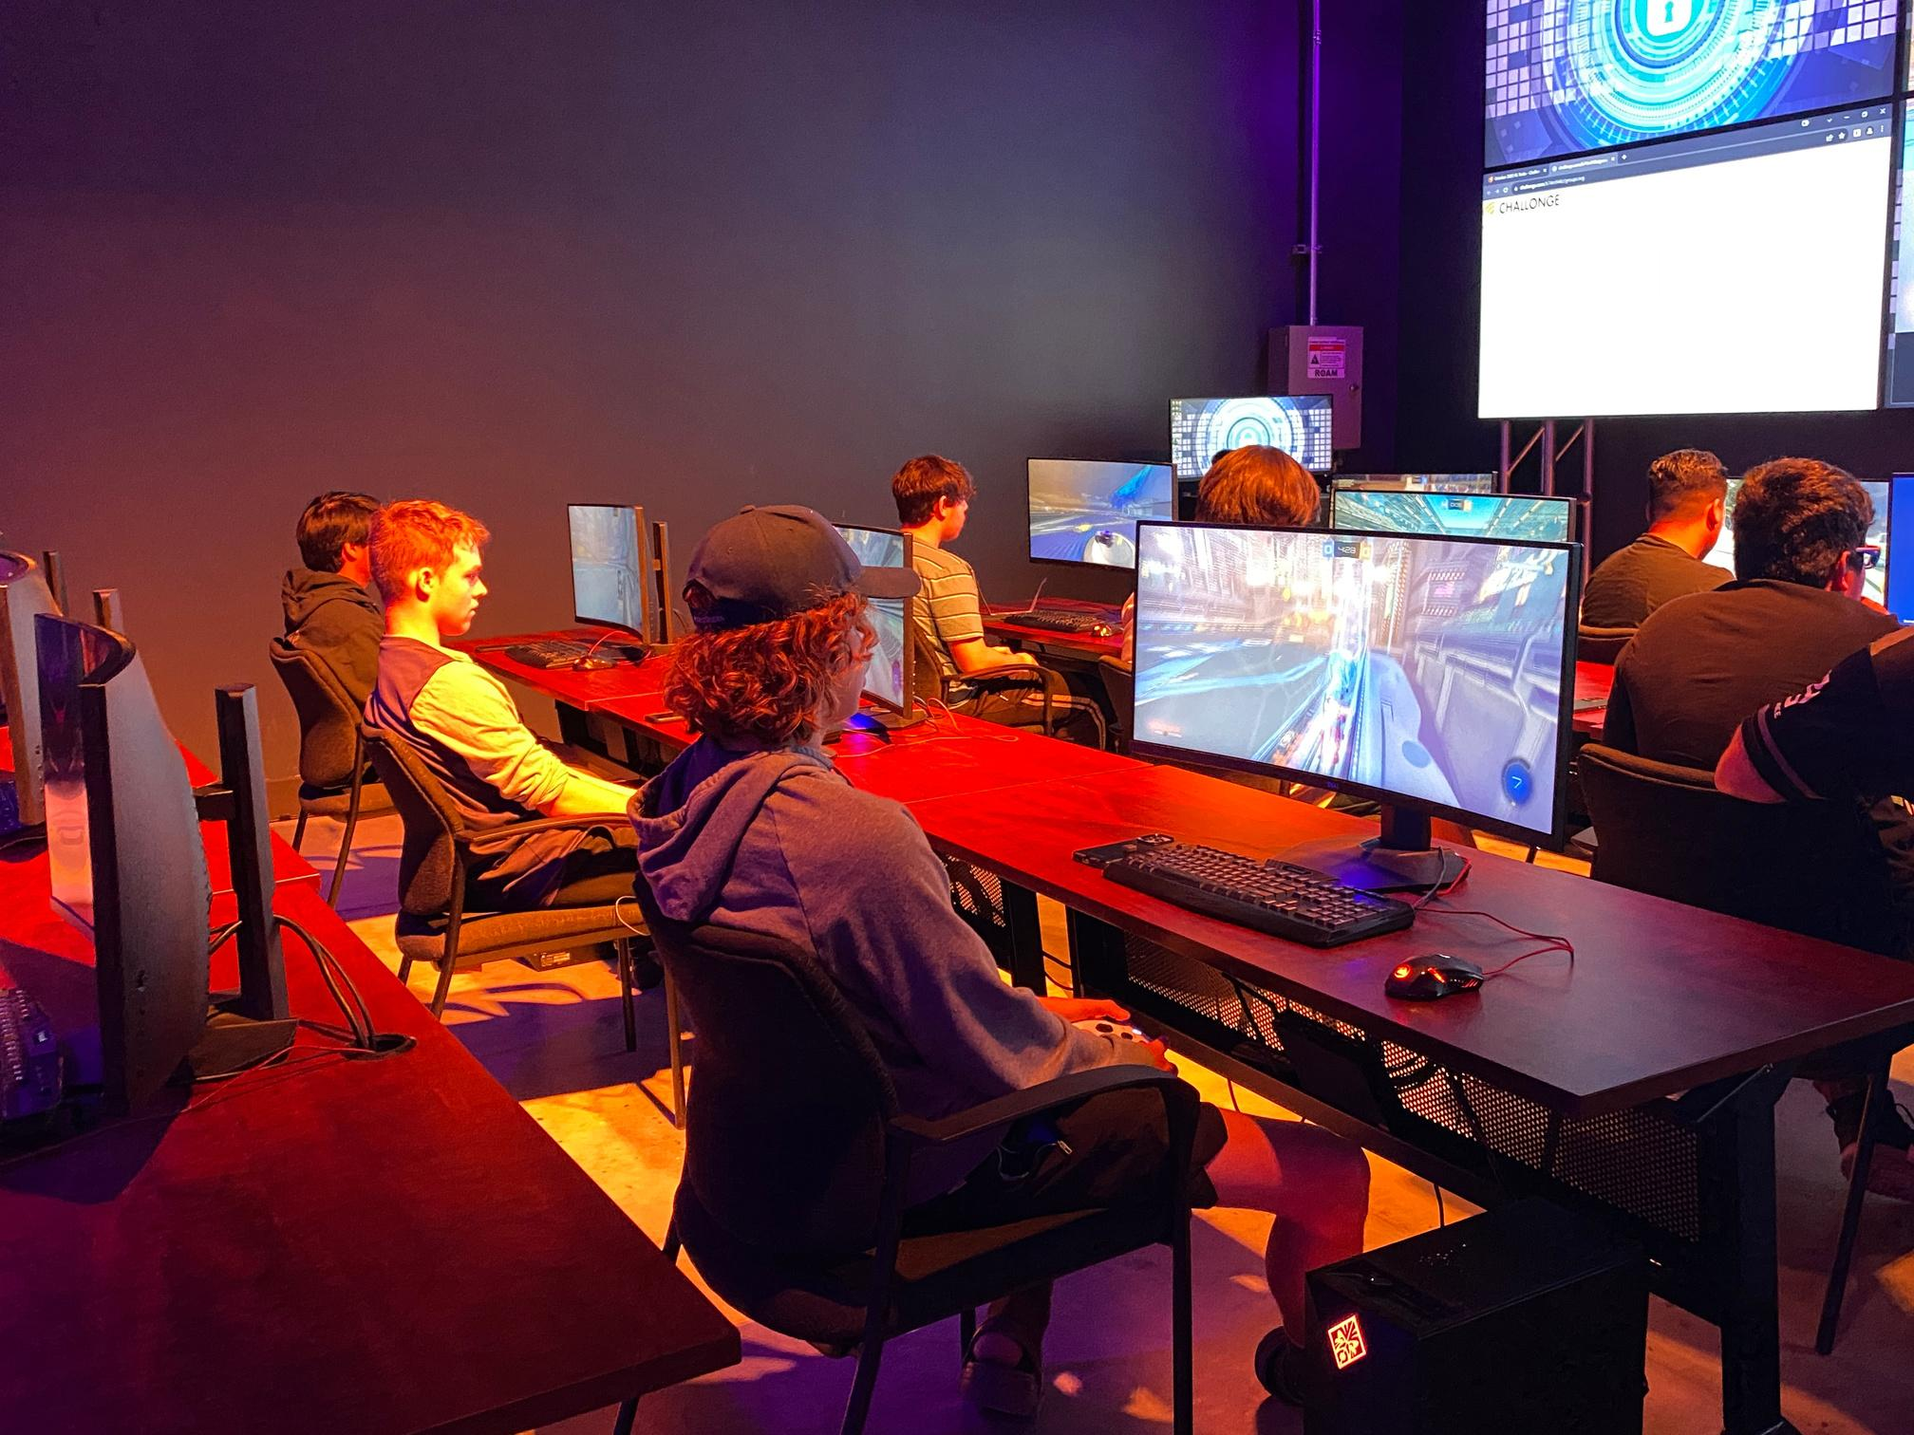
Career & Military Ready

Slide 25
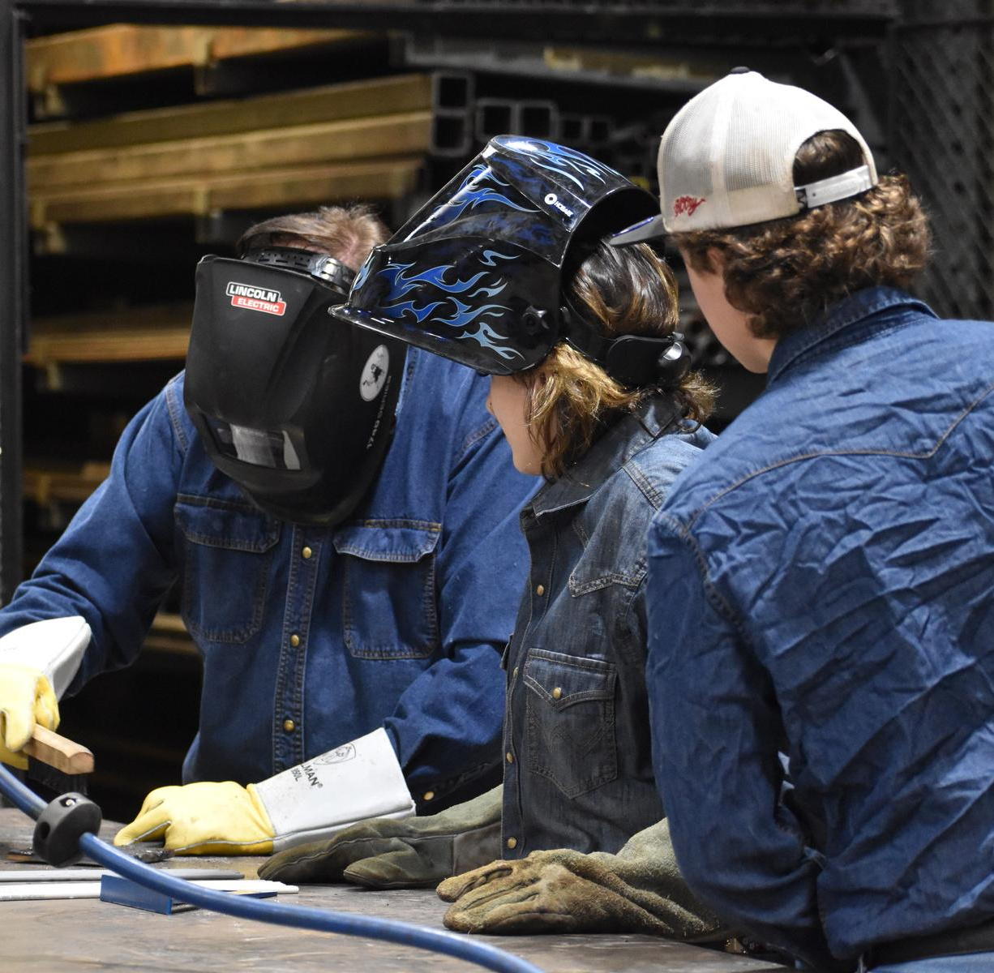
STUDENT SUCCESS
Career & Technical Education
By 2025 BISD will increase the number of reported CTE completers with credentials by 10%.

Slide 26
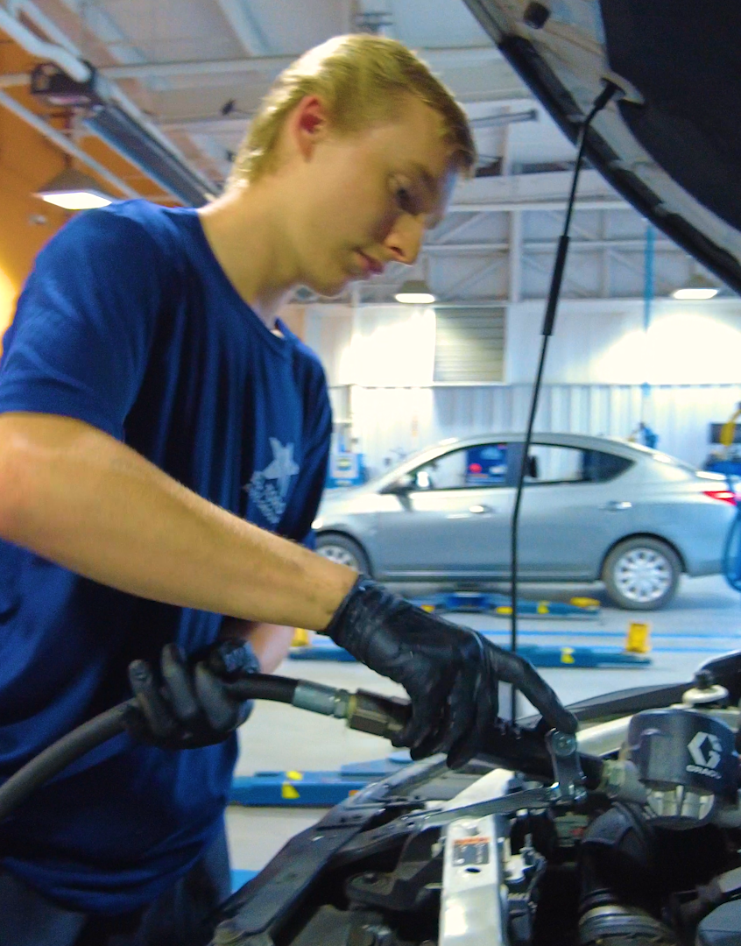
CAREER PATHWAYS
11 Career Clusters
18 Programs of Study
Over 300 in Work Based Learning

Slide 27
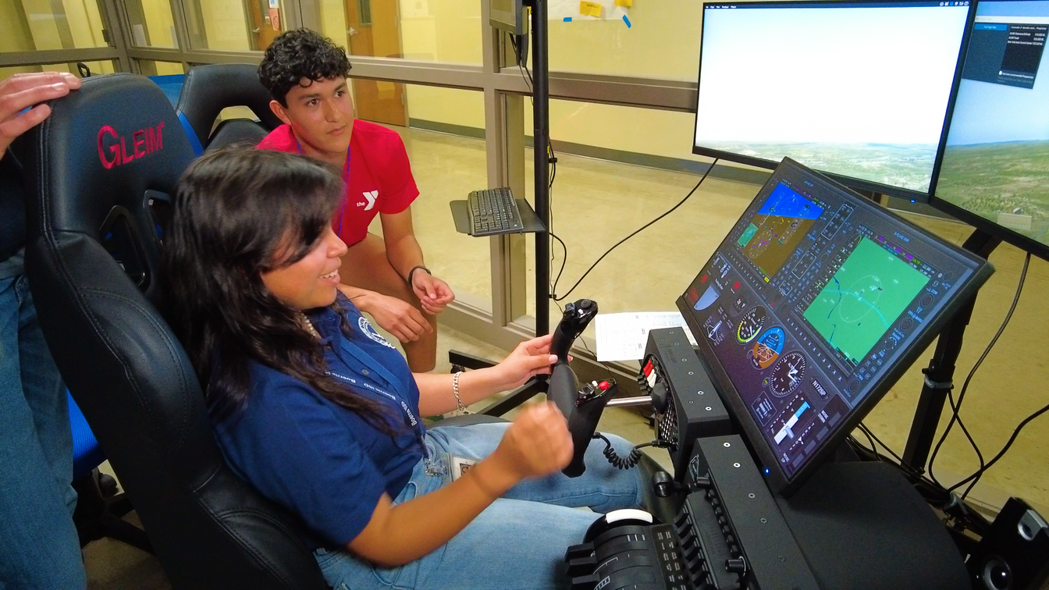


High Wage; In-Demand
PROGRAMS OF STUDY
Region 20 - Alamo Workforce
TOP BISD PROGRAMS
  Engineering/IT
  Health Science
  Hospitality & Tourism
  Agriculture, Food, & Natural Resources
  Transportation

Slide 28

Laying the Foundation
2020-21
2021-22
2022-23
2023-24
2024-2025
  Restructured CTE Course offerings to align with TEA Programs of Study (119 to 63)
  High School PLTW Engineering courses phased in.
TEA Designated P-TECH Cybersecurity
  Middle School Elective Course Redesign
  Added MS PLTW
  Applied for P-TECH Health Science
Elementary PLTW Launch - starting in Grade 5
P-TECH Health Science opens

Slide 29




Enhancements
Refreshed: Cybersecurity
Added: Real Estate
Added: Intro to Computer Aided Design/Gaming
Refresh: Education & Training

Slide 30




What If?
Construction
Law & Public Safety
Aviation
Energy

Slide 31


Enterprise Opportunities
WHAT IS AN ENTERPRISE?
Notes:
Enterprise Learning Labs

Slide 32


Caption
With your elbow partner summarize the learning about CTE in 2 sentences.
#Hashtag
On a sticky note, summarize the big idea with a hashtag.

Slide 33
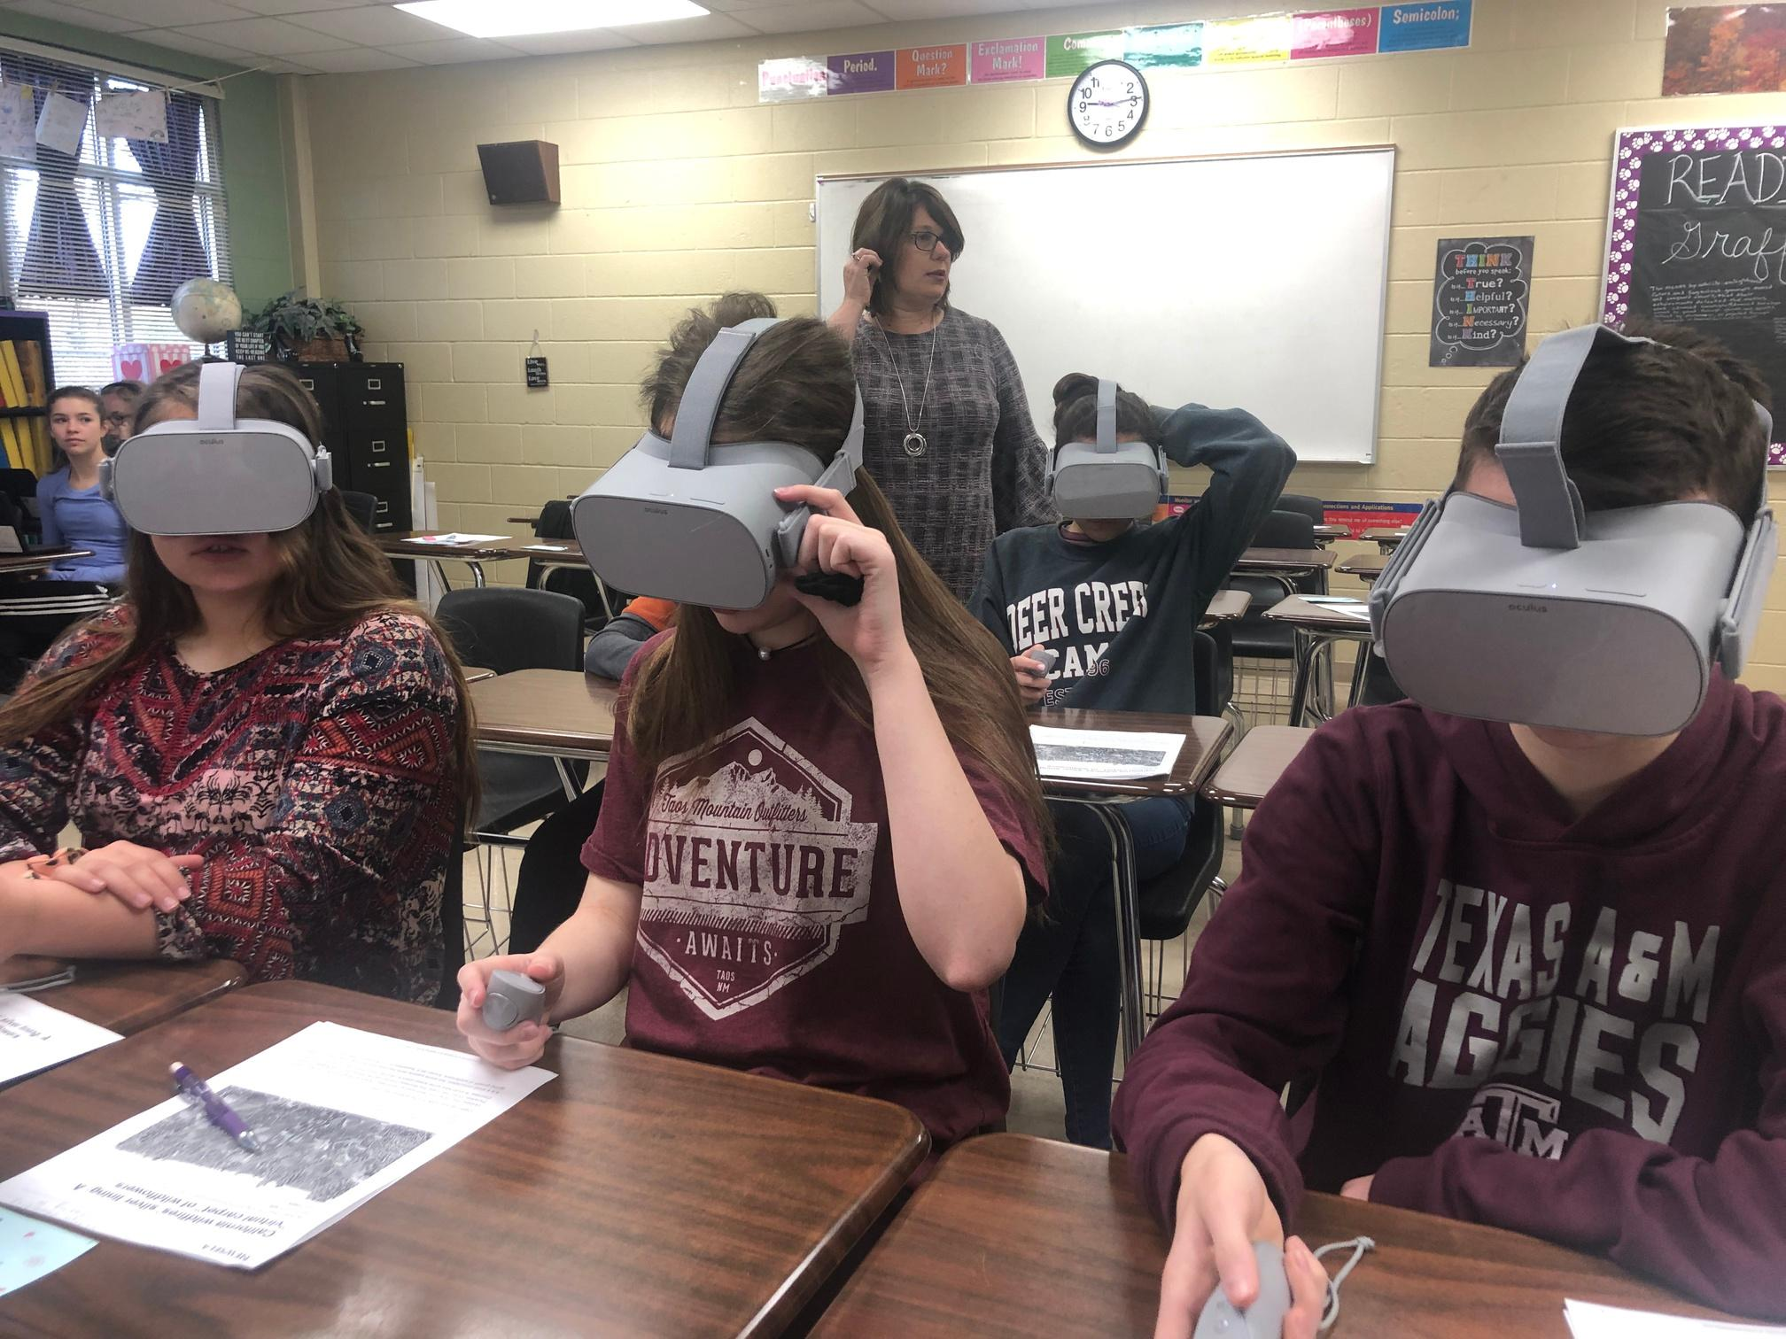
What If?
P-TECH
Education & Training

Slide 34

BARRIERS & CHALLENGES

Slide 35


Glow & Grow
Talk with an elbow partner and write 1 great thing (glow) you heard and 1 new idea (grow) about today’s learning.

Slide 36


Thank You
For Your Attention
www.boerneisd.net

