Slide 1
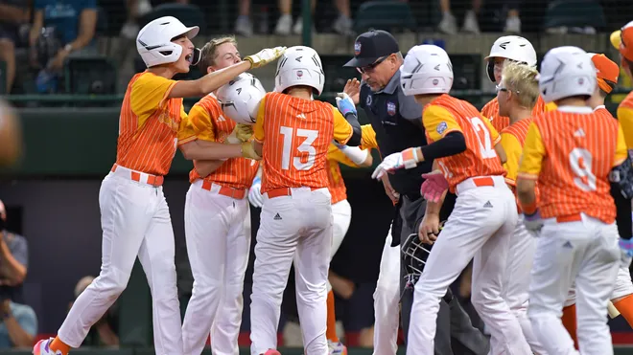


Future Progamming Focus Group
BRAINSTORMING MEETING
APRIL 2, 2025

Slide 2
Welcome
The Charge / The Norms
Recap: How did we get here?
“Pulse check” Survey Results
BMSN Tour + Small Group Work
Large Group Share Out
Look Ahead / Next Steps
Exit Ticket

Slide 3
Welcome
The Charge / The Norms
Recap: How did we get here?
“Pulse check” Survey Results
BMSN Tour + Small Group Work
Large Group Share Out
Look Ahead / Next Steps
Exit Ticket

Slide 4
The Future Programming Focus Group (FPFG) is:
Composed of invested BISD staff who are focused on the future of Boerne ISD
A source of insight and feedback about the future of educational programming and how facilities enhance these current and potential future needs
Committed to open and meaningful dialogue to propel the sharing of ideas and solutions
We applaud your dedication to Boerne ISD.

Slide 5
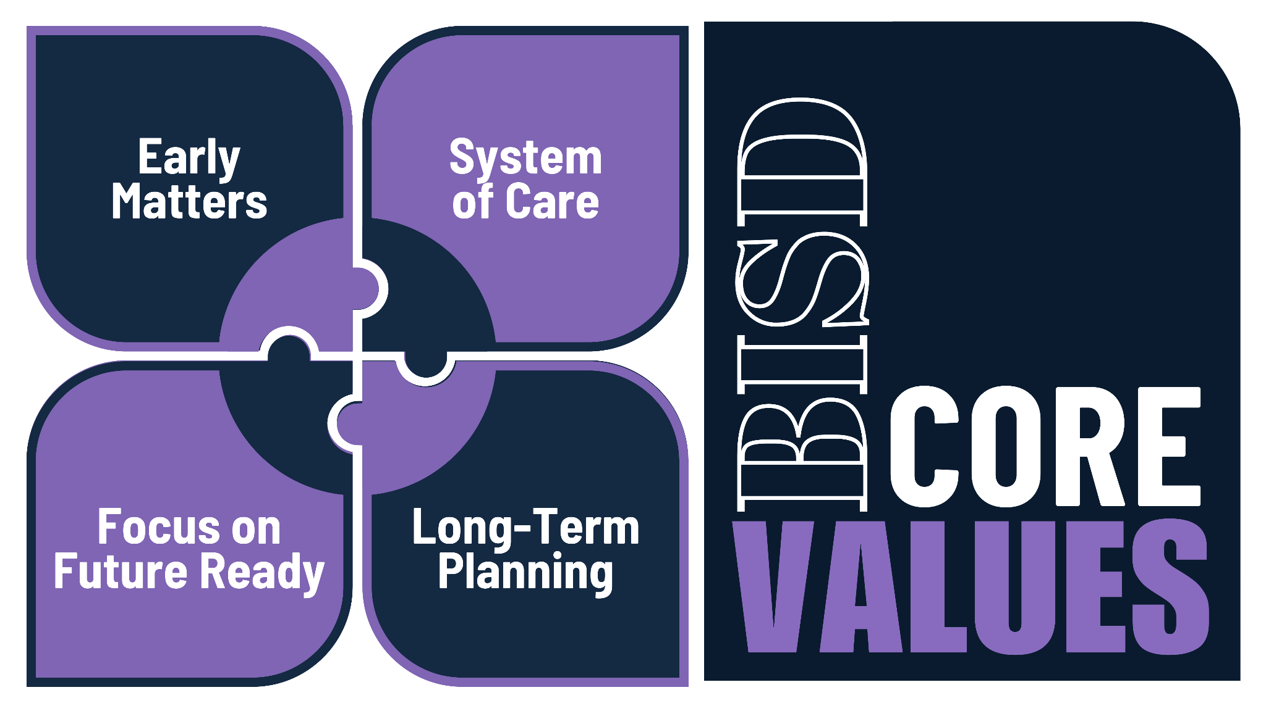
Notes:
How will you bring the BISD Core Values into the new school year?

Slide 6
Welcome
The Charge / The Norms
Recap: How did we get here?
“Pulse check” Survey Results
BMSN Tour + Small Group Work
Large Group Share Out
Look Ahead / Next Steps
Exit Ticket

Slide 7
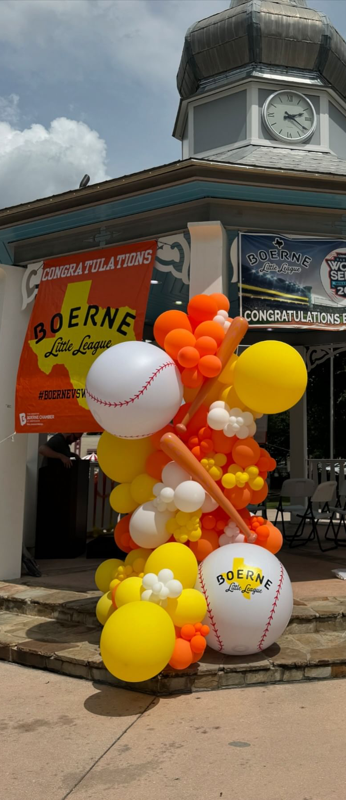
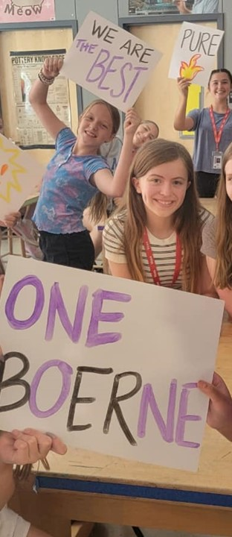
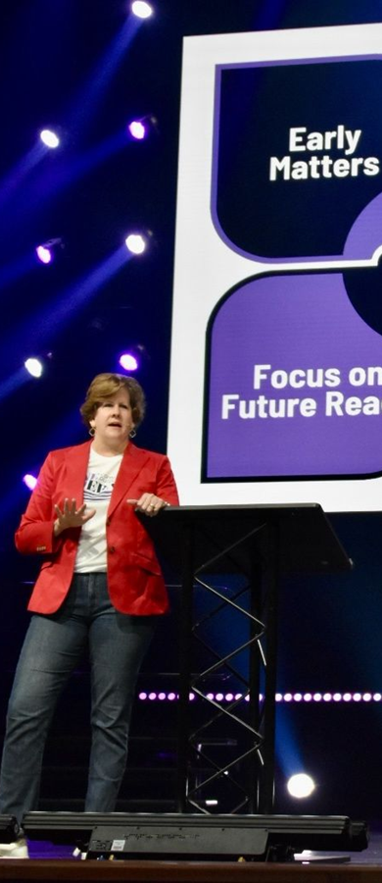
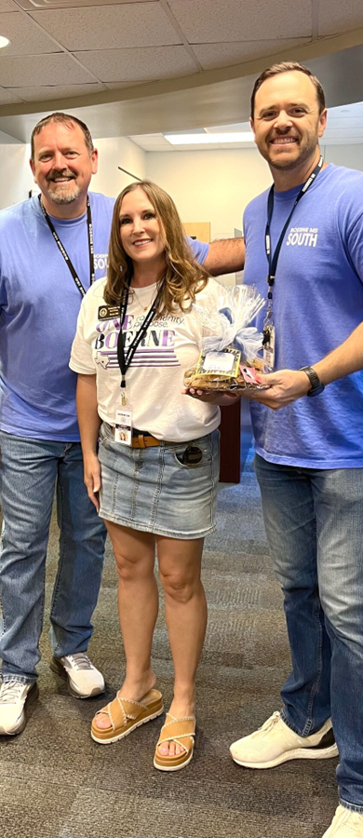
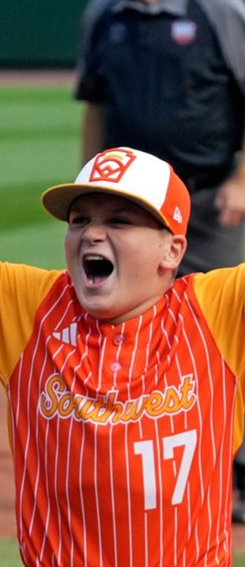
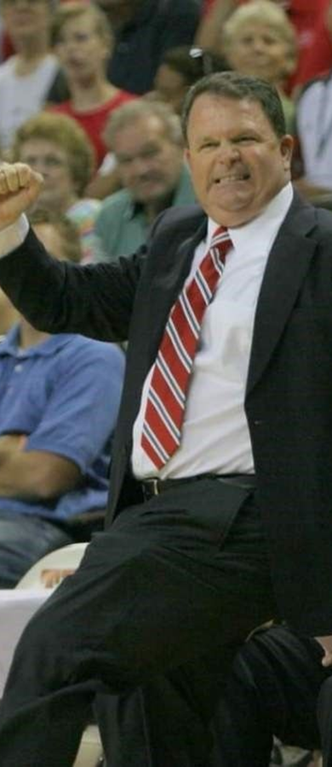
SEQUENCE:
A REVIEW OF
BOERNE ISD
SITE VISIT
REPORT OUT
SYNTHESIS &
CONCURRENCE
SFPFG RECAP
TOURS
REPORT OUT
DEC. 2024 – MAR. 2025
OCT. 8, 2024
NOV. 4, 2024
MAR. 20, 2025
APR. 2, 2025
MAY 12, 2025
Notes:
RECAP OF MTG. # 1

Slide 8

SEQUENCE:
A REVIEW OF
BOERNE ISD
SITE VISIT
REPORT OUT
SYNTHESIS &
CONCURRENCE
SFPFG RECAP
TOURS
REPORT OUT
DEC. 2024 – MAR. 2025
OCT. 8, 2024
NOV. 4, 2024
MAR. 20, 2025
APR. 2, 2025
MAY 12, 2025
Notes:
RECAP OF MTG. # 1

Slide 9
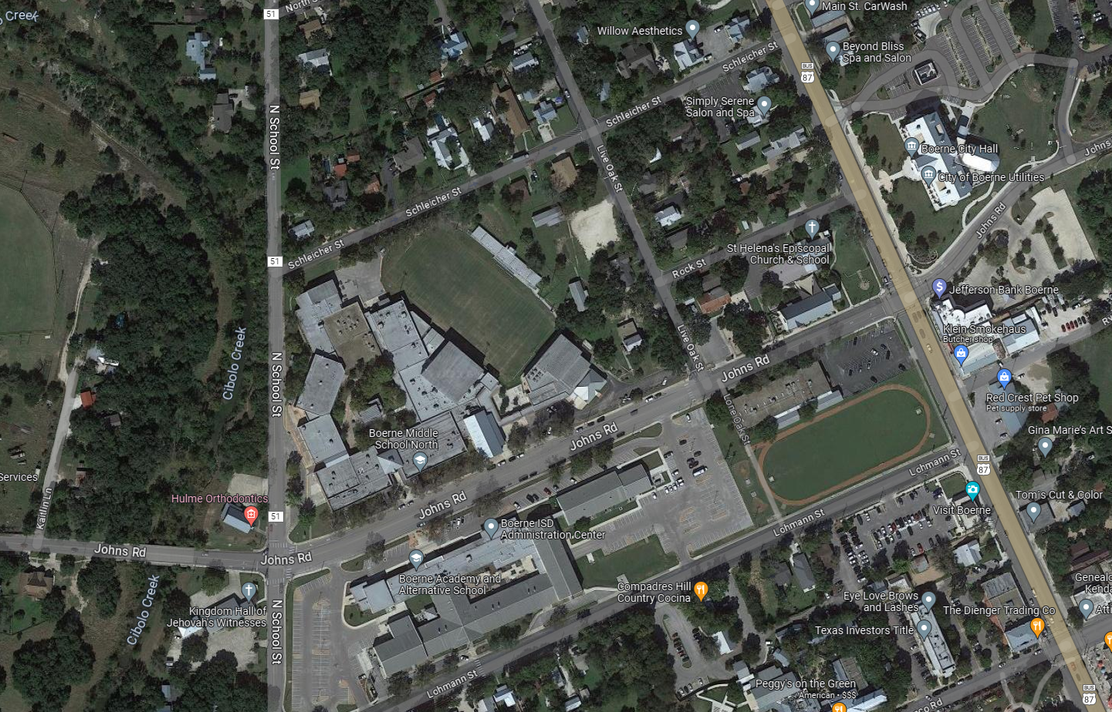
Boerne Middle School North
12.98 Acres
132,685 SF Building
975 Core Capacity
1,075 Gross Capacity

Slide 10
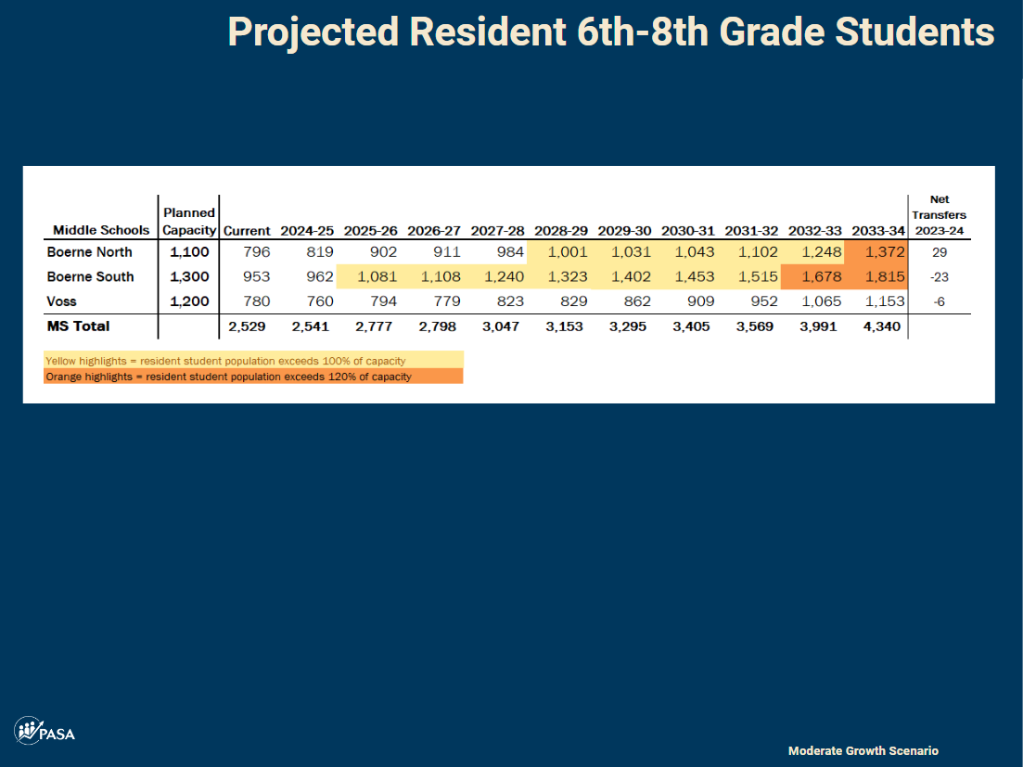
20
2023 Mini-Update
90% of Capacity:
BMSN: 990
BMSS: 1,170
VMS: 1,080
Spring 2024 PASA Demographics Report

Slide 11
Boerne Middle School North: Landlocked
Notes:
To add capacity, BMSN must grow – but where? Site is landlocked by residences, other BISD facilities, and Cibolo Creek

Slide 12
Boerne Middle School North: Traffic
Notes:
Compounding the growth issue is the traffic impact

Slide 13
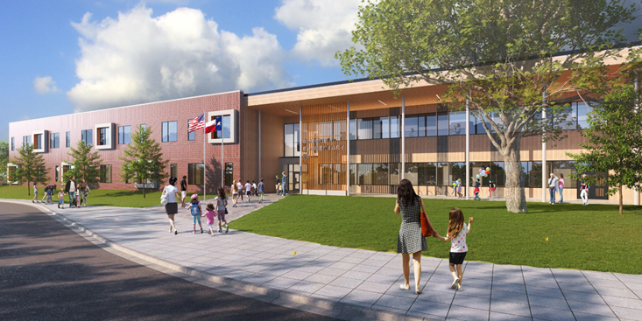

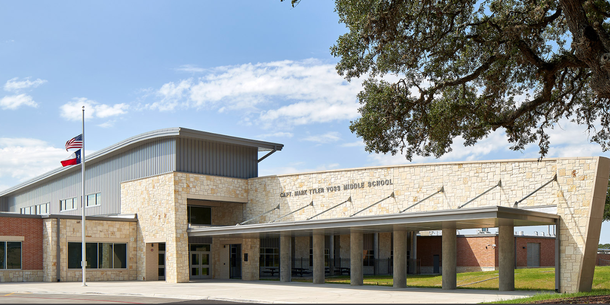
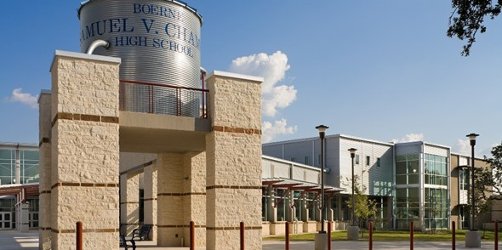
26
RULES OF THUMB – SELECTING A SCHOOL SITE:
Sufficient Acreage
  Athletics – Type/Number of Fields, Stadium, etc.
  CTE – Auto, Ag, etc.
Utility Requirements
  On-Site Water Quality Requirements
  Available Power, Water, Sewer, Etc.
Traffic Considerations
  Multiple Access Points to Larger Campuses
  Parking Requirements
Adequate Buildable Site
Flat vs. Steep Topography
Tree Mitigation / Preservation
Targeted Area per Demographic Trends
New ES:
15-20 Acres
Viola Wilson Elementary School
New MS:
30-40 Acres
Voss Middle School
New HS:
60-90 Acres
Champion High School

Slide 14









Explore simpler schools (not magnets)
Address the Stadium ASAP
Begin engaging the Community
Discuss more about what BMSN / Specialized Campus might be…
Start a Long-Range Planning Effort, with potential Bond Timelines
Notes:
RECAP OF MTG. # 1

Slide 15






Goal/Priority for Each Tour
If Convenient + Time Permitting
Min. 1
Min. 1
Min. 1
Career &
Technical Education
Early Childhood
Early College
Enhanced Academics
Fine
Arts
Community/ Admin.
Standalone
PK 3-4
College or university &
P-TECH
Includes Classical Studies & IB

Slide 16
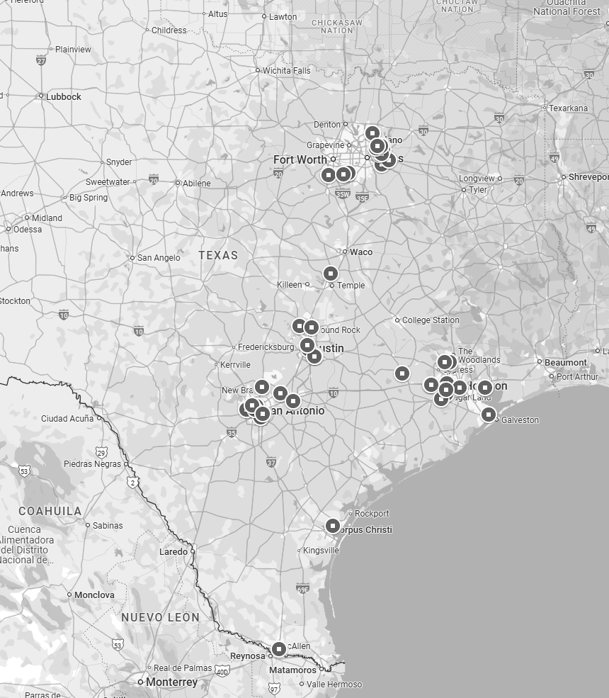
DFW-Area Tours
Austin-Area Tours
SA-Area Tours
Houston-Area Tours

Slide 17
NISD Health Careers + CCA
NEISD STEM
Science Mill
Georgetown FRLC
Bellville Learning Ctr.
Katy STEAM Ctr.
Katy Career & Tech. Ctr.
Tomball IC
Stuart Career Tech. HS
Mansfield STEM
Allen STEAM
Forney OC
17 TOURS!
Georgetown Hammerlun Ctr.
Bellville Learning Ctr.
Tomball IC
HCC Collaboratorium
Forney OC
Alief ECHS
Tomball IC
Forney OC
COSA PreK4SA
Forney OC
Georgetown FRLC
Career &
Technical Education
Early Childhood
Early College
Enhanced Academics
Fine
Arts
Community/ Admin.
Standalone
PK 3-4
College or university &
P-TECH
Includes Classical Studies & IB

Slide 18

“Sometimes if we look outside the box, amazing opportunities can happen!”
“…it takes more than an innovative building to create a useful learning space for students…professional development and student voice are equally essential to creating effective learning…”
“Overall, this trip and these visits have changed my mindset from building additional, comprehensive schools to addressing our growth, student needs and preparedness, and our community’s needs…”
Notes:
Photos & Descriptions

Slide 19
Welcome
The Charge / The Norms
Recap: How did we get here?
“Pulse check” Survey Results
BMSN Tour + Small Group Work
Large Group Share Out
Look Ahead / Next Steps
Exit Ticket

Slide 20
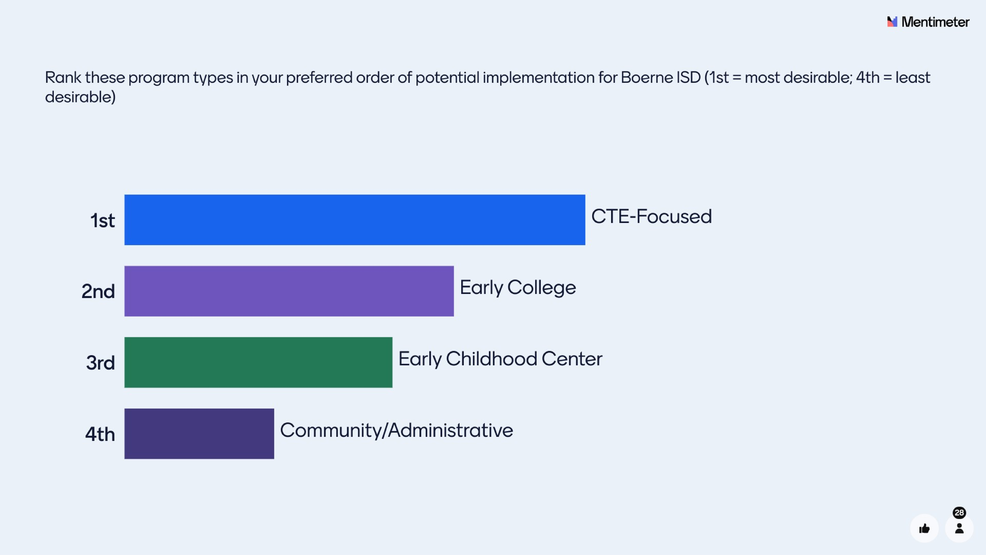
Notes:
Photos & Descriptions

Slide 21
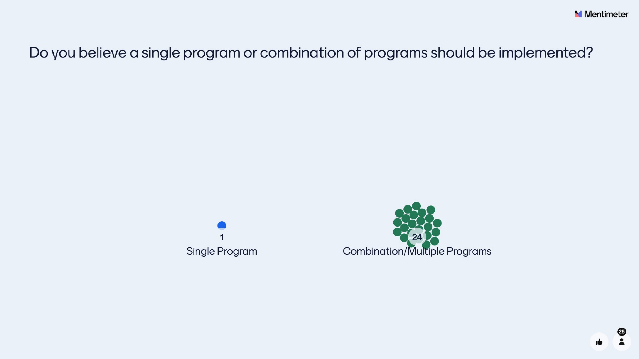
Notes:
Photos & Descriptions

Slide 22
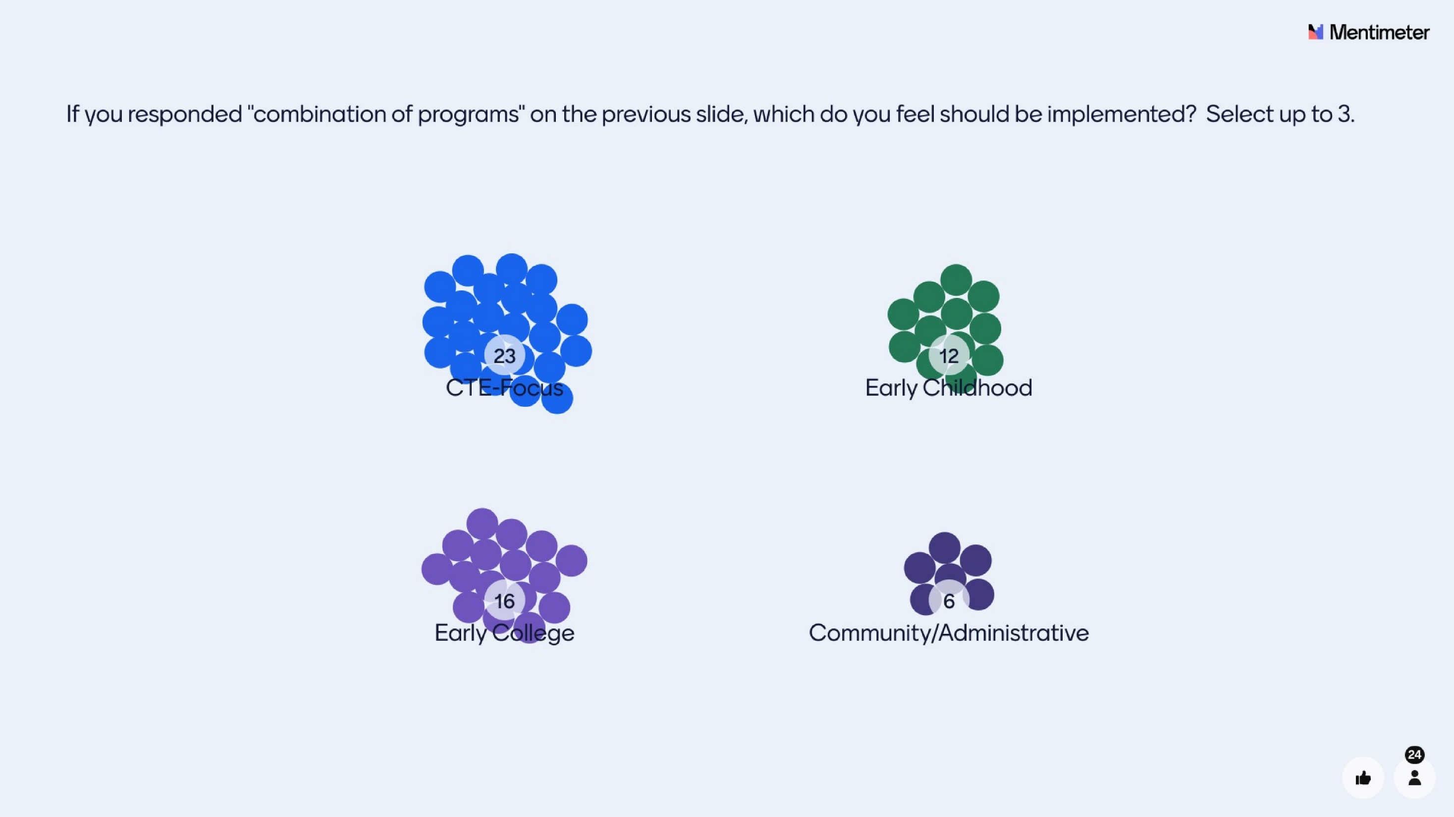
Notes:
Photos & Descriptions

Slide 23
Welcome
The Charge / The Norms
Recap: How did we get here?
“Pulse check” Survey Results
BMSN Tour + Small Group Work
Large Group Share Out
Look Ahead / Next Steps
Exit Ticket

Slide 24
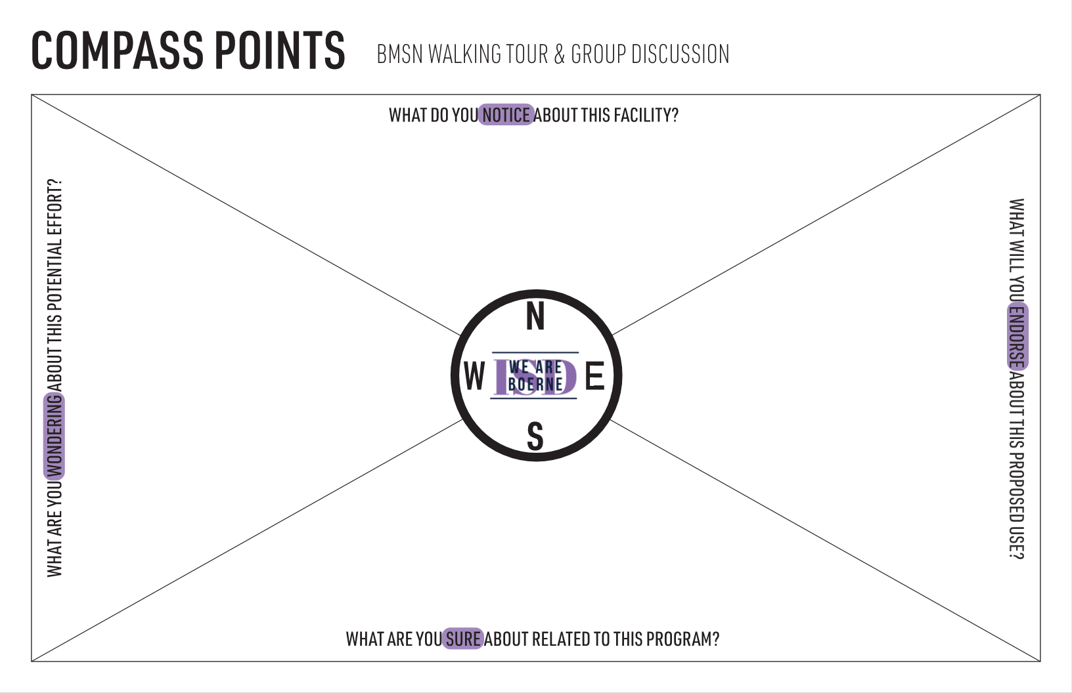
Notes:
BEFORE YOU LEAVE:
Make sure everyone has a Compass Point worksheet.
Your inputs should be through the lens of transforming BMSN into a CTE + Early College facility.

Slide 25
BEFORE YOU LEAVE:
FILL OUT “S” & “E” SECTIONS.
CONSIDER “N” & “W” DURING THE TOUR.
I can endorse a program that partners with local business and aligns with local industry needs!
I am sure that the Boerne community will support this program!

Slide 26
WHEN YOU GET BACK:
FILL OUT “N” & “W” SECTIONS.
RECONVENE WITH YOUR TOUR GROUP.

Slide 27

SMALL GROUP WORK:
Identify common and/or agreed-upon “group responses” for N-S-E-W and write them on your Post-Its.
Select a Spokesperson for the group.
We all said something very similar regarding this item…let’s jot that down!
I’ll be our spokesperson!
This is what I noticed, wondered about, am sure about, and can endorse…
That’s a great point! I didn’t think of it that way…let’s put that down!

Slide 28
Welcome
The Charge / The Norms
Recap: How did we get here?
“Pulse check” Survey Results
BMSN Tour + Small Group Work
Large Group Share Out
Look Ahead / Next Steps
Exit Ticket

Slide 29
Welcome
The Charge / The Norms
Recap: How did we get here?
“Pulse check” Survey Results
BMSN Tour + Small Group Work
Large Group Share Out
Look Ahead / Next Steps
Exit Ticket

Slide 30
LOOK AHEAD:
A REVIEW OF
BOERNE ISD
BRAIN-
STORMING
SYNTHESIS &
CONCURRENCE
SFPFG RECAP
TOURS
REPORT OUT
DEC. 2024 – MAR. 2025
OCT. 8, 2024
NOV. 4, 2024
MAR. 20, 2025
APR. 2, 2025
MAY 12, 2025
Notes:
RECAP OF MTG. # 1

Slide 31
AFTER THE FPFG:
Develop
the Program
Facility
Assessment
Cost
Implications
Report Out /
Recommendation
Refine Program Details
Establish Course Specifics
To be led by Boerne ISD Teaching & Learning Dept.
Assess Overall Building + Site Conditions (systems, structure, etc.)
Assessments done through the lens of the Program Requirements
Assess Functional Condition of the Building + Site (capacity, space adjacencies, level of renovation, etc.)
Budget analysis of renovation efforts needed to implement the program
Cost comparison to new construction
Report to, with potential recommendation, to Boerne ISD Board of Trustees
Report back to SFPFG
Report back to FPFG
Determine what Business, Industry, or other External Partnerships are needed
Estimated timeframes to be developed, including consideration of phased implementation
Boerne ISD Board of Trustees will determine the appropriate next steps for implementation
Notes:
Photos & Descriptions

Slide 32
Welcome
The Charge / The Norms
Recap: How did we get here?
“Pulse check” Survey Results
BMSN Tour + Small Group Work
Large Group Share Out
Look Ahead / Next Steps
Exit Ticket

