Slide 1


Welcome
Cherokee Parents
Thursday, September 11, 2025
2025-2026
Annual Title One Parent Meeting

Slide 2

Today’s Agenda
Notice of Title I School Status
Family Engagement Policies
Reporting Pupil Progress
Parent-Teacher Conferences
Parental Involvement Requirements
Availability of Parent Training and Meetings
District/School Progress
School Improvement Plan
Teacher Qualification
Parent’s Right to Know
School / Parent Compact
Student Code of Conduct
3rd Grade Commitment

Slide 3

What is Title One?
Title 1 is a federal program which provides additional funds above and beyond the funds provided to every Shelby County school for schools who have a certain percentage of socio-economic disadvantaged students.

Slide 4
Notice of Title One School Status…
Cherokee Elementary is a federally funded Title I school. Title I is a part of the No Child Left Behind Law. Title I requires that schools create a positive and supportive learning environment that results in high levels of achievement for all students.

Slide 5
Goals of Title I
Increase academic achievement
Provide direct instructional support to students
Provide professional development for teachers
Promote parent education and involvement
Notes:
Extra help (in addition to what they learn during math and reading time in the classroom)
Funding provided under No Child Left Behind

Slide 6




How Does Title One Help?
The funds provided by Title 1 help us to provide needed resources and support to all of the students at Cherokee Elementary.
Without these additional funds, many items and resources would not be available.

Slide 7

Title One Funds can Provide
Desktop Computers for students to use in classrooms
Instructional Resources for each teacher.
Professional Development for teachers.
Educational Assistants to help in classrooms.

Slide 8
working TOGETHER!
The ESSA law requires that all Title I schools and families work together.
The following documents are a collaboration between school and family:
✓ 2025-2026 School Improvement Plan (SIP);
✓ 2025-2026 Title I School-level Parent and
Family
Engagement Plan (PFEP); and
✓ 2025-2026 School-Parent Compact.

Slide 9
Our Mission and Vison
Our mission at Cherokee Elementary is to promote a safe learning environment that promotes a love for learning daily, while setting goals and celebrating growth for all students.
Cherokee Elementary stakeholders envision our school as an environment that fosters high levels of achievement to meet the needs of all students while developing life-long learners.

Slide 10

Our school performance data
Our School Identification:
Level 5 School
State Letter Grade: B

Slide 11

Reporting Pupil Progress
Progress Reports
Report Cards via Powerschool
Notes Home
Emails
Text/Phone Calls
Classdojo

Slide 12

Parent Teacher Conferences
  September 11, 2025 ( 3:30-5:00 pm)
  January 29, 2026 (3:30-5:00 pm)
  Parents may contact the teacher at any time to schedule a parent/teacher conference via email/phone/classdojo.

Slide 13
State and District Assessments
Students will take state mandated and district formative assessments this year.
iReady Assessments
    August 11-August 29, 2025 (IReady Universal Screener 1)
    December 15-Jan. 23, 2026 (IReady Universal Screener 2)
    April 28-May 13 (IReady Universal Screener 3 K-8)
    March 30- April 10, 2026 (AimsWeb 3rd Grade Only)
  TNReady Achievement Test Grades 3-8 (Paper and Pencil)
      Testing Window April 13-May 1, 2026 (Grades 2-5)
  New!!!!!
  Performance Matters District Benchmark Assessments
  -September 29-October 10, 2025
  -December 8-19,2025
  -March 2-13, 2026

Slide 14

Additional Assessments
Assessments are used to help teachers determine if a student is understanding the content presented in the classroom.
In addition to state and district assessments, we use the following assessments for our students:
  Bi-Weekly school-based assessments in all core subjects
  Progress Monitoring weekly (Tier 3) and biweekly (Tier 2) for identified students using iReady

Slide 15
Parent’s Right to Know
All parents have the right to request the following:
  A teacher’s professional qualifications, which includes state qualifications, licensure, grades (s) certification, waivers
  A teacher’s baccalaureate and/or graduate degree, fields of endorsement, previous teaching experience
  A paraprofessional’s qualification
  An assurance that their child’s name, address and telephone listing not be released to military recruiters
All parents will receive information on the following:
  Their child’s level of achievement in each of the state academic assessments.
  Their right to publics school choice, supplemental services and more effective involvement if their child’s school is identified for school improvement
  Their option to request a transfer to another school within the district their child is the victim of a violent crime at school improvement
  Their right to timely notifications that their child has been assigned, been taught for four or more consecutive weeks by, a teacher who is highly qualified.

Slide 16
Your involvement is Key to your child’s success
You are your child’s first teacher.
You have the ability to influence your child’s education more than any teacher or school.
You know your child best:
  Share information about your child’s interests and abilities with teacher; and
  Ask to see progress reports on your child and the school.

Slide 17
Ways to Participate/Support your Child’s Education
Express high expectations for their success.
Encourage their learning and progress in school;
Be a role model and show the value of learning, self-discipline, and hard work.
Read with and have frequent conversations with your child.

Slide 18
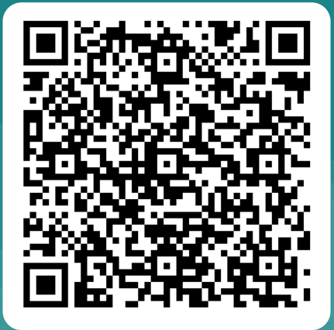
Thank you for your attendance!
Questions?
Should you have any questions about the Title I program at Cherokee please contact me by calling the school 901-416-5028 or email me at mcclendonfrisone@scsk12.org.

