Slide 1
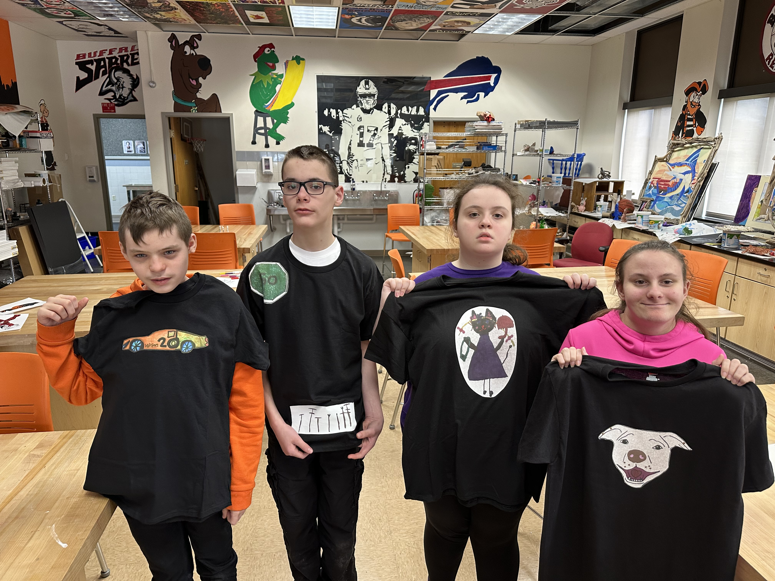

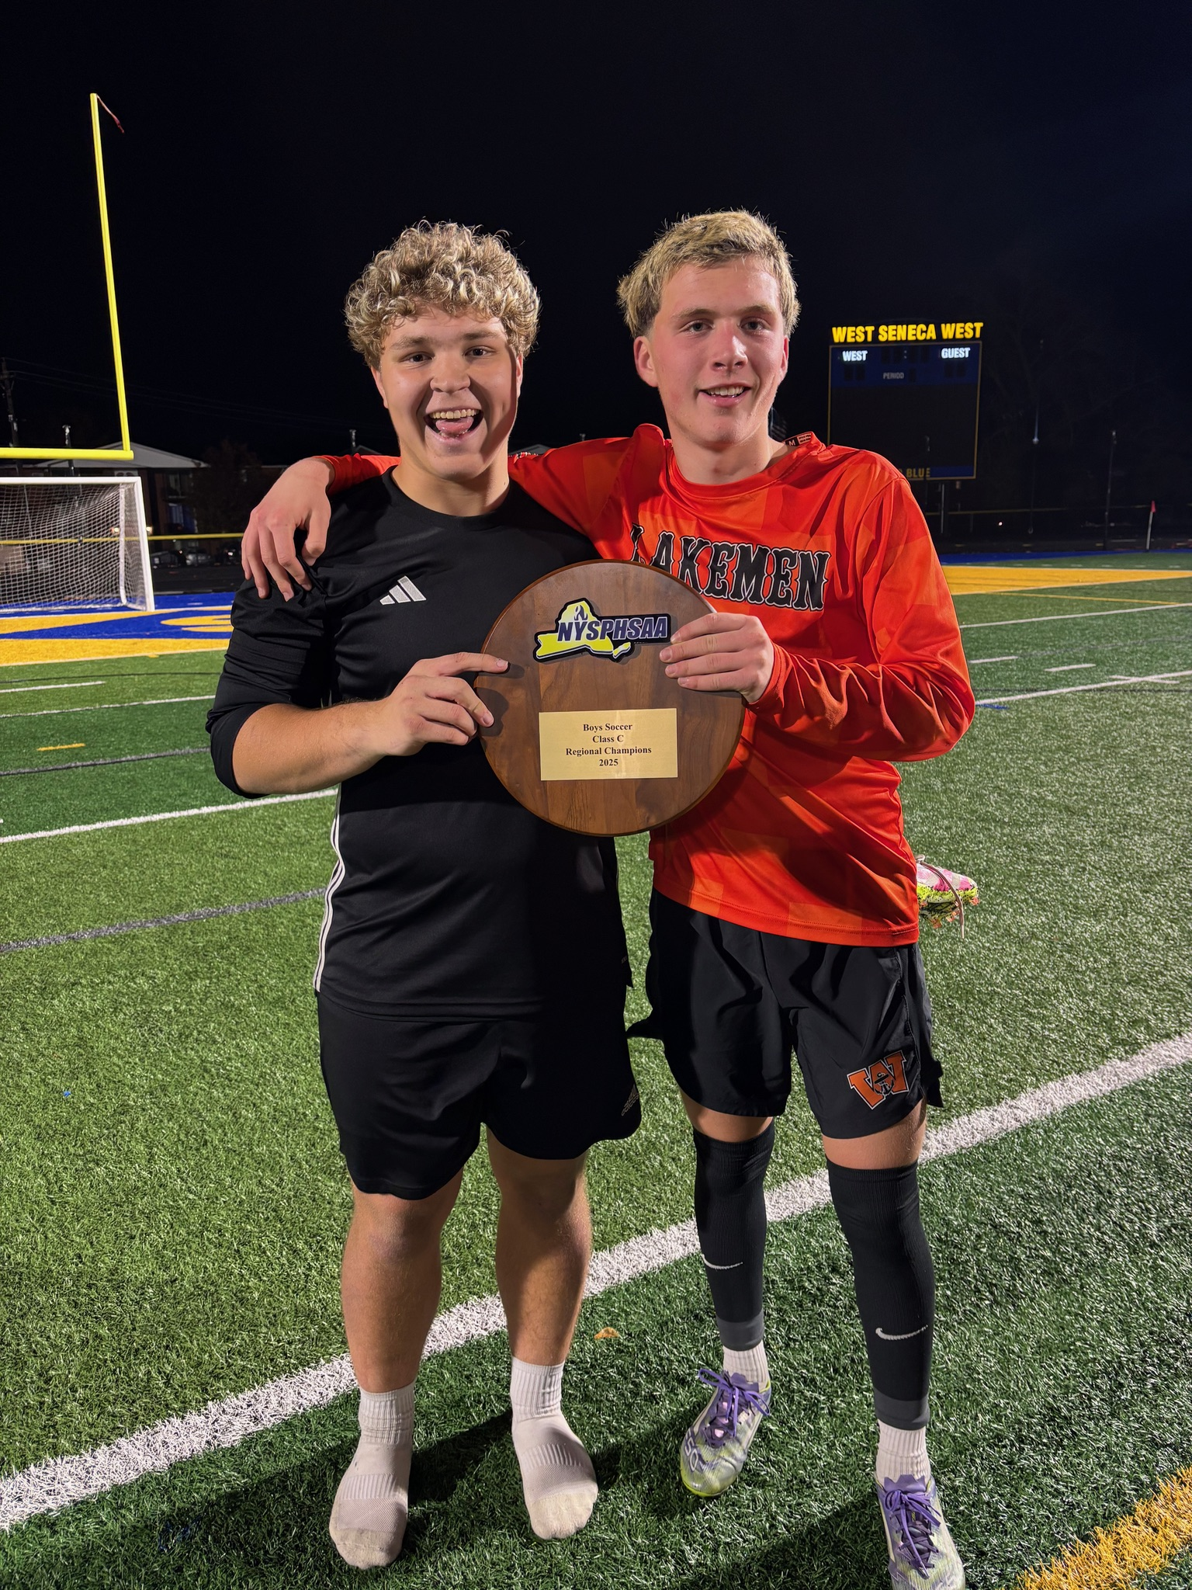
Wilson Central School District
Budget Hearing, May 12, 2026 6:30 pm

Slide 2

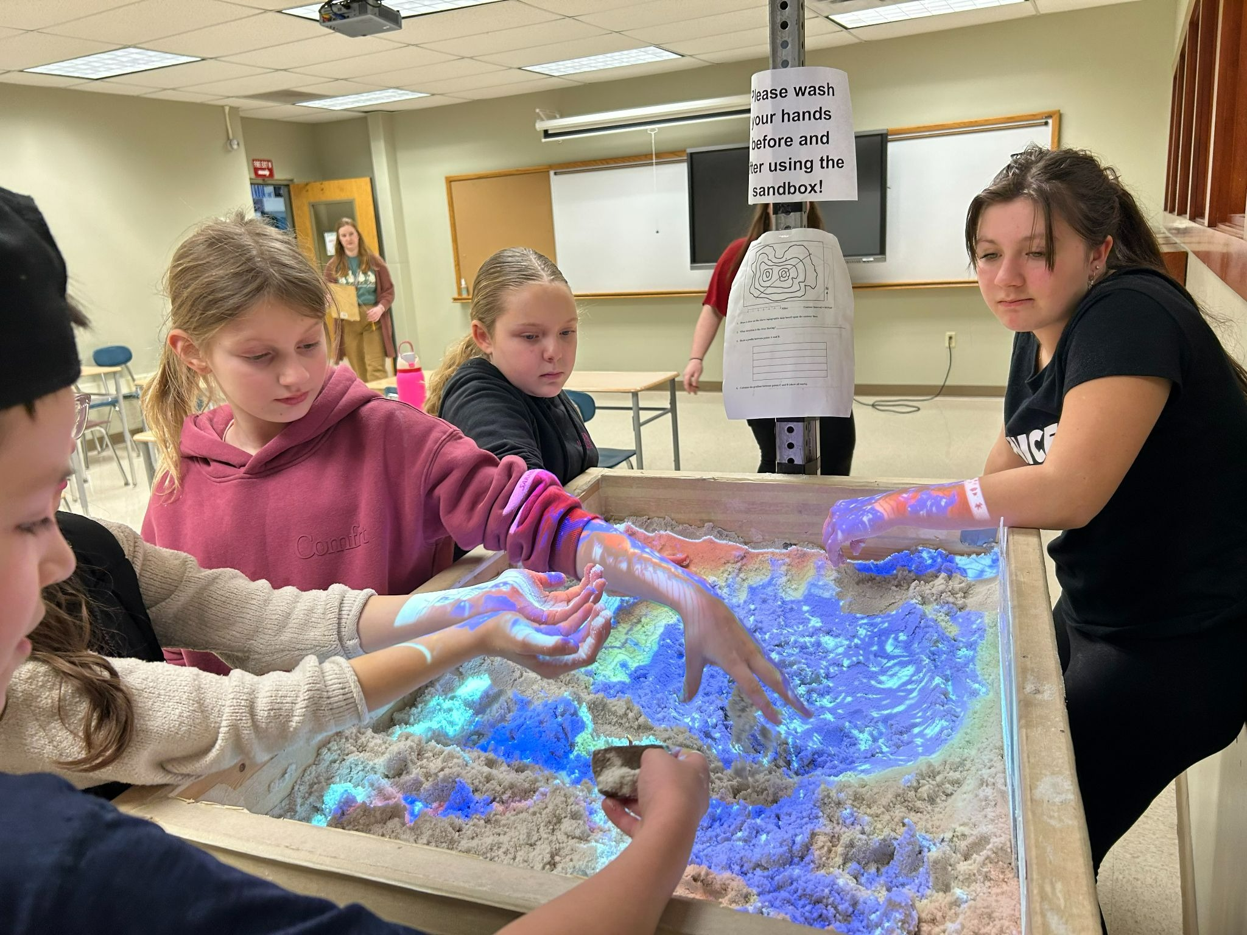
Overview of Presentation
Expected Revenue for 2026-27, Tax Cap Limit
Review Expenditures in the required Tri-Component Format, and by Function
Position changes expected for 2026-27
Introduce you to the Capital Outlay Project Planned for 2026-27
Go over the Propositions on the May 19, 2026 ballot and Candidate Selection

Slide 3
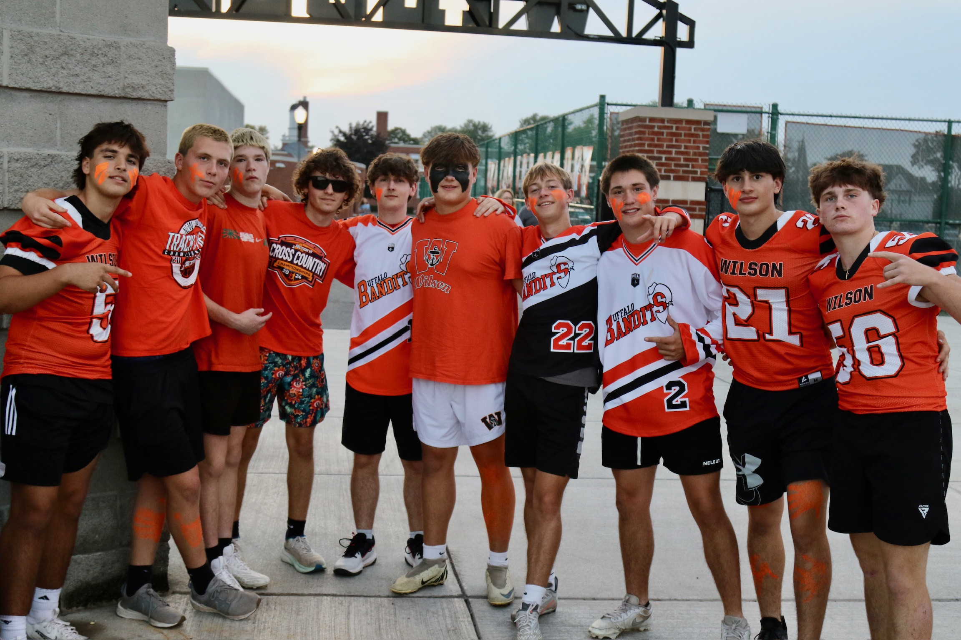
2026-2027 Budget
$31,584,299
Budget-to-Budget Increase of 2.55%
Tax Levy $13,944,841
2.5% increase over last year
Use of Appropriated Fund Balance/Reserves $712,911
* Please visit our website https://www.wilsoncsd.org Look for District tab and then Budget to get all the info presented throughout the budget season

Slide 4
Revenue By Category
2026-27 Proposed

Slide 5
Revenue Budget
  Calculate the Tax Levy Limit
  Project local revenues including interest, admissions, rent, etc.
  Estimate state aid, wait for approved State Budget
  Analyze tax levy to be used
  Analyze how much Fund Balance and Reserves to use
State Aid $15,880,169
Tax Levy $13,944,841
Other $ 1,046,378
Reserves $ 212,911
Fund Balance
Appropriated $ 500,000
Total $ 31,584,299

Slide 6
Tax Cap Calculation for 2026-27
25-26 Levy 13,604,723
Tax Base Growth Factor 1.0070
Total 13,699,956
Add: 25-26 PILOTS 18,973
Total 13,718,929
Allowable Growth Factor (CPI) 1.02
Total 13,993,308
Less: 26-27 PILOTS 19,678
Total 13,973,630
Add Eligible Carryover 208,694
Total Tax Levy Limit 14,182,324 4.25%

Slide 7
Tax Levy Historically
Year | Tax Levy | Percent Change
2021-22 | $12,689,987 | 1.79%
2022-23 | $12,689,987 | 0%
2023-24 | $13,019,926 | 2.6%
2024-25 | $13,351,053 | 2.54%
2025-26 | $13,604,723 | 1.9%

Slide 8

Expenditure Budget
NYS requires all school districts to present their expenditure budget in a Tri-Component Expenditure Format (3 parts)
Part I – Program Expenditures
Instructional Salaries & Benefits
Student Transportation
Instructional Supplies & Equipment
BOCES Instructional Service
Part II – Capital Expenditures
Maintenance of Buildings and Grounds
Maintenance Contracts for District Equipment
Debt Service
Part III – Administrative Expenditures
Board of Ed, Superintendent, Business Office
Principals and Administrative Supports
Contractual – Lawyers, Auditors, BOCES

Slide 9
Expenditures by Category

Slide 10
2026-27 Tri-Component Budget
Program
Capital
Administrative
Salaries $10,337,565
Benefits $ 5,676,342
BOCES $3,418,429
Outside Services $1,857,200
Debt n/a
Utilities n/a
M&S, Equip $ 438,150
Transportation $2,116,000
Transfers $ 45,000
Total $23,888,686
Percentage 75.63%
Salaries $ 996,992
Benefits $ 547,899
BOCES $ 34,470
Outside Services $ 275,000
Debt $ 1,626,194
Utilities $ 575,500
M&S, Equip $ 269,000
Transportation n/a
Transfers $ 100,000
Total $ 4,425,055
Percentage 14.01%
Salaries $ 1,444,471
Benefits $ 798,508
BOCES $ 601,823
Outside Services $ 381,504
Debt n/a
Utilities n/a
M&S, Equip $ 44,250
Transportation n/a
Tuition __ n/a
Total $3,270,556
Percentage 10.36%

Slide 11
Component | Proposed 2026-27 | Budget 2025-26 | Budget 2024-25
Program | 23,888,687 | 23,526,822 | 22,801,124
Capital | 4,425,056 | 4,132,879 | 3,634,477
Admin | 3,270,556 | 3,140,537 | 2,972,239
Total | 31,584,299 | 30,800,238 | 29,407,840
Change | 784,061 | 1,392,398

Slide 12
Expenditures by Function
Expenditures | Proposed 2026-27 | Budgeted 2025-26 | Increase/Decrease | % Change
Salaries | $12,779,029.00 | $12,558,905.00 | $220,124.00 | 1.75%
Benefits | $7,022,750.00 | $6,844,750.00 | $178,000.00 | 2.60%
BOCES | $4,054,722.00 | $3,776,570.00 | $278,152.00 | 7.37%
Outside Services | $2,513,704.00 | $2,452,900.00 | $60,804.00 | 2.48%
Debt | $1,626,194.00 | $1,538,835.00 | $87,359.00 | 5.68%
Utilities | $575,500.00 | $481,378.00 | $94,122.00 | 19.55%
Material/Equipment | $751,400.00 | $956,900.00 | -$205,500.00 | -21.48%
Transportation | $2,116,000.00 | $2,045,000.00 | $71,000.00 | 3.47%
Transfers | $145,000.00 | $145,000.00 | $0.00 | 0.00%
Total | $31,584,299.00 | $30,800,238.00 | $784,061.00 | 2.55%

Slide 13
New Program Changes
BOCES Services
  Early College Access- College credit courses for students will be tuition free as the District will now be covering them and receiving aid through this new co-ser.
  Home School Monitoring- The District currently has 70 students being homeschooled and our administration has to monitor and ensure compliance with NYSED guidelines. BOCES will now take this over and ensure compliance and record keeping and the District will receive aid for these costs.
New Software
  Papercut- help us move forward with centralized printing.
  Frontline STEPS-assist with teacher evaluation process changes.
  Parent Square-new communication tool for school to families.

Slide 14
Position Changes for 2025-26
Resignations/Retirements
We have five Teachers retiring this year, and one School Nurse for June 30th. We also have two teacher to replace due to resignations and two Long Term sub positions to fill. All have been actively recruited this Spring for 2026-27 and names for approval on the May 12th agenda.
We also had a School Psychologist and Teacher Aide retire earlier in the year. The teacher aide has been hired and we have been actively looking for a school psychologist.
Four out of the five teaching positions are being replaced for the same position. The one Art position is being changed into a Special Education position. We have several students that need supports in some higher level Math and Science courses at the High School.
Change in the teacher TOSA positions. The AIS/Curriculum Facilitator is being split into 2 positions, Curriculum and Learning Facilitator and the MTSS/Student Service Facilitator. The Technology Facilitator will no longer be a TOSA as of Jan 2027 and we have had the BOE create a new position. This position will be under the Civil Service Title Information Technology Project Manager and we will actively recruit this Fall.

Slide 15
Capital Outlay Project 2026-27
We are working with LaBella to look at a design update for the High School Office and some new flooring
With the reconfiguration the main space this frees up an area for a conference room to be created. New office furniture will include new reception desks, staff mailboxes, conference table and sidebar. Additionally, new informational digital boards will be installed. Estimating the costs we do believe there is room to continue some of the flooring in the building also, we are hopeful 4 more classrooms can be completed.
Capital Outlay Projects can be done each year with funds allocated from the General Fund for up to $100,000. The District receives building aid back the next year on the project. We receive aid back at the rate of $.82 cents on every $1 spent.

Slide 16
COP Project 2026-27 Locations
HS Office and Classroom Flooring

Slide 17
Budget Vote-May 19, 2026
Proposition #1
Proposition No. 1
–
2026
-
2027 Budget
Shall the following resolution be adopted?
RESOLVED, that the annual budget of the Wilson Central School District, Niagara
County, New York (the “District”)
for the fiscal year commencing July 1, 2026, and ending June 30, 2027, as presented by the Board of Education, in
the total sum of $31,584,299 is hereby approved and adopted and the required funds therefore are hereby
app
ropriated and the necessary real property taxes required shall be raised by taxation on the taxable property of
the District as required by law.
Yes
No

Slide 18
Proposition #2
Proposition No.
4
–
Purchase of Equipment for Use
by
the District
Shall the following resolution be adopted?
RESOLVED, that the Board of Education of the Wilson Central School District, Niagara County, New York (the
“District”) be, and it hereby is, auth
orized to purchase technology equipment at a maximum estimated cost of
$45,000 for use by the District, utilizing $45,000 from funds currently on hand in the District’s Technology
Equipment Reserve Fund, 2022.
Yes
No

Slide 19
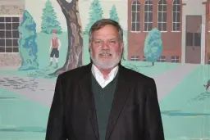
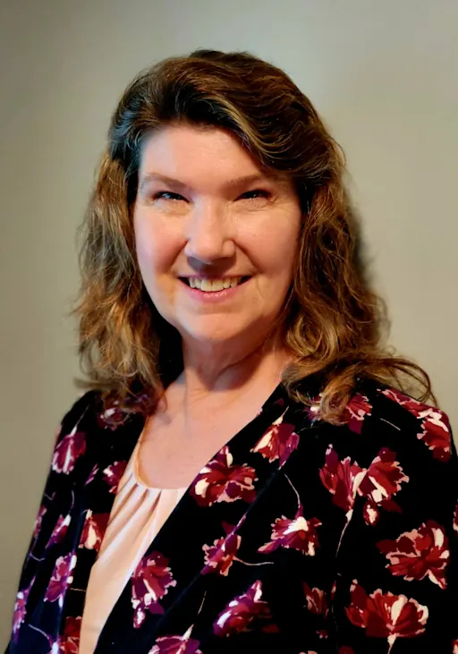
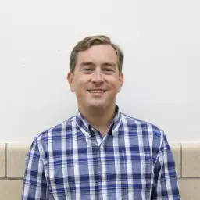

Board of Education Candidates
BOE has three seats up for election, 3 candidates running for three year terms July 1, 2026- June 30, 2029.
Timothy F. Kropp Laurette Clark R.J. Seager

Slide 20
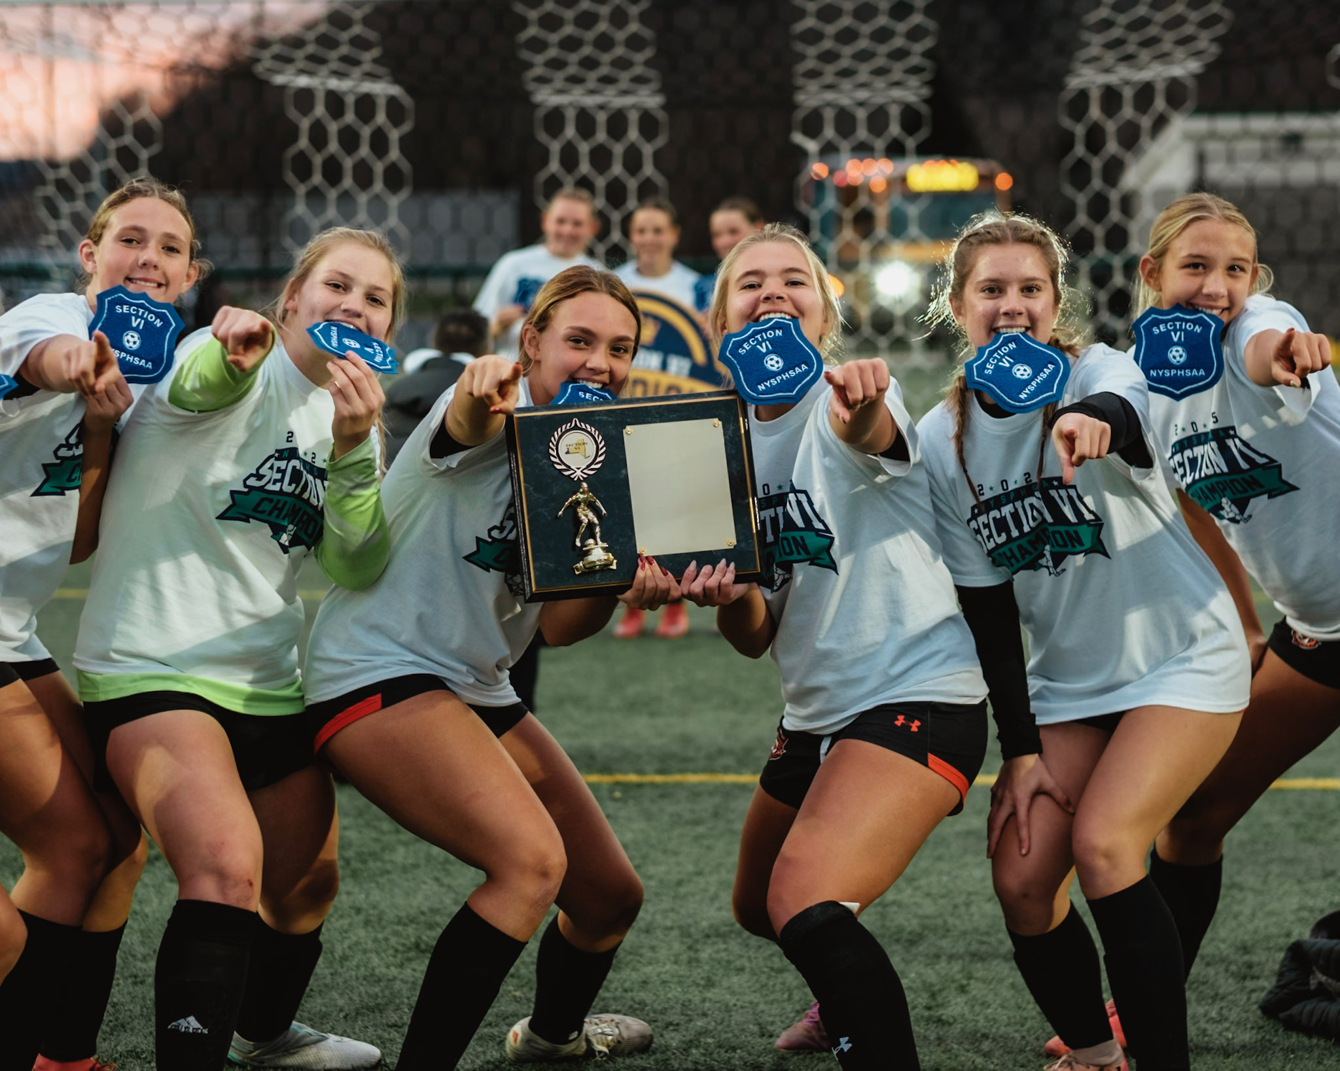
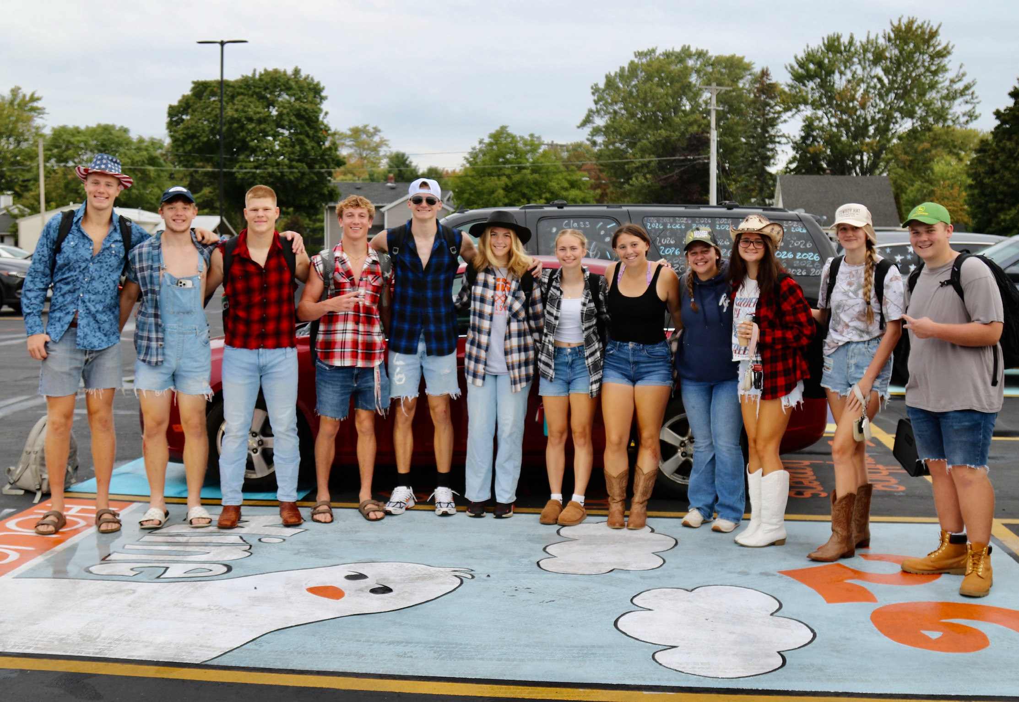
Any Questions?

