Slide 1

Annual Title 1 Parent Meeting
WELCOME Pandas!

Slide 2


Slide 3
Panda Parents!
“How Do We Spell Success…
T-E-A-M-W-O-R-K!!!”

Slide 4

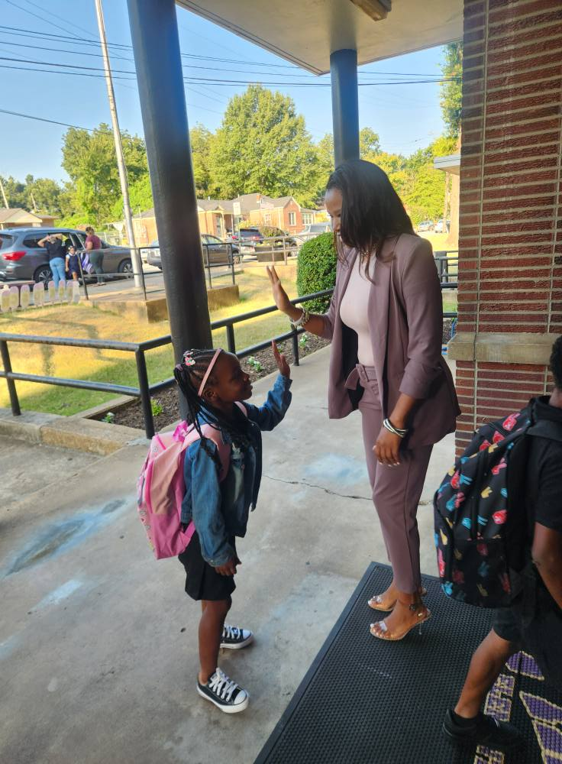
WELCOME

Slide 5

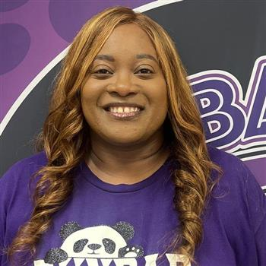

FACULTY INTRODUCTIONS
Administrators, Teachers, & Staff
Clifford The Red Dog

Slide 6

FACULTY INTRODUCTIONS
Administrators, Teachers, & Staff
Clifford The Red Dog

Slide 7
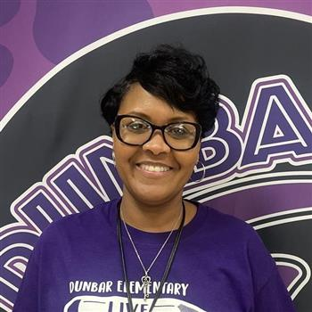
FACULTY INTRODUCTIONS
Administrators, Teachers, & Staff
Clifford The Red Dog

Slide 8

Who we are
Meet Your Child’s Teacher

Slide 9
Who are our Panda Leaders?
1st Grade
Ms. M. Johnson
Ms. L. Curtis
2nd Grade
Ms. J. Wallace
Ms. T. Dortch
Kindergarten
Kk-01:
Kk-02:

Slide 10
Who are our Panda Leaders?
4th Grade
Ms. L. Means
Ms. W. Wicks
5th Grade
Mrs. R. White
Mrs. R. Givens
3rd Grade
Ms. A. Tate
Ms. Calhoun

Slide 11
Who are our Panda Leaders?
Support
Art: Mr. McPherson
Music: Mrs. Crump
P.E. : Coach Jackson
Office Staff
GOS: Ms. Richmond
Financial Secretary:
Mrs. Goins
Inclusion, Speech and CLUE
Inclusion: Mrs. Greene
CLUE: Mrs. Perkins
Speech: Ms. Campbell

Slide 12

Crystal Browder, PLC Coach
TITLE ONE OVERVIEW

Slide 13

Why are we here?
The Every Student Succeeds Act (ESSA) requires that each Title 1 school hold an annual meeting of Title 1 families in order to:
Inform you of your school’s participation in Title 1.
Explain the requirements of Title 1, and
Explain your rights as parents and family members to be involved.

Slide 14
What Will I learn?
What is the Parent and Family Engagement Policy?
What is the School-Parent Compact?
What curriculum does our school use?
What tests will my child be taking?
How can I be involved?
Who can I contact for Help?
What is a Title 1 School?
What are my rights?
What can Title 1 funds be used for?
How does our school use Title 1 Funds?
What is the SIP?
What are our schoolwide program goals?
How is parent and family engagement funded?

Slide 15
What is a Title 1 School?
Title 1 was passed in 1965 under the Elementary and Secondary Education Act (ESEA). It is the largest federal assistance program for our nation’s schools.
Title 1 schools receive extra funding (Title 1 dollars) from the federal government. These dollars are used to:
Identify students experiencing academic difficulties and provide assistance to help these students;
Purchase additional staff, programs, materials, and/or supplies; and
Conduct parent and family engagement meetings, trainings, events, and/or activities.

Slide 16
What are my rights?
The families and parents of Title I students have a right, by law, to:
      be involved in decisions made at both the school and district level;
      be provided with information on your child’s level of achievement on tests in reading/language arts, writing, mathematics, and science;
      request and receive information on the qualifications of your child’s teacher and paraprofessionals who are working with your child and,
      request opportunities for regular meetings to formulate suggestions and to participate, as appropriate, in decisions about the education of your child. The school is required to respond to any such suggestions as soon as practicably possible.

Slide 17
What can Title I funds be used for?
In general, Title I funds may be used for:
      smaller class sizes,
      additional teachers and paraprofessionals,
      additional training for school staff,
      extra time for instruction (before and/or after school programs),
      parent and family engagement activities, and/or
      a variety of supplemental teaching materials, equipment, and technology.

Slide 18
How does our school use Title I funds?
We developed a Schoolwide Program, which means we plan to spend our funds on the following:
      Supplemental staff:
        SEA’s
        Tutors
        Etc.
      Programs/Materials/Supplies:
        Common core coach
        Blended learning devices
        Paper, pencils, notebooks, workbooks
        Etc.
      Teacher Professional Development:

Slide 19

Title One
Annual Meeting
School Improvement Plan

Slide 20
What is the SIP?
The SIP is the School Improvement Plan. It includes:
      the identification of the school planning team and how they will be engaged in the planning process;
      a needs assessment and summary of academic and non-academic data;
      prioritized goals, strategies, and action steps to help address the academic and non-academic needs of students;
      teacher and staff professional development needs; and
      budgets and the coordination of resources.
The school must include family representatives on our school planning team.

Slide 21
Title One
Annual Meeting
Notice of
Title 1
School Status

Slide 22

Title One
Annual Meeting
LEVEL 5 SCHOOL
District & School Progress
School Status

Slide 23
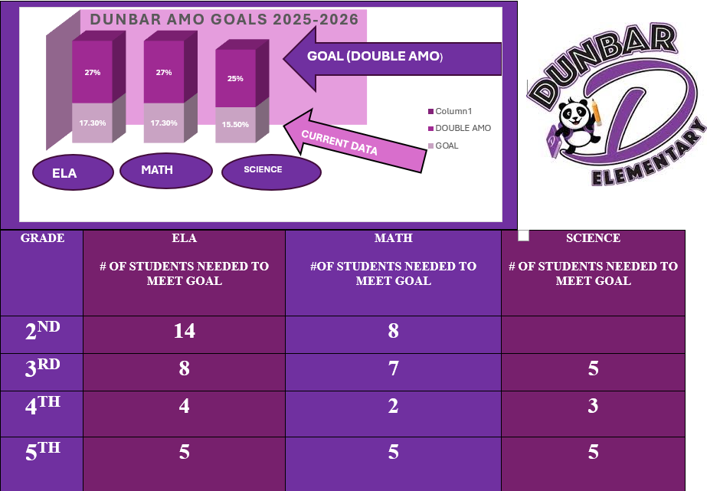
What are some of our schoolwide program goals?

Slide 24

Title One
Family Engagement
Parent-Family-School-Student-Teacher Connection

Slide 25



Title One
Annual Meeting
Polices for Family Engagement
(SCS Family Engagement Policy & Plan; School Plan)

Slide 26
How is parent and family engagement funded?
Any district with a Title I allocation exceeding $500,000 is required by law to set aside 1% of it’s Title I allocation for parent and family engagement.
Of that 1%, 10% may be reserved at the district for system-wide initiatives related to parent and family engagement. The remaining 90% must be allocated to all Title I schools in the district.
You, as Title I parents and family members, have the right to be involved in how this money is spent.

Slide 27
What is a Parent and Family Engagement Policy?
The district Parent and Family Engagement Policy can be found on our face book page and our school website.
The school Parent and Family Engagement Policy has been shared with you upon registration and has been signed and returned by each student that is enrolled here at Dunbar Elementary.
You can also find the Parent and Family Engagement Policy on our school website.

Slide 28
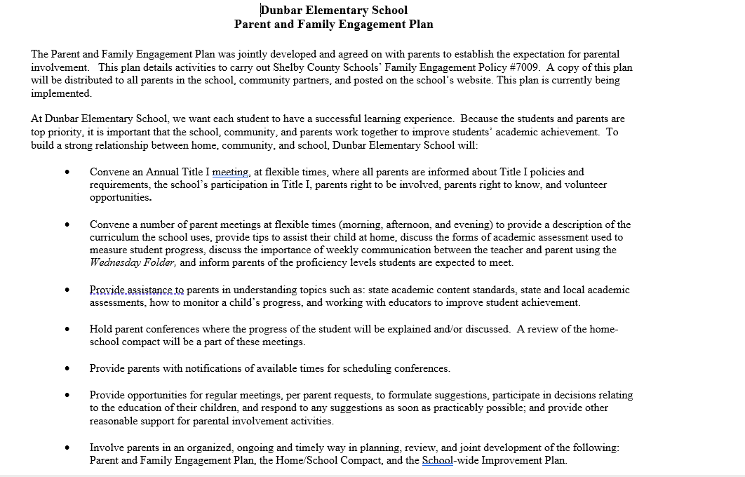
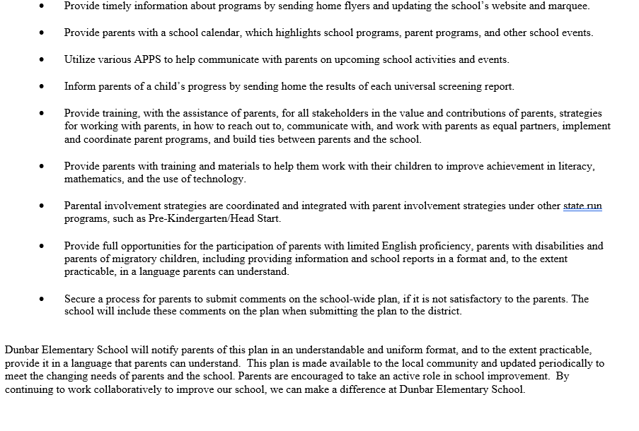
Policies for Parental Involvement
Family Engagement Plan

Slide 29

Opportunities for Parental Involvement
Meet the Teacher Night/Open House
Title I Meeting
Grade Level Parent Meetings
Read for the Record
Family Literacy Night
Family Math & Science Night
Grandparents Day
Muffins with Mom
Donuts with Dad
TCAP Parent Meeting
Field Day

Slide 30

Title One
Annual Meeting
School-Parent Compact

Slide 31
What is a School-Parent Compact?
A school-parent compact is a written commitment that outlines how the entire school community – teachers, families, and students will share the responsibility for improved academic achievement.
The compact must describe how the school will:
      provide high-quality curriculum and instruction;
      hold parent-teacher conferences, annually in elementary schools;
      provide parents with reports on their child’s progress;
      provide parents reasonable access to staff.
      provide parents opportunities to volunteer; and
      ensure regular two-way meaningful communication between family members and staff, to the extent practicable, in a language family members can understand.
You, as a Title I parent or family member, have the right to be involved in the development of the compact.

Slide 32
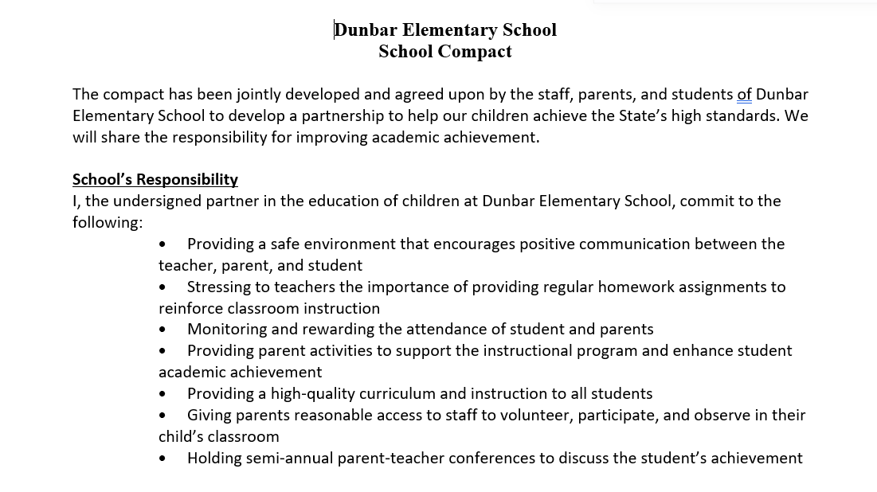
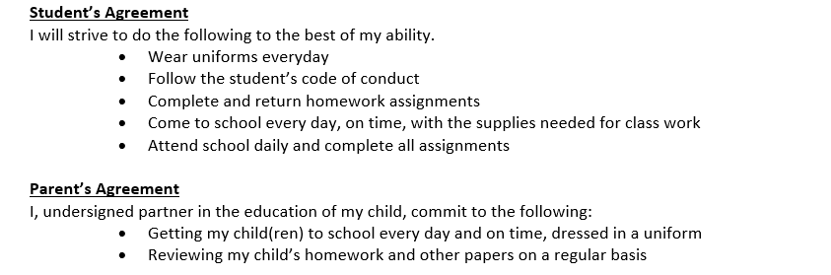
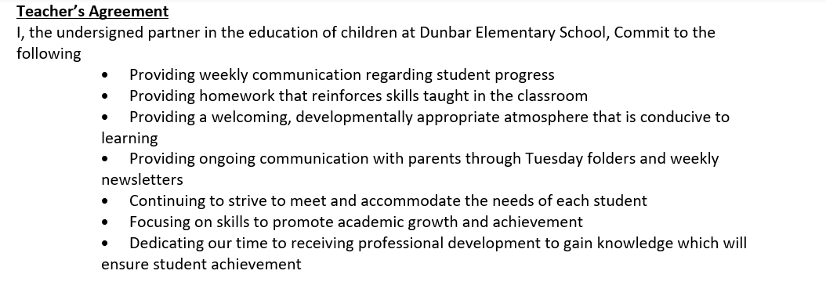
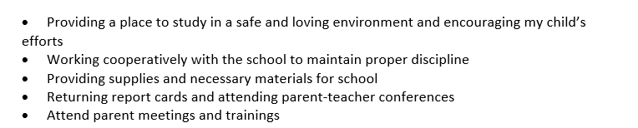
School and Parent Compact

Slide 33
What curriculum does our school use?
The Tennessee Academic Standards provide a common set of expectations for what students will know and be able to do at the end of a grade for each subject area.
Tennessee's academic standards form the framework for everything taught at Dunbar Elementary
For more information about Tennessee’s academic standards, see:
      https://www.tn.gov/content/tn/education/instruction/academic-standards.html

Slide 34

What test will my child be taking?
Test Time!!
Iready will be our universal screener for Grades K-8.
Iready will be used for ‘benchmark assessments’ for ALL grades.
AimsWeb will be used for RTI2 progress monitoring
TCAP is our State’s End of the Year Assessment

Slide 35
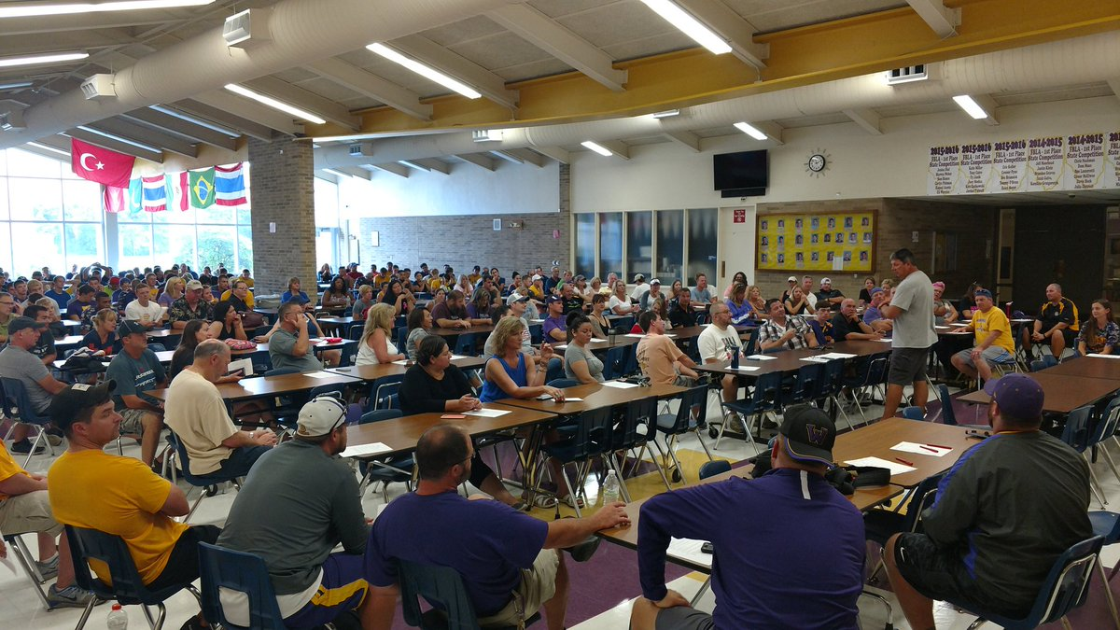
Title One
Annual Meeting
Opportunities for Additional Parent Meetings

Slide 36
How can I be involved?
We need you! Research has proven that family engagement in education has more impact on student achievement than any other factor.
To get involved with the SIP (School Improvement Plan, you can contact PLC Coach Ms. Wise or Principal Shaw
To get involved with the Parent and Family Engagement Policy,
To get involved with the School Parent Compact,

Slide 37
How can I be involved?
Other ways you can be involved in your child’s success:
    encouraging attendance;
    monitoring grades and schoolwork on an online system or portal;
    attending family events and meetings (provide specific dates when possible);
    observing or volunteering in classrooms;
    joining family groups and committees (e.g., PTA/PTO, advisory councils, etc.); and
    reading school/classroom newsletters or websites and that contain examples of learning activities families can do with students at home.]

Slide 38
RTI
What is it?
Why do we have it?
How can it be beneficial?

Slide 39
RTI² Components
Student Intervention Plans/Evaluations
Intervention Folders
Intervention Logs
Progress Monitoring Data
Fidelity Checks
Parent Communication Logs

Slide 40
TCAP/TNready
TCAP/TNReady will be administered between April 13–May 1
Students in grades 3-8 take the following exams each year: (2nd Grade ELA and Math)
  English/Language Arts
  Math
  Science
TNREADY practice questions will be available to parents online in the coming months. Continue to check TNReady.gov for more information.

Slide 41
2025-2026 Testing Structure:
Test items will include:
Multiple choice, evidence-based selected response, multiple select, writing prompt, and editing tasks
Multiple choice, multiple select, fill in the blank, two-part items, graphing, and matching

Slide 42
Reporting Pupil Progress
Teacher Communication | Progress Reports | Weekly Wednesday Communication Folder
Phone Calls | Report Cards (every 9 Weeks) Sent home | Goes home every Wednesday
Text Messaging to Parents | PowerSchool | Communicates your child's academic and behavior progress
Class Dojo communication Blooms Class Remind | TCAP Parents Reports | Parents should review the contents of the Wednesday folder, sign-off, and return all documents and Wednesday folder with your child.
Parent- Teacher conferences (in-person or via virtual platforms) | i-Ready Intervention Reports
Please ensure you provide updated contact information to the school

Slide 43

Parent-Teacher Conferences
Parent-Teacher Conferences will be held twice annually. The dates for this year are:
Note: Parents may also set up conferences with individual teachers at any time during the school year.
Thursday September 4, 2025 4pm – 7pm | Thursday January 29, 2026 4pm – 7pm

Slide 44

Title One
Annual Meeting
Parent’s Right to Know

Slide 45

Teacher Qualifications
Teachers are considered “highly qualified” under the NCLB law if they demonstrate subject knowledge in the core content areas, hold at least a bachelor’s degree, and have been issued a license from the State Department of Education.

Slide 46

The Memphis- Shelby County Board of Education accepts the responsibility for establishing and maintaining proper standards of discipline and behavior in the public schools. In order to maintain good order and ensure an environment conducive to learning, the Board considers behavior or conduct occurring on school property or at any school sponsored activity occurring off school property which interferes with the above to be offenses. The District establishes the MSCS Student Code of Conduct to provide a sample of unacceptable student behaviors and a related sample of disciplinary actions. The Code of Conduct and any revisions shall be approved and adopted by the MSCS Board of Education as the student discipline policy of the District.
Student Code of Conduct

Slide 47
Stay Informed
Website | https://schools.scsk12.org/dunbar-es
Facebook Page | Dunbar Elementary School
Phone | 901-416-5000
If you have questions or concerns relating to your child’s performance in school or other issues, please contact the school at or email your child’s teacher.
Thank you for entrusting our staff with your children.

Slide 48
WE JUST WANT TO SAY…
THANK YOU!
Notes:
Be sure to thank families for their time.
Move this slide to the end if additional slides are added.

Slide 49

Title One
Annual Meeting
Let’s meet our teachers

