Slide 1



Sue Reynolds Elementary School
Title I Input/Revision Meeting
Day: Tuesday
Date: May 12, 2026
Time: 4:30pm
Location: Media Center
Sue Reynolds Title 1 Parents
https://reynolds.rcboe.org/

Slide 4

Welcome Parents, School Staff, and Community Members
Sue Reynolds Elementary School receives money from Title I, Part A of the Elementary and Secondary Education Act, most recently reauthorized as Every Student Succeeds Act. This law provides federal funds through the Georgia Department of Education to school systems based on high numbers or percentages of children who meet certain financial criteria. These funds are provided to help ensure that all children have an equal opportunity to succeed in school by meeting the challenging State academic content and student academic achievement standards.”

Slide 5
Purpose of Meeting
The federal law requires that each school system receiving “Title I, Part A funds” jointly develop with parents and stakeholders of all participating children. Assistance is requested in planning our family engagement activities and specifically in revising district and school policies, School Improvement Plan, School-Parent Compact, Building Staff Capacity (determining what training our staff needs to promote good school-family partnerships, and determining how best to spend our family engagement funds).
Topics are covered in a way to provided an opportunity to ask questions, offer suggestions, and participate in more detailed discussions.

Slide 6
State of Title I Part A, Parent and Family Engagement-Review and Revision
Please read the Districtwide Policy, School Involvement Policy, and School-Parent Compact
Provide feedback for each document along with input about budget spending and school improvement plan revisions.
Write your suggestions on the input form as the documents are discussed
Remember, you have a voice at our school, USE IT!!

Slide 7
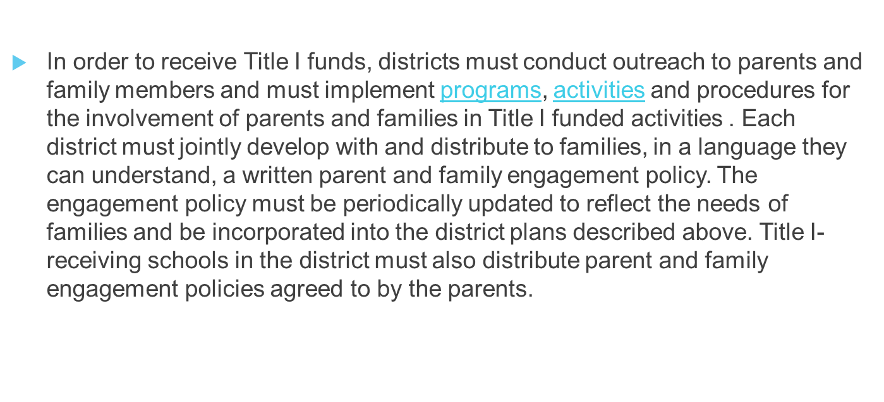
Parent and Family Engagement Policies (LEA-Local Education Agency & Schools)

Slide 8
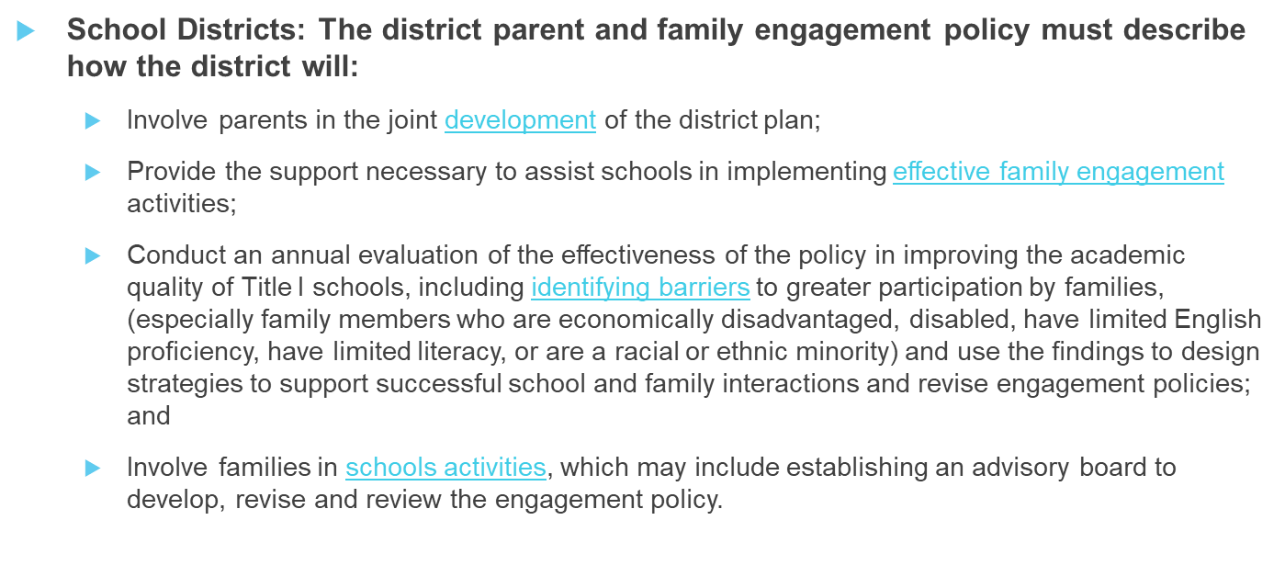
DISTRICTWIDE PARENT AND FAMILY ENGAGEMENT POLICY

Slide 9
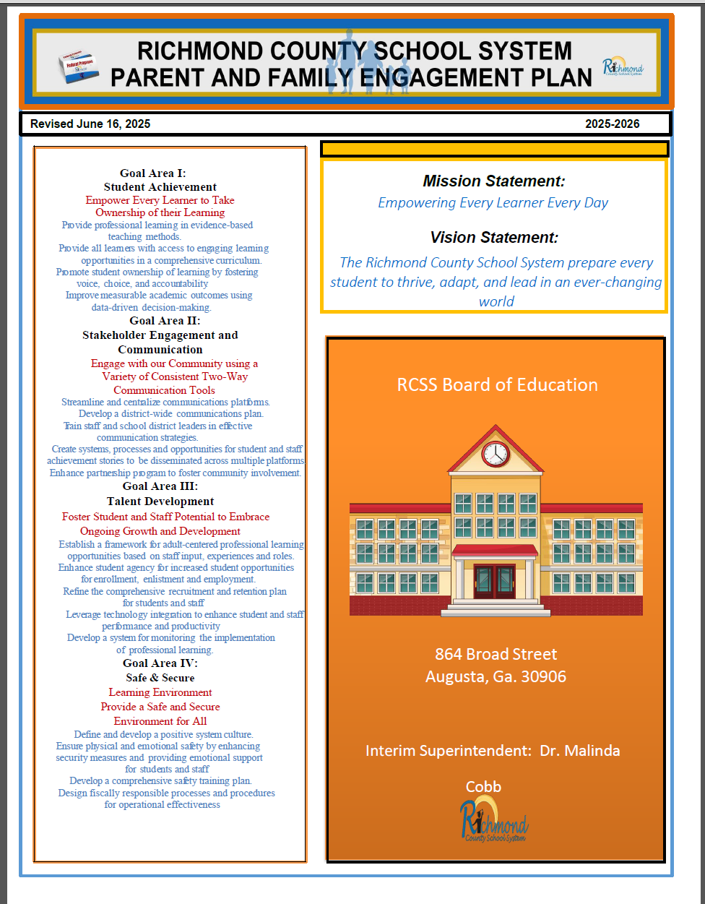
DISTRICT POLICY INPUT
Can be found on the School Webpage : Parents, Title I
What changes do you suggest?
Suggestion for District Policy

Slide 10
SCHOOL PARENT AND FAMILY ENGAGEMENT POLICY
Title I Schools:
The school parents and family engagement policy must describe how the school will:
Convene an annual meeting, at a convenient time to which all parents of low-income students are invited and encouraged to attend, to inform parents that their school receives Title I funds, that these funds come with requirements, and that parents have a right to be involved;
Offer a flexible number of engagement meetings at convenient times for families (for which the school may provide transportation, child care, or home visits using Title I funds);
Provide parents and families with:​
  Information about Title I-funded programs;
  An explanation of the curriculum and achievement levels the school uses; and
  If requested, opportunities for regular meetings to participate in decisions relating to the education of their student.

Slide 11
School Parent and Family Engagement Policy Input
Can be found on the School Webpage : Parents, Title I
School Parent and Family Engagement Policy
Sue Reynolds Elementary School
School Year: 2025-2026
Revision Date: 04-01/02-2026
In support of strengthening student academic achievement, Sue Reynolds Elementary School receives Title I, Part A funds and therefore must jointly develop with, agree on with, and distribute to parents and family members of participating children a written parent and family engagement policy that contains information required by section 1116(b) and (c) of the Every Student Succeeds Act (ESSA). The policy establishes the school’s expectations for parent and family engagement and describes how the school will implement a number of specific parent and family engagement activities, and it is incorporated into the school’s plan submitted to the local educational agency (LEA).
What changes do you suggest?
Sue Reynolds Elementary School Parental Input/Feedback

Slide 12
SCHOOL-PARENT COMPACT
Jointly develop with parents and stakeholders- a school-parent compact that outlines how families, school, staff and students will share the responsibility for improved student academic achievement and develop a partnership to help students achieve state standards.
  The compact must:
    Describe the school's responsibility to provide high-quality curriculum and instruction in a supportive and effective learning environment that enables students to meet the academic achievement standards, and the ways in which each parent will be responsible for supporting learning, including volunteering in their child’s classroom, and participating in decisions relating to the education of their children;
    Address the importance of communication between families and staff through, at a minimum:
      parent-teacher conferences in elementary schools, at least annually, during which the compact will be discussed as the compact relates to the individual child's achievement;
      frequent reports to parents on their children's progress; and
      opportunities to volunteer in or observe their child's class
    Ensure regular two-way meaningful communication between family members and school staff in a language they understand.

Slide 13


School-Parent Compact Input
Can be found on the School Webpage : Parents, Title I
What changes do you suggest?

Slide 14

Building Staff Capacity
Federal law also requires that Title I schools are to educate and train teachers, specialized instructional support staff, principals, other school leaders, and other staff in how to best develop partnerships with families.

Slide 15

Building Staff Capacity
What suggestions do you have to train teachers and school staff? What do staff members and leaders need to know in order to support parents with helping their child be successful?

Slide 16
TITLE I FUNDS
Title I Parent and Family Engagement Set Aside:
Each district receiving more than $500,000 in Title I Part A Funds is required to reserve at least one percent of its Title I funds to carry out parent and family engagement activities, including those described in the written policy section below. Ninety (90) percent of these “set-aside” funds must be distributed to schools, with priority given to “high-need” schools. The law further requires that parents and family members of students must be included in decisions regarding how these engagement funds are spent.

Slide 17


Title I Parent and Family Engagement Funds Input
How funds were used this school year
What are some suggestions for the use of Parent and Family Engagement Funds?

Slide 18
School Improvement Plan
Sue Reynolds Elementary School annually evaluates the schoolwide plan using data from the State’s assessments, other student performance data, and perception data to determine if the schoolwide program has been effective in addressing the major problem areas and, in turn, increasing student achievement, particularly for the lowest-achieving students. Schools must annually revise the plan, as necessary, based on student needs and the results of the evaluation to ensure continuous improvement. (ESEA section 1114(b)(3); 34 C.F.R. § 200.26(c)).

Slide 19
School Improvement Plan Input
School Goals:
Provide wellness resources and activities to improve mental health and work-life balance. Objective: Improve faculty climate and culture by adopting strategies that support well-being and professional growth which promotes teacher retention to 90%.
Provide targeted Professional Learning to include differentiation, small group learning, common assessments, and best practices in math and reading to aid Tier I Instruction. Implement strategies in math and reading to support Tier I instruction increasing on/above level students by 10% on GMAS (3-5) 10% I-READY(K-2)
What are some suggestions for goals and/or initiatives for the upcoming school year?

Slide 20
School Surveys
Surveys are meant to gather information that is geared to provide feedback to improve services to provide for students and parents.
Parents have a voice in what is done in the school and when the parents respond, the school knows what direction can be taken to achieve the maximum compatibility between home and community.
When a survey is given, please send back your feedback. This will help the school provide needed services for the students and parents.

Slide 21
Annual Parent and Family Engagement Evaluation
“Each year, Sue Reynolds Elementary School, conducts an annual evaluation to ask parents to help us determine the effectiveness of the parent and family engagement program in improving the academic quality of the Title I schools, including identifying possible barriers to greater participation of parents in activities and programs. Additionally, school systems will use the findings from the annual evaluation to design evidence-based strategies for more effective family engagement and to revise the Title I parent and family engagement policies.”
Your window to complete this survey was April 1, 2026- May 1, 2026

Slide 22

Next Steps
Your input will be used where possible for the 2026-2027 school year as we update the:
School Compact
Districtwide Policy
School Policy
Title I Parent Budget
School Improvement Plan
Documents will also be distributed at the school's Annual Meeting and on your school's website.

Slide 23
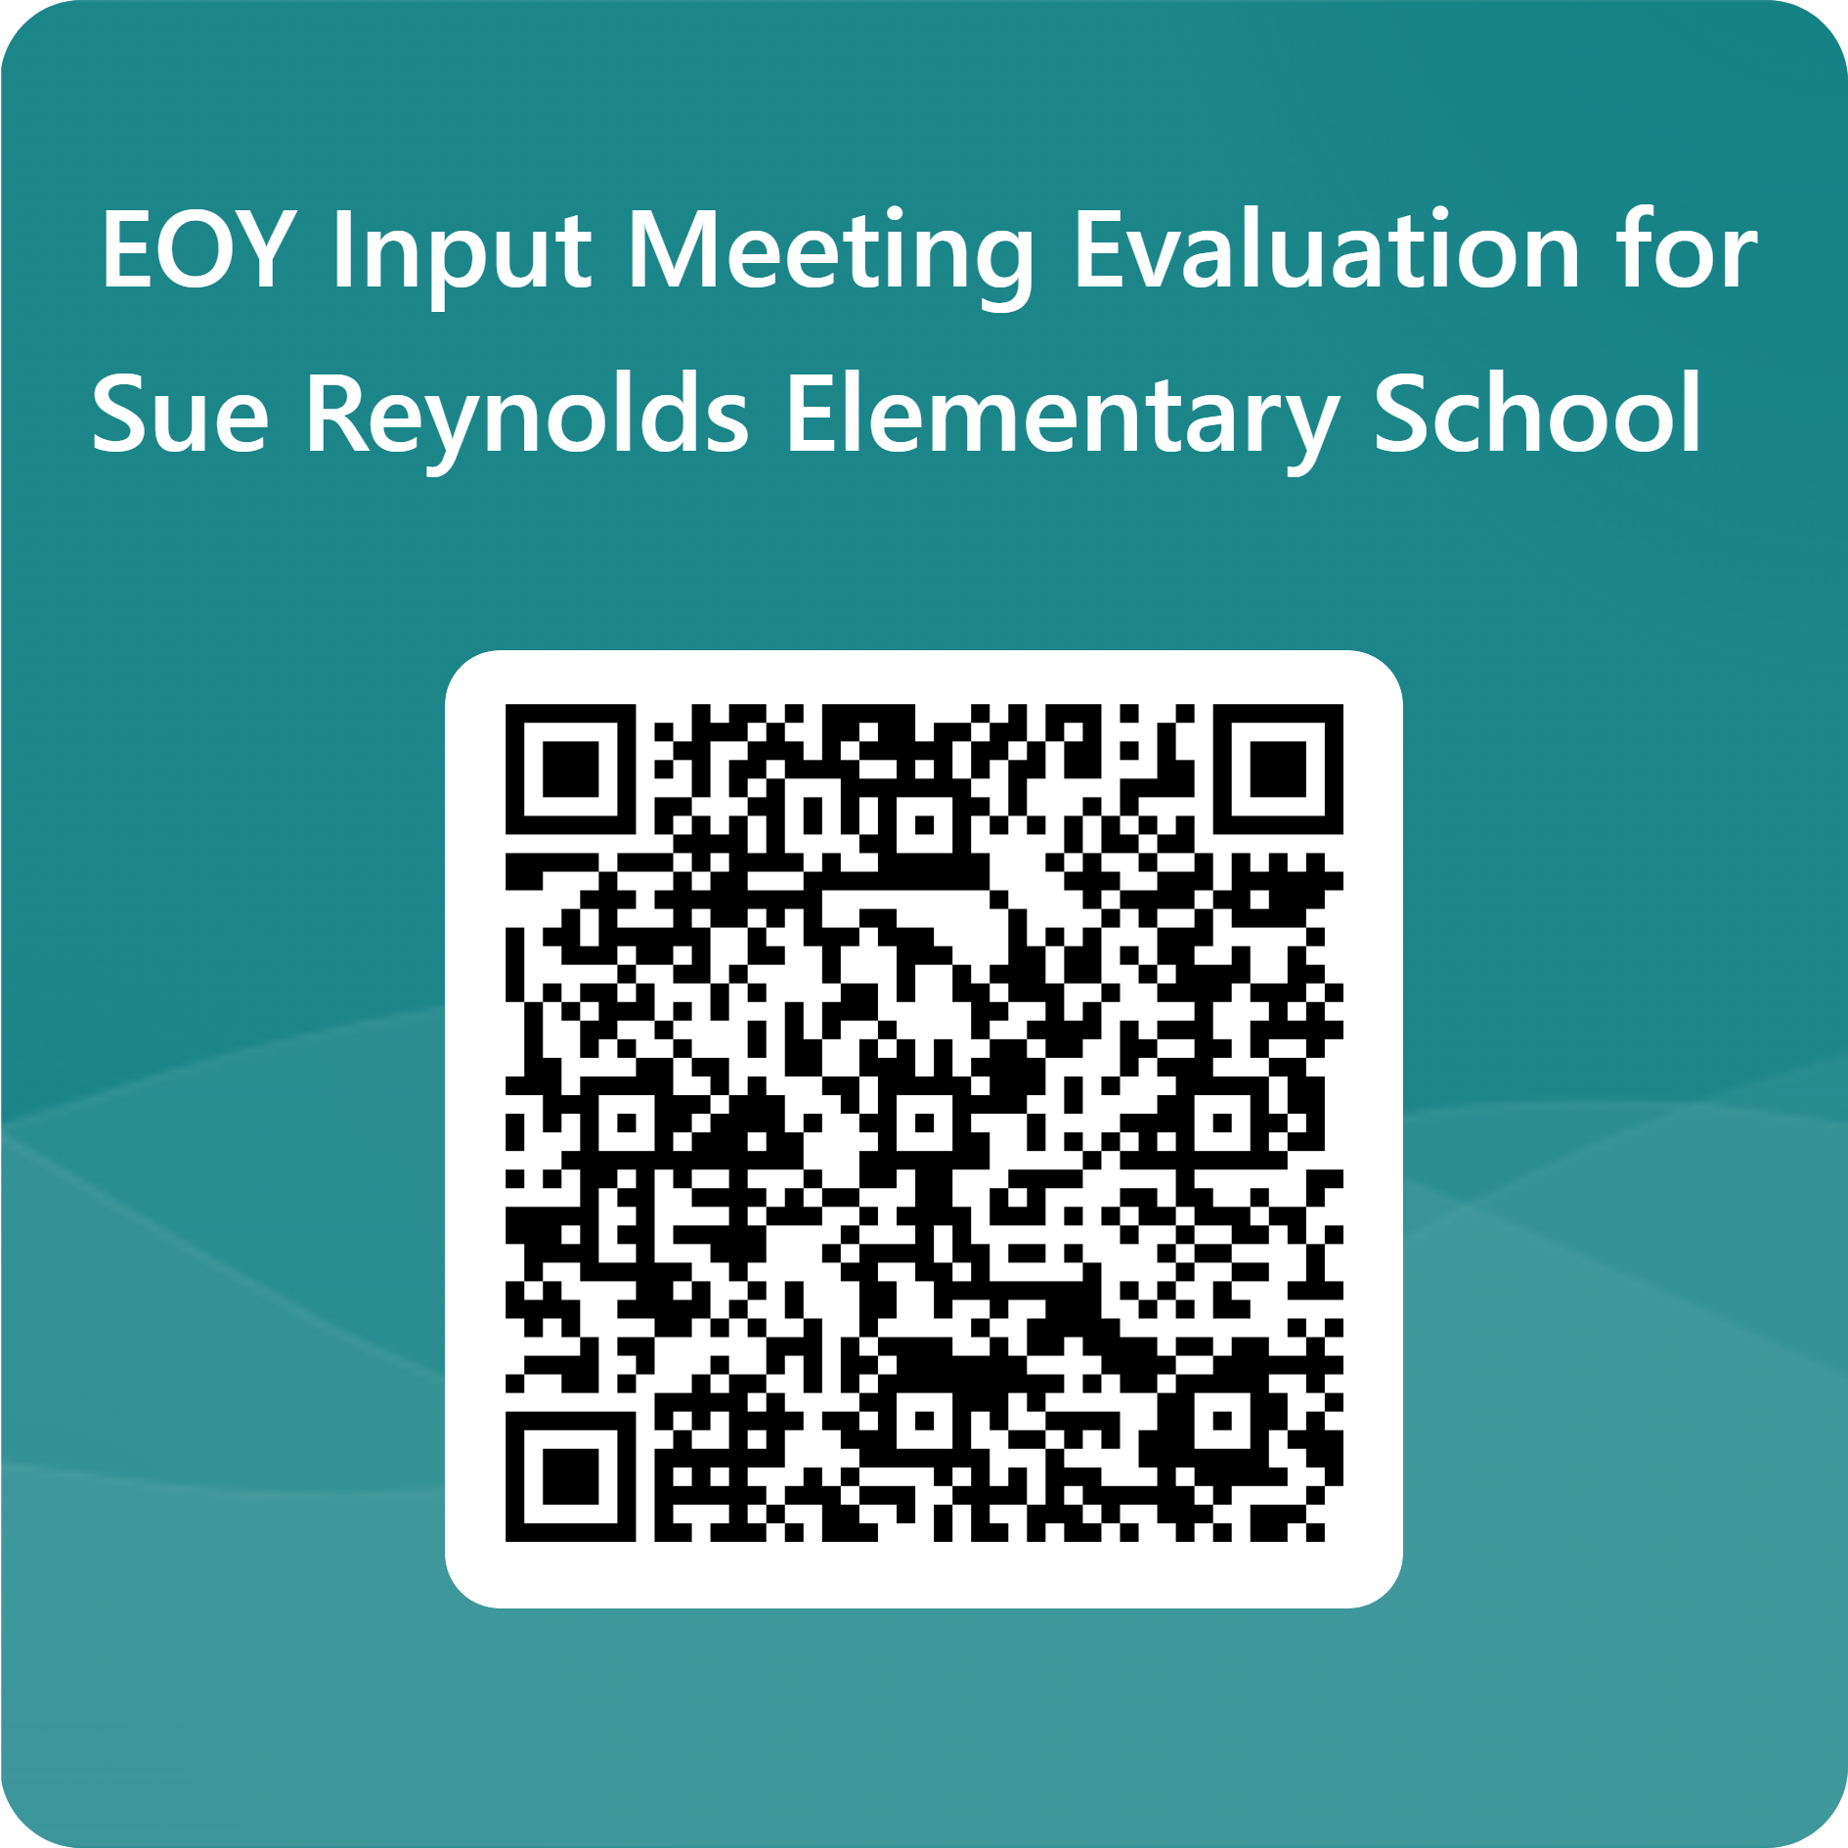
SCHOOL SURVEYS WORKSHEET
Thank you for attending our input/revision meeting. Please complete the EOY Meeting Evaluation!
{If you have any questions, please contact:
Ms. Regena Howard-Jennings
706-855-2540 ex. 4275
3840 Wrightsboro Road
Augusta, GA, 30909
EOY Meeting Evaluation
https://forms.office.com/Pages/ResponsePage.aspx?id=QC2yMGJzF0-DqSUwkntvZfPH_cQVEfJBnzCPe4xatadUM1lZTldUUEFFV1NFME5YVVYzVTY4MVY5UC4u

