Slide 1

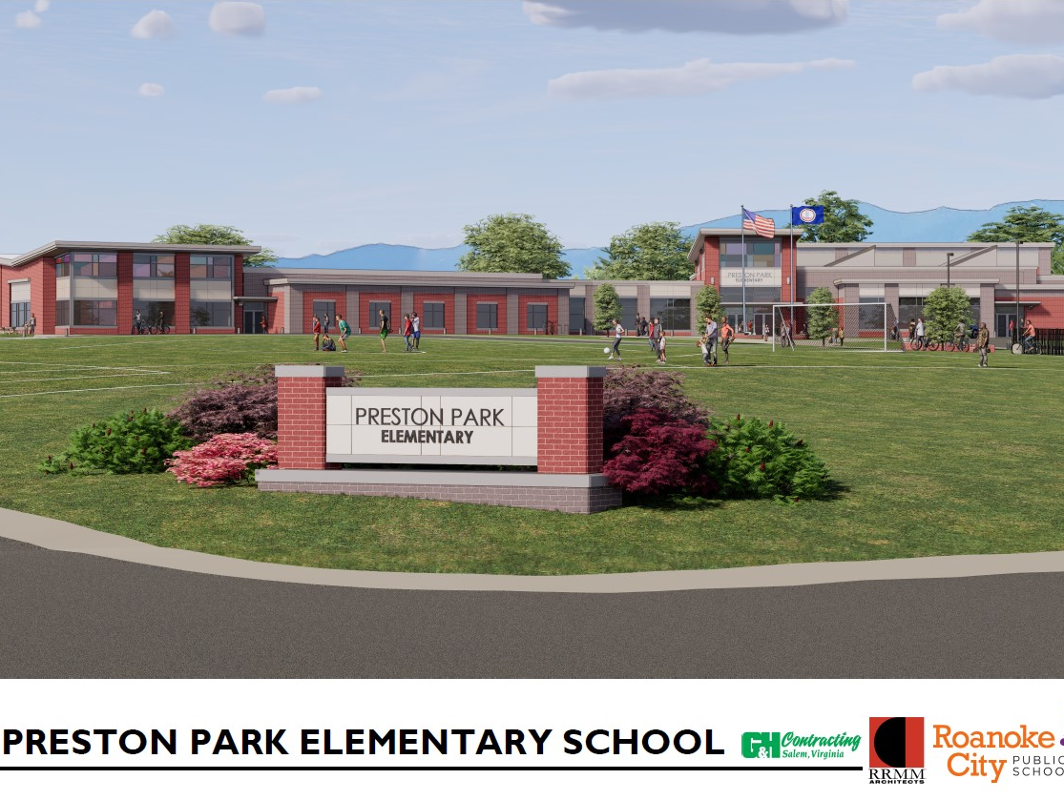
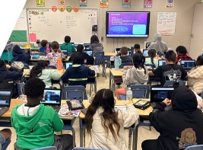
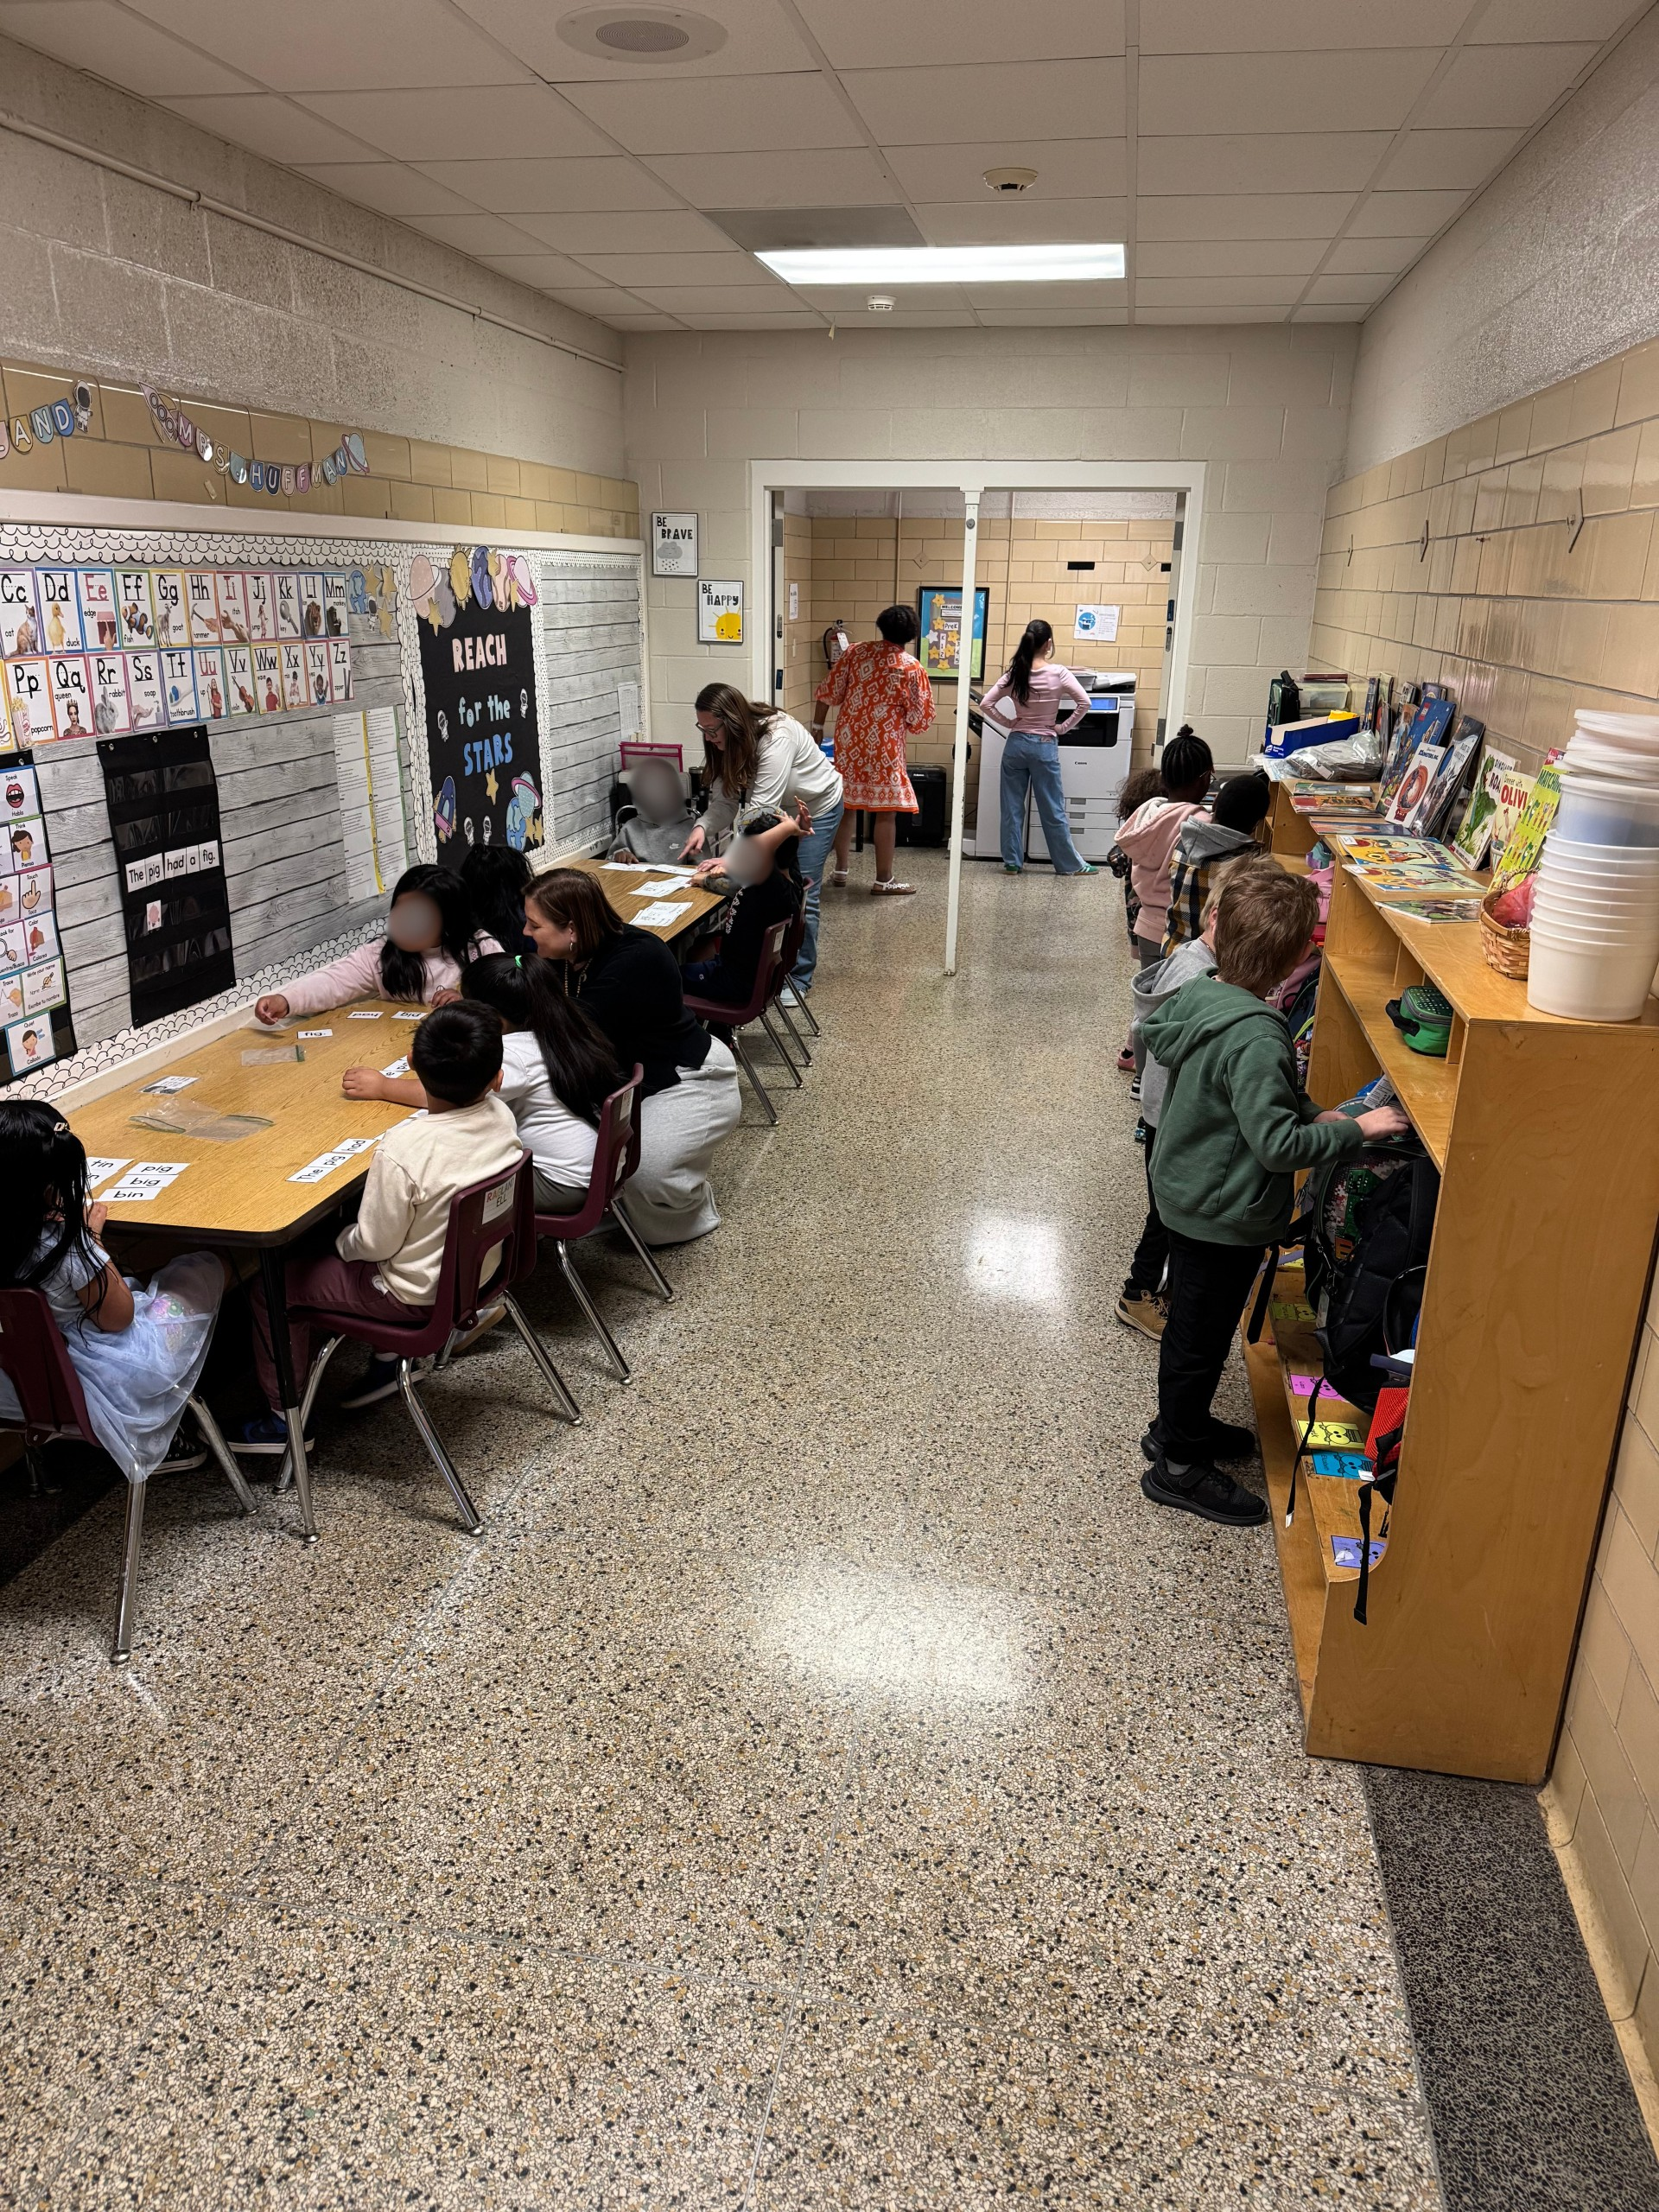
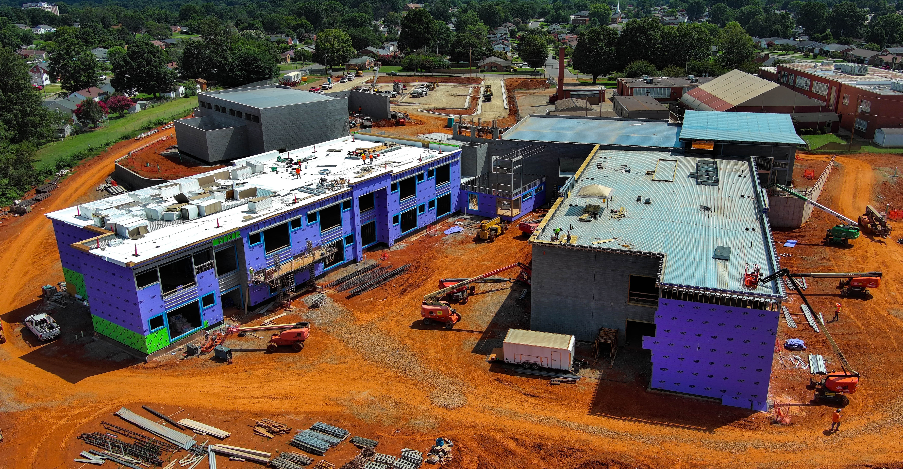
Boundary Steering Committee
Recommendation
We Are One #RCPSProud
May 4, 2026

Slide 2

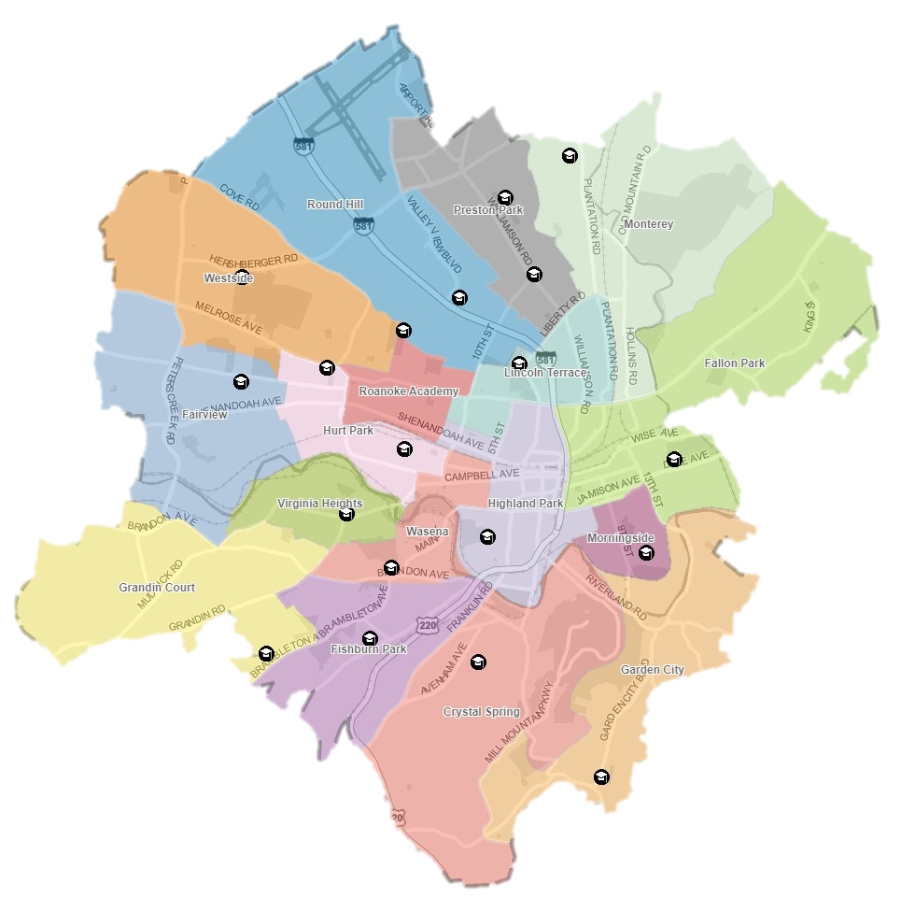
Purpose & Outcomes
Purpose: To ensure appropriate enrollment at Preston Park and relieve overcrowding at Monterey to create a balanced and sustainable system.
Minimize student movement and disruption.
Maintain ~85-90% functional capacity buffer for future needs

Slide 3
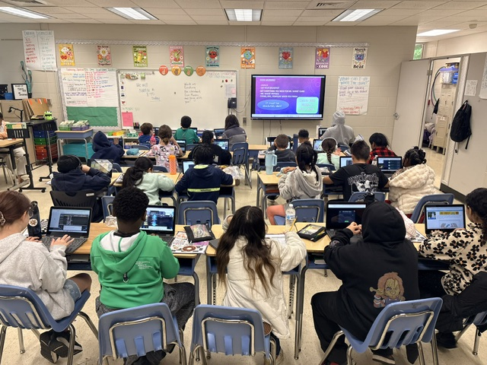
Next Steps
Why Boundary and Programming Review
Preston Park Elementary
Monterey Elementary

Slide 4
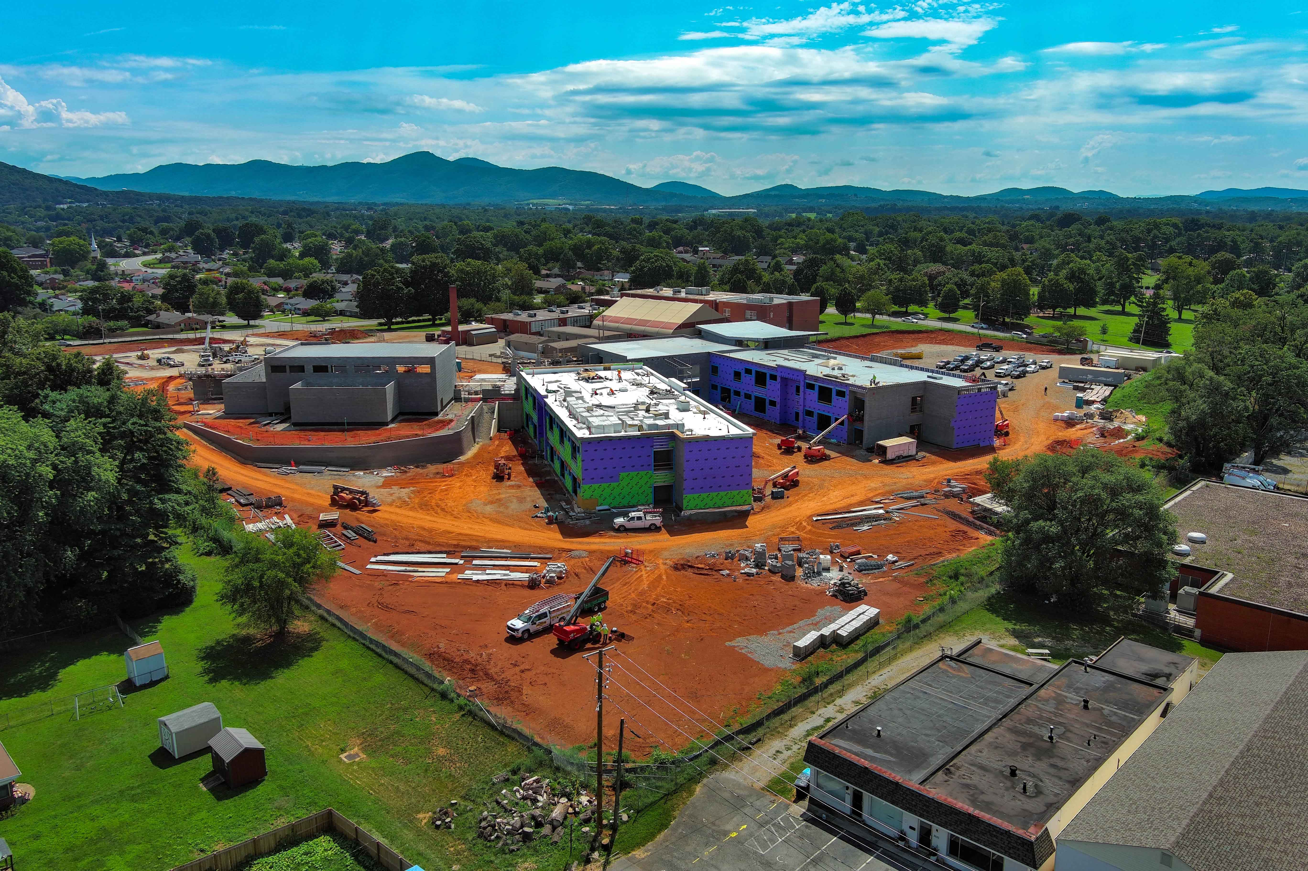
Next Steps
Boundary Review Steering Committee
Committee (18):
School Board Mr. Christopher Link
      Ms. Deidre Trigg
Division Leadership Dr. Cynthia Williams
Data & Analysis Ms. Melissa Eckert
Preschool Ms. Mary-Katherine Bishop
Transportation Mr. Walter Doughty
Special Education Ms. Jamay Gray
Principal Mr. William Krause
Assistant Principal Ms. Quiana Fields
Parents/Guardians Ms. Kim Corpening
          Ms. Dana McKenzie
Students Ms. Faith Pardue
Mr. Shane Wilson
School-based Staff Ms. Laura Hogan
Ms. Tamika Jones
Ms. Sherri Ambrose
Ms. DaeZhanae Taylor
REA Representative Ms. Lindsey Grubb
Feedback Repository:
RCPS will create a survey specifically for community input and feedback from community engagement sessions.

Slide 5

Planning Partners
FutureThink & RRMM
  Long-standing relationship, partnering on several projects throughout the Commonwealth
FutureThink
  Educational facility planning firm located in Columbus, OH
  Tracy Healy is the Owner/President
  Celebrating 20 years in business this month
  Worked with 1,000+ school districts across the country
  Rick Stein and Tyler Spears provide the GIS mapping services and scenario development

Slide 6
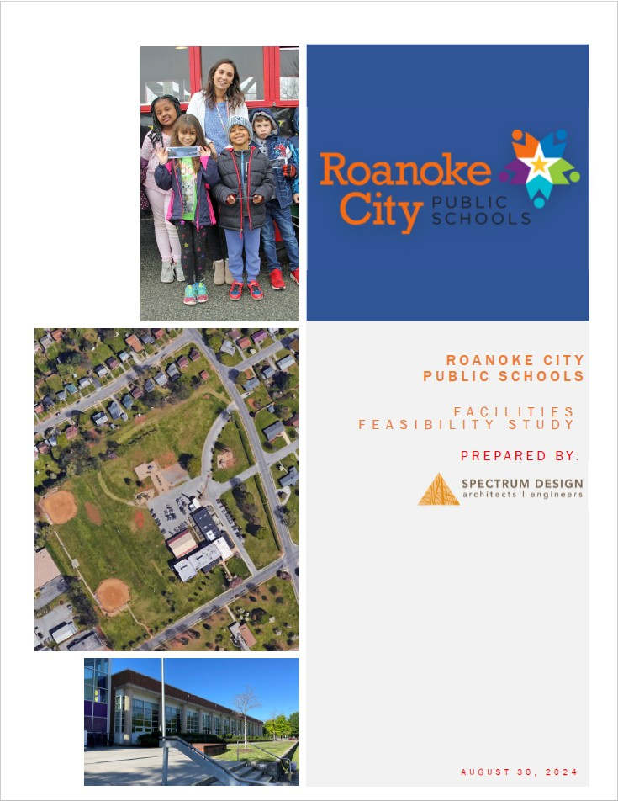

History – Two Independent Reports
August 30, 2024
March 5, 2026

Slide 7





Elementary Schools
3-5 Years
Phase 1 – North
2026 - 2027
Capacity
Preston Park – Fall 2026
Monterey – Fall 2026
Round Hill – Fall 2027
Westside – Fall 2027
Phase 2 – Study Results
2027 - 2029
Educational Use
Hurt Park
Lincoln Terrace
Fairview
Phase 3 – South
2029-2031
Capacity
Crystal Spring
Highland Park
Wasena
Grandin Court
Monterey
Preston Park
Round Hill
Westside
Roanoke Academy
Phases
Lincoln Terrace
Fairview
Hurt Park
Fallon Park
Virginia Heights
Highland Park
Morningside
Wasena
Grandin Court
Fishburn Park
Crystal Spring
Garden City

Slide 8
What Families Should Know
Capacity and Boundary Adjustments
  Preston Park is above functional capacity
    New School Opens August 2026 – Immediate Driving Factor
  Monterey is crowded and lacks space for Preschool
    Only school without Preschool Programming
  Fallon Park is below functional capacity
    Beautiful, recently built school
  Lincoln Terrace and Round Hill provide minor boundary adjustments for future school overcrowding measures
Student Transition Support
  Support includes orientation events, counselor assistance, and communication to ease reassigned students’ transition.
  Academic and support services, including special education and English Learner programs, will continue without interruption.
Family Communication and Stability
  Families will receive updates and have opportunities to ask questions and provide feedback
  Transportation changes will be minimal

Slide 9
What Families Should Know
Transition Impact Based on Address
School | Students Transitioning Out | Students Transitioning In | Net Impact
Preston Park | 11 | 124 | +113 Students
Monterey | 141 | 52 | -89 Students
School | Students Transitioning Out | Students Transitioning In | Net Impact
Fallon Park | 5 | 63 | +58 Students
Round Hill | 22 | 12 | -10 Students
Lincoln Terrace | 12 | 16 | +4 Students
Note: Special Transfers and Programmatic Transfers will be addressed on a case-by-case basis

Slide 10
What Families Should Know
Question | Summary Answer
What is changing? | Targeted boundary adjustments to relieve overcrowding at Preston Park and Monterey.
Which schools are involved? | Preston Park ES, Monterey ES, Fallon Park ES, Lincoln Terrace ES, and Round Hill ES.
Will my child move schools? | Some students will be reassigned; most will remain at their current school.
When would changes occur? | Implementation planned for the 2026–27 school year.
How will students be supported? | Transition activities, counseling supports, and family communication.
Transportation impacts? | Average changes are minimal; elementary ride times remain a priority.
How can parents ask questions? | RCPS will provide a dedicated survey and engagement opportunities through two town halls.
Will my student have to move again, since it is a phased plan? | RCPS plans to limit elementary students to no more than one boundary change

Slide 11
What Families Should Know
Question | Summary Answer
When will parents be notified of a change in school enrollment for students? | Families will be directly notified after the School Board votes on Tuesday, May 26, if approved. Parents can anticipate a notification prior to the last day of school (June 4, 2026).
How will parents be notified? | Mailed letters, robocalls, and emails will be sent to families.
When can families visit their new school? | Open houses will be scheduled at each school site during the summer. Back to school nights will be scheduled prior to the opening of school for the 2026-2027 school year. Notifications of open houses and back to school nights include a letter mailed to each home, email, and robocalls.
If parents have questions after the end of this school year, who do they contact? | Dr. Cyndi Williams, Department of Academics & Accountability: (540) 853-1787

Slide 12
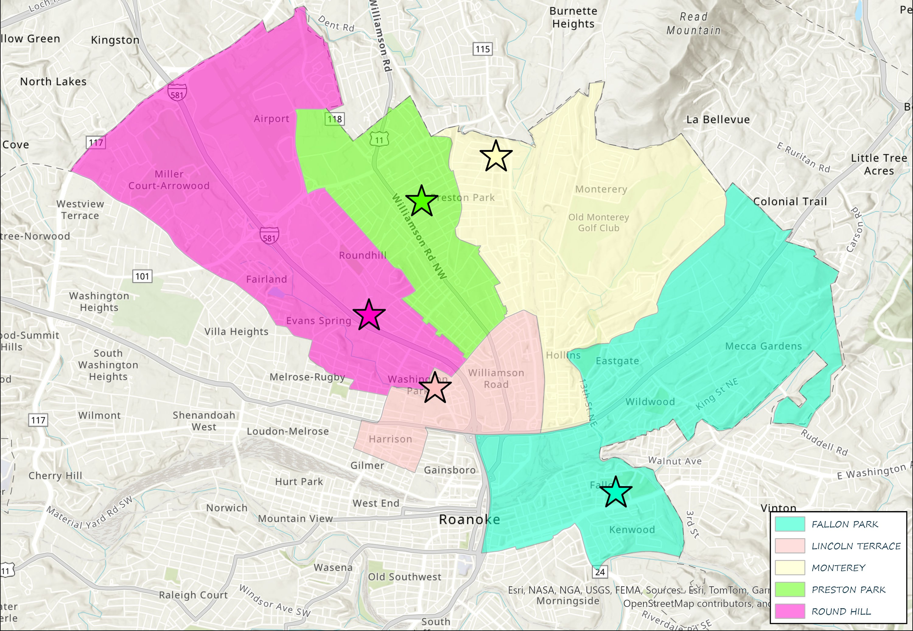
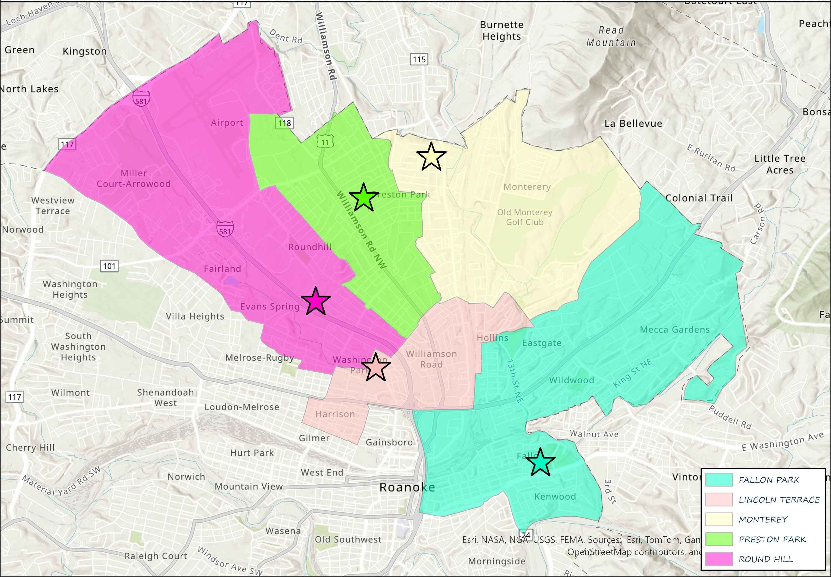
Attendance Zones Changes
Current Attendance Zones
Recommended Attendance Zones

Slide 13
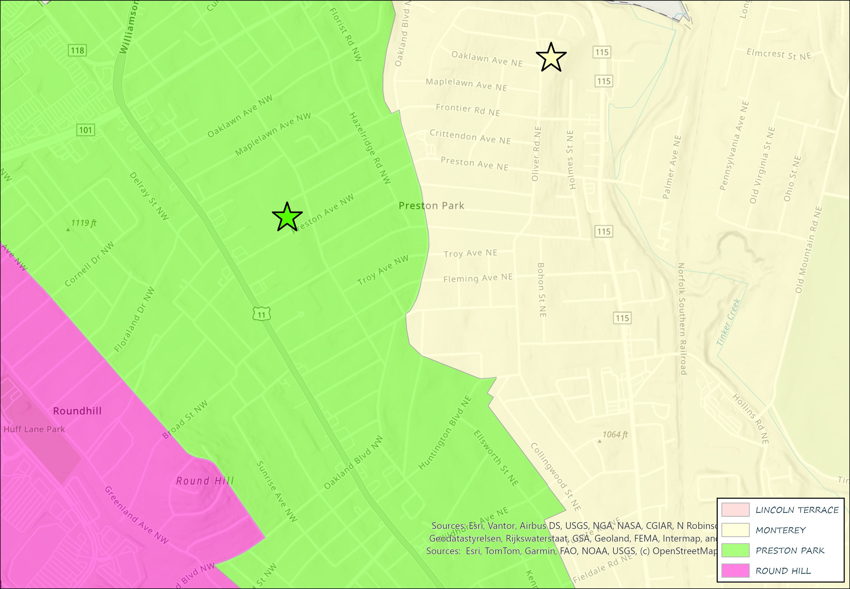
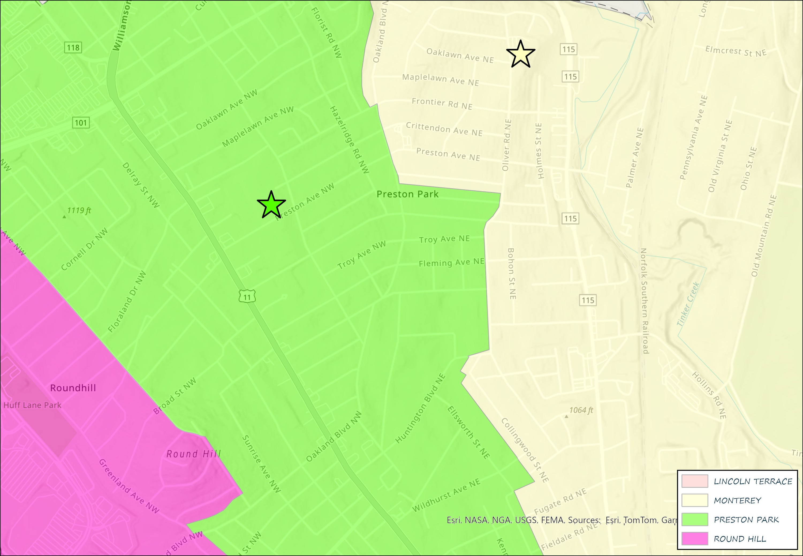

Focused Attendance Zones Changes
Current Attendance Zones
Recommended Attendance Zones

Slide 14
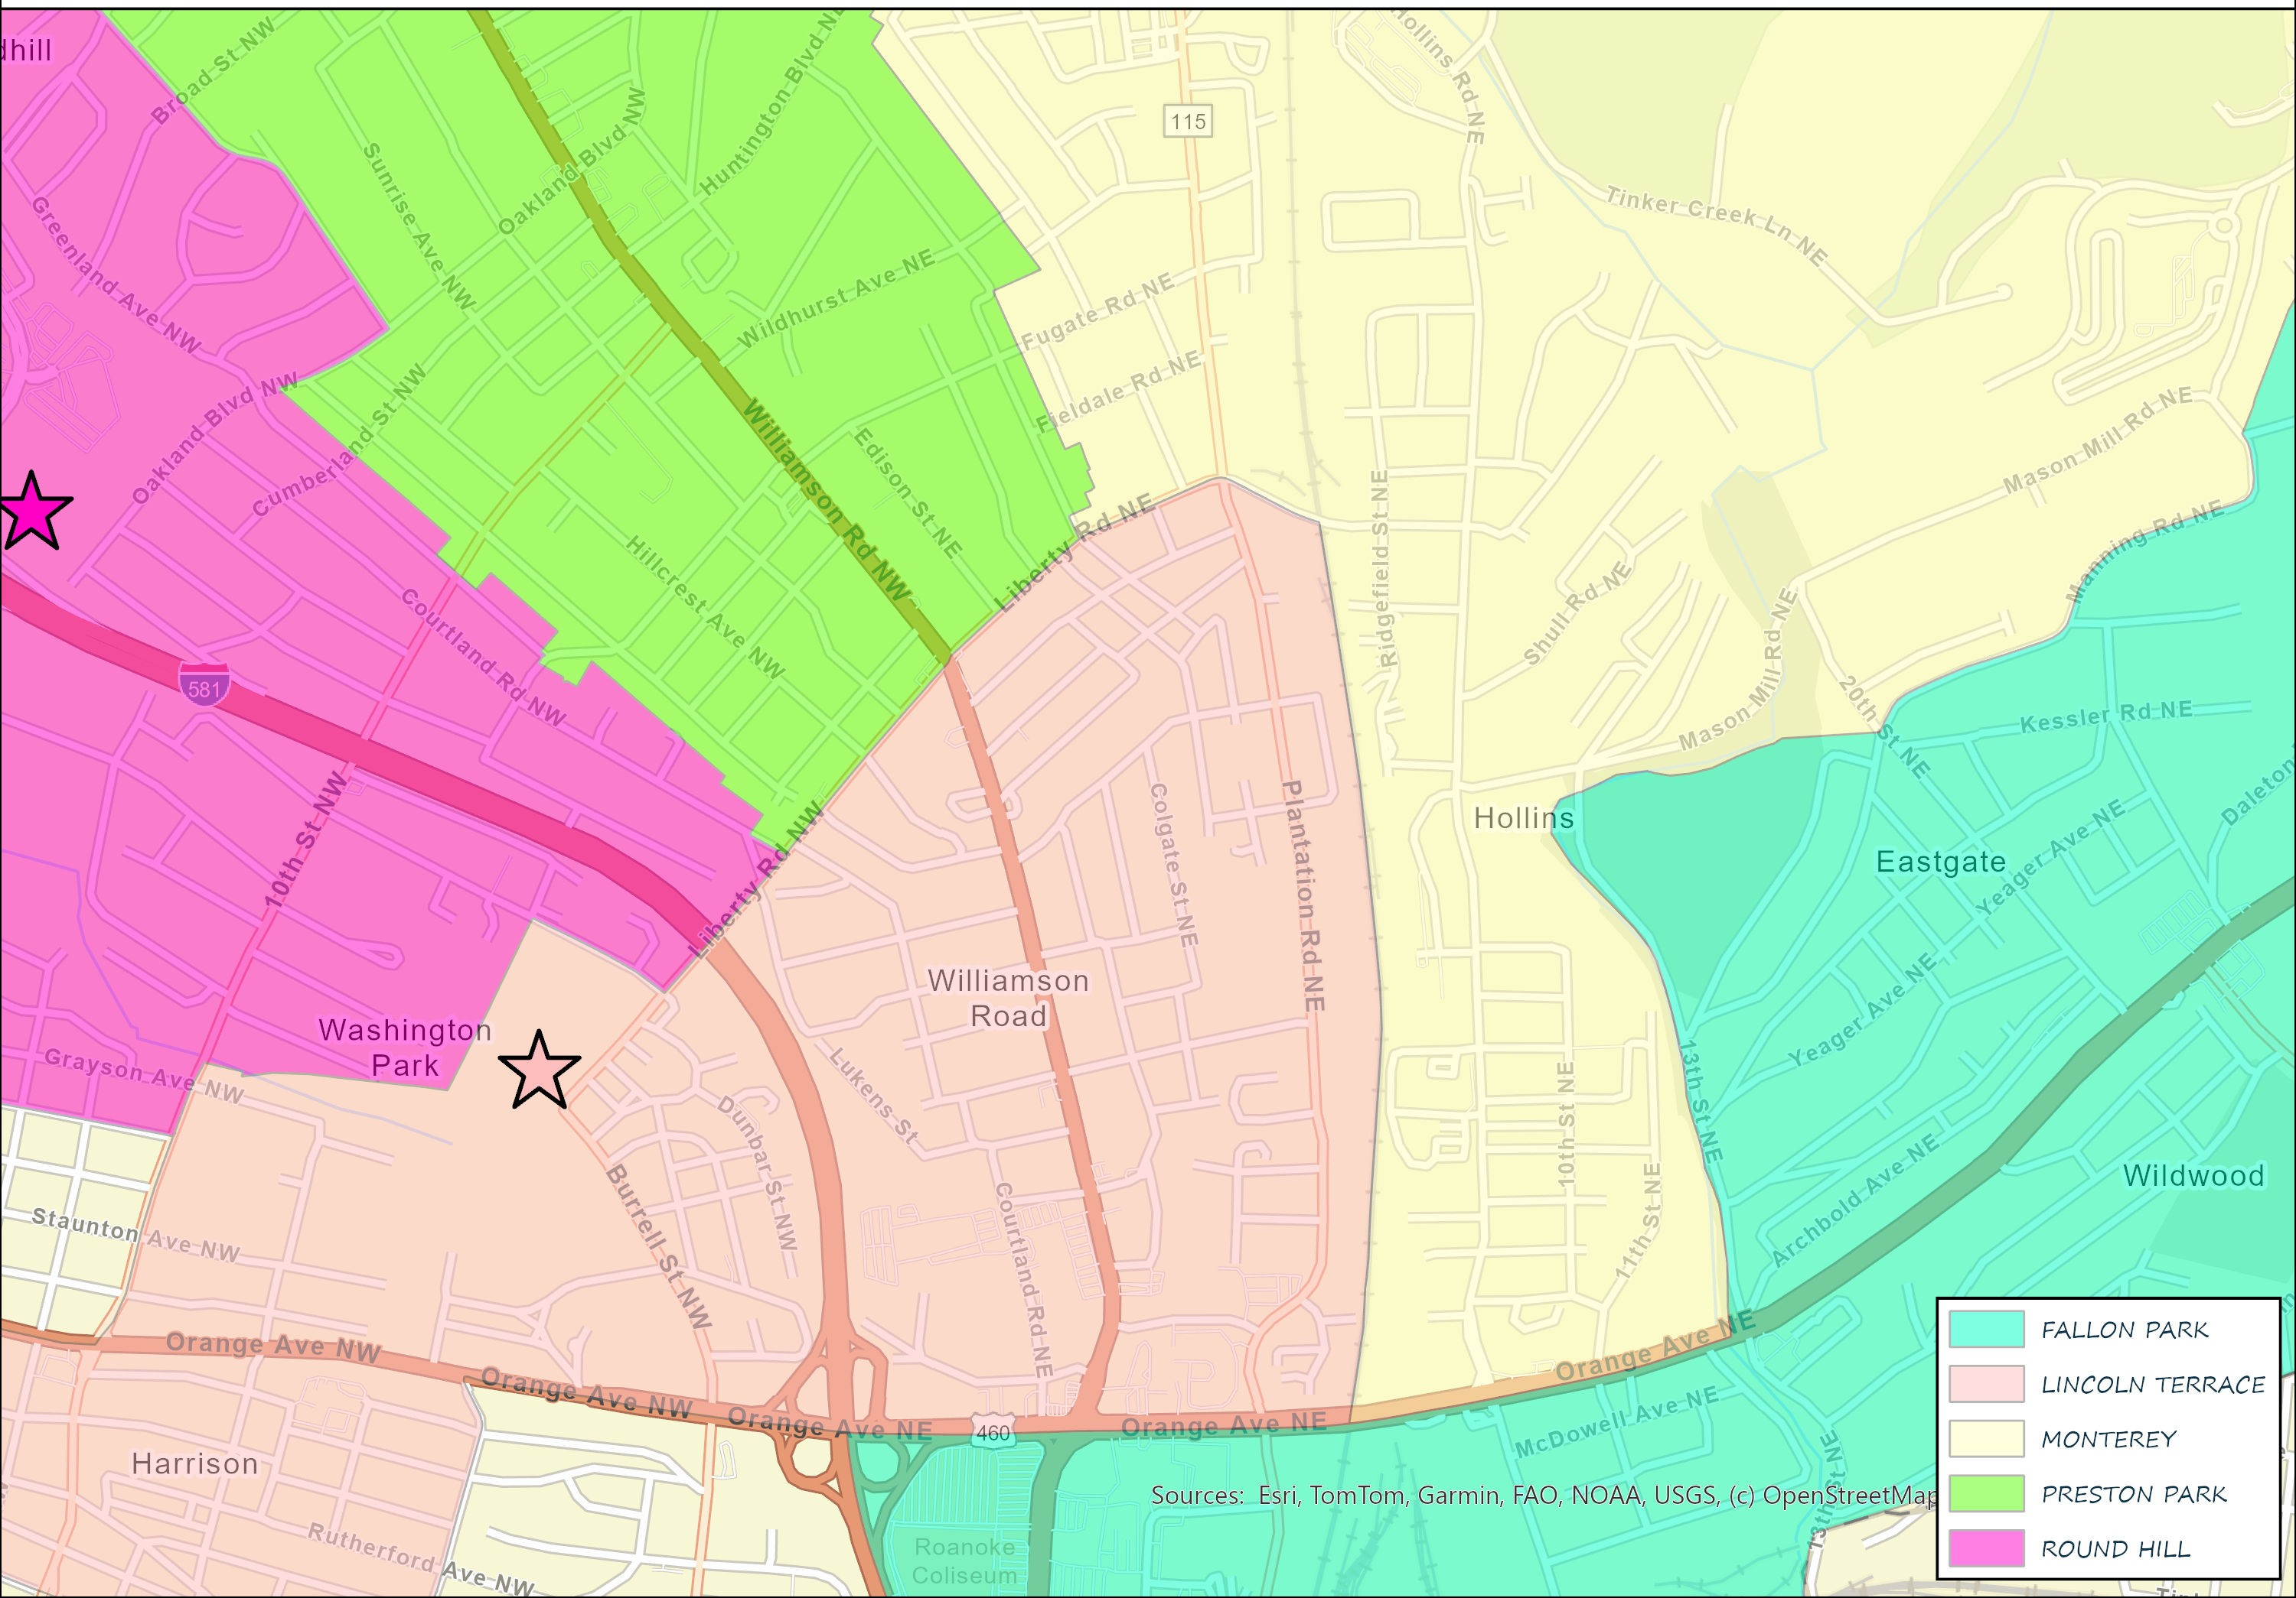
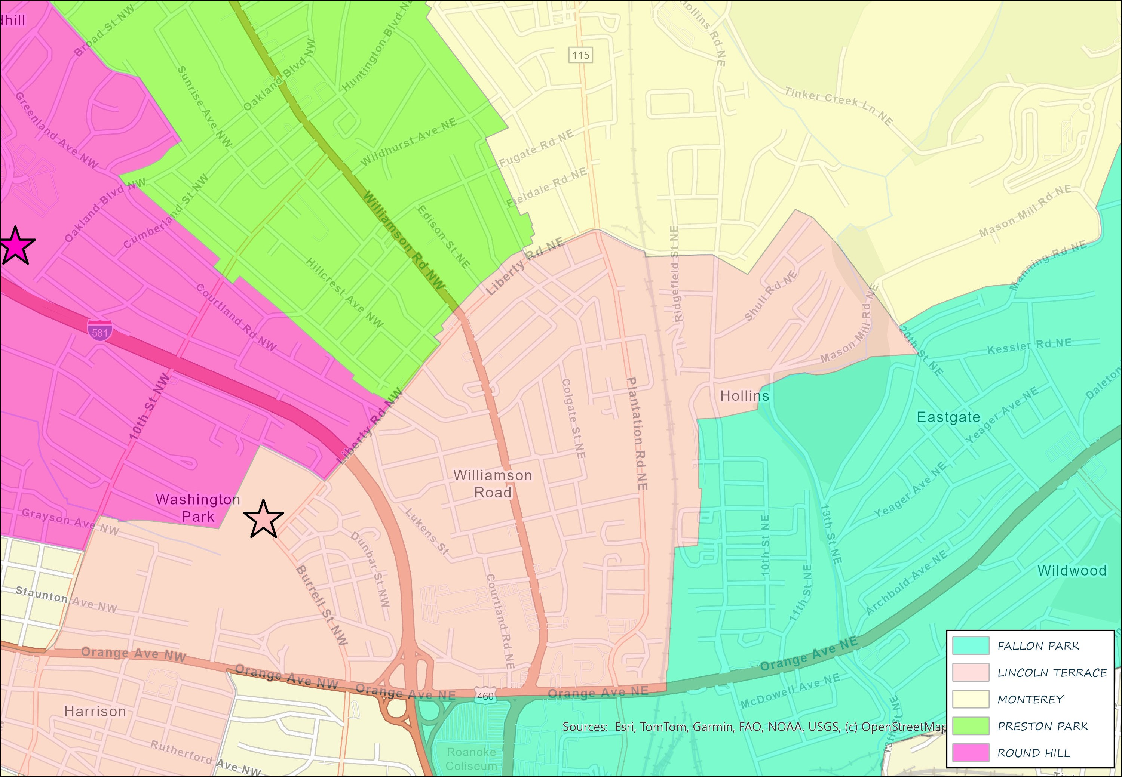


Focused Attendance Zones Changes
Current Attendance Zones
Recommended Attendance Zones

Slide 15
Impacted Addresses
New School Preston Park
Current School | New School | Address Range
LINCOLN TERRACE ELEMENTARY SCHOOL | PRESTON PARK ELEMENTARY SCHOOL | 1 - 79 FOREST HILL AVE NE
MONTEREY ELEMENTARY SCHOOL | PRESTON PARK ELEMENTARY SCHOOL | 100 - 187 TRINKLE AVE NE
MONTEREY ELEMENTARY SCHOOL | PRESTON PARK ELEMENTARY SCHOOL | 100 - 197 CHRISTIAN AVE NE
MONTEREY ELEMENTARY SCHOOL | PRESTON PARK ELEMENTARY SCHOOL | 100 - 198 HURST AVE NE
MONTEREY ELEMENTARY SCHOOL | PRESTON PARK ELEMENTARY SCHOOL | 100 - 225 PRINCETON CIR NE
MONTEREY ELEMENTARY SCHOOL | PRESTON PARK ELEMENTARY SCHOOL | 100 - 333 TROY AVE NE
MONTEREY ELEMENTARY SCHOOL | PRESTON PARK ELEMENTARY SCHOOL | 100 - 334 FLEMING AVE NE
MONTEREY ELEMENTARY SCHOOL | PRESTON PARK ELEMENTARY SCHOOL | 100 - 334 WENTWORTH AVE NE
ROUND HILL ELEMENTARY SCHOOL | PRESTON PARK ELEMENTARY SCHOOL | 1700 - 1717 EMPRESS DR NW
ROUND HILL ELEMENTARY SCHOOL | PRESTON PARK ELEMENTARY SCHOOL | 1700 - 1898 HERSHBERGER RD NW
ROUND HILL ELEMENTARY SCHOOL | PRESTON PARK ELEMENTARY SCHOOL | 2400 - 2536 CORNELL DR NW
ROUND HILL ELEMENTARY SCHOOL | PRESTON PARK ELEMENTARY SCHOOL | 2400 - 2541 MARR ST NW
ROUND HILL ELEMENTARY SCHOOL | PRESTON PARK ELEMENTARY SCHOOL | 2400 - 2545 FLORALAND DR NW
ROUND HILL ELEMENTARY SCHOOL | PRESTON PARK ELEMENTARY SCHOOL | 2400 - 2546 RAVENWOOD AVE NW
ROUND HILL ELEMENTARY SCHOOL | PRESTON PARK ELEMENTARY SCHOOL | 2400 - 2546 VANCOUVER DR NW
Note: Special Transfers and Programmatic Transfers will be addressed on a case-by-case basis

Slide 16
Impacted Addresses
New School Preston Park
Current School | New School | Address Range
ROUND HILL ELEMENTARY SCHOOL | PRESTON PARK ELEMENTARY SCHOOL | 2400 - 2643 DORCHESTER DR NW
MONTEREY ELEMENTARY SCHOOL | PRESTON PARK ELEMENTARY SCHOOL | 2400 - 4248 OAKLAND BLVD NW
ROUND HILL ELEMENTARY SCHOOL | PRESTON PARK ELEMENTARY SCHOOL | 2400 - 4248 OAKLAND BLVD NW
ROUND HILL ELEMENTARY SCHOOL | PRESTON PARK ELEMENTARY SCHOOL | 2409 - 2546 BROAD ST NW
ROUND HILL ELEMENTARY SCHOOL | PRESTON PARK ELEMENTARY SCHOOL | 2500 - 2532 EDINBURGH DR NW
ROUND HILL ELEMENTARY SCHOOL | PRESTON PARK ELEMENTARY SCHOOL | 2500 - 2535 CHURCHILL DR NW
ROUND HILL ELEMENTARY SCHOOL | PRESTON PARK ELEMENTARY SCHOOL | 2500 - 2540 DURHAM ST NW
ROUND HILL ELEMENTARY SCHOOL | PRESTON PARK ELEMENTARY SCHOOL | 2512 - 2546 AVALON AVE NW
ROUND HILL ELEMENTARY SCHOOL | PRESTON PARK ELEMENTARY SCHOOL | 2532 - 2565 ROUND TOP RD NW
MONTEREY ELEMENTARY SCHOOL | PRESTON PARK ELEMENTARY SCHOOL | 300 - 319 HUNTINGTON BLVD NE
MONTEREY ELEMENTARY SCHOOL | PRESTON PARK ELEMENTARY SCHOOL | 3500 - 4248 OAKLAND BLVD NE
MONTEREY ELEMENTARY SCHOOL | PRESTON PARK ELEMENTARY SCHOOL | 3600 - 3652 COOK AVE NE
MONTEREY ELEMENTARY SCHOOL | PRESTON PARK ELEMENTARY SCHOOL | 3700 - 3999 BRIGHTWELL ST NE
MONTEREY ELEMENTARY SCHOOL | PRESTON PARK ELEMENTARY SCHOOL | 3700 - 3999 MONTAGUE ST NE
ROUND HILL ELEMENTARY SCHOOL | PRESTON PARK ELEMENTARY SCHOOL | 3800 - 5099 GRANDVIEW AVE NW
Note: Special Transfers and Programmatic Transfers will be addressed on a case-by-case basis

Slide 17
Impacted Addresses
New School Fallon Park
Current School | New School | Address Range
MONTEREY ELEMENTARY SCHOOL | FALLON PARK ELEMENTARY SCHOOL | 1200 - 1898 11TH ST NE
MONTEREY ELEMENTARY SCHOOL | FALLON PARK ELEMENTARY SCHOOL | 1200 - 2161 HOLLINS RD NE
MONTEREY ELEMENTARY SCHOOL | FALLON PARK ELEMENTARY SCHOOL | 1400 - 2098 10th St NE
MONTEREY ELEMENTARY SCHOOL | FALLON PARK ELEMENTARY SCHOOL | 1800 -1999 20TH ST NE
MONTEREY ELEMENTARY SCHOOL | FALLON PARK ELEMENTARY SCHOOL | 1900 - 2151 TINKER DR NE
MONTEREY ELEMENTARY SCHOOL | FALLON PARK ELEMENTARY SCHOOL | 2200 - 2531 MANNING RD NE
MONTEREY ELEMENTARY SCHOOL | FALLON PARK ELEMENTARY SCHOOL | 686 - 1298 ORANGE AVE NE
MONTEREY ELEMENTARY SCHOOL | FALLON PARK ELEMENTARY SCHOOL | 700 - 1099 MISSOURI AVE NE
MONTEREY ELEMENTARY SCHOOL | FALLON PARK ELEMENTARY SCHOOL | 800 - 1021 CONNECTICUT AVE NE
MONTEREY ELEMENTARY SCHOOL | FALLON PARK ELEMENTARY SCHOOL | 800 - 1039 POCAHONTAS AVE NE
MONTEREY ELEMENTARY SCHOOL | FALLON PARK ELEMENTARY SCHOOL | 800 - 948 KYLE AVE NE
MONTEREY ELEMENTARY SCHOOL | FALLON PARK ELEMENTARY SCHOOL | 900 - 1047 MOHAWK AVE NE
MONTEREY ELEMENTARY SCHOOL | FALLON PARK ELEMENTARY SCHOOL | 900 - 1099 GEORGIA AVE NE
MONTEREY ELEMENTARY SCHOOL | FALLON PARK ELEMENTARY SCHOOL | 900 - 1828 INDIANA AVE NE
MONTEREY ELEMENTARY SCHOOL | FALLON PARK ELEMENTARY SCHOOL | 900 - 944 MONTICELLO AVE NE
Note: Special Transfers and Programmatic Transfers will be addressed on a case-by-case basis

Slide 18
Impacted Addresses
New School Lincoln Terrace
Current School | New School | Address Range
PRESTON PARK ELEMENTARY SCHOOL | LINCOLN TERRACE ELEMENTARY SCHOOL | 100 - 332 LIBERTY RD NE
MONTEREY ELEMENTARY SCHOOL | LINCOLN TERRACE ELEMENTARY SCHOOL | 1000 - 1099 RICHARDSON ST NE
MONTEREY ELEMENTARY SCHOOL | LINCOLN TERRACE ELEMENTARY SCHOOL | 1800 - 1899 13TH ST NE
MONTEREY ELEMENTARY SCHOOL | LINCOLN TERRACE ELEMENTARY SCHOOL | 2162 - 2198 HOLLINS RD NE
MONTEREY ELEMENTARY SCHOOL | LINCOLN TERRACE ELEMENTARY SCHOOL | 2190 - 2444 RIDGEFIELD ST NE
MONTEREY ELEMENTARY SCHOOL | LINCOLN TERRACE ELEMENTARY SCHOOL | 2200 - 2429 OVERLOOK RD NE
MONTEREY ELEMENTARY SCHOOL | LINCOLN TERRACE ELEMENTARY SCHOOL | 2200 - 2521 CRAIG RD NE
MONTEREY ELEMENTARY SCHOOL | LINCOLN TERRACE ELEMENTARY SCHOOL | 2300 - 2379 LOCUST GROVE CIR NE
MONTEREY ELEMENTARY SCHOOL | LINCOLN TERRACE ELEMENTARY SCHOOL | 2300 - 2631 SHULL RD NE
MONTEREY ELEMENTARY SCHOOL | LINCOLN TERRACE ELEMENTARY SCHOOL | 2400 - 2521 SHARON RD NE
MONTEREY ELEMENTARY SCHOOL | LINCOLN TERRACE ELEMENTARY SCHOOL | 2500 - 2760 RADFORD RD NE
PRESTON PARK ELEMENTARY SCHOOL | LINCOLN TERRACE ELEMENTARY SCHOOL | 2500 - 2799 LIBERTY RD NE
PRESTON PARK ELEMENTARY SCHOOL | LINCOLN TERRACE ELEMENTARY SCHOOL | 2500 - 2799 LIBERTY RD NW
Note: Special Transfers and Programmatic Transfers will be addressed on a case-by-case basis

Slide 19
Impacted Addresses
New School Lincoln Terrace
Current School | New School | Address Range
PRESTON PARK ELEMENTARY SCHOOL | LINCOLN TERRACE ELEMENTARY SCHOOL | 2600 - 2627 HILLCREST AVE NW
PRESTON PARK ELEMENTARY SCHOOL | LINCOLN TERRACE ELEMENTARY SCHOOL | 2600 - 2629 WILLIAMSON RD NE
PRESTON PARK ELEMENTARY SCHOOL | LINCOLN TERRACE ELEMENTARY SCHOOL | 2600 - 2629 WILLIAMSON RD NW
PRESTON PARK ELEMENTARY SCHOOL | LINCOLN TERRACE ELEMENTARY SCHOOL | 2600 - 2630 MEADOWS ST NW
PRESTON PARK ELEMENTARY SCHOOL | LINCOLN TERRACE ELEMENTARY SCHOOL | 2600 - 2738 MANSFIELD ST NE
PRESTON PARK ELEMENTARY SCHOOL | LINCOLN TERRACE ELEMENTARY SCHOOL | 2600 - 2926 KENNEDY ST NE
PRESTON PARK ELEMENTARY SCHOOL | LINCOLN TERRACE ELEMENTARY SCHOOL | 2600 - 2941 EDISON ST NE
MONTEREY ELEMENTARY SCHOOL | LINCOLN TERRACE ELEMENTARY SCHOOL | 2900 - 2998 REX ST NE
MONTEREY ELEMENTARY SCHOOL | LINCOLN TERRACE ELEMENTARY SCHOOL | 800 - 899 KILGORE AVE NE
MONTEREY ELEMENTARY SCHOOL | LINCOLN TERRACE ELEMENTARY SCHOOL | 800 - 899 PALMER AVE NE
MONTEREY ELEMENTARY SCHOOL | LINCOLN TERRACE ELEMENTARY SCHOOL | 900 - 1699 MASON MILL RD NE
Note: Special Transfers and Programmatic Transfers will be addressed on a case-by-case basis

Slide 20
Impacted Addresses
New School Round Hill
Current School | New School | Address Range
PRESTON PARK ELEMENTARY SCHOOL | ROUND HILL ELEMENTARY SCHOOL | 2300 - 2447 LYNDHURST ST NW
PRESTON PARK ELEMENTARY SCHOOL | ROUND HILL ELEMENTARY SCHOOL | 2301 - 2499 LIBERTY RD NE
Note: Special Transfers and Programmatic Transfers will be addressed on a case-by-case basis

Slide 21


Timeline
Virtual Townhall: May 4, 2026
In-person Townhall: May 6, 2026
Survey Feedback: May 4-18, 2026
School Board Presentation: May 12, 2026
School Board Vote: May 26, 2026
Scan the QR code or visit rcps.info/attendancezones to take the survey and view this presentation.

Slide 22
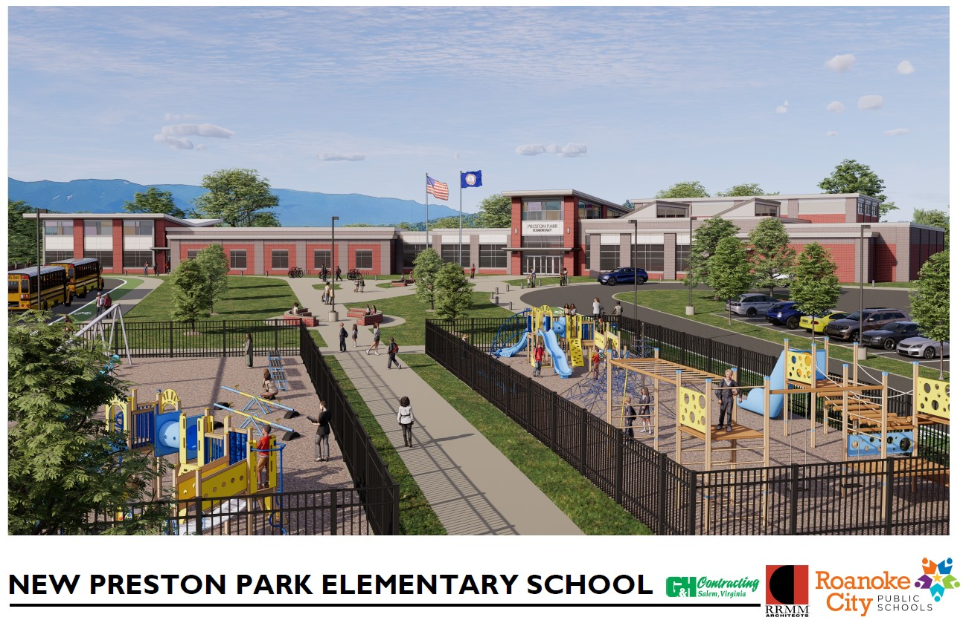
Summary
Summary
Preston Park has an appropriate enrollment starting day one.
Monterey is relieved of overcrowding and receives increased programming opportunities.
First of several steps within three phases to reduce overcrowding at all elementary schools.

Slide 23
Thank you!
Questions/Comments?
We Are One #RCPSProud
Strong Students. Strong Schools. Strong City.

